Slide 1
Gynaecological operations
Dr Mona Ahmed SMSB

Slide 2
1-Dilatation And Curettage(D&C):
Indication:
Miscarriage.
endometrial sample.
Assessment of ovulation .
IUCD removal.
Instrument:
uterine curette
uterine sound
sims speculum.
Hegar dilators.
Tenaculum.

Slide 3
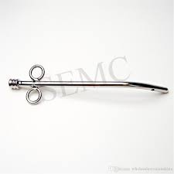
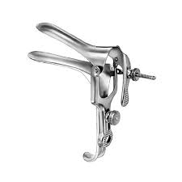
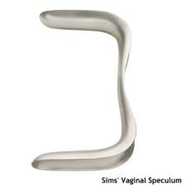
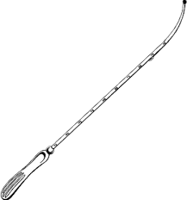
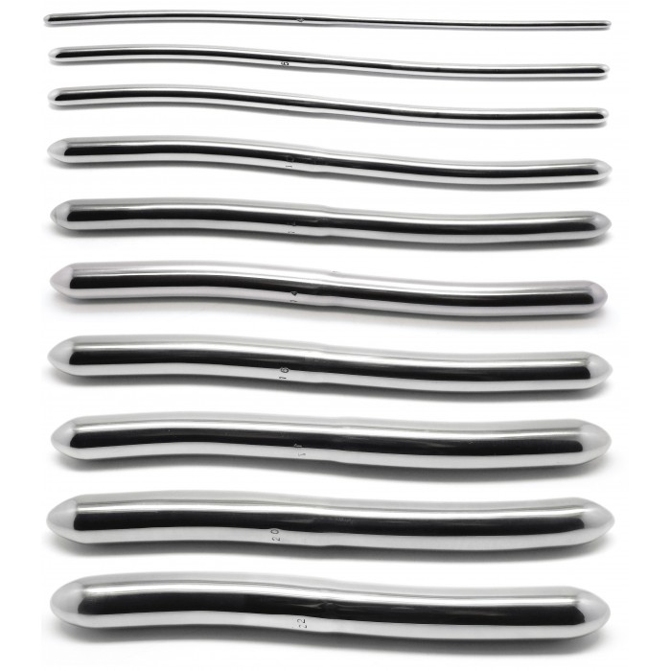
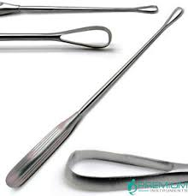


Slide 4
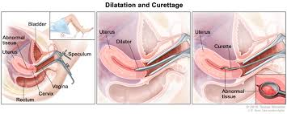
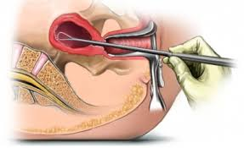
Technique: 1.Evacuate the bladder 2.Anesthesia 3.Vaginal speculum & grasp the cervix 4.Sounding 5.Dilate the cervix 6.Curette

Slide 5
Complication:
Cervical lacerations.
Cervical incompetence.(rec. miscarg.)
Asherman's syndrome(infertility).
Uterine perforation .
Infections.
Haemorrhage.
Risk of anaesthesia.
Risk of blood transfusion.

Slide 6
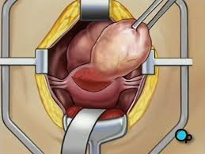
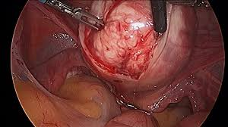
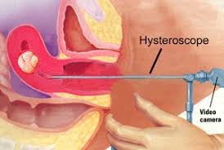
2.myomectomy
Indications:
Removal of symptomatic fibroid in those who do not complete their families.
Types:
1.Abdominal
2.Vaginal
3.Hysteroscopic: submucous <5cm
4.Laparoscopic: Pedunculated subserous
Complications:
Bleeding.
Hysterectomy.

Slide 7
3-Hysterocetomy:
Removal of uterus.
Complication:
infertility.
Depression.

Slide 8
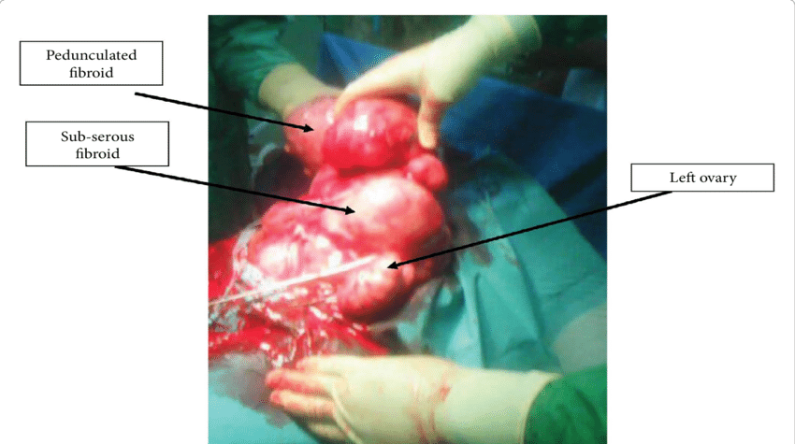
Gynaecological indications:
1.Fibroid.
2. Advanced endometriosis .
3.adenomyosis.
4. Malignant tumors of the cervix, body, tubes or ovary.
5. Recurrent DUB not responding to conservative treatment.
6.Prolapse.
7.Post menopausal bleeding.
8.Strlization.

Slide 9
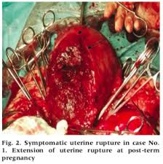
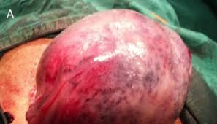
Obstetric indications
1.Uncontrolled postpartum haemorrhage.
2.Rupture uterus.
3.Placenta accreta.
4.Invasive mole.
5.Couvelaire uterus.

Slide 10
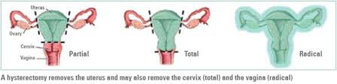
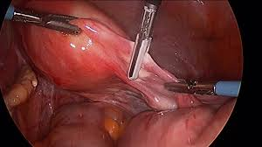
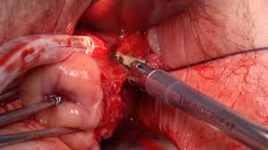
Types
1.Abdominal
2.Vaginal
3.Laparoscopic
4.Assessed Vaginal Hysterectomy (vaginal + laparoscope).
5.Caesarean hysterectomy:
Types of abdominal hysterectomy
Subtotal: removal of the uterus with preservation of
the cervix
Total: removal of the uterus & cervix
Radical: removal of the uterus, cervix, parametrial tissue, endopelvic fascia, uterosacral ligaments & pelvic lymph nodes
Caesarean hysterectomy:
removal of the uterus after C.S due to
Atonic uterus.
postpartum haemorrhage.
placenta accreta.

Slide 11
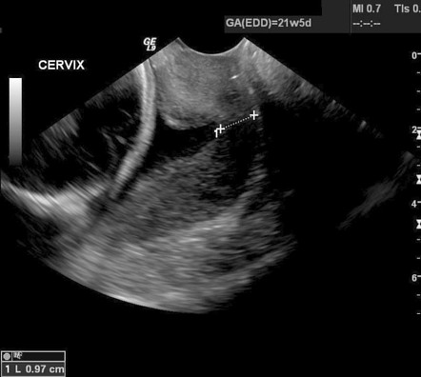
4.cervical cerclages
Indications
(1) Prophylactic (elective).
Suspected cervical incompetence.
Cerclage at 14 weeks {early miscarriage
caused by other factors}.
(2) Urgent (therapeutic)
Asymptomatic women with sonographic
evidence of cervical shortening
and/or funnelling.

Slide 12
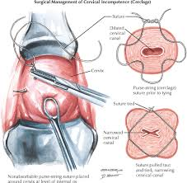
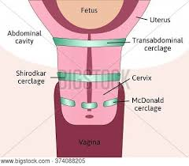
Contraindications:
1.Uterine contractions.
2.Uterine bleeding
3.Chorioamnionitis
4.Premature rupture of membranes
5.Fetal anomaly incompatible with life
Types:
Mc Donald.
Shirodkar.
Transabdominal.

Slide 13
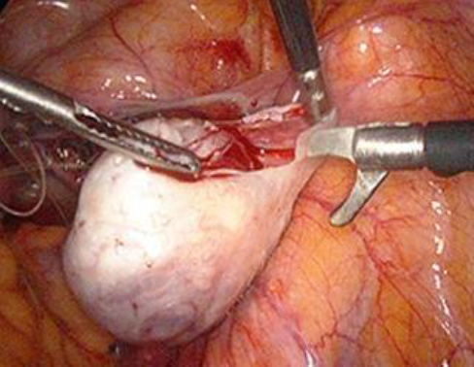
5.ovarian cystectomy:
Indication:
ovarian cyst.
Complication:
rupture of ovarian cyst.
Bleeding.
Adhesion.
bladder injury.
bowel injury.

Slide 14


Slide 15
pap smear:
Indication:
screening for cervical cancer.
Complication:
Infection.
failure.

Slide 16
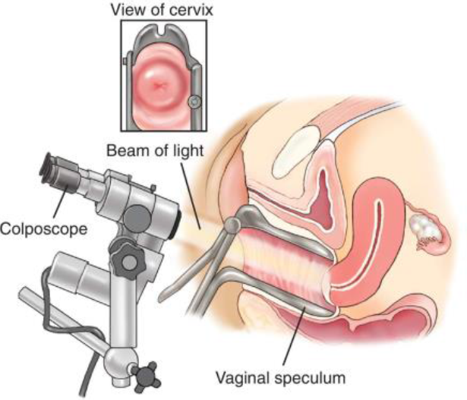
colposcopy:
Indication:
abnormal pap smear
bunch biopsy.

Slide 17
cone biopsy:
Indication:
CIN
Under anaesthesia
The dye we use in biopsy:
acetowhite test:
acetic acid, abnormal cell will absorb so take the biopsy from the white cell.
Iodine test:
logus solution normal cell
absorb and become brown because
its contain glycogen so take biopsy
from non-absorbed cells.

Slide 18
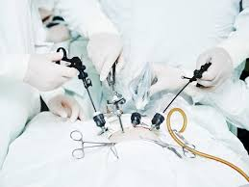
laparoscopy:
  minimal invasive procedure.
  Diagnostic or therapeutic.

Slide 19
Complication of laparoscopic:
Bowel perforation.
Bladder perforation.
Cardiac arrest by fluid overload.
Hyperkalaemia.
Hydrothorax.
Bleeding
Infection.
Risk of anaesthesia.
Indication general:

Slide 20
diagnostic for endometriosis.
laparoscopic adhesiolysis.
.
laparoscopic hysterectomy
laparoscopic removal of IUCD.

Slide 21
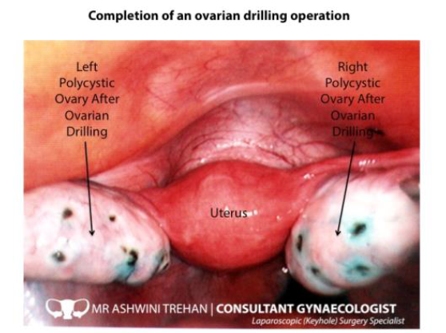
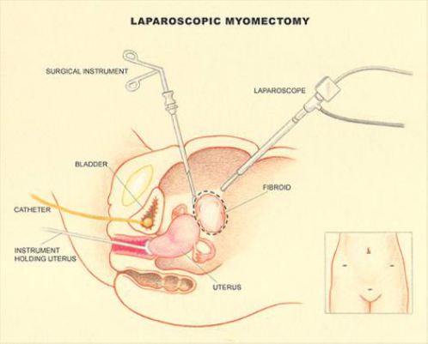
laparoscopic ovarian hysterectomy. laparoscopic removal of ectopic pregnancy.
laparoscopic drilling.
PCOS
laparoscopic myomectomy.

Slide 22
bilateral tubal ligation:
Indication:
family planning.
Routes :
Laparotomy
Laparoscopy
Hysteroscopic.
Complication:
Failure.
Risk of ectopic pregnancy.

Slide 23

Thank you
Any questions ???

