Slide 1
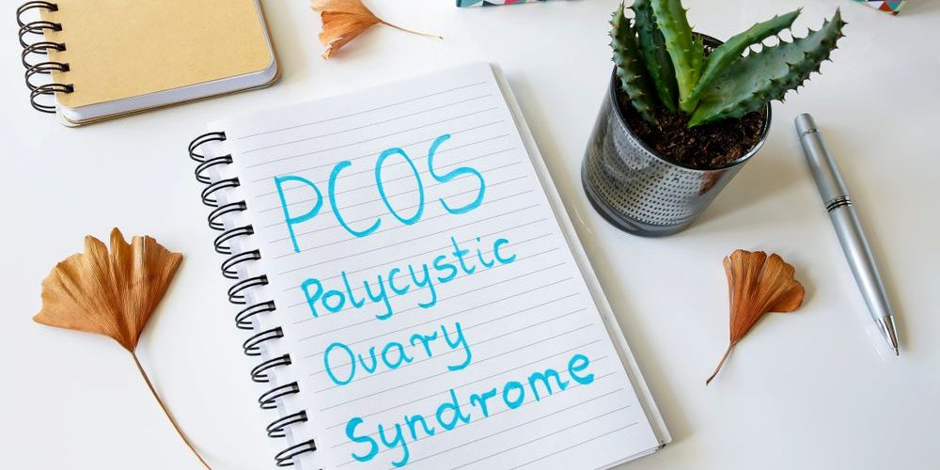
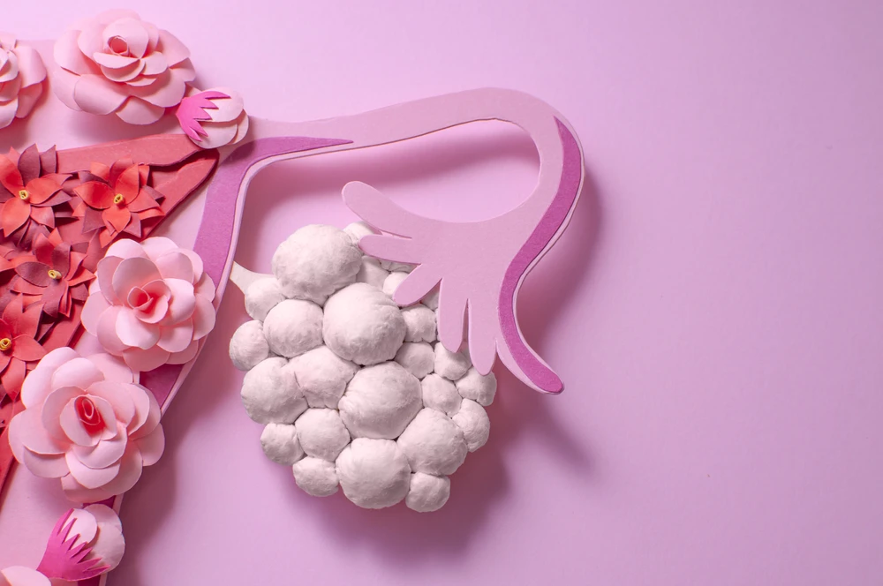

By dr Mona Ahmed
assisted professor
Elmareefa university
SMSB

Slide 2

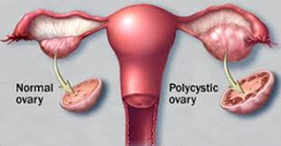
Polycystic ovarian syndrome
PCOS is a syndrome of :
ovarian dysfunction
with features of hyperandrogenism.
and polycystic ovary morphology .
Clinical manifestations
Menstrual irregularities.
Signs of androgen excess (e.g. hirsutism).
Obesity.
Elevated serum LH levels.
Insulin resistance .
Increased risk of type 2 DM and CVD events.
Affects around 5–10% of women of reproductive age.
The prevalence of PCOS on ultrasound is 25 %.

Slide 3
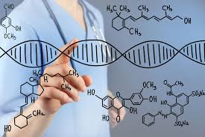
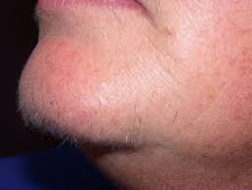
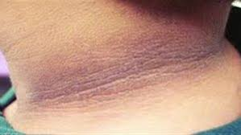
Aetiology
Aetiology is not completely clear.
There is often a family history
(gene is important in its development).
Clinical features:
Oligomenorrhoea/amenorrhoea up to 75%
(due to chronic anovulation).
Hirsutism.
Subfertility (75 %).
Obesity (40 %).
Recurrent miscarriage in around (50–60 %).
Acanthosis nigricans
(areas of increased velvety skin pigmentation
occur in the axillae and other flexures).
May be symptomatic.

Slide 4
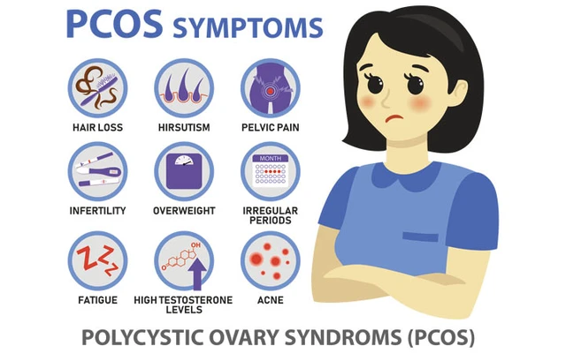

Slide 5
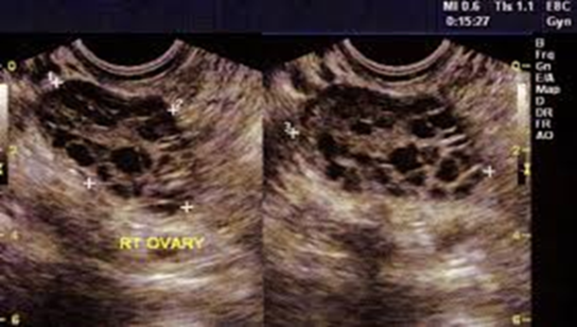
Diagnosis
Patients must have two out of the three features below:
Amenorrhoea/oligomenorrhoea.
Clinical or biochemical hyperandrogenism.
Polycystic ovaries on ultrasound.
The ultrasound criteria for the diagnosis of a polycystic ovary are:
Eight or more subcapsular follicular cysts <10 mm in diameter.
Increased ovarian stroma.
While these findings support a diagnosis of PCOS,
they are not by themselves
sufficient to identify the syndrome.

Slide 6

Management
Weight reduction.
Lifestyle advice:
Dietary modification and exercise because these patients
are at an increased risk of developing DM and CVS.
Medications:
COCP:
Regulate menstruation.
Cyclical oral progesterone:
Regulate menstruation.
Metformin:
In patients with PCOS with hyperinsulinemia and cardiovascular risk factors.
Clomiphene:
To induce ovulation where subfertility is a factor.

Slide 7
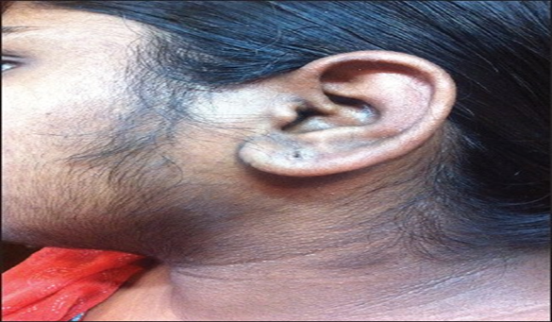
Hirsutism
Medical treatment:
Eflornithine cream topically.
Cyproterone acetate.
Dinette anti-androgen contraceptive pill).
Metformin:
improves insulin resistance,
Hyperandrogenaemia.
anovulation.
and acne .
GnRH analogues with low-dose HRT:
Reserved for women intolerant of other therapies.
Surgical treatments, e.g. laser or electrolysis.
Physical methods: shaving.

Slide 8



