Slide 1
PELVIC ORGAN PROLAPSE
Dr: Mona Ahmed
Associated professor
El Mareefa university
SMSB

Slide 2
Definition
      Prolapse:
      Latin word– procedere- to fall.
      POP:
The herniation of the pelvic organs to or beyond the vaginal walls.

Slide 3
PELVIC ORGAN PROLAPSE
ANTERIOR COMPARTMENT PROLAPSE
Hernia of anterior vaginal wall often associated with descent of the bladder
(cystocele)
[POSTERIOR
COMPARTMENT
PROLAPSE
Hernia of the
posterior vaginal
segment often
associated with
descent of the
rectum
(rectocele) .
ENTEROCELE
Hernia of the
intestines to or
through the
vaginal wall[[
APICAL
COMPARTMENT
PROLAPSE
(uterine prolapse,
vaginal vault
prolapse)‘
PROCIDENTIA
Hernia of all
three
compartments
through the
vaginal introitus.

Slide 4
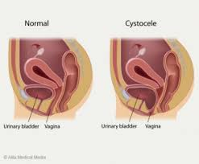
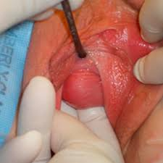
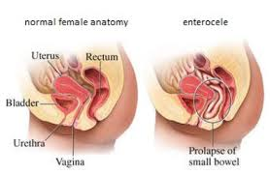
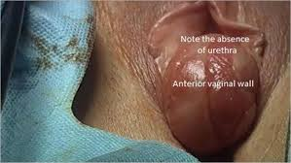
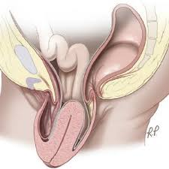
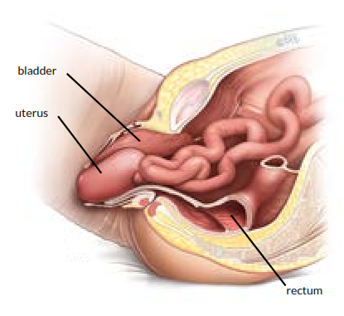
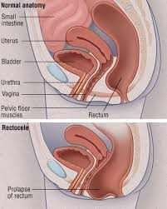
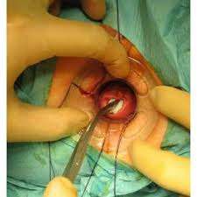

Slide 5
PREVALANCE
One of the most common gynaecological disorder
3rd most common cause of gynaecological surgery.
Lifetime risk for age 80yrs >10%

Slide 6
SUPPORTS OF PELVIC ORGAN:
ENDOPELVIC CONNECTIVE TISSUE .
AND
PELVIC DIAPHRAGM.

Slide 7
DEEP ENDOPELVIC CONNECTIVE TISSUE

Slide 8
Muscles of pelvic diaphragm
Levator Ani Ms.
Pyriformis
Coccygeus

Slide 9
LEVATOR ANI
Levator support prevents excessive tension or stretching of connective tissue ligaments & fascia

Slide 10
Normal axis of uterus/vagina and the levator plate
Levator plate

Slide 11
ETIOLOGY
MAIN CAUSE OF POP ARE:
Acquired
Congenital
○ Levator muscle weakness
○ Ligaments injury
○ Nerve injury (Pudendal nerve)
○ Endopelvic fascial weakness
○ Perineal body weakness
○ Inborn weakness of support system.

Slide 12
RISK FACTORS
○ Genetic predisposition.
○ Vaginal birth
○ Parity
○ Menopause
○ Advancing age
○ Prior pelvic surgery
○ Connective tissue dis.
○ ↑ IA pressure
○ Obesity
○ Chronic constipation
○ ↑ Straining
ACOG 2007

Slide 13
3 MOST IMPORTANT ESTABLISHED RF
1. Vaginal delivery
2. Advancing age
3. Obesity

Slide 14
STAGING OF POP
POP QUANTITATIVE SCORING
Stage | Description
0 | No descent of Pelvic Organs
I | Leading edge of Prolapse remaing≥1cm above the hymenal ring
II | Leading edge of Prolapse extends from 1cm above or 1cm below the hymenal ring
III | From 1cm beyond the hymenal ring but without complete eversion of vagina
IV | Essentially complete eversion of vagina

Slide 15
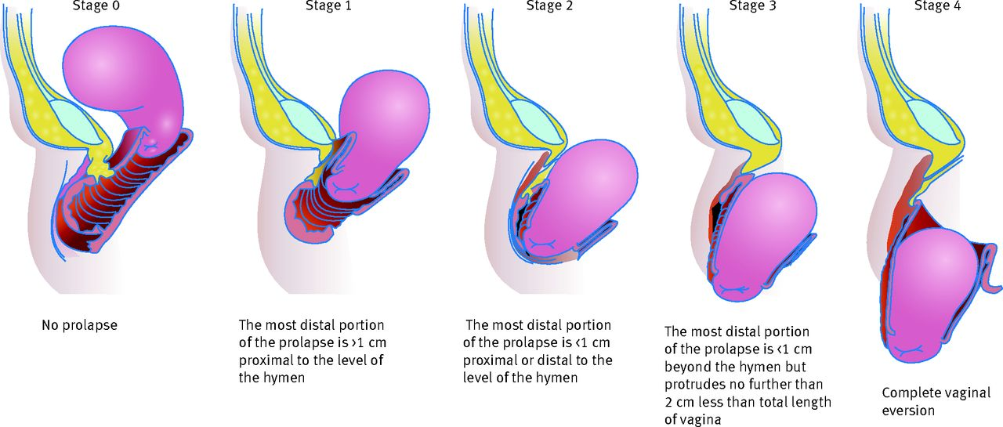
STAGING OF POP

Slide 16
STAGING OF POP

Slide 17
CLINICAL FEATURES:
CLINICAL MANIFESTATION:
○ Feeling like sitting on a small ball
○ Dyspareunia.
○ Frequent urination or a sudden urge to empty the bladder
○ Low backache
○ Uterus and cervix that stick out through the vaginal opening
○ Repeated bladder infections
○ Feeling of heaviness or pulling in the pelvis
○ Vaginal bleeding
○ Increased vaginal discharge

Slide 18
EXAMINATION
Abdominal Examination
To exclude organomegaly / Abdominal mass
Vaginal Examination
Examine in dorsal position ( if protrude beyond introitus )
Combined Rectal & Vaginal Examination
To differentiate rectocele from enterocele

Slide 19
DD of cystocele
Gartner Duct Cyst
Cystocele

Slide 20
D/D UTERINE PROLAPSE
1. Congenital elongation of cervix
2. Chronic inversion
3. Fibroid polyp

Slide 21
Rectocele

Slide 22
INVESTIGATION:
Routine pre operative investigations
Urine for C/S if any symptoms suggestive if UTI
Urodynamic studies:
No urinary symptoms – not justified.
Do only if significant urinary symptoms.

Slide 23
MANAGEMENT:
Management
Preventive
Conservative
Surgical

Slide 24
PREVENTIVE
1. Adequate ANC & intra-natal care: avoid injury to
supporting structure, correct anaemia, avoid prolong
labour, careful instrumental delivery.
2. Adequate post-natal care: Early ambulation, Pelvic floor
exercise.
3. Contraceptives: avoid too many & too frequent birth.
4. General measures: avoid strenuous exercise, chronic
cough, constipation, heavy wt lifting.

Slide 25
CONSERVATIVE
Indications:
1. Asymptomatic women
2. Mild degree of prolapse
3. POP in early pregnancy

Slide 26

CONSERVATIVE
1. Improvement of general health
2. Oestrogen replacement therapy may improve
minor degree prolapse in post menopausal women.
3. Pelvic floor exercise- Kegel’s exercise.
4. Pessary treatment.

Slide 27
PESSARY

Slide 28
SURGICAL MANAGEMENT
Preventive
Curative

Slide 29
PREVENTIVE SURGERIES TO PREVENT VAULT
PROLAPSE AFTER HYSTERECTOMY
1. Utero-sacral ligament fixation with the vault
2. Sacro-spinous fixation

Slide 30
Vaginal Wall prolapse
Anterior vaginal wall | Cystocele, & paravaginal defect | 1- Anterior colporrhaphy
Posterior vaginal wall ( lower 2/3rd ) | Retrocele | perineorrhaphy
Posterior vaginal wall ( Upper 1/3rd ) | Enterocele | 1- Repair of enterocele

Slide 31
Any questions ???
Thank you ….

