Slide 1

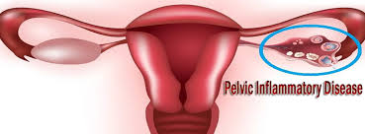
Mona Ahmed Associated professor Elmareefa University SMSB

Slide 2

Vaginal Discharge
Types of venial discharge:
*Physiological * pathological
Physiological
Normal physiological vaginal discharge characteristics:
clear (colourless).
non-offensive(odourless).
not itchy.
increase in amount:
around the time of ovulation.
during pregnancy.
with contraceptive use.

Slide 3
Abnormal vaginal discharge is characterized by change in:
colour
consistency
volume
odour
May be associated with symptoms :
Itching.
Soreness.
Dysuria.
pelvic pain.

Slide 4
Features of vaginal discharge to be elicited include:
its onset,
duration
timing related to menstrual cycle
odour
Colour
consistency
and any exacerbating factors.
Associated symptoms
(itching, pain, dysuria, dyspareunia and
irregular bleeding).

Slide 5
Causes of vaginal discharge
Physiological
Pathological :
.Non infective:
Bacterial vaginosis (BV)
Vulvovaginal candidiasis.
Infective STIs:
Trichomonas vaginalis.
Chlamydia
Gonorrhoea
Others
Irritants: perfumes.
Atrophic vaginitis
Cervical ectropion
Tumours of vulva, vagina, cervix and endometrium
Trauma.

Slide 6
STIs are often asymptomatic. can cause significant problems at the time of infection or in the future; for example, human papillomavirus (HPV) infection and cervical cancer. STIs often coexist and when one is found, screening for others is required. Tests for STIs have improved with highly sensitive and tests that are very easy to use and can detect several infections on a single swab or urine sample. Children may also require testing and treatment if they have been exposed during pregnancy, birth or breastfeeding

Slide 7
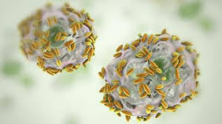
Infective causes of vaginal discharge
Bacterial vaginosis The commonest cause of abnormal vaginal discharge. Depletion of the lactobacilli dominant in the healthy vaginal flora , together with an elevation of vaginal pH to above 4.5. Gardnerella vaginalis and other species (causative organisms). Risk factors include douching. black race. smoking. Symptoms include Offensive vaginal discharge with ‘fishy’odour,. Homogenous white vaginal discharge. High pH .

Slide 8

Diagnosis: is made by using Amsel's criteria (3 of 4 are required): homogenous discharge high pH, ‘clue cells’ on microscopy Fishy odour when 10% potassium hydroxide is added to a sample of discharge. BV is associated with a number of pathologies including: pelvic inflammatory disease (PID). post hysterectomy vaginal cuff cellulitis and. Pregnancy. preterm birth. Rupture of membranes. miscarriage. An increased risk of HIV acquisition is observed in women at risk with BV.

Slide 9

Treatment: Oral or intravaginal treatments with metronidazole or clindamycin are indicated in women with symptoms . Prior to gynaecological surgical procedures. Women with BV should be advised that vaginal douching or excessive washing should be avoided.

Slide 10
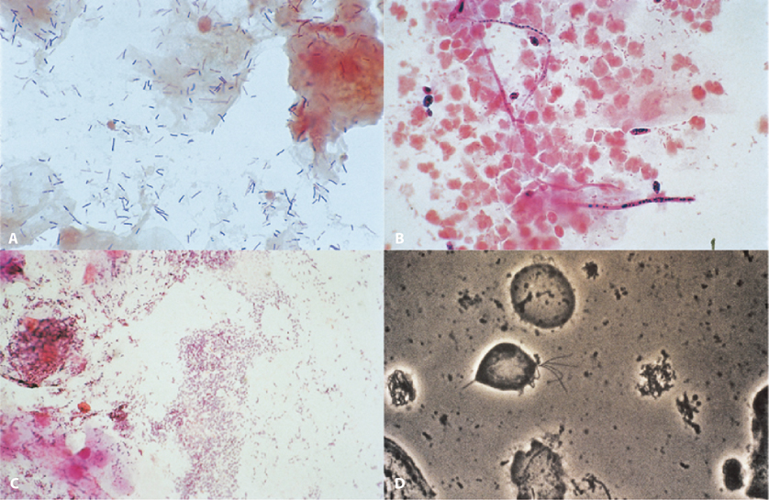
Vaginal and cervical flora:
A: Normal: lactobacilli – seen as large gram-positive rods –
predominate.
B: Candidiasis: there are gram-positive spores
and long pseudohyphae visible. There are polymorphs .
C: Bacterial vaginosis: there is an overgrowth of
anaerobic Gardnerella vaginalis and a decrease in the numbers of lactobacilli. A ‘clue cell’ is seen.
D: Trichomoniasis: ‘wet mount’ of vaginal fluid with Trichomonas vaginalis infection.
In practice, the organism is identified under the microscope by amoeboid motion and its flagella waving.

Slide 11
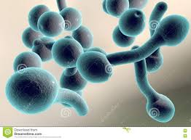
Vulvovaginal candidiasis
Causative organism
Candida species( C. albicans)cause vulval and vaginal inflammation.
The vagina is colonized with Candida sp. in up to 20% of women in their reproductive years, rising to 40% in pregnancy.
Symptoms
most asymptomatic.
itching.
Irritation.
Typically white, curdy vaginal discharge.
Dysuria.
Symptoms more frequent and persistent when the woman is:
diabetic.
Immunocompromised.
Pregnancy.

Slide 12
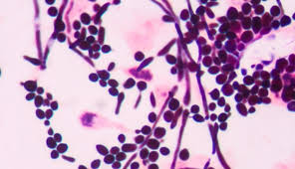

On examination:
signs of inflammation, including
erythema.
Oedema.
Fissuring of the vulva and vagina.
Discharge (whitish -yoghourt like ).
Diagnosis:
Bacterial swab for microscopy and culture.
Treatment:
Topical intravaginal pessaries
Or
Oral Imidazole .
Topical Vulval antifungals and the use of aqueous cream as an emollient and cleansing agent provide symptomatic relief.
This is not an STI and partners without symptoms do not require treatment.

Slide 13
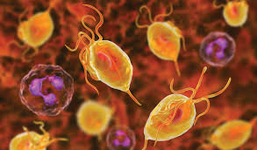
Trichomoniasis Vaginalis
Causative organism :
Flagellate protozoan Trichomonas vaginalis (TV).
Symptoms:
Asymptomatic in up to 50% of women .
Vaginal discharge with (vulvovaginitis).
TV is sexually transmitted and treatment of partners is required.
Yellow-green, frothy discharge
Bad odour.
There is association with pregnancy outcome:
preterm birth.
low birthweight
Maternal postpartum sepsis.

Slide 14
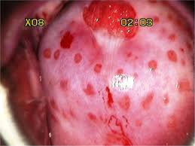
On examination :
strawberry appearance of the cervix.
Teste:
Nucleic acid amplification test (NAAT) preferably on a vaginal or endocervical swab or on urine.
Some NAATs also detect Neisseria gonorrhoea and Chlamydia trachomatis on the same sample.
Culture
PCR.
Treatment:
is with a systemic metronidazole regime.

Slide 15
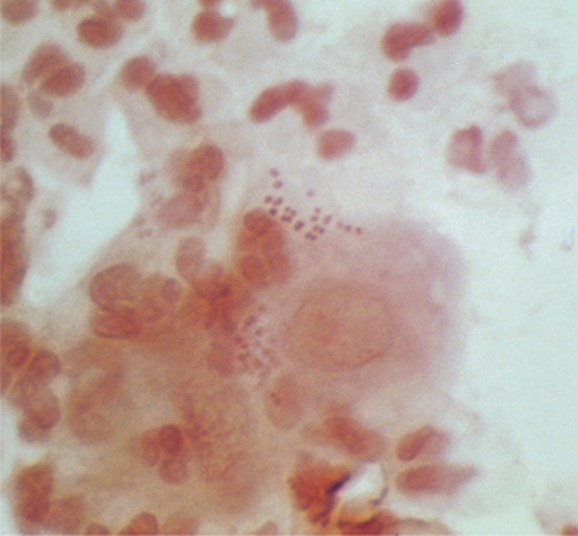
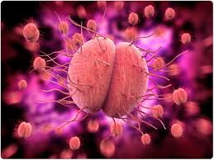
Gonorrhoea
Caused by infection with the bacteria Neisseria gonorrhoea.
Its STI, treatment of partners is required.
Symptoms:
Asymptomatic in up to 50% of cases.
Vaginal discharge the most common symptom.
Lower abdominal pain in up to 25%.
Examination:
is often normal.
cervicitis with or without a mucopurulent discharge may be seen.
Complications :
Ascending infection may result in PID and.
Haematogenous spread can cause disseminated gonococcal infection with arthritis that is typically (monoarticular).
Ophthalmic infection occurs due to inoculation from infected genital secretions.
Neonatal infection occurs when the mother has endocervical infection at the time of delivery .

Slide 16
Tests:
NAAT tests are highly sensitive and specific.
Culture and sensitivity testing (antimicrobiological resistance).
Screening for other STIs , particularly for( C. trachomatis).
Treatment
Third generation cephalosporin plus azithromycin.( to reduce drug resistance).

Slide 17
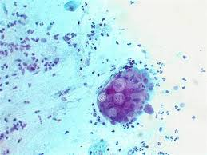
Chlamydia
Chlamydial infection is the most common
bacterial STI, with women under 25 years.
Symptoms:
Infection with C. trachomatis is often asymptomatic.
mucopurulent discharge
Testing is also indicated in women with risk factors:
New partner.
Altered vaginal discharge
Intermenstrual bleeding
Postcoital bleeding
Abdominal pain.

Slide 18
On Examination
cervicitis.
Neonates born to mothers with cervical infection may develop conjunctivitis.
A reactive arthritis that is typically( monoarticular) in men.
NAAT tests are widely available for C.
Treatment :
Regimens include azithromycin or doxycycline; the benefit of the former
is that it is single dose and well tolerated.

Slide 19
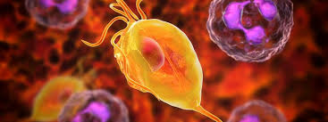
Pelvic inflammatory disease
This occurs when there is ascending infection from the endocervix to the higher reproductive tract.
It is a recognized complication of chlamydia and less frequently of gonorrhoea.
The diagnosis of PID is usually made clinically
symptoms typically include:
lower bilateral abdominal pain.
Dyspareunia.
altered vaginal discharge.
IMB.
PCB.

Slide 20
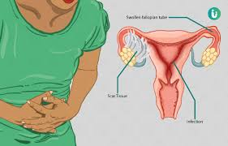
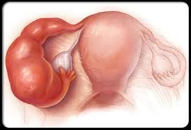
Systemic symptoms of infection :
lower abdominal
cervical motion tenderness
cervicitis. Testing for all STIs is required, as is exclusion of pregnancy.
Treatment :
Where PID is suspected empirical treatment should be started immediately, as delay increases the risk of complications.
Complication :
endometritis
Fallopian tube inflammation(salpingitis)
Subfertility
ectopic pregnancy
chronic pelvic pain.
Right upper quadrant pain due to perihepatitis
(called Fitz-Hugh–Curtis syndrome ).

Slide 21
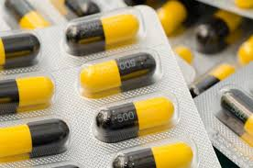
Management :
Laparoscopy in women with PID may reveal scarring and adhesion formation.
Intrauterine device (IUD) should be remove.
Treatment:
Regimes should cover all common pathogens and are 2 weeks in duration
they include a macrolide or tetracycline plus metronidazole with a parenteral third-generation cephalosporin at the start.
Partners require screening and empirical treatment, usually with azithromycin.
Women require clear information regarding possible sequelae from their infection.

Slide 22
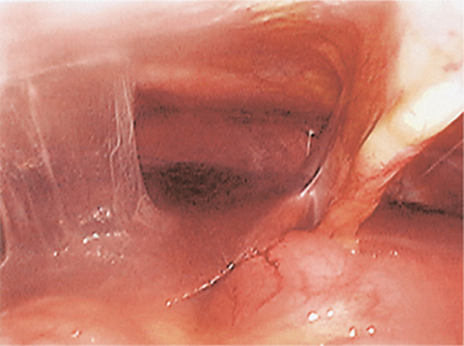
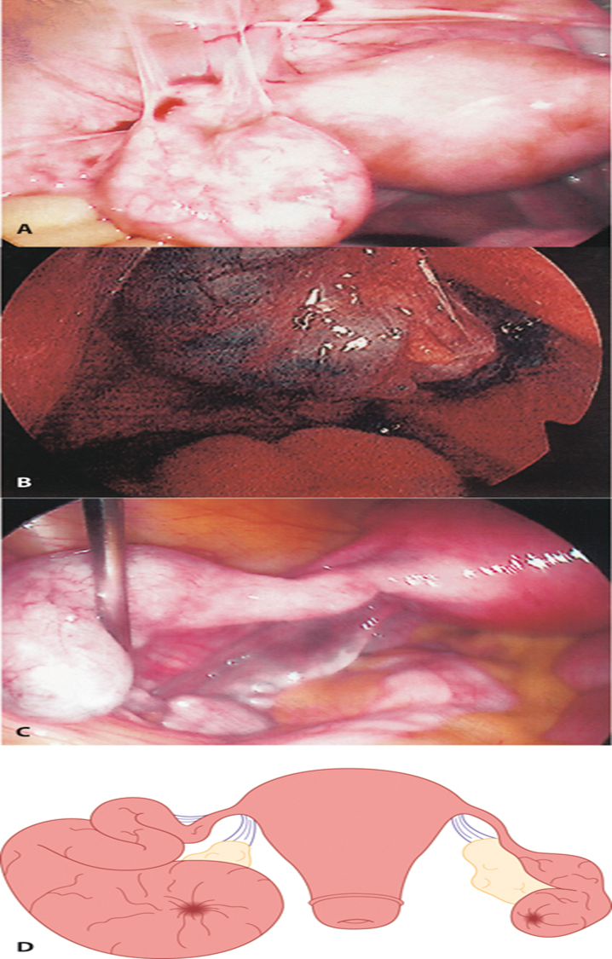
Fitz-Hugh–Curtis syndrome showing perihepatic adhesions (typical violin string appearance).
A Peri tubal adhesions of the left Fallopian tube;
B: ectopic pregnancy within hydrosalpinx;
C: left Fallopian tube hydrosalpinx;
D: large hydrosalpinx of the left Fallopian
tube with a smaller hydrosalpinx on the
right side

Slide 23
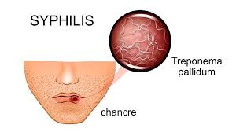
Syphilis
caused by infection with the bacterium Treponema pallidum .
This infection is multisystem and has many clinical features that may mimic other
conditions. late complications can present many years after the original infection.
The infection is classified as congenital or acquired, and each of these as late or early.
In acquired early syphilis the initial manifestation is the ‘chancre’, which develops at the site of exposure.
The lesion is painless, indurated and exudes serous fluid containing T. pallidum, and there is regional lymphadenopathy.
This resolves within a few weeks and followed by bacteria disseminate of clinical symptoms and signs.
These include a widespread erythematous rash, genital mucous lesions and raised lesions, termed ‘condylomata Lata’.

Slide 24
Complications :
neurological involvement
meningitis.
Eighth nerve palsy and consequent deafness.
Tinnitus
Ophthalmic( most often uveitis).
This stage also spontaneously resolves.
Relapse may occur for up to 2 years, the accepted time limit of early infection.

Slide 25
HIV
Natural history, epidemiology, testing and treatment Infection with HIV results in an initial acute viral illness followed by a chronic decline in cellular immunity due to progressive depletion of CD4-positive T-lymphocytes, and eventually resulting in one or more illnesses defined as the acquired immune deficiency syndrome (AIDS)
In gynaecological practice
include cervical cancer (cervical cytology is recommended)
cervical intraepithelial neoplasia (CIN) .
vaginal intraepithelial neoplasia.
The notification of partner and children, is crucial as improves outcomes and prevents onward transmission.

Slide 26
Management of the HIV-positive mother and her child:
Effective antiretroviral therapy.
Transmission (MTCT) occurs during birth or breastfeeding. Intrauterine infection is unusual and due to intervention (for example, amniocentesis).
Delivery by prelabour caesarean section further reduces MTCT rates when the HIV viral load is detectable.
Obstetric risk factors that increase the transmission include:
prolonged rupture of membranes
procedures that breach the infant’s skin (such as fetal scalp electrodes)
increase maternal blood in the birth canal.
these risks are reduced by effective control of maternal HIV
formula feeding is safe, this is preferable.

Slide 27



