Slide 1

By Dr. Mona Ahmed
Assisted Professor
Elmareefa University
SMSB

Slide 2
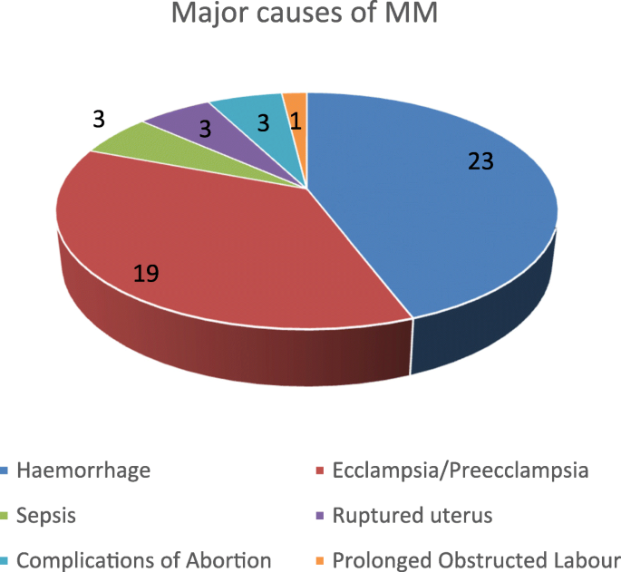
Importance of PPH
Obstetric haemorrhage remains one of the major causes of maternal death in both developed and developing countries

Slide 3
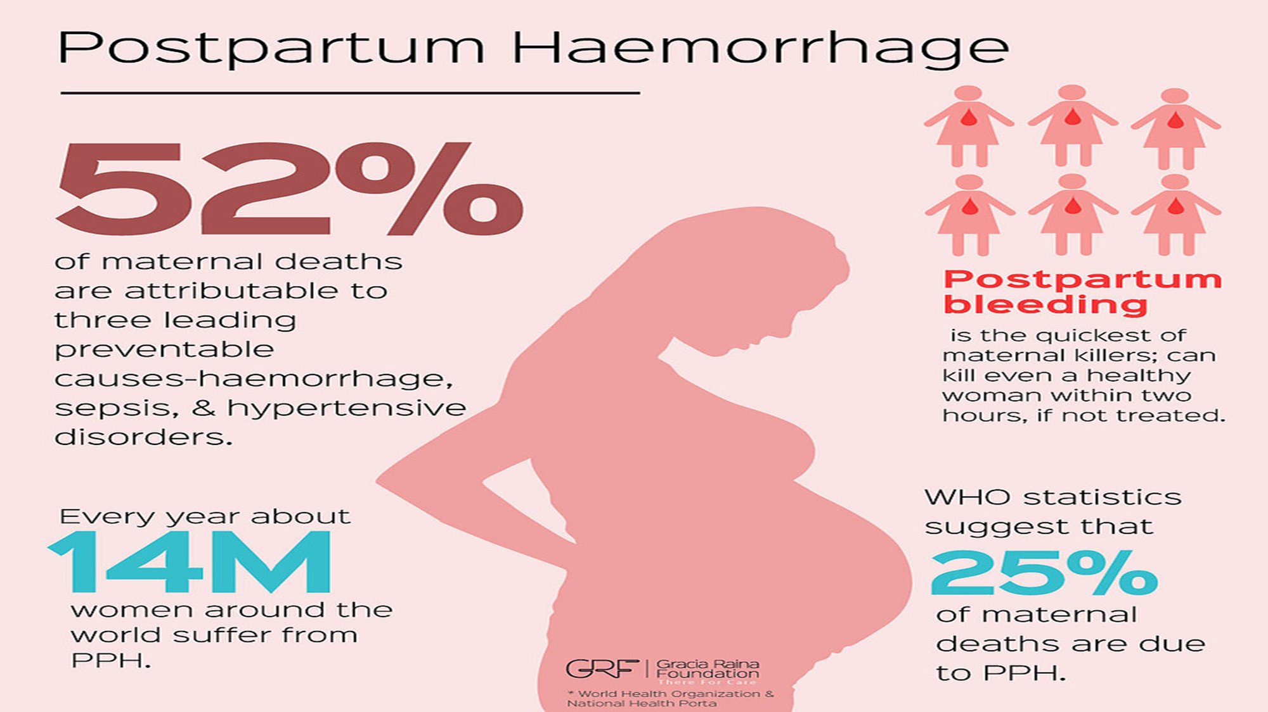

Slide 4


Slide 5

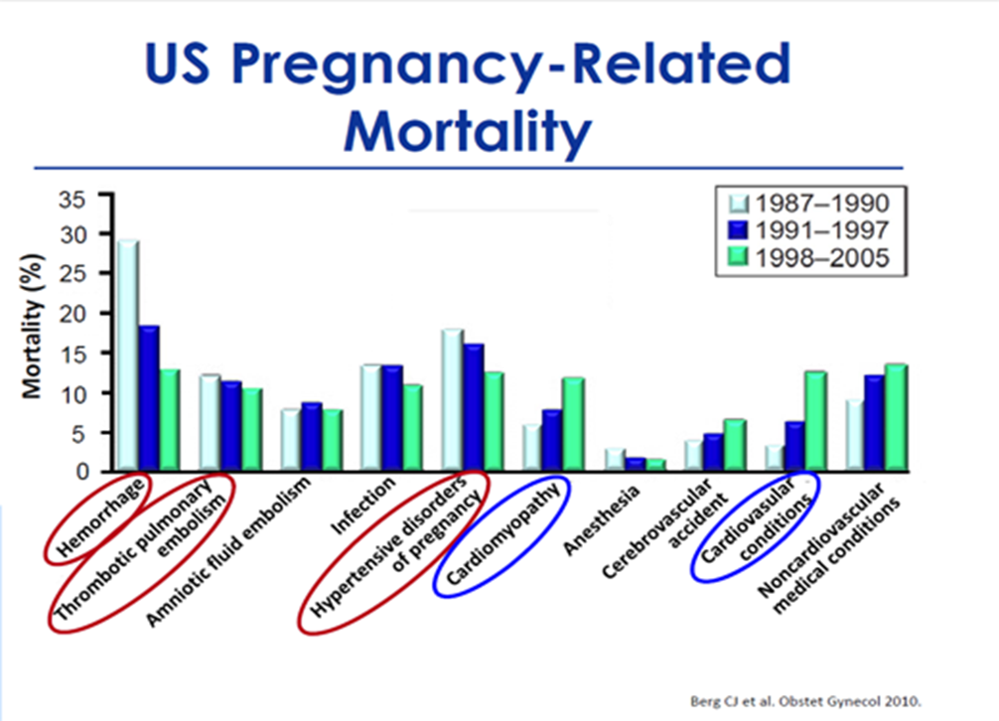
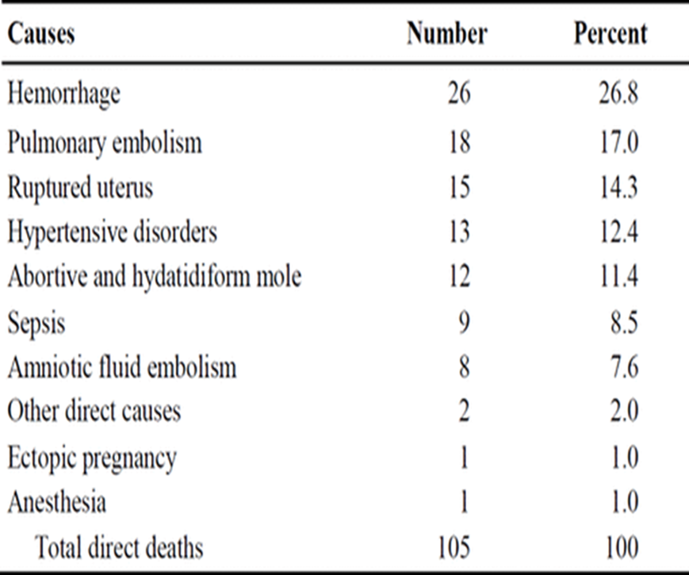
MMR due to PPH

Slide 6
Primary post partum haemorrhage
>500 ml blood loss from genital tract in the first 24 hours after birth.
Excessive or abnormal bleeding from genital tract between 24 hours & 6 weeks.
Secondary post partum haemorrhage

Slide 7
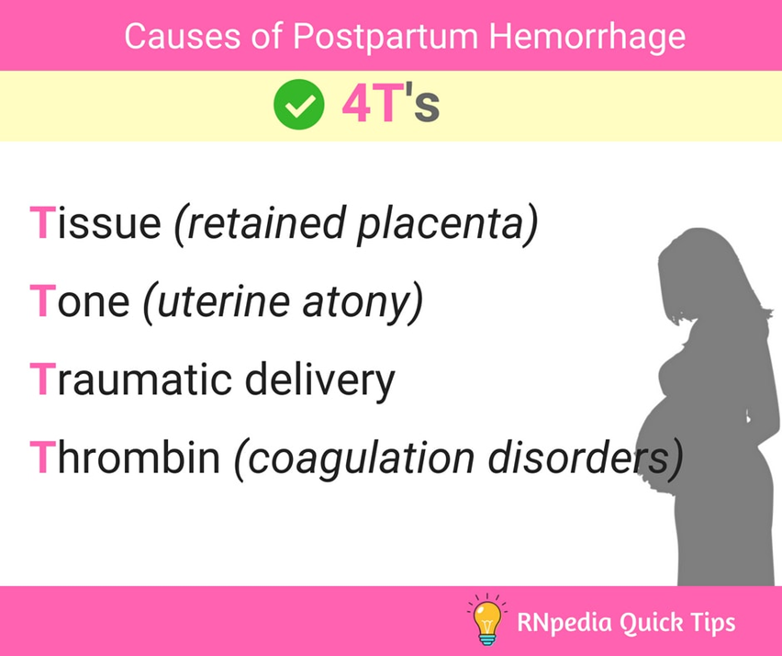

Slide 8
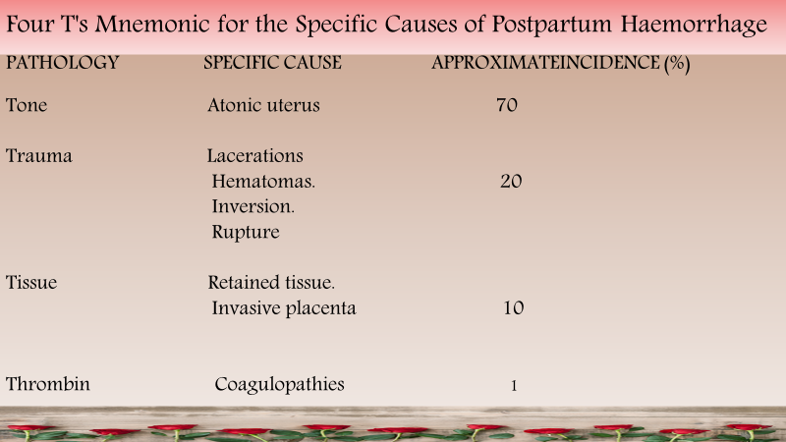

Slide 9
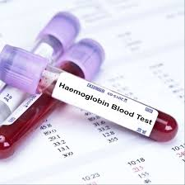
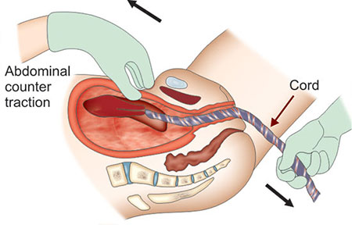
Prevention
Optimize haemoglobin
levels below normal should
be investigated & optimize prior to delivery.
Management of 3rd stage of labour:
prophylactic uterotonic(Oxytocin).
Early cord clamping.
Controlled cord traction to the placenta.

Slide 10
How to prevent lacerations?
Routine episiotomy should be avoided to decrease blood loss and the risk of anal laceration

Slide 11
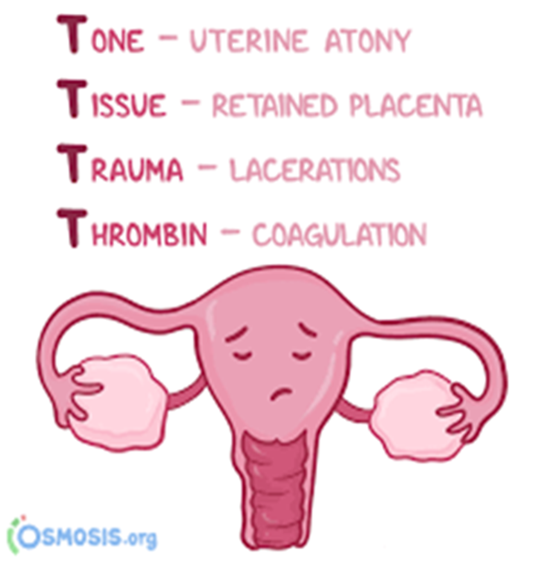
Causes of uterine atony
commonest causes of haemorrhage:
uterine rupture .
Uterine inversion
Macrosomia.
Multiple pregnancy.
oxytocin use.
grand multiparity.
Polyhydramnios.
Antepartum haemorrhage(Placental Abruption) .
Full bladder.
Anaesthesia.
overdistention

Slide 12


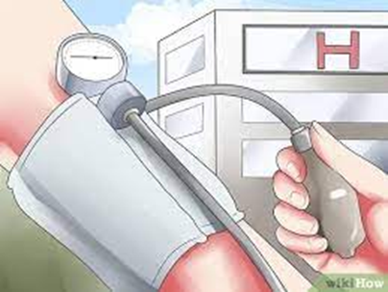
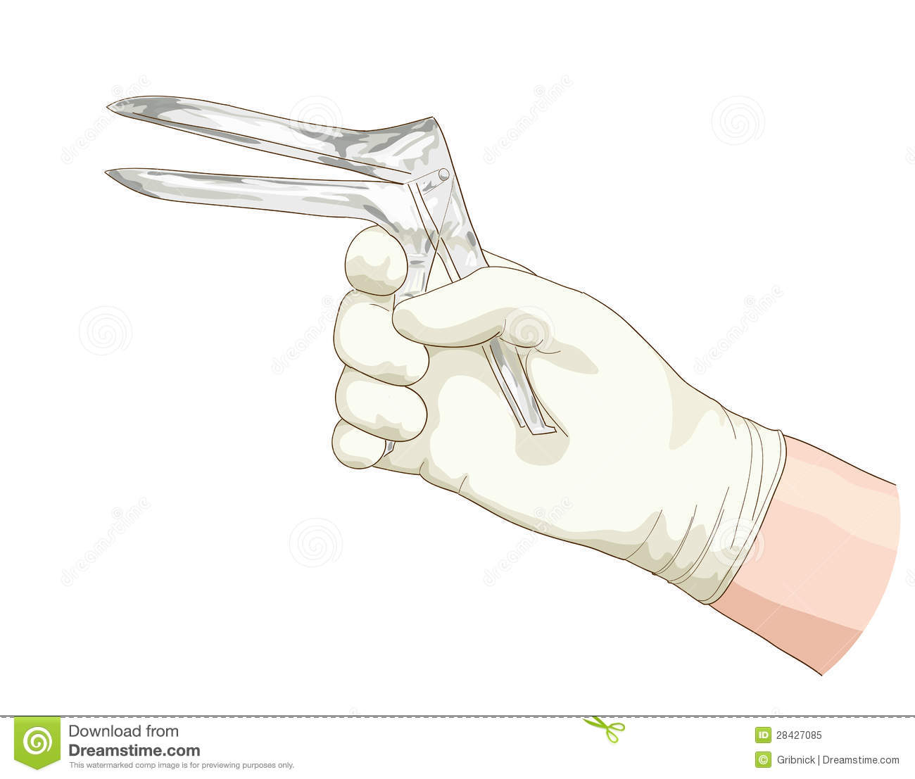
How to diagnose PPH
Detailed history including
Parity.
Mode of delivery.
Third stage and puerperal complications .
Examination:
Check pulse.
Blood pressure.
Temperature.
Assess uterine size & cervical excitation and uterine
tenderness Assessment.
Exclude other sources of infection (e.g. mastitis, UTI or DVT).
Assess clinical signs of blood loss.
Speculum examination : Cervical dilatation, tears, infection ,
blood or remnant of tissues

Slide 13
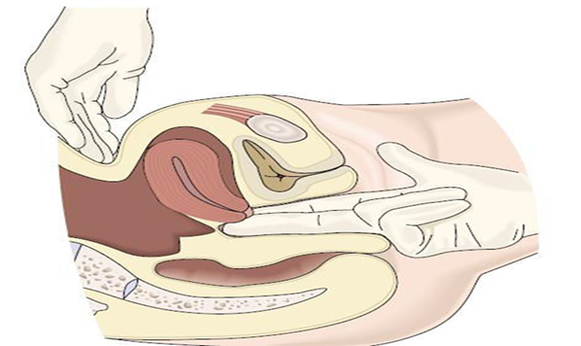
How to diagnose uterine atony
The main signs of uterine atony are:
Bleeding .
Enlarged and soft uterus in (bimanual examination)
commonly referred to as “boggy.”

Slide 14
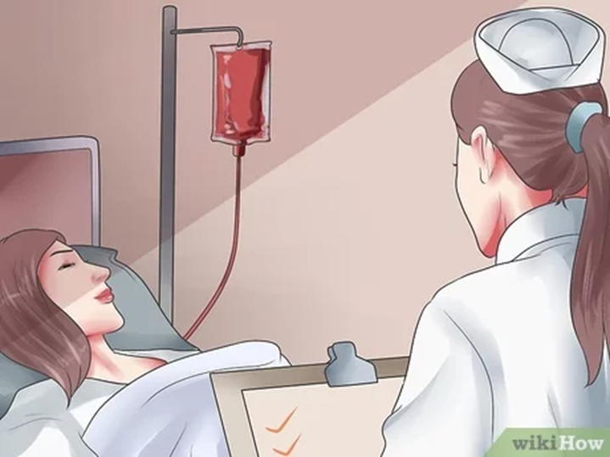
Management of postpartum haemorrhage (common)
Resuscitate women.
Stop bleeding.
Steps:
Call for help
Iv line(fluids , oxytocin).
Obtain blood sample for:
*FBC. *Clotting factors.
*U & E. *Crossmatching of 6 unites.
Insert urinary catheter :empty the bladder
allow monitoring of UOP.
Monitor(HR Pulse O2 saturation ).
If any evidence of coagulopathy. Involve the haematologist.

Slide 15
Treatment of atony
Call for help
ABC
Uterine massage
Bimanual compression(Increase oxytocin infusion)
Uterotonics()
Take the pt to the theatre
Exploration
Bakri's balloon.
Laparotomy
B lynch
Ligation
Emoblization
Hysterectomy

Slide 16
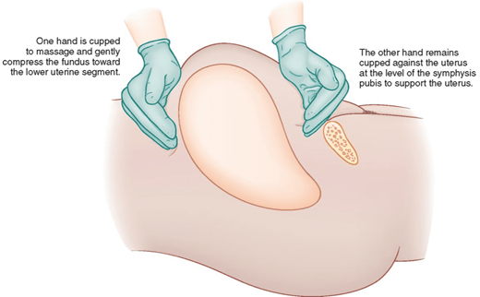
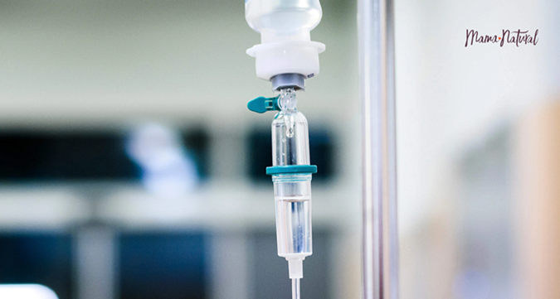
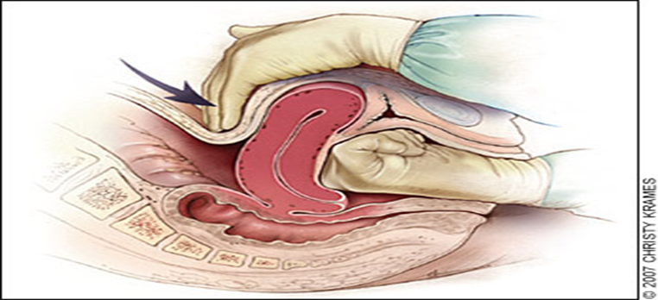
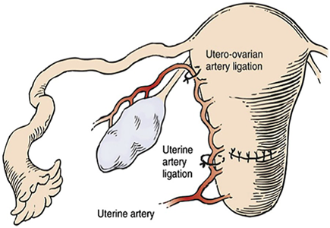
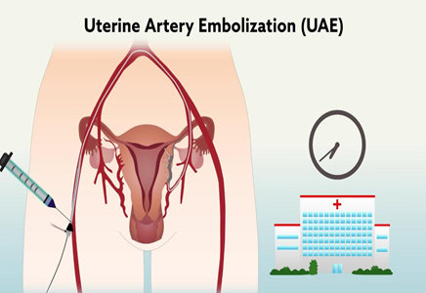
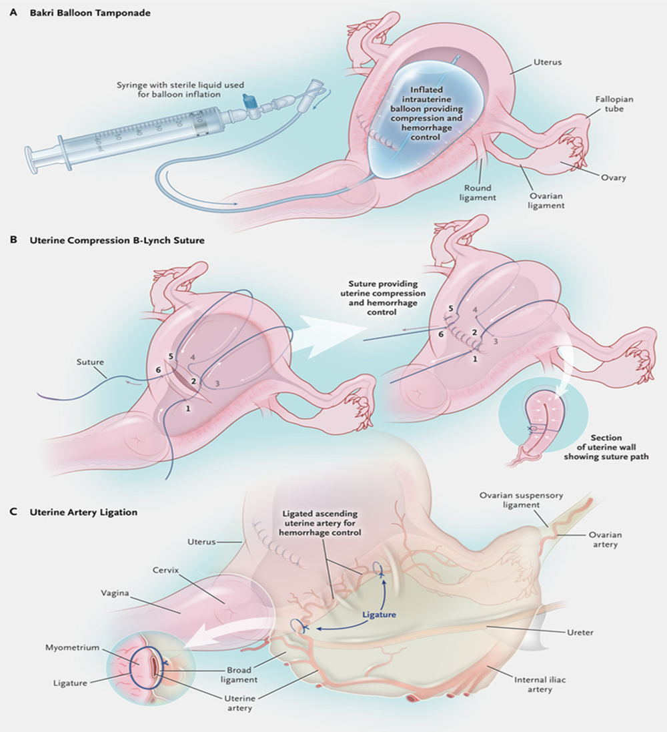
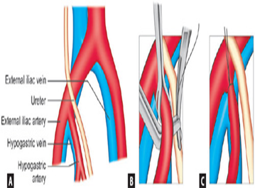

Slide 17
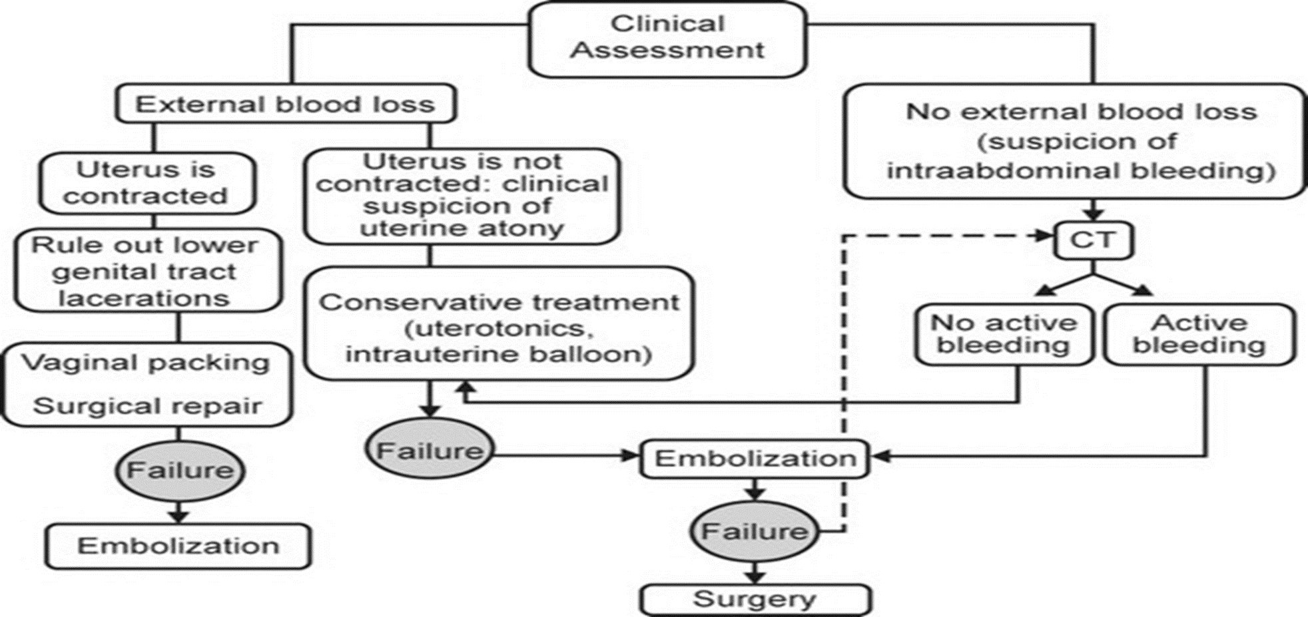

Slide 18
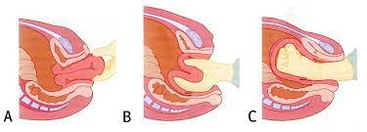
Treatment of uterine inversion
Hysterectomy
Hysterectomy
Uterine Rupture

Slide 19
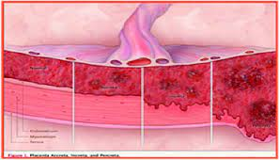
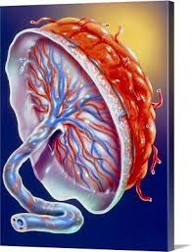
Tissue
Placenta accreta.
Retained placenta.
Retained products of conception.

Slide 20
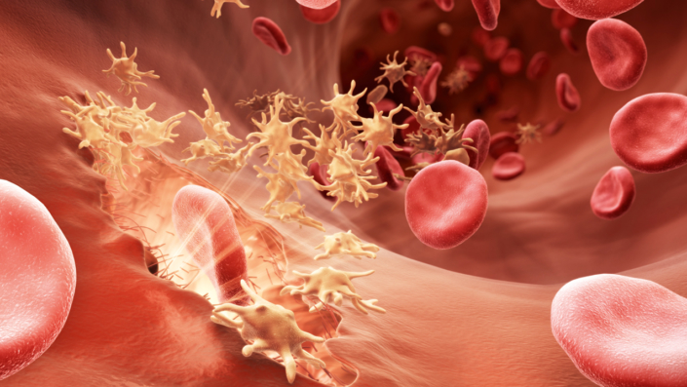
Truma
Previous caesarean sections.
Perineal tears.
Episiotomy.
Cervical laceration.
Macrosomic baby.
Instrumental delivery.

Slide 21
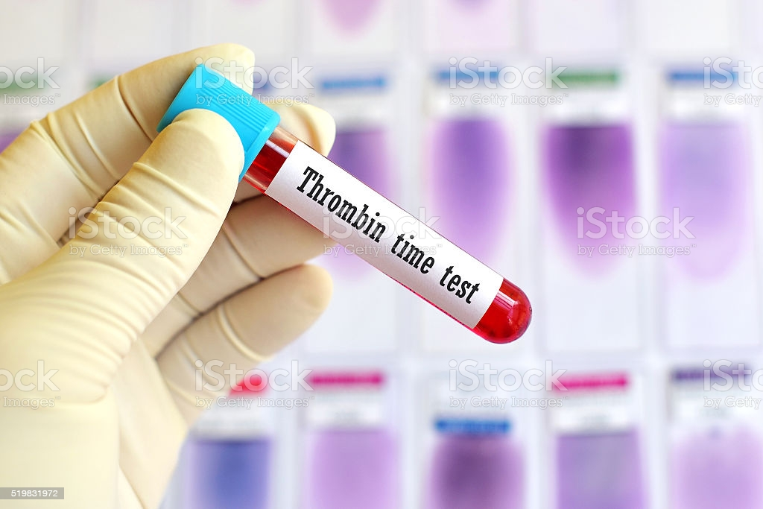
Thrombin
Disseminated intravascular coagulation.
Pyrexia in labour.
Placental Abruption.
Preeclampsia.
Bleeding disorders.
Use of Anticoagulants.
Chorioamnionitis.

Slide 22

Others
Asian ethnicity.
Induction of labour.
Anaemia.
Obesity.
Age >40 years.
Prolonged labour.

Slide 23
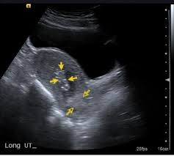
Risk factors for secondary postpartum haemorrhage
A history of primary PPH.
Past history of PPH.
Infections….C/S wound
…..Endometritis(uterine tenderness, fever or foul smelling lochia).
…..Mastitis.
…..UTI.
……Others.
Manual removal of placenta.
PROM.
Cancers.

Slide 24
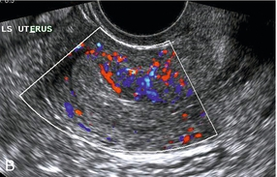

Investigations
1-U/S and Doppler study.
2- CBC, C-RP and ß-Hcg.
3- Low vaginal, high vaginal, endocervical and rectal swabs.
4- Coagulation profile.
5- Midstream urine specimen.
6- Blood cultures if temperature ≥ 38°C

Slide 25
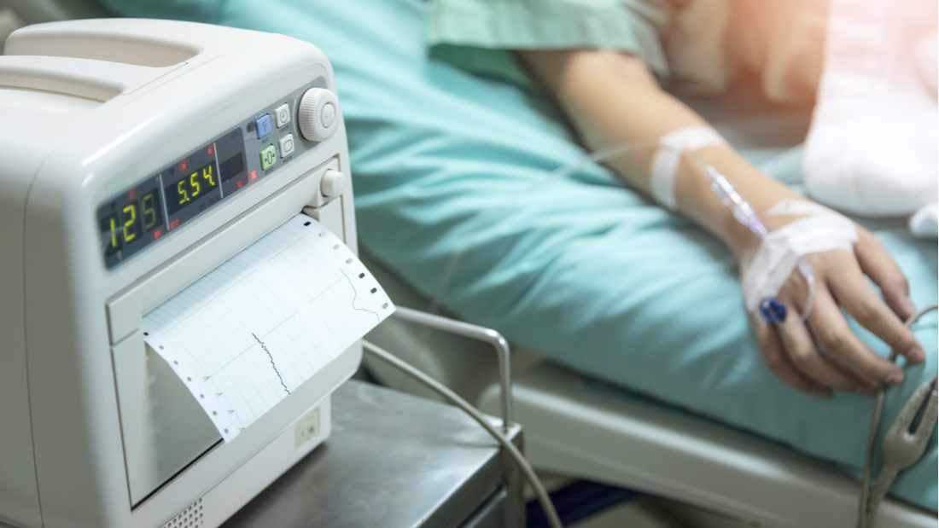

Slide 26
Signs and Symptoms of Uterine Rupture
Abdominal tenderness.
Circulatory collapse.
Elevation of presenting fetal part.
Fetal bradycardia.
Increasing abdominal girth.
Loss of uterine contractions.
Maternal tachycardia.
Vaginal bleeding

Slide 27
Complications of Postpartum Haemorrhage
Anaemia
Anterior pituitary ischemia with delay or failure of lactation (i.e., Sheehan syndrome or postpartum pituitary necrosis)
Blood transfusion
Death
Dilutional coagulopathy
Fatigue
Myocardial ischemia
Postpartum depression.
Orthostatic hypotension

Slide 28



Slide 29
Uterine Atony
Medical management

