Slide 1
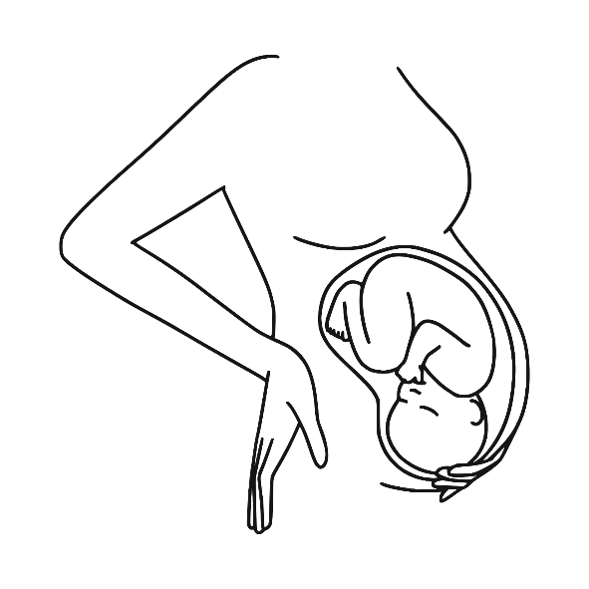

Preterm labor Dr.Bodoor Alshareef

Slide 2
Objective: Definition and Diagnosis Incidence Risk factor Management Prevention

Slide 3
Definition: Delivery after 20 week and before 37 week

Slide 4
Criteria of diagnosis: with ruptured or intact membranes documented uterine contractions (4 per 20 minutes or 8 per 60minutes) documented cervical change (cervical effacement of 80% or cervical dilation of 2 cm or more)

Slide 5
Incidence : In the United States, approximately 12% of all live births occur before term . Preterm births account for approximately 70% of neonatal deaths and 36% of infant deaths as well as 25–50% of cases of long-term neurologic impairment in children. In SA an overall preterm birth prevalence of 7.89 per 100 live births*
*Prevalence of Preterm Birth in Saudi Arabia: A Systematic Review and Meta-Analysis – PMC, Novmber 20204

Slide 6
Risk Factor

Slide 7
maternal cause Prior preterm birth . Bacterial infection (cervical , vaginal . Urinary). medical disease(DM. HTN .obesity .) Black race. Stress. lack of prenatal care . Smoking.

Slide 8
Uterine cause Uterine over distention ( multiple gestation , polyhydramnios) Uterine anomalies . Placental abruption. Cervical insufficiency PPROM IUGR

Slide 9
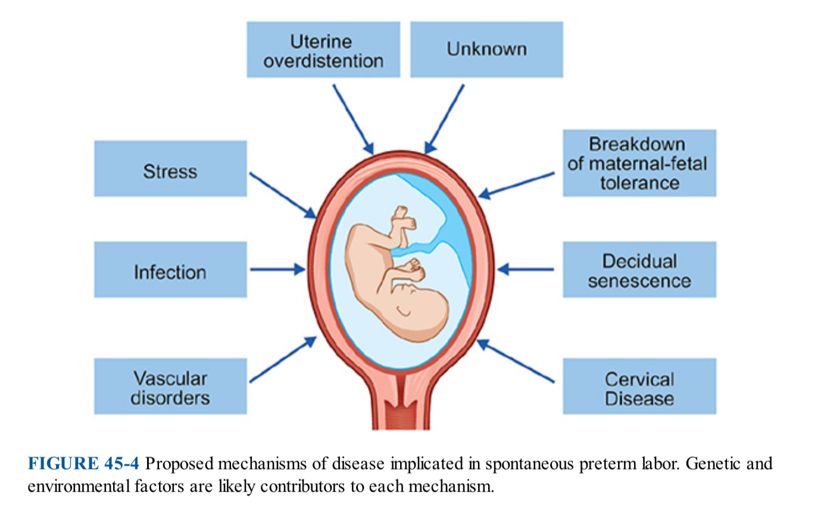

Slide 10
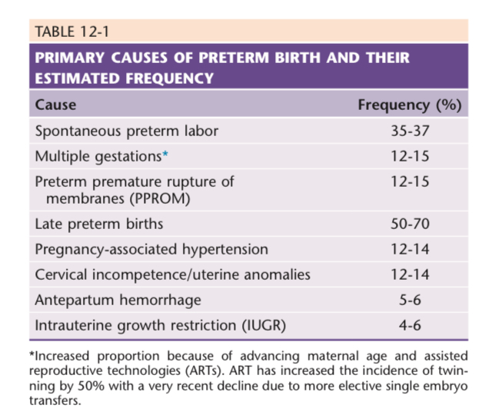

Slide 11
Management

Slide 12
27 year old lady G3p2 +0 GA 34 week , unsure about her LMP Came to ER complaining of abdominal pain and vaginal discharge No follow up in the clinic 2xSVD Medically and surgically free

Slide 13
physical examination

Slide 14
Vital sign: HR 115 bpm , BP120/85 , O2sat 99% on room air Temp:37 Abdominal and pelvic examination Ve : fully dilated vertex zero station

Slide 15
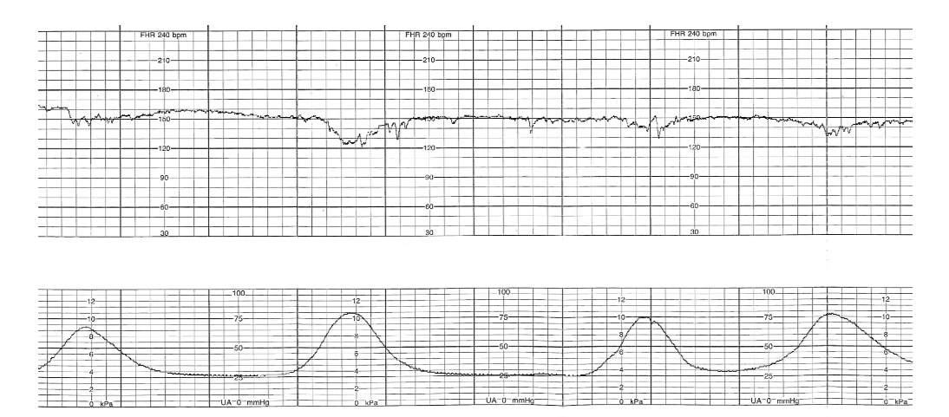

Slide 16
After 30 min patient delivered NSVD with intact perineum Outcome : baby girl , wt. 1650 gm baby admitted to NICU due to respiratory distress Mother stable admitted to postnatal

Slide 17
Investigation??

Slide 18
Ttreatment : Hydration With adequate hydration and bed rest, uterine contractions cease in approximately 20% of patients. Antibiotic For patients who are not allergic to penicillin, a 7-day course of ampicillin and erythromycin may be given. Those allergic to penicillin may be given clindamycin
Treatment : Admission Hydration

Slide 19
Corticosteriod : Treatment consists of 2doses of 12 mg of betamethasone, given intramuscularly 24 hours apart or 4 doses of 6 mg of dexamethasone given intramuscularly 12 hours apart.
Treatment : Admission Hydration

Slide 20
Tocolytic
Treatment : Admission Hydration

Slide 21
Calcium channel blocker (nifidipine ) Beta agonist( terbutaline) . Magnesium sulphate . NSAID (indomethacin ). Oxytocin antagonist (atosiban )

Slide 22
contraindication Intrauterine fetal demise Lethal fetal anomaly Nonreassuring fetal status Severe preeclampsia or eclampsia Maternal bleeding with hemodynamic instability Chorioamnionitis Maternal contraindications to tocolysis (agent specific )

Slide 23
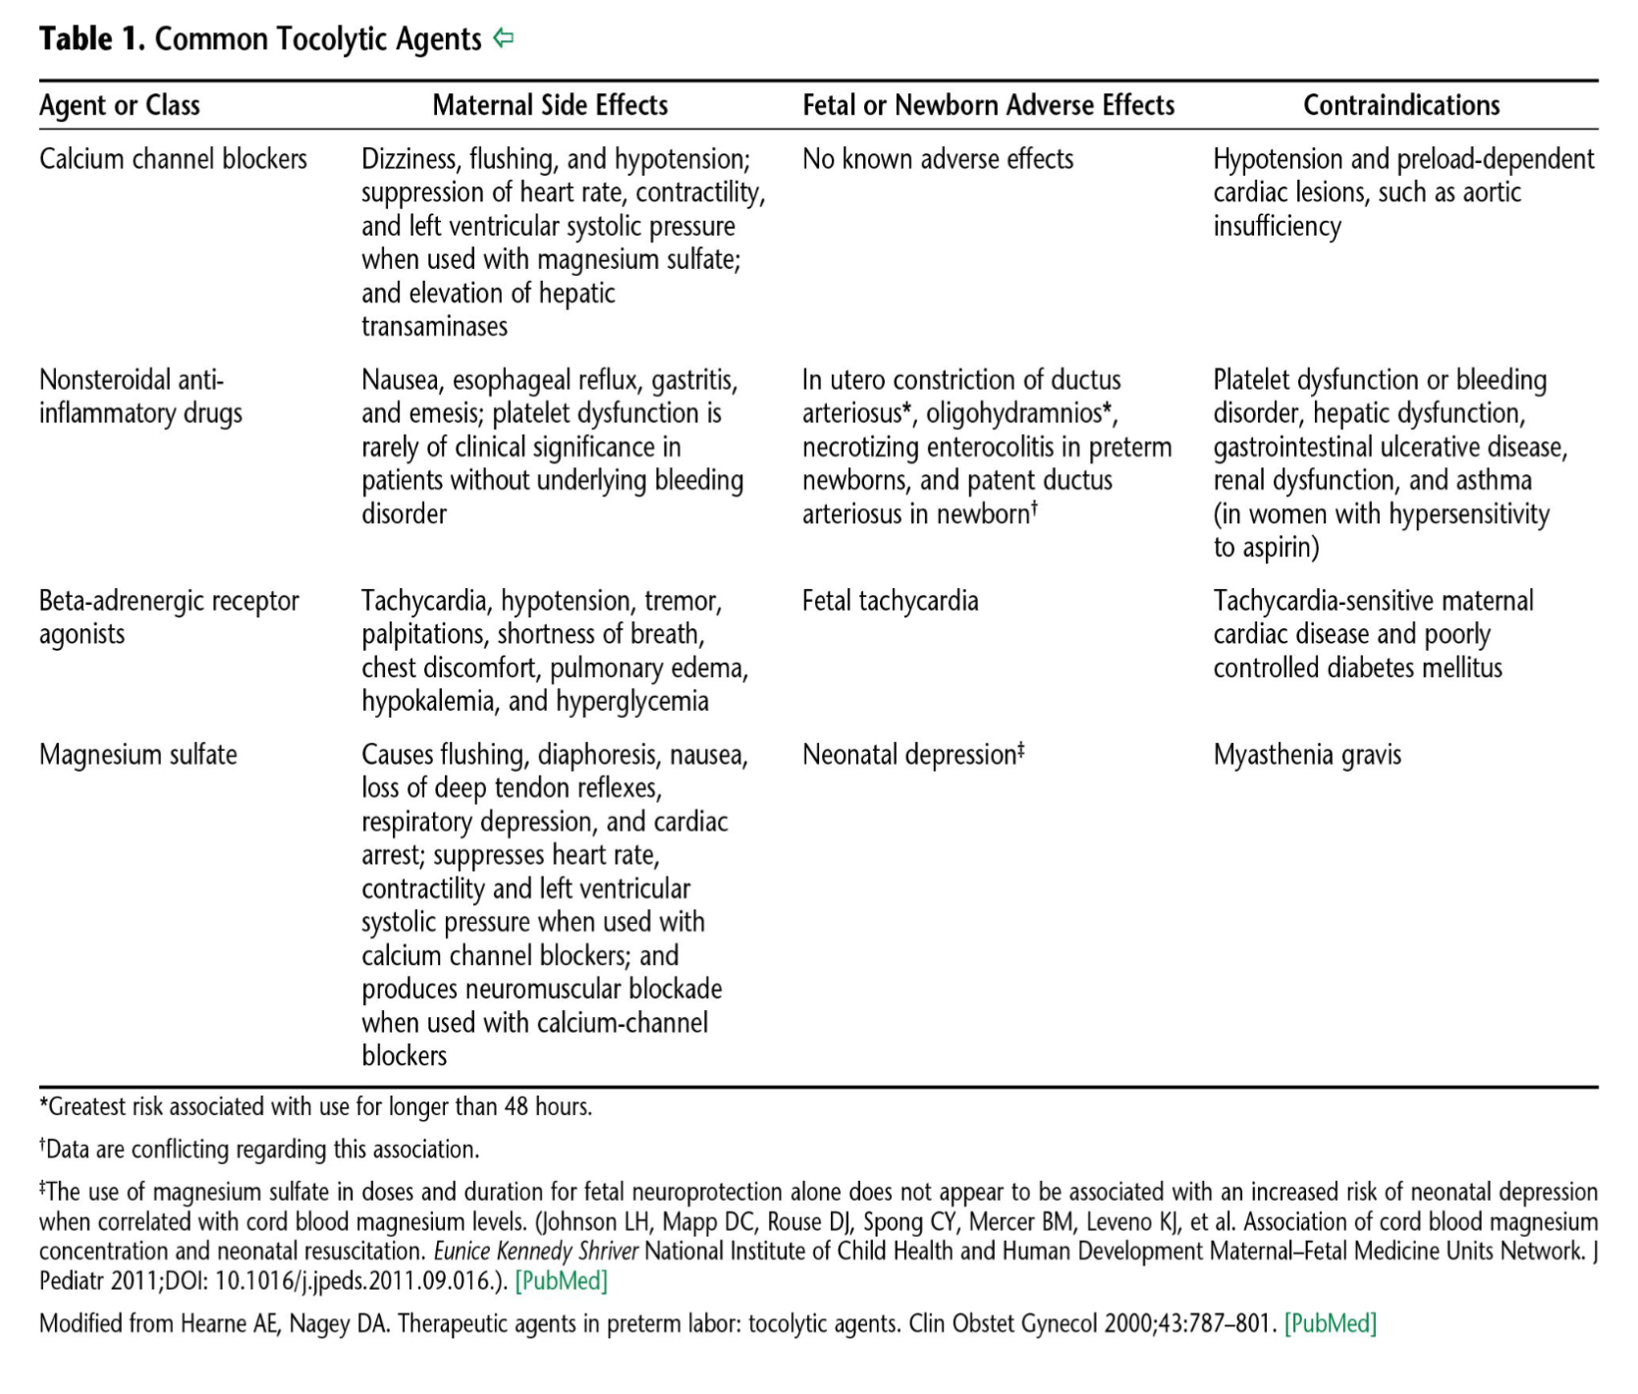

Slide 24
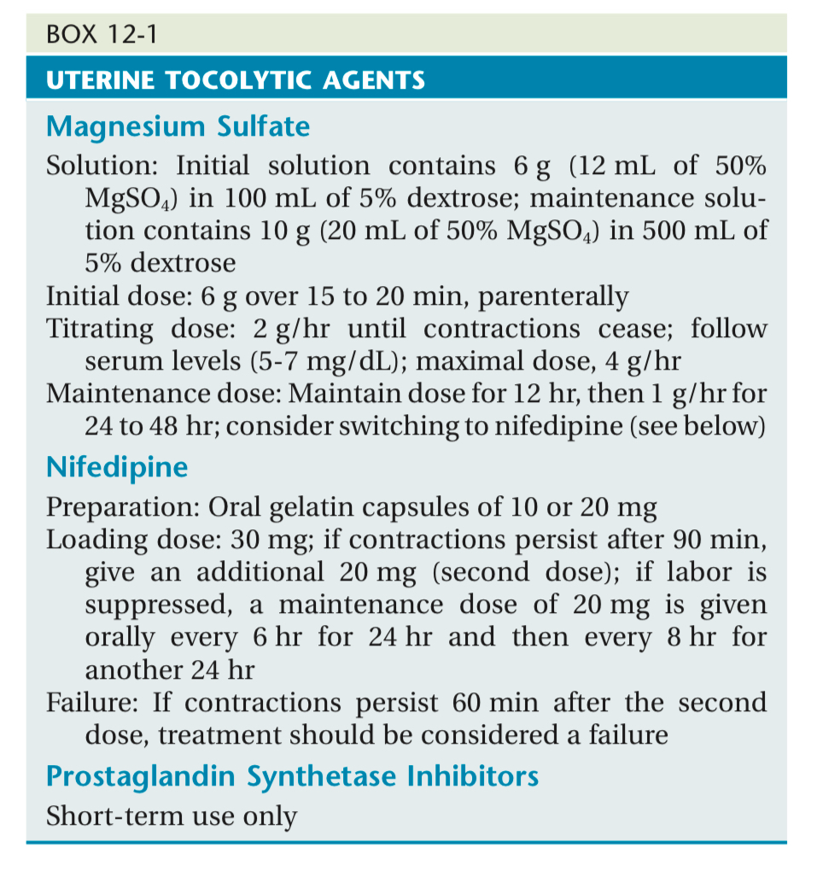

Slide 25
Labor and delivery of preterm infant: Delivery at tertiary Hospital, NICU available the lower limit of potential viability is 24 weeks or 500 g, although these limits vary with the expertise of the neonatal intensive care unit. Continuous fetal heart monitoring and prompt attention to abnormal fetal heart rate patterns are extremely important

Slide 26
Vertex presentation vaginal delivery is preferred. For the breech fetus estimated at less than1500 g, neonatal outcome is improved by cesarean delivery.

Slide 27
Complication Hypothermia Respiratory: (RDS, apnea of prematurity ,BPD Cardiac :PDA, shock, low BP IVH NEC Bacterial and fungal infection Anemia of prematurity. Retinopathy of prematurity .

Slide 28
Prevention : serial cervical length measurement at 16-24 week. 17-OH progesterone . Cervical cercalage .

Slide 29
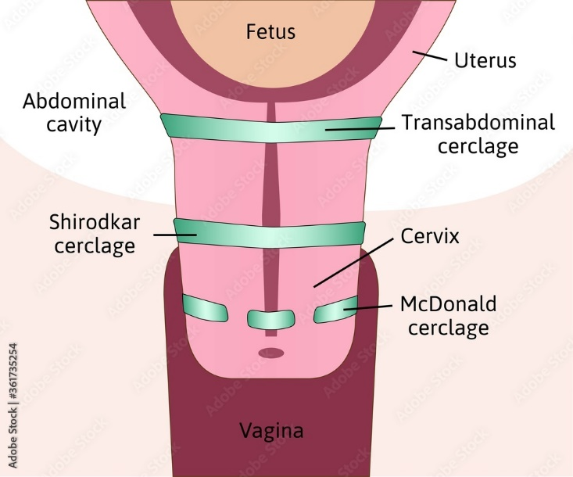

Slide 30
A 24-year-old G1P0 patient at 26 weeks’ gestation presents for a routine obstetric (OB) visit. She has had regular prenatal care, and her pregnancy has been uncomplicated. Her fundal height measures 40 cm, prompting an
ultrasound which demonstrates polyhydramnios. How should the patient be counseled about the risks of this
condition?
a. She has an increased risk of preterm delivery.
b. She has a decreased risk of requiring a cesarean delivery.
c. She has a decreased risk of gestational diabetes.
d. She has an increased risk of twin pregnancy.

Slide 31
Answer A

Slide 32
A 30-year-old G1P0 patient with a twin pregnancy at 28 weeks’ gestation presents to labor and delivery with light vaginal bleeding and uterine contractions. She does not report leaking fluid. A bedside ultrasound examination demonstrates normal amniotic fluid and anterior placentas and no evidence of placenta previa. The fetal heart rate tracing is Category I for both twins, and external monitor shows uterine contractions every 2 to 3 minutes. Examination demonstrates that the cervix is 2 cm dilated and 50% effaced, and the presenting part is at −3 station. Tocolysis with magnesium sulfate is initiated and intravenous antibiotics are started for group B streptococcus (GBS) prophylaxis. Betamethasone, a corticosteroid, is also administered. How should this patient be counseled about the benefits of betamethasone in this situation?

Slide 33
a. Betamethasone enhances the tocolytic effect of magnesium sulfate and decreases the risk of preterm delivery. b. Betamethasone decreases intraamniotic infections. c. Betamethasone promotes fetal lung maturity and decreases the risk of respiratory distress syndrome. d. The anti-inflammatory effect of betamethasone decreases the risk of GBS sepsis in the newborn. e. Betamethasone is the only corticosteroid proven to cross the placenta

Slide 34
Answer C

Slide 35
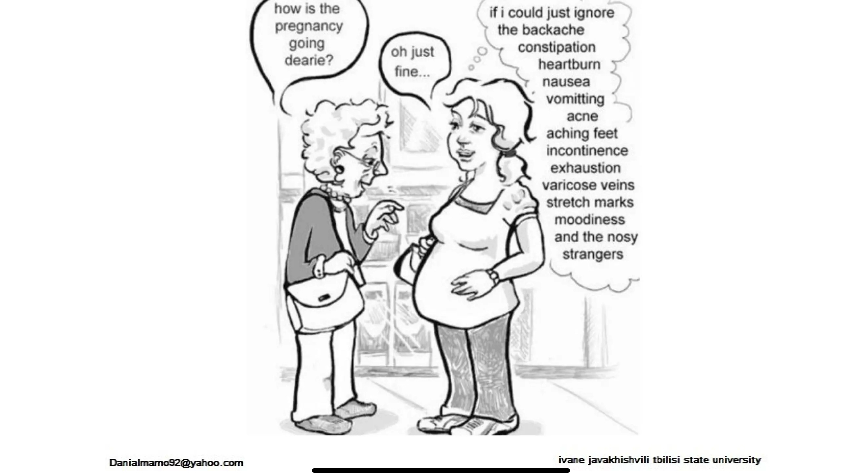

Slide 36
THANK YOU

