Slide 1
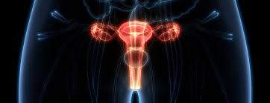
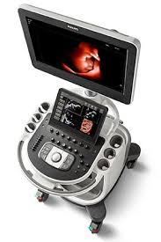
Radiology in gynaecology
By Dr. Mona Ahmed
Assisted Professor
Elmareefa University
SMSB

Slide 2

1st case
Mrs Huda is 28 years old PG .GA is 36 weeks came for routine follow up. Has no complain was regular follower .you did US you find single cephalic baby fundal placenta with –ve FH.
What is your diagnosis?
IUFD
What are other things you may suspect to be found in ultrasound?
Robert sing./ Buda sign /Spalding sign /oligohydramnios
Is there any other radiological tools you can use?
Xray

Slide 3
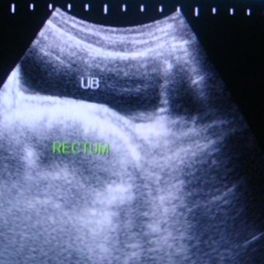

2nd case
Sammar is 18 years old .came c/o primary Amenorrhoea
you did ultrasound you find no uterus .
What is other things you will look for in history
& examination
What are other things you will look for ?
What is next step to confirm your diagnosis?

Slide 4
MRI done revealed absent uterus and ovaries with short vagina (MERK).
No associated renal anomalies
How will you manage?
Explore diagnosis
Reassurance
Hormonal treatment(Induce puppetry)(HRT)
Surgical treatment.

Slide 5
WHAT IS MEDICAL IMAGING?
MEDICAL IMAGING:
is the technique and process used to create images of the human body.
Aiming
for clinical purposes (medical procedures seeking to reveal, diagnose, or examine disease)
or medical science (including the study of normal anatomy and physiology)

Slide 6

Imaging methods in gynaecology
Ultrasonography
Computed tomography (CT)
Magnetic resonance imaging (MRI)
Conventional radiology (PET)
Angiography.
Hysterosalpingogram (HSG).
Cystourethrogram.
Hysteroscopy.
X-Ray.

Slide 7
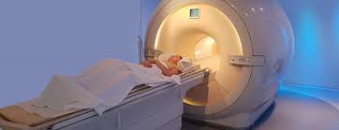
CT Scan
The diagnostic quality of pelvic scans is improved with use of oral & IV contrast .
Oral contrast media is used to differentiate between the bowel and adjacent structures .
IV contrast media used for blood vessels,
mass & lymph nodes .
The fallopian tubes & ovaries are not visible.

Slide 8
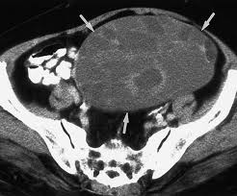
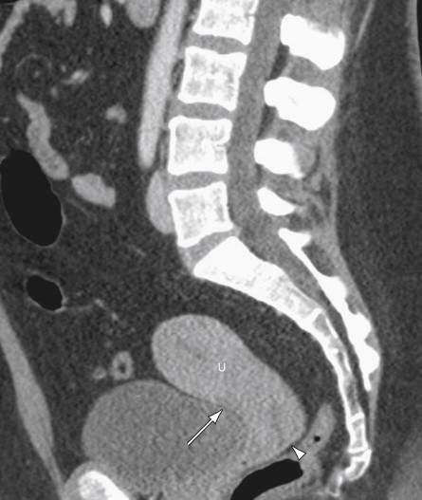
CT Scan
appropriate for detection of
ovarian tumors
less appropriate for examination of uterus

Slide 9
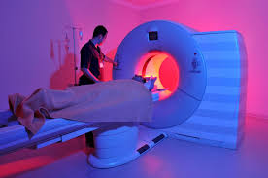
MRI
Advantages over CT scan and ultrasonography:
non-invasiveness.
Without repositioning the patient.
More sensitivity to flowing blood

Slide 10
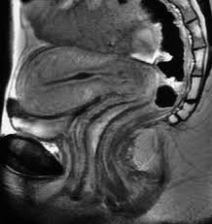
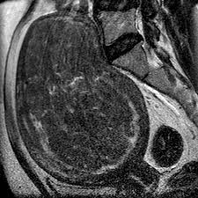
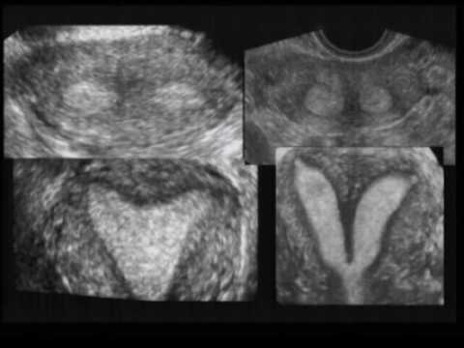
MRI
Study of normal uterus and adnexa.
Myoma.
Adenomyosis.
Congenital uterovaginal anomalies.
Gynaecological cancers.
Pregnancy --- complicated by genital cancers
Endometriosis.
Retroperitoneal lymph node.

Slide 11

Contraindications for MRI include the following:
prosthetic heart valves
Claustrophobia.
Pacemakers.
Contrast allergy.
Body weight (MRI tables not suite overweight).

Slide 12
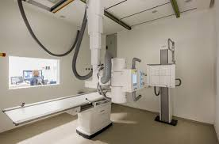
Conventional radiology uses:
Calcifications
Gas distribution
Skeleton
IUD detection

Slide 13
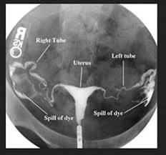
Hysterosalpingography (HSG)
Application of contrast agent into the uterine cavity
Indications :
infertility to assess :
uterine morphology
tubal patency.
Contraindications :
Inflammation (active pelvic infection).
Tumor
Pregnancy
Menses
recent uterine or tubal surgery

Slide 14
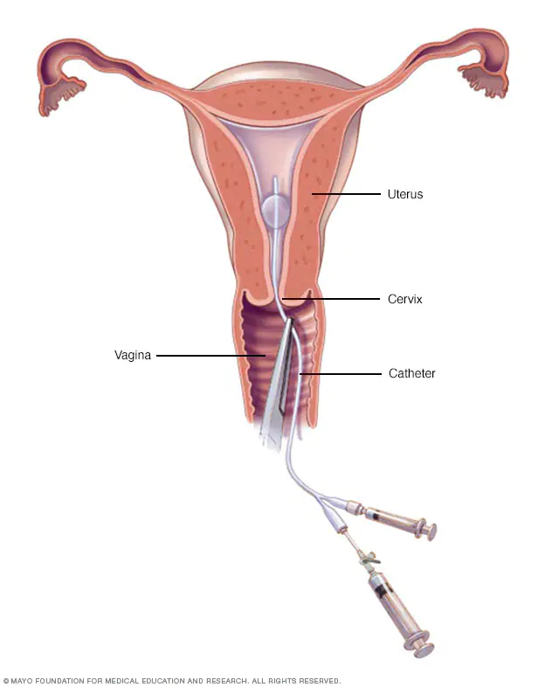
Technique
performed during proliferative phase of
the menstrual cycle (days 6-12)
……….when the endometrium is thinnest
patient in the lithotomy position
Vaginal speculum is inserted with the
the cervix is cleaned with an aseptic solution.
catheterization of the cervix.
Inject contrast.

Slide 15
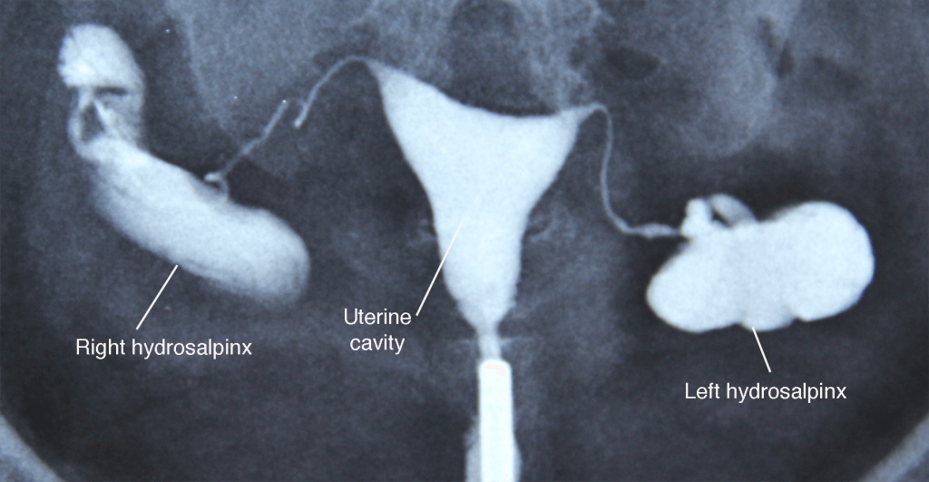
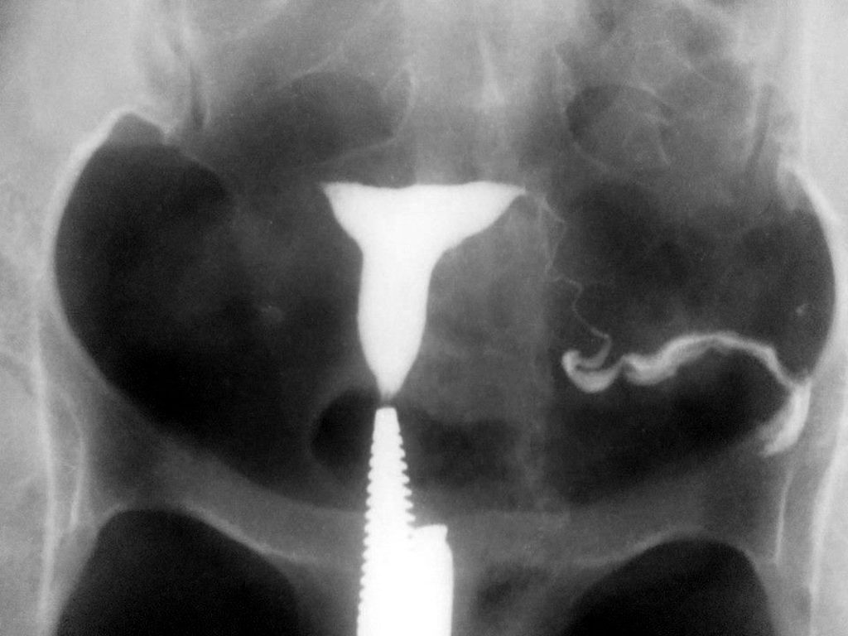
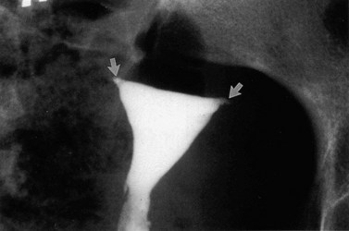
Technique

Slide 16

Complications
Common but self-limiting
abdominal cramping
spotting
venous extravasation
Rare but serious
pelvic infection
contrast reaction

Slide 17
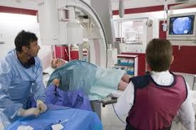
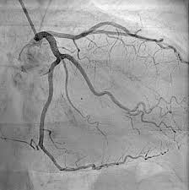
Angiography
Angiograms can help in detecting blood vessel abnormalities.
Rarely indicated:
pathologic vascularization
Involvement of pelvic vessels in tumors)

Slide 18
Potential risks and complications include:
Heart attack.
Stroke.
Injury to the catheterized artery.
Arrhythmias.
Allergic to the dye or medications .
Renal damage.
Infection.

Slide 19
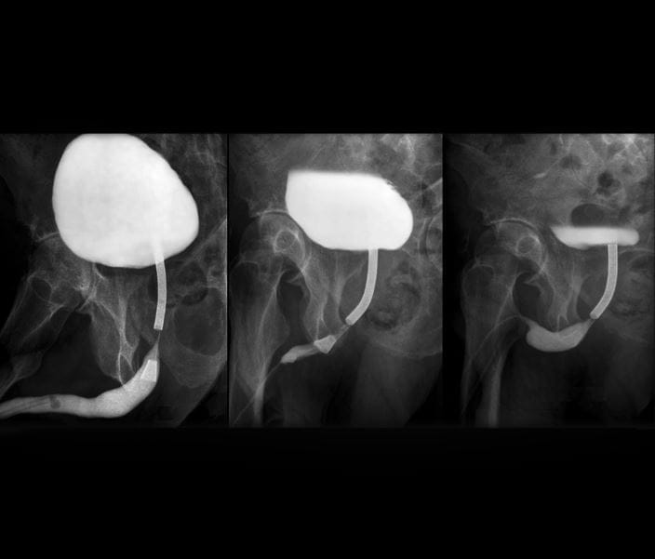
Cystourethrogram
Dynamic test used to Demonstrates :
the lower urinary tract
Vesico-ureteral reflux.
bladder pathology
Congenital anomalies of bladder.
Technique:
passing a catheter through the urethra into the bladder
filling the bladder with contrast material
Then taking radiographs while the patient voids

Slide 20

Indications:
Children:
Urinary tract infection
voiding difficulties .
Baseline study prior to lower UT surgery.
Adults:
Trauma to urethra.
urethral stricture.
urethral diverticula .
UTI.
Reflux nephropathy prior to renal transplant of one/both kidneys.

Slide 21
Complications
UTI.
Adverse reactions from contrast .
Trauma causing dysuria, frequency Hematuria and urinary retention .
perforation .
Catheterization of vagina or ectopic ureteral orifice.
Exposes gonads to some radiation. .

Slide 22
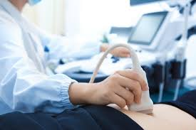
ULTRASONOGRAPHY
Ultrasound is not substituting good history
& a thorough examination .
Always do an abdominal scan before
using the vaginal probe.

Slide 23

Role od ultrasound
To examine the uterus, ovaries, cervix, vagina and adnexae.
Classification of a mass identified on other modalities eg:
* solid. *cystic. *mixed.
Post surgical complications eg: * abscess. * oedema.
Guidance of injections, aspiration or biopsy.
Assistance with IVF.
To identify the relationship of normal anatomy and pathology
to each other.

Slide 24
INDICATIONS
Vaginal bleeding .
vaginal discharge.
Menorrhagia.
Metrorrhagia (irregular uterine bleeding).
Amenorrhea.
Polymenorrhea.
Oligomenorrhea.
Pelvic pain.
Dysmenorrhea.
F/H uterine or ovarian Cancer.
Palpable lump,

Slide 25
Infertility- primary or secondary
*evaluation. *monitoring *and/or treatment.
Anomalies/evaluation.
Follow-up of previous abnormality.
Precocious Puberty & vaginal bleeding in a prepubertal child .
delayed menses or.
postmenopausal bleeding.
Signs/symptoms of pelvic infection.
IUCD Localisation.
Guidance for interventional or surgical procedures.
urinary incontinence
pelvic organ prolapse

Slide 26
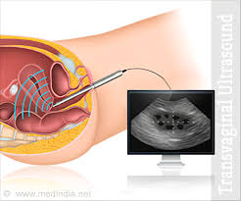
LIMITATIONS
Transvaginal scanning is contra-indicated:
if the patient is not yet sexually active.
or cannot provide informed consent.
Obese patient will reduce detail, particularly
via the transabdominal approach.
Excessive bowel gas can obscure the ovaries.
.

Slide 27
PATIENT PREPARATION
Scan the patient in the first 10 days of the cycle.
Full bladder is required .(Abdominal US)
Instruct the patient to drink 1 Litre of water.
The patient empties their bladder
before the transvaginal scan is started.

Slide 28
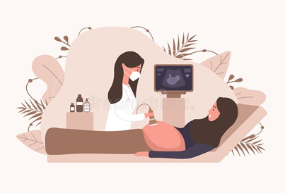
SCANNING TECHNIQUE

Slide 29
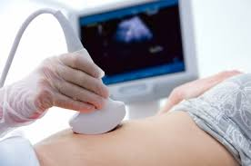
Trans abdominal
Full bladder
Panoramic view
For :
large masses
Abdominal organs
Lymph nodes

Slide 30

Trans abdominal approach
This is a generalised overview to identify the cervix, uterus and ovaries.
Check for the orientation the uterus (anteverted V's retroverted)
Assess the uterine size and shape.
Assess the myometrium.
Assess the endometrial status and measure the thickness:
*<10mm pre menopausal *<4mm post menopause *<6mm if post menopausal on HRT.
5.Assess the cervix.
6.Look for free fluid in the pouch of Douglas.
7.Check the ovaries and adnexae.
8.Assess bladder.

Slide 31
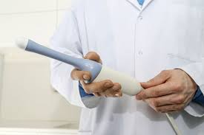
Trans vaginal ultrasound
Before inserting the probe
show the patient the TV probe and explain the procedure.
Explain the importance of a TV scan
(gold standard in gynaecological ultrasound).
Lit the patient empty their bladder.
Cover the probe with sheath & lubricate
with sterile gel .

Slide 32
WHAT TO DETECT IN
GYNAECOLOGY ULTRASOUND

Slide 33
Vaginal
Vaginal carcinoma
Haematocolpos (secondary to imperforate hymen or vaginal stenosis)
Foreign body

Slide 34
Cervical
Nabothian (retention) cysts
Polyps
Cervical fibroids
Cervical carcinoma
Cervical stenosis

Slide 35
Uterine
Fibroids (leiomyoma)
  submucosal
  intramural
  subserosal
  pedunculated
Leiomyosarcoma
Adenomyosis
Lipoleiomyoma
Anomalies.

Slide 36
Endometrial
Endometrial Polyps.
Endometrial Carcinoma.
Endometrial hyperplasia.
Endometritis.
Cystic hyperplasia secondary to Tamoxifen.
Adhesions- Asherman's Syndrome.
Submucosal fibroids.
Arterio-venous malformation (AVM).
Hydro/hematometra.
Blood/fluid/infection or retained products of conception .

Slide 37
Ovarian
Ovarian cysts
  *simple * complex (haemorrhagic, corpus luteal, ruptured, septated).
Dermoid cyst.
Ovarian tumours:
  *Benign *Malignant.
Polycystic Ovarian Disease.
Endometrioma.
Torsion.
Hyperstimulation syndrome,
Ectopic pregnancy,

Slide 38
Pouch of dogless
Fluid
Pus
Blood
Pelvic inflammatory disease-PID (may be indicated by above conditions)
Cysts (Mesenteric)
Ectopic pregnancy
Endometriosis
Pelvic venous congestion
Bowel pathology may be seen (but cannot be excluded)

Slide 39
Fallopian tubes
Normal fallopian tubes not seen, in a routine scan. Pathological tubes seen as dilated, truncated structures.
PID.
Pyosalpynx.
Hydrosalpinx.
Ectopic pregnancy.
Cyst.
Endometriosis. •

Slide 40
A pelvic series should include the following minimum images(Report):
Uterus - longitudinal, transverse (with measurements)
Endometrial thickness measured in the longitudinal plane
Cervix
Both ovaries- longitudinal, transverse
Both adnexae
Document the normal anatomy.
Any pathology found in 2 planes, including
measurements and any vascularity.

Slide 41
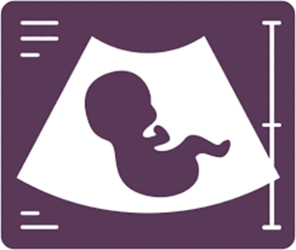
Obstetric ultrasound

Slide 42
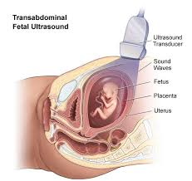
Ultrasonography
Method of the first choice
Recognition of multiple pregnancy
vitality
Confirmation of pregnancy
Fetal biometry
detection of congenital disorders
Screening -

Slide 43
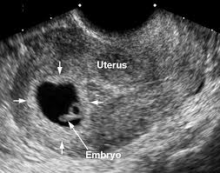
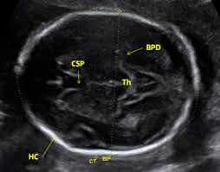
2. a 3. trimester
3-5 week – gestational sac
6. – 7. week – heart activity
Fetal biometry
Method for assessment of gestation age and Fetal growth

Slide 44
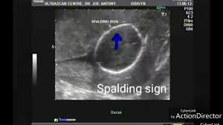
Dead fetus
1) Absence of flow and heart movements
2) Oligohydramnios
3) Superposition of skull bones

Slide 45
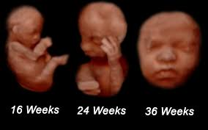
3D ultrasound
most frequently used in obstetrics
Commercial use
Diagnostics of congenital abnormalities

Slide 46
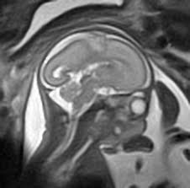
MRI
congenital disorders (in case of unclear US finding)
examination of mother (instead of X-ray or CT)
Congenital brain abnormality
(interhemispheric cyst and agenesis of corpus callosum)
Contraindications
First trimester

Slide 47
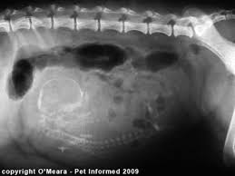
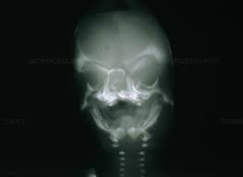
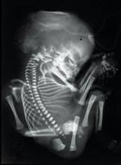
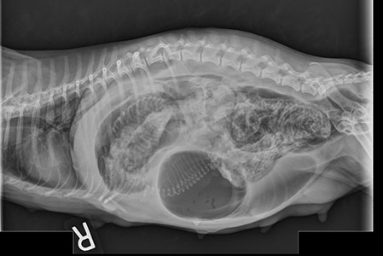
Plain film
Dead fetus
Distortion of vertebral column
Superposition of skull bones
Abnormal position of extremities
Presence of gas
Nowadays is this method replaced
by US or MRI

Slide 48



