Slide 1
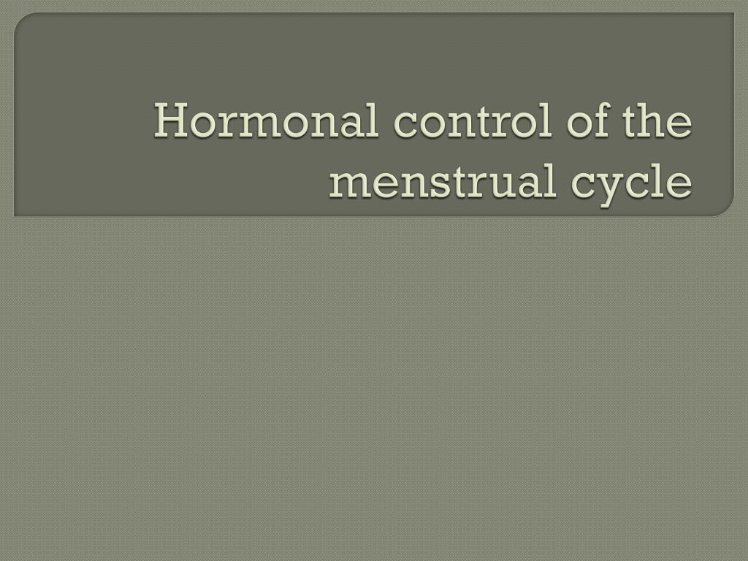
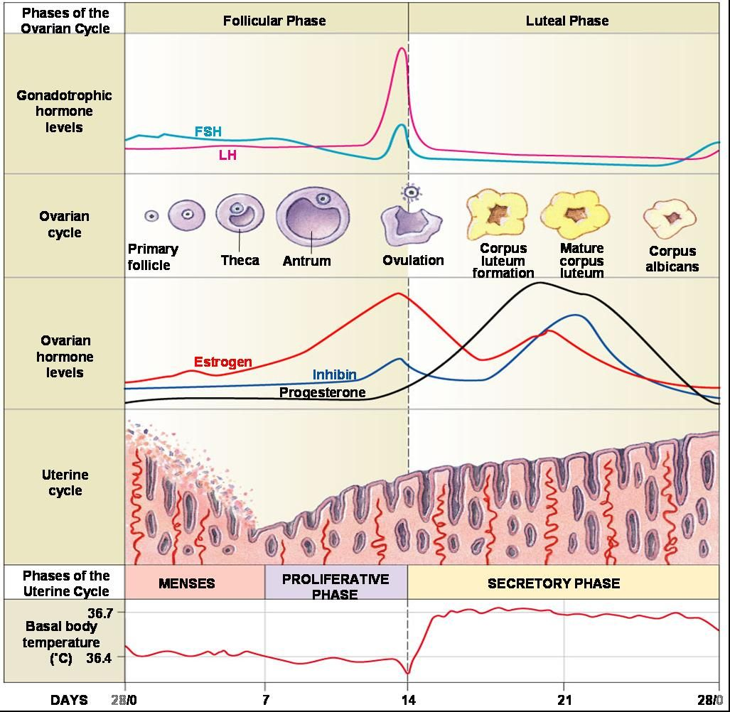
Hormonal control z
By dr Mona Ahmed…assisted professor ….Elmareefa university….SMSB

Slide 2
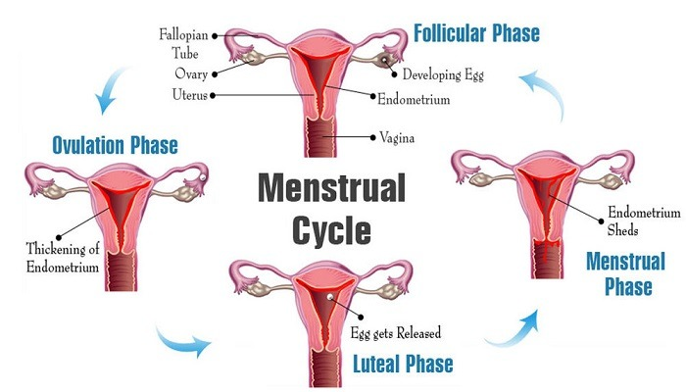

Slide 3
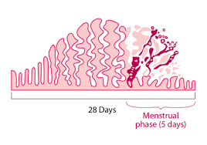
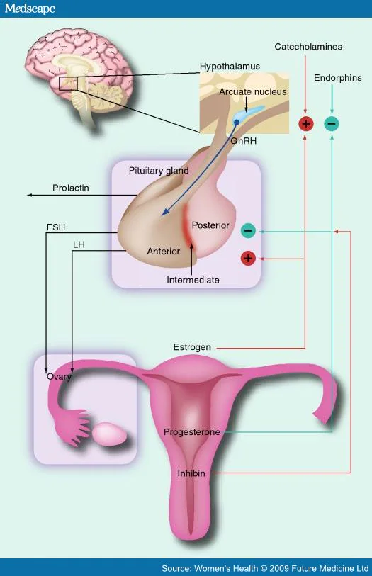
Manifestation of normal menstrual cycle Is:
Presence of regular vaginal bleeding as a result of
shedding of the endometrial lining following
failure of fertilization.
The cycle depends on:
Changes occurring in ovarian hormones
Which controlled by :
Pituitary .
&
Hypothalamus.
the hypothalamo–pituitary–ovarian axis (HPO).
Hormonal abnormalities lead to menstruation
abnormalities .

Slide 4
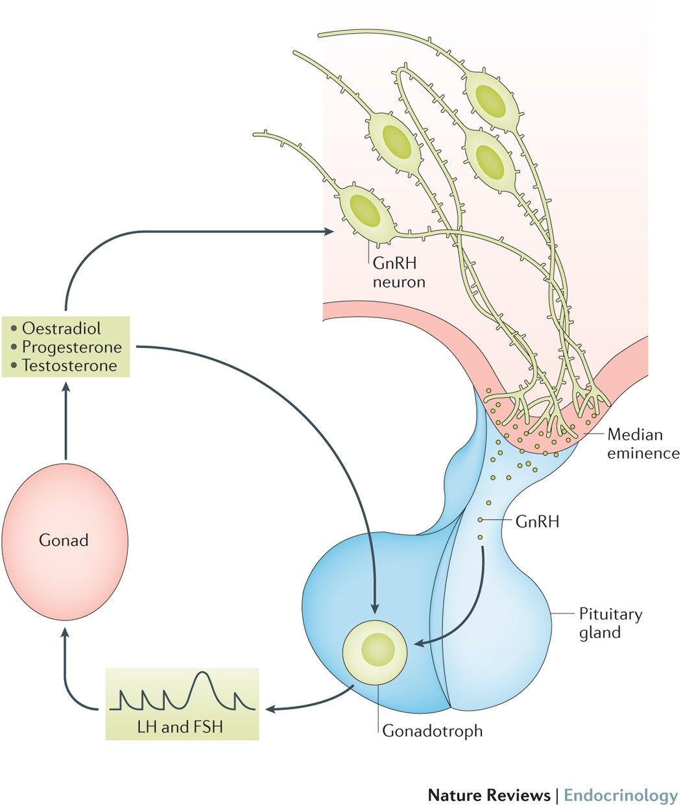
The hypothalamus
Secretes gonadotrophin-releasing hormone (GnRH),
which controls hormone secretion in the :
anterior pituitary gland
luteinizing hormone (LH).
follicle-stimulating hormone (FSH).
GnRH released in a pulsatile pattern .
This process is modulated by the
ovarian sex steroid hormones
oestrogen and progesterone

Slide 6
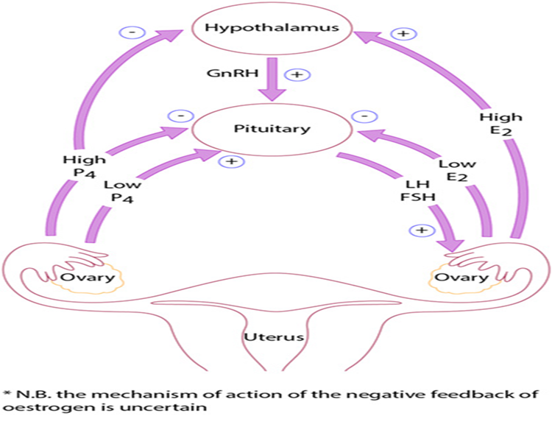

Slide 7
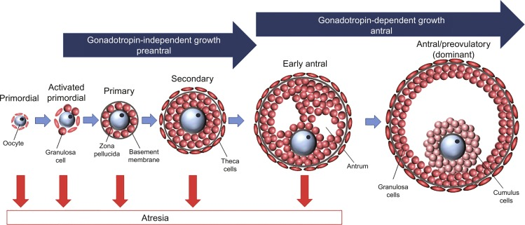
The initial stages of follicular development
independent of hormone stimulation.
follicular development will fail at the preantral stage and follicular atresia will ensue if pituitary hormones
LH and FSH are absent.
FSH levels rise in the first days of the menstrual cycle,
when oestrogen, progesterone and inhibin levels are low.
This stimulates a cohort of small antral follicles on the ovaries to grow.

Slide 8


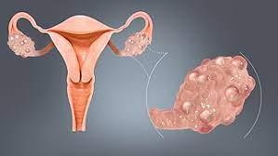

Slide 9
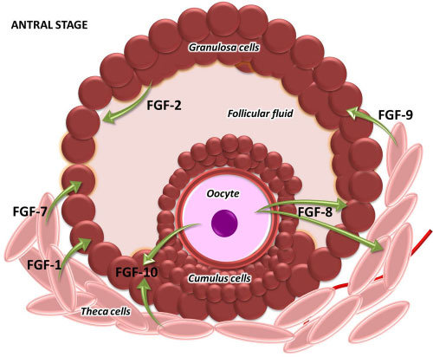
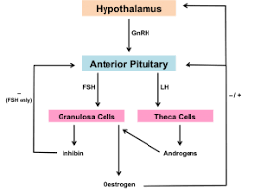
Within the follicles, there are two cell types that
are involved in the processing of steroids,
including oestrogen and progesterone.
These are the theca and the granulosa cells,
which respond to LH and FSH stimulation, respectively.
Theca cells LH Progesterone.
Granulosa cells FSH Oestrogen.
reoponse

Slide 10
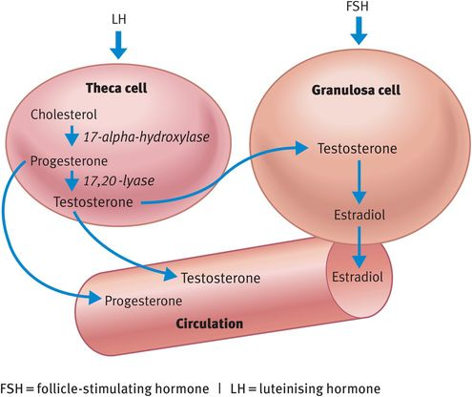
LH stimulates production of androgens
(from cholesterol )within theca cells.
……These androgens are converted into oestrogens .
in granulosa cells, under the influence of FSH.

Slide 11
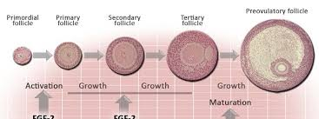
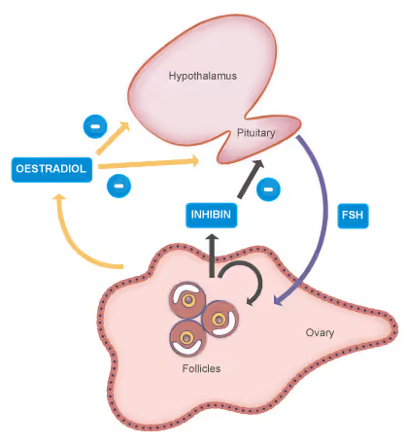
As the follicles grow
oestrogen secretion increases
negative feedback(on the pituitary)
decrease FSH secretion(Which assist in selection of
the dominant follicle while smaller follicles
will undergo atresia)

Slide 12
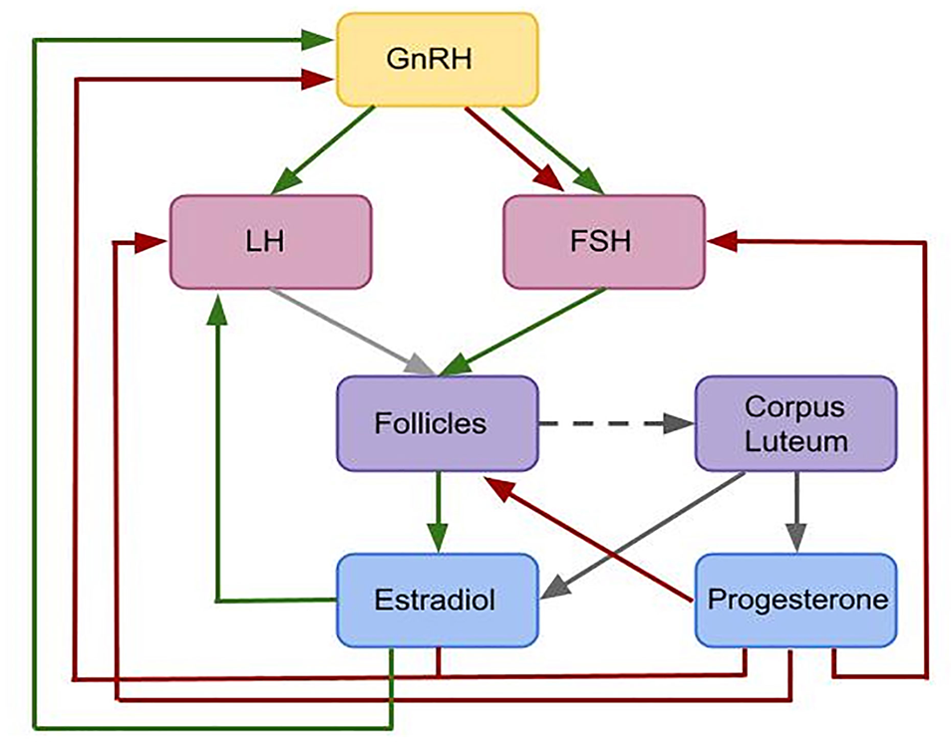

Slide 13
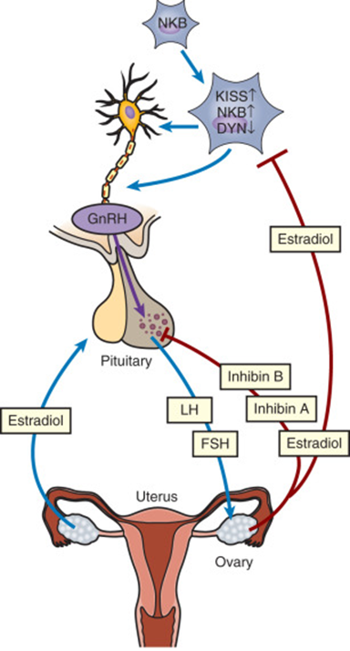

Regulation
Inhibin is secreted by granulosa cells….
enhance androgen synthesis.
Activin is secreted by granulosa cells…
(is structurally similar to inhibin, but has an opposite action).
increase FSH binding on the follicles.
Insulin-like growth factors (IGF-I, IGF-II) . highest level found in
the dominant follicle fluid towards ovulation.
Kisspeptins proteins recently found to play a role in regulation
of the HPO axis, mediated in metabolism of leptin.
Leptin (affect hypothalamus ) is play a role in energy production,
weight and reproductive health.
“ “Mutations in the kisspeptin receptors associated with delayed or absent puberty”.

Slide 14
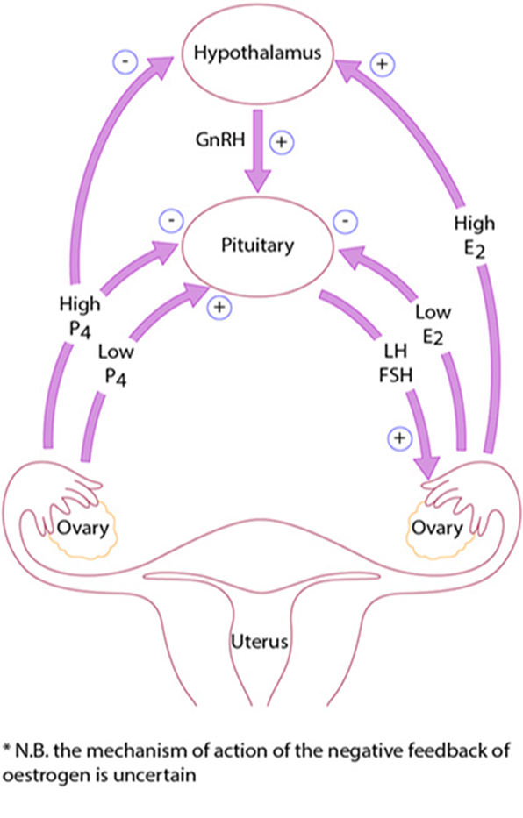
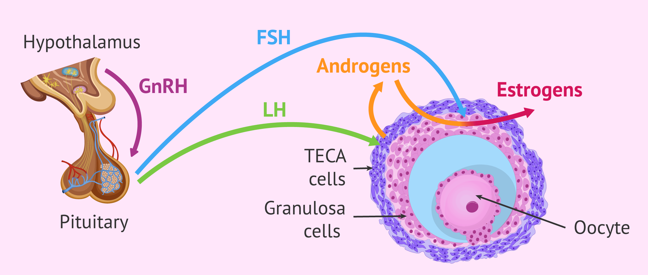
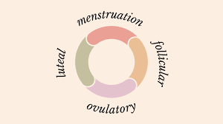

Slide 15
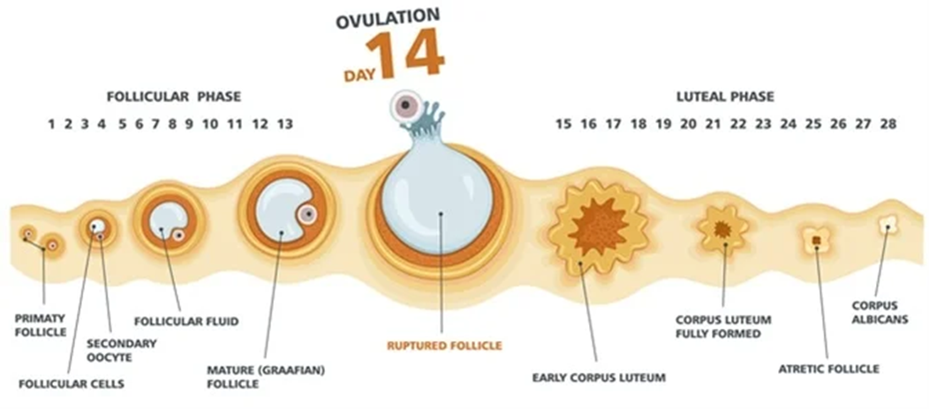
Ovulation
At the end of the follicular phase(which lasts an average of 14 days)
the dominant follicle has grown to approximately 20 mm(mature follicle).
FSH induces LH receptors on the granulosa cells.
oestrogen increases till making +ve feedback effect on PH .
LH surge(24–36 hours later)
progesterone from mature follicle make +ve
feedback for secretion and causing a small periovulatory rise in FSH.

Slide 16
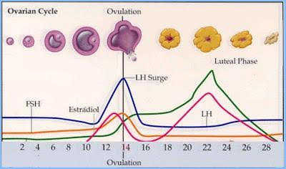
Ovulation occurs after breakdown of the follicular wall
The LH surge is predictors of ovulation.
under the influence of LH, FSH
and proteolytic enzymes(prostaglandins PGs).
Inhibition of PG production may result in failure of ovulation.
Thus,
women wishing to become pregnant should be advised
to avoid taking PG synthetase inhibitors, such as aspirin
and ibuprofen.

Slide 17
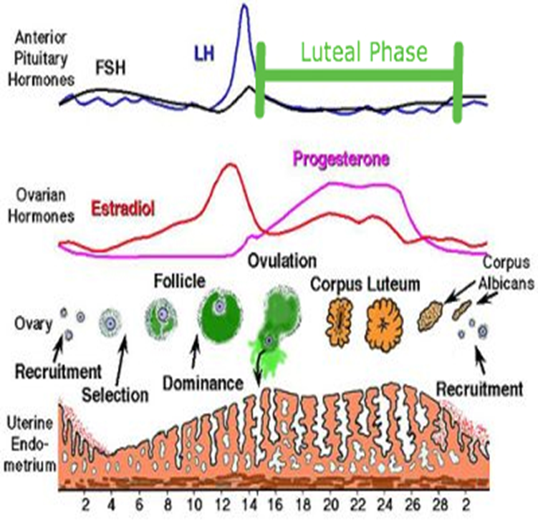
Luteal phase :
After release of oocyte, the remaining granulosa and theca cells
form the corpus luteum (CL ) (Due accumulated yellow pigment).
Why? To supply granulosa cells with rich blood for steroidogenesis.
Progesterone stabilizes the endometrium in preparation for
pregnancy.
High Progesterone levels suppress FSH and LH
which prevent another follicular growth.
The luteal phase lasts 14 days in most women.
it is relatively constant in all women.
In the absence of βhCG (pregnancy) the CL will regress
( luteolysis) Lead to progesterone withdrawal
& shedding of the endometrium and menstruation.

Slide 18
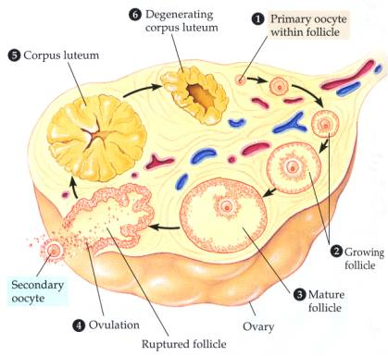
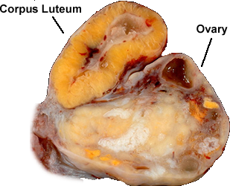
Corpus luteum

Slide 19
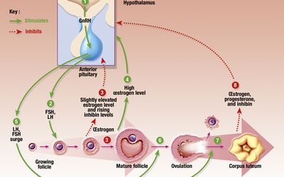
Reduction in levels of progesterone, oestrogen and inhibin feeding back to the pituitary cause increased secretion of gonadotrophic hormones.
New preantral follicles begin to be stimulated and the cycle begins anew.

Slide 20
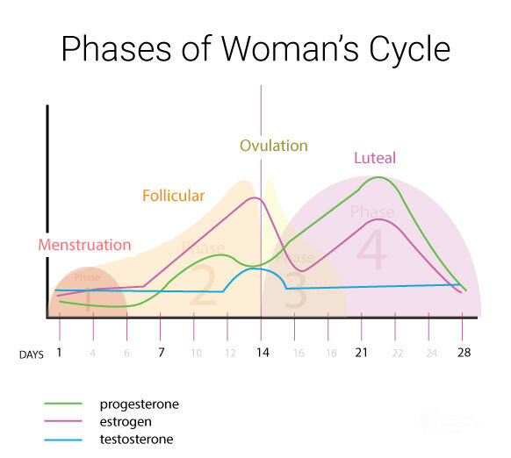

Slide 21
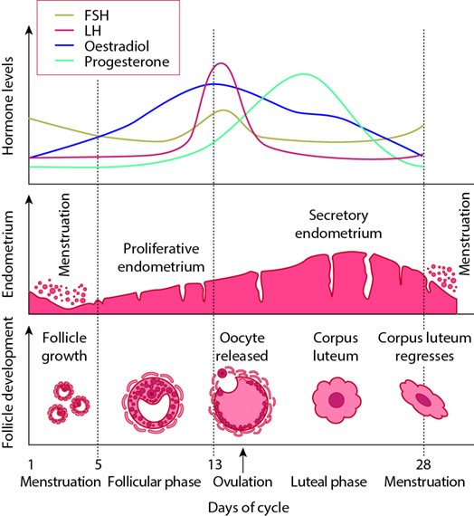
The endometrium
The hormone changes effected by the HPO
axis during the menstrual cycle will occur whether
the uterus is present or not.
The changes in the endometrium give
the most obvious external sign of a regular cycles.
The proliferative phase
After menstruation, when glandular
and stromal growth begin.
The epithelium lining the endometrial glands
cells increase by mitoses….. Endometrial thickness
increases from 0.5 mm to 3.5–5 mm at the end
of the proliferative phase.

Slide 22
The secretory phase
After ovulation (around day 14)
there is a period of endometrial glandular secretory activity.
Endometrial thickness does not increase any further.
The glands will become more tortuous.
spiral arteries will grow.
Fluid is secreted into uterine lumen.
Later , formation of a temporary layer,
known as the decidua, in the endometrial
stroma.

Slide 23
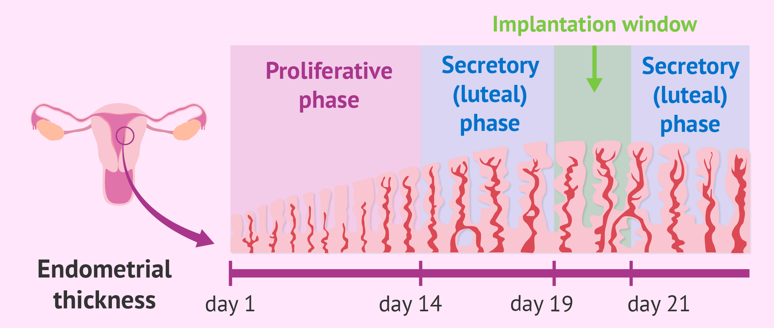
After day 21–22 …. a progesterone-dependent stage making the endometrium receptive for embryo implantation

Slide 24
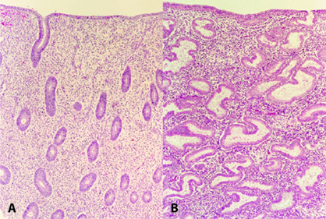
Tissue sections of normal endometrium during :
(A)proliferative phase.
(B)secretory phases
Of the menstrual cycle

Slide 25
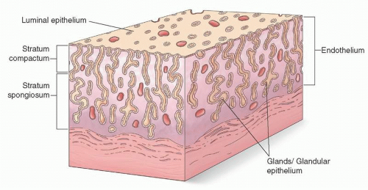
Menstruation
Menstruation (day 1) is the
shedding of the ‘dead’ endometrium and
ceases as the endometrium regenerates
(which normally happens by day 5–6 of the cycle).
Immediately prior to menstruation, three layers
of endometrium can be seen.
The basalis is the lower 25% of the endometrium,
which will remain throughout menstruation and
shows few changes during the menstrual cycle.
The midportion is the stratum spongiosum with oedematous stroma and exhausted glands. The superficial portion (upper 25%) is the stratum compactum with prominent decidualized stromal cells.

Slide 26
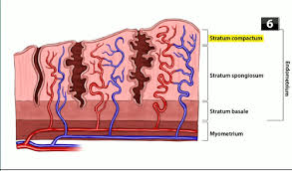
Menstruation
A fall in circulating levels of oestrogen and progesterone 14 days after ovulation leads to loss of tissue fluid, vasoconstriction of spiral arterioles and distal ischaemia. This results in tissue breakdown and loss of the upper layers, along with bleeding from fragments of the remaining arterioles,
seen as menstrual bleeding. Enhanced fibrinolysis
reduces clotting. (This effects can be reproduced
artificially, f or example in patients taking the COCP).
Vaginal bleeding will cease after 5–10 days
as arterioles vasoconstrict and the endometrium
begins to regenerate.
Haemostasis in the uterine endometrium is different from elsewhere in the body( no clot formation and no fibrosis).

Slide 27

Endometrial repair involves:
both glandular and stromal regeneration
and angiogenesis
to
reconstitute the endometrial vasculature.

Slide 28

Puberty
Is the process of reproductive and sexual development and maturation that changes a child into an adult.
During childhood, the HPO axis is suppressed and levels of GnRH, FSH and LH are very low.
From the age of 8–9 years GnRH is secreted in pulsations of increasing amplitude and frequency.
These are initially sleep-related, but as puberty progresses, these extend throughout the day. This stimulates secretion of FSH and LH by the pituitary glands, which in turn triggers follicular growth and steroidogenesis in the ovary.
The oestrogen produced by the ovary then initiates the physical changes of puberty. The exact mechanism of onset of puberty is still unknown, but it is influenced by many factors including
race heredity body weight and exercise.
Leptin plays a permissive role in the onset of puberty.

Slide 29
physical changes in puberty :
1.breast development (thelarche), first physical signs of puberty are breast budding 2–3 years before menarche
2.pubic (adrenarche), depend on the secretion of adrenal androgens and is usually after thelarche
3.axillary hair growth
4. growth spurt (growth hormone secretion +GRH & androgens)
5.onset of menstruation (menarche).
Leptin (metabolic hormones produces by adipose tissue in response to fat deposition play a role in puberty
The mean age of menarche is 12.8 years.
Initial cycles are usually anovulatory and can be irregular(may take over 3 years to be regular).
Pubertal development was described by Tanner ,a nd the stages of breast and pubic hair development are often referred to as Tanner stages 1–5
The absence of menstruation is called amenorrhoea and may be primary or secondary.

Slide 30
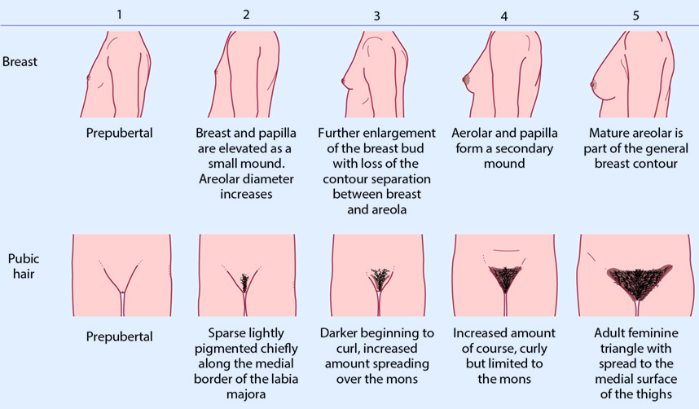
Tanner stages

Slide 31
Precocious puberty
onset of puberty before the age of in 8 a girl or 9 in a boy.
It is classified as either central or peripheral.
1.Central precocious puberty (true precocious):
Gonadotrophin dependent.
The aetiology is often unknown(75% idiopathic)
up to 25% are due to central nervous system (CNS) malformations or brain tumours).
2.Peripheral precocious puberty (pseudopuberty):
Gonadotrophin independent
is always pathological and can be caused by oestrogen secretion
Exogenous oestrogen ingestion.
Hormone-producing tumour.
McCune Albright syndrome .

Slide 32
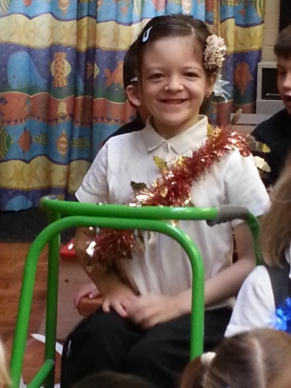
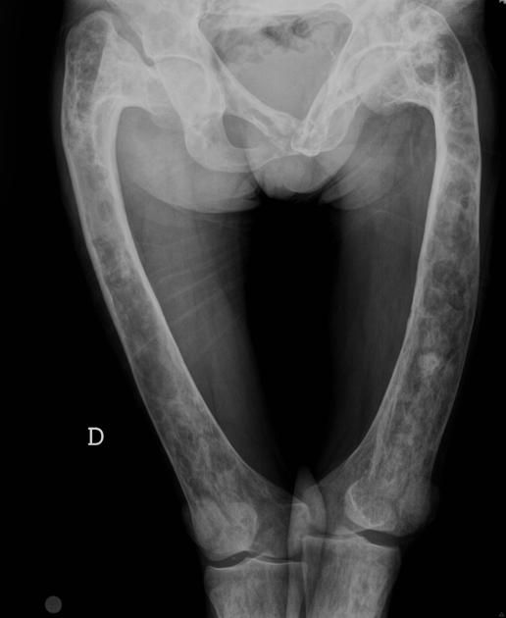
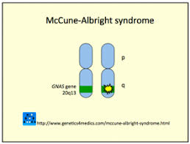
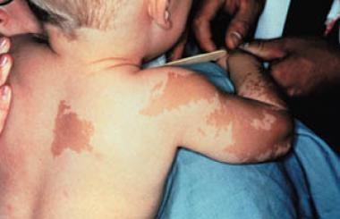
McCune Albright
Polyostotic fibrous dysplasia.
café au lait skin lesions.
Precocious puberty.

Slide 33

Precocious puberty con…
Investigations :
Serum gonadotrophin
(elevated in centrasl and low in
prepheral).
Brain images
Pelvic US
Treatment:
GNRH analoge
Surgary.

Slide 34
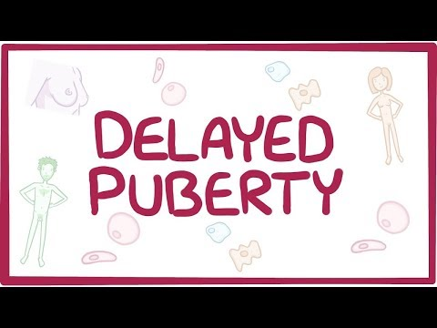
When there are no signs of secondary sexual characteristics by the age of 14 years.
causes
central defect (hypo gonadotrophic hypogonadism)
failure of gonadal function (hypergonadotropic hypogonadism).

Slide 35

Hypogonadotropic hypogonadism (central ):
gonadotrophins are
Constitutional.
anorexia nervosa.
excessive exercise.
chronic illness, (diabetes or renal failure).
pituitary tumour
Kallman's syndrome.
Associated with delayed puberty and primary amenorrhoea.

Slide 36
Hypergonadotropic hypogonadism (gonadal failure):
gonadotrophins are
The gonad does not function.
causes :
Turner syndrome
XX gonadal dysgenesis.
Premature ovarian failure at any age(including prior to pubertal age)
*idiopathic . * autoimmune . * metabolic disorder.
*following chemo- or radiotherapy for childhood cancer.
Associated with delayed puberty and primary amenorrhoea.
Hypergonadotropic hypogonadism can also occur later in life and will cause secondary amenorrhoea after normal sexual development.

