Slide 1

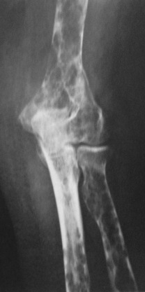
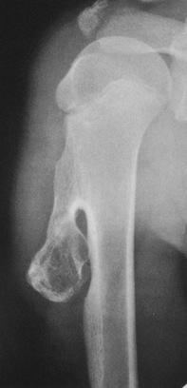
Bone Tumors and Tumor-like Conditions
Dr. Tarif Alakhras

Slide 2
Objectives
General presentation of bone tumors
Benign tumors
Tumor-like lesions:
Bone cysts and cortical defects
Malignant:
Primary malignant
Metastasis in bone

Slide 3
Classification – predominant tissue
Tissue of Origin | Benign | Malignant
Bone forming | Osteoma Osteoid Osteoma Osteoblastoma | Osteosarcoma
Cartilage forming | Chondroma Osteochondroma Chondroblastoma | Chondrosarcoma
Fibrous tissue | Fibroma | Fibrosarcoma
Giant-cell tumor | Benign Osteoclastoma | Malignant Osteoclastoma
Marrow tumors |  | Ewing’s Sarcoma Myeloma
Vascular | Haemangioma | Haemangiosarcoma
Other connective tissue | Fibrous histocytoma Lipoma | Malignant fibrous histocytoma Liposarcoma
Other tumors | Neurofibroma | Adamantoma

Slide 4
Clinical presentation - history
Prolonged history:
In most benign lesions
Some malignant:
Slow growing (chondrosarcoma) / in pelvis (expandable)
Age:
Childhood and adolescence
Most benign, and some malignant (e.g. Ewing’s sarcoma)
4th – 5th decade:
Chondrosarcoma
Sixth decade:
Myeloma (the commonest primary malignant bone tumor)
Over 50 yrs.:
Metastatic lesions are the commonest

Slide 5
Clinical presentation - history
Pain:
In both malignant and benign (usually more in malignant)
May be caused by:
Rapid expansion – stretching of tissues
Central hemorrhage or degeneration
Insipient pathological fracture
Tense encapsulation in bone (e.g. osteoid osteoma)
Swelling
H/O Trauma
Neurological symptoms
Pressure on nerve / stretching the nerve
Pathological fracture: minor trauma / strange fracture line

Slide 6
Clinical examination
A mass (lump)
Location
Discrete(separated) or ill-defined
Tenderness
Temperature
Pulsatile
Mobility
….etc
Range of motion
LN, pelvis, abdomen, chest, spine

Slide 7
Imaging – x-rays
Which bone, and which site in bone?
Solitary or multiple?
Bone forming or bone eating?
Margins: well-defined or ill-defined?
Calcifications in the lesion?
Is cortex eroded or destroyed?
Is there periosteal new bone formation?
Soft tissue extension?
Shall be discussed
separately

Slide 8
Other imaging
Bone scan (Tc⁹⁹):
Shows the site of lesion / skip lesions / metastasis
CT:
Shows Intra and extra-osseous structure and extension
Good in deep bones (pelvis, spine)
MRI:
Tumor spread
Within bone, into joints, into soft tissue
Relation to vessels
Soft tissue and cartilage tumors

Slide 9
Lab, investigations
Look for infection:
CBC, differ WBC, CRP, blood c/s
Look fro metabolic disease
Brown tumor in hyperparathyroid disease
Anemia, raised ESR
S. Alkaline phosphatase
Tumor markers
Bence Jones protein in urine: Myeloma
S. Acid phosphatase & PSA: Prostatic carcinoma
Raised serum Calcium in metastasis

Slide 10
Biopsy
Diagnostic
Needle biopsy:
CT- guided
In the line of further surgical incision
Open biopsy:
After all imaging techniques completed
More reliable
Site: considering further surgery
From boundaries
Jamshidi needle

Slide 11
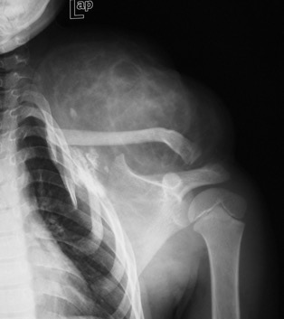
Differential diagnosis
Soft tissue hamartomas
Myositis ossificans
Stress fracture:
Histopathology may be confused with osteosarcoma?
Tendon avulsion injuries
Near hip and knee (e.g. Osgood-Schlatter)
Infection
https://www.pedrad.org/

Slide 12
Differential diagnosis
Soft tissue hamartomas
Myositis ossificans
Stress fracture:
Histopathology may be confused with osteosarcoma?
Tendon avulsion injuries
Near hip and knee (e.g. Osgood-Schlatter)
Infection
www.orthopaedicsandtraumajournal.co.uk

Slide 13
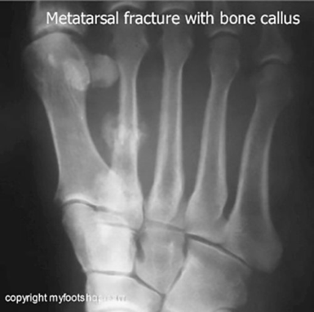
Differential diagnosis
Soft tissue hamartomas
Myositis ossificans
Stress fracture:
Histopathology may be confused with osteosarcoma?
Tendon avulsion injuries
Near hip and knee (e.g. Osgood-Schlatter)
Infection

Slide 14

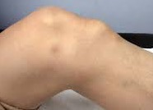
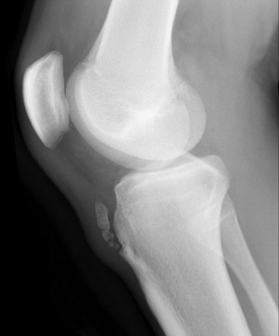
Differential diagnosis
Soft tissue hamartomas
Myositis ossificans
Stress fracture:
Histopathology may be confused with osteosarcoma?
Tendon avulsion injuries
Near hip and knee (e.g. Osgood-Schlatter)
Infection
http://kinedusport.com/

Slide 15
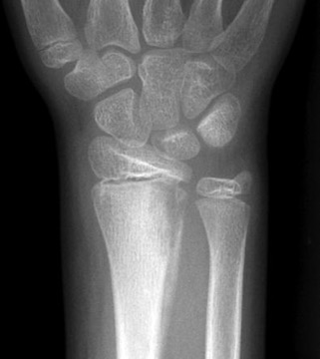
Differential diagnosis
Soft tissue hamartomas
Myositis ossificans
Stress fracture:
Histopathology may be confused with osteosarcoma?
Tendon avulsion injuries
Near hip and knee (e.g. Osgood-Schlatter)
Infection
https://radiopaedia.org

Slide 16
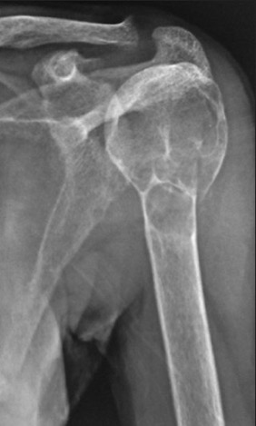
Differential diagnosis
Hyperparathyroid disease (Brown tumor)
Gout: Large gouty typhus
Other bone lesions:
Cortical defects, bone infarcts, “bone islands”
www.ijem.in/article.asp?issn=223

Slide 17
Differential diagnosis
Hyperparathyroid disease (Brown tumor)
Gout: Large gouty typhus
Other bone lesions:
Cortical defects, bone infarcts, “bone islands”
https://www.researchgate.net/publication/244892457_Tophaceous_gout_in_a_renal_allograft_recipient/figures?lo=1

Slide 18
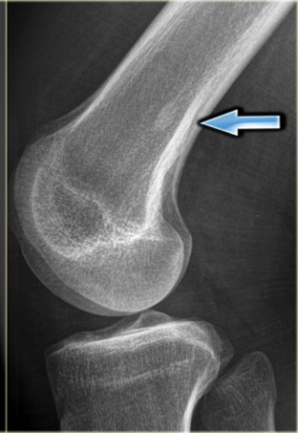
Differential diagnosis
Hyperparathyroid disease (Brown tumor)
Gout: Large gouty typhus
Other bone lesions:
Cortical defects, bone infarcts, “bone islands”
www.researchgate.net
www.radiologyassistant.nl/en/

Slide 19
Specific Lesions

Slide 20
Benign Bone Tumors

Slide 21
Benign bone lesions
Osteochondroma
Chondroma / chondroblastoma
Osteoid osteoma / osteoblastoma
Non-ossifying fibroma
Simple (Unicameral) Bone Cyst
Aneurysmal Bone Cyst
Giant Cell Tumor

Slide 22
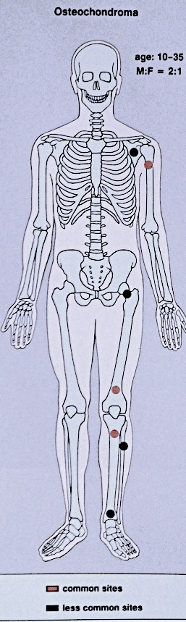
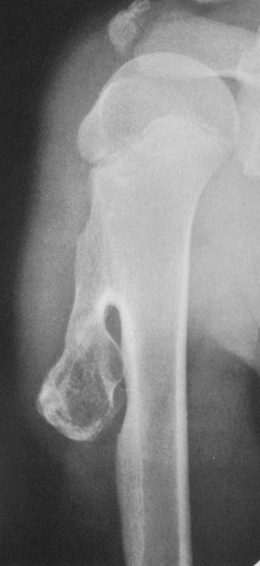
Osteochondroma (Exostosis)
A common lesion
Ends of long bone
Bony overgrowth
Away from epiph. plate
Covered by cartilage
Growth:
Stops when epiphysis close
If continues later:
? Malignant transformation
Orthopedic Radiolgy. A Greenspan. Lippincott-Raven

Slide 23
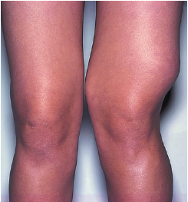
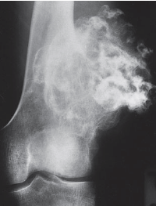
Osteochondroma (Exostosis)
emedicine.medscape.com
radiopaedia.org
Apley’s System of Orthop. And Fractures

Slide 24
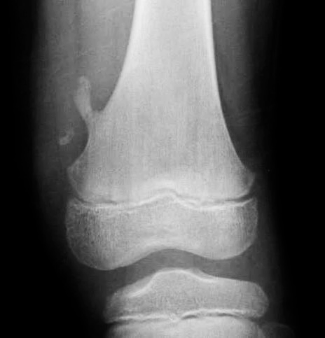
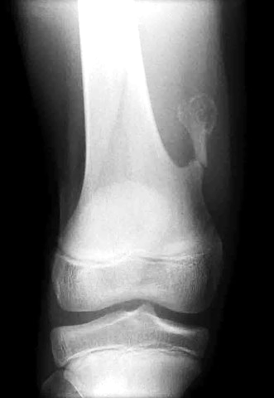
Osteochondroma (Exostosis)
May fracture: becomes painful
http://radiopaedia.org/

Slide 25
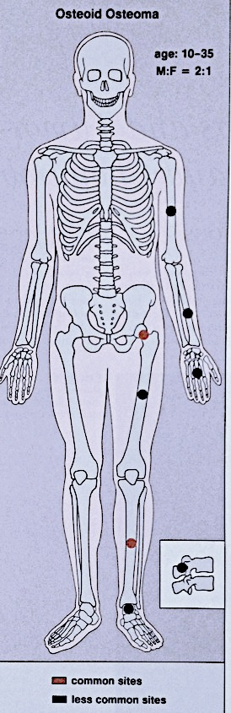
Osteoid osteoma
Small tumor (<1 cm)
Young adults
Pain, pain, pain
Typically relieved by Salicylates
Sites: Femur, tibia, spine
X-ray:
Small radiolucent “nidus”
Surrounded by sclerotic bone
CT: Shows “nidus” better
Tc⁹⁹ scan: hot
Treatment: surgical excision, or thermal ablation
Orthopedic Radiolgy. A Greenspan. Lippincott-Raven

Slide 26
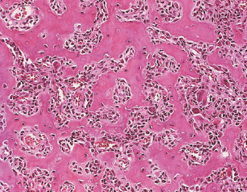
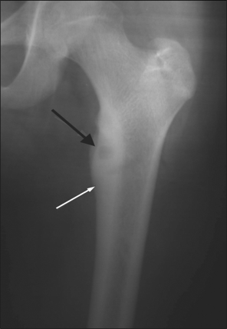
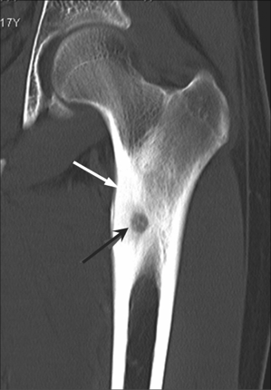
Osteoid osteoma
Small tumor (<1 cm)
Young adults
Pain, pain, pain
Typically relieved by Salicylates
Sites: Femur, tibia, spine
X-ray:
Small radiolucent “nidus”
Surrounded by sclerotic bone
CT: Shows “nidus” better
Tc⁹⁹ scan: hot
Treatment: surgical excision, or thermal ablation
Apley’s System of Orthop. And Fractures
http://openi.nlm.nih.gov/

Slide 27
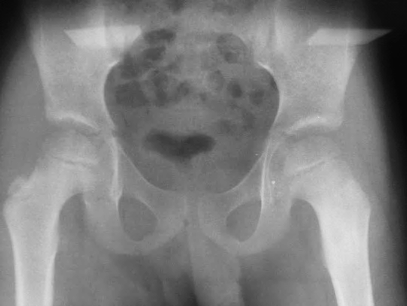
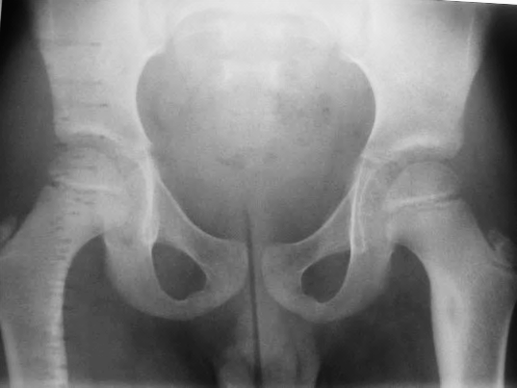
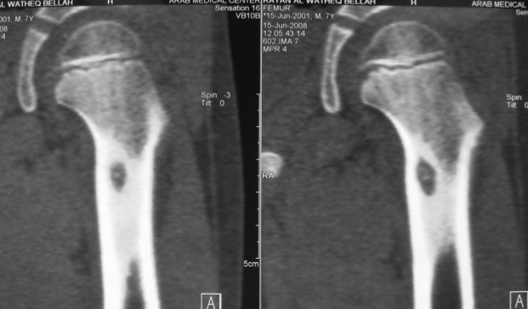
Osteoid Osteoma
11 year old boy: Pain in left hip

Slide 28
Osteoid Osteoma
Bone Tumors A Practical Guide to Imaging

Slide 29
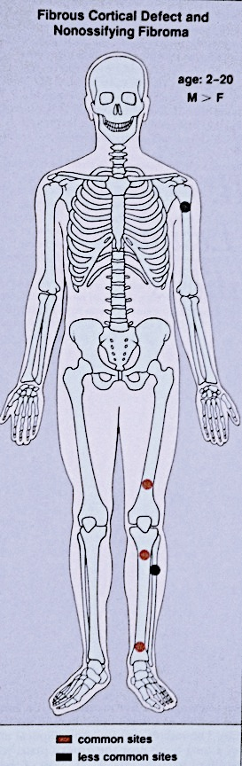
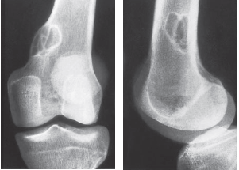
Non-ossifying fibroma
Another name:
Fibrous cortical defect
The commonest benign lesion of bone
Asymptomatic
Incidentally discovered
Children:
Disappears later
Common site:
Metaphysis of long bones
Treatment:
Observation
Surgery if very large
Apley’s System of Orthop. And Fractures
Orthopedic Radiolgy. A Greenspan. Lippincott-Raven

Slide 30
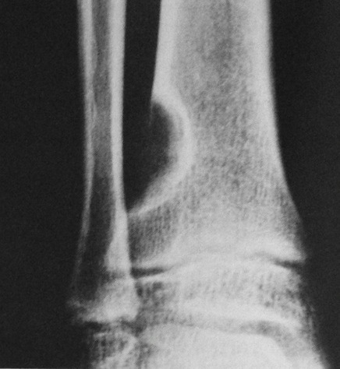
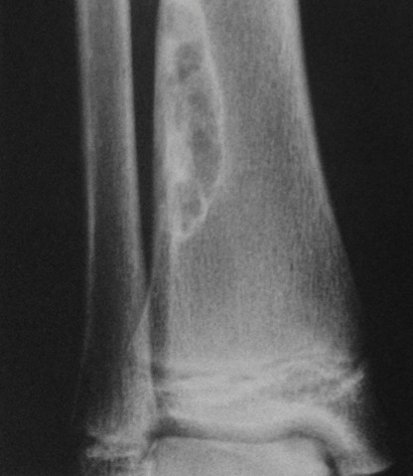
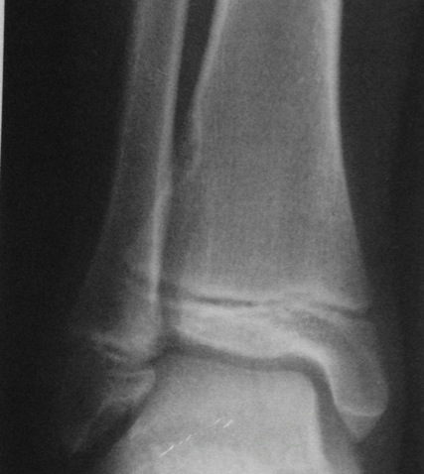
Non-ossifying fibroma
Non-ossifying fibroma ……..………Fibrous cortical defect
Orthopedic Radiolgy. A Greenspan. Lippincott-Raven

Slide 31
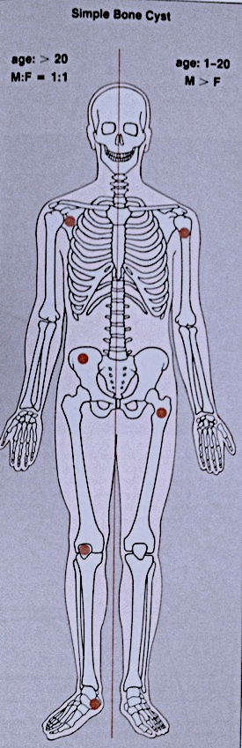
Simple bone cyst
Solitary – unicameral
Children
Metaphysis
Prox. Humerus and Femur
Not a tumor
Not seen in adults
Heals spontaneously
Pathological fracture / or incidental
Aspirate is clear straw-colored
www.juniorbones.com
Orthopedic Radiolgy. A Greenspan. Lippincott-Raven

Slide 32
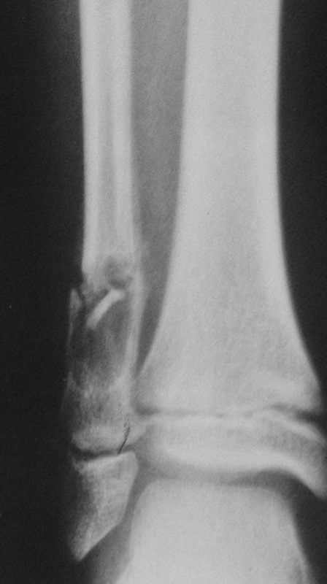
Simple bone cyst
Solitary – unicameral
Children
Metaphysis
Prox. Humerus and Femur
Not a tumor
Not seen in adults
Heals spontaneously
Pathological fracture / or incidental
Aspirate is clear straw-colored
https://radiopaedia.org
Orthopedic Radiolgy. A Greenspan. Lippincott-Raven

Slide 33
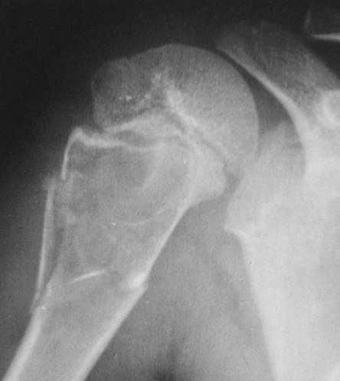
Simple bone cyst
Treatment:
Small, reducing in size
Leave alone
Increasing in size, active
Moderate trial of bone marrow
injection
Larg (risk of fracture) Curettage & grafting
Pathological fracture
Treat fracture
Cyst might heal
Recurrent / injection failed:
Surgical curettage and bone grafting
https://www.sciencedirect.com/science/article/pii/S1877056814003338
Orthopedic Radiolgy. A Greenspan. Lippincott-Raven

Slide 34
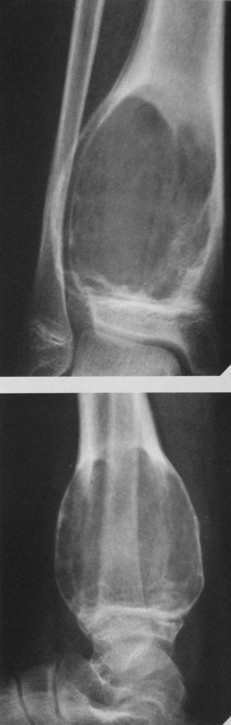
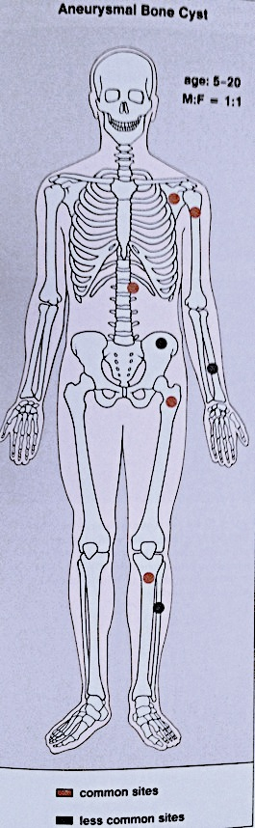
Aneurysmal bone cyst
Child - young adult
Metaphysis of long bone
X-ray:
Well-defined cyst
Trabeculated
Eccentrically placed
Ballooning
Bloody content
Treatment:
Curettage and bone graft
Orthopedic Radiolgy. A Greenspan. Lippincott-Raven

Slide 35
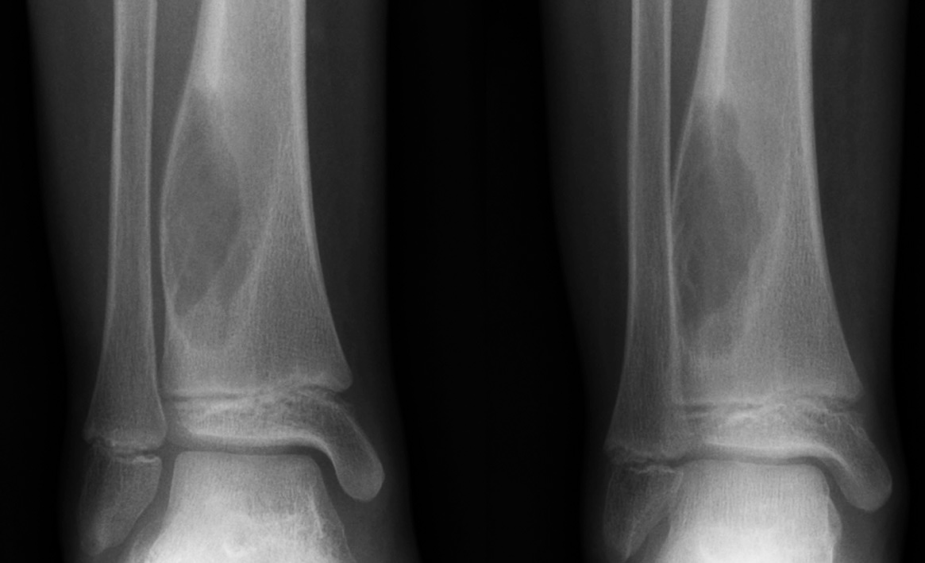
Aneurysmal bone cyst
Metaphysis, Eccentric
radiopaedia.org

Slide 36
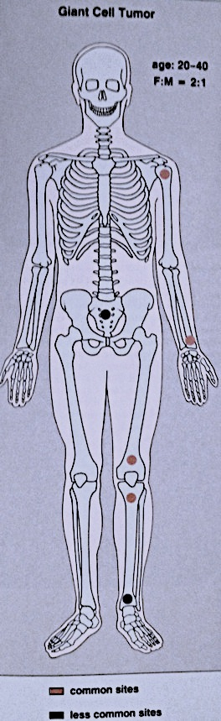
Giant-Cell Tumor
Unknown origin
Giant cells abundant
Behavior:
One third benign
One third locally aggressive
One third (less) with distant metastasis
Young adults
Common sites:
Around knee
Proximal humerus
Distal radius
Orthopedic Radiolgy. A Greenspan. Lippincott-Raven

Slide 37
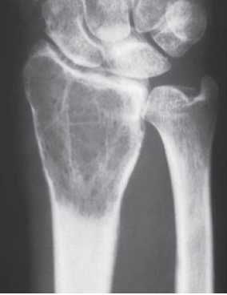
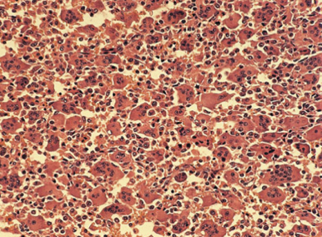
Giant-Cell Tumor
Unknown origin
Giant cells abundant
Behavior:
One third benign
One third locally aggressive
One third (less) with distant metastasis
Young adults
Common sites:
Around knee
Proximal humerus
Distal radius
Apley’s System of Orthop. And Fractures

Slide 38
Giant-Cell Tumor
Eccentric lesion
Radiolucent
Soap bubble
Abuts(adjacent) against the joint
Thin cortex
Margins may be clear / unclear
Depends on aggressiveness
Treatment
Curettage & bone grafting
More wide excision in recurrent and aggressive lesions
Bone Tumors A Practical Guide to Imaging

Slide 39
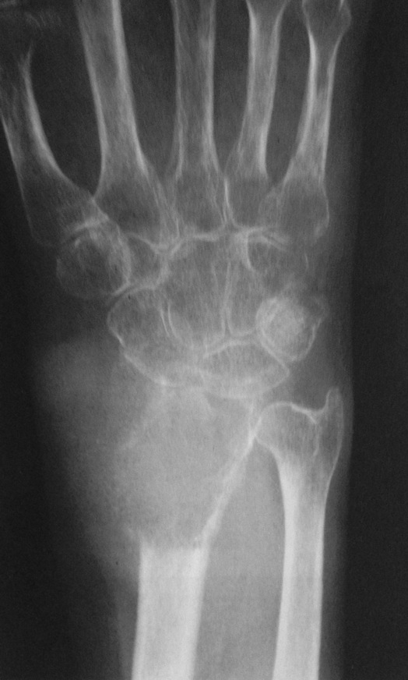
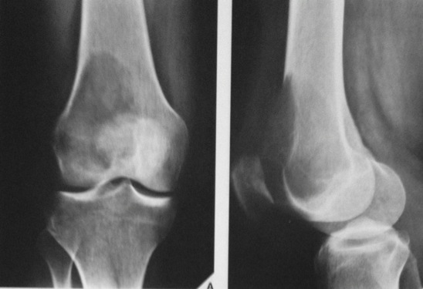
Giant-Cell Tumor
Apley’s System of Orthop. And Fractures

Slide 40
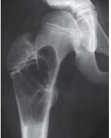
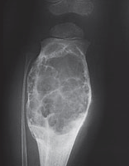
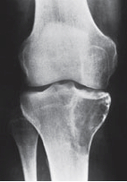
Cyst-like lesions in bone
Simple bone cyst
Aneurysmal bone cyst
Giant-cell tumor
Fills medullary cavity
Does not expand bone
At metaphyseal side of physis
Expansile
After fusion of physis
Extend to sub-articular
Apley’s System of Orthop. And Fractures

Slide 41
Malignant Bone Tumors
Primary (5%)
Secondary metastasis (95%)

Slide 42
Primary Malignant Bone Tumors

Slide 43
Primary malignant bone tumors
Multiple myeloma
Osteosarcoma
Chondrosarcoma
Ewing's sarcoma

Slide 44
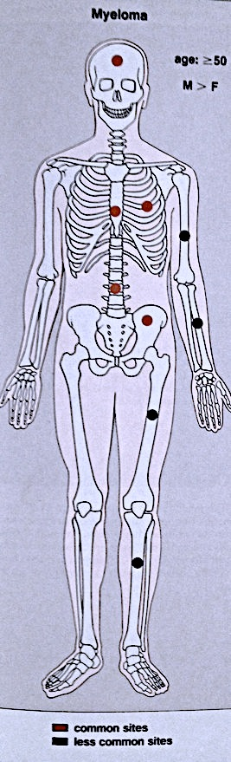
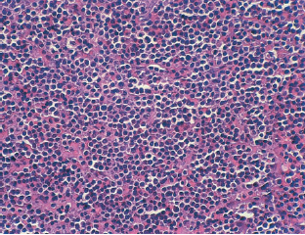
Multiple Myeloma
B-Cells of bone marrow
Plasma cells mainly
Age: 45-65 yrs.
Bone pains
Increased serum Calcium
Bence Jones protein in urine
Apley’s System of Orthop. And Fractures
Orthopedic Radiolgy. A Greenspan. Lippincott-Raven

Slide 45
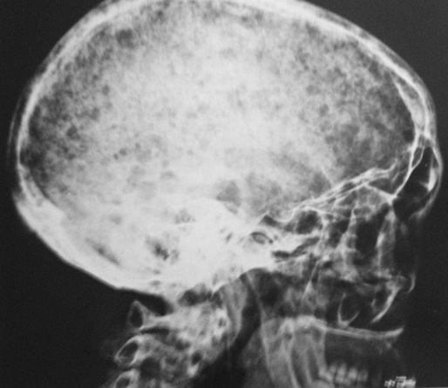
Multiple Myeloma
X-ray:
Multiple punched-out lesions
Osteoporosis & Vertebral compression fracture:
If both present in a male >45: ? Myeloma
Common sites:
Skull, Prox. Femur, vertebrae
Bone marrow biopsy
Orthopedic Radiolgy. A Greenspan. Lippincott-Raven

Slide 46
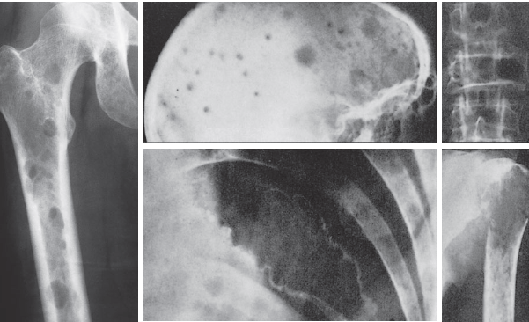
Multiple Myeloma
Apley’s System of Orthop. And Fractures

Slide 47
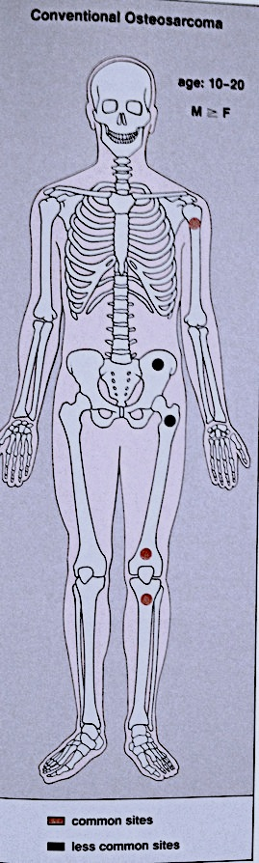
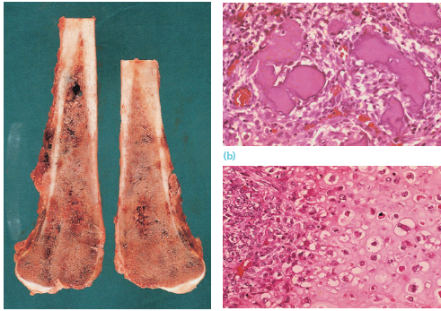
Osteosarcoma
Usually highly malignant
(10% already lung metastasis)
Children – adolescents (10-20 yrs.)
Presentation:
Pain
Mass
Sight:
Metaphysis of long bones
Pathology
Bone forming: osteoblastic
With chondroblastic areas
Apley’s System of Orthop. And Fractures
Orthopedic Radiolgy. A Greenspan

Slide 48
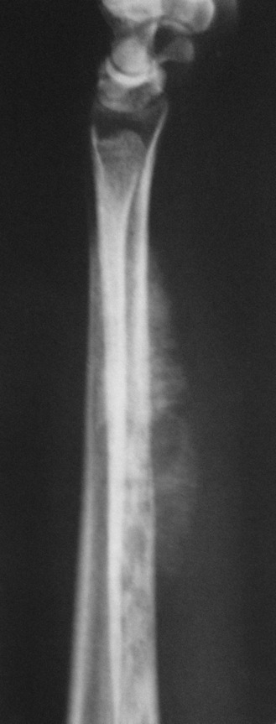
Osteosarcoma
X-ray:
Radiolucency and sclerosis
Poorly defined margins
Extends into soft tissue
Periosteal reaction:
Sunburst (sun-ray) appearance
Codman’s triangle
Orthopedic Radiolgy. A Greenspan. Lippincott-Raven

Slide 49
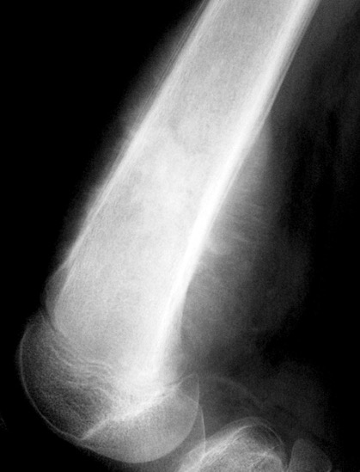
Osteosarcoma
X-ray:
Radiolucency and sclerosis
Poorly defined margins
Extends into soft tissue
Periosteal reaction:
Sunburst (sun-ray) appearance
Codman’s triangle
radiopaedia.org

Slide 50
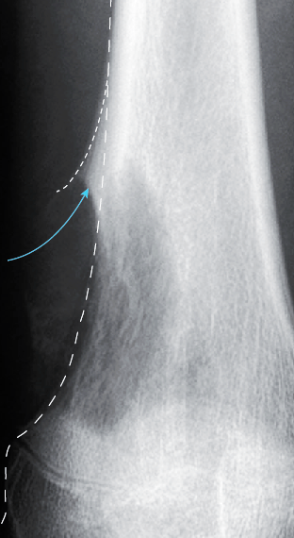
Osteosarcoma
X-ray:
Radiolucency and sclerosis
Poorly defined margins
Extends into soft tissue
Periosteal reaction:
Sunburst (sun-ray) appearance
Codman’s triangle
radiopaedia.org

Slide 51
Osteosarcoma
Bone scan
Primary lesion
Metastasis
Bone Tumors A Practical Guide to Imaging

Slide 52

Osteosarcoma
MRI very informative
Bone Tumors A Practical Guide to Imaging

Slide 53

Osteosarcoma
Treatment:
Look for metastasis
Biopsy a must
Well planned incision
Chemotherapy
Surgery:
Wide resection
Amputation
Orthopedic Radiolgy. A Greenspan. Lippincott-Raven

Slide 54


Ewing’s Sarcoma
From bone marrow cells
A round-cell tumor
Age: 10-20 yrs.
Tubular bone
Tibia, fibula, clavicle
Presentation:
Throbbing pain
Swelling
Tenderness
Hotness
ESR raised
Apley’s System of Orthop. And Fractures
Osteomyelitis ?
Orthopedic Radiolgy. A Greenspan. Lippincott-Raven

Slide 55

Ewing’s Sarcoma
X-ray:
Diaphyseal
Bone destruction
New bone formation
Along the bone
“Onion-peel” layers
? “Sun-ray”
? Codman’s triangle
Secondaries – in skeleton
Apley’s System of Orthop. And Fractures

Slide 56


Ewing’s Sarcoma
X-ray:
Diaphyseal
Bone destruction
New bone formation
Along the bone
“Onion-peel” layers
? “Sunray”
? Codman’s triangle
Secondaries – in skeleton
Orthopedic Radiolgy. A Greenspan. Lippincott-Raven

Slide 57
Ewing’s Sarcoma
Treatment
Poor prognosis – a killing tumor
Radiotherapy
Chemotherapy – multiple drugs

Slide 58
Metastatic bone disease
Secondary metastasis in bone
Primary tumor in other tissue

Slide 59

Metastatic bone disease
Common in skeleton
In patients >50 yrs.:
metastasis more common than all primary tumors together
Primary from:
Lung, Breast, Prostate, Kidney,, Thyroid, Bladder, GIT, ..
Common sites:
Vertebrae, pelvis, Proximal femur and humerus
Orthopedic Radiolgy. A Greenspan. Lippincott-Raven

Slide 60
Metastatic bone disease
Clinical features:
Age 50-70 yrs.
Pain – may be silent
H.O Carcinoma
Hypercalcaemia
X-ray:
Osteolytic, moth-eaten
Osteoblastic in ca prostate
Bone scan
Anemia, raised ESR
Antigen markers of tumors
https://radiopaedia.org

Slide 61



Metastatic - Prostate
Orthopedic Radiolgy. A Greenspan. Lippincott-Raven

Slide 62


Metastatic bone disease
Apley’s System of Orthop. And Fractures

Slide 63
Summary
Bone is a common site of tumors
Primary bone tumors:
Benign tumors
Tumor-like: Cysts
Malignant
Secondary metastatic
Features, bone, site, age, and X-ray shape characteristic for each tumor
Keep an open mind

