Slide 1








COLLEGE OF MEDICINE
VISION
VISION
Excellence In Medical Education Which Reconciles
Traditions & Modernity.
MISSION
MISSION
Providing
02
Providing
01
Excellent Medical Care for Saudi Society
High Quality Medical Education Environment
Competent
& Honest Physicians
Evidence Based Medicine
Enrich scientific Researches
VALUES
VALUES
Sincerity
Competency
Commitment
Professionalism
Innovation
Development
Honest
Central Quality And Accreditation Unit
C
c

Slide 2

Bone Tumors
Dr. Majed Alasbali
MBBS, SB-Orth
Assistant Professor & Orthopedic Consultant of Arthroplasty and Trauma

Slide 3
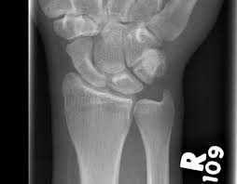
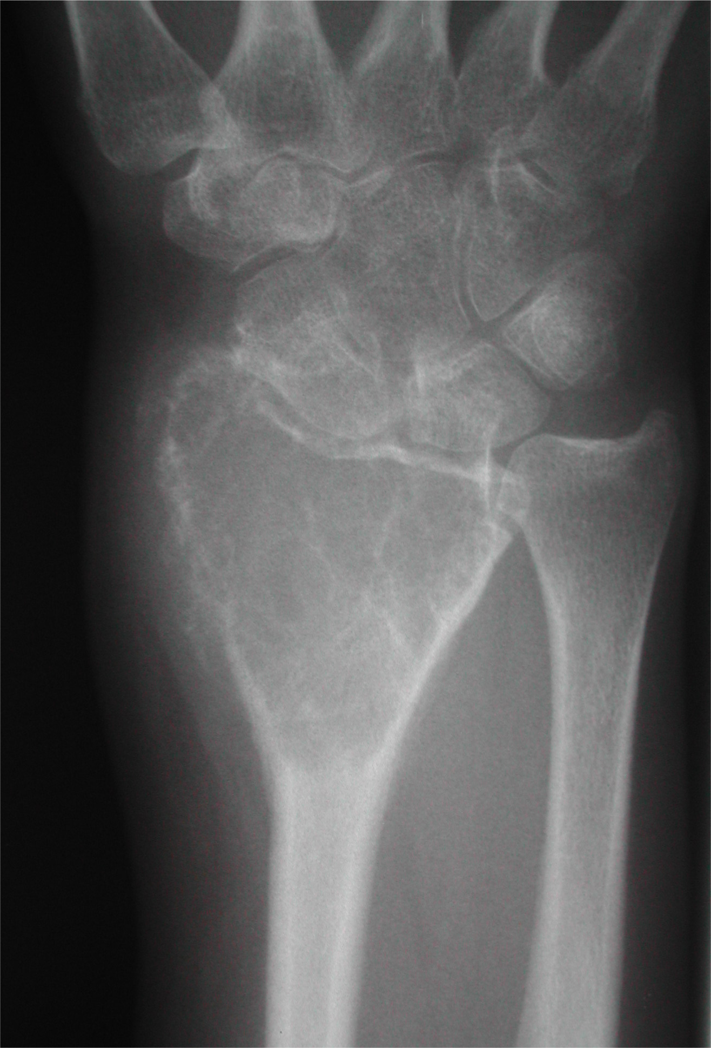

Slide 4
What this lesion could be?
Is it benign or malignant bone tumor?
Is it benign or malignant soft tissue tumor?
Is it primary tumor or metastasis?
Is it metabolic disease?
Is it infection?

Slide 5
evaluation
history
Physical
examination
biopsy
labs
imaging

Slide 6
History
Personal data : AGE
History of Presenting Illness
Functional
Constitutional symptoms
Past ,Family , Social

Slide 7
HPI
Painless Mass (Bony or soft tissue)
painful mass (Bony or soft tissue )
Pathological fracture
Incidental finding

Slide 8
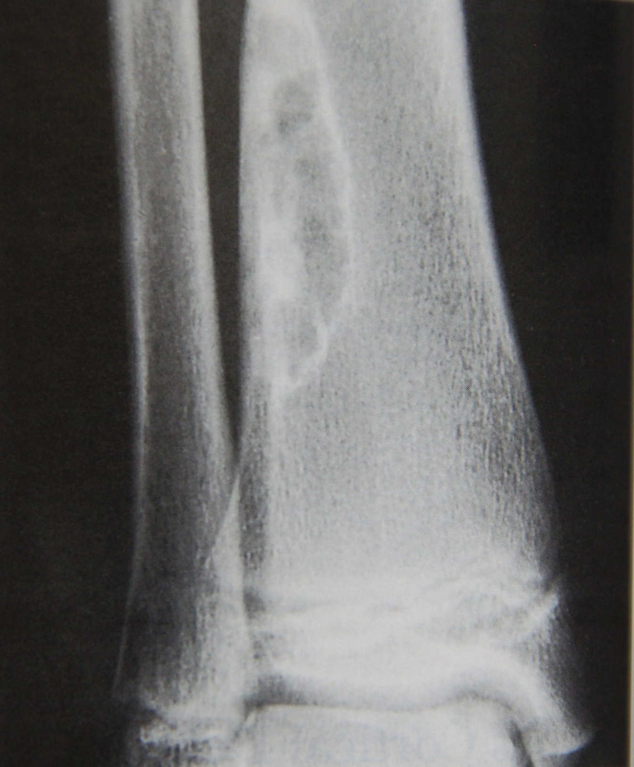
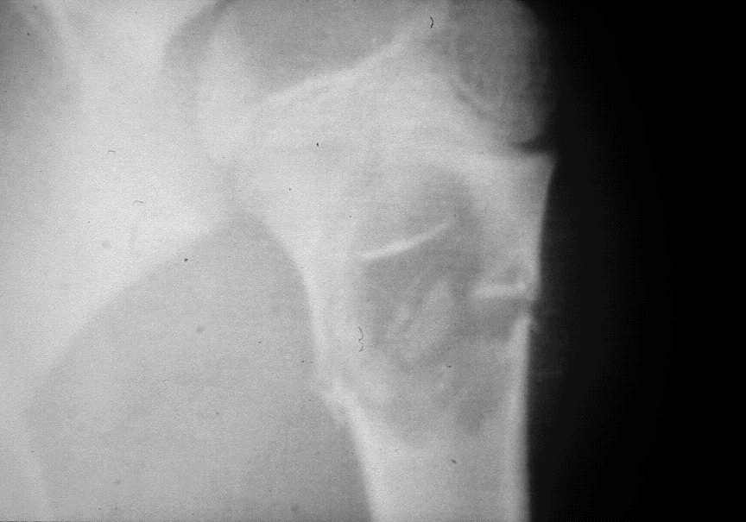

Slide 9
EXAMENATION
Look Feel Move
Adjacent joints ROM
NV exam
Lymph nodes
General

Slide 10
Imaging
X-Ray
CT
MRI
BONE SCAN
PET-CT

Slide 11
Imaging
Detection & Characterization (X-rays, CT scan)
Local staging (MRI)
Systemic staging
evaluation for regional and distant metastases
(CT chest, bone scan, PET scan)
Bone scan

Slide 12
What to read in X-Ray
Site
Size
Matrix
Pattern/margins incl. zone of transition
Effect of the lesion on bone
Reaction of bone to the lesion
Soft tissue mass

Slide 13
site
Which bone is affected (femur, radius,…)
Where in the bone
Diaphysis, metaphysis, epiphysis, or combination
Centric, eccentric, intracortical, surface

Slide 14
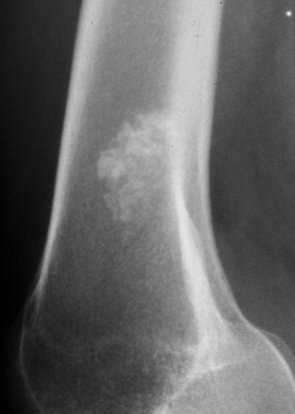
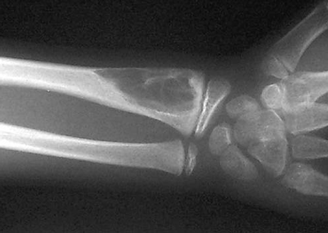
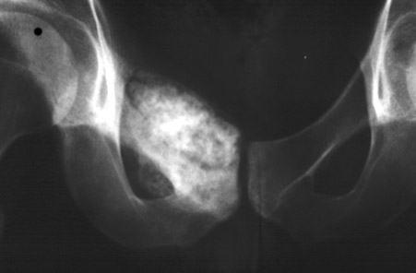
matrix
Fibrous , fluid , fat ( radiolucent)
Cartilagenous ( arcs and rings of calcification)
Osseous ( cloud-like , dense)
Mixed

Slide 15

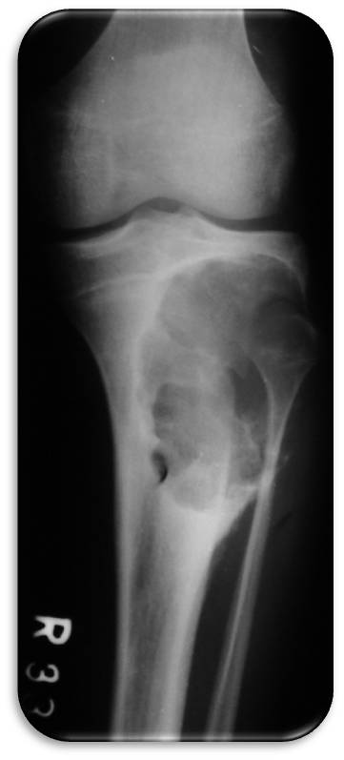

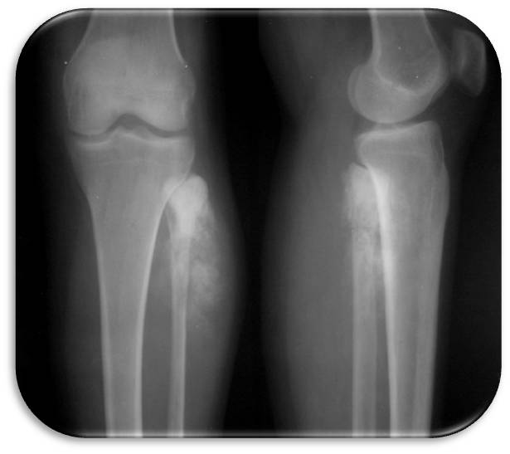

Slide 16
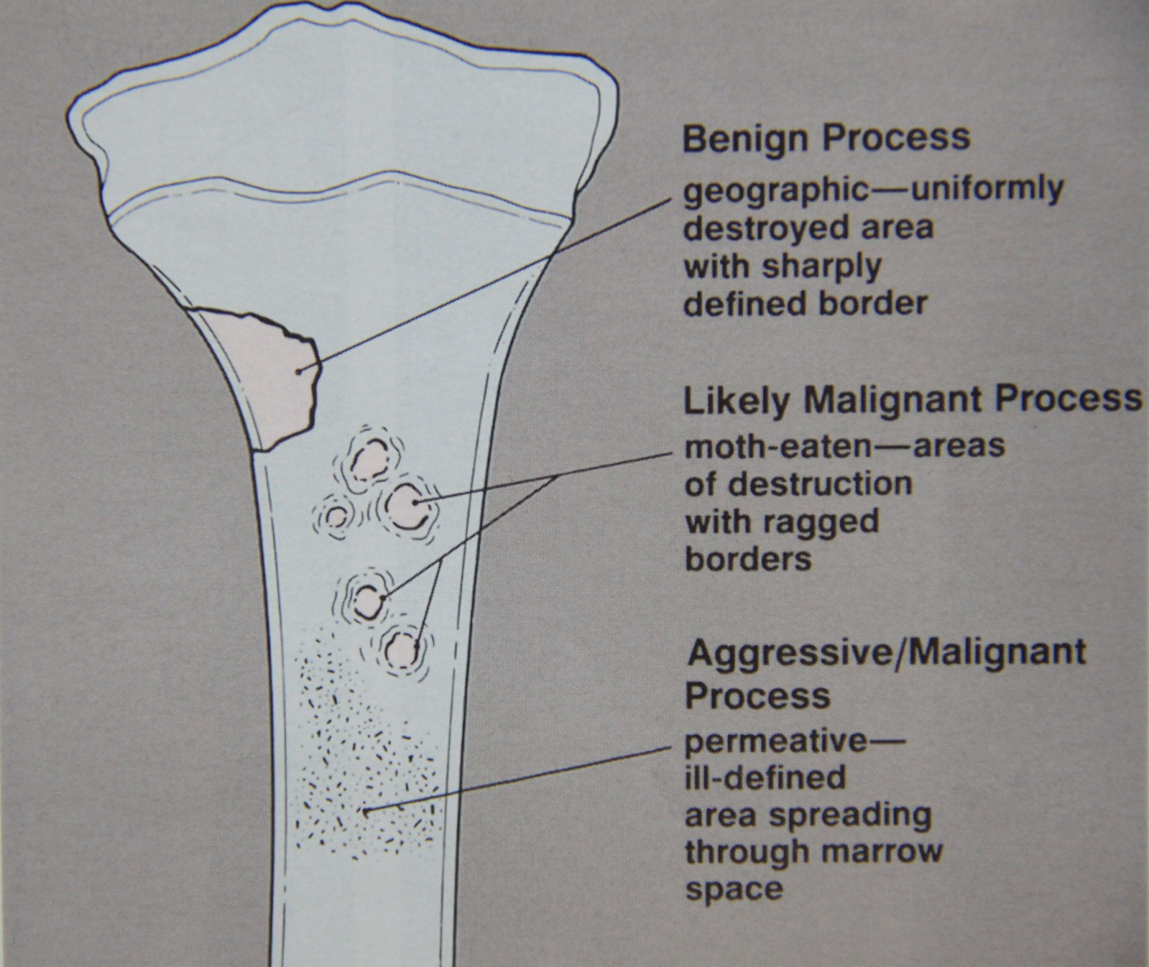
Benign Vs Malignant

Slide 17
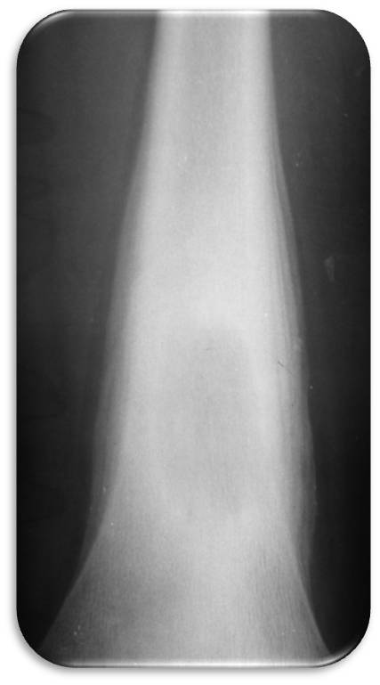
Zone of transition

Slide 18
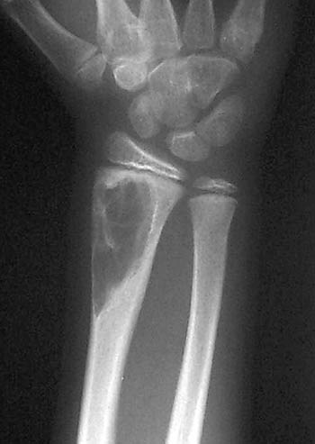
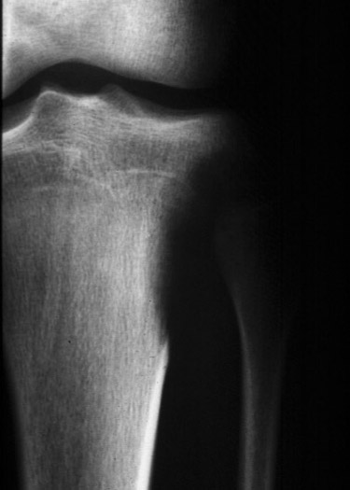
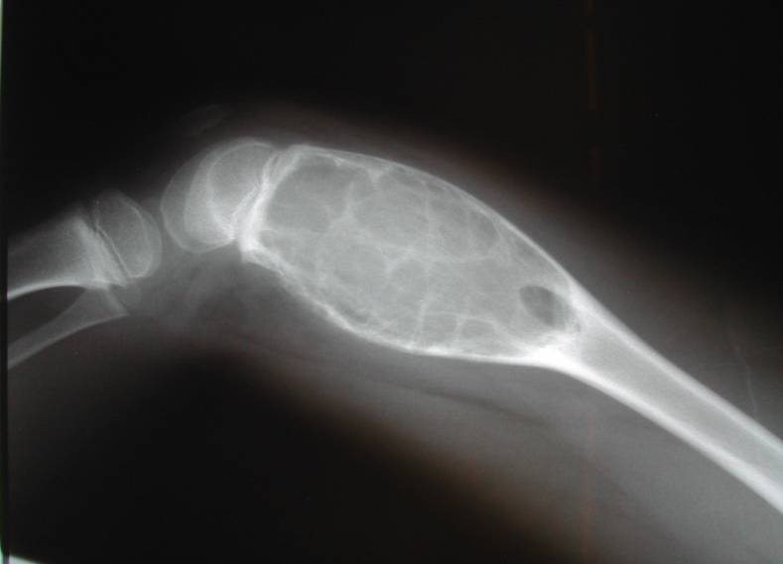
LESION EFFECT ON BONE
Cortical thinning
Lower grade, less aggressive
Cortical expansion
Low or high grade, tumor mimickers
Cortical destruction
High grade, aggressive

Slide 19
BONE EFFECT ON LESION
Periosteal reaction
Absent
Mild – one layer, 1-4 mm thick, adjacent to cortex
Major - >5mm, multilayered or lamellated
“onion-skinning”, “hair-on-end”, “sunburst”

Slide 20
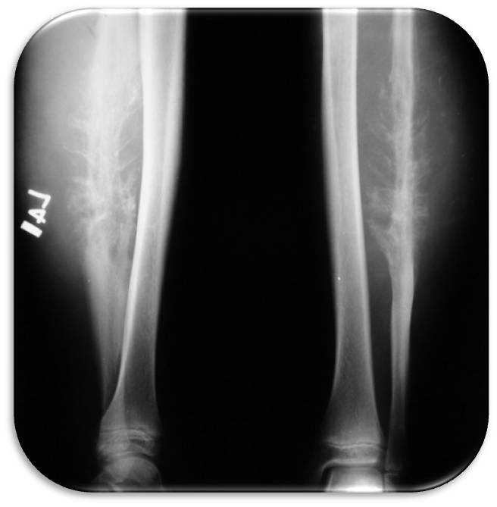

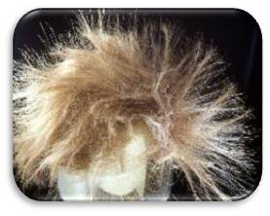

Slide 21
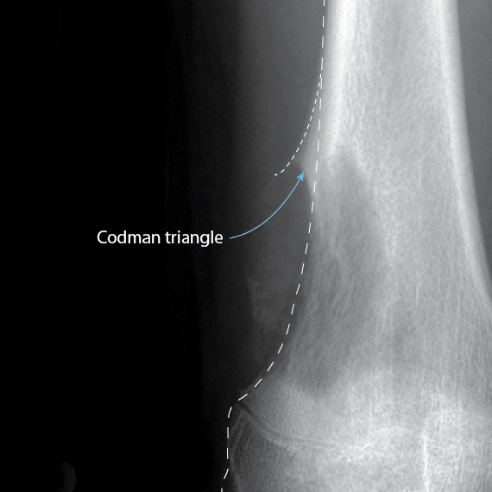

Slide 22
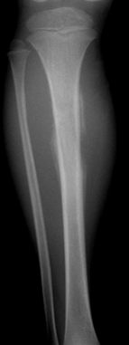
SOFT TISSUE MASS
Soft Tissue Mass
Absent
Present

Slide 23
LABORATORY STUDIES
GENERAL : CBC, renal profile , coagulation profile ,LFT
INFECTION : ESR, CRP
METABOLIC :calcium & phoshate, alkaline phosphatase , PTH
METS

Slide 24
Biopsy
Fine Needle Aspiration (FNA)
not used for sarcoma
Core Needle Biopsy (Tru-cut)
allow for tumor structural examination
cytologic and stromal elements of the tumor
frequently used for sarcoma
Incisional biopsy
small surgical incision carefully placed to access tumor without contamination of critical structures
Excisional biopsy
small, superficial soft tissue masses

Slide 25
INDICATIONS FOR BIOPSY
Aggressive or malignant appearing bone or soft tissue lesions
2) For soft tissue lesions - >5cm, deep to fascia or overlying bone or neurovascular structures
3) Unclear diagnosis in symptomatic patient

Slide 26
NOT FOR BIOPSY
An asymptomatic (latent) or symptomatic bone lesion (active) that appears entirely benign on imaging does not need a biopsy
A soft tissue lesion that appears entirely benign on MRI (lipoma, hemangioma) does not need a biopsy
When in doubt, it is safer to do a biopsy.

Slide 27
Treatment
Non-Operative
Observation
Bisphosphonate therapy
Radiation alone
Chemotherapy alone

Slide 28
Treatment
Operative
Radiofrequency ablation ( osteoid osteoma )
Aspiration and Injection ( Simple Bone Cyst )
Curettage and Bone Grafting ( giant cell tumor )
Marginal Resection
Wide Resection Alone ( chondrosarcoma )
Wide Resection + Chemotherapy ( osteosarcoma )

Slide 29
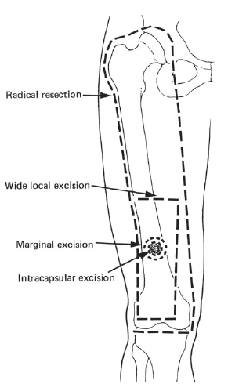
“Curettage”

Slide 30
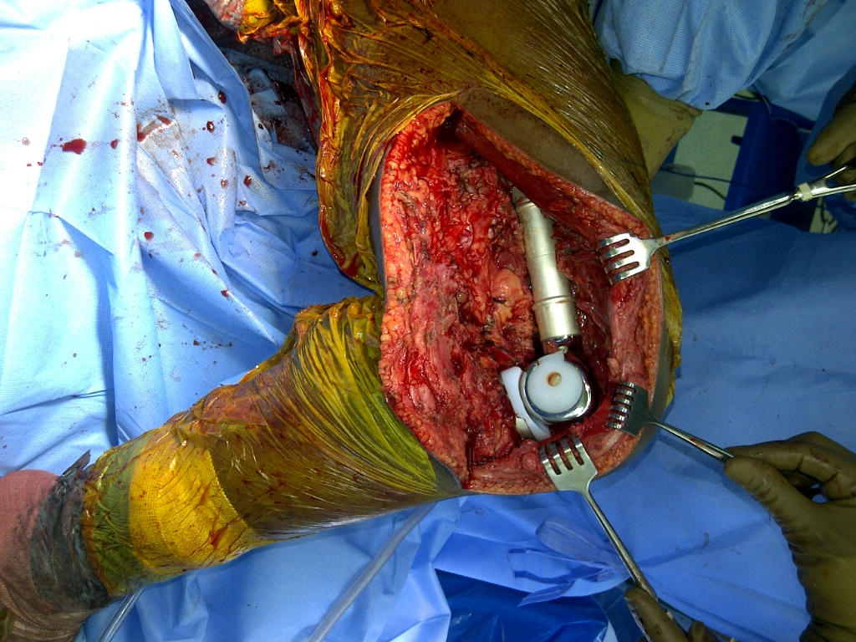
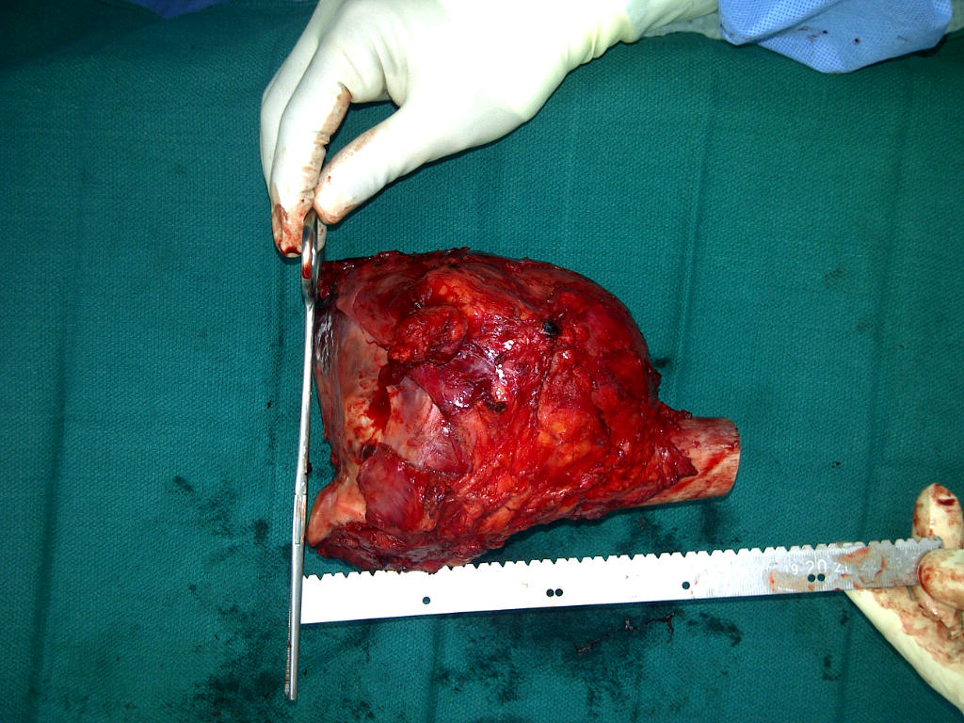
Resection & Replacement “ wide excision “

Slide 31
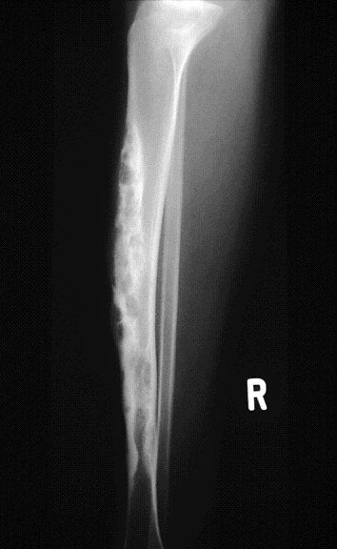
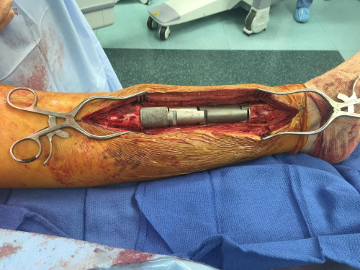
Resection & Replace “ wide excision “

Slide 32
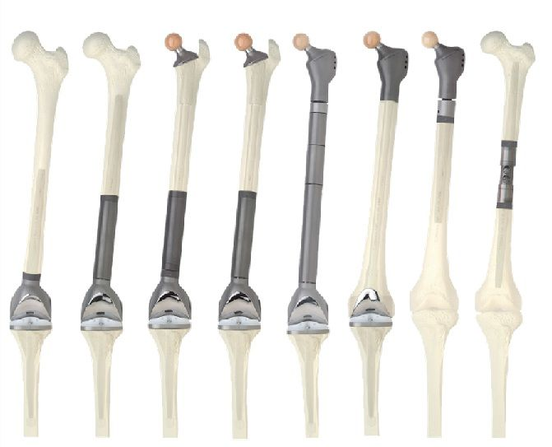

Slide 33
Things you need to know?

Slide 34
1- What is the age of the pt ?
above 40 yr
skeletal mature ( 20-40)
Skeletal immature
2- Then Look at the X-ray Feature ?
Benign looking Vs more aggressive feature
Matrix
3- Location of the lesion .
intra-articular
epiphysis
metaphysis
diaphysis
Then put in the spectrum .
Benign Lesion
Metz , vs primary bone tumor ( osteo sarcoma vs chondro, ewing )
Metabolic Bone disease , e.g brown tumor, paget
osteomyelitis ( local Tumor )

Slide 35
Bone forming Tumor
Benign lesion
Osteoma
Enostosis
osteod osteoma
Osteoblastoma
Malignant Tumor
Osteosarcoma
Soft tissue ( Extraskeletal ) osteosarcoma .

Slide 36
Cartilage ( chondrogenic Lesion)
Benign lesion
Enchondroma
perisoteal chondroma
osteochndroma
chondroblastoma
chondromyxoid fibroma
Malignant Lesion
chondrosarcoma

Slide 37
Fibrous lesion
Benign Lesion
Fibrous cortical defect
fibrous dysplasia
osteofibrous Dysplasia
Malignant Tumor
Malignant Fibrous Histiocytoma (MFH)

Slide 38
Tumor like lesion
Benign lesion
Giant cell tumor (GCT)
Simple bone cyst
Aneurysmal Bone Cyst (ABC)
Interosseous lipoma
Malignant Tumor
Adamantinoma

Slide 39
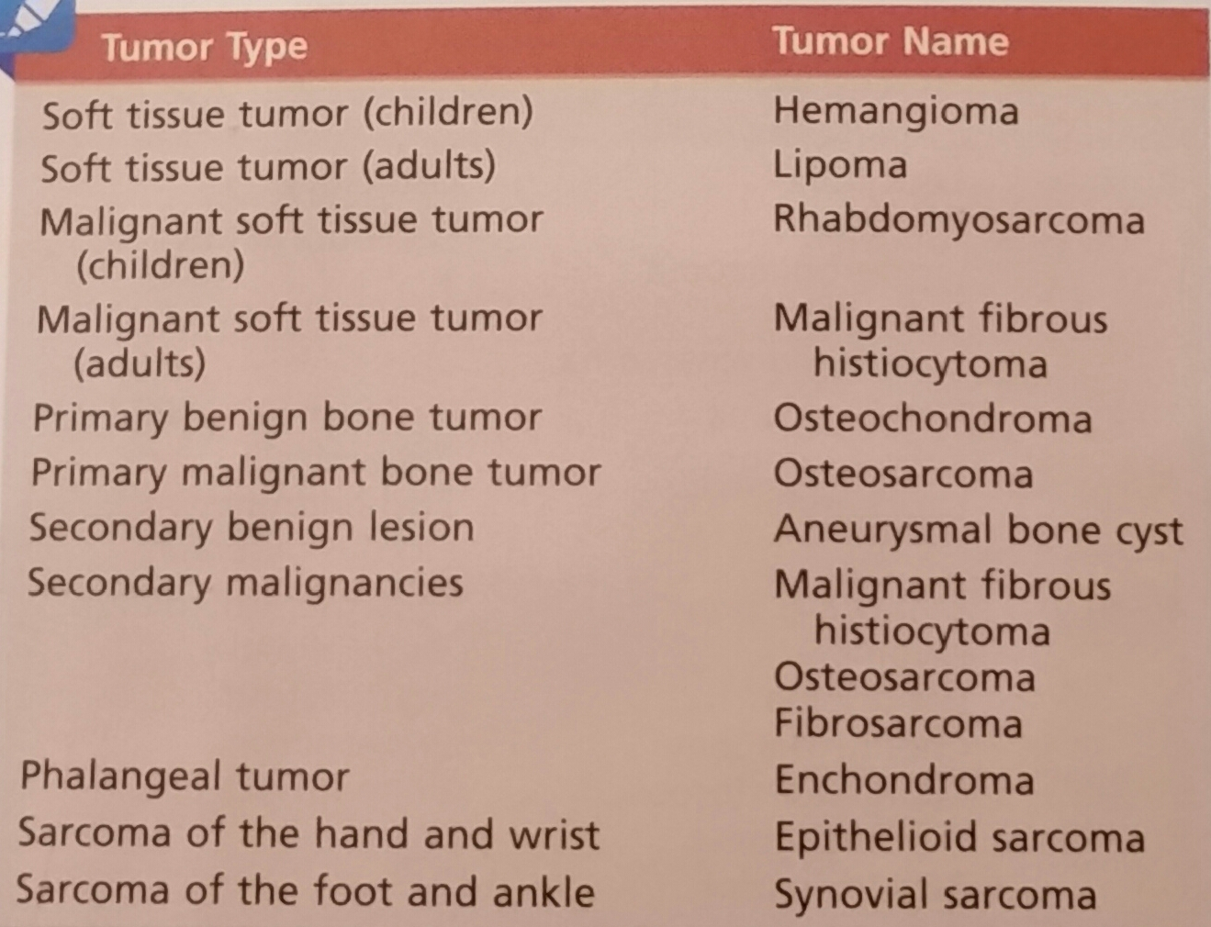
Most common tumors

Slide 40
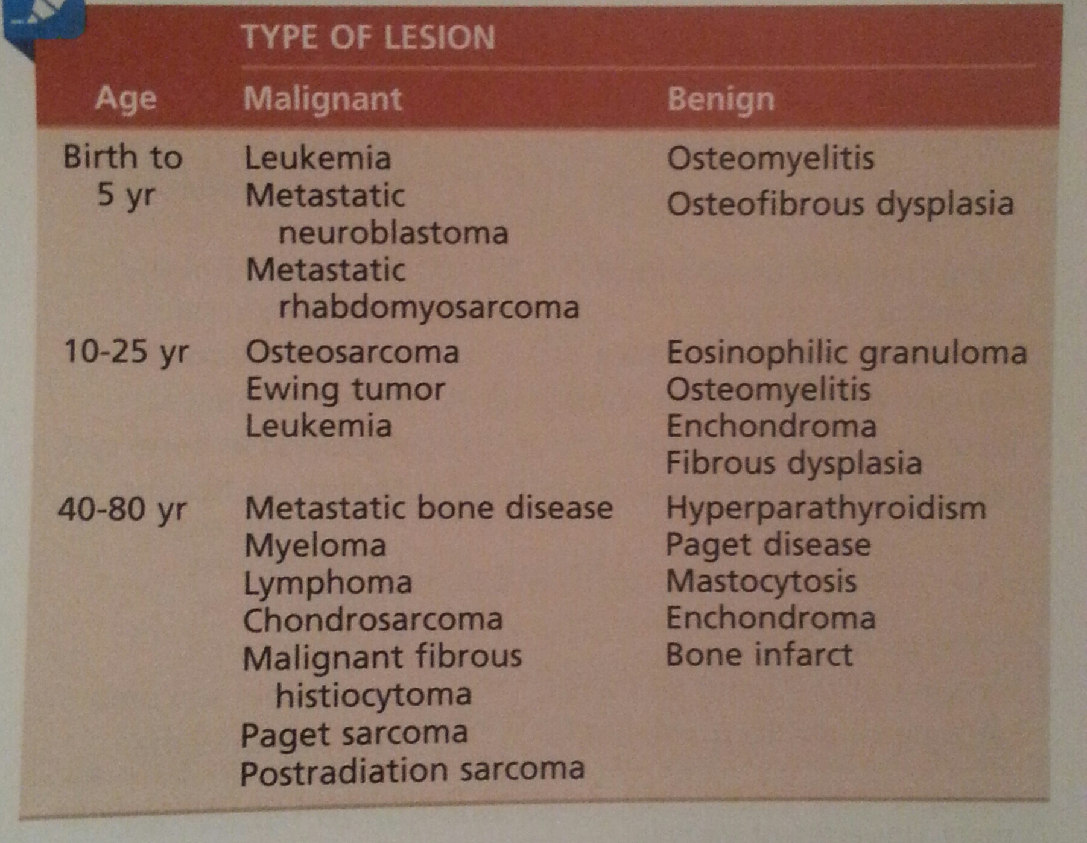
Differential by AGE

Slide 41
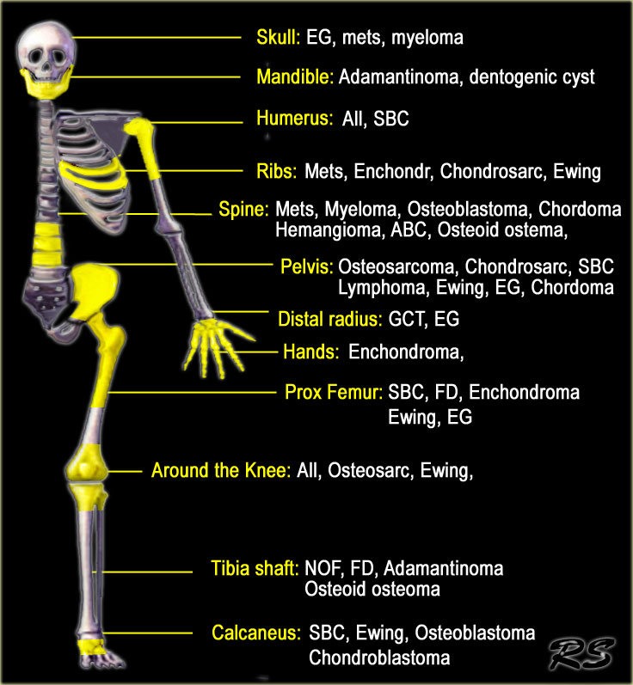
Differential by ANATOMY

Slide 42
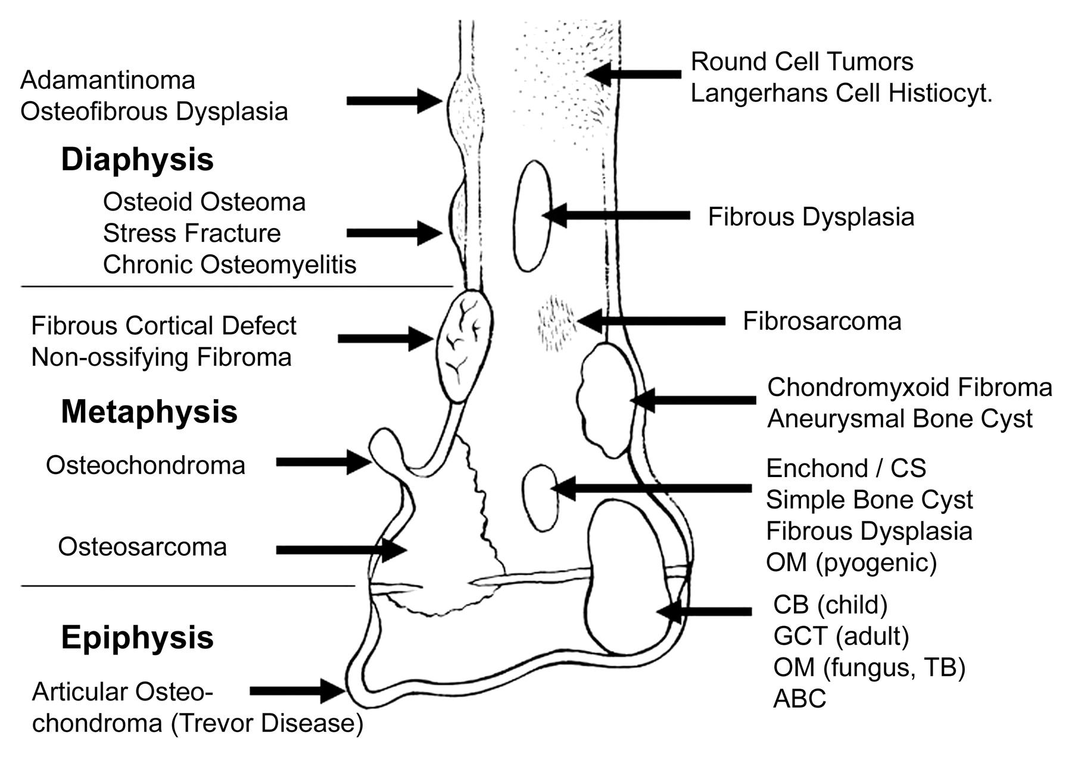
Differential by LOCATION

Slide 43
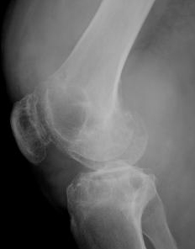
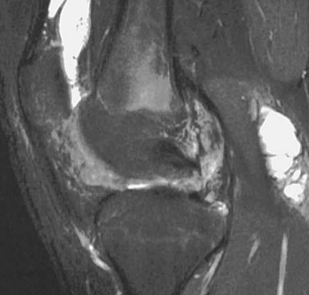
Intra-articular Tumor
Pigmented Villonodular Synovitis PVNS
Synovial Hmeangioma

Slide 44
Epiphyseal lesions
Chondroblastoma
Clear cell chondrosarcoma
Osteomyelitis (occasionally)

Slide 45
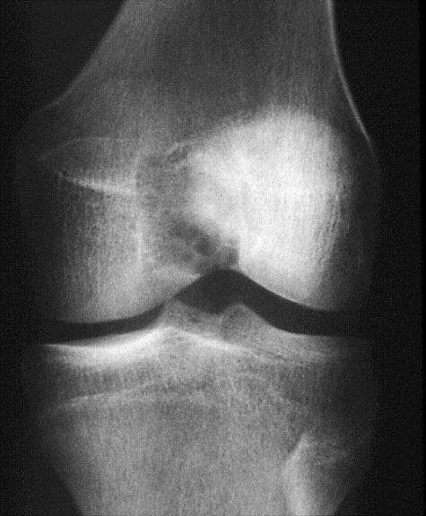
Epiphyseal
Chondroblastoma

Slide 46
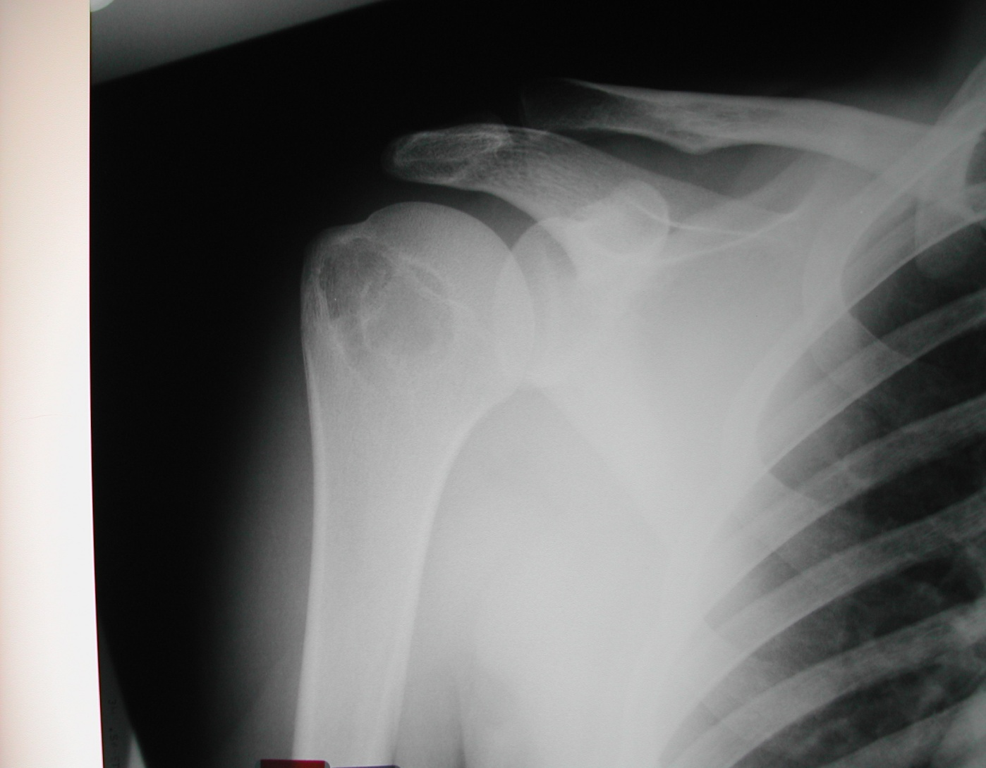
Apophyseal

Slide 47
Epiphyseal-Metaphyseal
Benign aggressive lesions
GCT
ABC
osteoblastoma

Slide 48
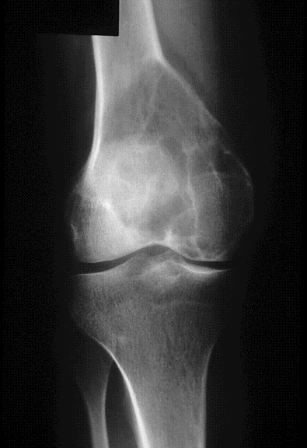
Epiphyseal-Metaphyseal
GCT

Slide 49
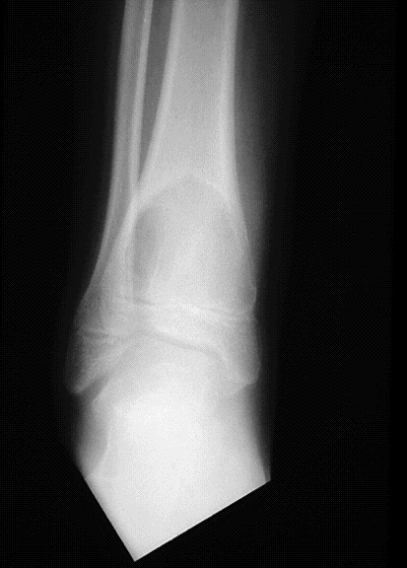
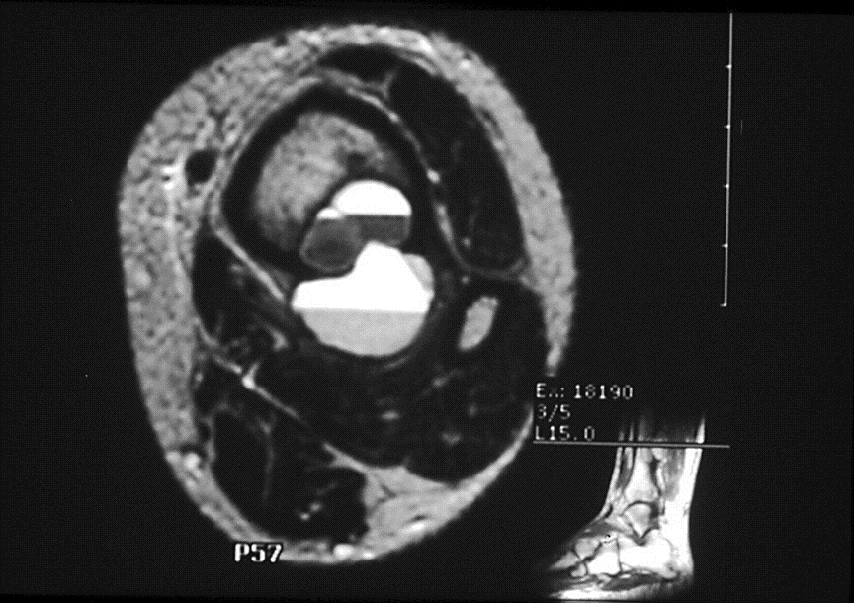
Epiphyseal-Metaphyseal
ABC

Slide 50
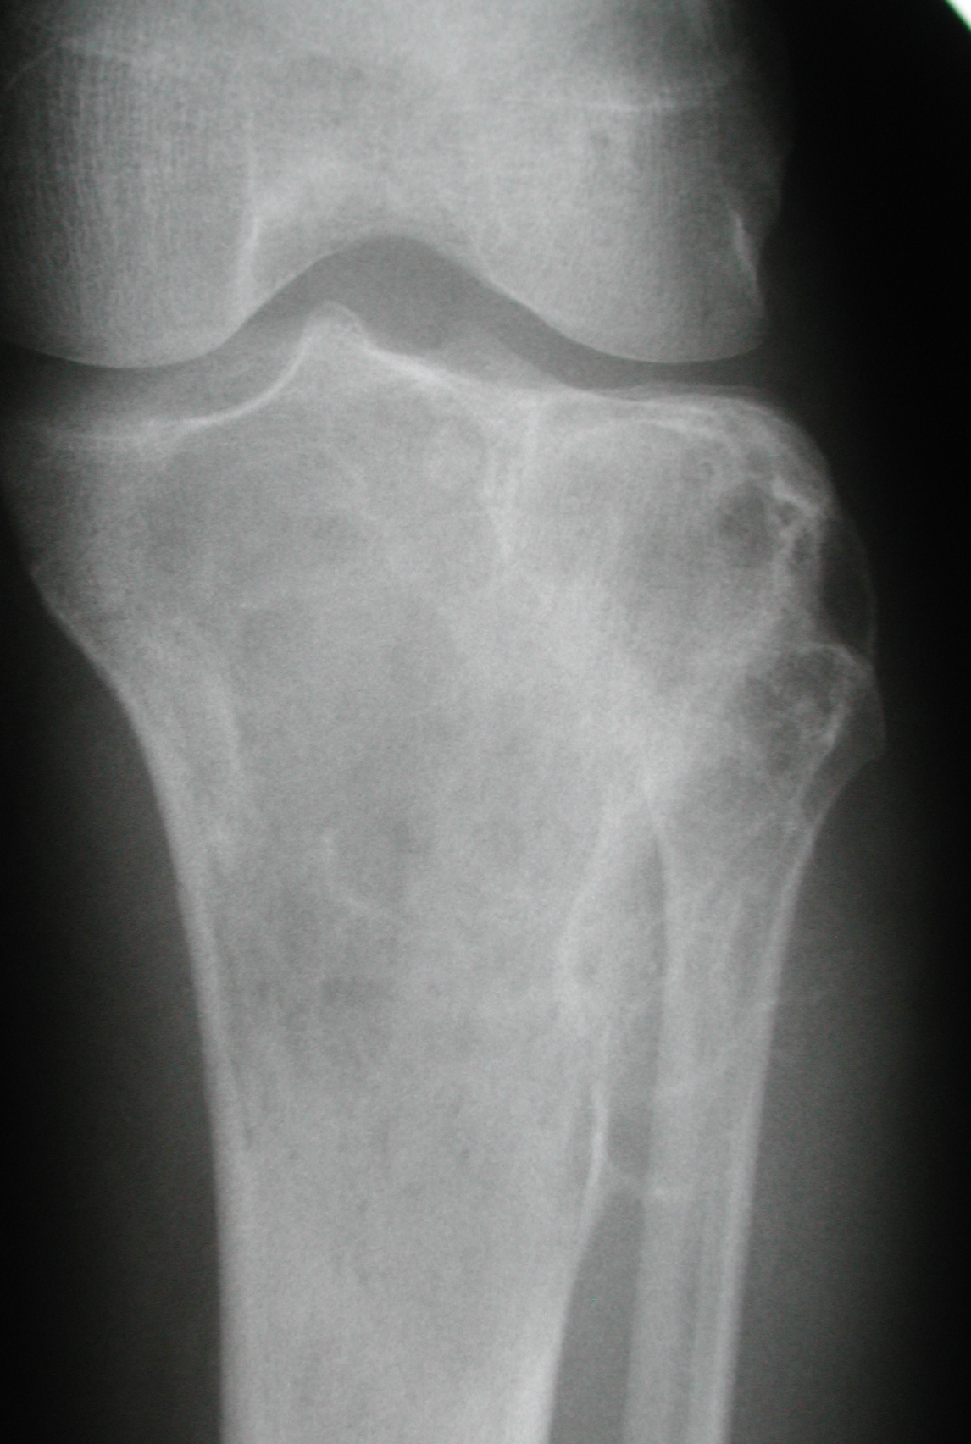
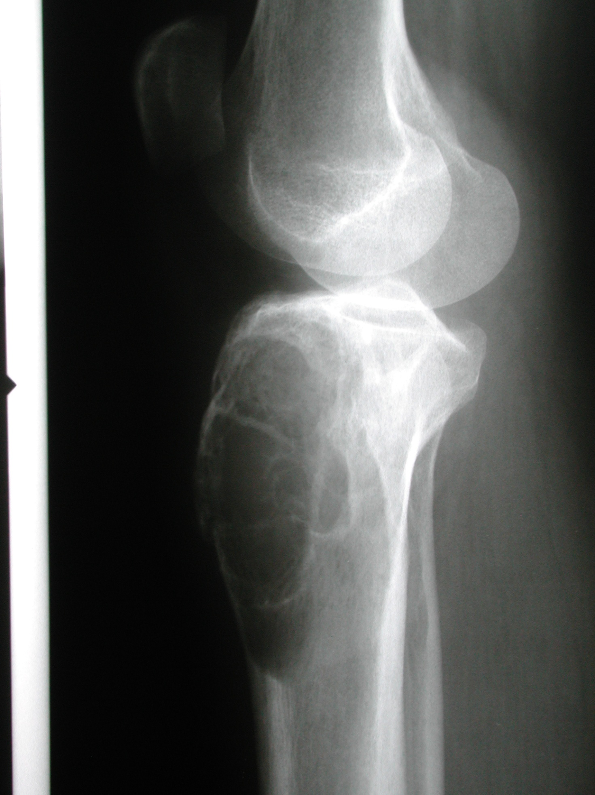

Slide 51
Metaphyseal lesions
Enchondroma
SBC “simple bone cyst”
NOF/fibrous cortical defect
Chondromyxoid fibroma
Osteosarcoma
Chondrosarcoma

Slide 52
Metaphyseal
SBC

Slide 53
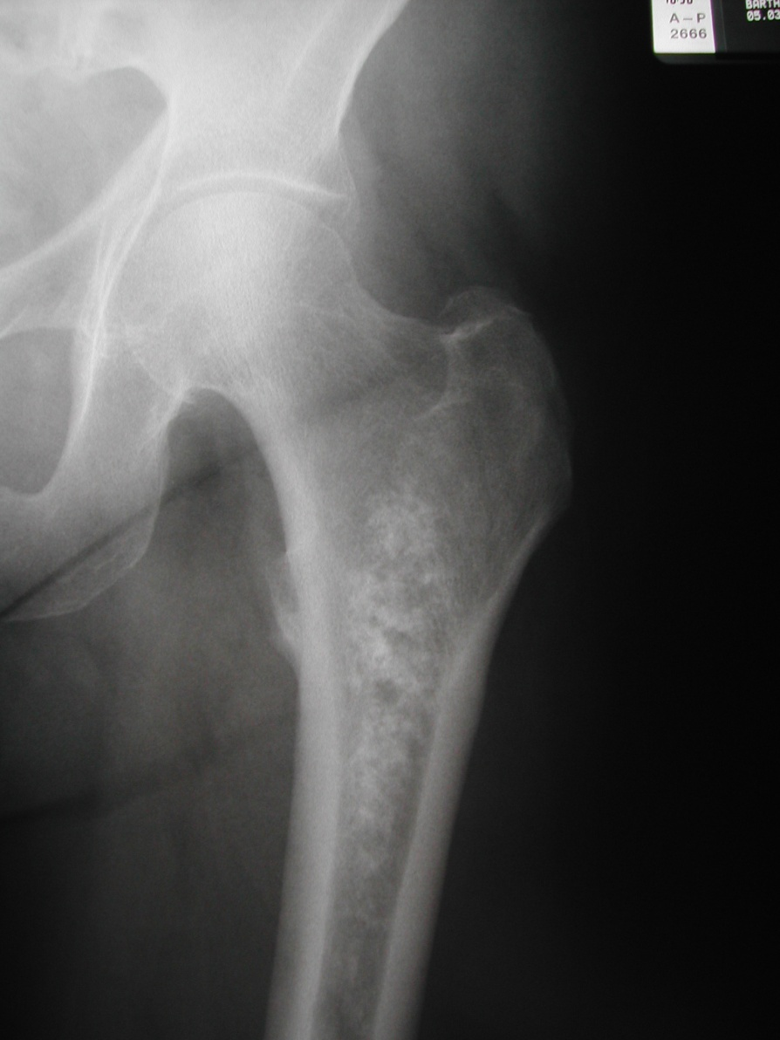
Metaphyseal

Slide 54
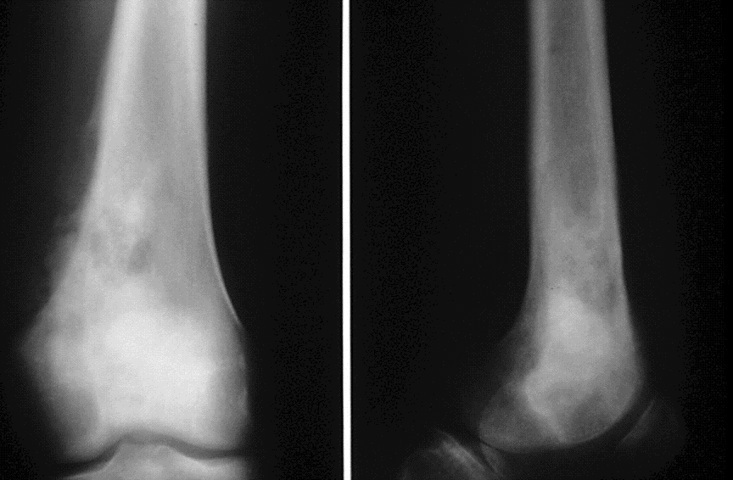
Metaphyseal

Slide 55
NOF

Slide 56
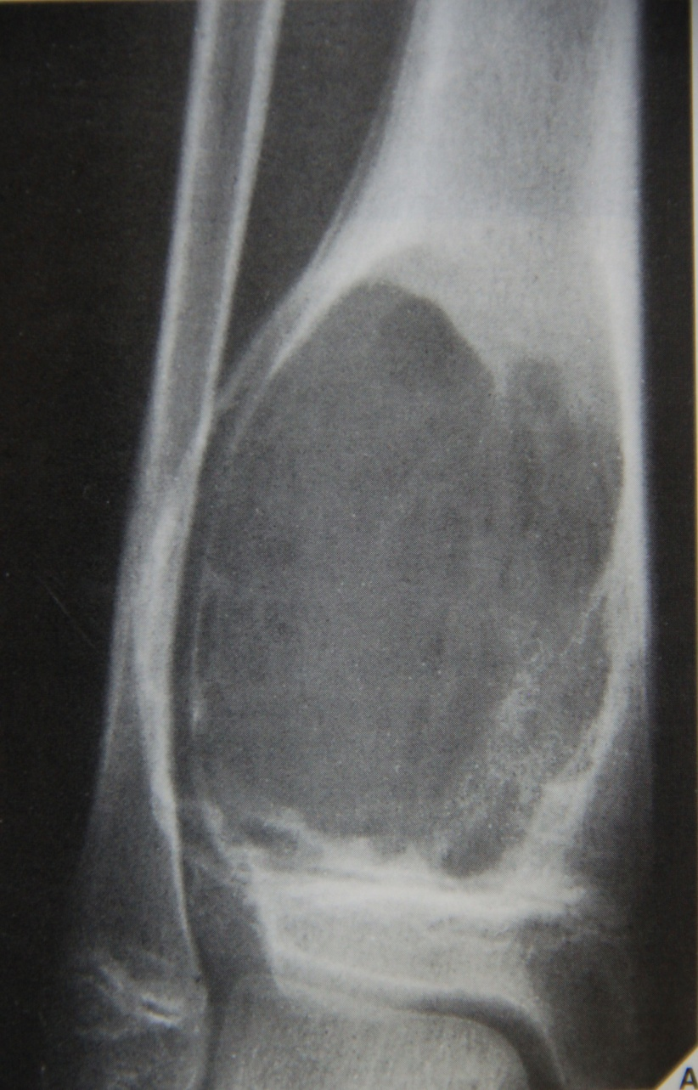
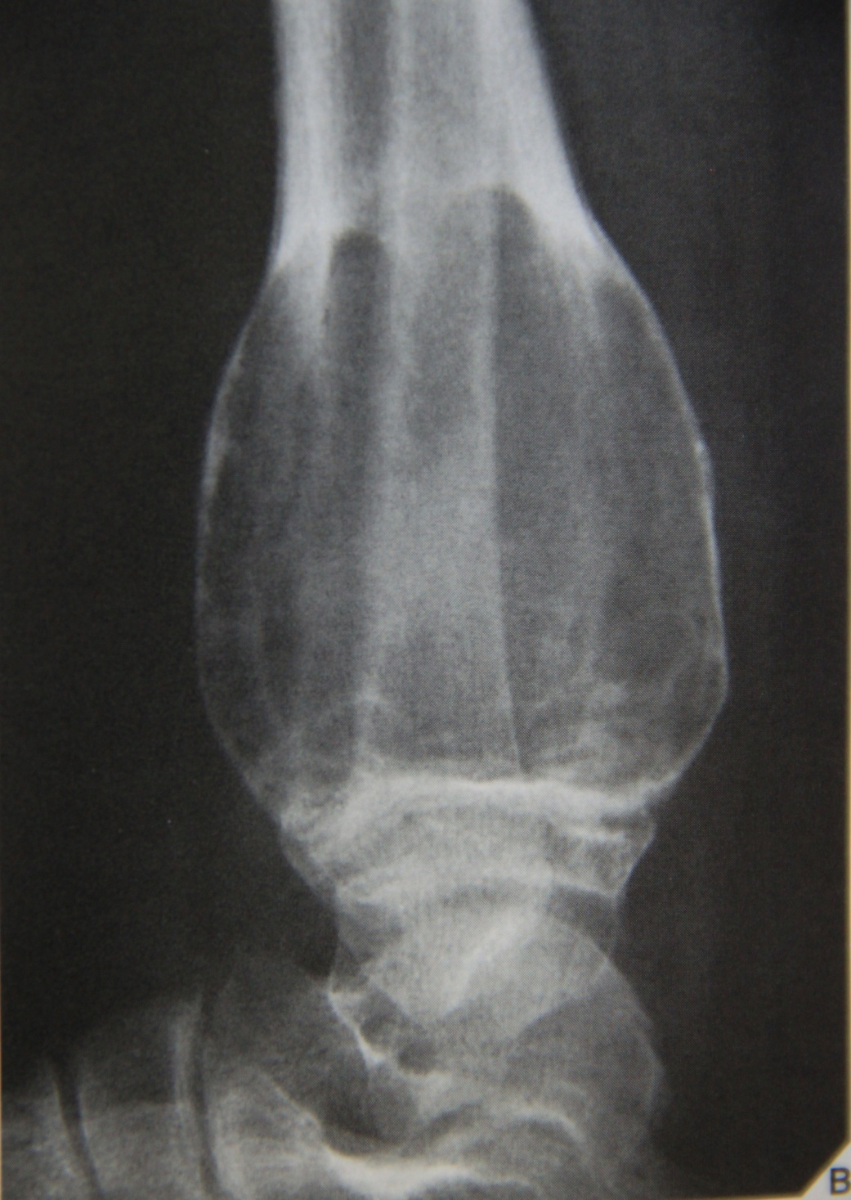
ABC

Slide 57
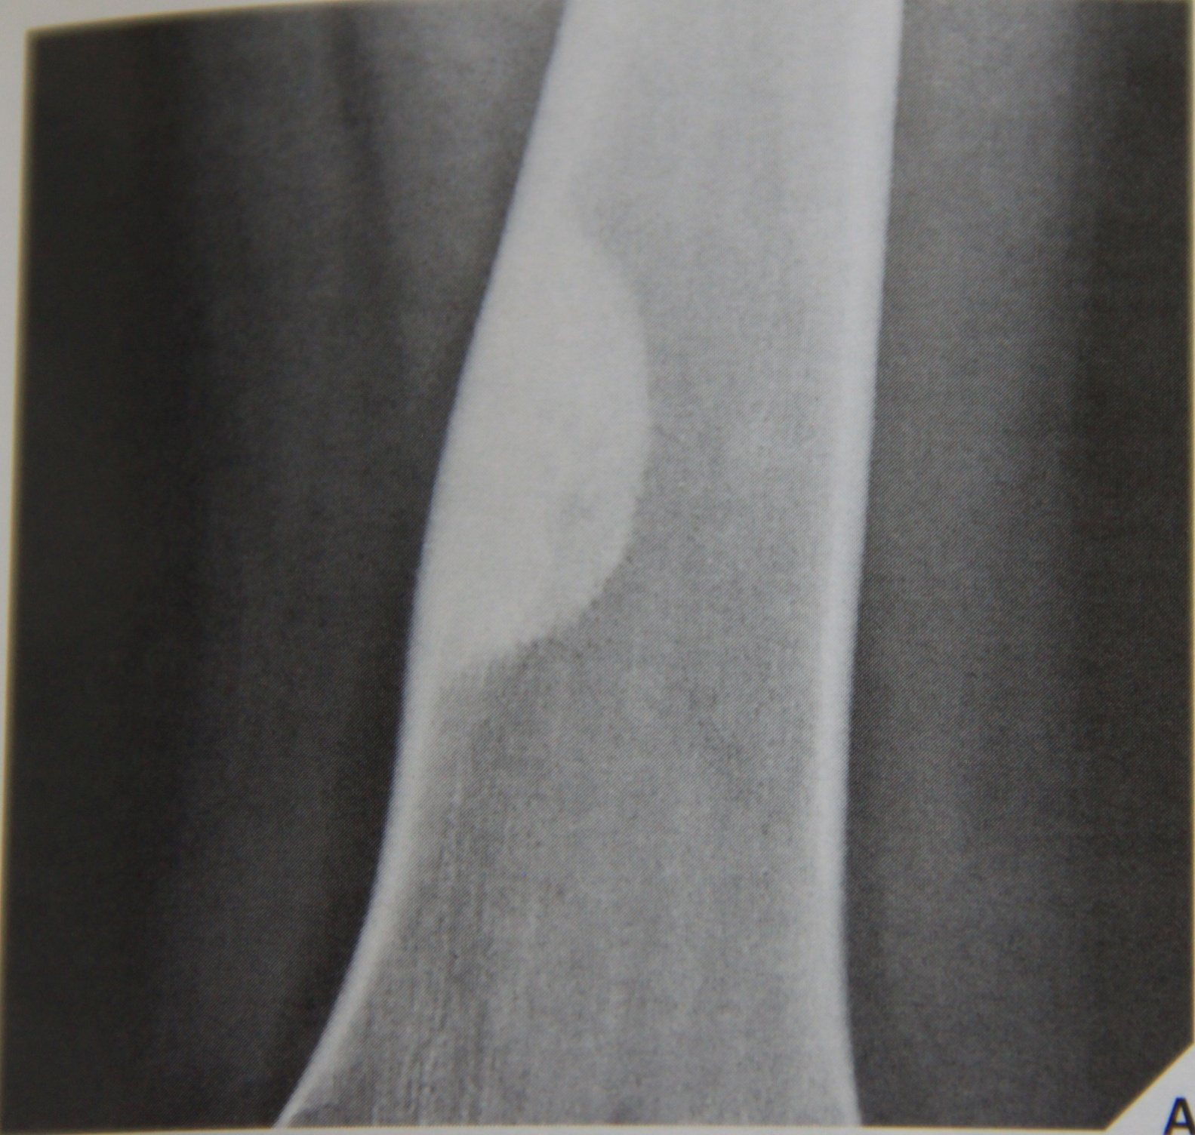

Slide 58
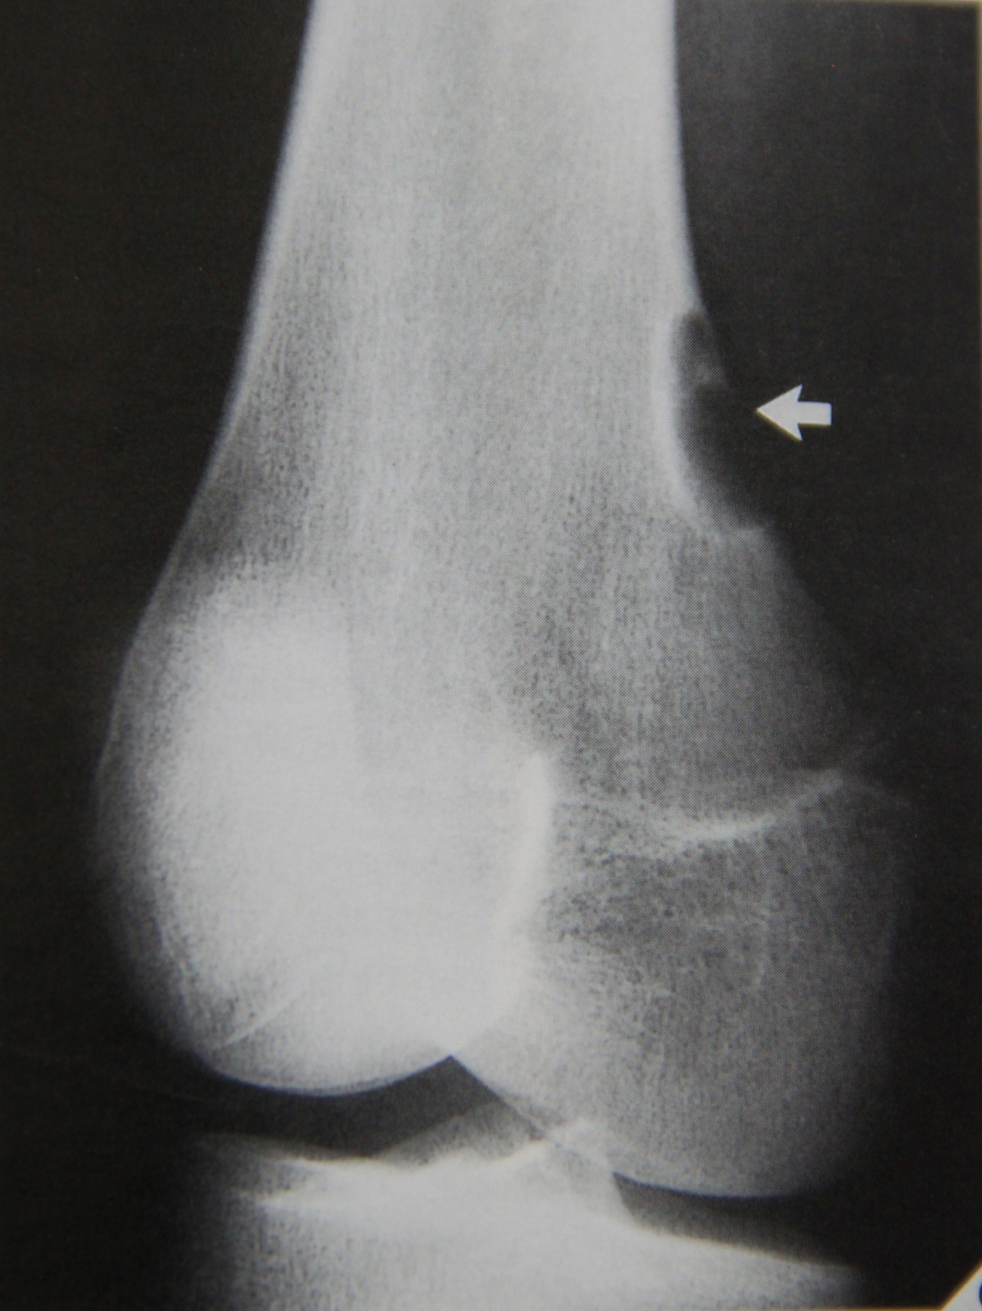

Slide 59
Diaphyseal lesions
Osteoid osteoma
Fibrous dysplasia
Osteofibrous dysplasia
Adamantinoma
Ewing’s sarcoma

Slide 60
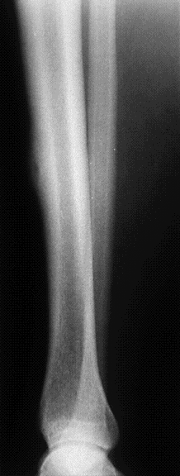
Diaphyseal
Osteoid osteoma

Slide 61
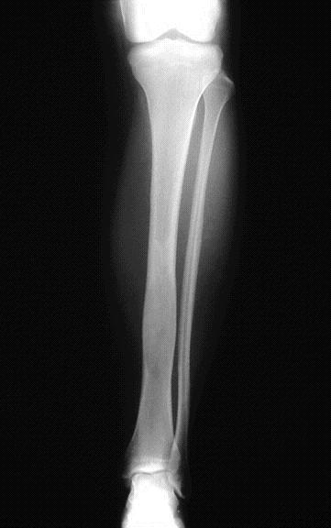
Diaphyseal

Slide 62
Diaphyseal

Slide 63
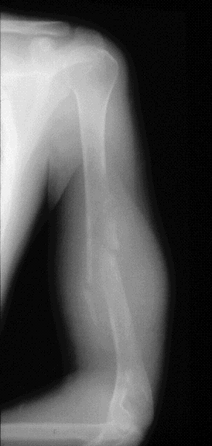
Diaphyseal

Slide 64
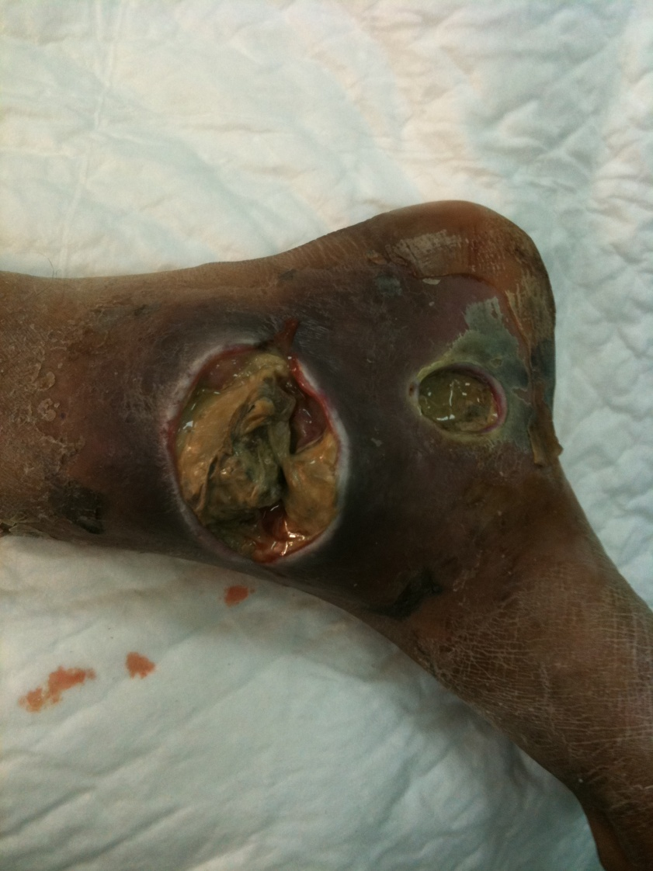
Always remember infection as DDx

Slide 65
Chemotherapy
induces apoptosis
eliminates micrometastasis in lungs
>98% necrosis with chemotherapy is good prognostic sign

Slide 66
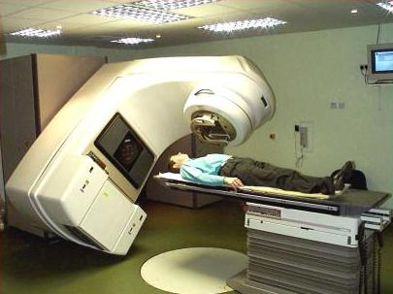
Radiation therapy
Two mechanisms of action
production of free radicals
direct genetic damage

Slide 67
Complications of Radiation therapy
Radiation effects on normal tissue
early effects
delayed wound healing , infection
late effects
fibrosis , joint stiffness
Post-radiation sarcoma
incidence is ~13% , poor prognosis
Post-radiation fractures

Slide 68
Take Home Message
How to approach Orthopedic oncology case
How to read Orthopedic Oncology X-Ray
SBC &ABC
Osteoid Osteoma
GCT
Osteosarcoma
Epiphyseal lesions? Intra-articular Tumor?
Treatment examples, treatment MOA & complications

Slide 69
Thank You

