Slide 1

Common Chronic Shoulder, Hand and Foot Disorders
Prof. Mamoun Kremli
Dr. Tarif Alakhras

Slide 2
Common Chronic
Shoulder Disorders

Slide 3
Objectives
Revision of anatomy
Discuss common disorders
  Shoulder instability
  Rotator cuff (impingement) syndrome
  Supraspinatus tendinitis
  Biceps tendinitis
  Adhesive capsulitis (frozen shoulder)
  Shoulder arthritis
  Scapular winging

Slide 4
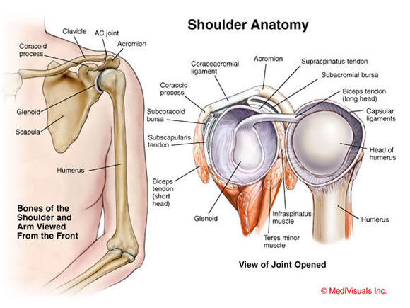
Anatomy
Glenohumeral Joint
Sternoclavicular Joint
Acromioclavicular Joint
Scapulothoracic Joint

Slide 5
Rotator Cuffs
Four muscles/tendons
insertion | Position | Muscle
G tuberosity | above | supraspinatus
G tuberosity | behind | Infraspinatus
G tuberosity | behind | Teres minor
L tuberosity | In front | Subscapularis

Slide 6
Common shoulder complaints
Pain
  Localized
  Generalized
  Painful arc
Loss / limitation of function
  Stiffness
  Painful

Slide 7
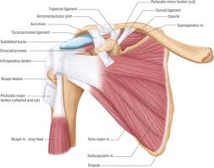
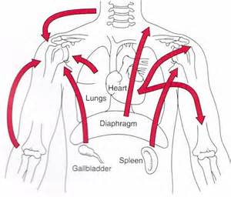
Shoulder Pain
INTRINSIC
Due to causes in the shoulder region
EXTRINSIC
Due to referred pain from outside the shoulder

Slide 8
Shoulder Instability
Shoulder (glenohumeral) joint is the most commonly dislocated joint of body
Instability means
  Excessive movement of humeral head on the glenoid during active shoulder movement
  May lead to recurrent dislocation

Slide 9
Shoulder Restraints
Static:
  Glenoid labrum
  Capsule
  Ligaments around capsule
Dynamic:
  Rotator cuff muscles
    stabilize the humeral head within the glenoid

Slide 10
Types of Instability
According to direction of instability
  Anterior
    The commonest
    Following acute traumatic dislocation
  Posterior
  due to a violent jerk in an unusual position
  Multi-directional
    Ligament laxity

Slide 11
Types of Instability
TUBS
  Traumatic
  Unilateral
  Bankarts lesion
  surgery
AMBRI
  Atraumatic
  Multidirectional
  Bilateral
  Rehabilitation or Inferior capsular shift

Slide 12
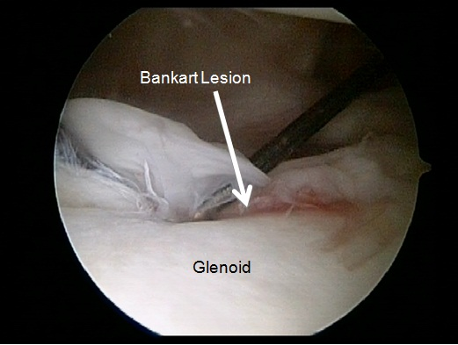
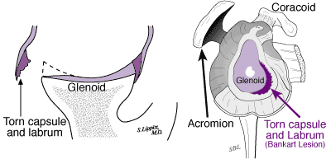
Traumatic – Soft Bankart
No bony lesion seen on x-ray
  A tear in the labrum and capsule

Slide 13

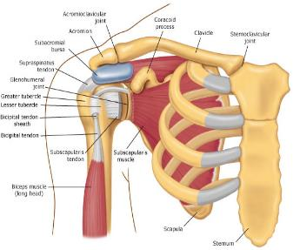
Rotator Cuff Disorders
insertion | Position | Muscle
G tuberosity | above | Supraspinatus
G tuberosity | behind | Infraspinatus
G tuberosity | behind | Teres minor
L tuberosity | In front | Subscapularis
Anatomy:
  Originate from the scapula
  Pass under coraco-acromial arch
  Insert in the Greater & Lesser tuberosities
  Separate from the ligament by bursa

Slide 14
Rotator Cuff Disorders
Rotator cuff syndrome – which comprises several conditions with distinct clinical features and natural history:
  Acute tendinitis (painful arc syndrome)
  Chronic tendinitis (impingement syndrome)
  Rotator cuff tears

Slide 15
Rotator Cuff Disorders
tps://www.drugs.com/

Slide 16
R.C.D - Acute Tendinitis
Supraspinatus tendinitis
  The supraspinatus is the most commonly injured rotator cuff M
Clinical features:
  Young adult
  Sever Pain, tenderness
  painful initiation of abduction
  X-ray:
    Normal
    Area of calcification

Slide 17
Supraspinatus tendinitis
Treatment:
  Rest
  NSAIDS
  Physiotherapy
  Local steroid injection
      Surgery: (acromioplasty, decompress the rotator cuff)
If symptoms do not subside after 3 months of conservative treatment, or if they recur persistently after each period of treatment

Slide 18
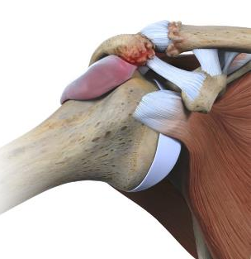
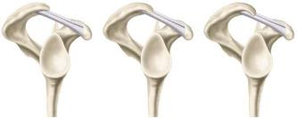

R.C.D - Impingement Syndrome
Chronic tendinitis
Causes
  Over-use / Minor tears
  Impingement under the coracoacromial arch
  Osteophytes in under surface of acromioclavicular joint
  Curved acromion
www.rocmd.com

Slide 19
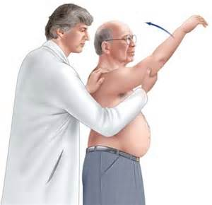
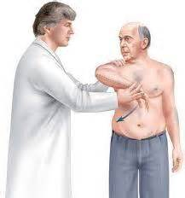
R.C.D - Impingement Syndrome
Clinical features
  Age 40-60 years
  Pain
  Shoulder looks normal or wasted
  Tenderness
  Painful abduction arch (6oº To 120º)
  Neer’s test (+ve)
  Hawkin’s test (+ve)

Slide 20
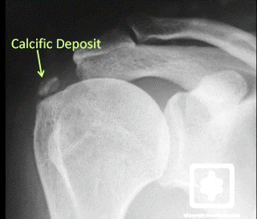
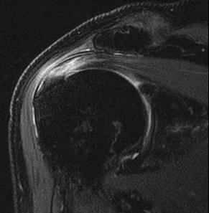
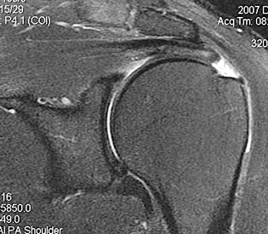
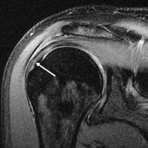
R.C.D - Impingement Syndrome
X-ray:
  Calcification
  Degenerated AC jt.
MRI:
  Bursitis / Thickening of tendon
http://emedicine.medscape.com

Slide 21
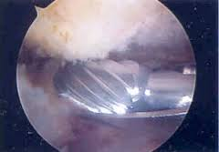
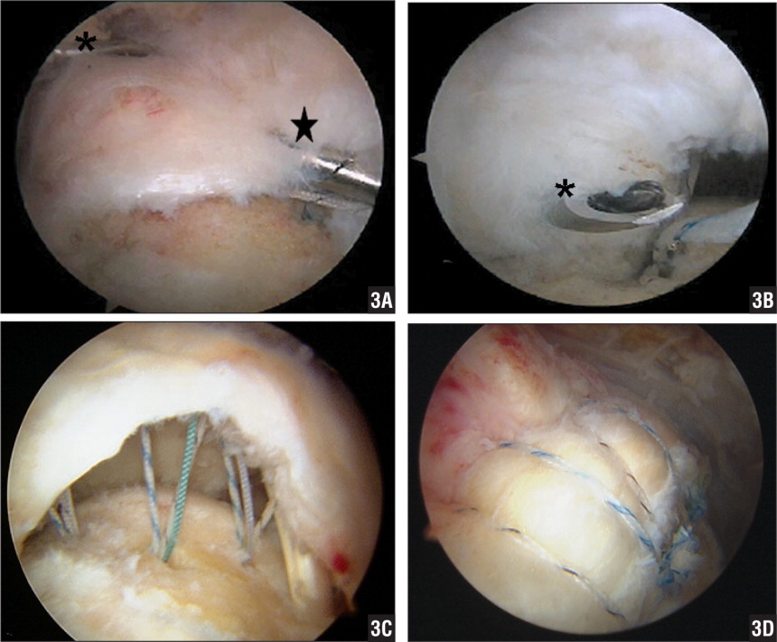
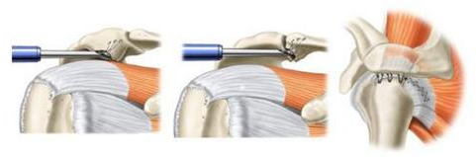
Treatment
Non-operative:
  Activity modification
  Sub-acromial steroid injection
  NSAIDS
  Rotator cuff and scapular stabilizing exercises
Surgery:
  Arthroscopic
    Acromioplasty
    Rotator cuff repair
www.rocmd.com

Slide 22
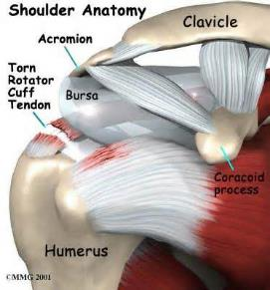
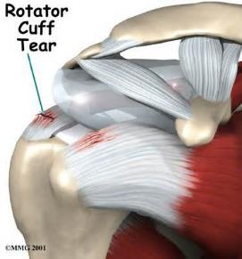
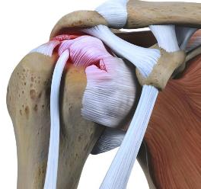

R.C.D - Tears
Predisposing factors
  Degeneration: middle age
  Chronic irritation by osteophyte
  Underlying disease:
    eg. Rheumatoid
  Precipitating factor: trauma
Types:
  Incomplete
  Complete

Slide 23
R.C.D - Tears
Clinical features:
  Trauma, pain, limited abduction
  After few weeks:
    Incomplete tear:
      improvement of pain and range of motion
    Complete tear:
      improvement of pain and decrease of active range of motion
Look:
  Early; normal appearance
  Late; wasting of supraspinatus and infraspinatus muscles
Feel:
  Tender greater tuberosity

Slide 24

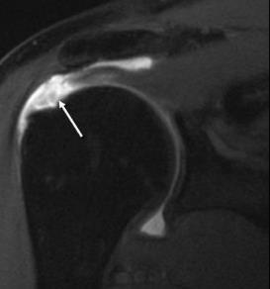
R.C.D - Tears
Normal tendon
Clinical features:
  Move:
    Incomplete tear:
      painful weak
    Complete tear:
      passive not painful
      active drop arm sign
X-rays:
  Early normal
  Late degenerative changes
MRI: image of choice
Treatment:
  Incomplete tear: PT, NSAID
  Complete tear: surgery
Torn tendon
http://emedicine.medscape.com

Slide 25
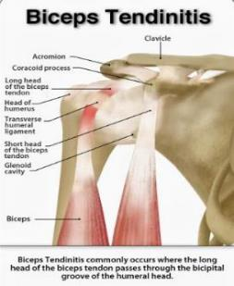
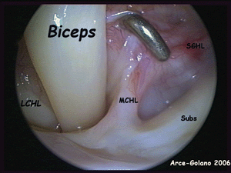
Biceps Tendon Disorders
Tendinitis:
  Often associated with impingement
  Pain
  Tenderness: Bicepital groove
  Painful forward flexion
  Speed/Yergason test
  Treatment:
    NSAID
    Local steroid injection
    Surgery
      Tenotomy / Tenodesis

Slide 26
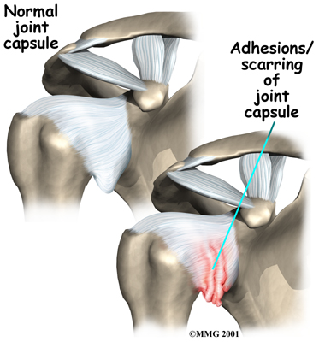
Adhesive Capsulitis Frozen shoulder
Presentation
  Pain and restriction of movements
Causes:
  Trauma, breast surgery, diabetes & immobilization
Self limiting with 3 stages
  Painful stage
  Stiffs stage
  Thawing stage: The range of motion of shoulder begins to improve.

Slide 27
Adhesive Capsulitis
Treatment:
  Intra-articular injection
  Physiotherapy
  Manipulation under anesthesia
  Arthroscopic release of adhesions

Slide 28
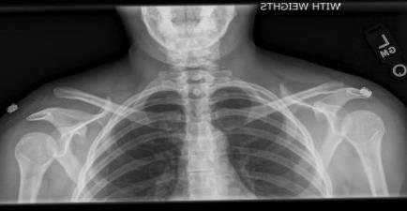
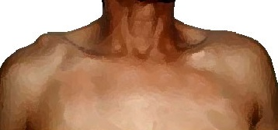
Acromioclavicular Arthritis
Pain, localized tenderness
Pain on abduction above shoulder level

Slide 29
Shoulder Summary
Shoulder Symptoms:
  Pain
  Loss of Function
  Stiffness
  Instability
Many causes of shoulder pain
  Can be differentiated by:
    History
    Clinical picture
    investigations
Common diseases:
  Shoulder instability
  Rotator cuff (impingement) syndrome
  Supraspinatus tendinitis
  Biceps tendinitis
  Adhesive capsulitis (frozen shoulder)

Slide 30
Common Hand and Foot Disorders
Prof. Mamoun Kremli
Dr. Tarif Alakhras

Slide 31
Common Hand Disorders
Rheumatoid arthritis
Osteoarthritis
Trigger finger
Ganglion

Slide 32
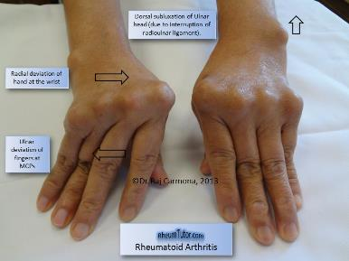
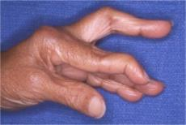
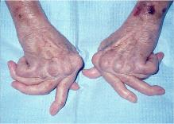
Rheumatoid arthritis
The hand is the most affected part
Mainly MCP and PIP joints
https://plasticandhandsurgery.com.au

Slide 33
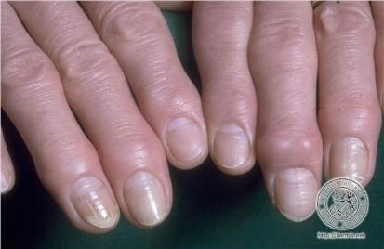
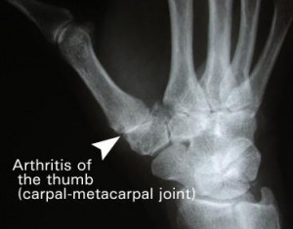
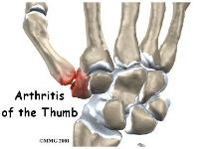
Osteoarthritis
Postmenopausal ladies
Mainly DIP joints
Thickened DIP joint (Heberden’s nodes)
May affect MCP joint of thumb
  ? New generation
http://osteoarthritisblog.com

Slide 34
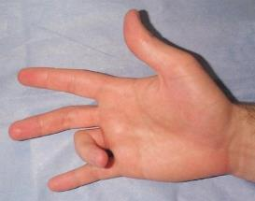
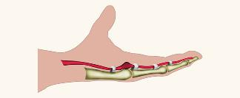
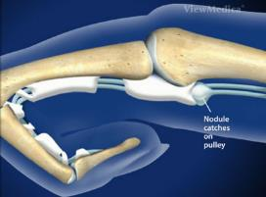
Trigger Finger
Common problem
Site:
  Usually middle or ring fingers
  maybe thumb
Intermittent deformity
  Finger stuck in flexion when clenching
  Suddenly snaps on extension
Cause
  Thickened tendon sheet, with nodule felt
www.orthobullets.com
www.miamihandcenter.com
www.handandwristinstitute.com

Slide 35
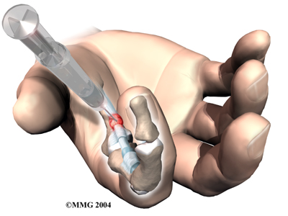
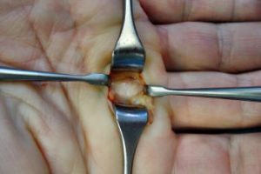
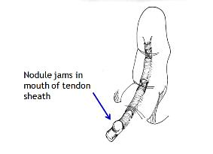
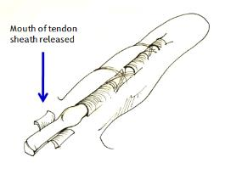
Trigger Finger
Treatment
  Usually self- limiting. Improve by NSAIDs
  If persists:
    Steroid injection inside tendon sheath
    Surgery in resistant cases
https://hand-arm.com
www.bssh.ac.uk
Notes:
7 HIDE SLIDE

Slide 36
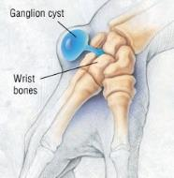
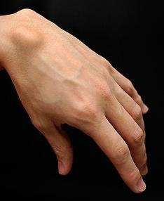
Ganglion
Most common in the dorsum of wrist
Cystic degeneration of joint capsule or tendon sheath
Clinical picture
  Young adult
  Painless lump / slight pain
  Non-tender, well localized, feels hard
Treatment
  Self-limiting
  May be aspirated
  Surgical excision
    (recurrent rate 30%)
www.quora.com
https://en.wikipedia.org

Slide 37
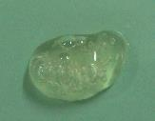
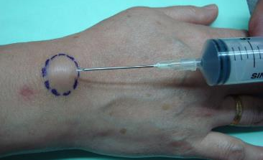
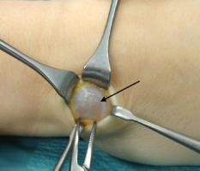
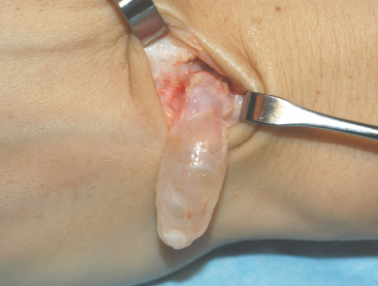
Ganglion
Most common in the dorsum of wrist
Cystic degeneration of joint capsule or tendon sheath
Clinical picture
  Young adult
  Painless lump / slight pain
  Non-tender, well localized, feels hard
Treatment
  Self-limiting
  May be aspirated
  Surgical excision
    (recurrent rate 30%)
https://rojosonmedicalclinic.wordpress.com
https://hand-arm.com
www.chir.ch
Notes:
Hide slide 7

Slide 38
Common Foot Disorders
Hallux valgus
Plantar fasciitis
Achilles tendinitis
Suggested site to visit
http://www.londonorthopaedicsurgery.co.uk/

Slide 39
Hallux Valgus
Definition: lateral deviation of the great toe (hallux) and medial deviation of the first metatarsal
  A common deformity
  F > M
  Types:
    Adolescent
    Adult → commonest
    Geriatric
http://www.med-practic.com/

Slide 40
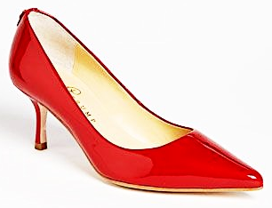
Etiology - Hallux Valgus
Familial: > 60%
2-4 % of the population
Wearing shoes
Shoes:
  High heels, or
  Pointed front
Metatarsus primus varus:
  Congenital, or
  Geriatric
Rheumatoid arthritis
Increase deformity
Cause?
http://www.healthyfeetni.co.uk/podiatry/

Slide 41
Presentation - Hallux Valgus
Deformity / Bunion / medial deviation MT-1
Issues in wearing shoes
Pain → over the bunion, forefoot
Bunion
Bunion
http://www.med-practic.com/

Slide 42
Presentation - Hallux Valgus
Deformity of big toe
Bunion
Medial deviation MT-1
https://nhi.no/sykdommer

Slide 43
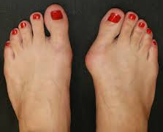
Clinical Picture - Hallux Valgus
Bunion may be (usually) inflamed / painful
Bunion
http://www.farmaconsejos.com/

Slide 44
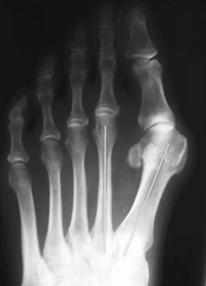
Radiology - Hallux Valgus
XR views:
  AP standing:
    Lateral deviation of big toe
    Increased varus of 1st MT
    Subluxation of MT-Phal. joint
http://www.thefootandankleclinic.com/

Slide 45
Treatment - Hallux Valgus
General: reducing symptoms – does not correct deformity
  Rest
  Elevation
  Cold / ice compressions
  NSAID:
    Oral & gel
  Changes in shoe wear
    Wide front
  Activity modifications

Slide 46
Treatment - Hallux Valgus
Adolescent:
  Main complaint: cosmetic
  Wise to try conservative 1st (to delay surgery):
    Shoes: wide front, no high heals
    Silicon spacer / splints
  Surgery
https://www.groupon.com/
Notes:
Recurrence rate is high → 20-40%

Slide 47
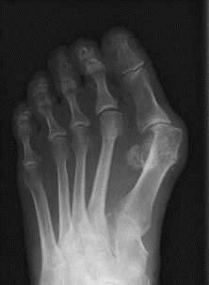

Treatment - Hallux Valgus
Adult:
  Surgery usually
  Many operations
  Aim:
    Re-align the 1st metatarsal
    Correct valgus deformity of big toe
    Soft tissue balancing

Slide 48
Treatment - Hallux Valgus
Pre-op. Immediate post op 1 year
J Korean Foot Ankle Soc. 2015 Sep;19(3):91-96. Korean

Slide 49
Complications - Hallux Valgus
Of Hallux Valgus:
  Shoes issues
  Recurrent bunion inflammation
  If D.M bunion infection or ulceration
  Transfer metatarsalgia (disturbed mechanics)
Of Hallux Valgus surgery:
  Infection (superficial or deep)
  Implant failure
  Recurrence

Slide 50
Plantar Fasciitis
Definition → inflammation of the plantar fascia
In the posterior 2/3 of the foot
Painful & sometimes disabling
www.fitforlifewellnessclinic.com
Notes:
Put pic of anatomy

Slide 51
Causes - Plantar Fasciitis
Insidious (not clear H/O an incident)
Some times:
  Increased sport / repetitive stress
  Change of footwear
  Change of walking surface
  Gain of weight (pregnancy, obese)
  Prolonged standing
  Connective tissue disorders (as D.M, Gout, …)

Slide 52
Symptoms - Plantar Fasciitis
Gradual onset
“Start-up Pain”:
  When wake up in the morning
  After sitting for some time
Pain:
  Pins and needles, or sharp, or persistent aches
  At hind & mid foot area
  Improves with:
    Walking for sometime
    Elevation
    NSAID
www.massagemag.com
Notes:
H.W= what blood works do they need, P-618

Slide 53
Radiology - Plantar Fasciitis
“Calcaneal Spur” on XR:
  It’s a result NOT the cause
  Implies chronicity
  Not diagnostic
    Present in 10% of normal
https://www.kybun.com
http://www.merckmanuals.com/

Slide 54
Treatment- Plantar Fasciitis
Rest
  Avoid repeated stress
  Elevation
  Heal cushion
Reduce inflammation
  Ice compressors
  NSAID
P.T: Stretching
  Calf & plantar fascia
P.T: Messaging ?
http://www.tallerheels.com/
https://heelthatpain.com
http://livewellcentre.com/

Slide 55
Treatment- Plantar Fasciitis
Rest
  Avoid repeated stress
  Elevation
  Heal cushion
Reduce inflammation
  Ice compressors
  NSAID
P.T: Stretching
  Calf & plantar fascia
P.T: Messaging ?
https://runnersconnect.net/plantar-fasciitis-in-runners

Slide 56
Treatment - Plantar Fasciitis
If all previous conservative fails → injection of:
  Local anesthesia & steroid
  At the most tender point
http://nursing-skills.blogspot.com/

Slide 57
Achilles Tendinitis
http://www.aminoapps.com/
http://www.fleetfeetstuart.com/

Slide 58
Types – Achilles Tendinitis
Insertional
  at insertion into Calcaneum
  not related to activity
Non-insertional
  within the tendon
  in younger active patients
http://kingbrand.com/

Slide 59
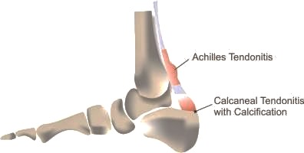
Clinical Picture
Pain: posterior foot / lower leg
Pain is worse
  Getting up from sleep in the morning
    Gradually improves throughout the day
  After a prolonged periods of inactivity/activity
Difficulty in planter flexion of the ankle??
Tenderness:
  Over the lower calf muscle
  Achilles tendon
http://www.medicalnewstoday.com/
http://www.physiocapsule.com/

Slide 60
Clinical Picture
Tenderness:
  Over the lower calf muscle
  Achilles tendon
Some swelling over the tendon (+/-)
http://www.physiocapsule.com/
http://lfaclinic.co.uk/

Slide 61
Causes – Achilles Tendinitis
Extrinsic factors
Intrinsic factors
Prolonged walking/ standing
  Repeated stress
Sports
  Sudden increase in activity
  No proper warm-up before exercise
Shoes:
  Rubbing against tendon
  Improper shoes
Tight gastrocnemius
Tight Achilles tendon
Flat feet
Genu valgus

Slide 62
Workup - Achilles Tendonitis
A clinical diagnosis
X-ray:
  may show calcification around the tendon
U/S:
  Edema in tendon
  some effusion around the tendon
https://rad.washington.edu
http://www.wheelessonline.com/

Slide 63
Treatment - Achilles Tendonitis
Rest
Elevation
Cold/Ice compressions
NSAID: oral & gel
Physiotherapy: stretch the tendon
Heel pads in proper home shoe to rest the tendon

Slide 64
Treatment - Achilles Tendonitis
If no improvement → below knee cast with the foot in equinus, for 3-6W may work
Surgery may be needed in persistent cases

Slide 65
Treatment - Achilles Tendonitis
Achilles tendon pain should be treated
If left untreated, the tendon can become weak, frayed, and eventually may rupture

Slide 66
Take Home Message
Hallux Valgus
  Conservative is still 1st line of management
  Surgery for adult moderate/sever hallux valgus
  Prevention → by proper shoes education
Plantar fasciitis
  Conservative treatment
  Patient education is a must
Achilles Tendinitis
  Conservative treatment
Notes:
12 hide slide

