Slide 1

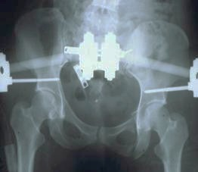
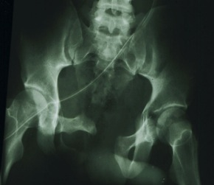
Common Adult Injuries
Axial Skeleton
Pelvis
Prof. Mamoun Kremli

Slide 2
Outline
Introduction
  The pelvic ring
  What does a pelvic injury indicate?
Emergency assessment & management
  Differentiation between stable & unstable injuries
  Classification and reading x-rays
Treatment options

Slide 3
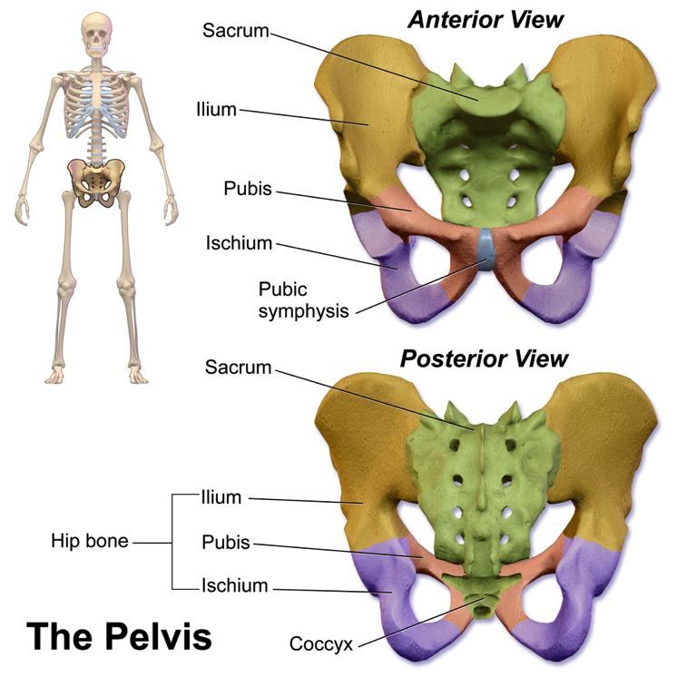
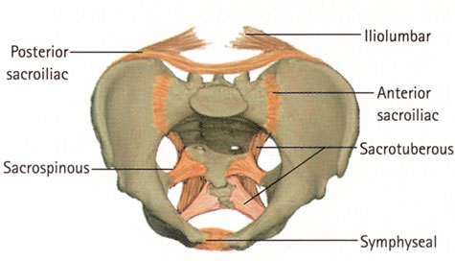
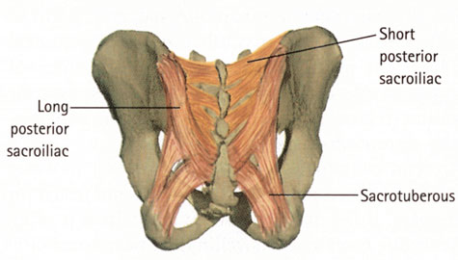
Anatomy
Bones and ligaments
http://en.wikipedia.org/wiki/Pelvis
Appley’s System of Orthop and Fr

Slide 4
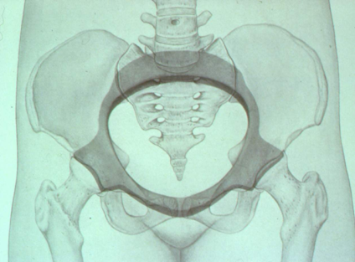
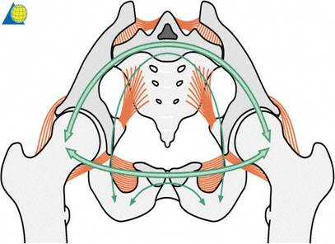
The pelvic Ring
Integrity and stability of the pelvic ring is essential

Slide 5
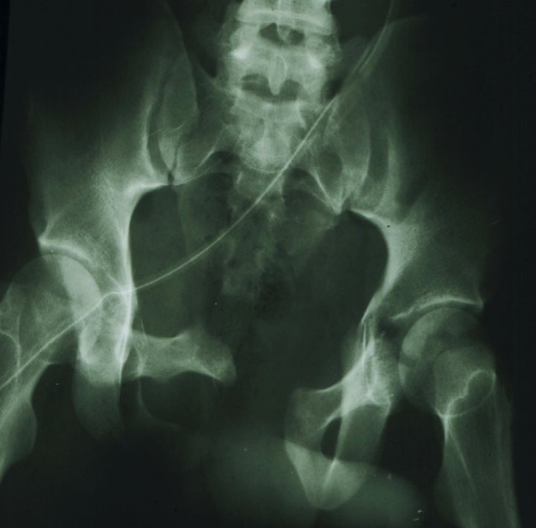
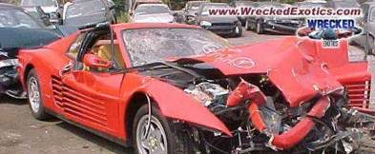
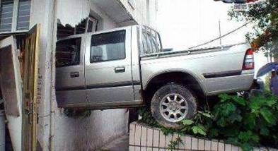
High Energy
It takes high energy to create such damage

Slide 6
Serious Injury
  Bleeding – up to 3L or more
  Damage to other soft tissues
    Urethra, bladder
    Bowel
    Nerves
    Genitalia
    Rectal sphincter
  Usually with other major fractures / Injuries

Slide 7
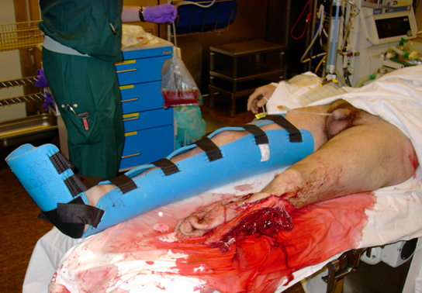
Primary Assessment
Bone is not of primary importance. Life is !
Assessment in suspected pelvic ring fracture is according to ATLS (advanced trauma life support)

Slide 8
Primary Assessment - ATLS
Vital parameters
Airway
Breathing
Circulation
Stable Unstable …Why??
  Disability
  Exposure/environment

Slide 9
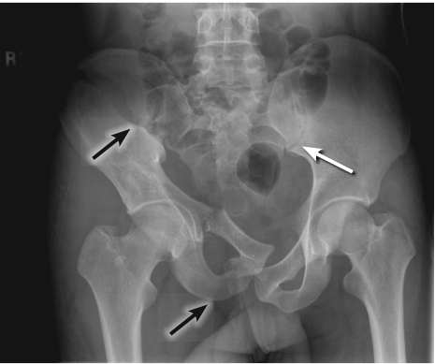
Unstable – Why??
Pelvic fracture (may loose 3L of blood)
Exclude other sources
  Open wound (adds sepsis)
  Hemothorax
  Hemabdomen
  Long-shaft bone fractures

Slide 10
Unstable – Why??
Pelvic fracture
Exclude other sources
  Open wound (adds sepsis)
  Hemothorax
  Hemabdomen
  Long-shaft bone fractures
https://www.youtube.com/watch?v=xBMhGPCx-20

Slide 11
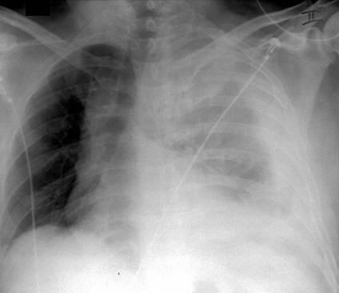
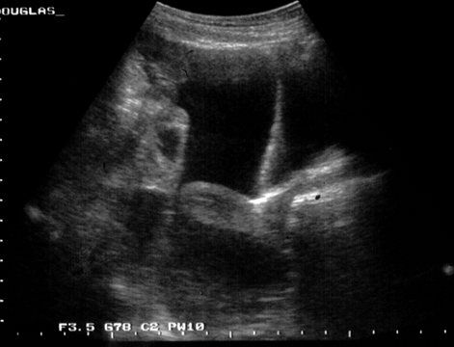
Unstable – Why??
Pelvic fracture
Exclude other sources
  Open wound (adds sepsis)
  Hemothorax
  Hemabdomen
  Long-shaft bone fractures

Slide 12
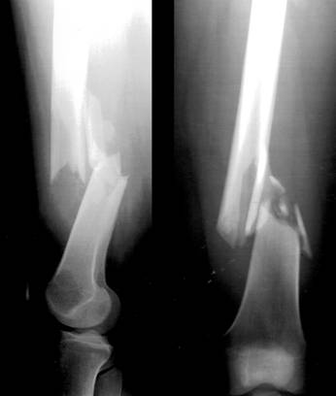
Unstable – Why??
Pelvic fracture
Exclude other sources
  Open wound (adds sepsis)
  Hemothorax
  Hemabdomen
  Long-shaft bone fractures

Slide 13

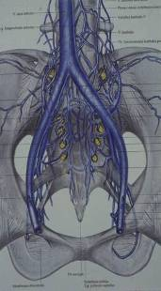
Bleeding from Pelvis
If the pelvis is the source of bleeding, massive blood loss is:
  Mostly venous 80%,
  Cancelous bone oozing
  posterior disruption
  Supported by enlarged compartment
  Arterial source is rare

Slide 14
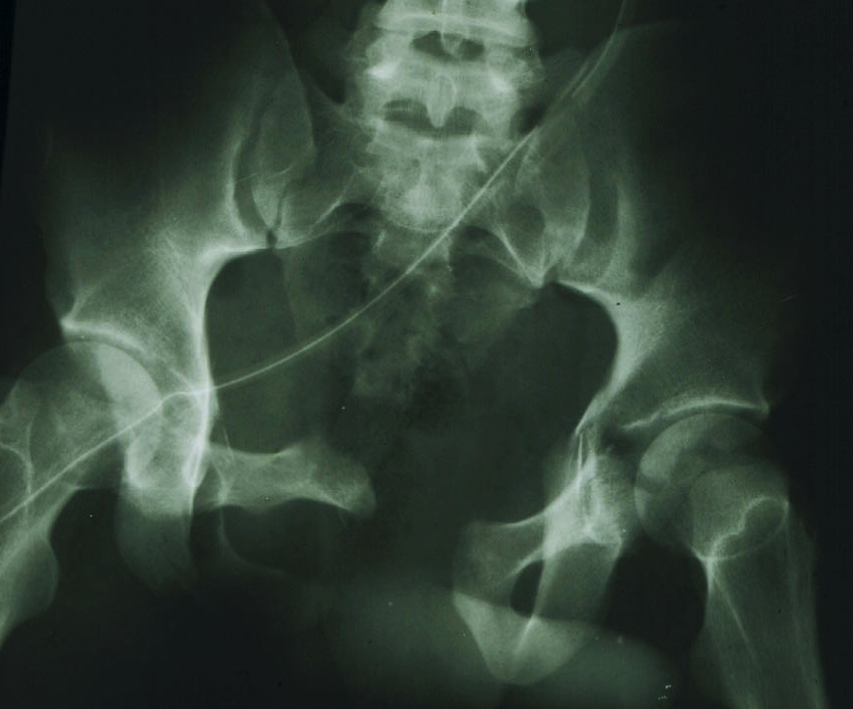
Bleeding from Pelvis
Emergency treatment: Reduce Compartment

Slide 15
Emergency Treatment
Protect primary blood clot by
  Early pelvic splintage / sheet/ clamp. External fixator and
  Prevention of exessive movement
Resuscitation by IV fluids, early blood transfusion& fresh frozen plasma, platelets, cryoprecipitate( antihaemophilic factor )
PRBC: FFP: Platelets ideally should be transfused 1:1:1 for massive transfusions
Prevent hypothermia & acidosis
Stop other bleeding sites(!!)

Slide 16
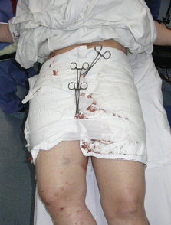
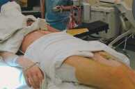
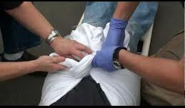
Bleeding from Pelvis
Emergency treatment: Reduce Compartment
  Pelvic sheet
  External fixator
  Pelvic clamp
www.aaos.org

Slide 17
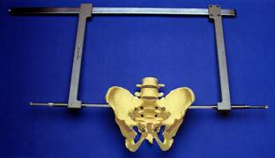
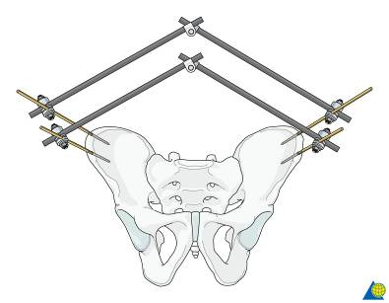
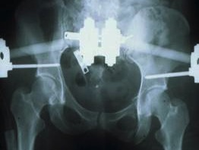
Bleeding from Pelvis
Emergency treatment: Reduce Compartment
  Pelvic sheet
  External fixator
  Pelvic clamp

Slide 18
Bleeding from Pelvis
If the patient still not responding
Think of arterial sources
Either need pelvic packing or embolization by interventional radiologist

Slide 19
Primary Assessment - ATLS
Vital parameters
Airway
Breathing
Circulation
Stable Unstable
  Disability
  Exposure/environment

Slide 20
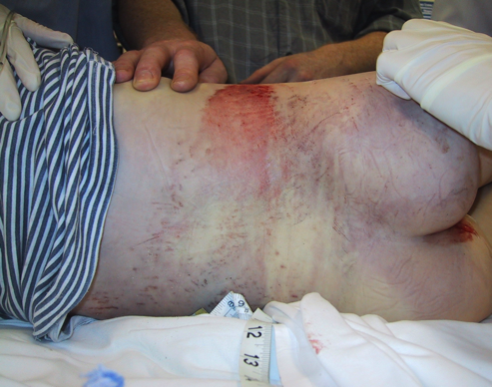
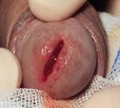
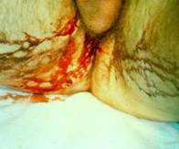

Clinical picture
Bruising
Urethral / genital bleeding
  indicates injury to viscera
  Rectal and vaginal examination is mandatory to role out open fracture
  Do not forget to asses the perineum for wounds
http://cdn.lifeinthefastlane.com/
http://www.wheelessonline.com/userfiles/fig%2016.jpg

Slide 21
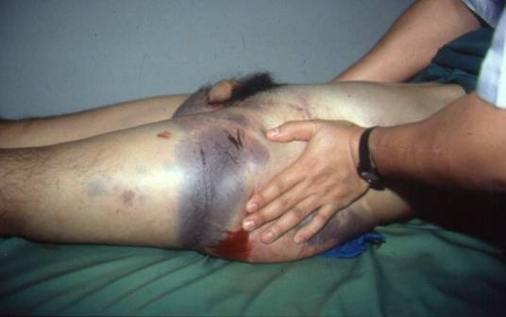
Clinical picture
Tenderness on attempted pressure
Neurologic exam
  Rule out lumbosacral plexus injuries (L5 and S1 are common)
  Rectal exam to evaluate
    Sphincter tone
    Perirectal sensation

Slide 22
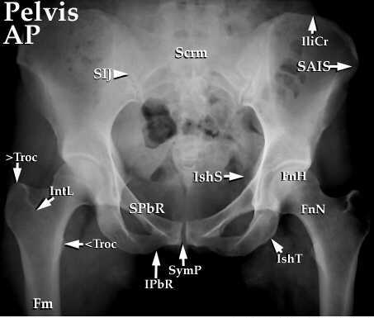
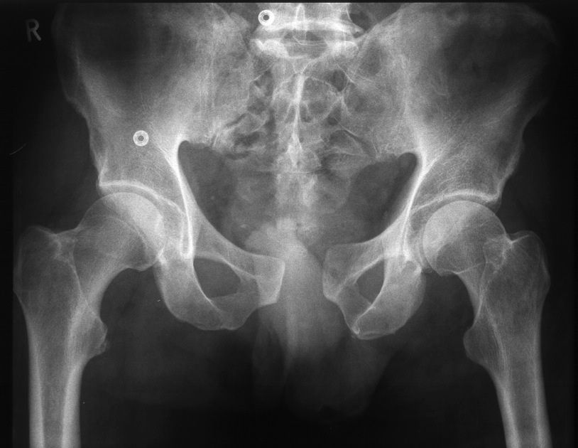
Primary Assessment
A standard x-ray reveals up to 90% of fractures
www.edoctoronline.com

Slide 23
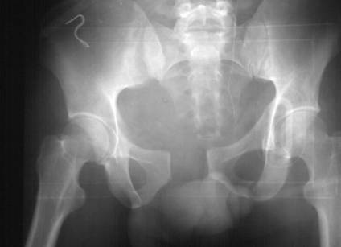
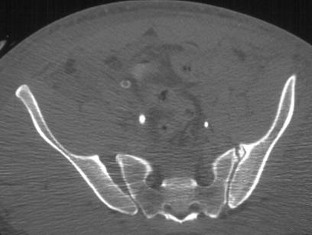
Additional Imaging
CT scan must be done for pelvis fracture to study condition of posterior ring
?

Slide 24
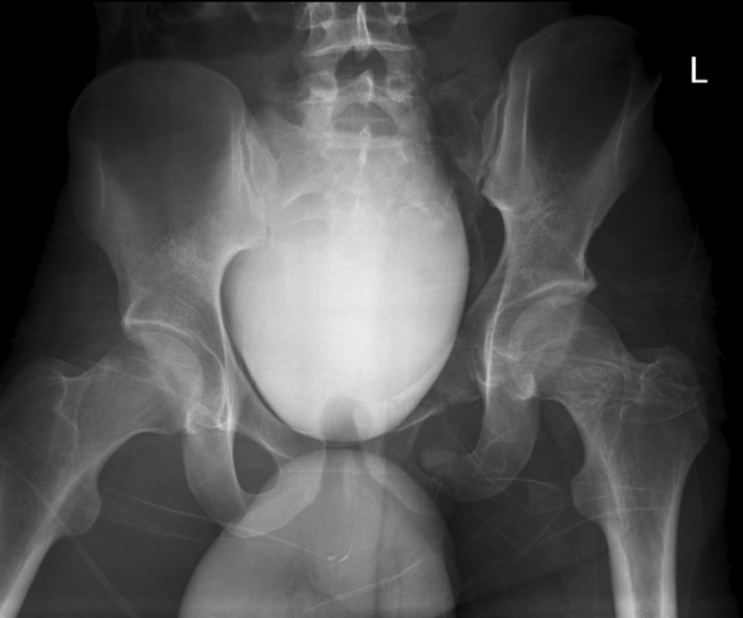
Imaging for Pelvic Organs
Ruptured bladder
http://cdn.lifeinthefastlane.com/

Slide 25
Pelvic Fractures
Isolated fractures
Pelvic Ring fractures

Slide 26
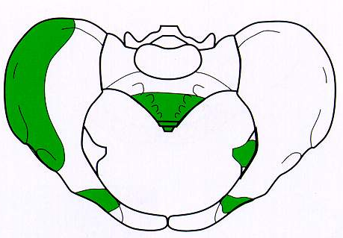
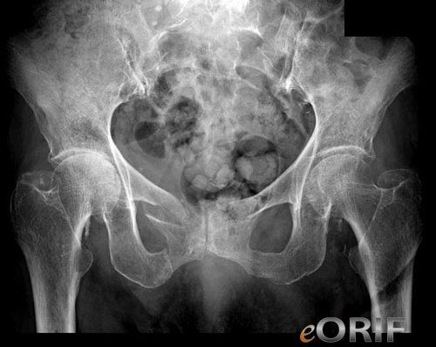
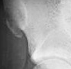
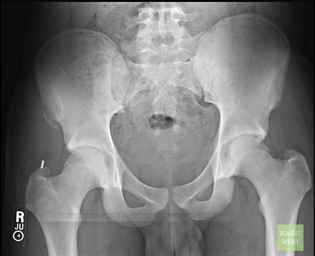
Isolated Fractures
All are Stable
One bone only
  Or ring on one side
Avulsion Fractures
  Sudden pull of muscles
    Sartorius: ASIS
    Rectus Femoris: AIIS
    Adductor Longus: Pubis
    Hamstring: Ischium
Treatment: Rest / analgesics
http://radiopaedia.org/images

Slide 27
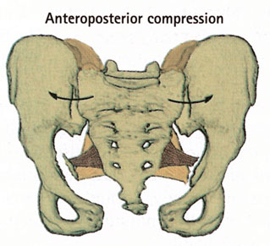
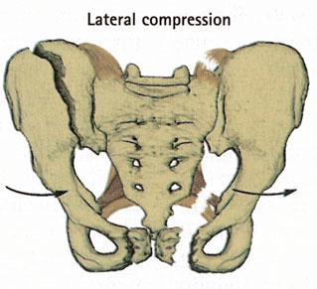
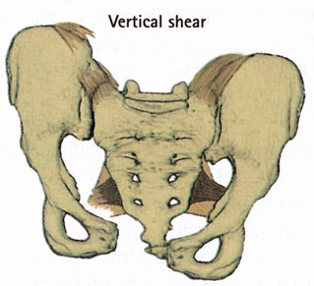
Fractures of Pelvic Ring
In adults, one break in the ring is accompanied by another break in the ring
Three mechanisms:
AP compression Lateral compression Vertical shear
Appley’s System of Orthop and Fr

Slide 28
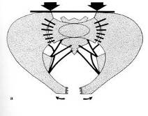

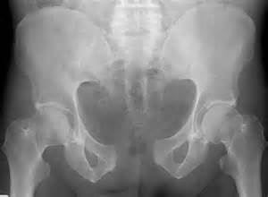
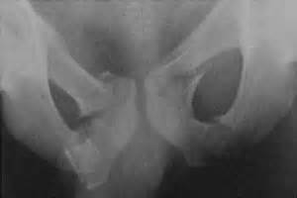
A-P Compression
Frontal collision of car-pedestrian
  Pubic rami fractured or
  Disruption of symphysis pubis
    Open-book (stable if <2cm)
http://www.bing.com/
http://gentili.net/

Slide 29
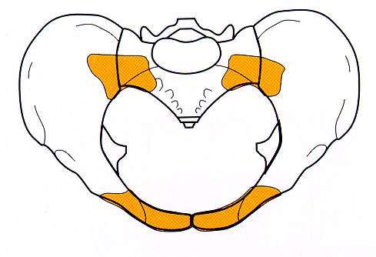
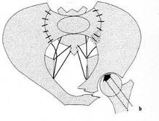
Lateral Compression
Mechanism:
  Side-on impact in RTA / fall from height
Anteriorly:
  Fractured pubic rami
Posteriorly:
  Sacroiliac strain / fractured ilium & sacrum
  Unstable if severely displaced

Slide 30
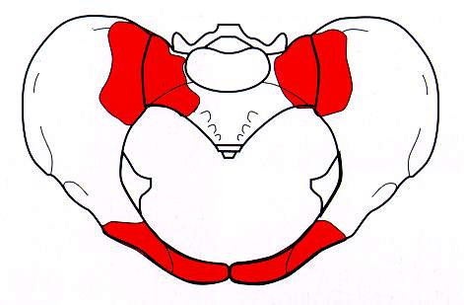
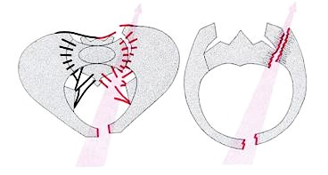
Vertical Shear
Mechanism:
  Fall from height on one leg
Innominate bone displaced superiorly on one side
  Fracture of pubic bones
  Disrupted sacroiliac joint on the same side
  Sever, unstable, soft tissue damage, bleeding

Slide 31
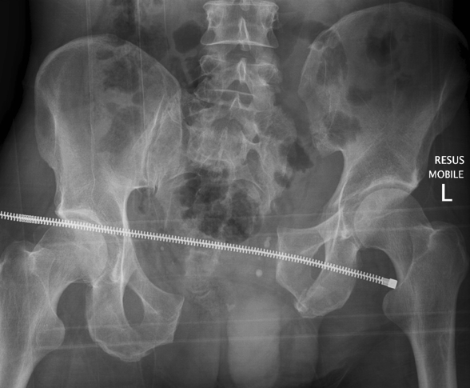
Vertical Shear
Mechanism:
  Fall from height on one leg
Innominate bone displaced superiorly on one side
  Fracture of pubic bones
  Disrupted sacroiliac joint on the same side
  Sever, unstable, soft tissue damage, bleeding
http://cdn.lifeinthefastlane.com/

Slide 32
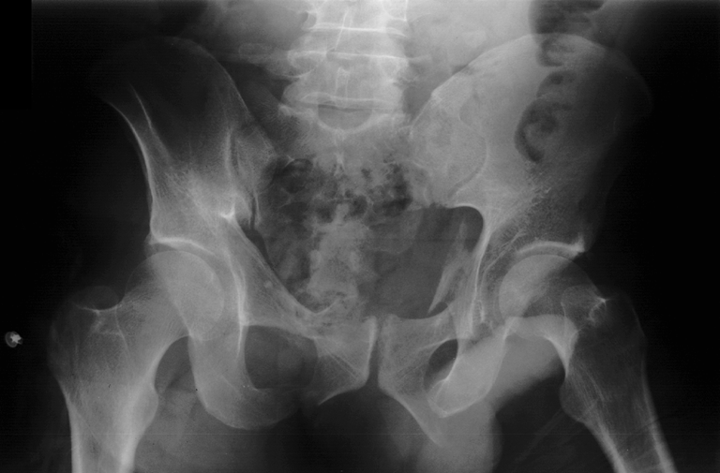
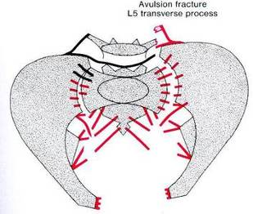
Vertical Shear
Red Flag

Slide 33
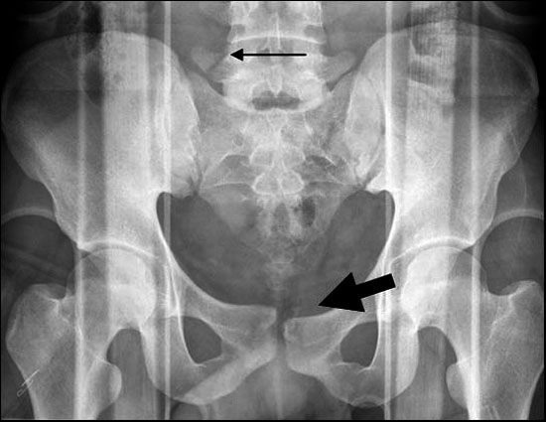
Vertical Shear
Red Flag
radiology.casereports.net

Slide 34



Operative treatment options
External fixation
  Or Temporary clamp

Slide 35

Operative treatment options
External fixation
Internal fixation
  Screws & Plates

Slide 36

Operative treatment options
External fixation
Internal fixation
  Screws &Plates
Combinations

Slide 37

Conclusions
Pelvic Fractures – Emergency management
  More than just a bony injury
  Suspect high energy trauma
  First, save patient’s life
  If unstable: Stabilization of paramount importance
  Many might be treated nonoperatively

