Slide 1

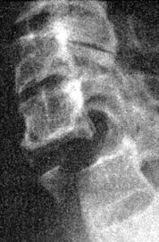
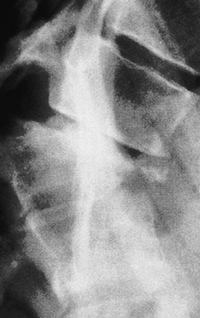
Common Adult Injuries
Spine
Prof. Mamoun Kremli

Slide 2
Objectives
Revision of Anatomy
Principles of spine injury
Differentiation between:
  Stable &Unstable injuries
Common injuries of :
  Cervical – Thoracic – Lumbar
treatment

Slide 3
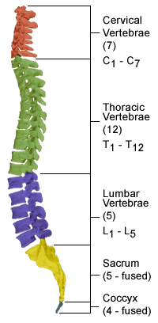
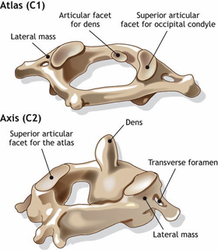
Basic Anatomy
http://www.ivanchengmd.com/
http://morphopedics.wikidot.com/

Slide 4
Thoracic
Lower not protected by ribs / more mobile
ViewMedica

Slide 5
Lumber
Main weight-bearing – very mobile
ViewMedica

Slide 6
Basic Anatomy
Spinal cord in spinal canal – spinal roots
ViewMedica

Slide 7
Basic Anatomy
Superior facet
Inferior facet
ViewMedica

Slide 8
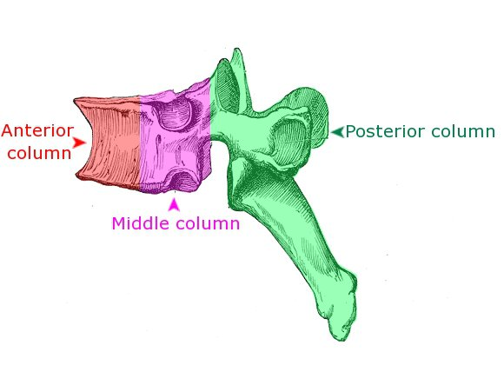
Structural Elements
Posterior column:
  Pedicles, Facet joints, Posterior bony arch, Interspinous and Supraspinous ligaments
Middle column:
  Posterior ½ of vertebral body, Posterior part of IV disc, Posterior longitudinal ligament
Anterior column:
  Anterior ½ of vertebral body, Anterior part of IV disc, Anterior longitudinal ligament
Apley’s System

Slide 9
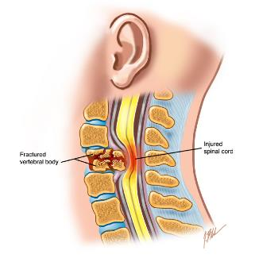
Types of Spine Injuries
Double threat:
  Damage to vertebral column & to neural tissue
    Stable: (90%)
      Less risk of displacement
      Little risk of neural elements damaged If it initially undamaged
    Unstable:(10%)
Unstable if:
  Fracture of middle column + one more column
  Risk of displacement / further damage to neural tissue
http://www.backpain-guide.com

Slide 10
Mechanism of Injury
Direct:
  Penetrating injuries: firearms & knives
Indirect: (common)
  Traction: avulsion fractures
  Falls & violent free movements
    axial /lateral Compression
    Flexion / Extension
    Rotation
    Shear
Apley’s System of Orthopedics and Fractures

Slide 11
Suspicion of Spinal Injury
  Head injury
  Loss of consciousness
  Severe facial injuries
  Blunt injury above clavicle
  Pain /stiffness in neck/back
  Fall from height
  Crushing accident
  High-speed deceleration
  Neurological symptoms in limbs
  Rib fractures or seat belt bruising
  Severe abdominal/pelvic and injuries
Cervical spine
Thoracolumbar spine

Slide 12
Principles of Management
Diagnosis and management go hand in hand
Follow ATLS protocol: ABC
Inappropriate movement & examination worsen the injury
Must immobilize the spine If any suspicion of spinal injury

Slide 13
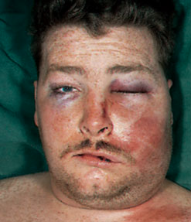
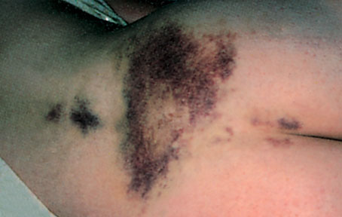
Examination
Look:
  General, attitude, bruises on head ,face, back
Feel
  Tenderness, swelling
Do NOT Move
Apley’s System of Orthop and Fr
Apley’s System of Orthopedics and Fractures

Slide 14
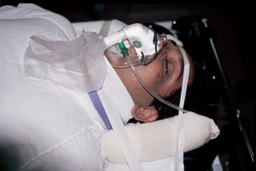
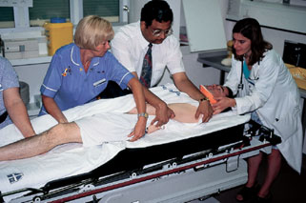
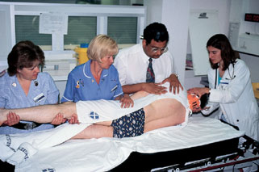
Examination
Protect spine
Log-roll patient to see back
Apley’s System of Orthop and Fr
Apley’s System of Orthopedics and Fractures

Slide 15
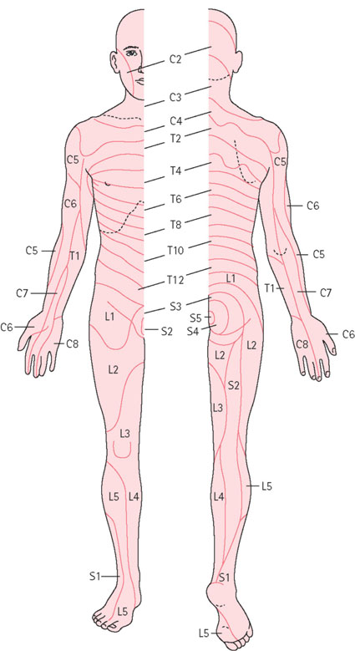
Neurological Examination
Full neurological examination is a must
  Dermatomes
  Myotomes
  Reflexes
To be repeated over days
Apley’s System of Orthop and Fr

Slide 16
Imaging
C- Spine:
  AP – Lateral – Open-mouth
T and L- Spine:
  AP – Lateral
Plain X-rays alone insufficient to show the true picture
CT for difficult areas (upper/lower C, upper T)
  Shows structural damage of vertebrae and vertebral fragments into the canal
MRI the best to show:
  IV disc, Ligamentum flavum, Neural structures

Slide 17
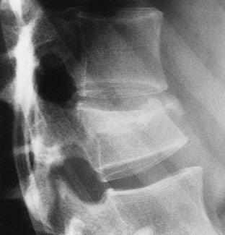
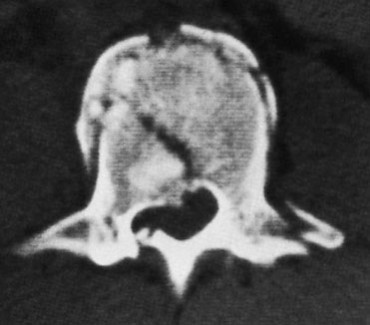
Imaging
Plain X-rays alone may be insufficient to show the true picture
CT Scan
Apley’s System of Orthopedics and Fractures

Slide 18
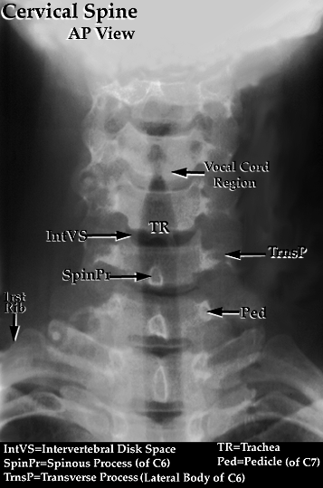
X-rays for C- Spine Injuries
AP:
  Intact lateral outline
  Spinous processes & Trachea in the middle
http://radiology-anatomy.blogspot.com/

Slide 19
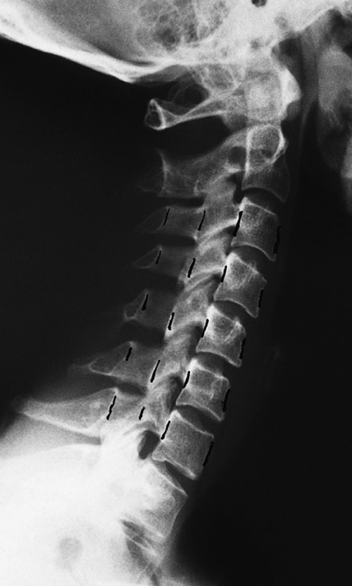
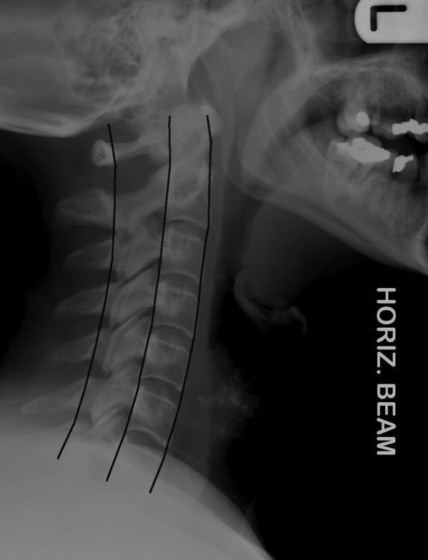
X-rays for C- Spine Injuries
Lateral:
  All C- vertebrae & upper T1
  Prevertebral soft tissue width
  Four parallel curves
    Front of vertebral bodies
    Back of vertebral bodies
    Posterior borders of lateral masses
    Bases of spinous processes
Apley’s System of Orthop and Fr
http://www.imageinterpretation.co.uk/

Slide 20
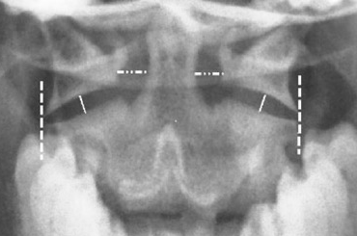
X-rays for C- Spine Injuries
Open-mouth view
For C1 and C2
  Odontoid fractures
  Lateral mass fractures
Look for:
  Symmetry
  Continuity of bone
http://nypemergency.org/

Slide 21
Treatment
Factors:
  Stable / Unstable
  With / without neurological injury
Objectives of Treatment:
  Preserve neurological function
  Relieve reversible neural compression
  Restore alignment of spine
  Stabilize the spine
  Rehabilitate the patient

Slide 22
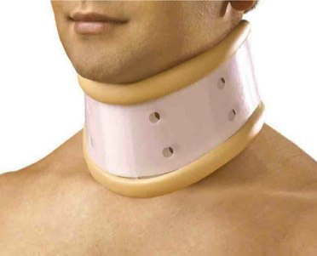
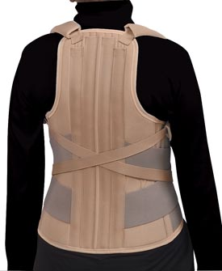
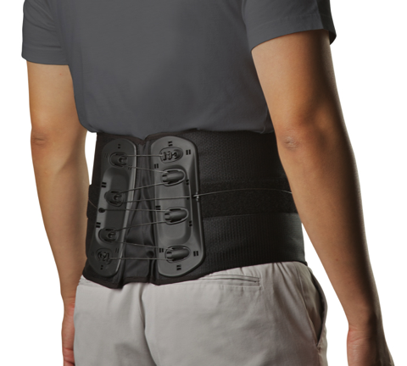
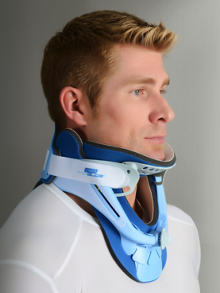
Treatment
Stable Without Neurological Injury:
  Conservative (support by orthotics ,rest)

Slide 23
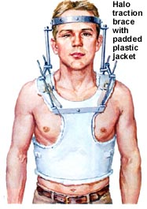
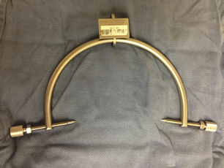
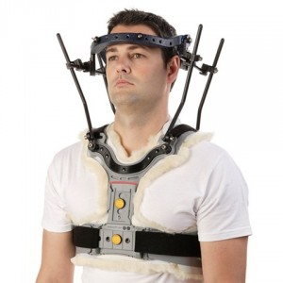
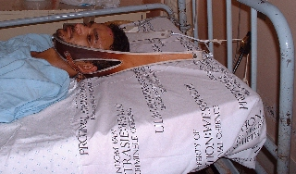
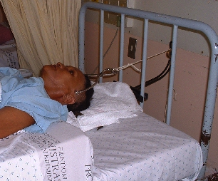
Treatment
Unstable With/out Neurological Injury:
  Secure stabilization:
    Skin / Skeletal Traction
    Surgery +/-Decompression
http://reviews.jbjs.org/
Halo-Vest
http://thenerdynurse.com/
http://www0.sun.ac.za/
http://www.spineuniverse.com/

Slide 24
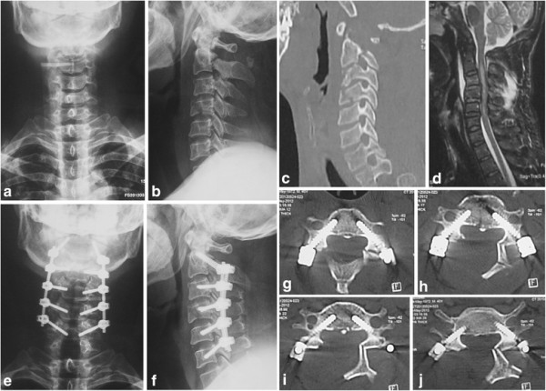
Treatment
Unstable With/out Neurological Injury:
  Secure stabilization:
    Skin / Skeletal Traction
    Surgery +/-Decompression
www.researchgate.net/publication/264990343_S

Slide 25
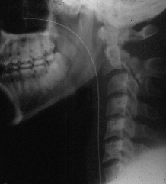
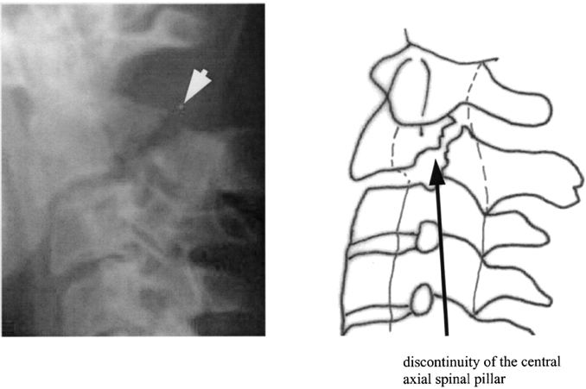
Fractures of C2- Pedicle (Hangman’s)
  hyperextension/distraction injury
  In MVA when forehead strikes dashboard
  Unstable
  May cause death (why?)
www.nature.com
www.med.wayne.edu

Slide 26
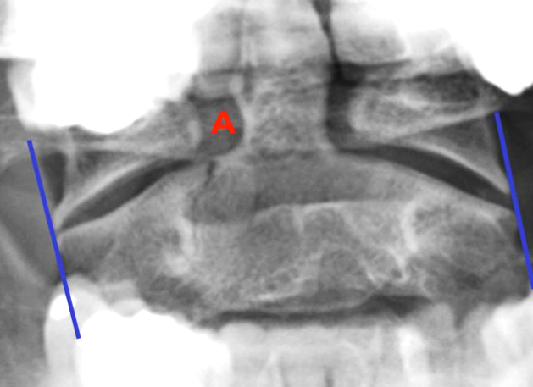
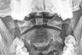
Fractures of C2-Odontoid
Identified easily by
  Open mouth view
  CT scan
www./ortho-teaching.feinberg.northwestern.edu/
http://www.casereports.in/articles/6/3/Anterior-Odontoid-Screw-Fixation-for-Type-II-Odontoid-Fracture.html

Slide 27
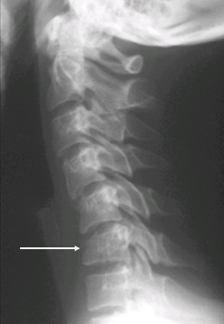
Cervical Wedge-Compression Fracture
Pure flexion injury
Mid- & lower cervical
Stable if only anterior column affected
reference.medscape.com

Slide 28
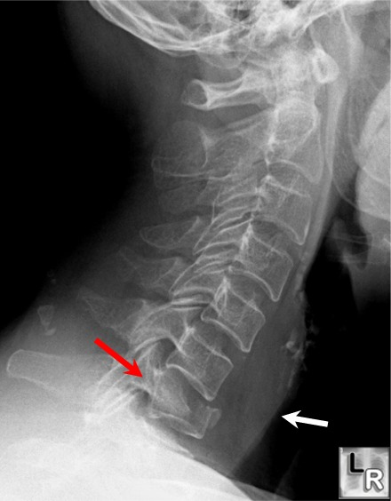
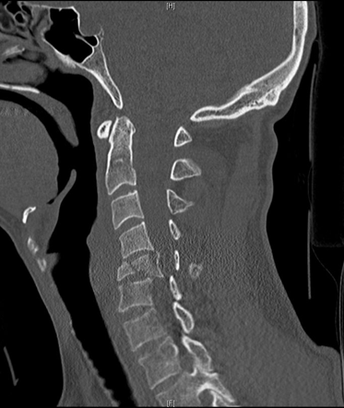
Cervical Burst Fracture
Axial compression
Diving
Unstable
  Neurological injury
http://radiopaedia.org/
http://www.learningradiology.com/

Slide 29
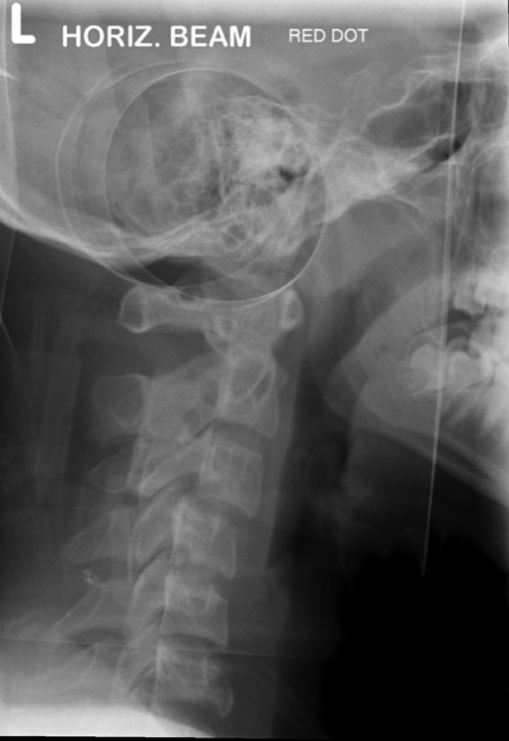
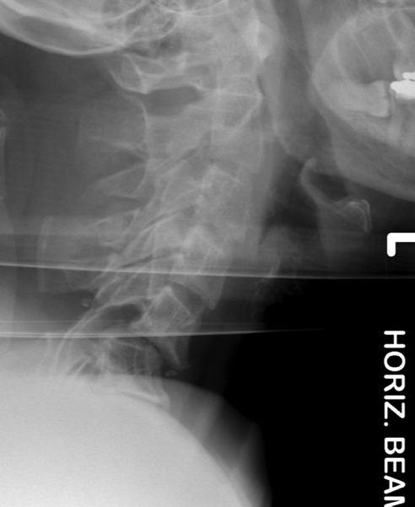
Fracture-Dislocation
Flexion-Rotation
  Articular facets ride forwards over facets below
  Usually with fracture of articular mass
    Unilateral facet: stable
      Displacement <25% of vertebral body width
    Bilateral facet: Unstable
      Displacement >25% of vertebral body width
http://www.imageinterpretation.co.uk/
http://www.imageinterpretation.co.uk/

Slide 30
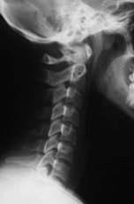
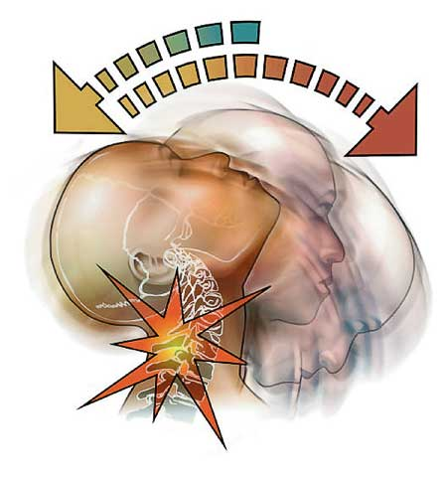
Sprained Neck (Whiplash inj.)
Soft tissue sprain only - stable
RTA: Rear-end collision:
  Body thrown forwards, neck jerked backwards
  Pain/stiffness over 48 hours
Treatment:
  Pain relief
  C-Collar
  Physiotherapy
http://drcaram.files.wordpress.com/

Slide 31
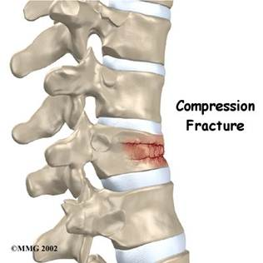
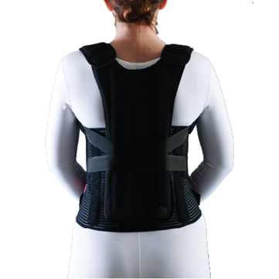
Thoracic Spine Injuries
Wedge compression
  Common in osteoporotic spine
    Mild trauma to old lady
  Usually stable
  Causes ↑kyphosis
Sever injuries in young
  More in T11, T12 (not protected)
  May cause neurological injury
Upper T-spine:
  Lateral not clear
  need CT
http://www.braceshop.com/

Slide 32
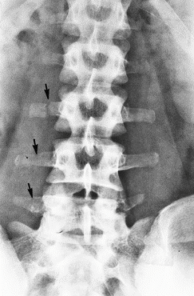
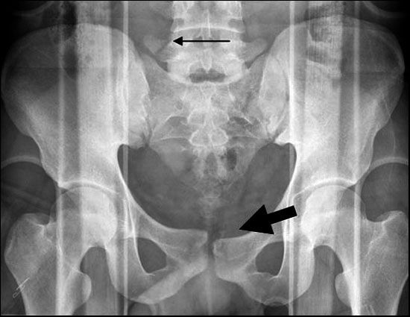
Transverse Processes Fracture
Avulsion fracture of Transverse Processes
  Isolated, stable
  Supportive treatment
Fracture of L5 transverse process (Red flag)
  Might indicate a shear injury of pelvis
www.msdlatinamerica.com
radiology.casereports.net

Slide 33
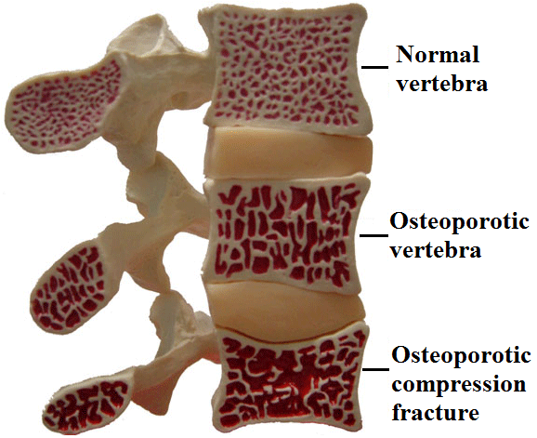
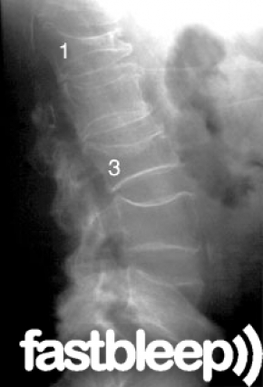
Wedge Compression L-Spine
The commonest vertebral injury
  Minor trauma in osteoporotic people
http://www.neuros.net/

Slide 34
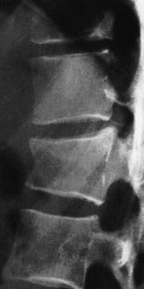
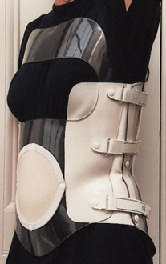
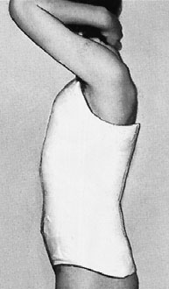
Wedge Compression L-Spine
  Stable (posterior elements intact)
    Anterior vertebral body height reduced by <50%
Apley’s System of Orthop and Fr
Apley’s System of Orthop and Fr

Slide 35
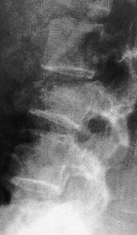
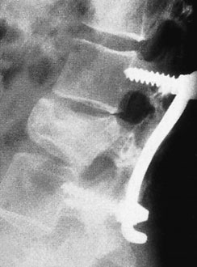
Wedge Compression L-Spine
  Unstable (posterior elements injured)
    Anterior vertebral body height reduced by >50%
Apley’s System of Orthop and Fr

Slide 36




Burst Injury L-Spine
Axial compression: shattered vertebral body
Posterior fragments into spinal canal
Usually unstable
CT
www.doereport.com

Slide 37

Burst Injury L-Spine
Is this a compression or a burst fracture?
    A burst fracture
  Why?
    Posterior displacement
http://studydroid.com/

Slide 38

Neurological Injuries
Traumatic Quadriplegia / Paraplegia:
  Burst fractures or Fracture-Dislocation of
  C-spine and T-L spine
Complete transection of spinal cord:
  Initial spinal shock:
    Complete paralysis and anesthesia with loss of anal reflex
    If anal reflex returns and neural deficit persists – should assume complete cord transection
    Gradually: UMNL

Slide 39
Summary
Vertebral injuries are common
Stable VS. Unstable
  Which column(s) are injured
Forces:
  Axial compression, flexion, shear, combinations
Imaging:
    X-rays: AP, Lateral, Special views
Always assess neurological status

