Slide 1

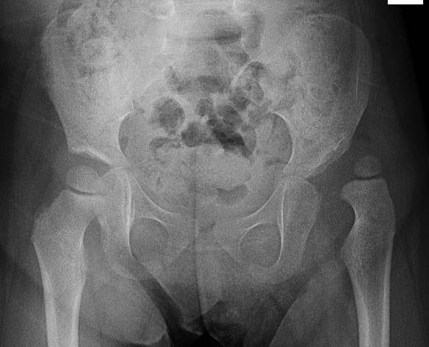
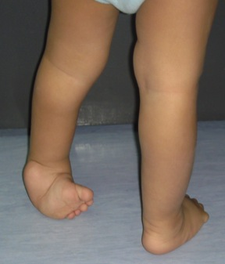
Common Congenital Lower Limb Problems
CDH - CTEV
Prof. Mamoun Kremli
Dr. Tarif Alakhras

Slide 2

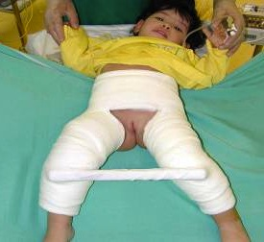
Congenital Dislocation of the Hips
CDH
Prof. Mamoun Kremli
Dr. Tarif Alakhras

Slide 3
Nomenclature
CDH: Congenital Dislocation of the Hip
DDH: Developmental Dysplasia of the Hip
CHD: (Congenital Heart Disease)!
X

Slide 4
Spectrum of Diseases
Different etiologies, pathologies, and natural history
Affects proximal femur and acetabulum
Initial pathology is congenital, but
  Progresses if untreated
Does not always result in dislocation

Slide 5
CDH - Spectrum
Teratologic hip:
  Fixed dislocation at birth, often with other major anomalies
Dislocated hip:
  May or may not be reducible
Unstable hip:
  Dislocatable - Reducible
Acetabular dysplasia:
  Shallow acetabulum

Slide 6
Incidence
Hip instability at birth: 0.5 – 1 %
Classic CDH: 0.1%
Mild dysplasia: Substantial
  Up to 50%of hip arthritis in ladies have underlying hip dysplasia

Slide 7
Incidence
Differs in different parts of the world
Area | Incidence per 1000
Canadian Indians | 188.5
Hungary | 28.7
Uppsala, Sweden | 20
USA: Caucaseans Blacks | 15.5 4.9
Malmo, Sweden | 2.18
Chinese, Hong Kong | 0.1
Bantus, Africa | 0.0

Slide 8
Etiology
Multi-factorial

Slide 9
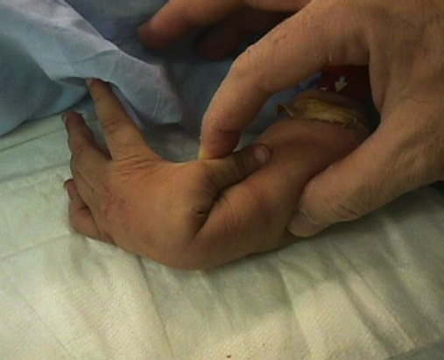
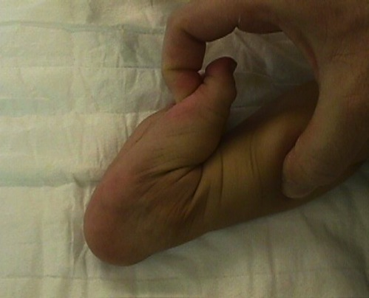
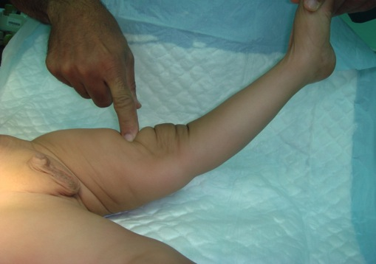
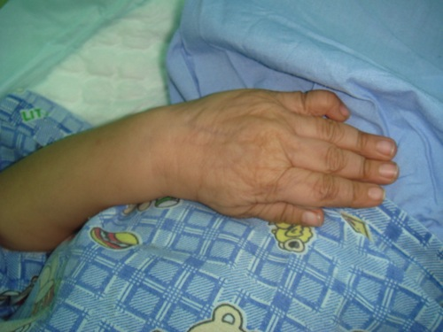
Etiology
Ligament laxity
  Hormonal:
    Estrogen, Relaxin: by mothers
    May affect baby girls more – receptors?
  Familial (congenital):
    Mild – Moderate – Sever – Ehler Danlos syndrome

Slide 10
Etiology
Genetic factors
  Females: 4-6 X more than males
  Twin studies:
    If one twin has DDH, the incidence of DDH in the second twin is:
      Monozygotic: 38%
      Dizygotic: 3% (similar to other siblings)

Slide 11
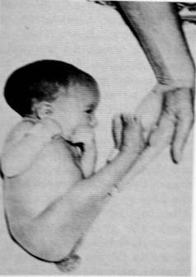
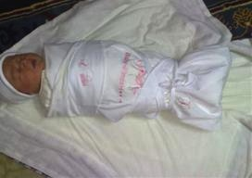
Etiology
Mechanical factors
  Prenatal::
    Breach position:
      Normally: 2-4%, In CDH: 16%
    Oligohydramnious – Primigravida
    Torticollis – metatarsus adductus
  Postnatal:
    Swaddling / strapping hips adducted and extended, and knees extended

Slide 12
Infants at risk
Positive family history: 10X
A baby girl: 4-6 X
Breach presentation: 5-10 X
Torticollis: CDH in 10-20% of cases
Foot deformities:
  Calcaneo-valgus and metatarsus adductus
Knee deformities:
  Hyperextension and dislocation (Teratologic)

Slide 13
Infants at risk
When risk factors are present
  The infant should be examined repeatedly
  The hips should be imaged: (U/S or X-ray)

Slide 14
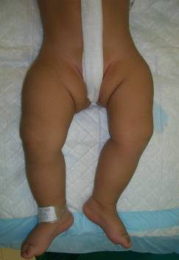
Clinical Examination
Look:
  Externally rotated hip

Slide 15
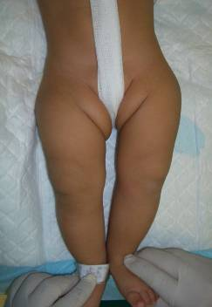
Clinical Examination
Look:
  Externally rotated hip
  Lateralized contour
  Wide perineum
    In bilateral

Slide 16
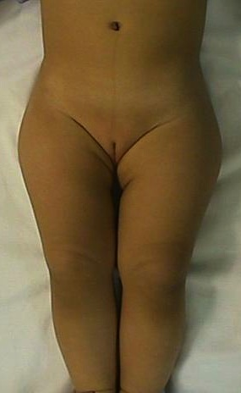
Clinical Examination
Look:
  Externally rotated hip
  Lateralized contour
  Wide perineum
    In bilateral
  Asymmetrical folds
    Anterior - Posterior

Slide 17
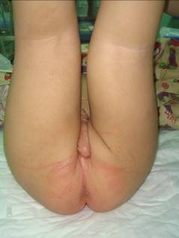
Clinical Examination
Look:
  Externally rotated hip
  Lateralized contour
  Wide perineum
    In bilateral
  Asymmetrical folds
    Anterior - Posterior

Slide 18
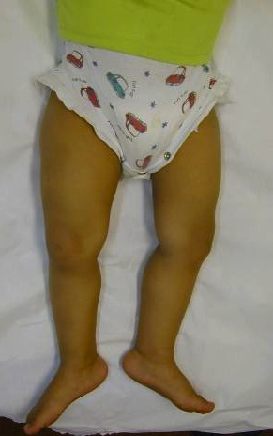
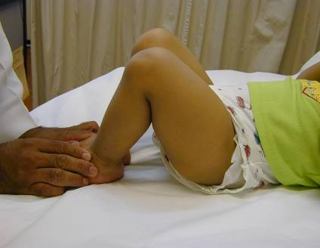
Clinical Examination
Look:
  Shortening
    Supine
    Galeazzi

Slide 19
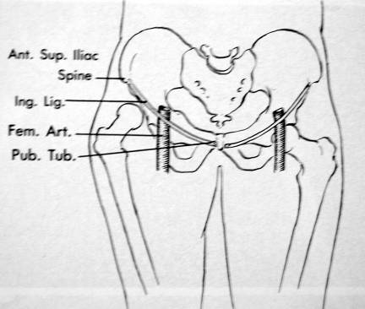
Clinical Examination
Feel:
  Empty groin
  Weak femoral pulse

Slide 20
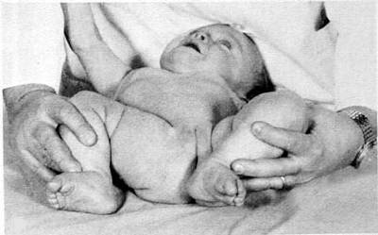
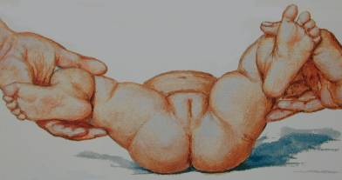
Clinical Examination
Move:
  Limitation of abduction in flexion
    Careful in bilateral
      Symmetrical limitation
      If abduction < 600 bilaterally: abnormal

Slide 21
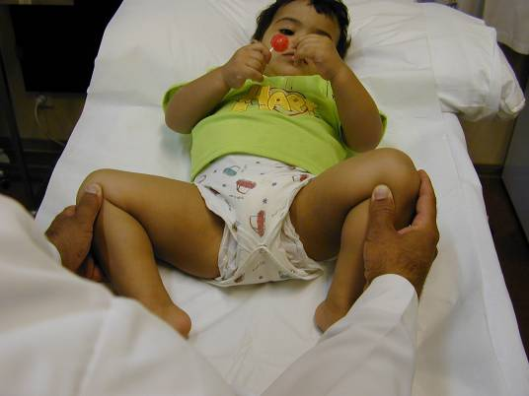
Clinical Examination
The importance of a lollipop
Galeazzi / Limited abduction in flexion

Slide 22
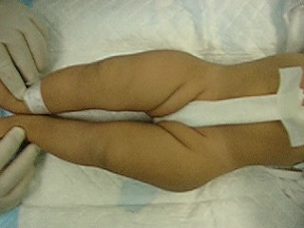
Clinical Examination
Galeazzi / Limited abduction in flexion

Slide 23
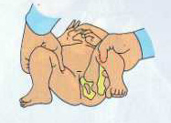
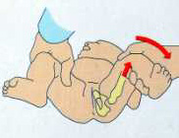
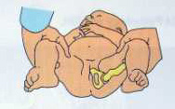
Neonatal Examination for CDH
Ortolani Test: (reduces a dislocated hip)
Feel a clunk
Not hear a click !

Slide 24
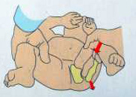
Neonatal Examination for CDH
Barlow Test: (dislocated a reduced hip)!
Feel a clunk
Not hear a click !

Slide 25
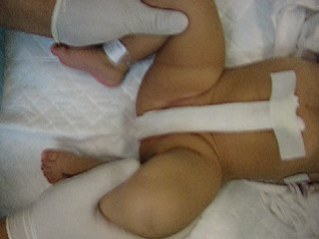
Clinical Examination
Ortolani / Barlow

Slide 26
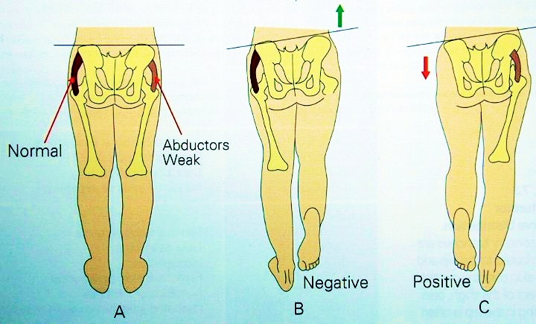
Clinical Examination
Trendelenburg Sign
  Unilateral: Trendelenburg gait
  Bilateral : Waddling gait

Slide 27
Clinical Examination
Neonatal:
  Limited abduction, Ortolani/Barlow
Toddler:
  Shortening, limited abduction
Walker:
  Shortening, limited abduction, Trendelenburg

Slide 28
Imaging - Ultrasound
In early infancy U/S more reliable than x-ray
  Good in expert hands
  Incidence of hip stability declines rapidly to 50% within the first week of neonatal life
    Better to delay U/S after 2 weeks

Slide 29
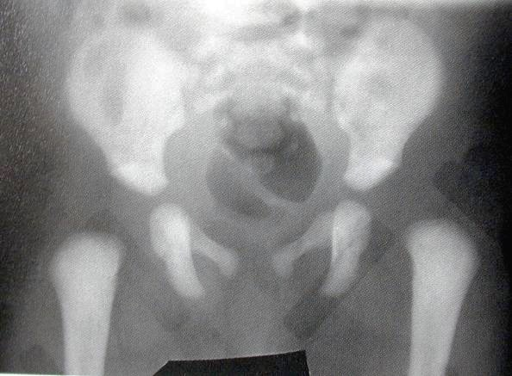
Radiology
Early infancy: not reliable - U/S better

Slide 30
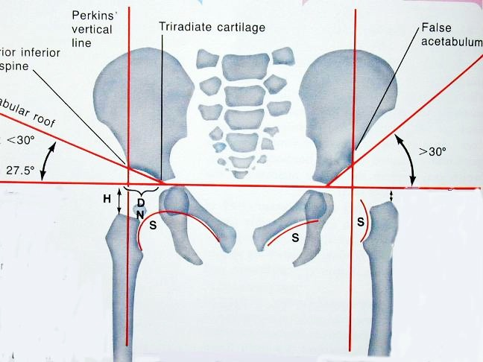
Radiology
After 3 months: more reliable

Slide 31
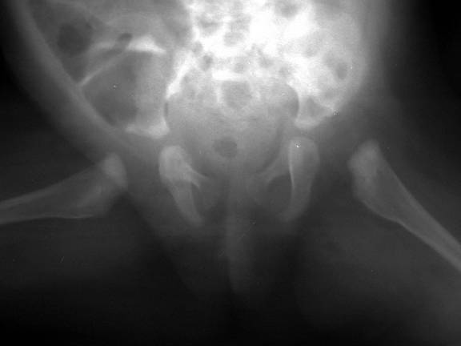
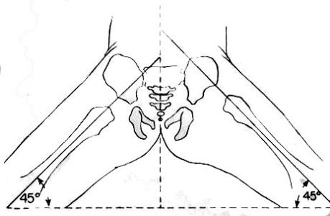
Radiology
After 3 months: more reliable
AP abduction view
  Long axis of femur normally passes through acetabulum
in
out
in
out
in
out
in
out

Slide 32
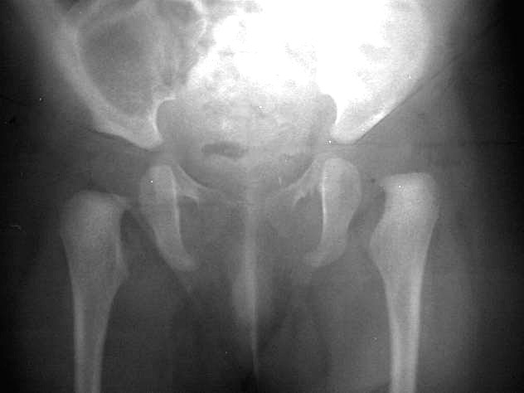
Radiology
After 3 months: more reliable
27º
39º

Slide 33
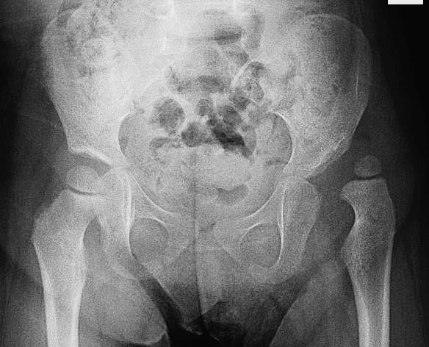
Radiology
After 6 months: clearly shows dislocation

Slide 34
Radiology
After 6 months: clearly shows dislocation
  Size of femoral head ossific center
Smaller on the dislocated side – if unilateral
Not valid in bilateral dislocation

Slide 35
Radiology
After 6 months: clearly shows dislocation
  Horizontal line through the tri-radiate cartilage
Look at position of the femoral head ossific center
Dislocated:
Above the horizontal line
Normal:
Below the horizontal line

Slide 36
Radiology
After 6 months: clearly shows dislocation
  Perpendicular line from edge of acetabulum
Look at position of the femoral head ossific center
Dislocated:
Lateral to perpendicular line
Normal:
Medial to perpendicular line

Slide 37
Radiology
After 6 months: clearly shows dislocation
  Acetabular angle from edge to base at horizontal line
Measure the acetabular index (angle)
20⁰
45⁰
Normal: ≤ 25⁰
Dislocated: > 35⁰

Slide 38
Radiology
After 6 months: clearly shows dislocation
  Shenton’s line
medial side of femoral neck &
inferior border of superior pubic ramus

Slide 39
Treatment - Aims
Obtain concentric reduction
In a non-traumatic fashion
  Without disrupting the blood supply to femoral head

Slide 40
Treatment
Method depends on age
The earlier started, the easier it is
The earlier started, the better the results are
Should be detected EARLY

Slide 41
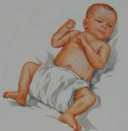
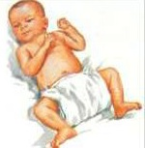
Treatment: Neonatal hip instability
Most resolve spontaneously
Can initially wait
  Avoid adduction swaddle
  Apply double diapers – to bring back!!
  See at 2 weeks of age

Slide 42
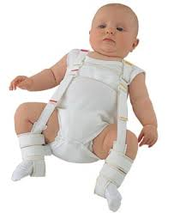
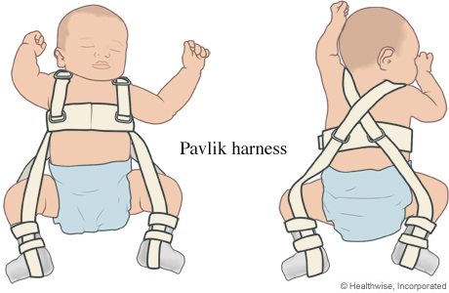
Treatment: Neonatal hip instability
Unstable at 2 weeks:
Pavlik Harness
  Dynamic, effective, safe
www.webmd.com

Slide 43

Treatment
At 6-12 months of age:
  Possibly closed reduction & hip spica cast
  Possibly open reduction (Surgery) & hip spica cast
  Arthrography-guided

Slide 44
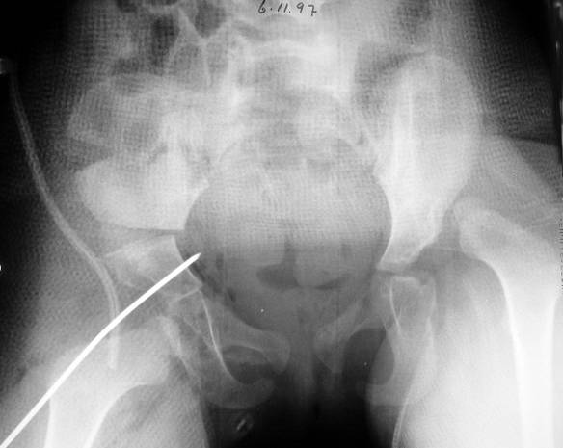
Treatment
At 18-24 m of age: Surgery
  Open reduction & possibly Acetabuloplasty

Slide 45
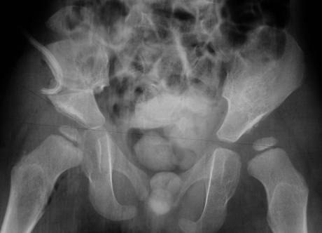
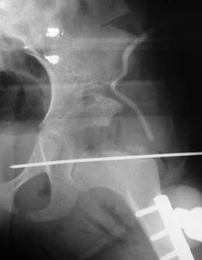
Treatment
Above 2y of age: Surgery
  Open reduction & Acetabuloplasty &Femoral shortening

Slide 46
Treatment
Birth – 6m
  Pavlik harness or hip spica
6-12 m:
  Closed reduction under GA and hip spica
12 - 18 m:
  Open reduction
18 – 24 m:
  Open reduction and Acetabuloplasty
2-8 years:
  Open reduction, Acetabuloplasty, and femoral shortening
Above 8 years:
  Open reduction, Acetabuloplasty cutting all three pelvic bones, and femoral shortening

Slide 47
CDH - Summary
Complex multi-factorial, endemic disease
Identify at risk groups
Learning proper examination methods
The earlier we treat the easier it is
The earlier we treat the better the results

Slide 48
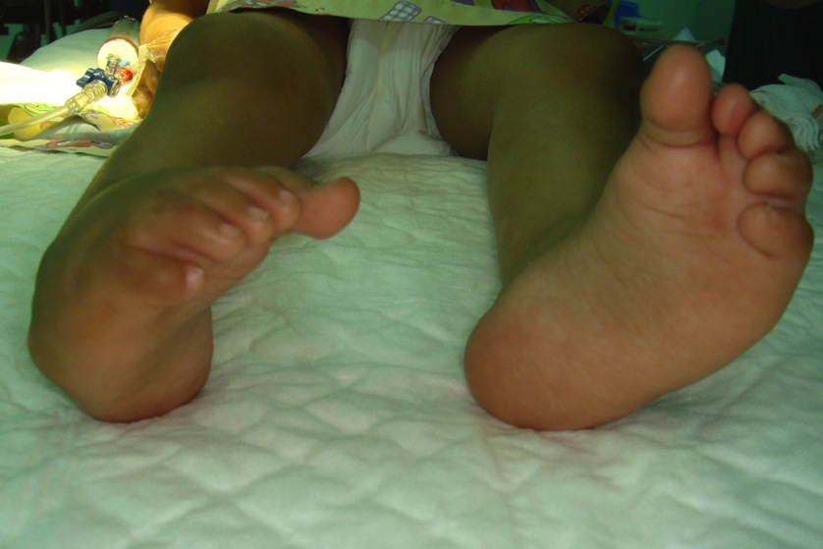
Club Foot
CTEV
Prof. Mamoun Kremli
Dr. Tarif Alakhras

Slide 49
Outline
Clubfoot
  Types
  Causes
  Management
  Case example
Mamoun Kremli

Slide 50
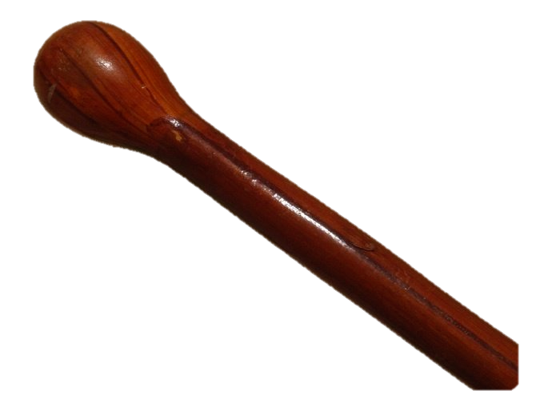
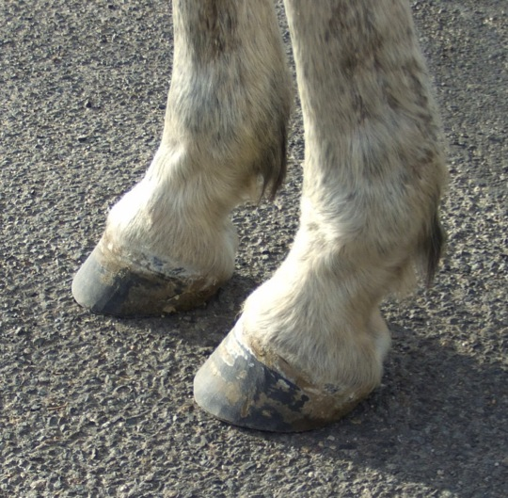
Clubfoot (Talipes Equinovarus)
Nomenclature:
  Clubfoot: foot shaped like a club
  Talipes: Latin: talus (ankle) + Pes: (foot)
  Equino: Equine: horse
    Ankle plantar flexed like foot of horse
  Varus: towards midline
Congenital Talipes Equinovarus (CTEV):
  Ankle and foot directed down and inwards
www.mexat.com
www.theequinest.com

Slide 51
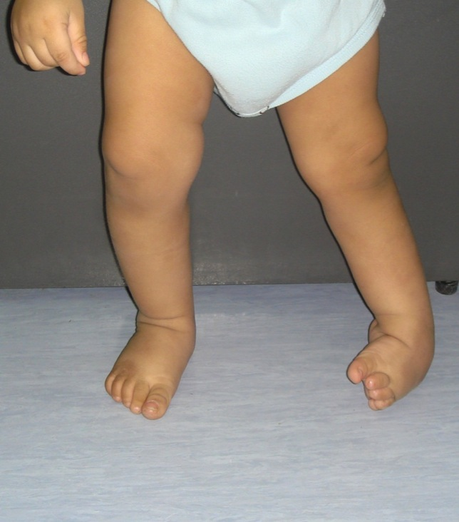
Clinical types
There are two main variations of clubfoot:
Talipes Equinovarus: most common
  The foot and ankle turn downward
  (equinus), and inward (varus)
Talipes Calcaneovalgus:
  The foot and ankle turn upward
  (calcaneous), and outward (valgus)
  Associated with DDH
Mamoun Kremli

Slide 52
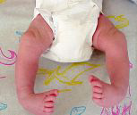
Types of Clubfeet
Idiopathic (Unknown Etiology) :
  Positional
  Congenital Talipes Equino-Varus CTEV
Acquired, Secondary to :
  CNS Disease : Spina bifida, Poliomyelitis
  Arthrogryposis
  Absent Bone : fibula / tibia
http://www.clubfeet.net/

Slide 53
Types of TEV
Positional:
  Held in a deformed position in utero
  Flexible on examination (correctable)
  Needs manipulation – corrects spontanuously
Congenital: (CTEV)
  Multifactorial inheritance, envoirnmental
  Fixed deformity, not flexible (not easily correctable)
  Needs treatment

Slide 54
CTEV
Congenital Talipes Equino Varus typically occurs in an otherwise normal child
  Incidence: 1/1000 live birth
  Positive family history 30X more frequent in offspring
  Males: 65% of cases
  Bilateral: 30–40 %

Slide 55
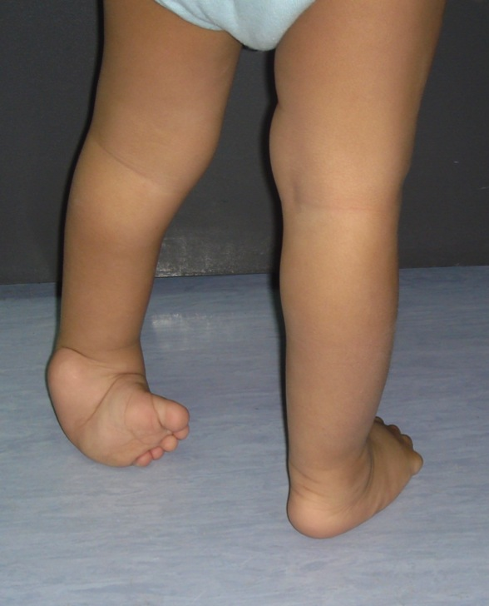
CTEV - deformities
Hindfoot:
  Equinus: plantar flexion of ankle
  Varus: medially tilited subtalar joint
  Empty heel pad
Forefoot:
  Adduction of midtarsal joint
    Transverse medial crease
  Supination
  Cavus
Wasted calf
free-stock-illustration.com
Mamoun Kremli

Slide 56
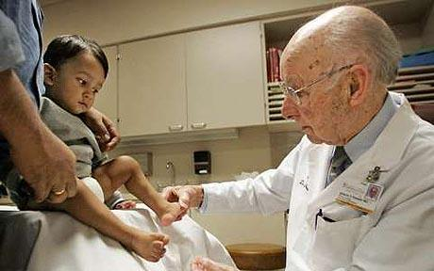
Management of CTEV
The Ponseti technique
Serial manipulation and change of cast
  (every week) – for 4-6 weeks
Followed by tenotomy of Achilles Tendon
  (teno): tendon, (otomy): cutting
www.telegraph.co.uk

Slide 57
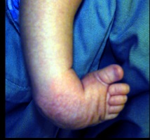
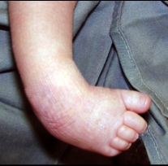
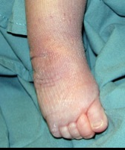
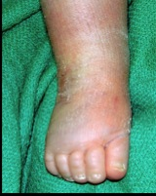






Management of CTEV
Serial manipulation and change of cast
Week 1
Week 2
Week 3
Week 4
Week 5

Slide 58

Serial casting: Ponseti technique
Serial manipulation and change of cast
Tenotomy of Achilles tendon
ispub.com

Slide 59

Serial casting: Ponseti technique
Serial manipulation and change of cast
Tenotomy of Achilles tendon
www.ponseti-gulf.ae

Slide 60

Tenotomy of Achilles Tendon
Complete cut of the Achilles Tendon
With knife, under local anesthesia
Before tenotomy
Local anesthesia
Tenotomy
Full correction

Slide 61

Tenotomy of Achilles Tendon
Complete cut of the Achilles Tendon
With knife, under local anesthesia
orthoinfo.aaos.org

Slide 62


Ponseti method
After casting
still tight Achilles Tendon
Can not dorsiflex ankle
After Tenotomy
Tightness released
Can dorsiflex ankle

Slide 63

Management of CTEV
After tenotomy of Achilles tendon, cast is applied again for 6 wks.
Followed by special splint
  (Dennis-Brown shoes)
    Initially most of the time
    Later at night (for 4yrs)
Long-term follow-up is needed, with possible need for splints or later surgery
quoteimg.com

Slide 64
Management of CTEV
In severe or resistant cases, surgery is performed
  Lengthening of tight tendons
  Correcting joints, and bone

Slide 65


Case example
Mamoun Kremli

Slide 66

Case example
Mamoun Kremli

Slide 67

Case example
Mamoun Kremli

Slide 68

Case example
Mamoun Kremli

Slide 69

Case example
Mamoun Kremli

Slide 70

Case example
Mamoun Kremli

Slide 71




Case example
Mamoun Kremli

Slide 72


Summary
Definition and Types of club feet
Treatment of CTEV
  Positional: manipulation
  CTEV: serial casting & tenotomy
Mamoun Kremli

