Slide 1

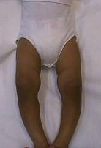
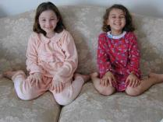
Common Lower Limb Deformities in Children
Prof. Mamoun Kremli
Dr.Tarif Alakhras

Slide 2
Objectives
Angular deformities of LLs
  Bow legs
  Knock knees
Rotational deformities of LLs
  In-toeing
  Ex-toeing
Feet problems

Slide 3
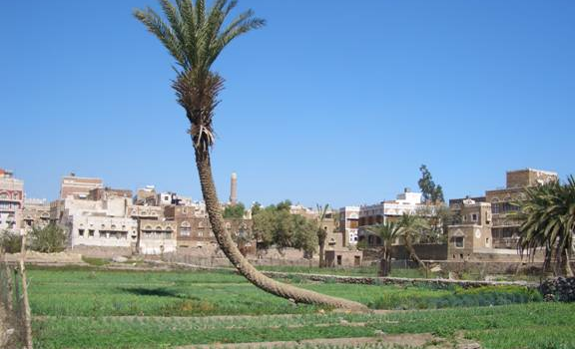
Angular LL Deformities of LL

Slide 4
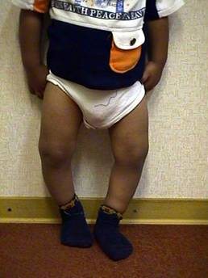
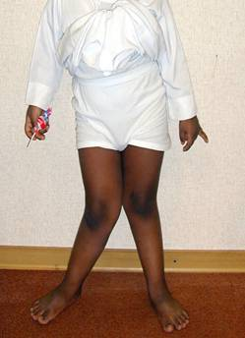
Nomenclature
Bow legs
Knock knees
Genu Varus
Genu Valgus

Slide 5
Normal range varies with age
During first year: Lateral bowing of Tibiae
During second year: Bow legs (knees & tibiae)
Between 3 – 4 years: Knock knees

Slide 6
Evaluation
Should differentiate between
“physiologic” and “pathologic” deformities

Slide 7
Evaluation
Physiologic
Pathologic
Symmetrical
Asymmetrical
Mild – moderate
Severe
Regressive
Progressive
Generalized
Localized
Expected for age
Not expected for age

Slide 8
Causes
Physiologic
Pathologic
Normal for age
Rickets
Exaggerated :
Endocrine disturbance
- Overweight
Metabolic disease
- Early wt. bearing
Injury to Epiphys. Plate
- Infection / Trauma
- Use of walker?
Idiopathic

Slide 9
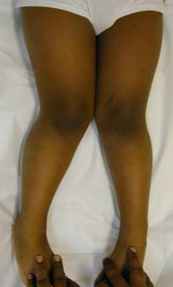
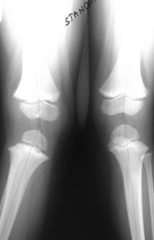
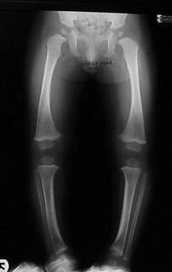
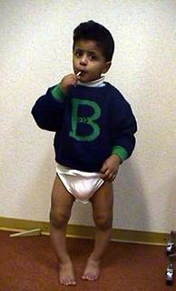
Evaluation
Symmetrical deformity

Slide 10
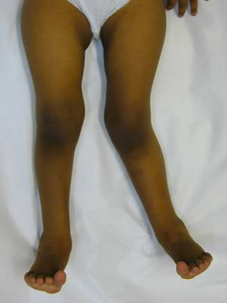
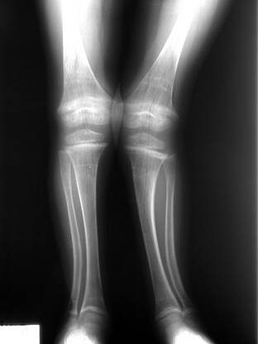
Evaluation
Asymmetrical deformity

Slide 11
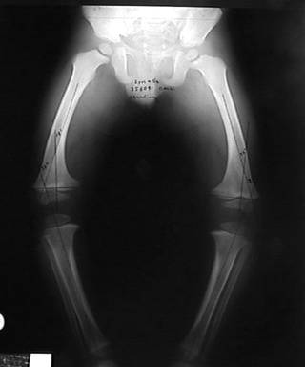
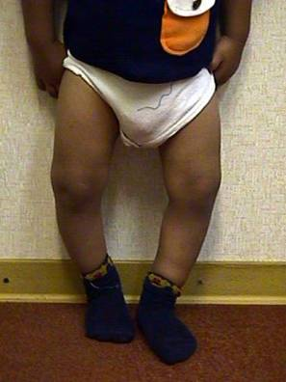
Evaluation
Generalized deformity

Slide 12
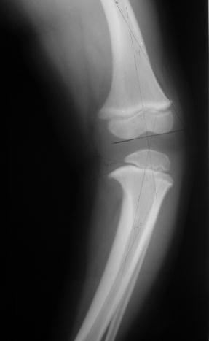
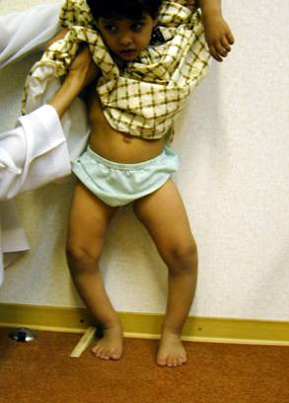
Evaluation
Localized deformity
Blount’s
disease

Slide 13
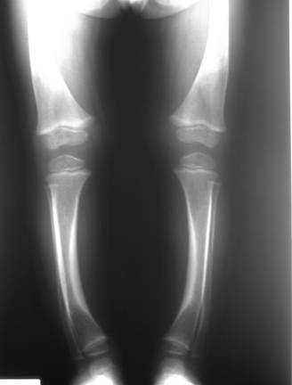
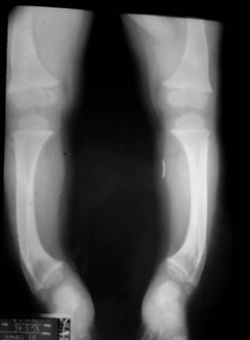
Evaluation
Localized deformity
Rickets
Improves
in time

Slide 14
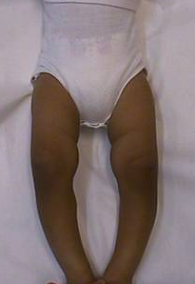
Assess angulation - standing/supine
Bow Legs
(genu varus)
Inter- condylar distance

Slide 15
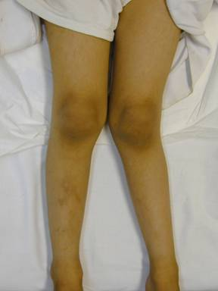
Assess angulation - standing/supine
knock knees
(genu valgus)
Inter- malleolar distance

Slide 16
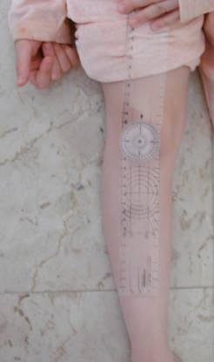
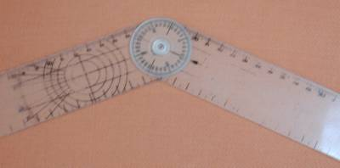
Measure angulation - standing/supine
Use Goniometer
Measures angles directly
More accurate
More appropriate

Slide 17
Investigations / Laboratory
Serum Calcium / Phosphate?
Serum Alkaline Phosphatase
Serum Creatinine / Urea – Renal function

Slide 18
Investigations / Radiological
X-ray when severe or possibly pathologic
Standing AP film:
  long film (hips to ankles) with patellae directed forwards
Look for diseases:
  Rickets / Tibia vara (Blount’s) / Epiphyseal injury..
  Measure angles

Slide 19
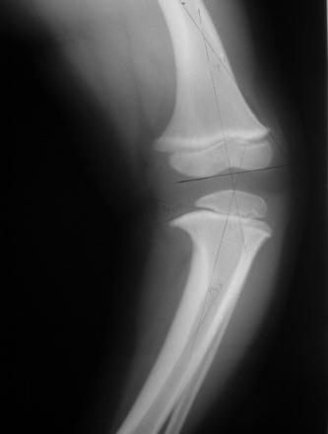
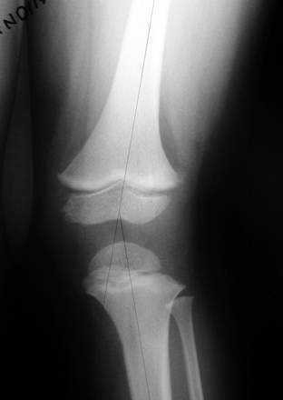
Investigations / Radiological
Medial Physeal Slope
Femoral-Tibial Axis

Slide 20
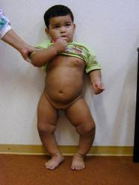
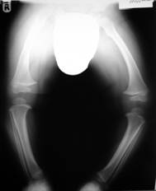
When To Refer ?
Pathologic deformities:
  Asymmetrical
  Localized
  Progressive
  Not expected for age
Exaggerated physiologic deformities
  Definition ?

Slide 21
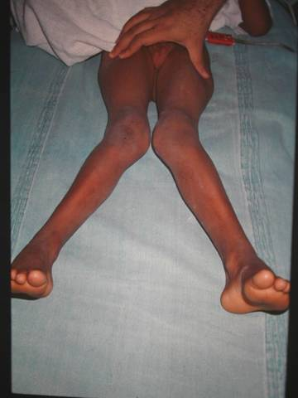
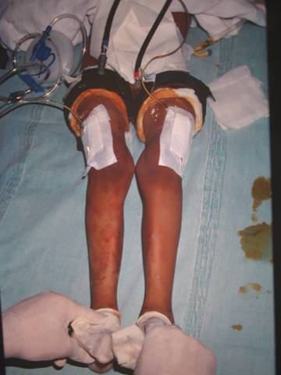
Surgery
Mamoun Kremli

Slide 22
Knock Knees
Rickets in sheep

Slide 23
Rotational LL Deformities
In-toeing / Ex-toeing
Frequently seen
Concerns parents
Frequently prompts varieties of treatment
  often un-necessary / incorrect

Slide 24
Rotational Deformities
Level of affection:
Femur
Tibia
Foot

Slide 25
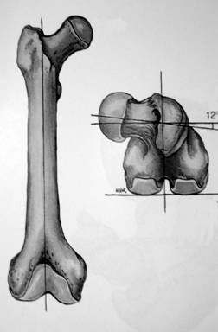
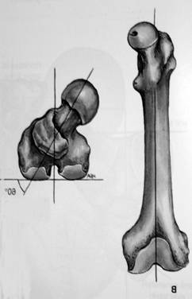
Femur
Ante-version = more medial rotation
Retro-version = more lateral rotation
Normal anteversion
Increased anteversion

Slide 26
Normal Development
Femur: Ante-version:
  30 degrees at birth
  10 degrees at maturity
Tibia: Lateral rotation:
  5 degrees at birth
  15 degrees at maturity

Slide 27
Normal Development
Both Femur and Tibia laterally rotate with growth in children
  Femoral ante-version
  Medial tibial torsion
  Lateral Tibial torsion
Improve (reduce) with growth
Increases (worsens) with growth

Slide 28
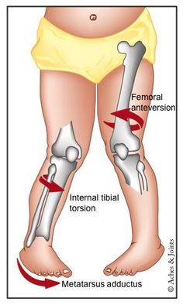
Clinical Examination
Rotational Profile
  How severe is the rotational deformity?
  At which level is the rotational deformity?
Four components:
  Foot propagation angle
  Assess femoral rotational arc
  Assess tibial rotational arc
  Foot assessment

Slide 29
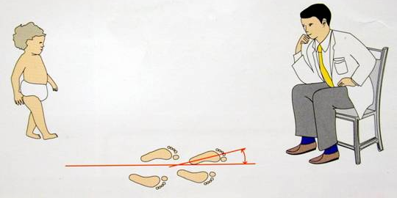
Rotational Profile
Foot propagation angle – Walking
  Normal Range: ( +10º to -10º )
? In Eastern Societies
  Normal range: ( +25º to - 5^{o )}
Fundamentals of Pediatric Orthopedics, L Stahili

Slide 30
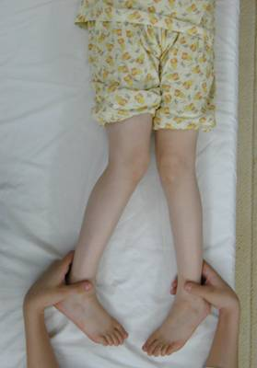
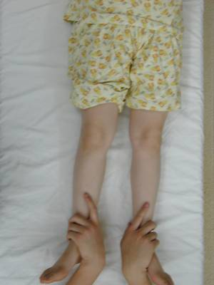
Rotational Profile
Assess femoral rotation arc
Supine
Extended

Slide 31
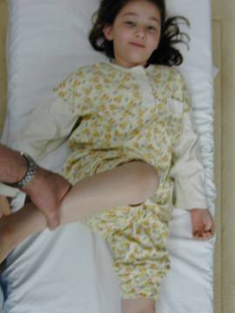
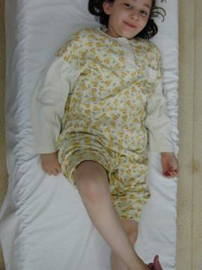
Rotational Profile
Assess femoral rotation arc
Supine
Flexed

Slide 32
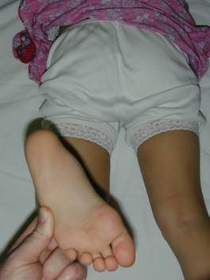
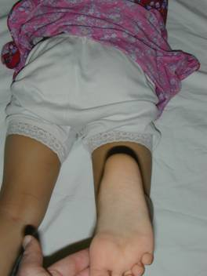
Rotational Profile
Assess tibial rotational arc
  Foot-thigh angle in prone / or: Bimalleolar axis

Slide 33
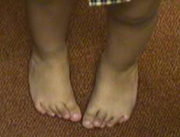
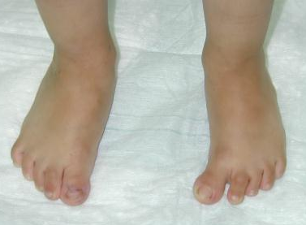
Rotational Profile
Foot assessment
  Metatarsus adductus
  Searching big toe
  Everted / Inverted foot
  Flat foot

Slide 34
Common Presentations
Infants: out-toeing
Toddlers: In-toeing
Early childhood: In-toing
Late childhood: Out-toing

Slide 35
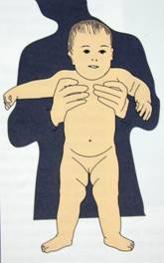
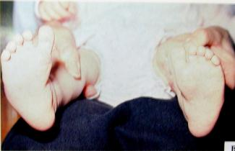
Infants: out-toeing
Normal
seen when infant positioned upright
  (usually hips laterally rotate in-utero)
Metatarsus adductus (intoeing):
  medial deviation of forefoot
  90% resolve spontaneously
  casting if rigid or persists
  late in 1st year
Fundamentals of Pediatric Orthopedics, L Stahili

Slide 36
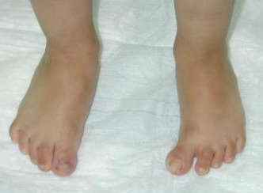
Toddlers: In-toeing
Most common during second year
  (at beginning of walking)
Causes:
  Medial tibial torsion: does not need treatment
  Metatarsus adductus: if sever, casting works
  Abducted great toe: resolves spontaneously

Slide 37
Child
In-toeing: due to medial femoral torsion
Out-toeing: in late childhood
  lateral femoral / tibial torsion

Slide 38
Medial Femoral Torsion
Starts at 3-5 years
Peaks at 4–6 years
Resolves spontaneously by 8-10 years
Girls > boys
Look at relatives - family history – normal
Treatment usually not recommended
If persists > 8-10 years and severe, may need surgery

Slide 39
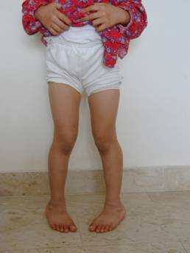
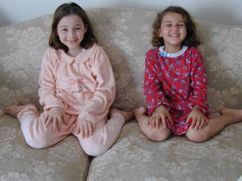
Medial Femoral Torsion (Ante-version)
Stands with knees medially rotated
  (kissing patellae)
Sits in “W” position
Runs awkwardly (egg-beater)
Family History

Slide 40
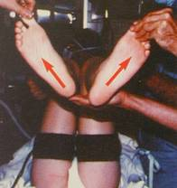
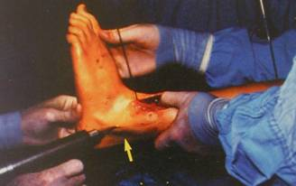
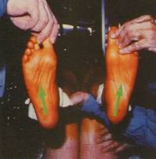
Lateral Tibial Torsion
Usually worsens
May be associated with knee pain (patellar)
  specially if LTT is associated with MFT
  (knee medially rotated and ankle laterally rotated)
Fundamentals of Pediatric Orthopedics, L Stahili

Slide 41
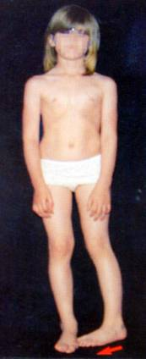
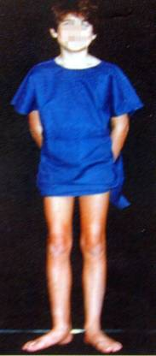
Medial Tibial Torsion
Less common than LTT in older child
May need surgery if :
  persists > 8 year,
  and causes functional disability
Fundamentals of Pediatric Orthopedics, L Stahili

Slide 42
Management of Rotational Deformities
Challenge : dealing effectively with family
In-toeing:
  Spontaneously corrects in vast majority of children as LL externally rotates with growth
  Best Wait !

Slide 43
Management of Rotational Deformities
Convince family that only observation is appropriate
Only < 1 % of femoral & tibial torsional deformities fail to resolve and may require surgery in late childhood

Slide 44
Management of Rotational Deformities
Attempts to control child’s walking, sitting and sleeping positions is impossible and ineffective, cause frustration and conflicts
Shoe wedges and inserts:
  ineffective
Bracing with twisters:
  ineffective - and limits activity
Night splints:
  better tolerated - ? Benefit

Slide 45
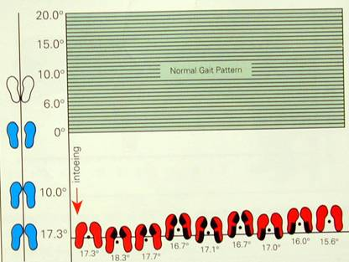


Management of Rotational Deformities
Shoe wedges Ineffective
Twister cables Ineffective
Fundamentals of Pediatric Orthopedics, L Stahili

Slide 46
When To Refer ?
Severe & persistent deformity
Age > 8-10y
Causing a functional disability
Progressive

Slide 47
Summary
Angular deformities are common:
  Genu varus
  Genu valgus
  Differentiate between physiologic and pathologic deformities
Rotational deformities are common
  Part of normal development
  In-toing vs Out-toing
  Cause may be in femur, tibia, or foot
  Most improve with time

