Slide 1

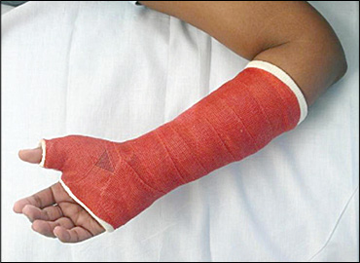
Conservative Treatment of Fractures
Dr. Tarif Alakhras

Slide 2
Objectives
Traction:
Types
Indications / Contraindications
Complications
Casting:
Types
Indications / Contraindications
Complications

Slide 3
Traction
Function
Reduction of fractures
Maintaining fracture reduction
Immobilization of joint
Rest
Pain relief

Slide 4
Traction
Uses pulling force to a part of the body to overcome
Muscle spasm
Shortening
Gravity
Parts used at:
Limbs
Spine
Pelvis

Slide 5
Usage of Traction
Restoring and maintaining bone alignment following fractures
By: Ligamentotaxis / Muscle tightening
Resting inflamed joint and maintaining them in functional position
Relieving pain due to muscle spasm
Gradually correcting deformity due to contracted soft tissue

Slide 6
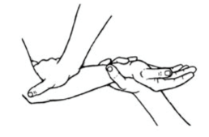
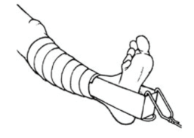
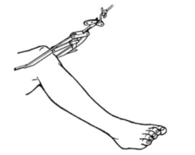
Types of Traction
Manual traction
Skin traction
Skeletal traction
Traction by gravity
zimmer-traction-handbook
msurgery.ie

Slide 7
Manual Traction
Exerted directly when the physician pulls on the part during manipulation to obtain closed reduction of a fracture or dislocation
scientificillustration.tumblr.com

Slide 8
Manual Traction
Exerted directly when the physician pulls on the part during manipulation to obtain closed reduction of a fracture or dislocation
Look up fracture reduction techniques in YouTube
Examples:
https://youtu.be/gQDebkQEmUE
https://youtu.be/cy6f7he2e4w
https://youtu.be/EhJ7kpurKnk
https://youtu.be/oEcWS-YShh0

Slide 9
Skin Traction
Traction is applied on skin
By adhesive or non-adhesive strapping
ascentmeditech.com

Slide 10
Skin Traction
More commonly used in children
Temporary management in adults
Duration limit < 3 weeks
Weight limit < 10 pounds (4.5 Kg)

Slide 11
Skin Traction
Contraindications
Diseases predisposing to skin damage and poor healing
(DM, varicose ulcers and usage of steroids)
Wounds, sores or rash
Marked swelling
History of hypersensitive skin
Suspicion of circulatory problem

Slide 12
Skin Traction - Advantages
Easy to apply
No hazard of bone infection or epiphyseal plate injury
https://www2.aofoundation.org/

Slide 13
Skin Traction -Types
Foam traction
Adhesive traction
www.indiamart.com
www.corflex.com
/
www.vmorthotics.co.uk
thenursepath.com

Slide 14
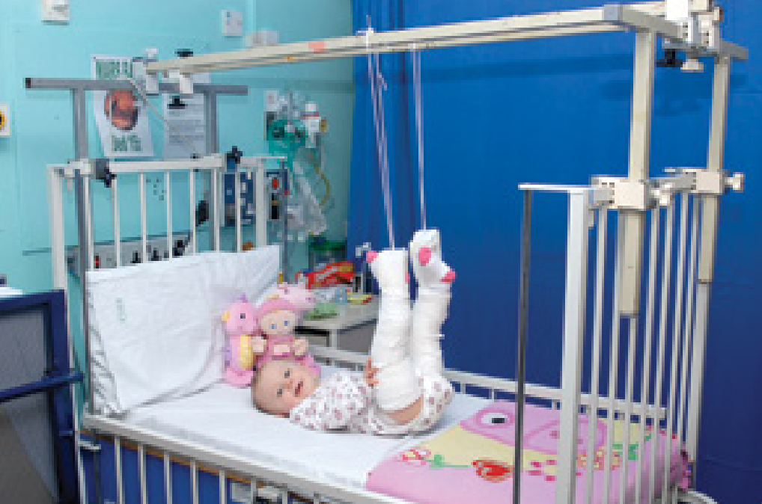
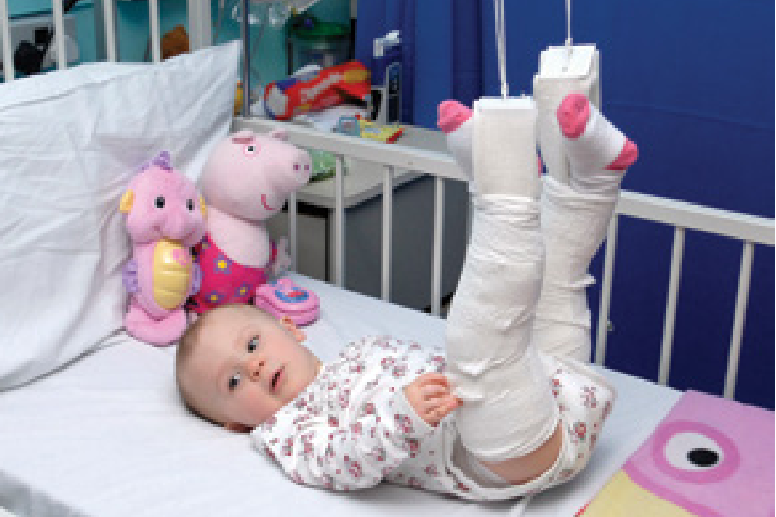
Skin Traction -Types
Gallows
For femoral fracture
Children < 2yrs age, maximum body weight 10-12 Kg
If more, may affect circulation
Hips flexed 90º
http://www.rcn.org.uk/

Slide 15
Skin Traction -Types
Fixed traction
For transport
Balanced traction
For treatment
Using Thomas splint
Using Thomas splint
www.emed.ie
www0.sun.ac.za

Slide 16
Skin Traction -Types
Cervical skin traction
Temporary in trauma & for cervical disc / spondylosis
physio4u.co

Slide 17
Skeletal Traction
By inserting a metal (Steinman pin) into the bone and applying traction on it

Slide 18
Skeletal Traction
Indications:
Adults where surgical treatment of fractures is not possible or not desirable
When a strong force is needed
(weight more than 4-5 Kg) ( Adults)
When traction is needed for more than 3 weeks
To avoid skin blisters
http://emedicine.medscape.com/

Slide 19
Skeletal Traction
Common sites for pin insertion:
Upper tibia
Femoral condyle
Calcaneum
Skull
medical-beyond. blogspot.com
www0.sun.ac.za
www.hwbf.org
imgbuddy.com

Slide 20
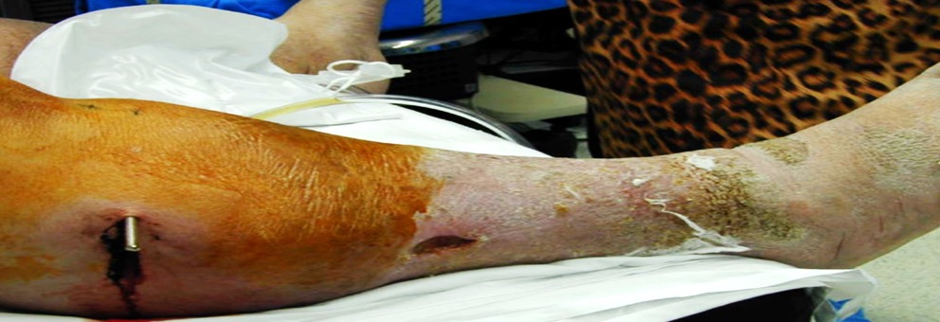
Skeletal Traction - Complications
Infection
Over distraction of the bone fragments
Nerve damage
From heavy traction force
Direct during insertion!
e.g. Common Peroneal n.
Bone fragmentation/break
Breaking of the pin

Slide 21
Traction - Disadvantages
Costly in terms of hospital stay
Hazards of prolonged bed rest
Thromboembolism
Decubitus ulcers
Pneumonia, UTI
Depression, …
Requires meticulous nursing care

Slide 22
Casting
Plaster of Paris (Gypsum)
Synthetic
Fiberglass
www.aktifhaber.com
www.mtex.co

Slide 23
Plaster of Paris
POP was first used in orthopedics by a Dutch surgeon in 1852
Commercially available since 1931
(CaSO⁴)2H₂O+3H²O 2(CaSO⁴×H²O)+heat
Hemihydrated calcium sulfate
Hydrated calcium sulfate
Plaster of Paris
Gypsum
www.myswag.org
www.activahealthcare.co.uk

Slide 24
Advantages / Disadvantages
Plaster of Paris
Synthetic - Fiberglass
Disadvantages:
Weak
Long setting time – 24 hours
Heavy weight
Breaks in water
Radio-opaque
Advantages
Blunt edges
Moldable – for correction
Cheap
Advantages:
Strong
Quickly sets
Light weight
Water resistant
Radiolucent
Disadvantages
Sharp edge
Not moldable
Costly

Slide 25
Cast forms
Slab
Applied on one side only
Safer if limb is swollen
sweetvioletsa.blogspot.com
www2.aofoundation.org
www.rch.org.au

Slide 26
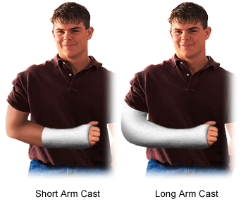
Cast forms
Slab
Applied on one side only
Complete
Applied all around the limb
msurgery.ie
http://www.stanfordchildrens.org/
www.stanfordchildrens.org

Slide 27
Cast forms
Slab
Applied on one side only
Complete
Applied all around the limb
Spica
Covering limb and trunk
Encircles body part
Hip spica
Shoulder spica
Thumb spica
www.massgeneral.org
bogey.lima-city.de
http://www.aafp.org/

Slide 28
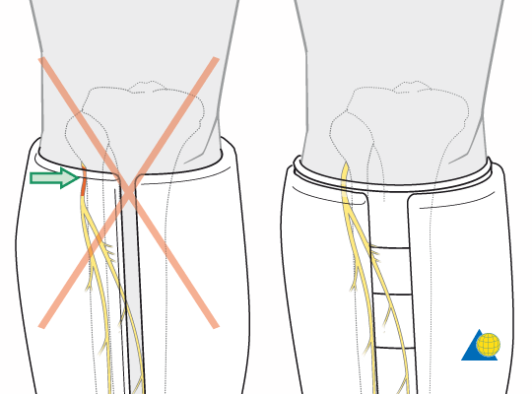
Complications of Casting
Immobilization
Muscle wasting
Joint stiffness
Osteoporosis
Pathological fracture
Pressure on Nerves
Thermal burn with Synthetic cast
Must use cold water with synthetic cast

Slide 29
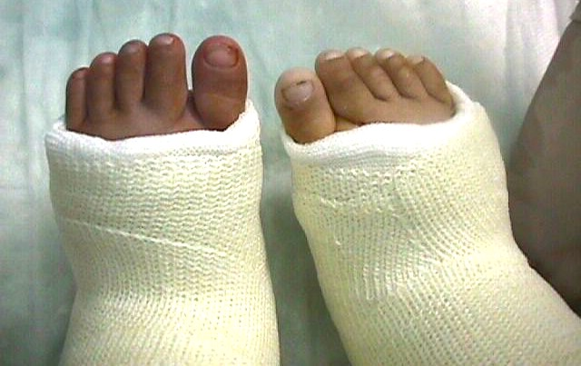
Complications of Casting
Tight Cast – Vascular Problem
Mamoun Kremli
www.cprcertified.com
www.eorthopod.com

Slide 30
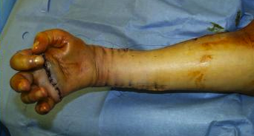
Complications of Casting
Tight Cast – Vascular Problem
Causes Volkmann's ischemia
www.tetraplegia.info

Slide 31
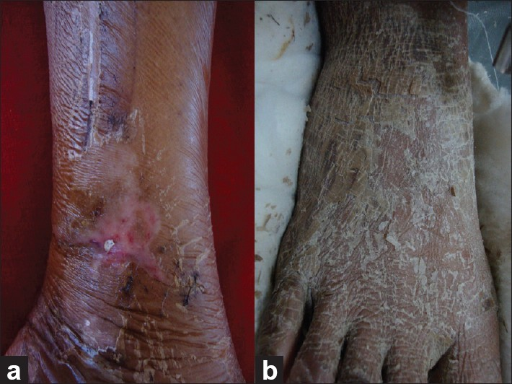
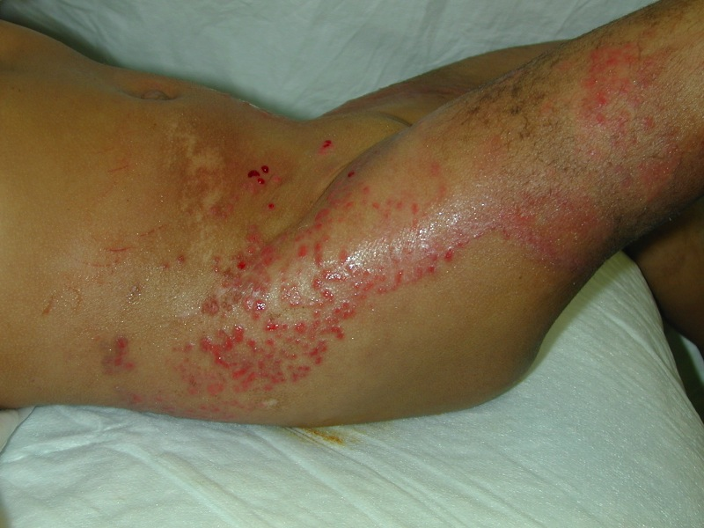
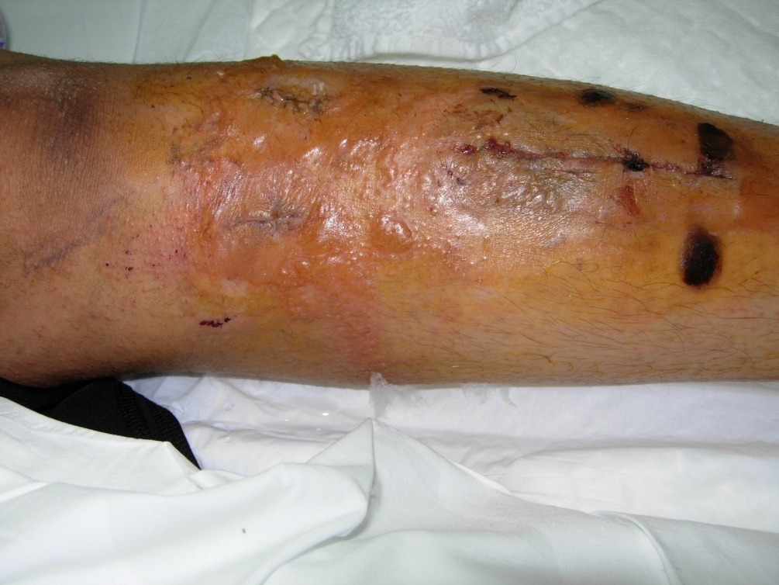
Complications of Casting
Skin Atrophy and Scaling
Dermatitis Skin Ulceration
Skin Blisters
http://www.ijdvl.com/article.asp?issn=0378-6323;year=2011;volume=77;issue=5
Mamoun Kremli

Slide 32
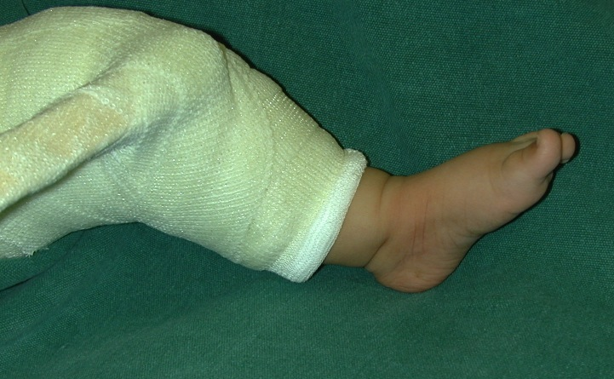
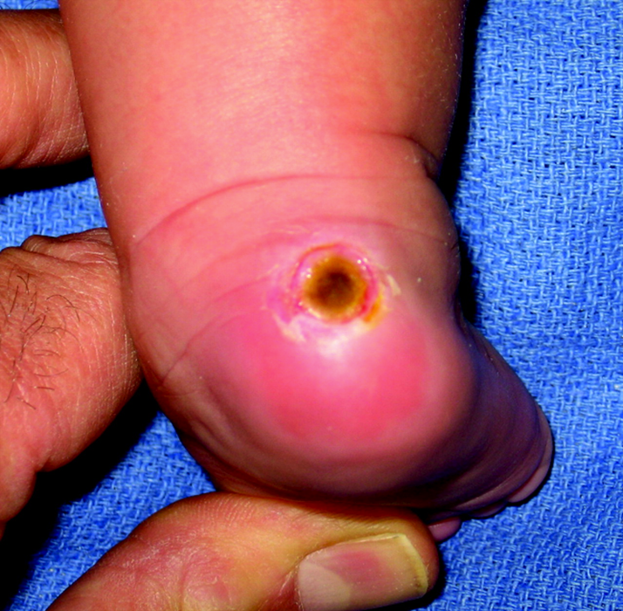
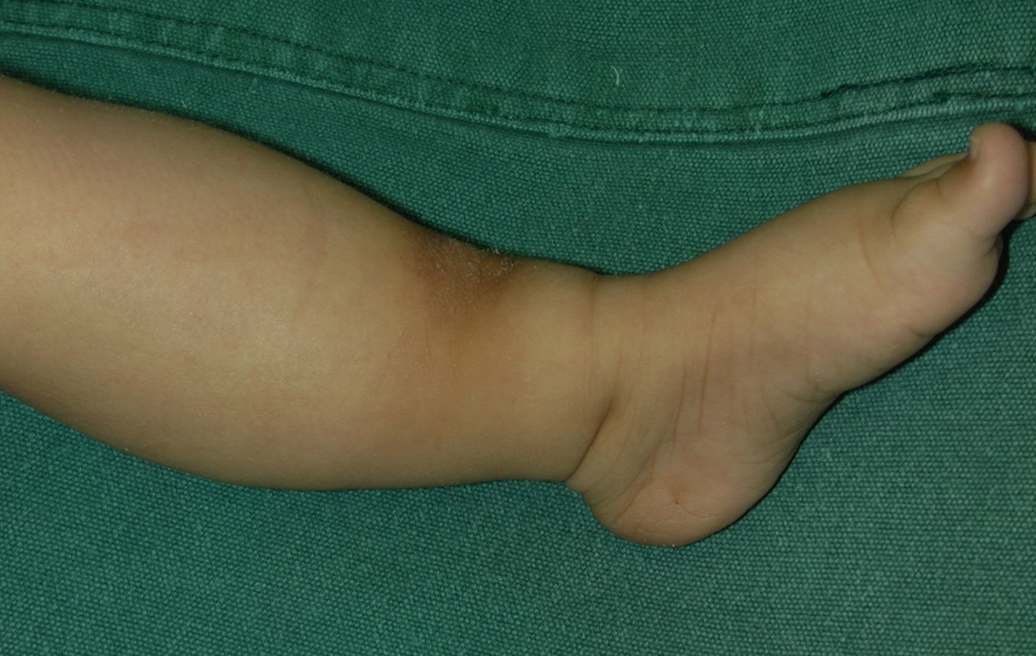
Complications of Casting
Pressure from Cast Edge
Pressure Sores
http://www.jaaos.org/content/18/8/486/F7.expansion

Slide 33
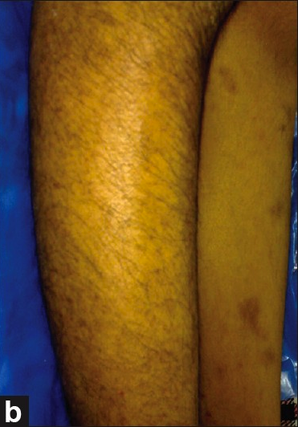
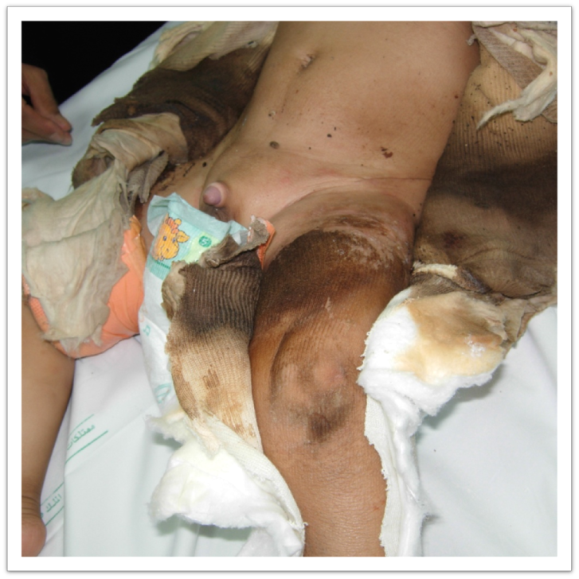
Complications of Casting
Hypertrichosis – Increased hair
Temporary localized
Resolves (80% after 6m)
Dirty cast
http://www.ijdvl.com/article.asp?issn=0378-6323;year=2011;volume=77;issue=5

Slide 34
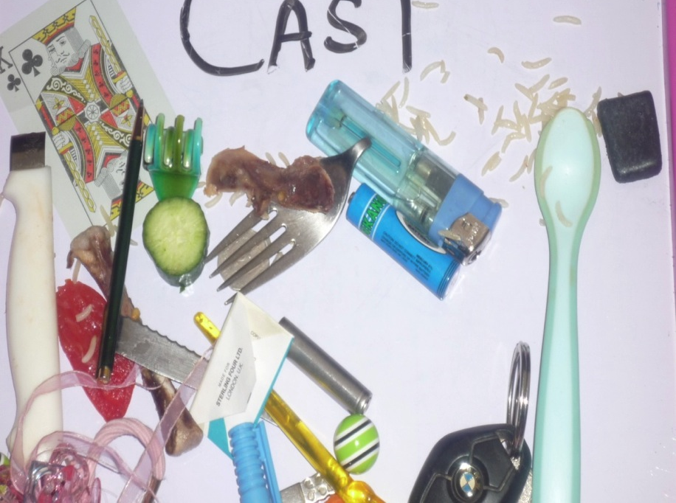
Complications of Casting
Items under the cast !
May cause pressure sores

Slide 35
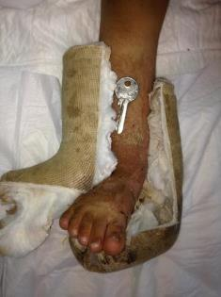
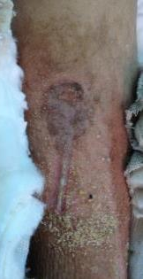
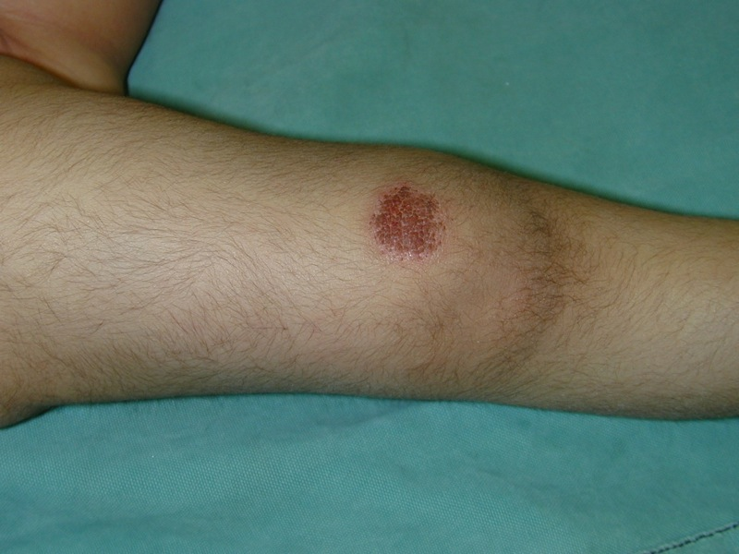
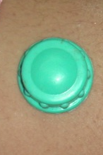
Complications of Casting
Items under the cast !
May cause pressure sores

Slide 36
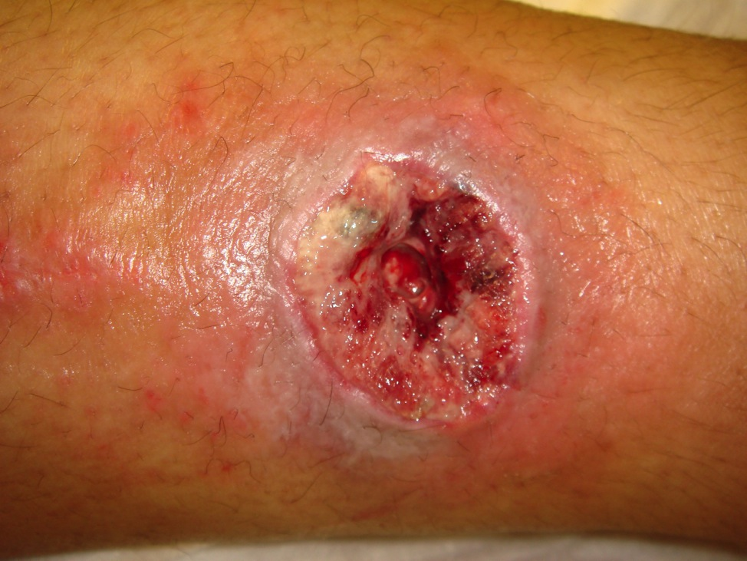
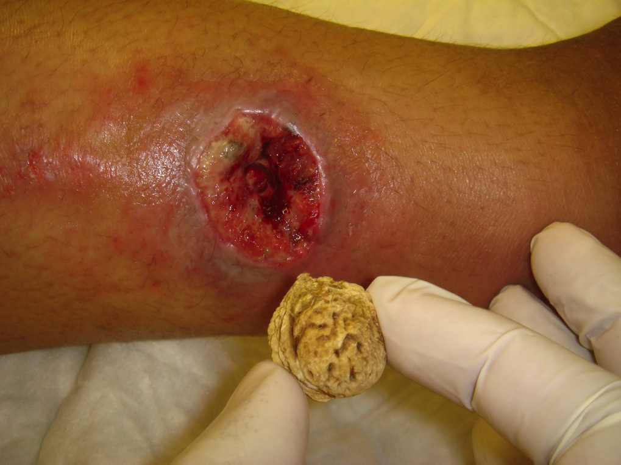
Complications of Casting
Items under the cast !
May cause pressure sores

Slide 37
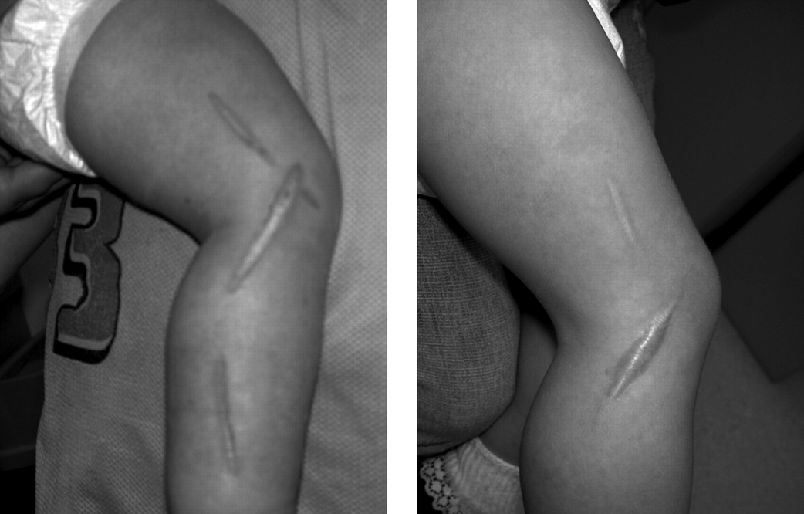
Cast Saw Burns
Too quick - old blunt blade - inexperienced technician
www.jaaos.org

Slide 38
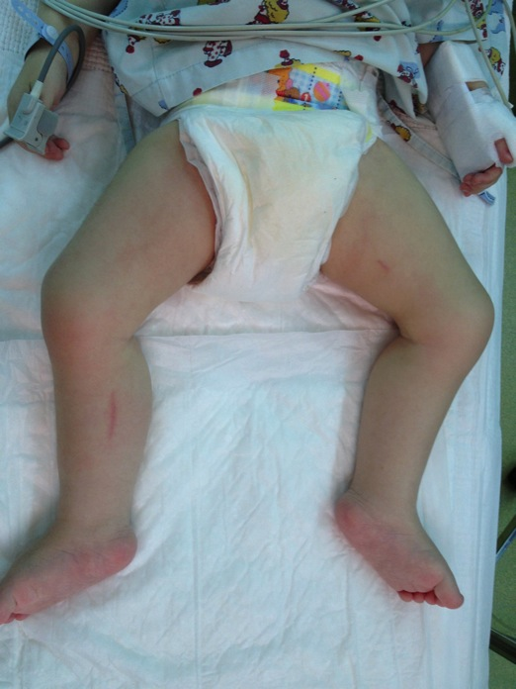
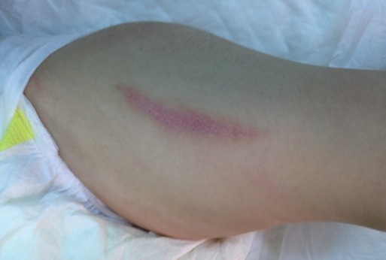
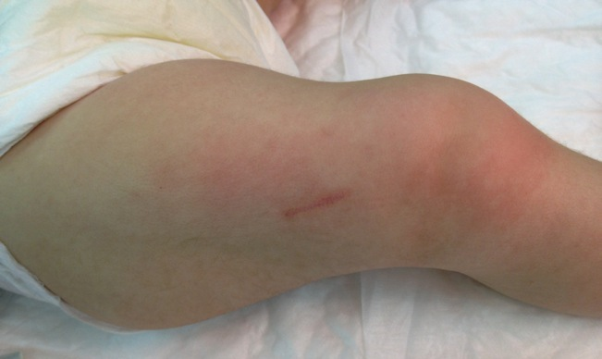
Cast Saw Burns
Too quick - old blunt blade - inexperienced technician
Mamoun Kremli

Slide 39
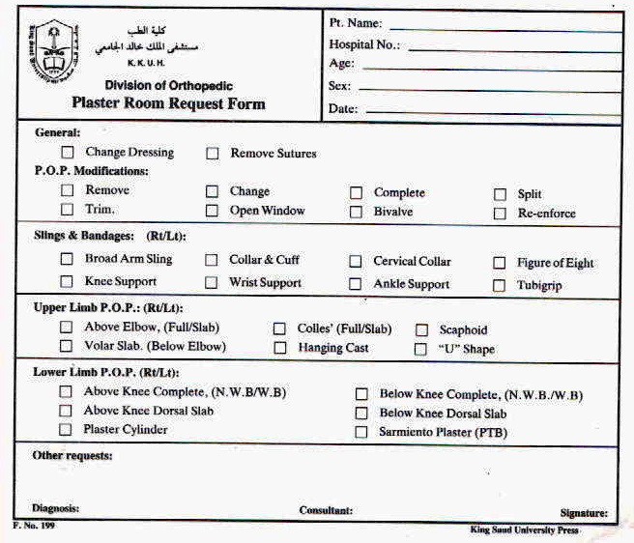
Cast Request Form

Slide 40
Summary
Many fractures could still be treated non-operatively
Traction:
Types
Indications / Contraindications
Complications
Casting:
Types
Indications / Contraindications
Complications
Notes:
Hiding slid 27

