Slide 1

Examination of the Back and Neurological Lower Limbs
Prof. Mamoun Kremli, AlMaarefa College
Yousef T. Khoja, MBBS, SB-Orth, JBOrth

Slide 2
Orthopedic Examination
The system to use:
Look
Feel
Move
Special tests

Slide 3
Look
General ➔ on patient.
General ➔ local (knee, thigh, leg):
Position.
Major deformity, swelling.
Extra: cast, splint, traction, dressing …
Anatomic local:
Skin: swelling, scars, color, hair, dryness …
Subcut.: LN, veins, nerves, tendons …
Muscles: bulk, wasting, twitches …
Bones: landmarks, swelling, angulation, deformity.
Joints: position, swelling, redness…

Slide 4
Look
Proper exposure

Slide 5
Look
General ➔ on patient :
Standing, tilting forwards with hand on L side of lower back
http://www.pocketsalute.it

Slide 6
Look
General ➔ local (back, shoulder, flanks, chest):
Posterior, Lateral, Anterior

Slide 7
Look
General ➔ local (back, shoulder, flanks, chest):
Position:
Best in standing
Normal curves
Alignment
https://theyogaroomtulsa.com

Slide 8
Look
General ➔ local (back, shoulder, flanks, chest):
Position:
Best in standing
Normal curves
Alignment
http://stronglifts.com

Slide 9
Look
General ➔ local (back, shoulder, flanks, chest):
Position:
Best in standing
Normal curves
Alignment
http://www.srs.org

Slide 10
Look
General ➔ local (back, shoulder, flanks, chest):
Major deformity- swelling:
Best in standing
Shoulder height
Deformity
Flanks
Space between arm and trunk
Masses
http://www.eurospine.org

Slide 11
Look
General ➔ local (back, shoulder, flanks, chest):
Major deformity- swelling:
Best in standing
Shoulder height
Deformity
Flanks
Space between arm and trunk
Masses
http://www.eurospine.org

Slide 12
Look
General ➔ local (back, shoulder, flanks, chest):
Major deformity- swelling:
Best in standing
Shoulder height
Deformity
Flanks
Space between arm and trunk
Masses
http://www.eurospine.org

Slide 13
Look
General ➔ local (back, shoulder, flanks, chest):
Major deformity- swelling:
Best in standing
Shoulder height
Deformity
Flanks
Space between arm and trunk
Masses
http://www.eurospine.org

Slide 14
Look
General ➔ local (back, shoulder, flanks, chest):
Major deformity- swelling:
Best in standing
Shoulder height
Deformity
Flanks
Masses
http://www.atmph.org/

Slide 15
Look
General ➔ local (back, shoulder, flanks, chest):
Extra:
Support
Dressing
http://e-medicalbroker.com

Slide 16
Look
Anatomic local:
Skin: swelling, scars, color, hair, dryness …
Subcut.: LN, veins, nerves, tendons …
Muscles: bulk, wasting, twitches …
Bones: landmarks, swelling, and deformity.
Joints: position, swelling
(Do not forget the Anterior aspect) !!!

Slide 17
Look
Anatomic local:
Skin:
Subcut.:
Muscles:
Bones:
Joints:
http://www.etsu.edu/com/medicalmystery

Slide 18
Look
Anatomic local:
Skin:
Subcut.:
Muscles:
Bones:
Joints:
http://ozonprp.com

Slide 19
Look
Anatomic local:
Skin:
Subcut.:
Muscles:
Bones:
Joints:
http://morphopedics.wikidot.com/

Slide 20
Look
Anatomic local:
Anterior aspect !
http://patient.info/doctor/Chest-Deformity.htm

Slide 21
Look
General ➔ on patient.
General ➔ local (back, shoulder, flanks, chest):
Position.
Major deformity, swelling.
Extra: support, dressing …
Anatomic local:
Skin: swelling, scars, color, hair, dryness …
Subcut.: LN, veins, nerves, tendons …
Muscles: bulk, wasting, twitches …
Bones: landmarks, swelling, deformity.
Joints: position, swelling, redness…

Slide 22
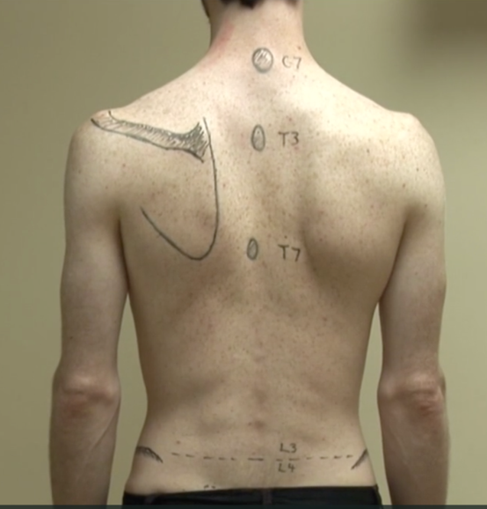
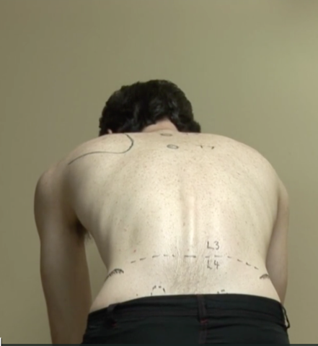
Look
General ➔ on patient.
General ➔ local (back, shoulder, flanks, chest):
Position.
Major deformity, swelling.
Extra: support, dressing …
Anatomic local:
Skin: swelling, scars, color, hair, dryness …
Subcut.: LN, veins, nerves, tendons …
Muscles: bulk, wasting, twitches …
Bones: landmarks, swelling, deformity.
Joints: position, swelling, redness…
McMaster MSK Examination Series
From: Raj Camona

Slide 23
Feel
Tenderness:
Generalized
Specific
Temperature: compare distal/proximal, R / L
Anatomic:
Skin: dryness, scars
Subcut.: nodules
Muscle: (Paravertebral): spasm, bulk, tender.
Bone: landmarks (spinous processes, iliac crest, coccyx) tenderness, mass
Joint: sacro-iliac,: tenderness

Slide 24
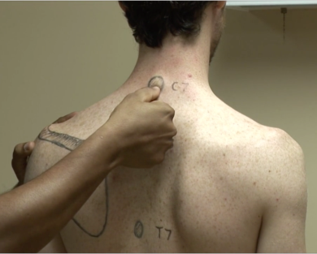
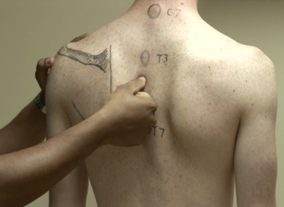
Feel
Tenderness:
Generalized: to start with
Specific:
Spinous processes
Sacroiliac joints
Paravertebral M
McMaster MSK Examination Series
From: Raj Camona

Slide 25
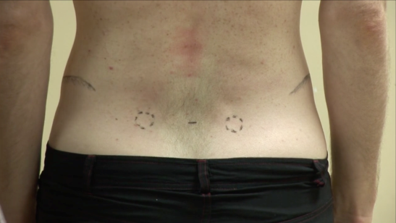
Feel
Tenderness:
Generalized: to start with
Specific:
Spinous processes
Sacroiliac joints
Paravertebral M
McMaster MSK Examination Series
From: Raj Camona

Slide 26
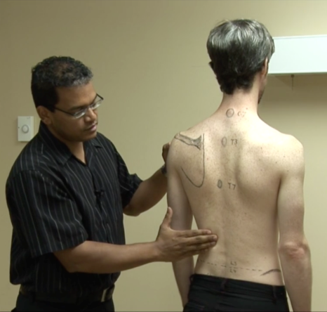
Feel
Tenderness:
Generalized: to start with
Specific:
Spinous processes
Sacroiliac joints
Paravertebral M
McMaster MSK Examination Series
From: Raj Camona

Slide 27
Feel
Temperature: compare distal/proximal, R / L

Slide 28
Feel
Anatomic:
Skin: Scars
Subcut.: Nodules
Muscle (Paravertebral): spasm, bulk, tenderness
Bones (spinous processes, iliac crest)
Joints (Sacroiliac)

Slide 29
Move
Any change of shape/deformity during motion
Smoothness of motion
Extent (Range)
reach more than angles!

Slide 30
Move
Any change of shape/deformity during motion
Smoothness of motion
Extent (Range)
reach more than angles!
http://www.britscoliosissoc.org.uk

Slide 31
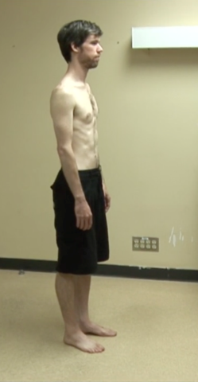
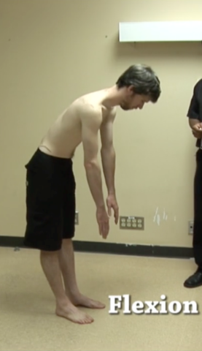
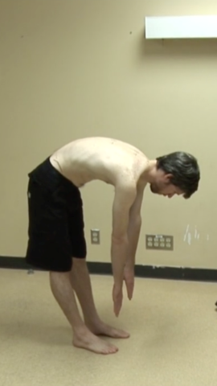
Move
Flexion / Extension
McMaster MSK Examination Series
From: Raj Camona

Slide 32
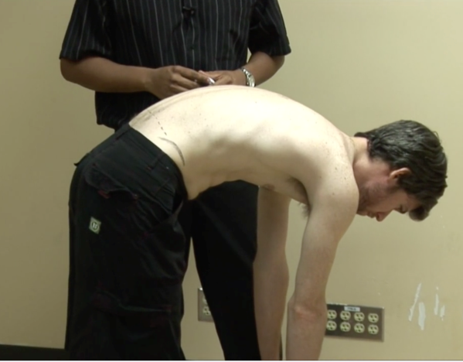
Move
Flexion / Extension
McMaster MSK Examination Series
From: Raj Camona

Slide 33

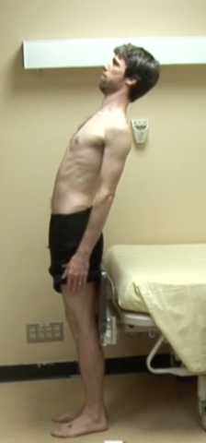
Move
Flexion / Extension
McMaster MSK Examination Series
From: Raj Camona

Slide 34
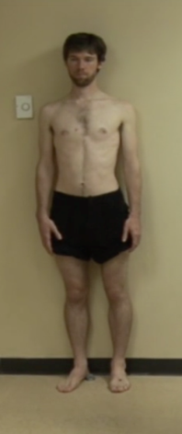
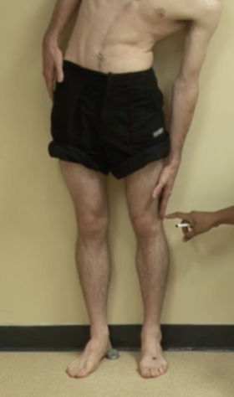
Move
Sideway bending (lateral flexion)
McMaster MSK Examination Series
From: Raj Camona

Slide 35
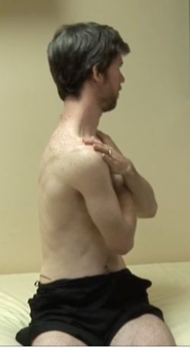
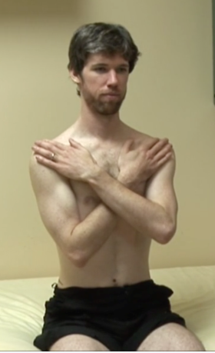
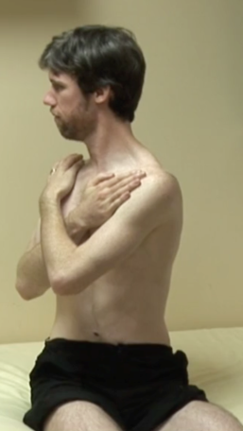
Move
Rotation
McMaster MSK Examination Series
From: Raj Camona

Slide 36
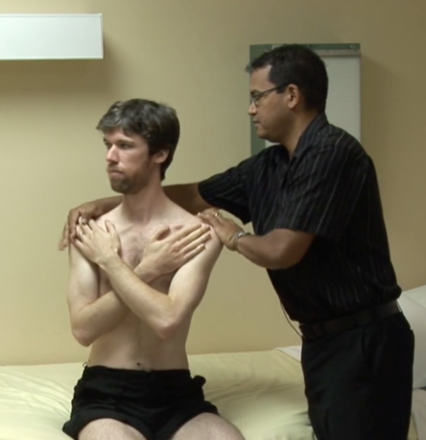
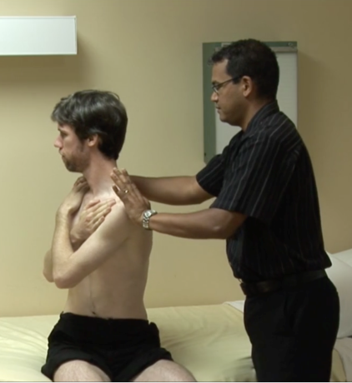
Move
Rotation: help patient understand!
McMaster MSK Examination Series
From: Raj Camona

Slide 37
Special tests
Adam’s Forward Test
Sacroiliac joint
SLR test (Lasègue test)
Femoral stretch
Neurological LL:
Dermatomes, Myotomes, Reflexes
Gait – walking
Standing / sitting
PR examination

Slide 38
Special tests
Adam’s Forward test
http://www.britscoliosissoc.org.uk

Slide 39
Special tests
Sacroiliac joint stress: (Faber Patrick Test)
https://www.pinterest.com/pin/516436282246704635/

Slide 40
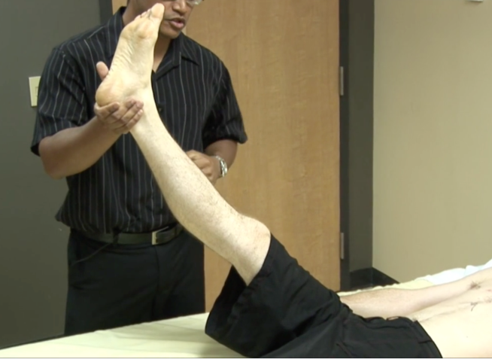
Special tests
SLR test (and Lasègue test):
McMaster MSK Examination Series
From: Raj Camona

Slide 41
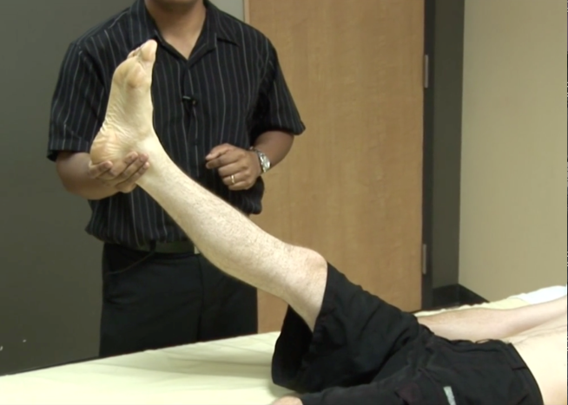
Special tests
SLR test (and Lasègue test):
McMaster MSK Examination Series
From: Raj Camona

Slide 42
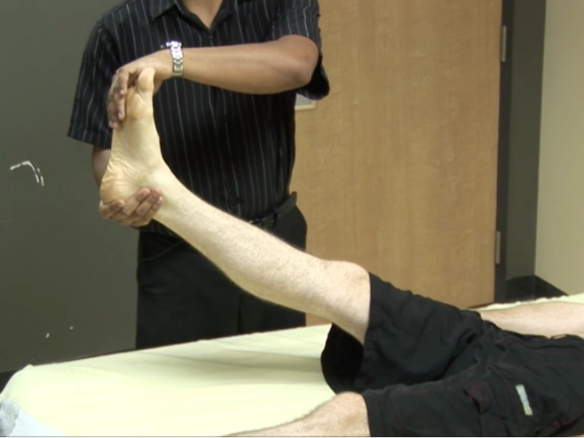
Special tests
SLR test (and Lasègue test):
McMaster MSK Examination Series
From: Raj Camona

Slide 43
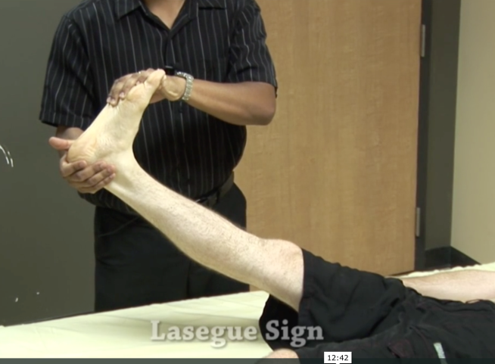
Special tests
SLR test (and Lasègue test):
McMaster MSK Examination Series
From: Raj Camona

Slide 44
Special tests
SLR test (and Lasègue test):

Slide 45
Special tests
Femoral stretch test:
https://quizlet.com

Slide 46
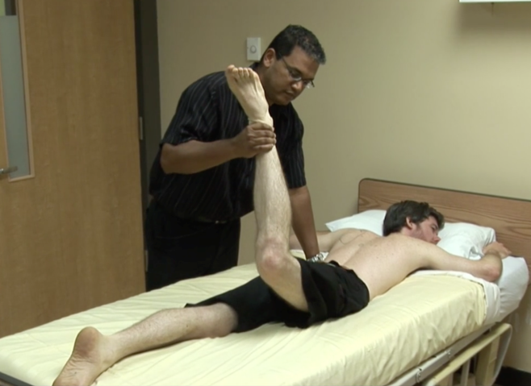
Special tests
Femoral stretch test:
McMaster MSK Examination Series
From: Raj Camona

Slide 47
Special tests
Neurological LL:
Dermatomes
Myotomes
Reflexes

Slide 48
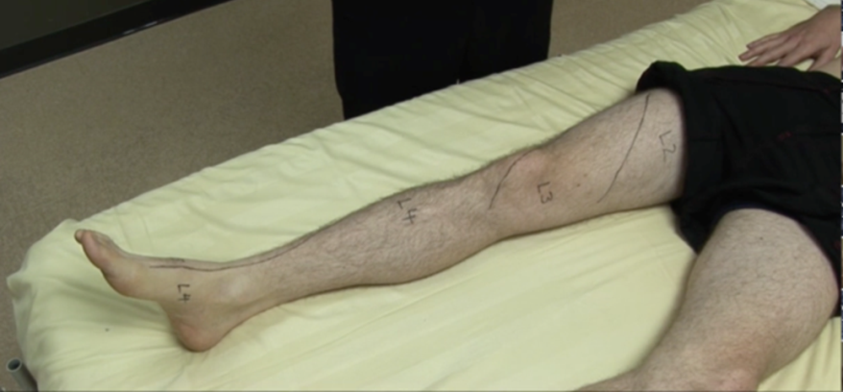
Special tests
Neurological LL:
Dermatomes
McMaster MSK Examination Series
From: Raj Camona

Slide 49
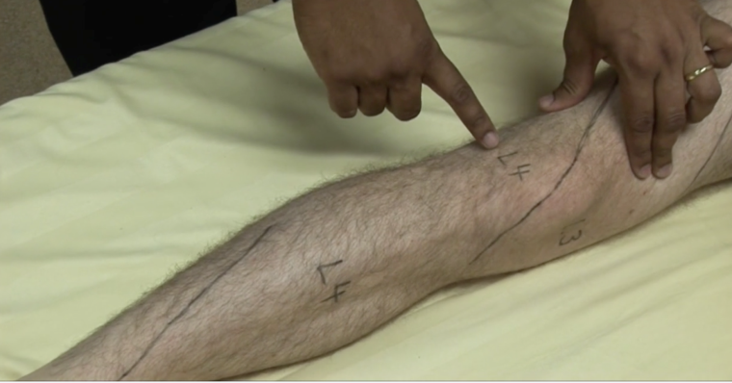
Special tests
Neurological LL:
Dermatomes
McMaster MSK Examination Series
From: Raj Camona

Slide 50
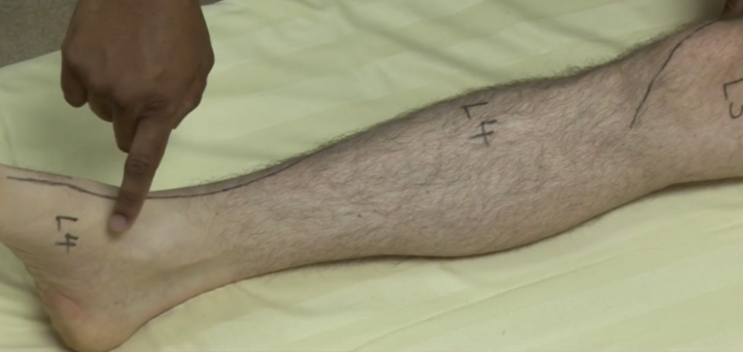
Special tests
Neurological LL:
Dermatomes
McMaster MSK Examination Series
From: Raj Camona

Slide 51
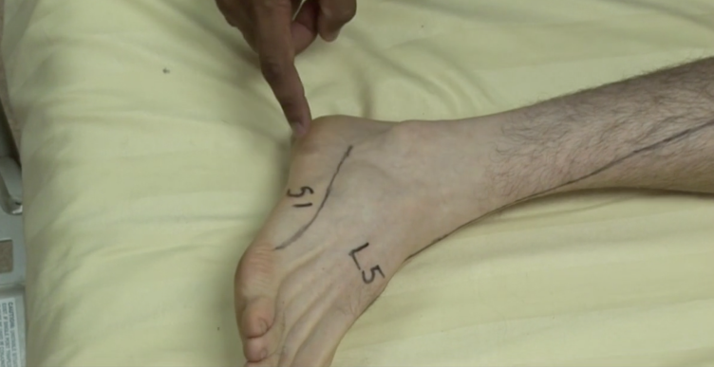
Special tests
Neurological LL:
Dermatomes
McMaster MSK Examination Series
From: Raj Camona

Slide 52
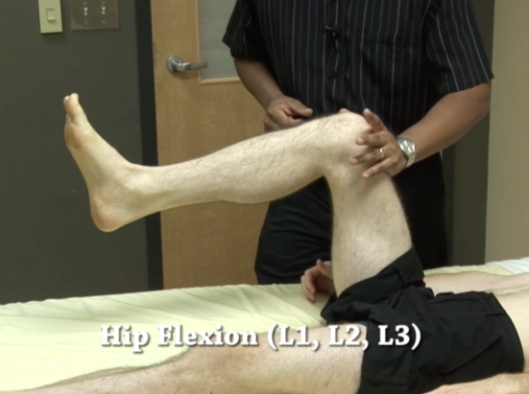
Special tests
Neurological LL:
Myotomes
McMaster MSK Examination Series
From: Raj Camona

Slide 53
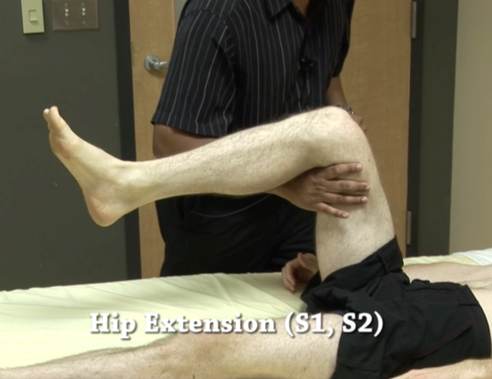
Special tests
Neurological LL:
Myotomes
McMaster MSK Examination Series
From: Raj Camona

Slide 54
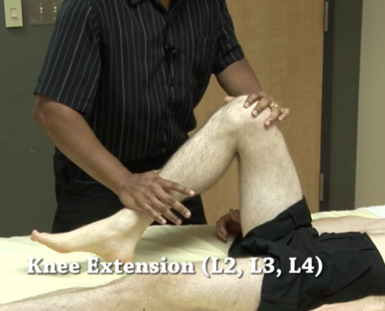
Special tests
Neurological LL:
Myotomes
McMaster MSK Examination Series
From: Raj Camona

Slide 55
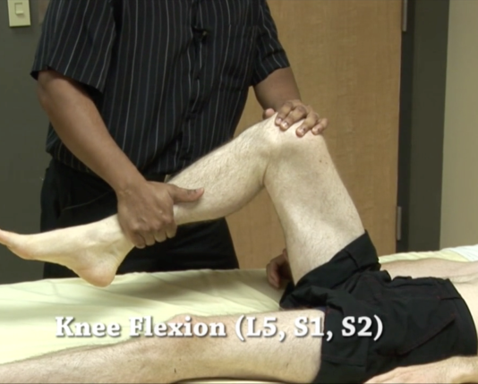
Special tests
Neurological LL:
Myotomes
McMaster MSK Examination Series
From: Raj Camona

Slide 56
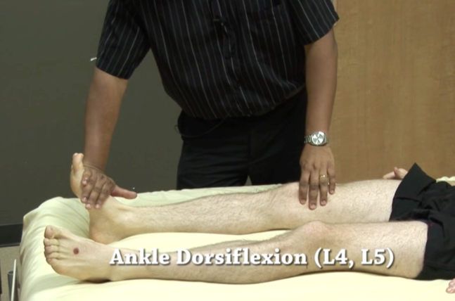
Special tests
Neurological LL:
Myotomes
McMaster MSK Examination Series
From: Raj Camona

Slide 57
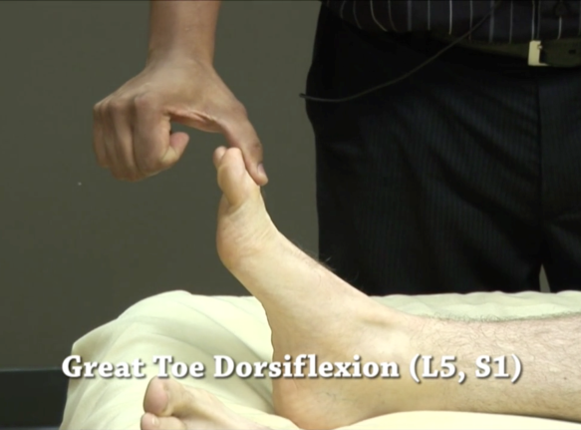
Special tests
Neurological LL:
Myotomes
McMaster MSK Examination Series
From: Raj Camona

Slide 58
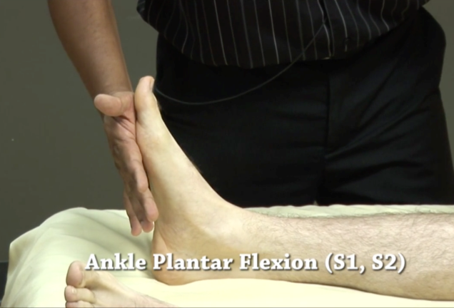
Special tests
Neurological LL:
Myotomes
McMaster MSK Examination Series
From: Raj Camona

Slide 59
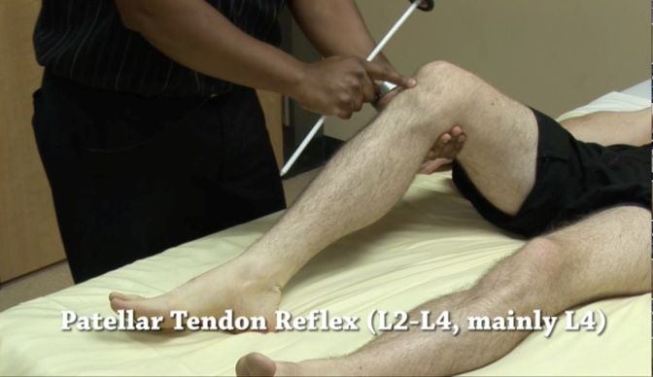
Special tests
Neurological LL:
Reflexes
McMaster MSK Examination Series
From: Raj Camona

Slide 60
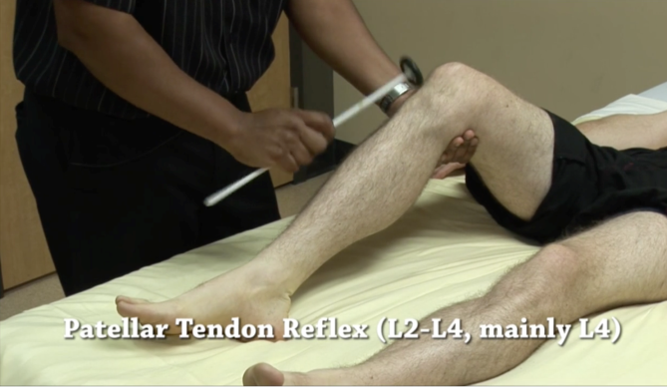
Special tests
Neurological LL:
Reflexes
McMaster MSK Examination Series
From: Raj Camona

Slide 61
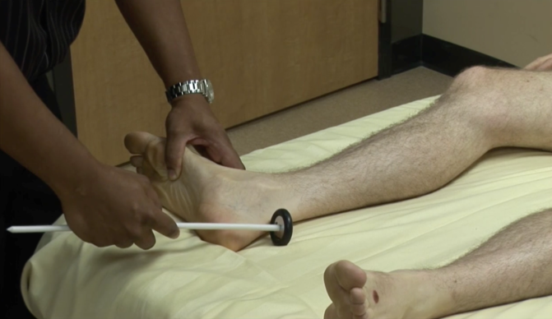
Special tests
Neurological LL:
Reflexes
McMaster MSK Examination Series
From: Raj Camona

Slide 62
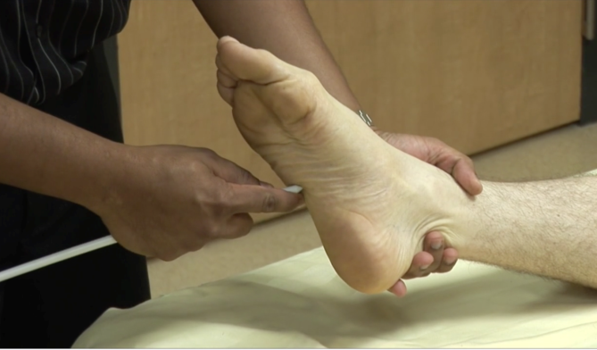
Special tests
Neurological LL:
Reflexes
McMaster MSK Examination Series
From: Raj Camona

Slide 63
Special tests
Gait – walking
www.osceskills.com

Slide 64
Special tests
Standing / sitting
Smoothness of action
PR examination

Slide 65
Summary
Examination of back & Neurological LL:
Look:
back, side, front
Feel
Move:
Flexion/Extension, Lateral flexion, Rotation
Special tests
Adam’s forward test
Sacroiliac joint
SLR test (Lasègue test)
Femoral stretch
Neurological LL:
Dermatomes / Myotomes / Reflexes
Gait – walking
Standing / sitting
PR examination

Slide 66
Video on back examination
McMaster MSK Examination Series
From: Raj Camona
https://vimeo.com/36295624
Spine Examination – OSCE Guide
By Lewis Potter
http://geekymedics.com/spine-examination/

Slide 67
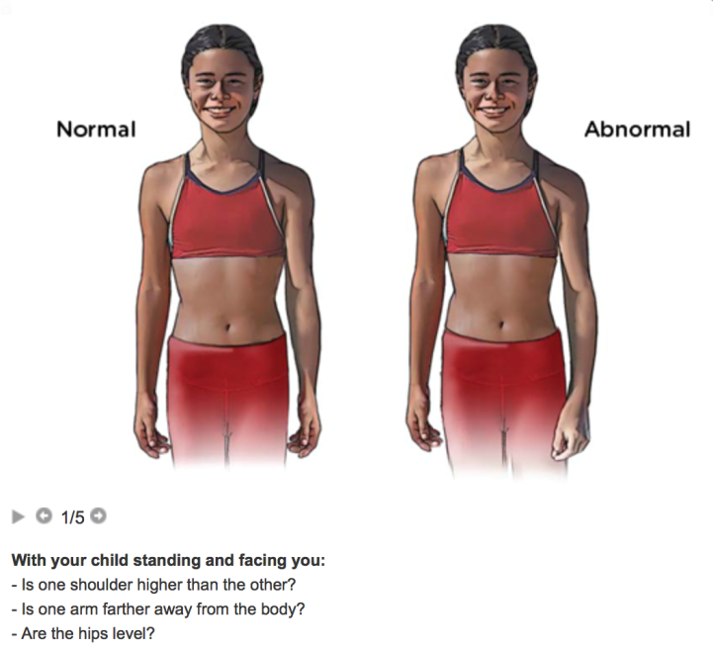
http://www.choa.org/Childrens-Hospital-Services

Slide 68
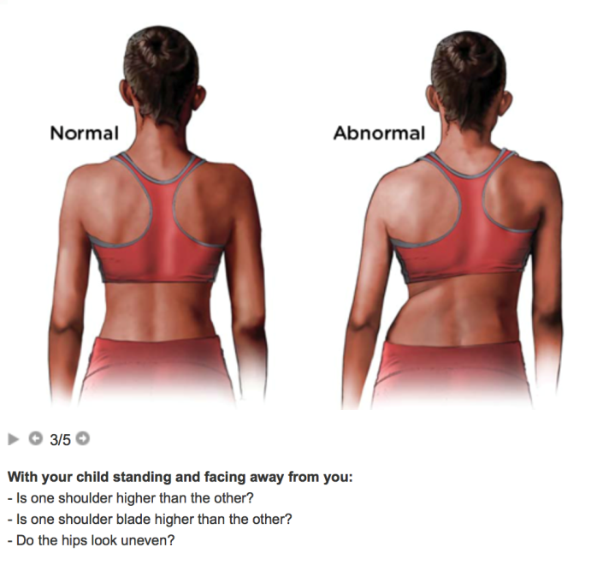
http://www.choa.org/Childrens-Hospital-Services

Slide 69
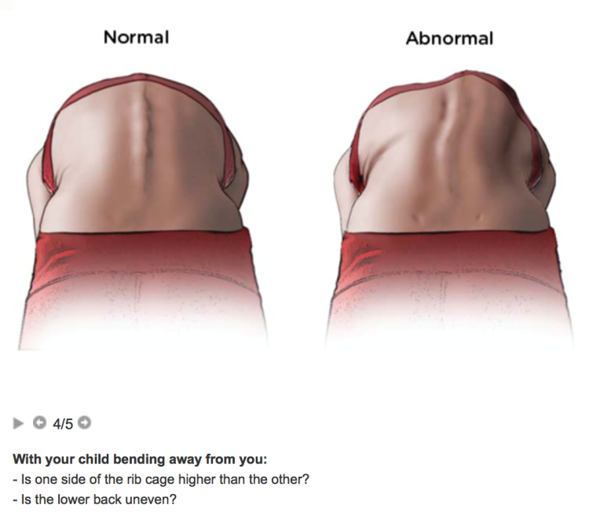
http://www.choa.org/Childrens-Hospital-Services

Slide 70
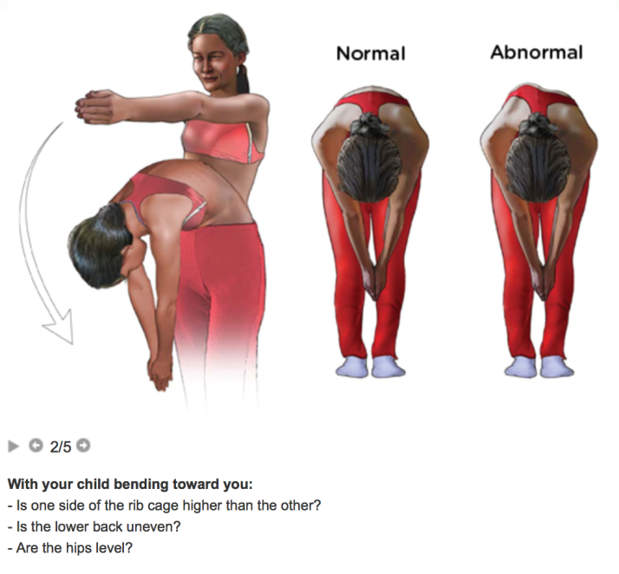
http://www.choa.org/Childrens-Hospital-Services

Slide 71
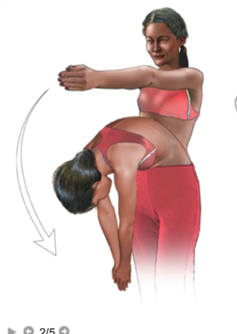
http://www.choa.org/Childrens-Hospital-Services

Slide 72
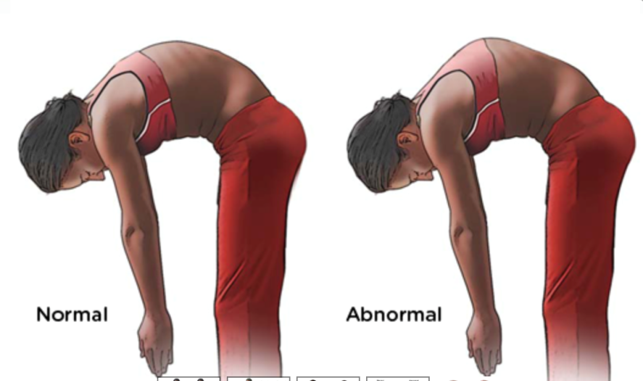
http://www.choa.org/Childrens-Hospital-Services

