Slide 1

Examination of the Knee
Prof. Mamoun Kremli
AlMaarefa College

Slide 2
Orthopedic Examination
The system to use:
Look
Feel
Move
Special tests

Slide 3
Look
General ➔ on patient.
General ➔ local (knee, thigh, leg):
Position.
Major deformity, swelling.
Extra: cast, splint, traction, dressing …
Anatomic local:
Skin: swelling, scars, color, hair, dryness …
Subcut.: LN, veins, nerves, tendons …
Muscles: bulk, wasting, twitches …
Bones: landmarks, swelling, angulation, deformity.
Joints: position, swelling, redness…

Slide 4
Look
Proper exposure
The patient should be in either a gown or shorts.
Rolled up pant legs do not provide good exposure!
www.osceskills.com

Slide 5
Look
General ➔ on patient :
Sitting comfortably on edge of couch, with knees flexed 90º
http://utahshoulderknee.com

Slide 6
Look
General ➔ on patient :
Sitting, in pain, with both hand around his R flexed knee
http://www.123rf.com/photo_25506370

Slide 7
Look
General ➔ on patient :
Sitting on a wheel chair, with L knee extended on a board
http://homecareequipment.com.au

Slide 8
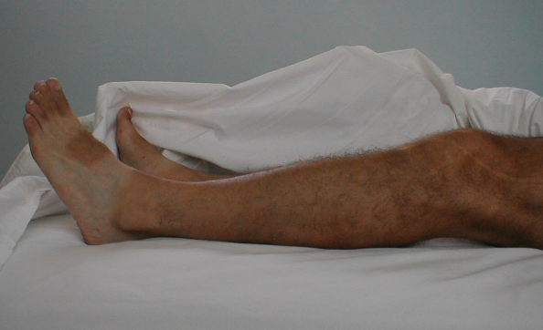
Look
General ➔ local (knee-thigh-LL):
Position
Flexion / Extension
https://meded.ucsd.edu/clinicalmed/joints

Slide 9
Look
General ➔ local (knee-thigh-LL):
Major deformity- swelling:
Varus / Valgus
Best in standing
Swelling / Masses
https://meded.ucsd.edu/clinicalmed/joints

Slide 10
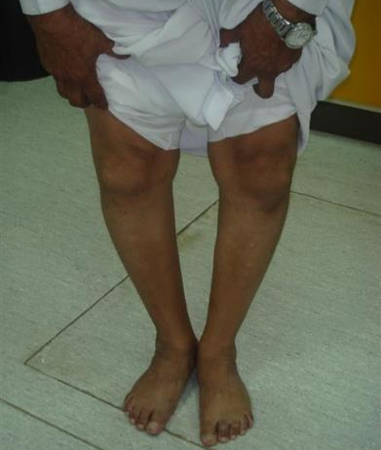
Look
General ➔ local (knee-thigh-LL):
Major deformity- swelling:
Varus / Valgus
Best in standing
Swelling / Masses
Dr AbduAziz AlAhaideb

Slide 11
Look
General ➔ local (knee-thigh-LL):
Extra:
Cast
Splint
Dressing
http://mannipples.blogspot.com
http://www.medscape.com

Slide 12
Look
General ➔ local (knee-thigh-LL):
Extra:
Skin traction
Skeletal traction
http://rdo.psu.ac.th/en
http://www.healthgenie.in

Slide 13
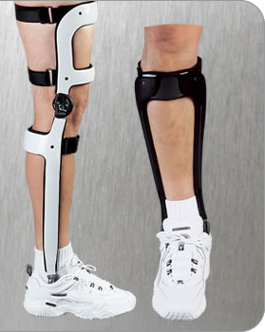
Look
General ➔ local (knee-thigh-LL):
Extra:
Orthotics
AFO
KAFO
HKAFO
www.integratif.com.sg/

Slide 14
Look
Anatomic local:
Skin: swelling, scars, color, hair, dryness …
Subcut.: LN, veins, nerves, tendons …
Muscles: bulk, wasting, twitches …
Bones: landmarks, swelling, and deformity.
Joints: position, swelling
(Do not forget the posterior aspect) !!!
(All patients have a posterior aspect) !!!

Slide 15
Look
Anatomic local:
Skin:
Subcut.:
Muscles:
Bones:
Joints:
https://meded.ucsd.edu/clinicalmed/joints

Slide 16
Look
Anatomic local:
Skin:
Subcut.:
Muscles:
Bones:
Joints:
www.osceskills.com

Slide 17
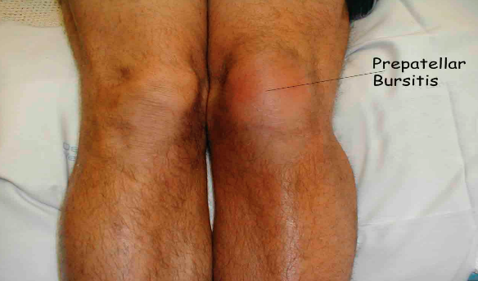
Look
Anatomic local:
Skin:
Subcut.:
Muscles:
Bones:
Joints:
https://meded.ucsd.edu/clinicalmed/joints

Slide 18
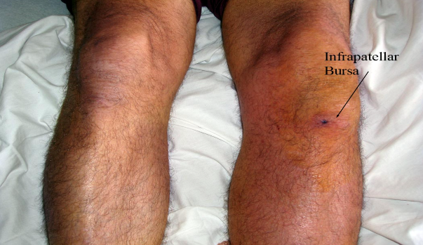
Look
Anatomic local:
Skin:
Subcut.:
Muscles:
Bones:
Joints:
https://meded.ucsd.edu/clinicalmed/joints

Slide 19
Look
Anatomic local:
Skin:
Subcut.:
Muscles:
Bones:
Joints:
https://kneeobliteration.wordpress.com

Slide 20
Look
Anatomic local:
Skin:
Subcut.:
Muscles:
Bones:
Joints:
http://rpatersonknee.publishpath.com/

Slide 21
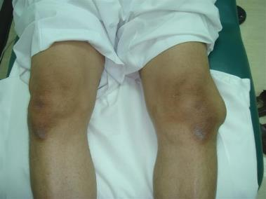
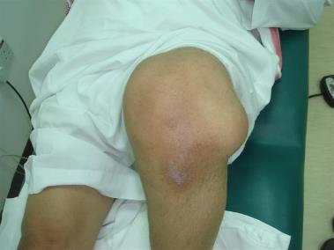
Look
Anatomic local:
Skin:
Subcut.:
Muscles:
Bones:
Joints:
Dr AbduAziz AlAhaideb

Slide 22
Look
Anatomic local:
Skin:
Subcut.:
Muscles:
Bones:
Joints:
http://www.justanswer.com/health

Slide 23
Look
Anatomic local:
Posterior aspect !
https://meded.ucsd.edu/clinicalmed/joints

Slide 24
Look
General ➔ on patient.
General ➔ local (hip, thigh, leg):
Position.
Major deformity, swelling.
Extra: cast, splint, traction, dressing …
Anatomic local:
Skin: swelling, scars, color, hair, dryness …
Subcut.: LN, veins, nerves, tendons …
Muscles: bulk, wasting, twitches …
Bones: landmarks, swelling, deformity.
Joints: position, swelling, redness…

Slide 25
Look
Important Considerations:
Amount of exposure
Duration of exposure
Persons present during exposure
Place of exposure
Attitude and behavior during exposure

Slide 26
Feel
Tenderness:
Generalized
Specific
Temperature: compare distal/proximal, R / L
Anatomic:
Skin: dryness, hyper/hyposthesia, scars
Subcut.: LN, nerves, vessels, tendons, nodules
Muscle: (Quadriceps): tone, bulk, twitches, gaps, tender.
Bone: landmarks (Patella, Tib. Tuberos., head of Fibula) tenderness, mass, crepitus
Joint: swelling, effusion, crepitation, synovial thickening, joint line tenderness

Slide 27
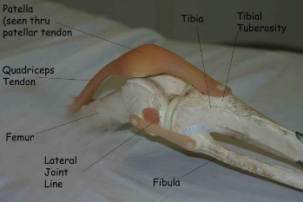
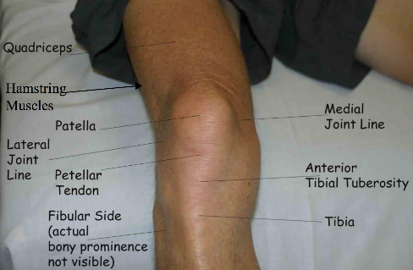
Feel
Tenderness:
Generalized: to start with
Specific:
Quadriceps M
Patella
Patellar tendon
Tibial tuberosity
Joint lines: med./lat.
Collateral ligs.
Head of Fibula
Popliteal fossa
Hamstrings
https://meded.ucsd.edu/clinicalmed/joints

Slide 28
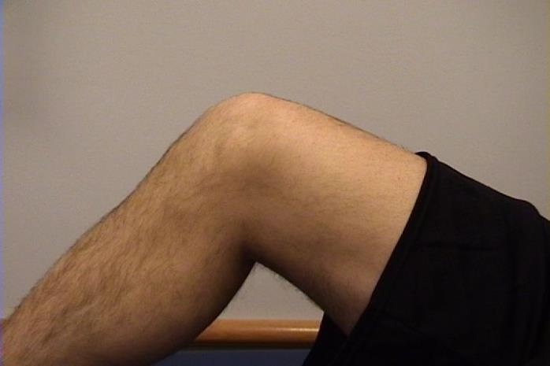

Knee – Medial
Tibial
Tuberosity
Patella
Medial
Femoral
Condyle
Joint
Line
Medial
Tibial
Condyle

Slide 29
Knee – Medial
Medial Collateral Ligament (MCL)*

Slide 30
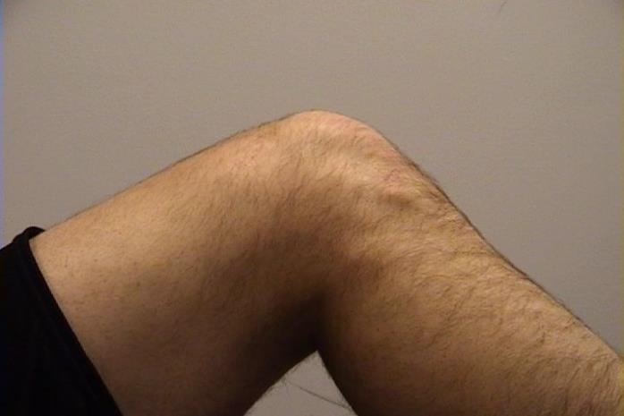
Knee - Lateral
Patella
Quadriceps
Tibial
Tuberosity
Head
Of
Fibula

Slide 31
Knee - Lateral
Quadriceps
Lateral Collateral
Ligament (LCL)**
Lateral joint
line

Slide 32
Feel
Temperature: compare distal/proximal, R / L
www.osceskills.com

Slide 33
Feel
Anatomic:
Skin: dryness, hyper/hyposthesia, scars
Subcut.: LN, nerves, vessels, tendons, nodules
Muscle (Quadriceps): tone, bulk, twitches, gaps, tenderness – (measure girth if needed)
http://www.suggestkeyword.com

Slide 34
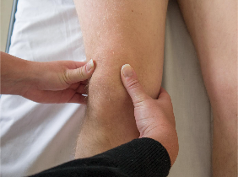

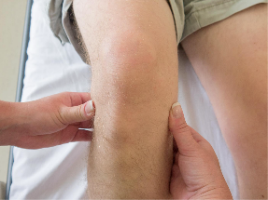
Feel
Anatomic:
Bone: landmarks (Patella, Tib. Tuberos., head of Fibula) tenderness, mass, crepitus
www.osceskills.com

Slide 35
Feel
Anatomic:
Joint lines: anterior, medial, lateral
http://www.kneeclinic.com.au

Slide 36
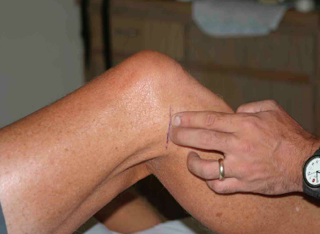
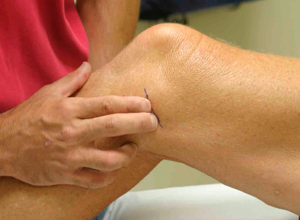
Feel
Anatomic:
Joint: swelling, effusion, crepitation, synovial thickening, joint line tenderness
https://meded.ucsd.edu/clinicalmed/joints

Slide 37

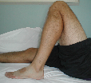
Move
Active Vs. Passive
Better to start with active
Need to assess the range of motion
painless / painful
Extension: 0º Flexion: 140º
Describe loss of degrees of extension
Example: “lacks 5 degrees of extension”

Slide 38
Move
Locking:
Patient unable to fully extend or flex knee due to a mechanical blockage in the knee (i.e., loose body, bucket-handle meniscus tear)

Slide 39
Move
Normal range:
Flexion / Extension
Abnormal range:
Anything less
Increased
Within normal direction:
hyper-extension
Abnormal direction:
unstable
http://benefitscroungingscum.blogspot.com

Slide 40
Special tests
Patella-related
Effusion
Ligaments
Collaterals
Cruciate
Menisci
Gait – walking

Slide 41

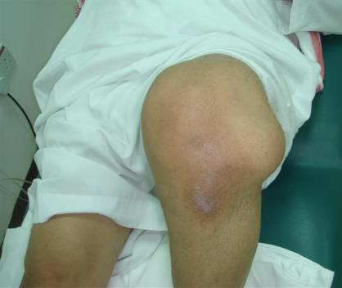
Special tests
Patella-related:
Patellar tracking: while knee flexes
Dr AbduAziz AlAhaideb

Slide 42
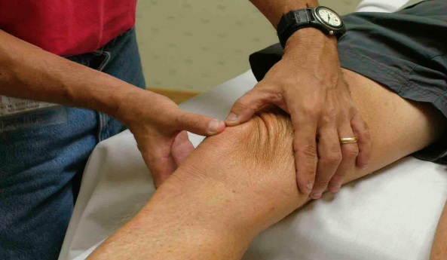
Special tests
Patella-related:
Patellofemoral grind test (chondromalacia, osteoarthritis)
Compress patella down while quadriceps tightens
Positive when painful
https://meded.ucsd.edu/clinicalmed/joints
Notes:
Patellofemoral grind test
Patient supine with knees extended
Examiner’s thumb on superior patella
Pt. contracts quadriceps muscle
Examiner applies downward and inferior pressure
Positive - pain with movement or unable to complete test
Positive test suggests patellofemoral dysfunction (patellofemoral stress syndrome)

Slide 43
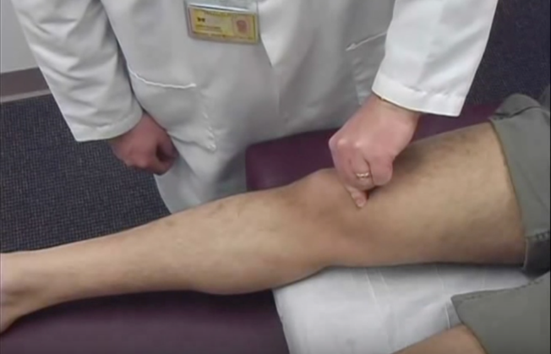
Special tests
Patella-related:
Patello-femoral (chondromalacia, osteoarthritis)
Resist patellar motion while quadriceps tightens
Positive when painful
University of Michigan, Dept. of Family Medicine

Slide 44
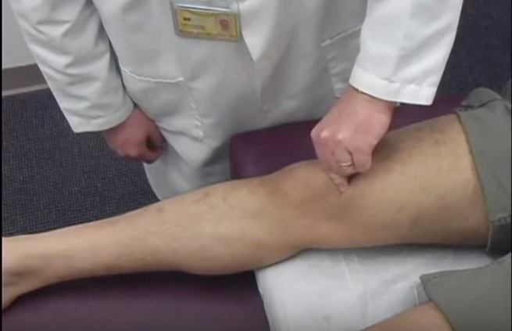
Special tests
Patella-related:
Patello-femoral (chondromalacia, osteoarthritis)
Resist patellar motion while quadriceps tightens
Positive when painful
University of Michigan, Dept. of Family Medicine

Slide 45
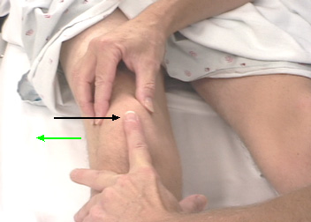
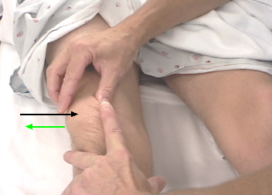
Special tests
Patella-related:
Patellar apprehension test
Starting position
Push patella laterally
http://www.sportsdoc.umn.edu/Clinical_Folder/Knee_Folder/Knee_Exam/lateral%20patellar%20apprehension.htm)
Notes:
Patellar apprehension test:
Apply firm, laterally-directed force toward medial aspect of patella
Positive test is trepidation of the patient (pain or fear that patella will dislocate)
Positive test implies a preceding episode of patellar instability (subluxation or dislocation)

Slide 46
Special tests
Patella-related:
Patellar tracking
Patellar grinding
Apprehension test
http://skat.ihmc.us/
http://gelenk-klinik.de/orthopaedische

Slide 47
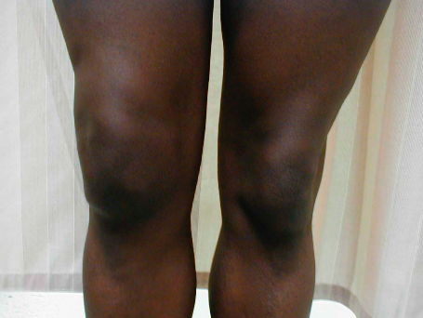
Special tests
Effusion:
Large effusion is easy to see
http://howshealth.com
https://meded.ucsd.edu/clinicalmed/joints

Slide 48
Special tests
Effusion:
Large effusion is easy to see
Look at normal depression medial to patella
If present, “milking” test may demonstrate minimal effusion

Slide 49
Special tests
Effusion:
Large effusion is easy to see
Look at normal depression medial to patella
If obliterated, fluid can be pushed away, but reappears as hand is removed: mild effusion

Slide 50
Special tests
Effusion:
Large effusion is easy to see
Look at normal depression medial to patella
If obliterated, and fluid can not be pushed away by hand: moderate effusion

Slide 51
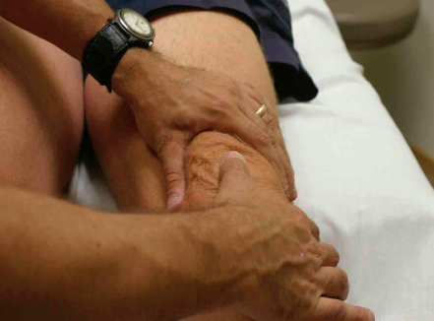
Special tests
Effusion:
Large effusion is easy to see
Look at normal depression medial to patella
If positive patellar tap (Balloting): moderate/severe effusion
https://meded.ucsd.edu/clinicalmed/joints

Slide 52
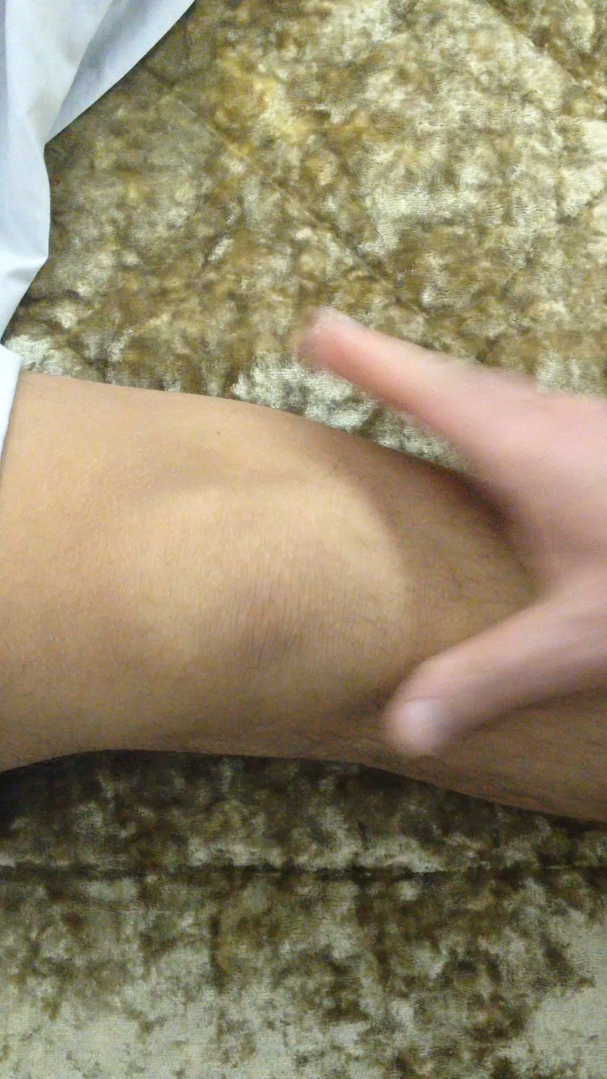

Slide 53
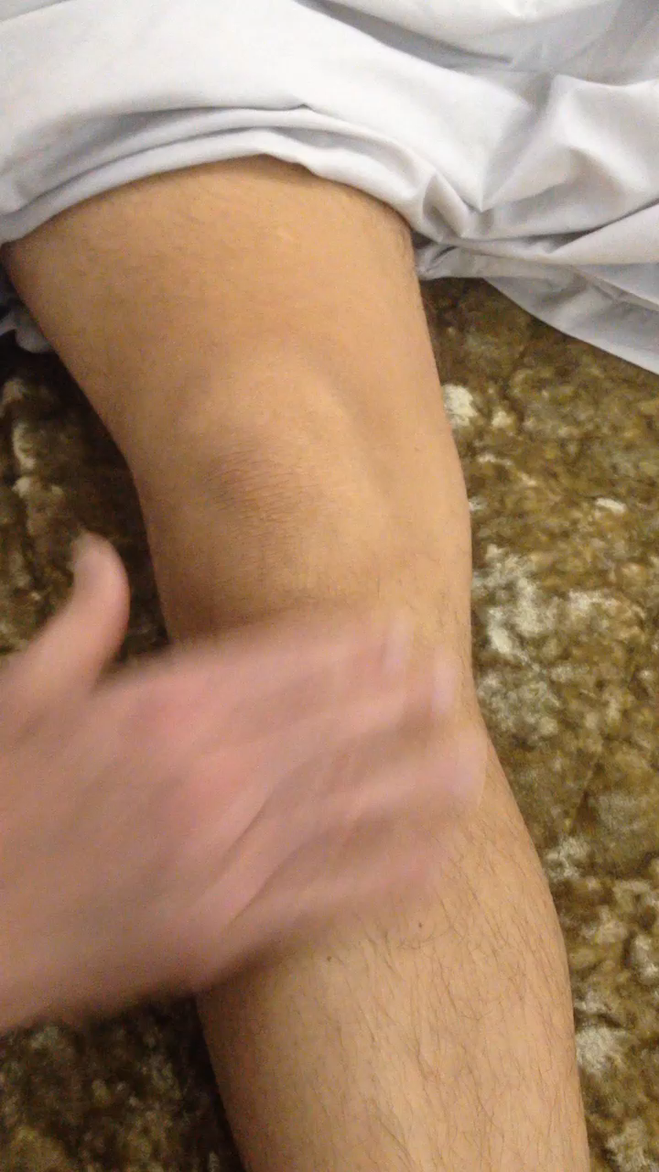

Slide 54
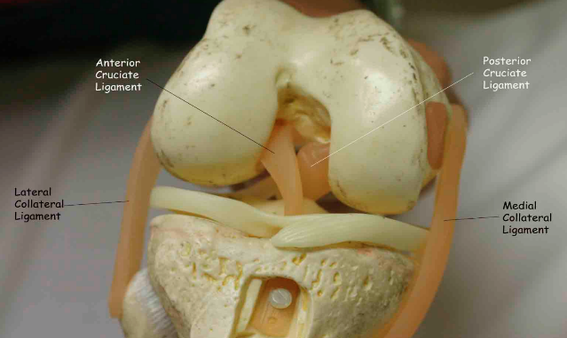
Special tests
Ligaments
Collateral ligaments: Medial / Lateral
Cruciate ligaments: Anterior / Posterior
https://meded.ucsd.edu/clinicalmed/joints

Slide 55
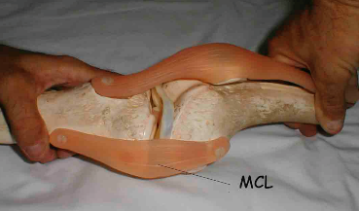
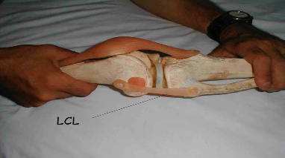
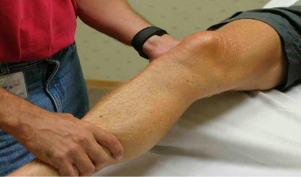
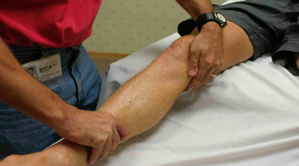
Special tests
Collateral Ligaments
Stress test, with knee slightly flexed
https://meded.ucsd.edu/clinicalmed/joints

Slide 56
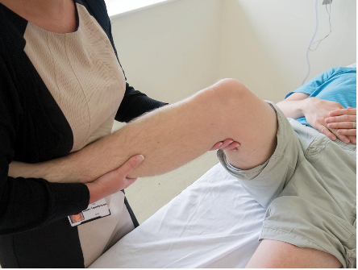
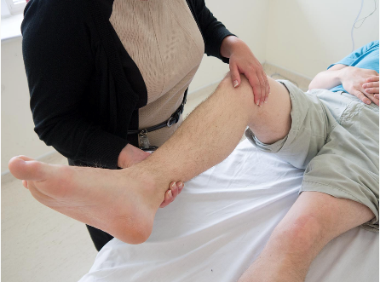
Special tests
Collateral Ligaments
Stress test, with knee slightly flexed
www.osceskills.com

Slide 57
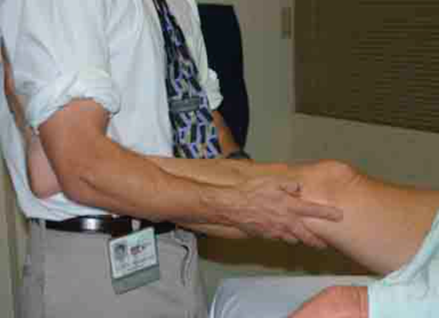
Special tests
Ligaments
Collaterals: “alternative technique”
https://meded.ucsd.edu/clinicalmed/joints

Slide 58
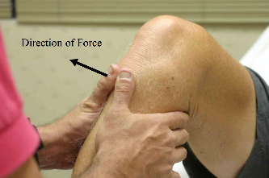
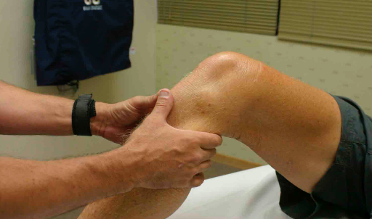
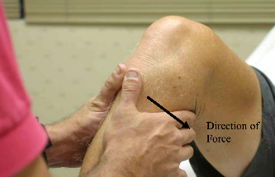
Special tests
Cruciate ligaments
Anterior / Posterior Drawer Test
https://meded.ucsd.edu/clinicalmed/joints

Slide 59
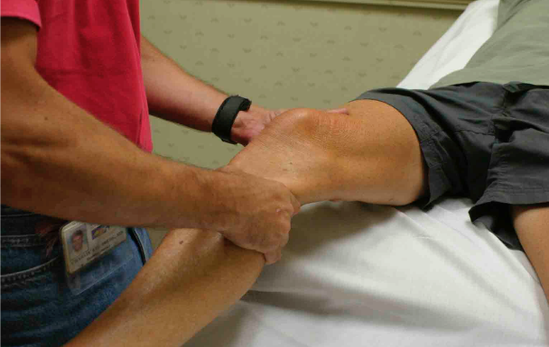
Special tests
Cruciate ligaments
Anterior / Posterior Drawer Test
Lachman’s
https://meded.ucsd.edu/clinicalmed/joints

Slide 60
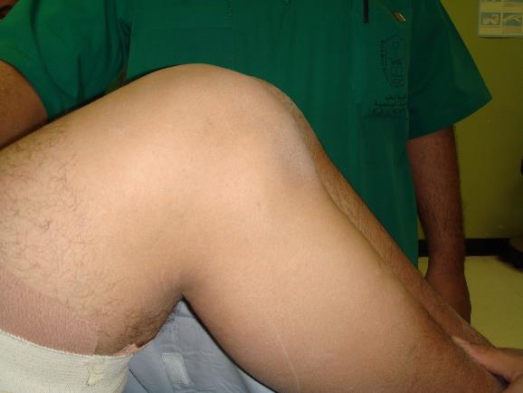
Special tests
Cruciate ligaments
Sagging sign: Posterior cruciate torn
Dr AbduAziz AlAhaideb

Slide 61
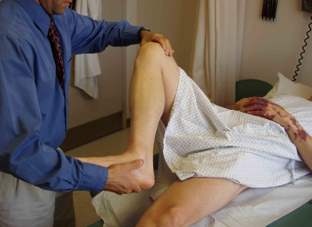
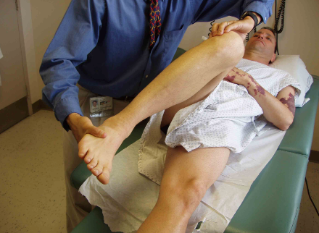
Special tests
Menisci:
McMurray’s test for medial & lateral meniscus
https://meded.ucsd.edu/clinicalmed/joints

Slide 62
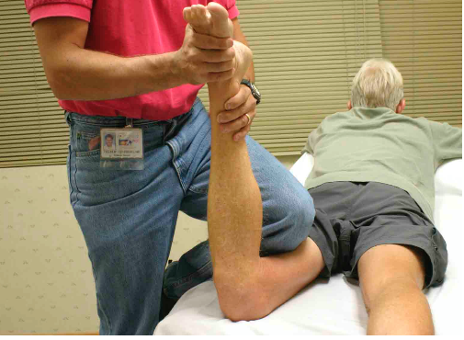
Special tests
Menisci:
McMurray’s test for medial & lateral meniscus
Appley grinding test
https://meded.ucsd.edu/clinicalmed/joints

Slide 63
Special tests
Gait – walking
www.osceskills.com

Slide 64
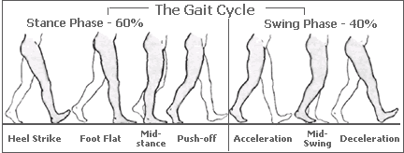
Special Tests: Gait
The Normal Gait Cycle
Stance phase (60%)
Swing phase (40%)
Heel strike
Foot flat - mid-stance
Push off
Acceleration
Mid-swing
Deceleration
http://www.root2being.com/foot-function.html

Slide 65
Special Tests: Gait
Gait | Explanation
Normal | Normal stance and swing phases
Antalgic | Painful to weight-bear – short stance phase
Lurch | Shortening – painless limping – normal stance period
Circumduction | Stiff hip – motion of pelvis compensates
High Step | Foot drop – more hip & knee flexion needed to free toes from ground
Tip-toe | Heel off the ground

Slide 66
Summary

Slide 67
Knee Examination
Look
General ➔ on patient
General ➔ local (knee, thigh, leg):
Position, Major deformity, swelling, Extra
Anatomic local
Feel
Tenderness, Temperature, Anatomical
Move
Active, Passive
Special tests

Slide 68
Special tests
Patella-related
Effusion
Ligaments
Collaterals
Cruciate
Menisci
Gait – walking

