Slide 1

Examination of the
Shoulder
Prof. Mamoun Kremli
AlMaarefa Medical College

Slide 2
Orthopedic Examination
Which system to use?
  Look
  Feel
  Move
  Special tests

Slide 3
Look
General on patient
General local – shoulder, arm, upper limb
  Position
  Major deformity- swelling
  Extra – cast, splint, traction, dressing …
Anatomic local
  Skin : swelling, scars, colour, hair, dryness …
  Subcut. : LN, veins, nerves, tendons ….
  Muscles : bulk, wasting, twitches ….
  Bones : landmarks, swelling, angulation and deformity.
  Joints : position, swelling, redness..

Slide 4
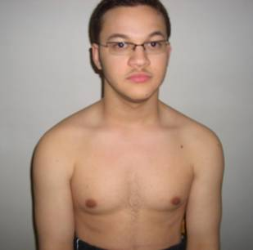
Look
General on patient :
  Lying comfortably in bed, not in pain.
  Lying in bed in pain keeping the R upper limb on his chest.
  Standing with the R shoulder adducted and internally rotated and elbow extended.
  Sitting uncomfortably in a chair with R forearm in an arm sling.

Slide 5
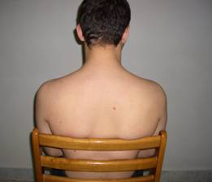
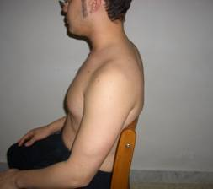
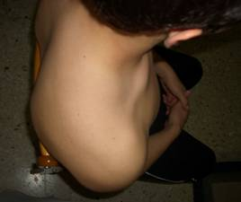
Look
Anterior
Posterior
Lateral
Above
Axilla

Slide 6
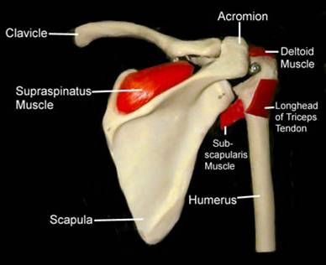
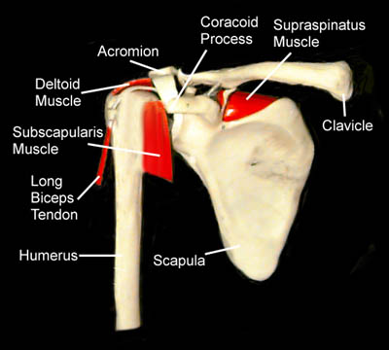
Look

Slide 7
Look
General local
Shoulder – Arm – Upper Limb
  Position
    Abduction
    Adduction
    Flexion
    Rotation

Slide 8
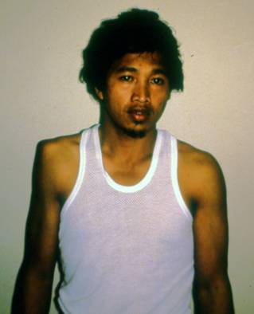
Look
General local
Shoulder - Arm – Upper Limb
  Major deformity- swelling
    Contour
    Masses
    Asymmetry

Slide 9
Look
General local
Shoulder - Arm –Upper Limb
  Extra
    Cast
    Splint
    Traction
    Dressing …

Slide 10
Look
Anatomic local
  Skin : swelling, scars, colour, hair, dryness …
  Subcut. : LN, veins, nerves, tendons ….
  Muscles : bulk, wasting, twitches ….
  Bones : landmarks, swelling, angulation and deformity
    (sterno-clavicular, acromio-clavicular, greater tuberosity, scapula)
  Joints : position
  (Don’t forget Posterior / Lateral / Superior !)

Slide 11
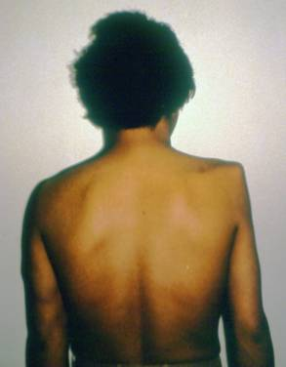
Look
Anatomic local
  Muscles : bulk, wasting, twitches
  With the patient sitting, look for atrophy in three sites:
    The supraspinatus fossa
    The infraspinatus fossa
    The deltoid
  This demonstrates weakness due either to a rotator cuff tear, or a neurological deficit.

Slide 12
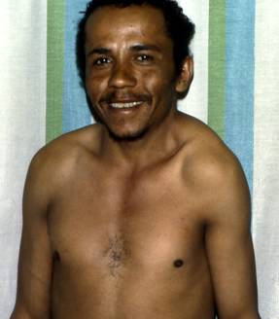
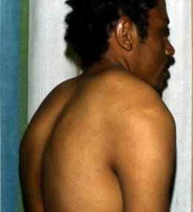
Look
Anatomic local
  Bones / Joints:
  landmarks,swelling,
  angulation and deformity.
    Sterno-clavicular joint.
    Clavicle.
    Acromio-clavicular joint.
    Greater tuberosity.
    Scapula and scapular spine

Slide 13
Look
Important Considerations:
  Amount of exposure
  Duration of exposure
  Persons present during exposure
  Place of exposure
  Attitude and behavior during exposure

Slide 14
Feel
What do we look at?
What do we look for?
Do we need a sub-system?

Slide 15
Feel
Tenderness:
  Generalized / specific
Temperature:
  compare distal/proximal, compare Rt/Lt
Anatomic:
  Skin : dryness, hyper/hypothesia, scars
  Subcut. : LN, nerves, vessels, tendons, nodules
  Muscle : tone, bulk, twitches, gaps, tenderness
  Bone : tenderness, mass, crepitus, landmarks:
  ( Sternoclavicular, Acromioclavicular, Coracoid Process, Greater Tuberosity, scapular spine, and scapula ).
  Joint : swelling, effusion, crepitation, synovial thickening, joint line tenderness.

Slide 16
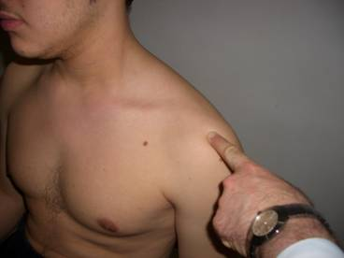
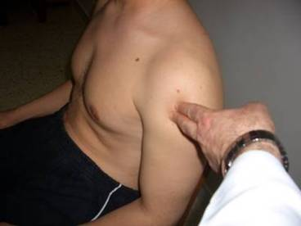
Feel
Acromio-clavicular Jt.
Bicipital groove

Slide 17
Move
Shoulder joint motion is associated with Scapulo-thoracic motion
Practically we deal with BOTH as one joint

Slide 18
Move
Active / Passive
Start with active range of motion
Supplement with passive if active not full

Slide 19
Move
Movement Directions (normal range)
  Abduction (150º)
  Forward flexion (180º)
  Extension (45º)
  External Rotation (90º), elbow at 90º
    With arm comfortably at side
    With arm at 90o abduction
  Internal rotation (90º)

Slide 20
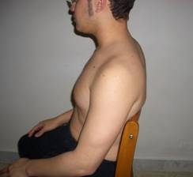
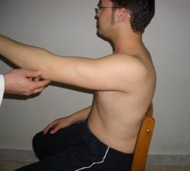
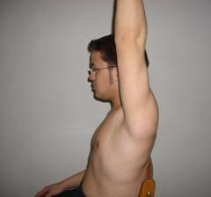
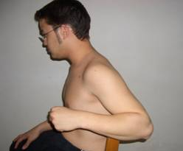
Move: Flexion / Extension

Slide 21
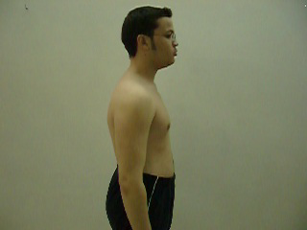
Move: Flexion / Extension

Slide 22
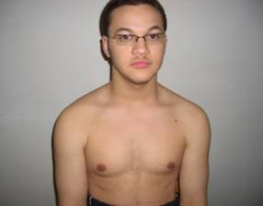
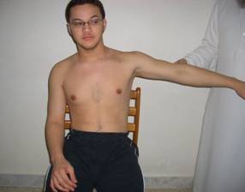
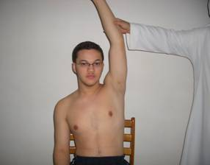
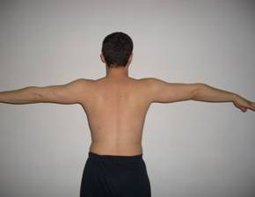
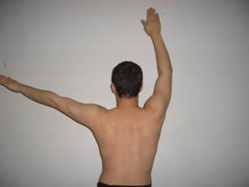
Move: Abduction / Adduction

Slide 23
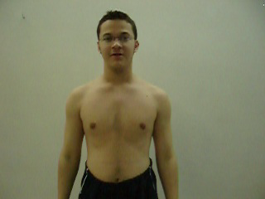
Move: Abduction / Adduction
Look at :
  Range of motion
  Smoothness of motion
  Painful motion

Slide 24
Move: Abduction / Adduction
Shoulder abduction involves the gleno-humeral joint and the scapulo-thoracic articulation
The first 20º - 30º of abduction should not require scapulo-thoracic motion

Slide 25
Move: Abduction / Painful Arc
active abduction:
  Initiation, range, rhythm
  Note the arc of painful movement
    Initiation of abduction: Supraspinatus
    Middle abduction (30º–90º): Rotator cuff
    Extreme abduction (>90º): Acromio-clavicular

Slide 26
Move: Abduction / Painful Arc
active abduction:
  Note the arc of painful movement
empodcasts.com

Slide 27
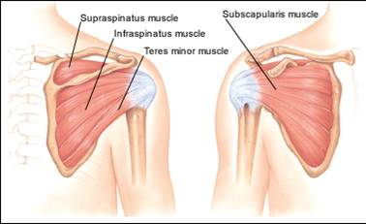
Move: Internal / External Rotation

Slide 28
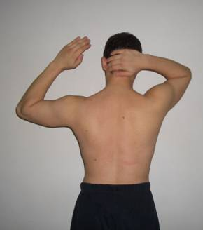
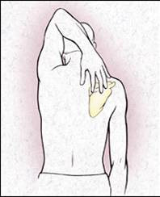
Move Internal / External Rotation
Apley’s Scratch Test
Abduction and External Rotation

Slide 29
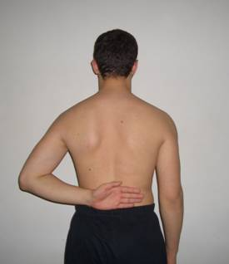
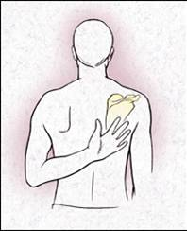
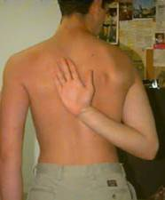
Move Internal / External Rotation
Apley’s Scratch Test
Adduction and Internal Rotation
Limited Normal

Slide 30
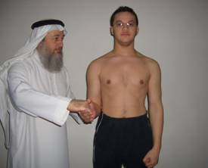
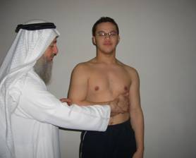
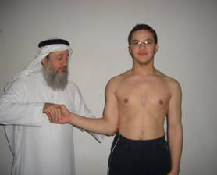
Move Internal / External Rotation
In neutral position
Keep elbow at patient’s side

Slide 31
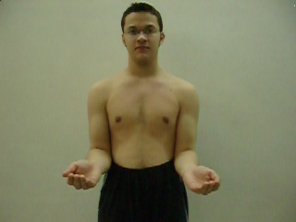
Move Internal / External Rotation
In neutral position
Keep elbow at patient’s side

Slide 32
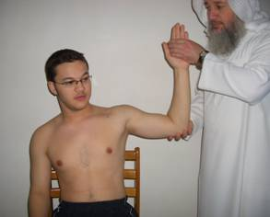
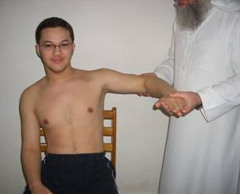
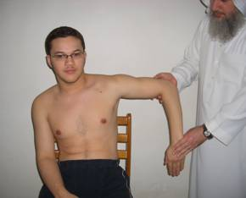
Move Internal / External Rotation
In abduction

Slide 33
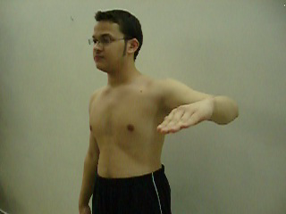
Move Internal / External Rotation
In Abduction

Slide 34
Special Tests
Apprehension test
Impingement tests
Muscle power tests
Axillary nerve assessment

Slide 35
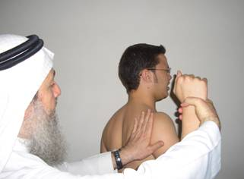
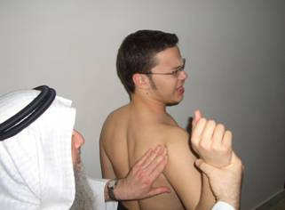
Apprehension test
Technique
  Patient's Start Position:
    Elbow flexed 90o
    Shoulder abducted 90o
  Apprehension Maneuver:
    Examiner holds patient's wrist
    Apply forward pressure from behind shoulder
    Externally rotate shoulder
    Positive if causes apprehension

Slide 36
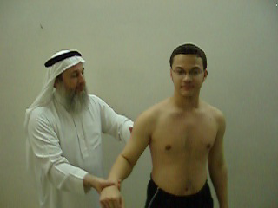
Apprehension test

Slide 37
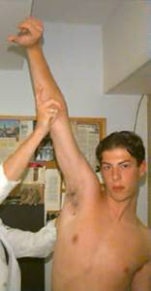
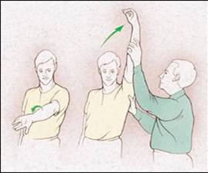
Neer's Impingement Test
Tests for impingement of the rotator cuff tendons under the coracoacromial arch
  Internally rotate the arm with
  the thumb facing downward
  Abduct and forward flex
  the arm
  If impingement is present,
  the patient will experience
  pain as the arm is abducted

Slide 38
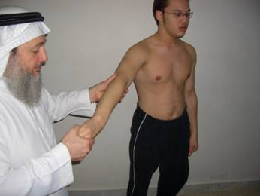
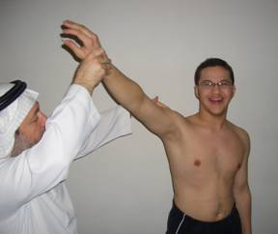
Neer's Impingement Test

Slide 39
Hawkins' Impingement Test
Tests for subacromial impingement or rotator cuff tendinitis.
The arm is forward elevated to 90 degrees, then forcibly internally rotated.

Slide 40
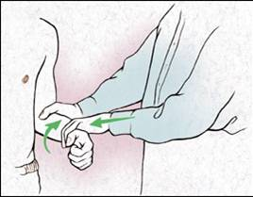
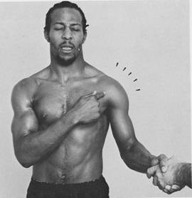
Yergason Test (Biceps tendon)
Test for biceps tendon instability or tendinitis
  The patient's elbow is flexed to 90o
  The examiner resists the patient's active attempts to supinate the arm and flex the elbow

Slide 41
Special Tests
Muscle power tests:
  Abductors / Adductors
  Internal / External Rotators
  Serratus Anterior (winging)
  Biceps Brachii

Slide 42
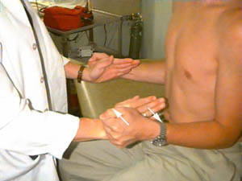
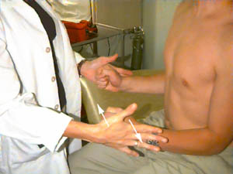
Muscle power
External / Internal Rotators Strength Test

Slide 43
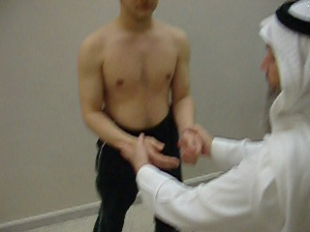
Special Tests: Muscle power
External / Internal Rotators Strength Test

Slide 44
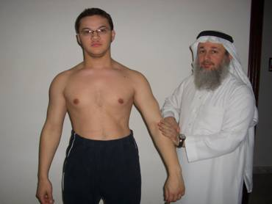

Special Tests: Muscle power
Supraspinatus Test
  Assess power and for look for pain on resisted action

Slide 45


Special Tests: Muscle power
Serratus Anterior - Scapular Winging
  Nerve to Serratus Anterior – The Long Thoracic Nerve

Slide 46

Special Tests: Muscle power
Serratus Anterior - Scapular Winging
  Nerve to Serratus Anterior – The Long Thoracic Nerve

Slide 47


Special Tests: Biceps Tendon
Look for tenderness / pain on resisted action
  Ruptured long head.

Slide 48
Axillary nerve assessment
Motor : active abduction (Deltoid)
Sensory : upper lateral aspect of arm

Slide 49
Summary
Shoulder examination follows the usual
  Look, Feel, Move, Special tests
Active motion is more important
  Gleno-humeral and scapulo-thoracic together
Special tests:
  Apprehension test
  Impingement tests
  Muscle power tests
  Axillary nerve assessment

