Slide 1
History Taking in MSK Trauma
Prof. Mamoun Kremli
Dr.Tarif Al Akhras

Slide 2
History taking
Patient's story / or companion’s
Doctor/student reconstructs the history
  Open ended questions
    How did it happen?
  Leading questions
    Were you able to stand/walk after the injury?
    What increases the pain?
    Did you vomit?

Slide 3
History Structure
Follow History theme
  Patient Demographic
  Chief Complaint
  History of Presenting Complaint
  Past medical/surgical history
  Medication/allergy history
  Family history
  Social history
  Diet
  Activity
  Systemic review
Relate to function

Slide 4
Trauma History
Detailed of injury:
  Mechanism of injury. High Vs. Low velocity Open Vs. Closed
  Date, time, type, force, method of impact, direction,
  Consciousness level.
  Other injuries. Life/ Limb threatening
  Other medical problems
Details of facture:
  pain. Swelling, Deformity, movement of injured part
  wounds/ bleeding.
  Anti-Tetanus status (if skin breached)
  Other major injuries
Relate to function
Details of initial management

Slide 5
Trauma History
For all cases, ask about
  Progression
  Previous investigations
  Previous treatment
Careful:
  Fractures are not always at the site of impact
  Some fractures do not need severe force
From Trauma history, you should be able to differentiate
  Low energy from High energy trauma

Slide 6
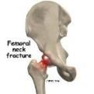
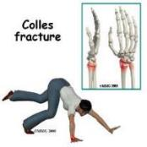
Trauma History
Low Energy:
  When, Where, How?
  AMPLE History(acute):
    Allergy,
    Medication,
    Past Medical & Surgical History,
    Last Meal,
    Event(How? Or Mechanism of injury)
All covered by our history, except: Last meal

Slide 7
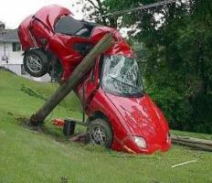
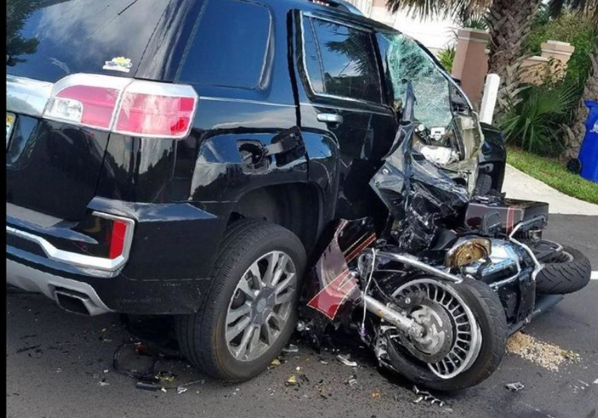
Trauma History
High Energy:
  Road Traffic Accident (RTA)
    Low energy Qs,
    Driver / Passenger / Pedestrian
    Seat belted / non-belted
    Speed and location of impact
    Position of the patient and the limb at impact
    Severity of crash
      Need to use the “Jaws of Life”
    Type:
      Head-on collision. Side impact. Car turn-over
http://trendingnow-2016.blogspot.com
https://www.reaction.cam/
ionconnects.com
https://imgflip.com/
https://www.fox30jax.com
https://www.sandiegopersonalinjuryattorneys.com

Slide 8
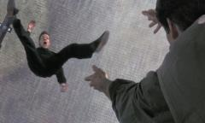
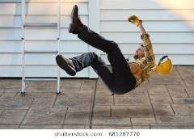
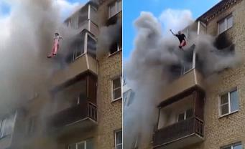
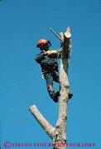
Trauma History
High Energy:
  Fall from Height
    Low injury Qs
    How many levels
    Position of the patient and the limb at impact
    Missed injuries
      combination injuries
https://www.dailymotion.com
https://videos-mdr.com

Slide 9
? Pathological fractures
Minor trauma (e.g. slipped at home) indicates a pathological fracture
  In elderly:
    Osteoporosis: Diet, sun exposure, risk factors of osteoporosis
    Secondary metastasis: history of known malignancy, systematic review carefully looking for unknown primary
  In younger: look for cause of weak bone
    Osteomalacia, hyperparathyroid, bone disease
  In very young: local pathology: cyst, infection

Slide 10
Trauma Case History
A 25-tear-old injured his knee while playing football
  Mechanism of injury
  Swelling:
    Immediate: hemarthrosis: Cruciate / fracture
    Later: effusion: meniscal injury
  History of locking / giving way

Slide 11
Trauma Case History
A 32-year-old female was brought to the emergency room after a motor vehicle accident
A 45-year-old man was seen in the emergency room after falling from a scaffold in a building site
A 65-year-old lady presented to the emergency room with pain in right hip after falling at home

