Slide 1
How to Read Musculoskeletal X-Rays
Prof. Mamoun Kremli
Dr. Tarif Alakhras

Slide 2
Introduction
X-rays are part of diagnostic tools
When requesting an X-ray, information given (written) helps in reaching a diagnosis
  Important points in history
  Relevant physical findings
  Age and sex
  Differential diagnosis
  Question(s) to be answered
  Required views should be mentioned

Slide 3
X-ray Request Form
Name of the institution
Name of the patient, including UR number, date of birth, gender
Indicates if the patient is ambulant, arriving in a wheel chair or confined to a bed
Any allergies applicable to the imaging procedure e.g. allergy to contrast media

Slide 4
X-ray Request Form
The name of the referring doctor, signature and date of request
Contact details of referring doctor, in this case an internal pager number is given
Clinical details of the patient, to enable the radiographer to perform the most beneficial views and information for the radiologist to assist with reporting

Slide 5
X-ray Request Form
indicates if previous imaging studies have been performed for this patient at this department, old films are an excellent source of information as they enable you to compare images over time
What examination has been requested e.g. chest x-ray
Where is the patient located e.g. Emergency Department
The head of the department of the referring doctor, often for billing purposes

Slide 6
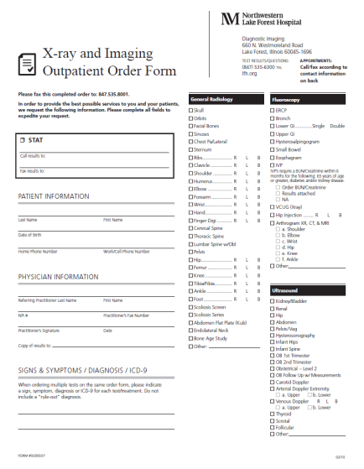
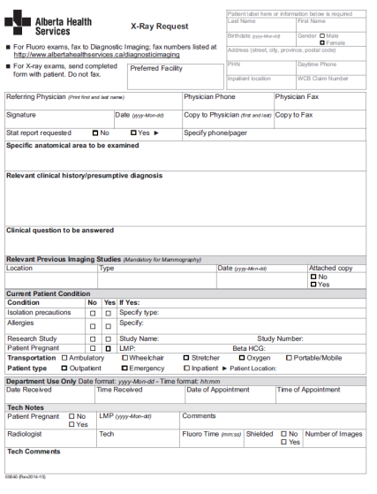
X-ray Request Form

Slide 7
Reading X-rays
General information
Reading bone
Reading joints
Reading soft tissues

Slide 8
General Information
Identify patient’s information
  Name, sex, age, file number, date of X-ray
Anatomical area
  What parts are seen on the film
View(s)
  AP, Lat., Oblique, Special, ….
X-ray quality
Extra:
  In full cast. cast slab, splint, traction pin, implants….

Slide 9
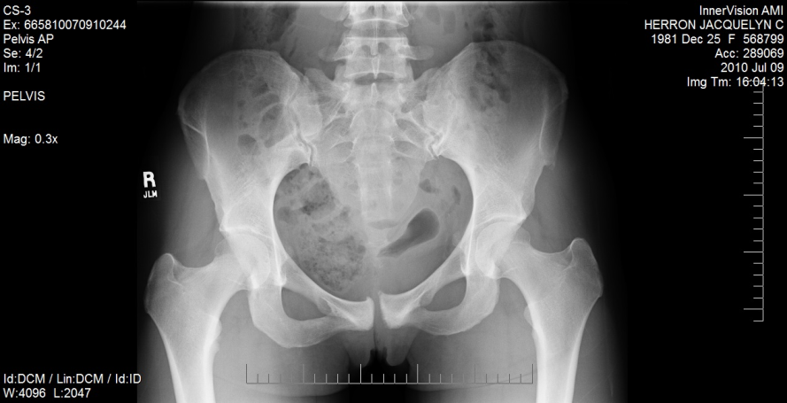
General Information
Identify patient’s information
  Name, sex, age, file number, date of X-ray
Anatomical area
  What parts are seen on the film
View(s)
  AP, Lat., Oblique, Special, ….
X-ray quality
Extra:
  In full cast. cast slab, splint, traction pin, implants….
camilleherron.com

Slide 10
General Information
Identify patient’s information
  Name, sex, age, file number, date of X-ray
Anatomical area
  What parts are seen on the film
View(s)
  AP, Lat., Oblique, Special, ….
X-ray quality
Extra:
  In full cast. cast slab, splint, traction pin, implants….
radiopaedia.org
www.dreamstime.com

Slide 11
General Information
Identify patient’s information
  Name, sex, age, file number, date of X-ray
Anatomical area
  What parts are seen on the film
View(s)
  AP, Lat., Oblique, Special, ….
radiopaedia.org
www.vwmin.org

Slide 12
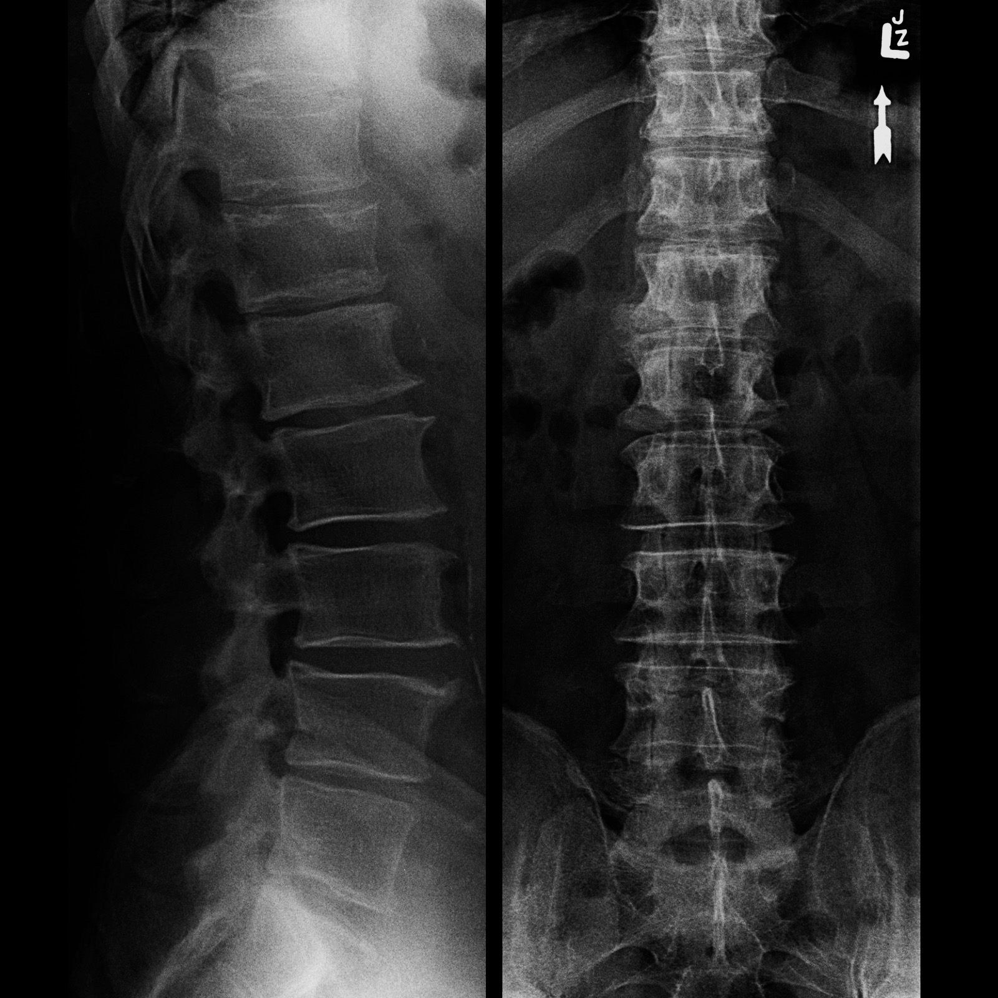
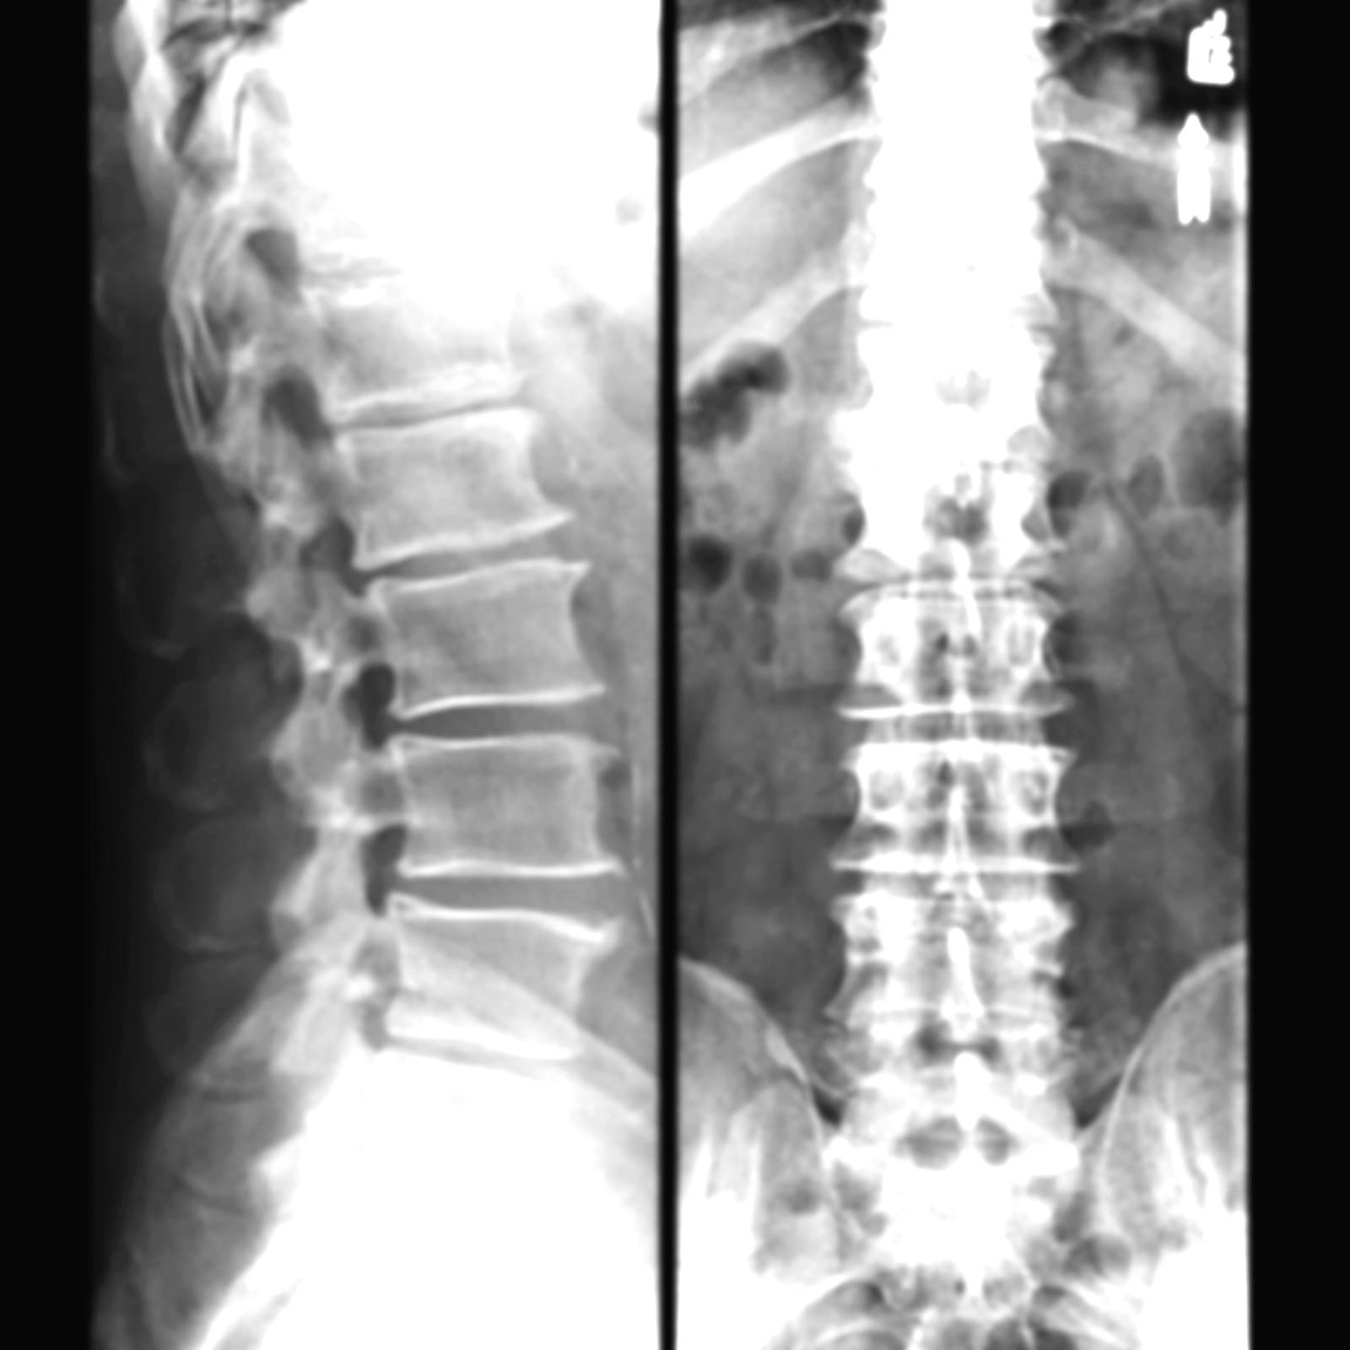
General Information
Identify patient’s information
  Name, sex, age, file number, date of X-ray
Anatomical area
  What parts are seen on the film
View(s)
  AP, Lat., Oblique, Special, ….
X-ray quality
Under-exposed
Over-exposed

Slide 13
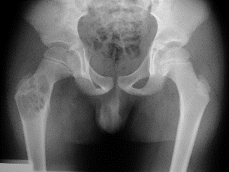
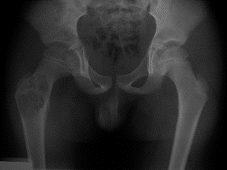
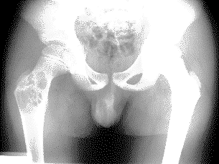
General Information
X-ray quality
  With new electronic x-ray formats
  Can change “contrast” & “brightness” as needed
M Kremli

Slide 14
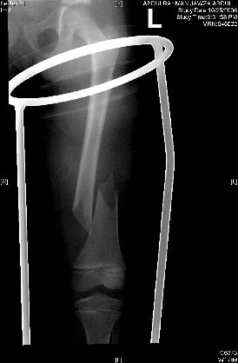
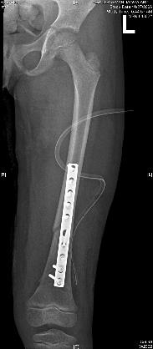
General Information
Identify patient’s information
  Name, sex, age, file number, date of X-ray
Anatomical area
  What parts are seen on the film
View(s)
  AP, Lat., Oblique, Special, ….
X-ray quality
Extra:
  In full cast. cast slab, splint, traction pin, implants….
openi.nlm.nih.gov
M Kremli
1aled.fotomaps.ru
M Kremli

Slide 15
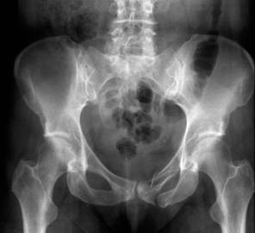
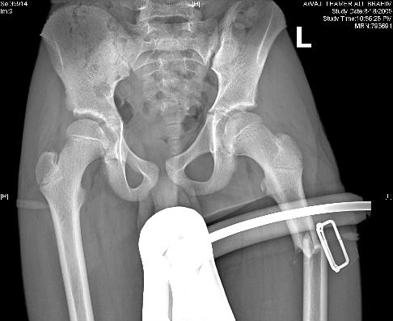

Reading Bone
Bone age
  Epiphyseal plates open/closed (child Vs. adult)
M Kremli

Slide 16
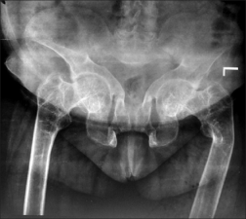
Reading Bone
Bone age
  Epiphyseal plates open/closed (child Vs. adult)
Bone Quality (Texture)
  Generalized
  Local area
  Cortex
  Medulla
www.ijem.in
Bone Tumors A Practical Guide to Imaging

Slide 17
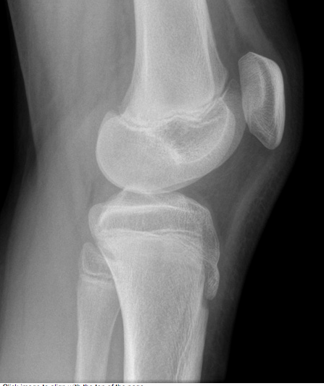
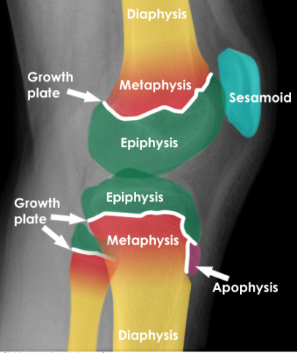
Bone Anatomy
http://radiologymasterclass.co.uk/

Slide 18
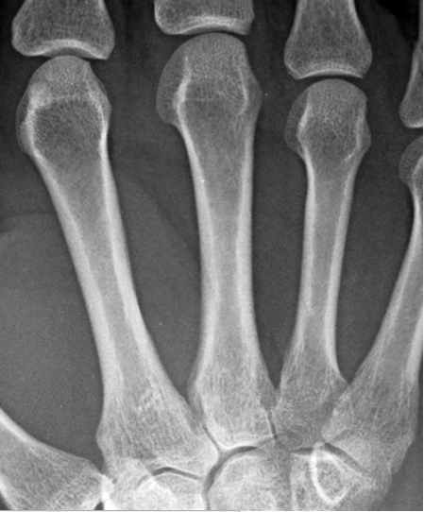
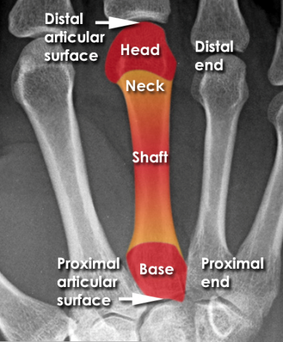
Descriptive Terms
http://radiologymasterclass.co.uk/

Slide 19
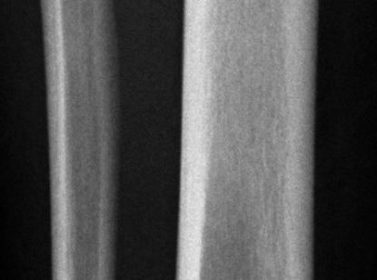
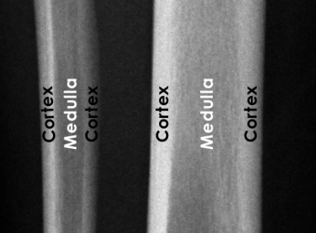
Bone Structure
http://radiologymasterclass.co.uk/

Slide 20
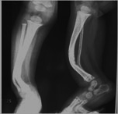
Reading Bone
Bone age
  Epiphyseal plates open/closed (child Vs. adult)
Bone Quality (Texture)
  Generalized
  Local area
  Cortex
  Medulla
Bone Morphology
  Shape, size, deformities,
kidzorth.com

Slide 21
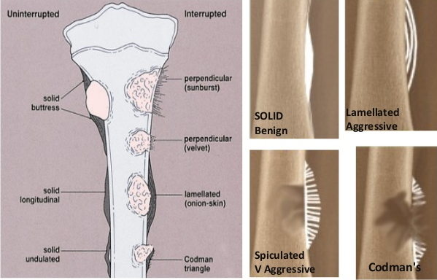
Reading Bone
Periosteal reaction
Bone growth
Bone destruction
Solid: Benign
Interrupted: Aggressive
  Lamellated / Sun-burst / Codman’s triangle
www.slideshare.net

Slide 22
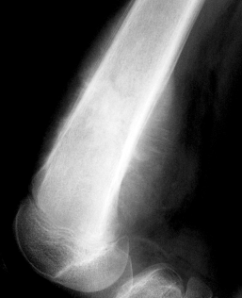
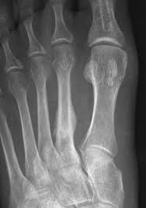
Reading Bone
Periosteal reaction
Bone growth
Bone destruction
radiopaedia.org
www.georgelianmd.com

Slide 23
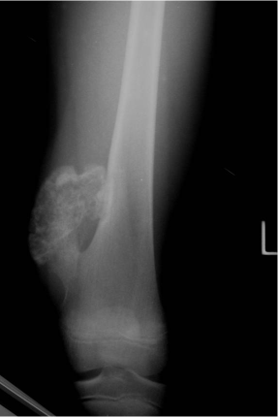
Reading Bone
Periosteal reaction
Bone growth
Bone destruction
www.tumorsurgery.org

Slide 24
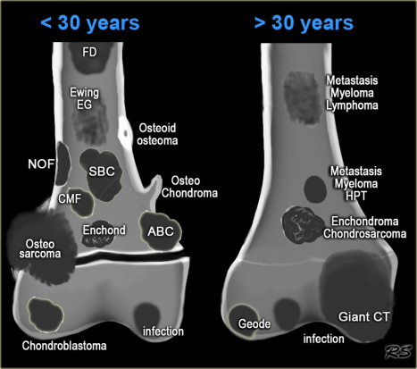
Reading Bone
Periosteal reaction
Bone growth
Bone destruction
www.radiologyassistant.nl

Slide 25
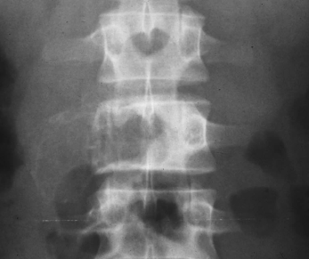
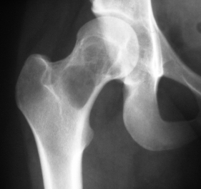
Reading Bone
Periosteal reaction
Bone growth
Bone destruction
Blinking Awl
www.tumorlibrary.com
www.orthopaedicsone.com

Slide 26
Reading Joints
Position
Relations
Alignment
Joint “Space”
Joint line
Subchondral bone

Slide 27
Joint Position
www.123rf.com

Slide 28
Joint Relations
imglop.com

Slide 29
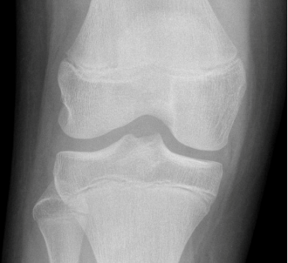
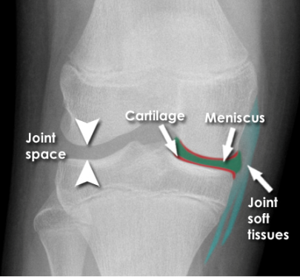
Reading Joint Anatomy
http://radiologymasterclass.co.uk/

Slide 30
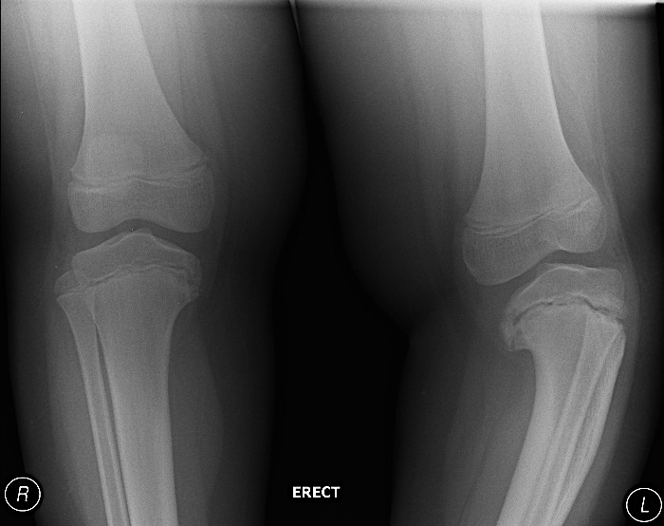
Bone and Joint Alignment
radiopaedia.org
www.emoryhealthcare.org

Slide 31
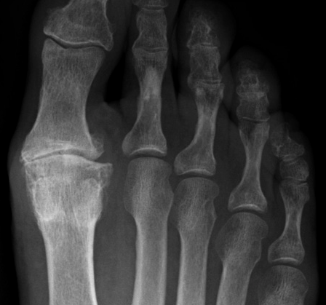
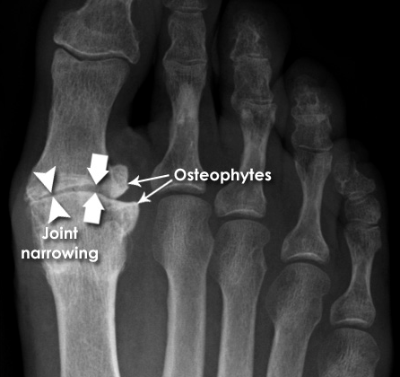
Joint Space
http://radiologymasterclass.co.uk/

Slide 32
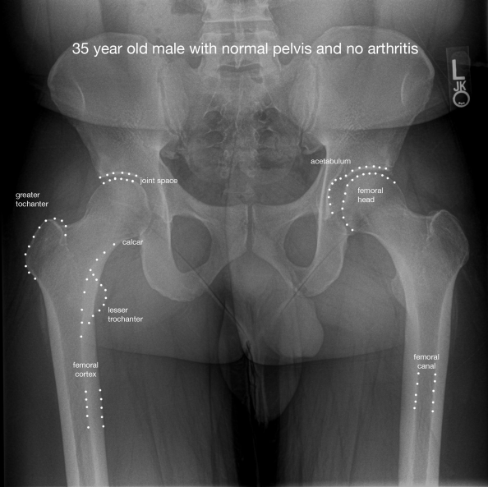
Bone and Joint
www.mercurywebsolutions.net

Slide 33
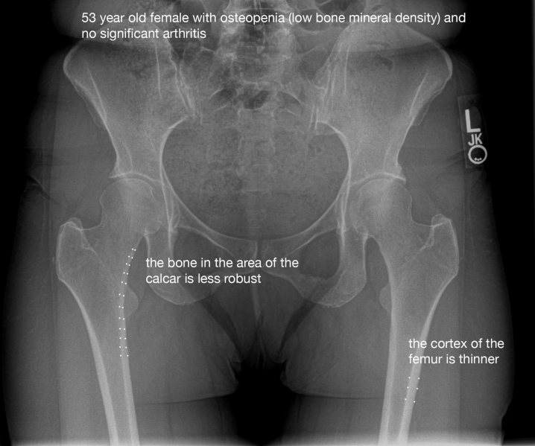
Bone and Joint
www.anteriorhipreview.com

Slide 34
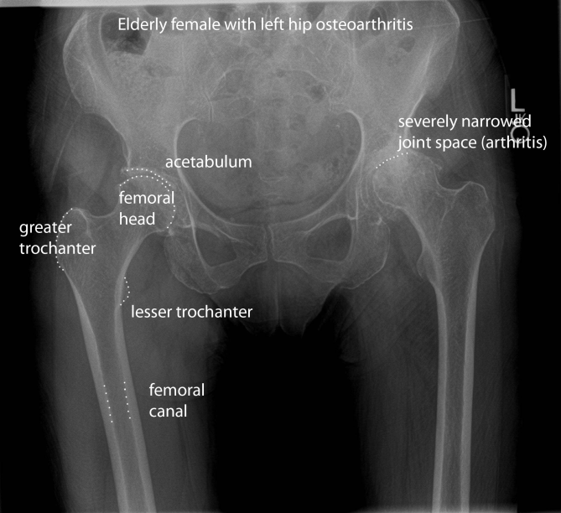
Bone and Joint
www.reddit.com

Slide 35
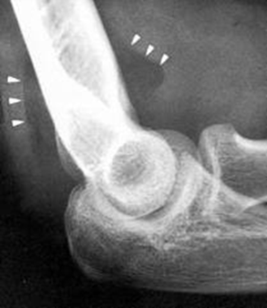
Soft Tissue Reading
In relation to bone cortex
Next to bone
  e.g. fat pad
Muscles
  Muscle planes, bulk
Other soft tissues
  Vessels, lungs, organs, cartilage
Calcifications, Air, Fluid, ….
usmorthopaedic.blogspot.com

Slide 36
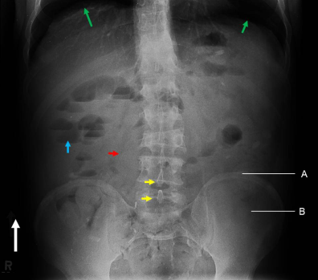
Soft Tissue Reading
In relation to bone cortex
Next to bone
  e.g. fat pad
Muscles
  Muscle planes, bulk
Other soft tissues
  Vessels, lungs, organs, cartilage
Calcifications, Air, Fluid, ….
www.ceessentials.net

Slide 37
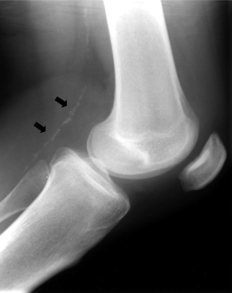
Soft Tissue Reading
In relation to bone cortex
Next to bone
  e.g. fat pad
Muscles
  Muscle planes, bulk
Other soft tissues
  Vessels, lungs, organs, cartilage
Calcifications, Air, Fluid, ….
circ.ahajournals.org

Slide 38
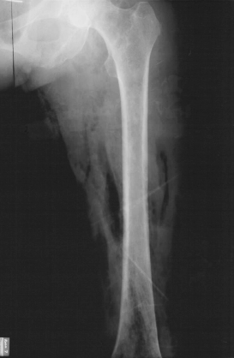
Soft Tissue Reading
In relation to bone cortex
Next to bone
  e.g. fat pad
Muscles
  Muscle planes, bulk
Other soft tissues
  Vessels, lungs, organs, cartilage
Calcifications, Air, Fluid, ….
file.scirp.org

Slide 39
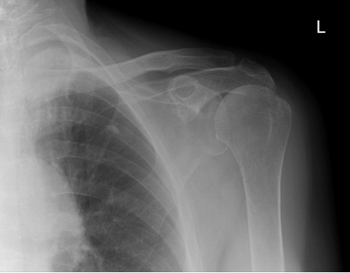
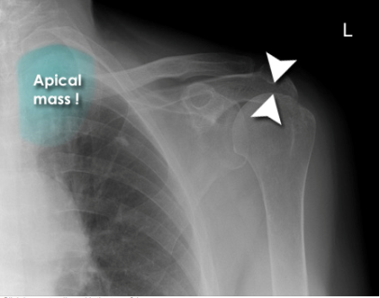
Look for the Unexpected
Minor narrowing of the subacromial space (arrowheads) - suggesting rotator cuff disease - very common cause of shoulder pain
It would be easy to consider this the only abnormality if not checking the image systematically
Unexpected apical lung mass!
Clinically suspected rotator cuff disease
Pain distal to the elbow - rarely if ever caused by shoulder pathology
Diagnosis
Minor rotator cuff disease
'Pancoast' tumour - apical lung cancer (cause of distal pain - referred from brachial plexus)
http://radiologymasterclass.co.uk/

Slide 40
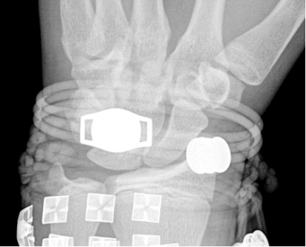
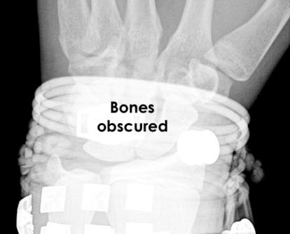
Artifacts Obscuring Diagnosis
http://radiologymasterclass.co.uk/

Slide 41
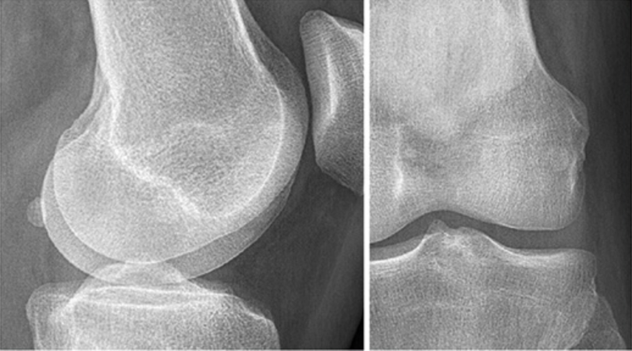
Reading Joints
http://www.startradiology.com/

Slide 42
The fabella - Normal
http://www.startradiology.com/

Slide 43
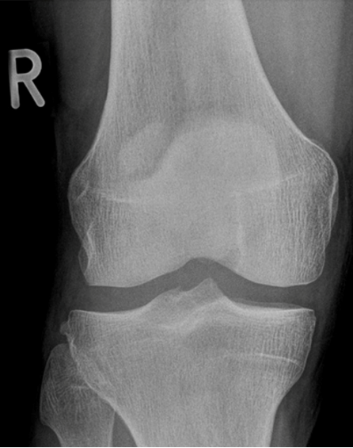
Bipartite patella - Normal
No localized tenderness
Superolateral
Line not that of a fresh fracture
http://www.startradiology.com/

Slide 44
Bipartite patella - Normal
No localized tenderness
Superolateral
Line not that of a fresh fracture
http://www.startradiology.com/

Slide 45
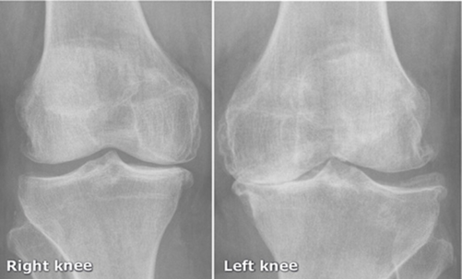
Reading Joints
http://www.startradiology.com/

Slide 46
Reading Joints
http://www.startradiology.com/

Slide 47
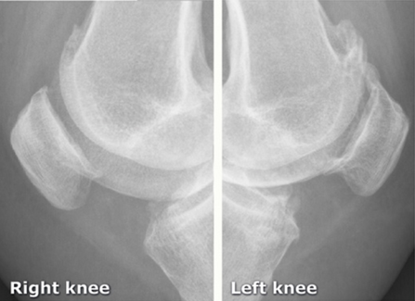
Reading Joints
http://www.startradiology.com/

Slide 48
Reading Joints
http://www.startradiology.com/

Slide 49
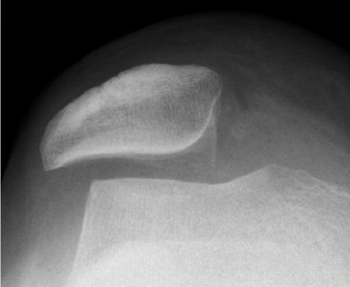
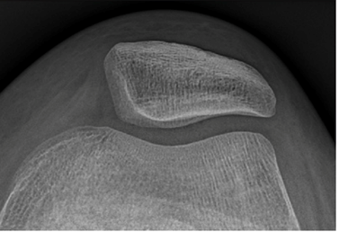
Patellar position
Normal
http://www.startradiology.com/

Slide 50
Patellar position
Normal
http://www.startradiology.com/

Slide 51
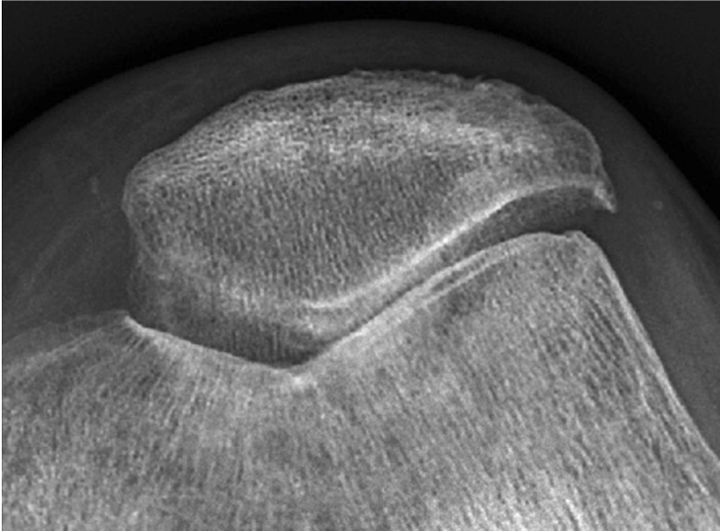

Reading Joints
Normal
http://www.startradiology.com/

Slide 52

Reading Joints
Normal
http://www.startradiology.com/

Slide 53

Reading Joints
http://www.startradiology.com/

Slide 54
Reading Joints
Traction apophysitis
  Osgood Schlatter
http://www.startradiology.com/

Slide 55

Reading Joints
64-year-old lady
Pain R shoulder
Limited ROM
http://www.startradiology.com/

Slide 56
Reading Joints
64-year-old lady
Pain R shoulder
Limited ROM
http://www.startradiology.com/

Slide 57

Reading Joints
Inflamed tendons
http://www.startradiology.com/

Slide 58
Reading Joints
Inflamed tendons
http://www.startradiology.com/

Slide 59

Reading Joints
Osteoarthritis
http://www.startradiology.com/

Slide 60

Reading Joints
Osteoarthritis
http://www.startradiology.com/

Slide 61

Arthroplasty
http://www.startradiology.com/

Slide 62
Arthroplasty
http://www.startradiology.com/

Slide 63

Infected arthroplasty
Pain after arthroplasty
Mild fever
http://www.startradiology.com/

Slide 64

Infected arthroplasty
Pain after arthroplasty
Mild fever
http://www.startradiology.com/

Slide 65
Reading of bone lesions
Which bone, and which site in bone?
Solitary or multiple?
Bone forming or bone eating?
Margins: well-defined or ill-defined?
Calcifications in the lesion?
Is cortex eroded or destroyed?
Is there periosteal new bone formation?
Soft tissue extension?

Slide 66

Location
Orthopedic Radiolgy. A Greenspan. Lippincott-Raven

Slide 67

Location
Orthopedic Radiolgy. A Greenspan. Lippincott-Raven

Slide 68

Radiographic features
Which bone, and which site in bone?
Solitary or multiple?
Bone forming or bone eating?
Margins: well-defined or ill-defined?
Calcifications in the lesion?
Is cortex eroded or destroyed?
Is there periosteal new bone formation?
Soft tissue extension?
Orthopedic Radiolgy. A Greenspan. Lippincott-Raven

Slide 69

The Border
Orthopedic Radiolgy. A Greenspan. Lippincott-Raven

Slide 70

The Matrix
Orthopedic Radiolgy. A Greenspan. Lippincott-Raven

Slide 71

Type of Bone Destruction
Orthopedic Radiolgy. A Greenspan. Lippincott-Raven

Slide 72

Type of Periosteal Reaction
Orthopedic Radiolgy. A Greenspan. Lippincott-Raven

Slide 73

Soft Tissue Extension
Orthopedic Radiolgy. A Greenspan. Lippincott-Raven

Slide 74

Benign Vs. malignant
Orthopedic Radiolgy. A Greenspan. Lippincott-Raven

Slide 75

Type of Periosteal Reaction
radiopaedia.org

Slide 76

Type of Periosteal Reaction
Sunburst
radiopaedia.org

Slide 77

Bone lesion
45-year-old lady with knee pain
http://www.startradiology.com/

Slide 78

Bone lesion
45-year-old lady with knee pain
http://www.startradiology.com/

Slide 79

Bone lesion
Osteopenic lesion
Eccentric
Clear narrow zone of transition
Breaking through posterior cortex
Periosteal reaction
MRI recommended
45-year-old lady with knee pain
MRI shows soft tissue extension
Biopsy showed mammary carcinoma – had undiagnosed Ca Breast
http://www.startradiology.com/

Slide 80
Bone lesion
15-year-old boy
Asymptomatic
Simple bone cyst
Osteopenic lesion
Uniform consistency
Eccentric
Clear narrow zone of transition
Respecting cortex
No periosteal reaction
https://radiopaedia.org

Slide 81
Bone lesion
12-year-old boy - Swelling lower leg
Aneurysmal bone cyst
Osteopenic lesion
Eccentric
Clear narrow zone of transition
Respecting cortex
Ballooning cortex
No periosteal reaction
https://radiopaedia.org

Slide 82


Bone lesion
45-year-old – Pain R thigh – Swollen - Tender
Aggressive lesion
Tumor / infection
Need further investigation
Osteopenic lesion
Inside medulla
Unclear /Wide zone of transition
Ill-defined
Respecting cortex
No periosteal reaction
https://radiopaedia.org

Slide 83



Bone lesion
45-year-old – Pain R thigh – Swollen – Tender
Osteomyelitis
Widely spread Inside medulla
Extends to soft tissues
Edema in soft tissues
https://radiopaedia.org

Slide 84

Bone lesion
2-year-old – Fever, vomiting - Pain L hip – Limited rom
?Osteomyelitis
?Septic arthritis
Need further investigation
  CBC, Diff. WBC, CRP, ESR
  Ultrasound
  MRI
Localized osteopenic lesion upper metaphysis L femur
Reaching epiphyseal plate
https://radiopaedia.org

Slide 85
Bone lesion
2-year-old – Fever, vomiting - Pain L hip – Limited rom
U/S: large hip effusion with echogenic content
(Pus)
https://radiopaedia.org

Slide 86
Bone lesion
2-year-old – Fever, vomiting - Pain L hip – Limited rom
MRI: hyperintense T2
Oedema
Fluid collection outside bone
Effusion in hip joint
https://radiopaedia.org

Slide 87

Bone lesion
10-year-old – Pain L hip – No tenderness - Full rom
Need CT
Osteopenic lesion
Sclerosis in intertrochanteric area
https://radiopaedia.org

Slide 88
Bone lesion
10-year-old – Pain L hip – No tenderness - Full rom
Osteoid osteoma
CT
Osteopenic lesion with nidus
Surrounded by sclerosis
No periosteal reaction
https://radiopaedia.org

Slide 89
Bone lesion
17-year-old – Painful swelling lower thigh
Osteogenic sarcoma
Osteosclerotic lesion
Inside and outside medulla
Unclear /Wide zone of transition
Ill-defined
Not respecting cortex
Extending into soft tissue
Periosteal reaction
www.juniorbones.com

Slide 90
Other imaging
Bone scan (Tc⁹⁹):
  Shows the site of lesion / skip lesions / metastasis
CT:
  Intra-osseous and extra-osseous structure and extension
  Good in deep bones (pelvis, spine)
MRI:
  Shows:
    Soft tissue and cartilage
    Spread of lesion/tumor:
      Within bone, into joints, into soft tissue
    Relation to vessels

Slide 91
Summary
General guidelines: systematic approach
  General information
  Reading bone
  Reading joints
  Reading soft tissue

Slide 92
Reading of bone lesions
Which bone, and which site in bone?
Solitary or multiple?
Bone forming or bone eating?
Margins: well-defined or ill-defined?
Calcifications in the lesion?
Is cortex eroded or destroyed?
Is there periosteal new bone formation?
Soft tissue extension?

Slide 93
Reading Joints
Position
Relations
Alignment
Joint “Space”
Joint line
Subchondral bone

Slide 94
Very good site
http://radiologymasterclass.co.uk/
http://www.startradiology.com/
https://radiopaedia.org

