Slide 1
ORTH536 Introduction to Orthopedics Introduction to The Course
Moaath A. Alamir, MBBS, SB-Orth
Assistant Professor and Consultant Orthopedic Surgeon
Upper extremity, Sports Medicine and Arthroscopy
masoa86@gmail.com

Slide 2
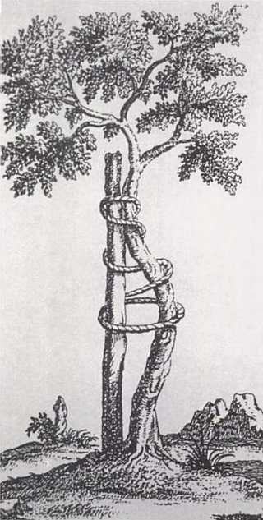
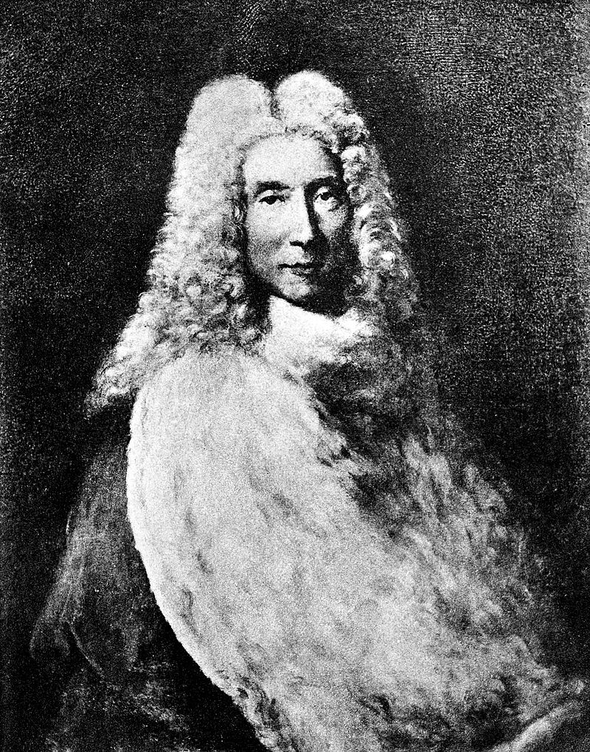
What is Orthopedic Surgery ?
Derived from the Greek word
Orthos: straight, free from deformity
Paidon: child
In 1741, Dr. Nicholas Andry published Orthopedie
the Art of Correcting and Preventing Deformities in Children.
Straight stake tied to a crooked sapling

Slide 3

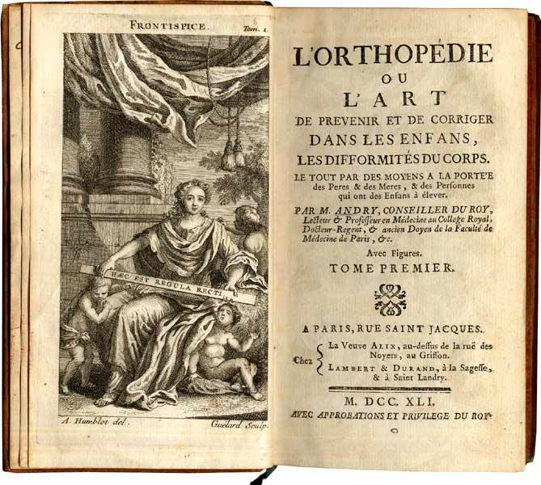
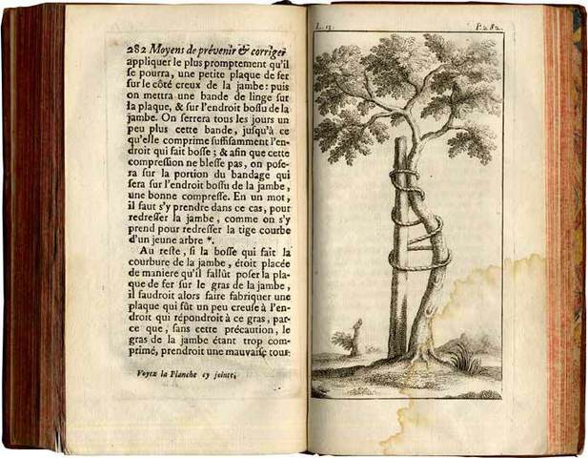

Slide 4


2006 - 2012
2012 - 2021

Slide 5
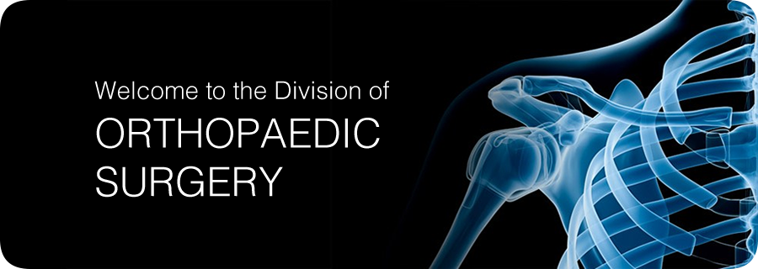
What is Orthopedic Surgery ?
Branch of surgery concerned with conditions involving the musculoskeletal system using both surgical and non-surgical means of management.

Slide 6
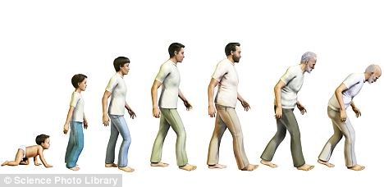
Who Do We Treat ?

Slide 7

Who Do We Treat ?

Slide 8
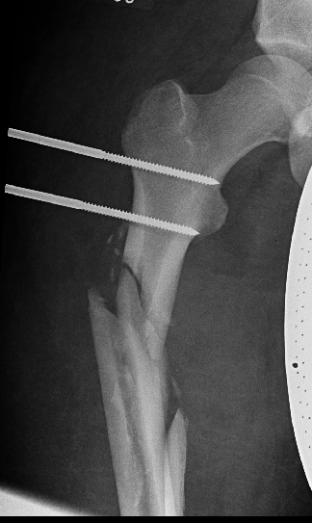
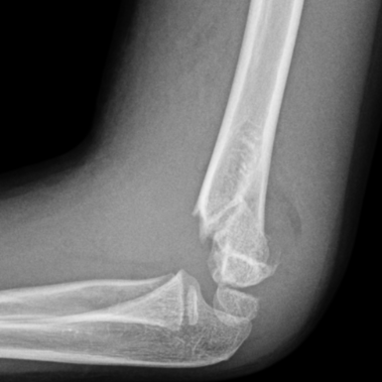
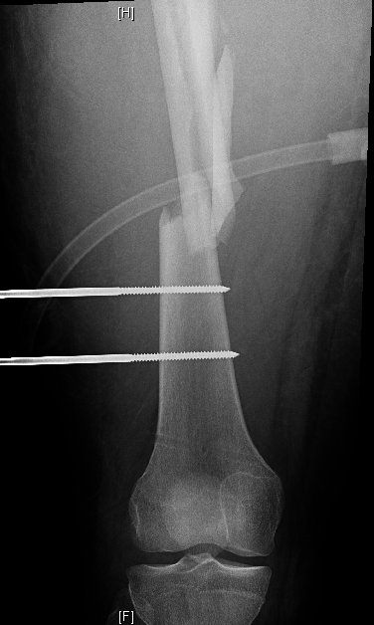
Subspecialties ??!!
☺ I have a fracture ☺
☺ I need to fix it ☺

Slide 9
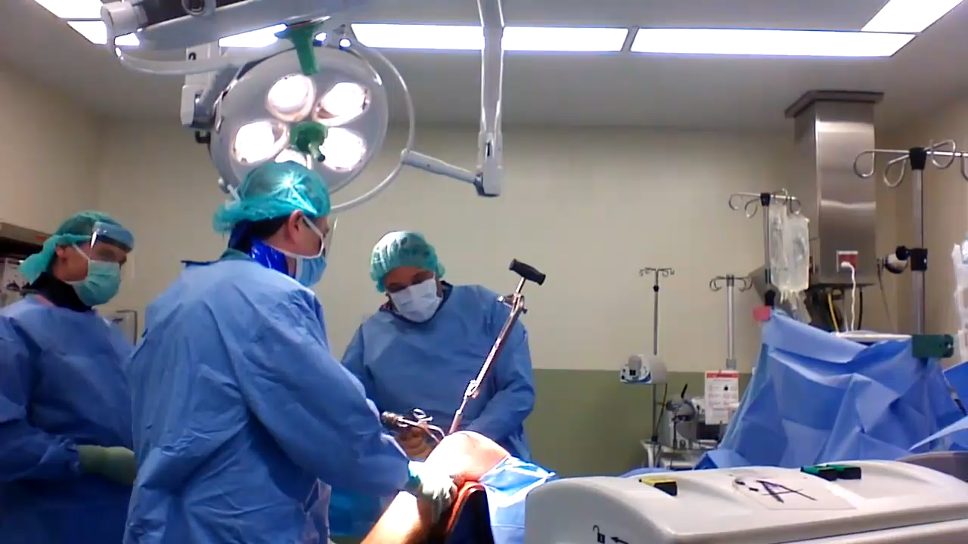
Subspecialties ??!!

Slide 10
Subspecialties ??!!
Foot & Ankle
Spine
Upper Limb
Pediatric
Trauma
Arthroplasty
Sport
Oncology

Slide 11

Subspecialties ??!!

Slide 12
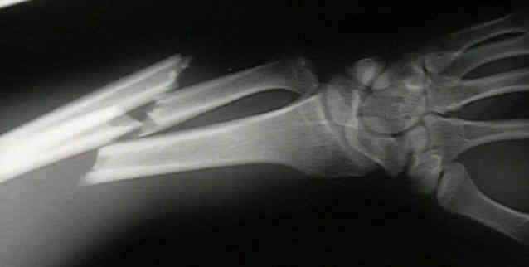
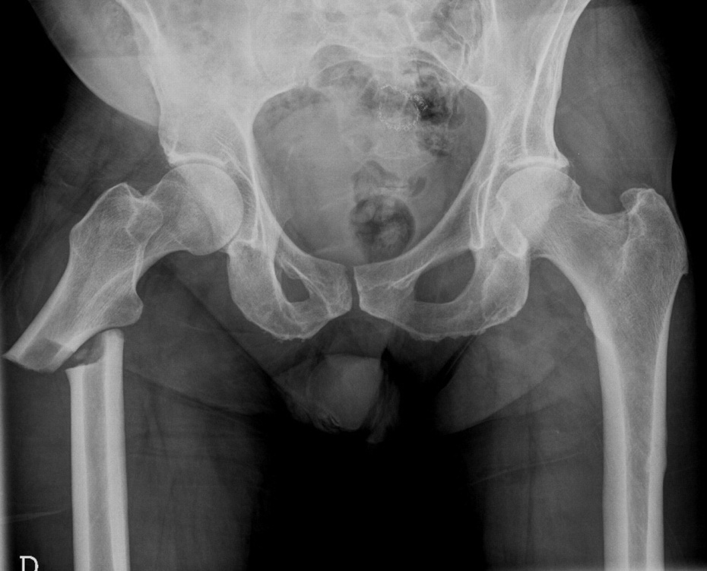
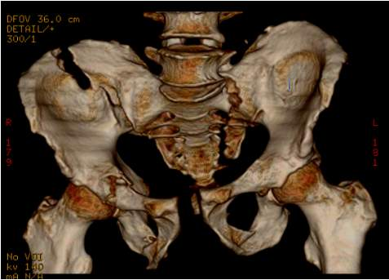
Trauma

Slide 13
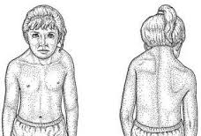
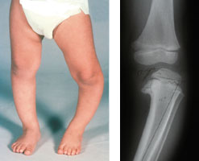
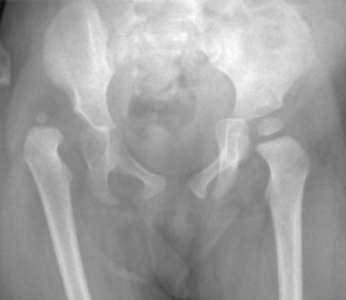
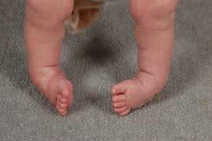
Pediatric Orthopedic

Slide 14
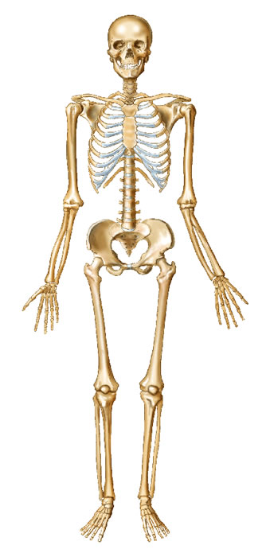
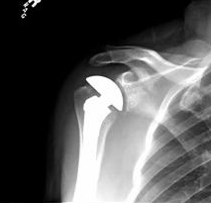
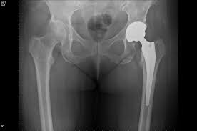
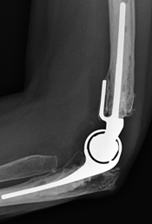
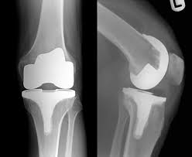
Arthroplasty

Slide 15
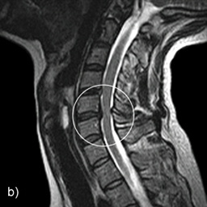
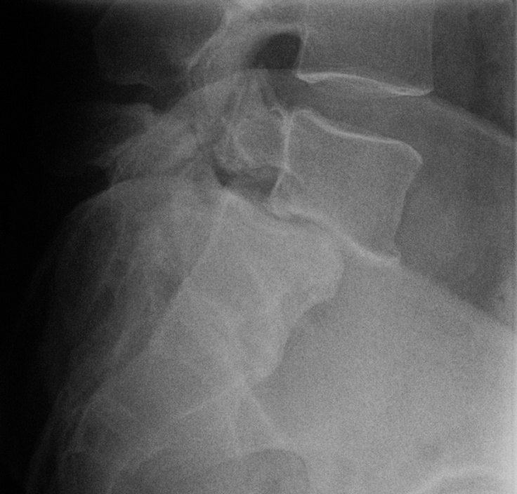
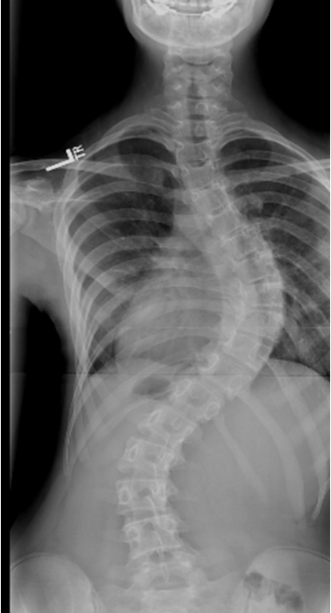
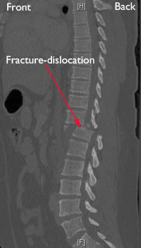
Spine Surgery

Slide 16
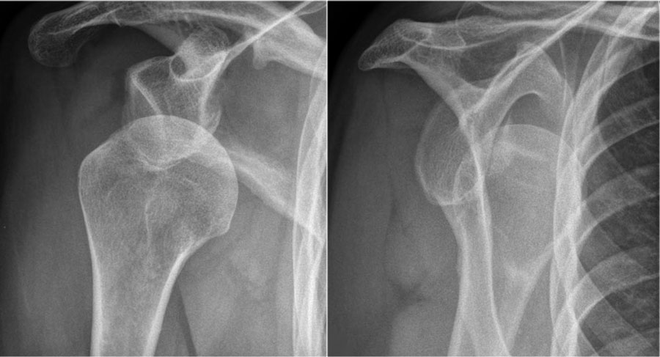
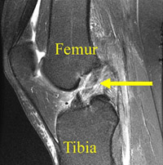
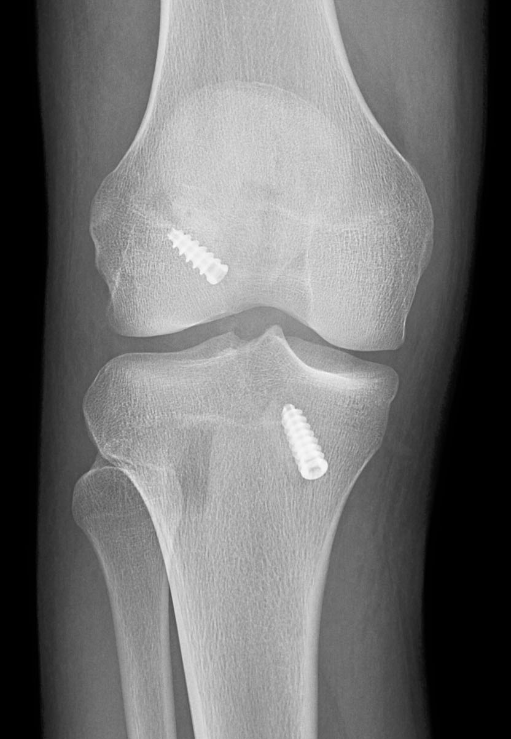
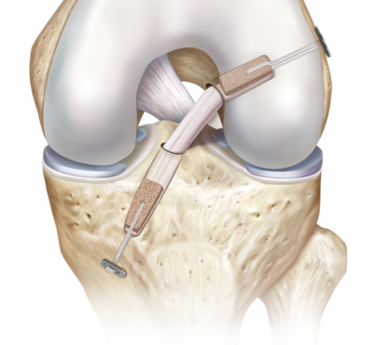
Sport Surgery

Slide 17
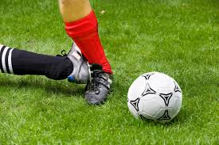
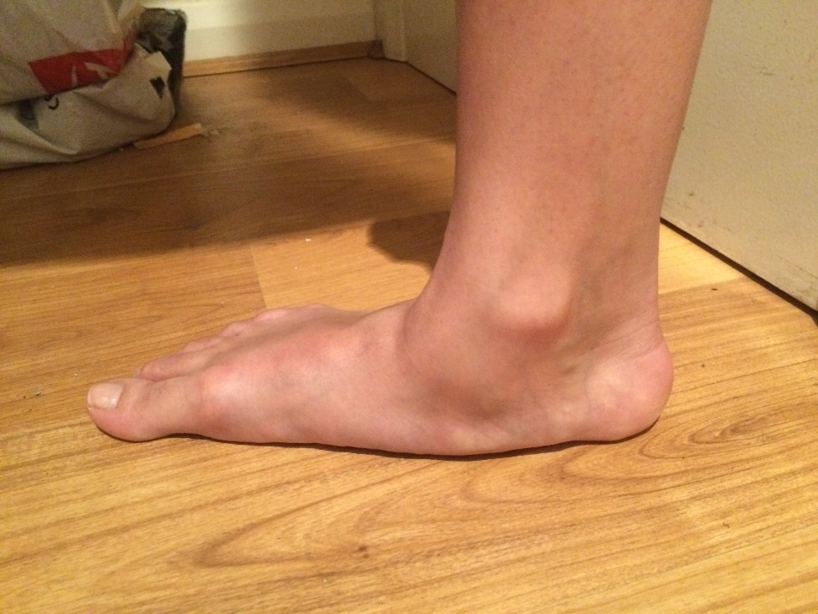
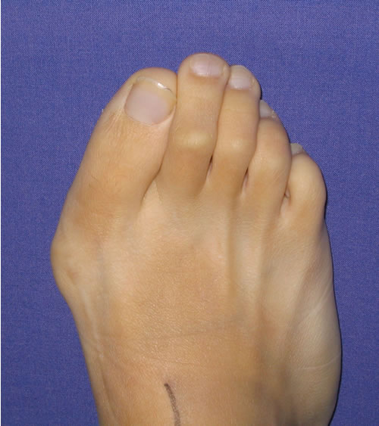
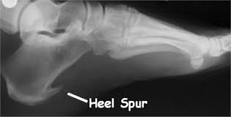
Foot & Ankle

Slide 18
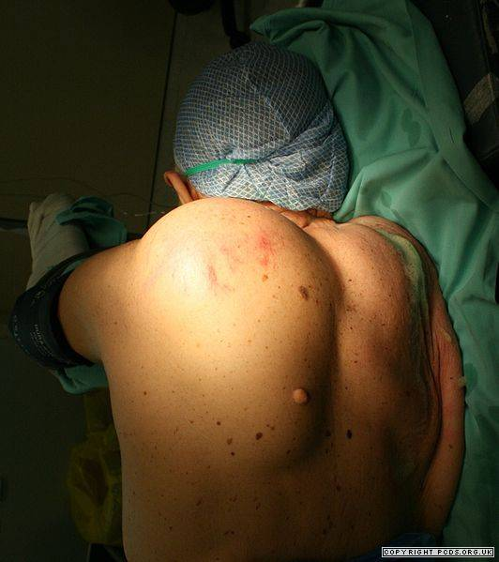
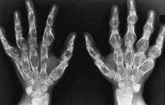
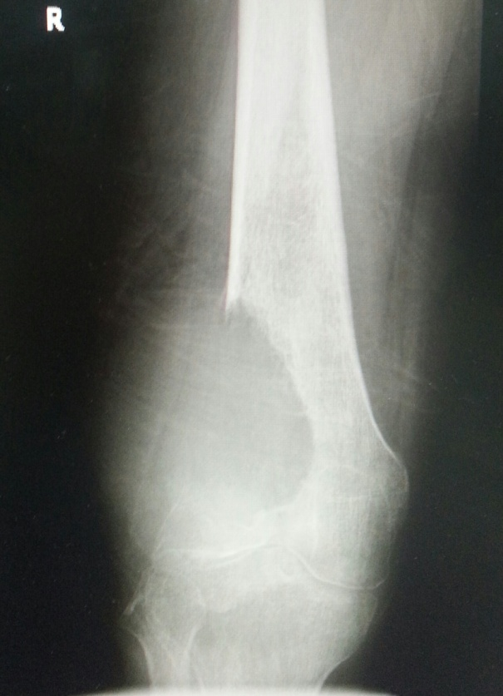
Oncology

Slide 19
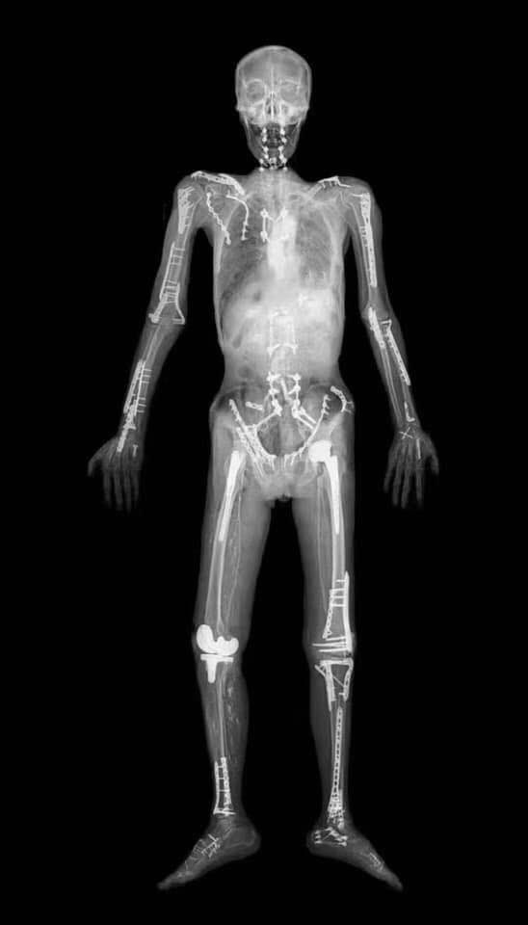
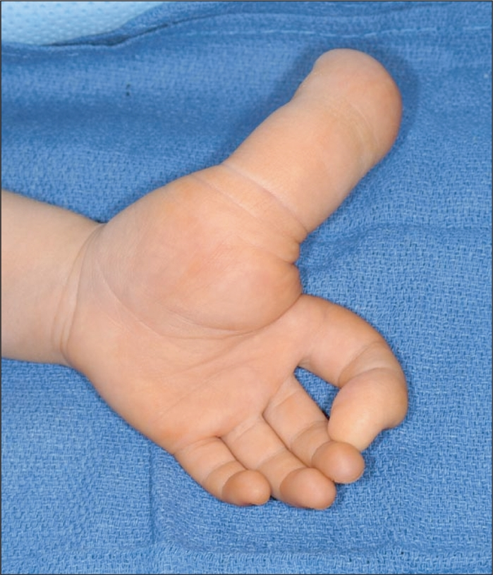
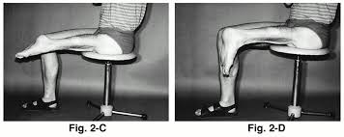

Slide 20
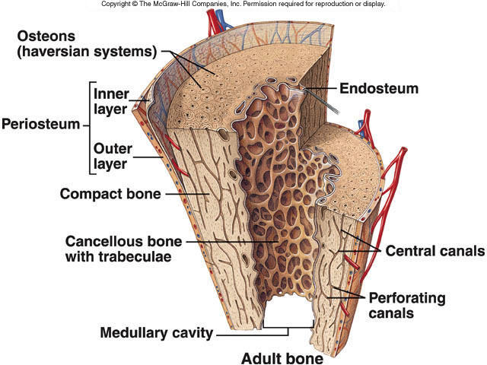
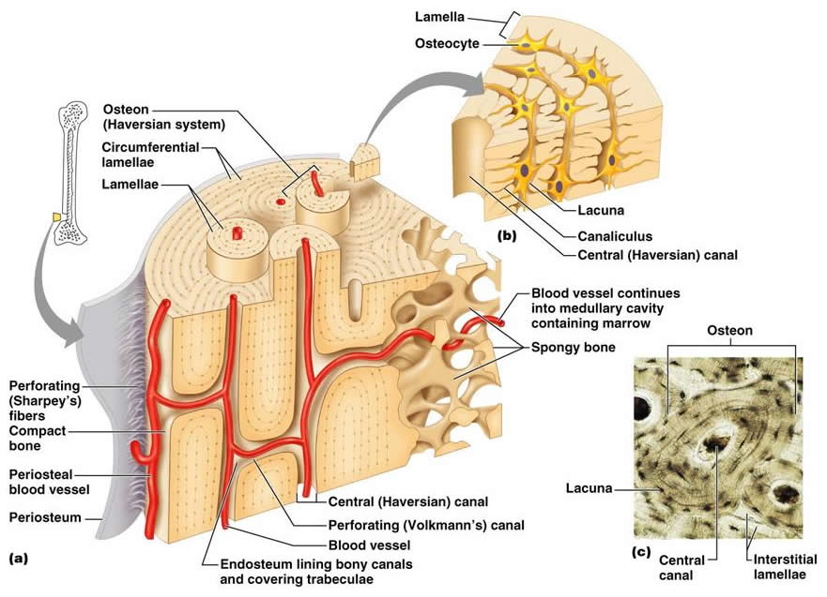
Basic Anatomy of Bone
Periosteum
Endosteum
Cortex
Cortical bone
Medulla
Cancellous bone
http://classes.midlandstech.edu/

Slide 21
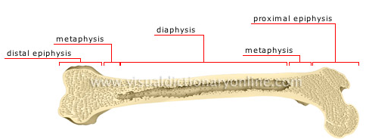
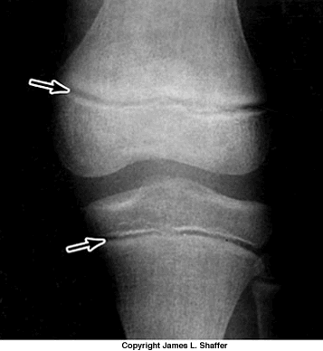
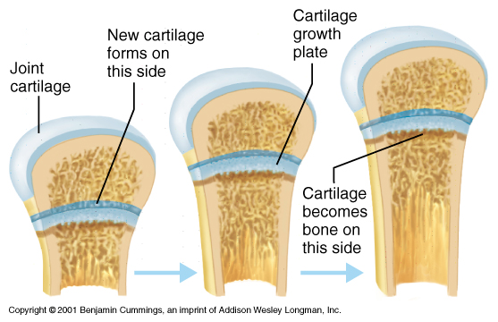
Basic Anatomy of Bone
Epiphysis
physeal plates(child)
Diaphysis
Metaphysis

Slide 22
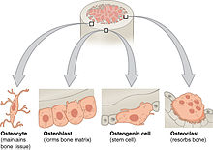
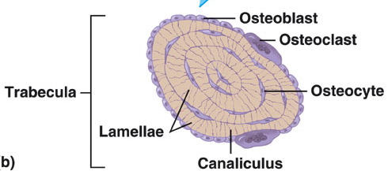
Bone components
A: Matrix:
Inorganic (Minerals): (60%)
Ca hydroxyapetite, Ca phosphate
Organic: (40% of dry weight)
Collagen fibers
Cells
B: Cells:
Osteoblasts, osteoclasts, osteocytes
Osteon:
a unit, not a cell

Slide 23
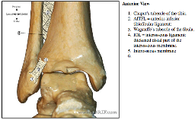
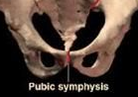
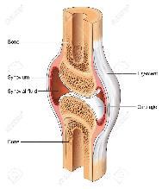
Basic Anatomy of Joints
Types:
Fibrous (slight movement)
Tbio-fibular Syndesmosis
Cartilaginous (some movement)
Symphysis pubis, Intervertebral disk
Synovial (more movement)
Elbow, Hip, Knee

Slide 24



Types of Synovial Joints
Plane / Gliding( ACJ) Saddle(CMC )
Hinge(knee)
http://www.studyblue.com/notes/note/n/ch-8-joints/deck/10845328

Slide 25



Types of Synovial Joints
Pivot(atlas-axis) Ball &Socket(hip)
Ellipsoid(MTP,MCP)
http://www.studyblue.com/notes/note/n/ch-8-joints/deck/10845328

Slide 26
Divisions in Orthopedics
Arthroplasty (joint replacement)
Arthroscopy &sports
Foot & ankle
Hand (Upper limb)
Oncology
Pediatric orthopedics
Spine
Trauma

Slide 27
Structures affected
Bones
Joints
Muscles
Nerves
Tendons

Slide 28






Diseases
Congenital
Developmental
Infections / Inflammations
Metabolic
Tumors / tumor-like
Neuromuscular
Traumatic

Slide 29





Diseases
Congenital
Developmental
Infections / Inflammations
Metabolic
Tumors / tumor-like
Neuromuscular
Traumatic

Slide 30
Descriptive terms
Proximal / Distal
Medial (Ulnar in forearm & hand) / Lateral (Radial in forearm & hand)
Anterior( hand: Palmar), ( foot: Plantar), (hand & foot: Volar)/ Posterior= Dorsal

Slide 31
Descriptive terms
Hallux: Big toe
Genu: Knee
Coxa: Hip
Cubitus: Elbow
Pes: Foot
Pullicis: Thumb
Indecis: Index
Capital: Head

Slide 32

Descriptive terms
Valgus: away from midline
Varus: towards midline
Describing position of distal part in relation to proximal part
Cubitus varus

Slide 33

Tilting vs. angulation
Tilting:
Describes position of distal fragment in relation to proximal
Angulation:
Describes position of apex of angulation
Varus
tilting
Apex lateral
(valgus) angulation

Slide 34
Courses in Your Level
Code | Course Name | Weeks | Credit Hrs.
ORTH536 | Orthopedics | 6 | 4
GYN535 | Obstetrics & Gynecology | 6 | 6
EMR539 | Emergency | 6 | 4
FRNS537 | Forensic Medicine | 15 | 3
Forensic time will change with each course
with ORTH: Tuesday 8-10

Slide 35
ORTH536 - Objectives
Knowledge of common orthopedic diseases & musculoskeletal injuries (traumatology)
1.1 Describe the etiology, pathogenesis & clinical presentation
1.2 Describe the management, prognosis & complications

Slide 36
ORTH536 - Objectives
Cognitive Skills of common orthopedic diseases & musculoskeletal injuries (traumatology)
2.1 Analyze clinical data gathered from history, physical examination & diagnostic investigations to formulate differential diagnosis
2.2 Demonstrate the ability to make clinical judgement & construct appropriate immediate & long-term management plans by adopting strategies of Evidence-Based practice.
2.3 Differentiate life-threatening & organ-threatening conditions & propose an acute management plan

Slide 37
ORTH536 - Objectives
Interpersonal Skills & Responsibility
3.1 Demonstrate ability to accurately convey relevant explanations &information to colleagues & other professionals to develop a share plan of patient's care
3.2 Demonstrate professional attitude & follow ethical principles including respect for physicians & health workers & patients' confidentialities

Slide 38
ORTH536 - Objectives
Communication, Information Technology & Numerical
4.1 Communicate effectively with patients & their families
4.2 Demonstrate the ability to present a case using IT techniques & proper communication skills

Slide 39
ORTH536 - Objectives
Psychomotor
5.1 Demonstrate the ability to perform a proper history taking & physical examination, following high ethical standards
5.2 Demonstrate the ability to perform basic diagnostic & treatment procedures correctly

Slide 40
Summary - Objectives
History
Clinical examination
Investigations
Principles of management
Identify major life-threatening & limb-threatening emergencies in orthopedics and trauma
Perform basic skills properly safely.
Maintain high ethical and professional standards.

Slide 41
Time Frame – Six Weeks
First week theoretical knowledge &tutorials
4weeks clinical rotation in hospitals
Outpatient, inpatient, operating room, cast room, ER.
Includes 3 days / week in the college
Lectures, tutorials, practicing history taking, clinical examination & case scenarios for management
Week 5: Case presentations by students
Week 6: Assessment
MCQ, Slide show, Clinical Scenarios, Clinical Exam

Slide 42
Assessment
30% Written
70% Clinical
50 MCQs
Mid-Block Exam in Wk. 3
20 (12 marks)
Covers lectures as blueprint
Final 30 (18 marks)
Covers all lectures
Cover ALL topics in the course
Case presentation
One case (10 marks) (Wk. 5)
Slide show
15 slides (35 marks)
Clinical Case scenario
One case (5 marks)
History taking
One case (5 marks)
Clinical / Skill examination
Two joints/ one skill (15 marks)

Slide 43
Attendance
Shall be taken for all sessions
Lectures/Tutorials in the college
Closed after 15min
Hospital training (AM / PM)
Use only ONE signature
Absence >25% = Denial

Slide 44

Program
Skill Tutorials
Clinical Tutorials
Clinical in hospital
Lectures
Discussion of recorded Lecture
Exams

Slide 45
??Optional
Mondays in hospital alternative
Operation Room (Prof. Mamoun, Dallah Hospital)
4students each (16 students total)
Optional extra on Saturdays:
Clinic (Prof. Mamoun, Dallah Hospital)
2students each (8 students total)
List arranged through students’ group leader

Slide 46
References
Apley and Solomon's Concise System of Orthopaedics and Trauma
Clinical Orthopedic Examination. Ronald McRae
Netter's Orthopaedic Clinical Examination. An Evidence-Based Approach, 2e (Netter Clinical Science

Slide 47
E-learning management system نظام إدارة التعليم الالكتروني
All presentations & course material
Can be downloaded
All correspondence , Announcements, Changes, Interactions
All correspondence using the Al-Maarefa e-mail
123456789@student.mcst.edu.sa

Slide 48


Sincere Personal Advice !
Take notes in all sessions !
Print material (Lectures / Tutorials) before the teaching session
Add notes on your printed material
Read from books, your notes & slides
Read regularly
According to teaching topics
According to cases seen in the hospital
Read before/ after lecture/session
Read lecture/session – same day!

Slide 49
Summary
Orthopedic course is interesting
Logic, makes sense
Related to Anatomy & mechanics
Diseases
All types of disease & injury affecting bones & joints
Uses special descriptive terms

Slide 50

Personal phone #
0561993366

