Slide 1

Orthopedic Implants and Splints
Dr. Tarif Alakhras /
Prof. Mamoun Kremli /

Slide 2
Implants

Slide 3

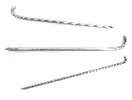
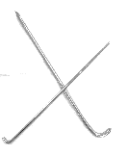
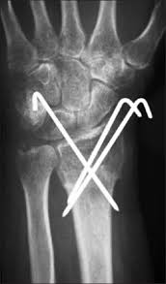
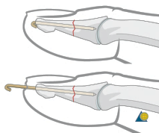
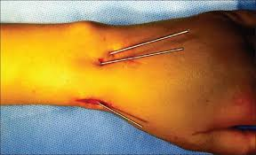
K-wire (Kirschner Wire)
Indications:
Fixation of Pediatric fractures
Small bone fractures in adults
Advantages:
Easy to apply
Easy to remove
Disadvantages/Problems:
Not stable alone
Infection if end left outside skin
http://www.ijhas.in/article.asp?issn=2278-344X;year=2013;volume=2;issue=1;spage=23;epage=29;aulast=Madhukar

Slide 4
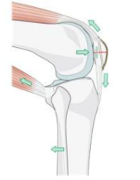
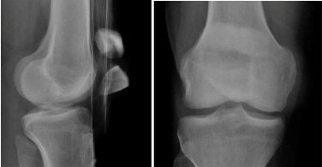
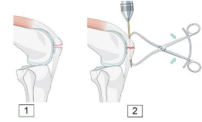
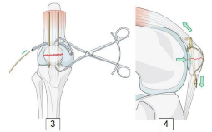
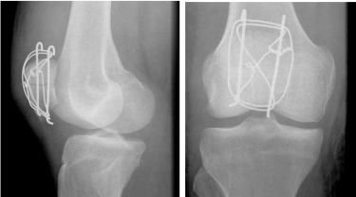
Tension-band wires
Indications:
Patellar and olecranon fractures
Possible to use in malleolar fractures
Application:
K-wires, then tension-band wire

Slide 5
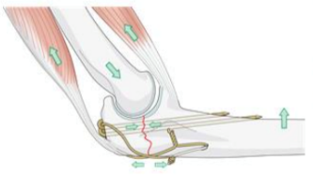
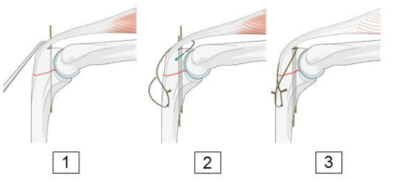
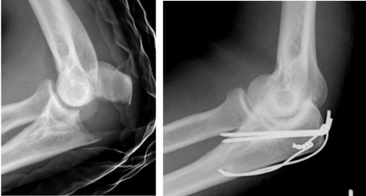

Tension-band wires
Indications:
Patellar and olecranon fractures
Possible to use in malleolar fractures
Application:
K-wires, then tension-band wire

Slide 6
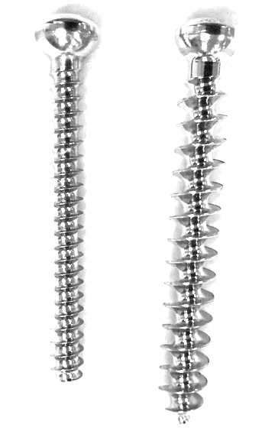

Orthopedic screws
Usually made of stainless steel or Titanium
Thread design varies according to type of bone to be fixed
Cortex screw:
Smaller threads
Smaller distance between threads
Cancellous screws::
Larger threads
Larger distance between threads
Cortical
Cancellous

Slide 7
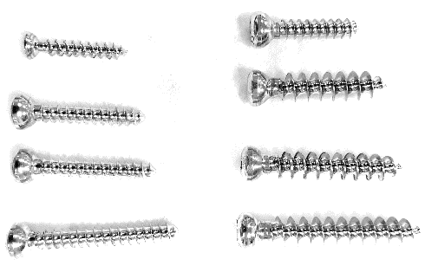
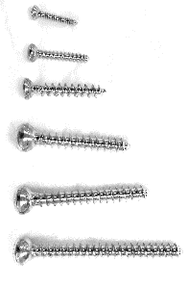
Orthopedic screws
All screws come in different sizes and different lengths

Slide 8

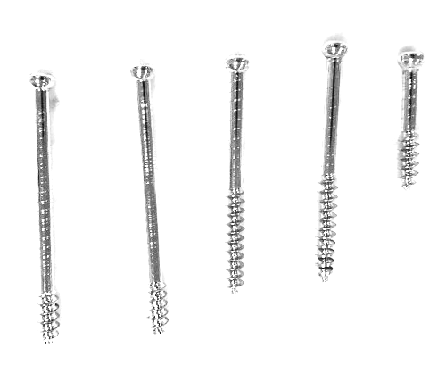
Orthopedic screws
Cortex and Cancellous screws can be Fully threaded or partially threaded
Fully threaded:
Provides purchase (holds)
Partially threaded:
Provide lagging (compression)

Slide 9
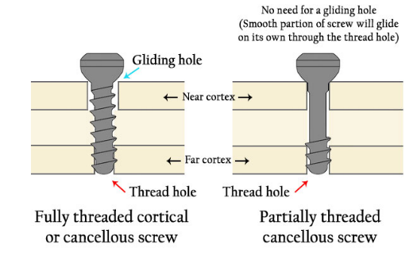
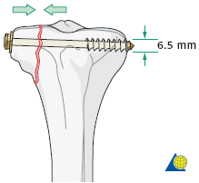
Partially-threaded Screws
Work as lag screw to achieve compression across a fracture site
Fully threaded screws can achieve compression if cortex near screw head is over-drilled
http://cal.vet.upenn.edu/projects/orthopod/csfr/terms/screws.htm

Slide 10
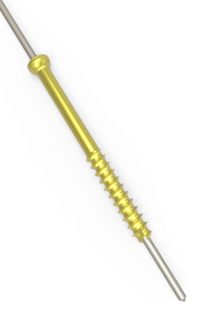
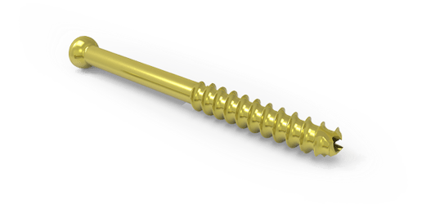
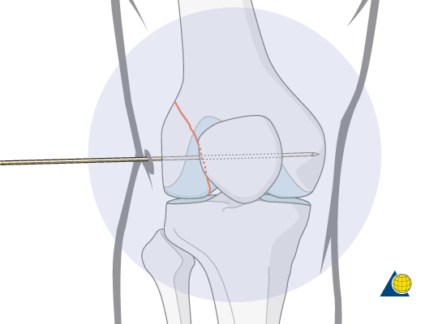
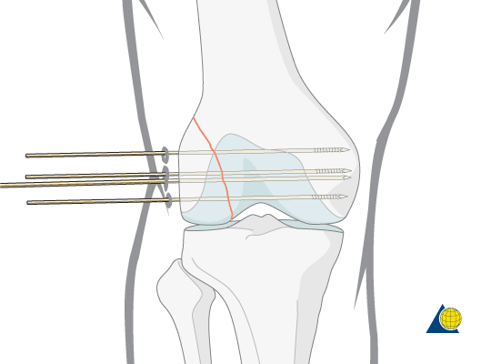
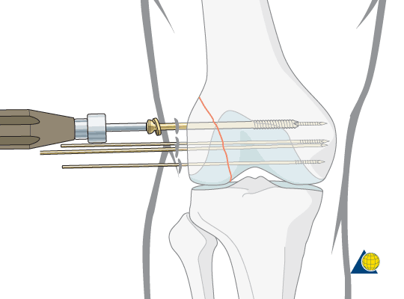
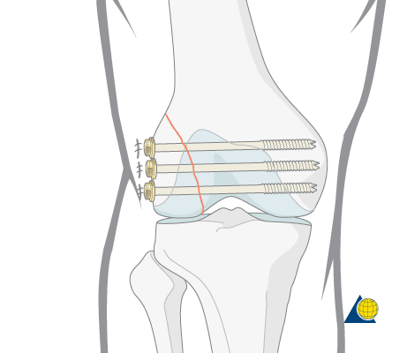
Cannulated Screws
Screws are hollow to be inserted over a wire
Makes insertion of screw more accurate in minimally invasive techniques

Slide 11
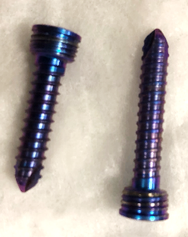
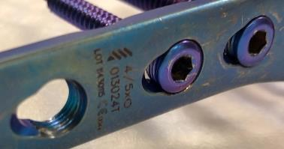
Locked-head Screws
Screw heads are threaded
Hold to the plate and to the bone
Used with special plates with threaded screw holes
Advantage in osteoporotic bone
Plate does not press on bone
Does not disturb periosteal blood supply

Slide 12
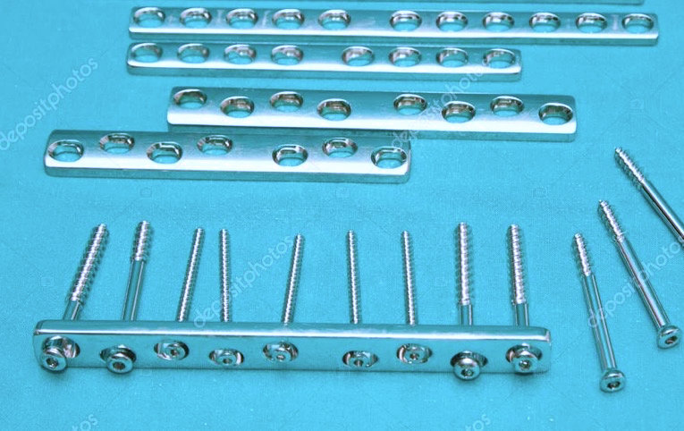
Plate and Screws
Indications:
Metaphyseal fractures
Forearm fractures
Long bone fractures
Complex fractures
Alternative to IMN
Advantages:
Anatomical reduction
Disadvantages:
Does not allow early weight-bearing
Exposure of fracture and fracture hematoma
https://www.canstockphoto.com/orthopedic-implant-plates-and-screw-on-12307967.html

Slide 13
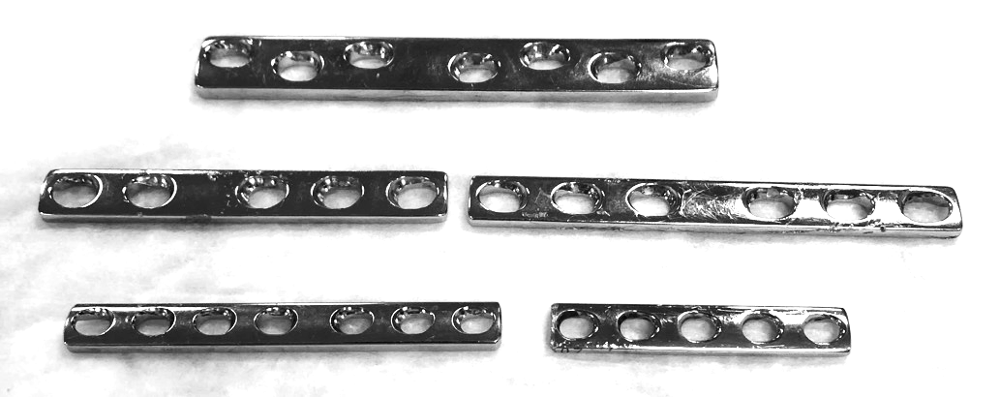
Plate and Screws
Plates come in different sizes, lengths, and shapes
The plate may have several functions:
Compression
Bridging
Protection
Buttress

Slide 14
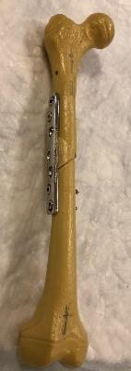
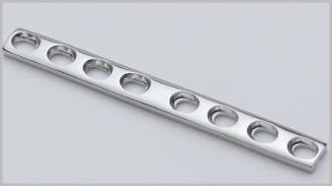
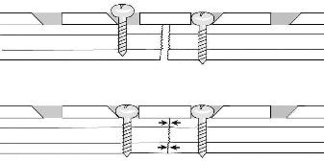
Dynamic compression plate DCP
Characterized by oval halls
it is designed to exert dynamic pressure between the fragments of fracture to be transfixed to provide absolute stability
Used for simple diaphyseal fractures
https://www2.med.wayne.edu/diag

Slide 15

Bridging plate
Provides relative stable fixation
Achieving correct length, alignment, and rotation
The fracture site is left undisturbed
Ordinary Round-hole plate

Slide 16



Bridging plate
Semi-tubular Plate
Designed in the shape of half tube
Indications:
Fixation of lateral malleolus / fibula
Metacarpals / Metatarsals
http://rrsurgicals.com/bone-plates.html

Slide 17
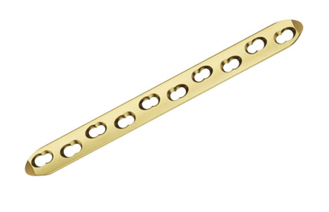
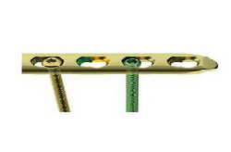
Locked Compression Plate (LCP)
Has a combination hole:
Oval hole for compression or ordinary screw
Serrated hole for locked-head screws
https://www.indiamart.com/proddetail/locking-compression-plate-1225990797.html

Slide 18

Locked Compression Plate (LCP)
Advantages of a locked-head screw:
Plate fixation more resistant to failure from screw loosening and pullout
Very good fixation in osteoporotic bone
Plate does not press on bone
Does not disturb periosteal blood supply
Indications:
Fracture of osteoporotic bone
Bridging severely comminuted fractures
https://www.indiamart.com/proddetail/locking-compression-plate-1225990797.html

Slide 19
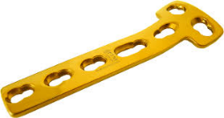
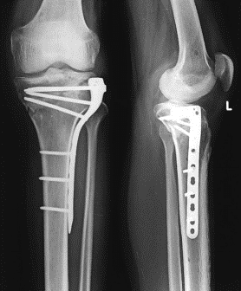
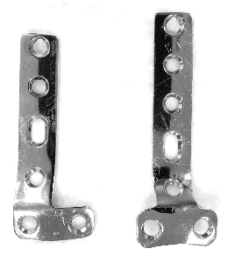
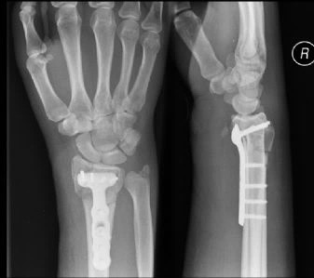
Buttress Plate (T-Plate / L-Plate)
Indications:
Lateral or medial tibial plateau fractures
Distal radius fractures
http://www.orthopaediclist.com/product/implant-66.html
http://plate.prissy.us/internal-fixation-plate/

Slide 20
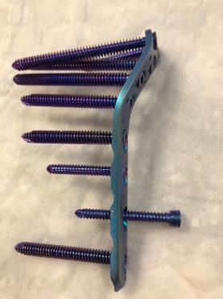
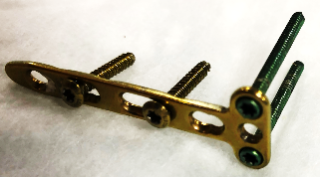
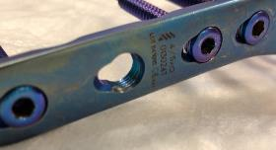
Anatomical plates with Locked Screws
Indications
Metaphyseal fractures
Advantages
Anatomically contoured
Very good fixation in metaphyseal area and osteoporotic bone

Slide 21
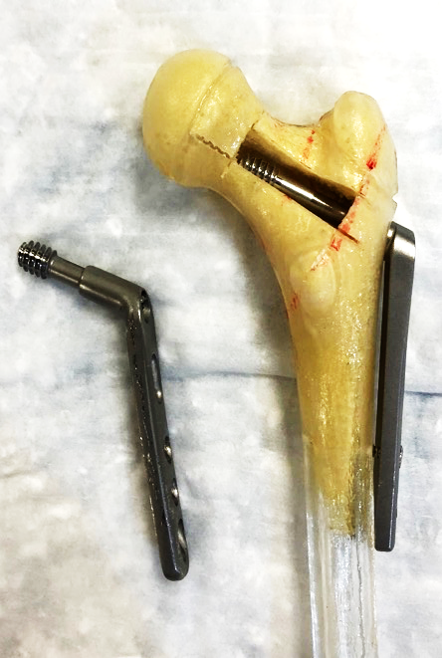
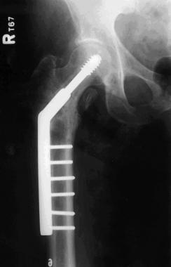
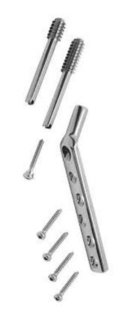
Dynamic hip screw DHS
Indications:
Fixation of intertrochanteric fractures
http://orthopedicsurgeryarticles.blogspot.com/

Slide 22
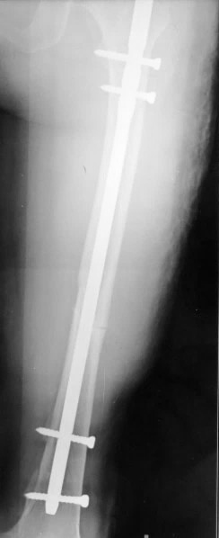
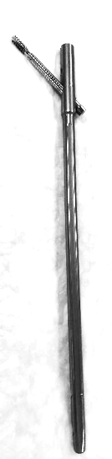
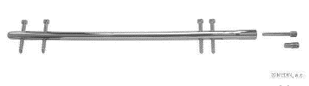
Inter-locking Nail
Indications:
Treatment of fractures of long bones
Advantages:
Minimally invasive
Does not disturb fracture hematoma
Allows early weight-bearing on LL
Femoral Interlocking Nail
https://gunaceblogs.wordpress.com/interlocking-nail/

Slide 23
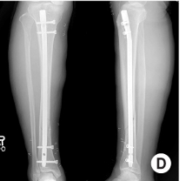
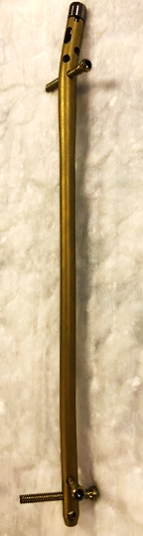
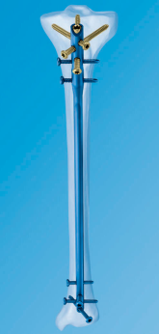
Inter-locking Nail
Indications:
Treatment of fractures of long bones
Advantages:
Minimally invasive
Does not disturb fracture hematoma
Allows early weight-bearing on LL
Tibial Interlocking Nail
http://www.medicalexpo.com

Slide 24


Orthopedic Staples
Indications:
Foot surgery
Epiphysiodesis to correct lower limb deformity
https://www.podiatrytoday.com/does-new-nitinol-staple-redefine-reliable-compression

Slide 25
Splints

Slide 26



Figure-of-8 Brace
Indication:
For immobilization of clavicle fractures
Application
Wearing the figure of eight bandage should be done with the shoulder pressing back in an arch position.
Can use ready-made figure-of-8 brace

Slide 27



Figure-of-8 Brace
Indication:
For immobilization of clavicle fractures
Application
Wearing the figure of eight bandage should be done with the shoulder pressing back in an arch position
Can use foam-sling to make afigure-of-8

Slide 28

Arm Sling
Indications:
Shoulder support in shoulder and clavicle injuries
Forearm support (in cast)
Applications:
Shoulder adducted, elbow flexed 90° and wrist at neutral position
The sling supports the elbow and overcomes gravity

Slide 29

Arm Sling with shoulder immobilizer
Indications:
Shoulder support after major surgeries
Applications:
Shoulder adducted, elbow flexed 90° and wrist at neutral position
The sling supports the shoulder by applying the waist sling keeping the shoulder adducted
https://www.carolinabrace.com

Slide 30


Forearm Sling
Indications:
Support in humerus fractures (allowing traction by gravity)
Forearm support (in cast)
Applications:
Shoulder adducted
Elbow not supported to allow gravity to pull down on humerus
https://www.medical-world.co.uk
http://myorthoclinic.com

Slide 31





Back Supports
Indications:
Limiting motion of the spine to enhance healing (after surgery or in stable fractures)
Reduces back pain and discomfort (in back sprains and muscle pain)
Types:
Soft or more rigid with rods
Thoraco-lumbar , lumbar , lumbo-sacral
Precaution:
Long-term use causes weakness of muscles

Slide 32

Soft Cervical Collar
Indications:
Provides partial support of cervical spine and neck muscles
Muscle spasm
Post operative
Nerve root entrapment syndrome in the cervical spine
Applications:
Choose proper size (height and length)
Apply reasonably tightly under the chin
Precaution:
Long-term use causes weakness of muscles

Slide 33




Rigid Cervical Collar
Indications:
Used in trauma emergency when suspecting neck injuries
Head or facial / forehead injuries
Neck pain
Unconscious patients
Application:
Adjust to proper height
Use traction to support the neck while applying
Apply around the neck, with chin piece fitting well under chin
Opening anterior for possible tracheostomy

Slide 34



Rigid Cervical Collar
Application:
Adjust to proper height
Use traction to support the neck while applying
Apply around the neck, with chin piece fitting well under chin
Opening anterior for possible tracheostomy
https://www.youtube.com/watch?v=mdeExV26nts

Slide 35


Knee Immobilizer
Contains metal rods to completely immobilize the knee
Indications:
Immediate after knee injuries
Instability, patellar fractures, haemarthrosis
Post knee surgery
Applications:
Apply with the wider end on upper thigh
Make sure the opening of the support is on the patella
Apply tightly from up downwards

Slide 36


Hinged Knee Splint
Supports and stabilizes an injured knee (prevent varus and valgus movements)
Allows flexion and extension (hinged metal supports on sides)
Indications:
Used in collateral ligament injuries

Slide 37




Malleable Finger Splints
Indications:
Phalangeal fractures
Sprained interphalangeal joints
Applications:
Flexion of MCP joint and extension of interphalangeal joints

Slide 38



Mallet Finger Splint
Indications:
Mallet finger injury (rupture/avulsion of extensor tendon at the distal phalanx)
Application:
The finger must be fully extended in the DIPJ

Slide 39


Wrist splint
Indications:
Wrist support after minor soft tissue injuries and sprains
Wrist immobilization for carpal tunnel syndrome (before and after surgery)
Temporary intermittent support after cast removal post fractures
Application:
Rigid/metal part with a bend at volar aspect – wrist immobilized in position of slight dorsiflexion

Slide 40


Thumb splint
Indications:
Thumb support after minor soft tissue injuries and sprains
In Tenosynovitis Immobilizing thumb to reduce pain and inflammation of tendons
Application:
Rigid/metal part on dorsum of thumb

Slide 41



Ankle Foot Orthosis (AFO)
Indication:
Foot support for foot drop
Application
Wear shoe on top of brace
http://www.chaneco.co.uk
http://www.klmlabs.com

Slide 42
Silicone Spacer / Splint
Indications
Adolescent hallux valgus when the main complaint is cosmetic
Initial treatment choice in mild cases
https://www.groupon.com/
https://www.myfootshop.com
Notes:
Recurrence rate is high → 20-40%

Slide 43
Traction

Slide 44
Traction
For information on:
Indications
Contraindications
Advantages
Disadvantages
Complications
See presentation: “Conservative Treatment of Fractures”

Slide 45
Skin Traction
Skin traction is used to:
Treat fractures in children
Temporary immobilize fractures in adults
Rest an inflamed hip joint and reduce pain
Gradually realign a joint (e.g. flexion deformity of hip)

Slide 46



Skin Traction - Types
Adhesive Non-adhesive Foam

Slide 47

Application of Skin Traction
Need two persons
Manual traction by assistant to realign limb and reduce pain

Slide 48



Application of Skin Traction
The other to apply the skin traction
Centralize the end piece so that traction pull is correct
Keep away from heel skin (5cm)
Correct
Wrong
Wrong

Slide 49

Application of Skin Traction
The other to apply the skin traction
Centralize the end piece so that traction pull is correct
Keep away from heel skin (5cm)

Slide 50

Application of Skin Traction
Smoothly apply traction tape on skin
Apply bandage evenly with 50% overlap, not too tight, not too loose

Slide 51

Application of Skin Traction
Smoothly apply traction tape on skin
Apply bandage evenly with 50% overlap, not too tight, not too loose

Slide 52

Application of Skin Traction
Smoothly apply traction tape on skin
Apply bandage evenly with 50% overlap, not too tight, not too loose

Slide 53

Application of Skin Traction
Smoothly apply traction tape on skin
Apply bandage evenly with 50% overlap, not too tight, not too loose

Slide 54

Application of Skin Traction
Upper part should stop below level of fracture

Slide 55

Application of Skin Traction
Upper part should stop below level of fracture
Assistant continues pulling throughout the procedure

Slide 56


Thomas Splint
Indications:
Immobilization of femur fractures for
Transportation of patients
Apply fixed traction at end of splint

Slide 57






Thomas Splint
Parts of Thomas splint
Ring
Lateral bar (angulated)
Medial bar
R
L

Slide 58


Thomas Splint
Complete ring: original design
Half-ring: easier to apply

Slide 59
Application of Thomas Splint
Prepare splint by adding a bandage or foam pads between the medial and lateral bars
The lower limb will rest on it

Slide 60

Application of Thomas Splint
Apply Thomas splint correctly while assistant continues pulling
Angulated bar on lateral side
Wrong

Slide 61

Application of Thomas Splint
Apply Thomas splint correctly while assistant continues pulling
Angulated bar on lateral side
Correct

Slide 62

Application of Thomas Splint
Apply Thomas splint correctly while assistant continues pulling
Angulated bar on lateral side

Slide 63


Application of Thomas Splint
Apply Thomas splint correctly while assistant continues pulling
Angulated bar on lateral side

Slide 64

Application of Thomas Splint
Apply Thomas splint correctly while assistant continues pulling
Push the ring as high as possible

Slide 65

Application of Thomas Splint
Pull rope and fix to end of Thomas splint

Slide 66

Application of Thomas Splint
Pull rope and fix to end of Thomas splint

Slide 67


Application of Thomas Splint
Pull rope and fix to end of Thomas splint
https://link.springer.com/chapter/10.1007/978-3-642-20641-2_29

Slide 68

Application of Thomas Splint
Apply pillow under the splint
Note there is no pressure under the heel

Slide 69

Application of Thomas Splint
Check tightness of rope

Slide 70

Traction Splint
The modern traction splint
Can easily hold LL with straps
Can easily apply fixed traction

Slide 71
Skeletal Traction
By inserting a metal (Steinman pin) into the bone and applying traction on it

Slide 72
Skeletal Traction
Indications:
When skin traction is contraindicated
When the weight needed is >10 Lbs. (4.5 Kg)
When the traction needs to be applied for >3weeks
Advantages:
Reduces fractures: Regains length and alignment
Maintains reduction of fractures
Reduces pain and overcomes muscle spasm

Slide 73




Skeletal Traction
Entry point - Proximal tibial site:
Insert pin laterally at a point 2cm distal and 2cm posterior (lateral) to the Tibial tuberosity and exit medially to avoid injury to the common peroneal nerve
2cm
2cm

Slide 74

Skeletal Traction
Entry point - Distal femoral site:
Insert pin medially at level of upper patella in-line with mid-femur and exit laterally
This level avoids popliteal vascular damage and intra-articular injury

Slide 75
Skeletal Traction - Preparation
Prepare pack with:
Disinfectant
Sterile towels
Needles and Syringe
Local anesthetic
Scalpel with pointed blade
Sharp pointed Steinmann pin
T-handle
Stirrup

Slide 76

Technique
Give adequate sedation if needed
Paint the skin with antiseptic, drape with sterile towels

Slide 77

Technique
Inject local anesthesia (5 ml of 2% lignocaine) into skin at the proposed site of pin insertion & anticipated exit point down to the periosteum

Slide 78



Technique
Inject local anesthesia (5 ml of 2% lignocaine) into skin at the proposed site of pin insertion & anticipated exit point down to the periosteum

Slide 79

Technique
Make a stab incision through the skin with a pointed scalpel
Connect a Steinmann pin in the T-handle (or drill)

Slide 80



Technique
Insert the pin into the entry point.
As the pin penetrates the far cortex and elevates the skin, make a small stab incision in the overlying skin
http://www0.sun.ac.za/ortho/webct-ortho/general/trac/trac-2.html

Slide 81



Technique
Insert the pin into the entry point.
As the pin penetrates the far cortex and elevates the skin, make a small stab incision in the overlying skin
http://intranet.tdmu.edu.ua

Slide 82

Technique
Apply a sterile gauze on the skin around the pin on both sides

Slide 83


Technique
Apply a stirrup on both ends of the pin, and apply the cord on the stirrup, with weight attached over pulleys at the end of the traction
(10% of the patient’s body weight)
http://intranet.tdmu.edu.ua
http://wanderdoc.blogspot.com/2013/05/

