Slide 1

Peripheral Nerve Injuries
Prof. Mamoun Kremli
Dr.Tarif Al-Akhras

Slide 2
Objectives
Outline types of peripheral nerve injuries
Reaction of peripheral n. to injury
Common peripheral nerve injuries
  Brachial plexus
  Axillary
  Radial
  Ulnar
  Median
  Sciatic
  Common peroneal

Slide 3
The Nervous System
Central:
  Brain & spinal cord
Peripheral:
  Nerves & ganglia outside CNS
    Not protected by bones and blood-brain-barrier
    Exposed to toxins and mechanical injuries
    Capacity to regenerate - re-grow if cut (not CNS)
askabiologist.asu.edu

Slide 4
Nerve Structure
Covers
  Epineurium
  Perineurium
  Endoneurium

Slide 5
Nerve Structure
Bundles
  Motor axons
  Sensory axons
  Coated with myelin
    Lipoprotein from Schwann cells
www.studyblue.com

Slide 6
Nerve Injury
Types
Damage
Neuropathies
Ischemia
Injury
  Compression
  Traction
  Laceration / Cut
  Burn
Transient
  Recoverable loss of function
Complete
  Irreversible damage
  Complete/partial loss of function

Slide 7
Neuropathies - Causes
Category | Examples
Traumatic | Incision, compression, stretching, burn
Metabolic | Diabetes, renal failure, hypothyroidism, amyloid
Malignancy | Especially small cell carcinoma of the lung
Drugs | Isoniazid, phenytoin, nitrofurantoin, cancer chemotherapy
Toxins | Alcohol, lead
Infections | Leprosy, hepatitis, Lyme disease, HIV
Inflammatory | Guillain-Barre, sarcoidosis
Vascular | Ischemia, polyarthritis nodosa, rheumatoid disease
Genetic | Charcot-Marie-Tooth disease, porphyria
Vitamin deficiencies | B1, B6, B12. nicotinic acid
www.rcemlearning.co.uk

Slide 8
Reaction to Injury
When a peripheral nerve is cut:
  Axon segments distal to cut degenerate (die)
    Wallerian degeneration
      Retrograde degeneration to first Node of Ranvier
  Axons in proximal segments regrow (regenerate)
    Rate: 1mm/day
www.snipview.com

Slide 9
Regeneration
If muscles are paralyzed for a long time:
  Muscle atrophy – degeneration of motor end plates
  Joints get stiff
    Should keep muscles ready and joints flexible (How?)
stevegallik.org
houseofmind.tumblr.com

Slide 10
Problems of Regeneration
Mixed nerves
  Motor to sensory / sensory to motor
Loss of some axons – away – go astray
Time for regeneration:
  Degeneration of motor end plates of muscles
  Stiffness of joints

Slide 11
Mechanical Nerve Injuries
Neuropraxia
  Overstretching without a cut
Axonotemesis
  Axons cut but bundle covers are saved
Neurotemesis
  Complete cut in nerve
wkhanbang.tistory.com

Slide 12
Neuropraxia
Usually a result of a blunt injury
Transient localized physiological conduction block
  No anatomical disruption
  No distal Wallerian degeneration
Often a motor paralysis
  With some residual sensory or autonomic function
Nerve conduction studies:
  Conduction block at the level of the injury
Recovery:
  Full in days to weeks
Diagnosis by exclusion

Slide 13
Axonotmesis
Often the result of a more intensive blunt injury or pull (over stretch)
Axon damage within the nerve
The axons are cut
  Intact endoneural tubes and surrounding connective tissue elements
Distal Wallerian degeneration
Recovery: Expected
  May take weeks / months
  May leave residual deficit

Slide 14
Neurotmesis
Complete cut of nerve
  axons, myelin, endoneurium, perineurium, and epineurium
Neuroma formation at the site of injury
  (regenerating axons, Schwann cells and Fibroblasts)
Function never returns to normal
Surgical repair is typically needed
Recovery: Incomplete; imperfect, neuroma

Slide 15
Neurotmesis
Surgical repair is typically needed
  Epineural repair
  Endoneural repair (microscopic)
  Cable grafting (Sural n.) / tube scaffolds
www.axogeninc.com
http://www.slideshare.net/subbujampana
biotextiles2012.wordpress.com

Slide 16
Assessment
Proper history
  Symptoms suggesting a nerve dysfunction
  Looking for cause
    Type of nerve injury
Clinical examination
  Signs
Investigations
  Looking for cause
  Nerve conduction studies
    Determines site
    Assesses recovery
www.urmc.rochester.edu

Slide 17
Brachial Plexus Injury
The brachial plexus
  Originate from (C5-C8), and (T1) spinal nerves
Mechanism of injury:
  Compression
  Stretch
Cause:
  Traumatic
  Obstetric
bmedesign.engr.wisc.edu

Slide 18
Brachial Plexus Injury
Common causes:
  Obstetric injury
  High-speed vehicular accidents
  Stab or gunshot wounds
  Compression (e.g. caused by a growing tumor, Pancoast tumor)
www.humankinetics.com
en.wikipedia.org

Slide 19
Types Of Brachial Plexus Injury
Overstretching only
  Intact nerve roots
    Intact axons
    Cut axons
Rupture:
  Nerve roots stretched and at least partially torn
Avulsion:
  Nerve roots pulled out from the spinal cord and has no chance to recover
Neuropraxia:
  excellent prognosis
Axonotemesis:
  prognosis is moderate
Neurotemesis:
  The prognosis is very poor

Slide 20
Brachial Plexus Palsy
Obstetric Injury (Palsy)
  Occurs in <1% of live births
  Most common when there is difficulty delivering the baby's shoulder
    Baby's shoulder may become impacted on the mother’s pubic bone causing the brachial plexus nerves to stretch or tear (shoulder dystocia)
www.allposters.com

Slide 21
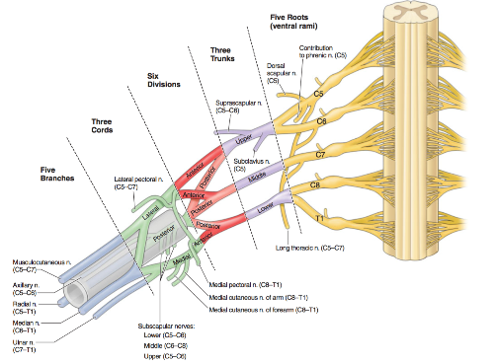
Brachial Plexus Palsy
Three patterns:
  Upper root injury (Erb’s palsy):
    Overweight babies with shoulder dystocia
  Lower root injury (Klumpke’s palsy):
    Breech delivery of smaller babies
  Total plexus injury
Erb’s
Dutton’s Orthopaedic Examination, Evaluation, and Intervention
Klumpke’s

Slide 22
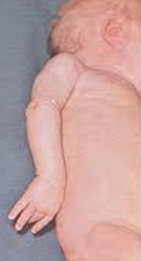
Erb’s Palsy
injury of C5, C6
  and (sometimes) C7
Paralysis of:
  Shoulder abductors
  Shoulder external rotators
  Biceps and Supinators
The arm is held adducted, internally rotated, elbow extended, and forearm pronated (waiter tip position)
http://caseoftheday.blogspot.com/

Slide 23
Klumpke’s Palsy
Lower root injury
Traction injuries by excessive abduction of the arm
Falling from a height clutching at an object to save himself or herself
Can be caused by cervical rib
T1 is usually torn (ulnar and median nerves)
https://quizlet.com/16082021/brachial-plexus-flash-cards/

Slide 24
Klumpke’s Palsy
Motor:
  Paralysis of all the small muscles of the hand
Sensory:
  loss of sensation along the medial side of the arm
Deformity:
  Forearm supinated,
  Elbow flexed
  Claw hand
http://pediatricneuro.com/alfonso/pg220.htm

Slide 25
Total Plexus Injury
Arm is flail and pale
All fingers paralyzed
May be unilateral Horner’s syndrome
Horner’s syndrome:
  Ptosis: dropping of eyelid
  Miosis: constriction of pupil
  Enophthalmos: impression that eye is sunken
www.riversideonline.com

Slide 26
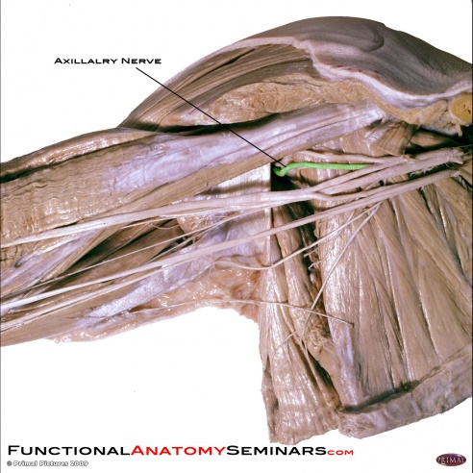
Axillary Nerve Injury
From C5-C6 roots
Arise from posterior cord of brachial plexus at the level of axilla
Frequently injured in:
  Anterior-inferior dislocation of the shoulder
  Fractures surgical neck of the humerus
  Compression of the axilla with a crutch
www.physio-pedia.com

Slide 27
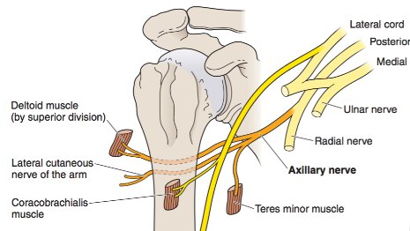

Axillary Nerve Injury
Muscular innervations
  Deltoid
  Teres minor
  Coracobrachialis
Cutaneous innervation
  skin covering inferior region of deltoid muscles
Dutton’s Orthopaedic Examination, Evaluation, and Intervention

Slide 28
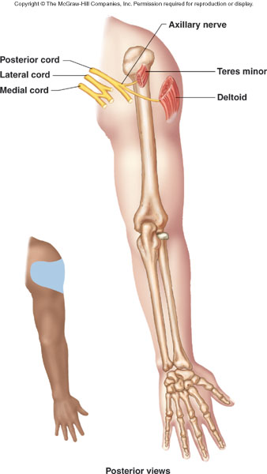
Axillary Nerve Injury - Signs
Wasting of deltoid & Teres minor
  Flat shoulder deformity
Inability to abduct the arm beyond that possible by the action of the supraspinatus
Loss of sensation in the skin over a small part of the lateral upper arm
pixcooler.com

Slide 29
Axillary Nerve Injury
Arm Drop Test:
  Elevate the patient's arm to near full abduction
  Ask the patient to actively maintain that position
  Positive test is if the patient's arm drops
javla.com

Slide 30
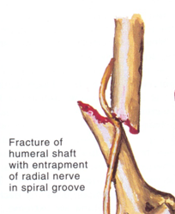

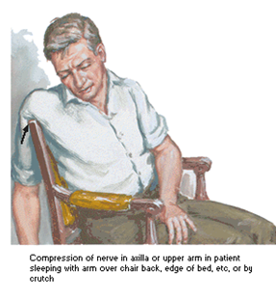
Radial Nerve Injury
Injury in axilla:
  Crutch pressing up into armpit (wrong usage)
  Fractures of humeral shaft
  Drunkard falling asleep with one arm over the back of a chair

Slide 31
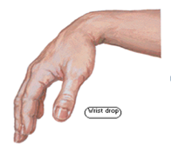

Radial Nerve Injury
Motor effects: paralysis of:
  Triceps
  Anconeus
  Extensors of the wrist
  Extensors of fingers
  Brachioradialis
  Supinator muscle
Deformity:
  Wrist and finger drop
lookfordiagnosis.com

Slide 32
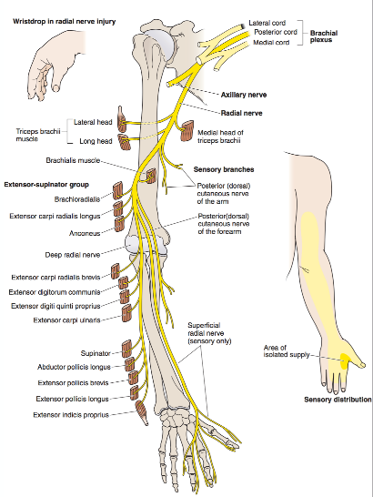
Radial Nerve Injury
Motor effects: paralysis of:
  Triceps
  Anconeus
  Extensors of the wrist
  Extensors of fingers
  Brachioradialis
  Supinator muscle
Deformity:
  Wrist and finger drop
Dutton’s Orthopaedic Examination, Evaluation, and Intervention

Slide 33
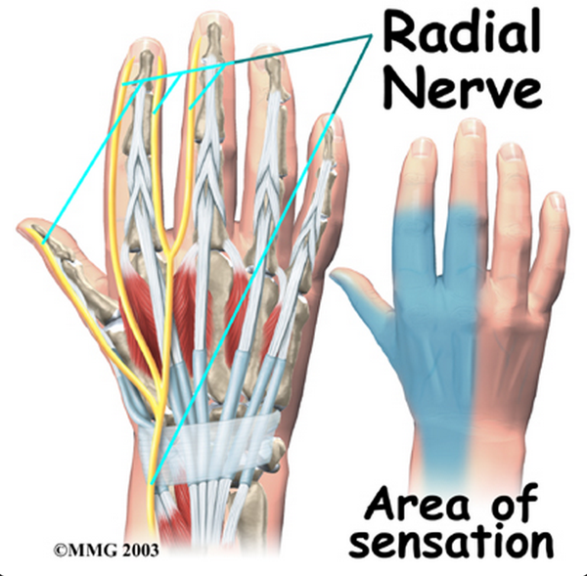
Radial Nerve Injury
Sensory effects:
  sensory loss over lateral part of the dorsum of the hand (more at anatomical snuffbox))
http://www.eorthopod.com/

Slide 34
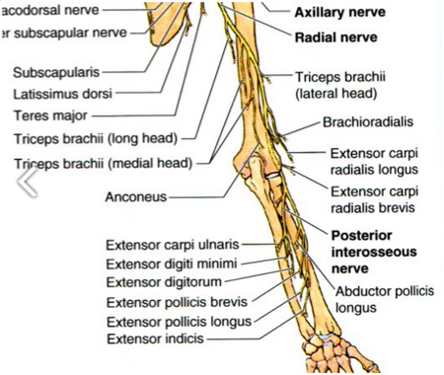
Radial Nerve Injury
Injuries at Spiral Groove
Caused by:
  Fracture shaft of humerus
  Tourniquet palsy
Motor effects: Paralysis of
  Extensors of the wrist
  Extensors of finger
    (inability to extend the MCP joints or elevate the thumb)
Injury in the forearm:
  Posterior interosseous N.
  Only finger drop (remember)
http://pixgood.com/

Slide 35
Radial Nerve Injury
Closed injuries: usually recover (Neuropraxia)
  Splinting
Open injuries:
  Nerve explored and repaired or grafted as soon as possible
  If no recovery:
    Tendon transfers
Dynamic splint
www.orfit.com

Slide 36
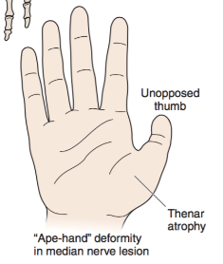


Median Nerve Injury
Dutton’s Orthopaedic Examination, Evaluation, and Intervention
Dutton’s Orthopaedic Examination, Evaluation, and Intervention

Slide 37
Median Nerve Injury
High (above the elbow) – loss of:
  Pronation of forearm
  Wrist flexion
  Index & middle finger flexion
  Thumb flexion
  Opposition
  Sensory loss
Low (below the elbow) - Loss of:
  Thumb opposition (abductor policies brevis)
  Sensory loss
synapse.koreamed.org

Slide 38
Median Nerve Injury
Deformity:
  Ape-like hand
  Thenar muscles wasted
  Thumb is adducted
pixcooler.com
https://thingtheory2009.wordpress.com/

Slide 39
Median Nerve Injury
Anterior interosseous nerve
  OK sign
  Pointing index sign
http://www.wheelessonline.com/ortho/anterior_interosseous_branch_of_median_nerve
https://www.youtube.com/watch?v=55vkBR4ENuo

Slide 40
Median Nerve Injury
Sensory loss:
Lateral 3.5 fingers on palmar side
Distal phalanges of lateral 3.5 fingers on dorsal surface

Slide 41
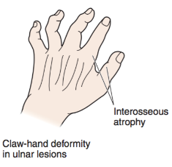



Ulnar Nerve Injury
Dutton’s Orthopaedic Examination, Evaluation, and Intervention

Slide 42
Ulnar Nerve Injury
Common sites for injury
At the elbow
  Fracture of the medial epicondyle
  Cubitus valgus
    (causing tardy ulnar nerve palsy)
  Ulnar nerve entrapment
At the wrist
  Cut wound
properpillow.com
www.photos-albums.com

Slide 43
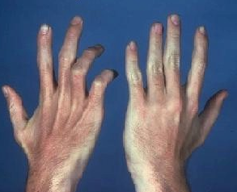
Ulnar Nerve Injury
Motor effects: paralysis of
  Flexor carpi ulnaris
  Medial half of the flexor digitorum profundus
  All interossi
  3-4 lumbricals
Loss of abduction and adduction of fingers
Wasting of hypothenar m.
Wasting interosseous

Slide 44
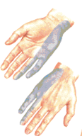
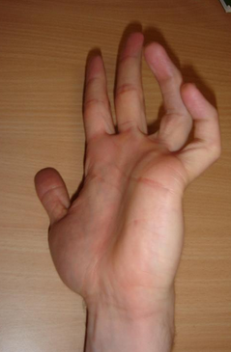
Ulnar Nerve Injury
Sensory
Deformity:
Sensory loss over 1.5 fingers on both surfaces
Claw hand

Slide 45
Ulnar Nerve Injury
Ulnar Paradox:
  In low ulnar nerve lesion
    Clawing of little and ring finger is very obvious
  in high ulnar nerve lesion
    Clawing is less
    Because of paralysis of ulnar half of FDP

Slide 46
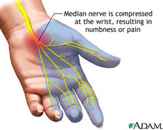
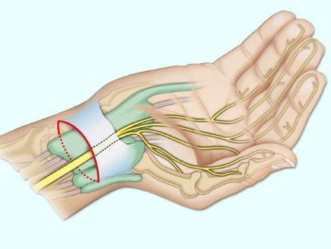
Carpal Tunnel Syndrome
Numbness, tingling, or burning sensations in the thumb ,index, middle fingers, and radial half of the ring fingers
http://de.drugster.info/

Slide 47
Carpal Tunnel Syndrome
Numbness, tingling, or burning sensations in the thumb ,index, middle fingers, and radial half of the ring fingers
Causes:
  Idiopathic
  Obesity
  Oral contraceptives
  Hypothyroidism
  Arthritis
  Diabetes
  Trauma
en.wikipedia.org

Slide 48
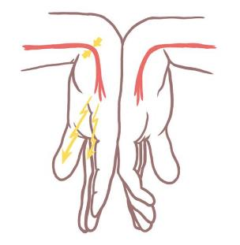
Carpal Tunnel Syndrome
Clinical tests:
  Phalen’s test: reproduces symptoms (1 minute)
akirchner.hubpages.com

Slide 49
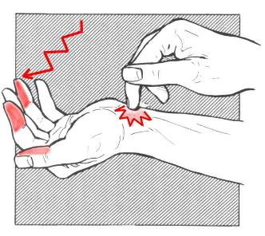
Carpal Tunnel Syndrome
Clinical tests:
  Phalen’s test: reproduces symptoms (1 minute)
  Tinel’s sign: reproduces the symptoms
www.slideshare.net
www.flickr.com

Slide 50
Carpal Tunnel Syndrome
Causes:
  Often combination of factors that increase pressure in the carpal tunnel
    Congenital predisposition - the carpal tunnel is smaller in some people
    Fluid retention during pregnancy or menopause (F 3x M)
    Injury causing swelling (sprain / fracture)
    Overactivity of the pituitary gland
    Hypothyroidism
    Rheumatoid arthritis
    Mechanical problems / repeated use of vibrating hand tools
    Cyst or tumor in the canal
    In some cases no cause can be identified

Slide 51
Carpal Tunnel Syndrome
Treatment:
  Rest – splints
  NSAID
  Ultrasound / Cold packs
  Steroid injection!
  Surgical decompression of carpal tunnel
www.aafp.org
massagebyenzo.wordpress.com

Slide 52
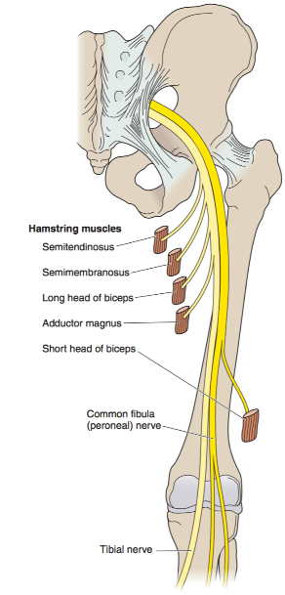
Sciatic Nerve Injury
Dutton’s Orthopaedic Examination, Evaluation, and Intervention

Slide 53
Sciatic Nerve Injury
Division of the main sciatic nerve is rare
Traction lesions:
  Traumatic hip dislocations
  Pelvic fractures
Iatrogenic lesions:
  During surgery: total hip replacement
  Wrong injection site !!
www.findmemes.com

Slide 54
Sciatic Nerve Injury
Complete lesion:
  Paralyzed hamstrings and all muscles below the knee
Sensation is lost below the knee, except on the medial side of the leg
Foot-drop
  High-stepping gait
  Ankle jerk absent
medical-dictionary.thefreedictionary.com

Slide 55
Common Peroneal N. Injury
Branches from the sciatic nerve
Provides sensation to the anterior and lateral parts of the leg and to the top of the foot
Innervates dorsiflexors of the foot (in the leg)
infiniteendurance.com

Slide 56
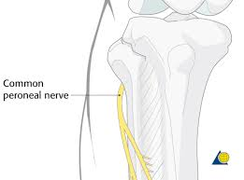
Common Peroneal N. Injury
Often injured at level of the fibular neck
  Severe traction when the knee is forced into Varus
    e.g. in lateral ligament injuries
    and fractures around the knee
  Intraoperative
  Pressure from
    Splint
    Plaster cast
    Lying with the leg externally rotated

Slide 57
Summary
Types of peripheral nerve injuries
Reaction of peripheral n. to injury
Common peripheral nerve injuries:
  Brachial plexus
  Axillary N.
  Radial N.
  Ulnar N.
  Median N.
  Sciatic N.
  Common peroneal N.

