Slide 1
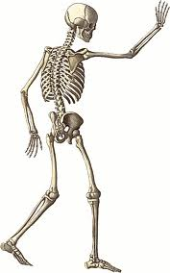
Principles of Fractures
Prof. Mamoun Kremli

Slide 2
Objectives
What is a Fracture – the soft tissue part
Fracture types / classification
Relation between fracture and force
History and physical exam. In fractures
Principles of imaging

Slide 3
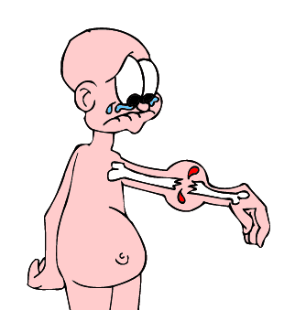
What is a fracture?
A fracture is a break in the structural continuity of bone

Slide 4
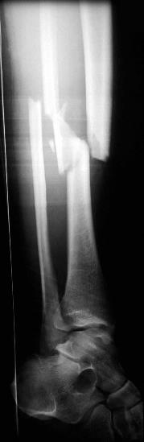
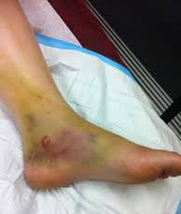
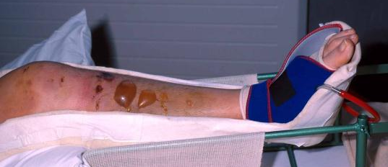
What is a fracture?
A fracture is a break in the structural continuity of bone
  Always associated with some soft tissue injury
A fracture is a soft tissue injury in which the underlying bone is broken!

Slide 5
Type of injury
Mechanism of injury helps expect the
  Extent and type of bone injury
    Simple / comminuted / complex
    Associated fractures/injuries
      Fall from height on feet
        fractured calcaneus and lumbar spine
      Car dashboard injuries
        fractured patella and hip dislocation
  Extent of soft tissue injury
  Suggested treatment and reduction technique
  Prognosis

Slide 6

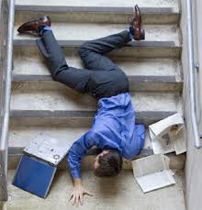
Type of injury
Fall: height, point of impact, twist
https://nationaltradesmen.co.uk/

Slide 7
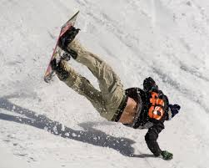
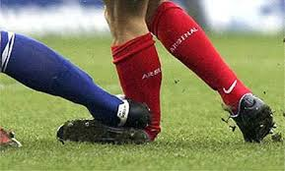
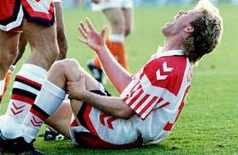
Type of injury
Fall: height, point of impact, twist
Sport: type, direction of force

Slide 8
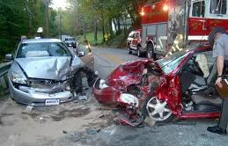
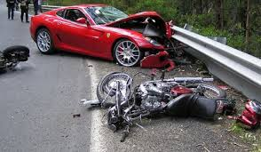
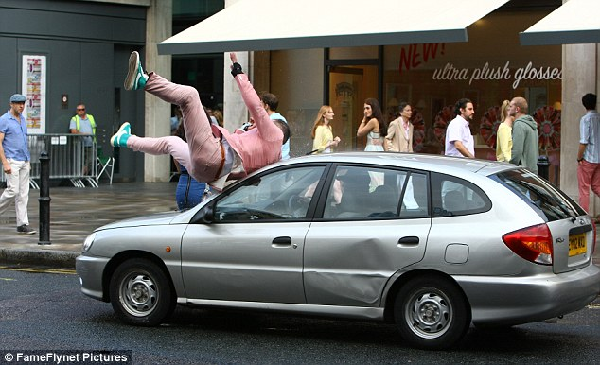
Type of injury
Fall: height, point of impact, twist
Sport: type, direction of force
Road traffic accident (RTA):
  Car (MVA) , motorcycle, pedestrian

Slide 9
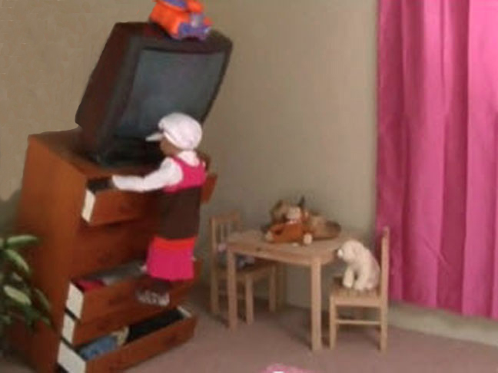
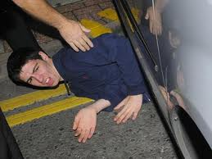
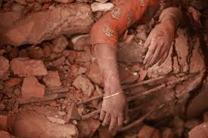
Type of injury
Fall: height, point of impact, twist
Sport: type, direction of force
Road traffic accident (RTA):
  Car (MVA) , motorcycle, pedestrian
Heavy object fall:
  TV, wall, metal, earthquake

Slide 10
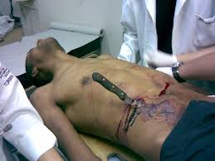
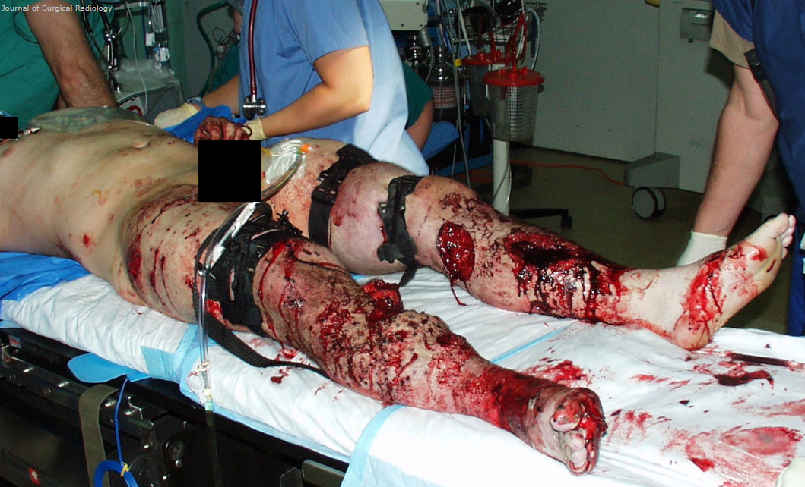
Type of injury
Fall: height, point of impact, twist
Sport: type, direction of force
Road traffic accident (RTA):
  Car (MVA) , motorcycle, pedestrian
Heavy object fall:
  TV, wall, metal, earthquake
Assault & firearms / blast
http://simple.wikipedia.org/wiki/Blast_injury

Slide 11
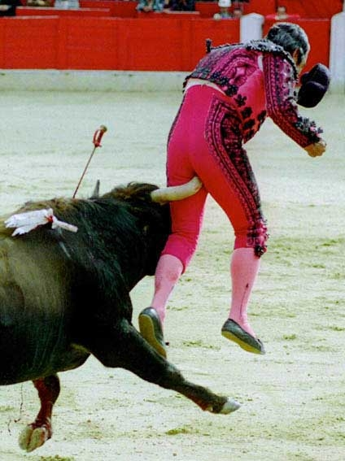
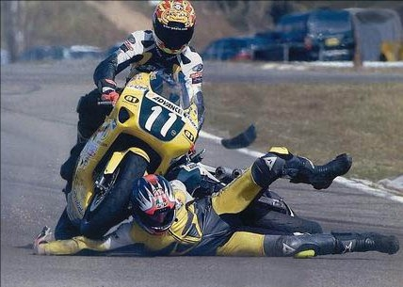
Mechanism of Injury
Need to Differentiate
Low energy
High energy

Slide 12
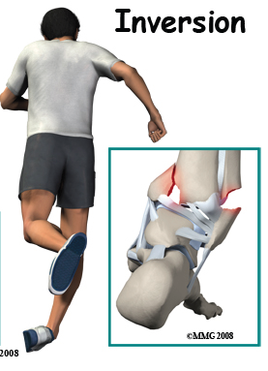
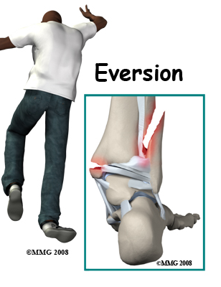
Mechanism of Injury
Low energy
High energy
Direction of force

Slide 13
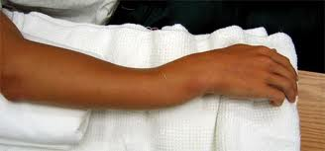
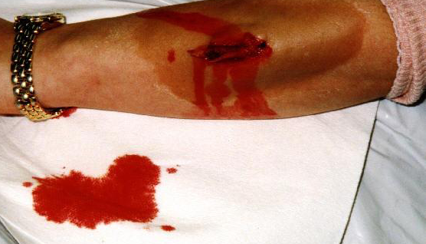
Mechanism of Injury
Low energy
High energy
Direction of force
Blunt / Sharp
Closed / Open
http://eorif.com/

Slide 14
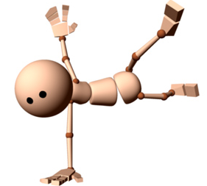
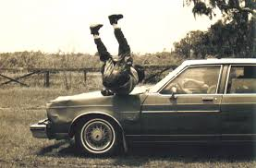
Energy dissipated during injury
Kinetic Energy = ½ MV²
If a Simple fall = 1
Skiing injury = 3-5
High-velocity gunshot = 20
Car bumper (25 km/hr) = 100

Slide 15
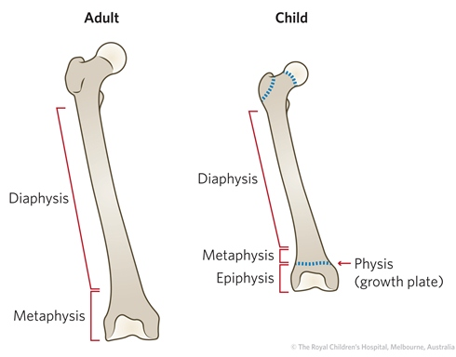
Fracture Classification
According to site of Fracture:
  Diapyhseal
  Metaphyseal
  Articular
  Epiphyseal
  (in children)
Diaphyseal (Shaft)
Epiphyseal
Metaphyseal
Articular

Slide 16
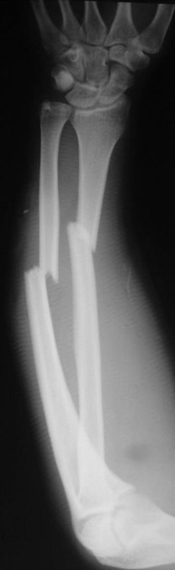
Fracture Classification
According to fracture line:
  Complete (usual)
    Cortex fractured on both sides
https://orthoinfo.aaos.org

Slide 17
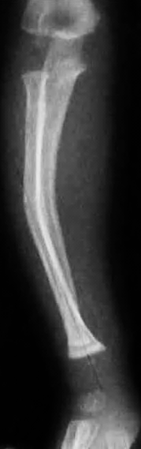
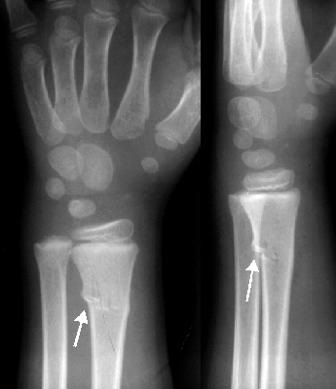
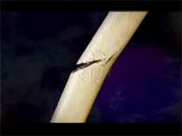
Fracture Classification
According to fracture line:
  Complete (usual)
    Cortex fractured on both sides
  Incomplete (in children)
    Green stick / Torus, Buckle /Deformation
https://radiopaedia.org

Slide 18



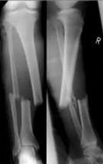
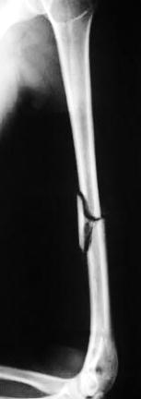
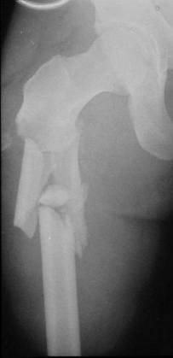
Fracture Classification
According to fracture pattern:
  Simple
  Wedge comminuted
  Complex comminuted
    Multi-fragmented
A
Simple
B
Wedge
C
Complex

Slide 19
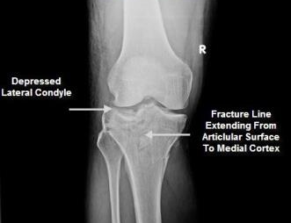
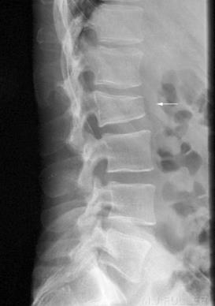
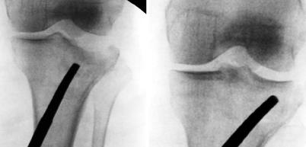

Fracture Classification
According to fracture pattern:
  Compressed Depressed
http://boneandspine.com
http://www.wikiradiography.net/
J Korean Fract Soc. 2014 Jul;27(3):245-260

Slide 20
Fracture Classification
According to type of injury (force):
  Ordinary fracture
    Expected from force of injury
  Stress fracture
    Repetitive loading
  Pathological fracture
    Force too weak to cause fracture
    Bone is pathologically weak
  Avulsion fracture
    Resisted muscle action, or where ligaments and tendons pull a bone fragment off

Slide 21
Stress Fractures
Bone reacts to repeated loading, may become fatigued & a crack develops
Fatigue fractures
  Abnormal stress or torque on a bone that has normal elastic resistance
  Examples:
    military recruits, athletes, ballet dancers
Insufficiency fractures
  Normal muscular activity stresses a bone that is deficient in mineral or elastic resistance

Slide 22
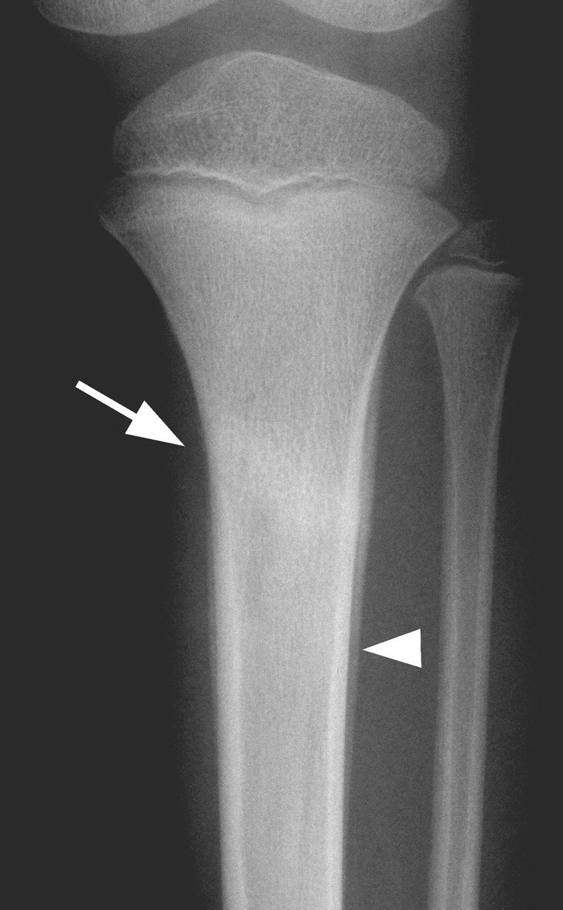
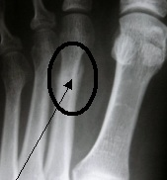
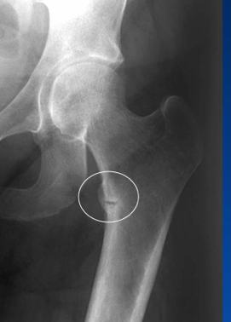
Stress Fractures
Fatigue fractures
  Usually Transvers
    2nd metatarsal
    Tibia
    Fibula
Insufficiency fractures
  In osteopenia, osteomalacia
    Neck of femur
    Ribs
    Neck of humerus
    Scapula
www.imaging.birjournals.org
www.sanluispodiatrygroup.com
www.studyblue.com

Slide 23
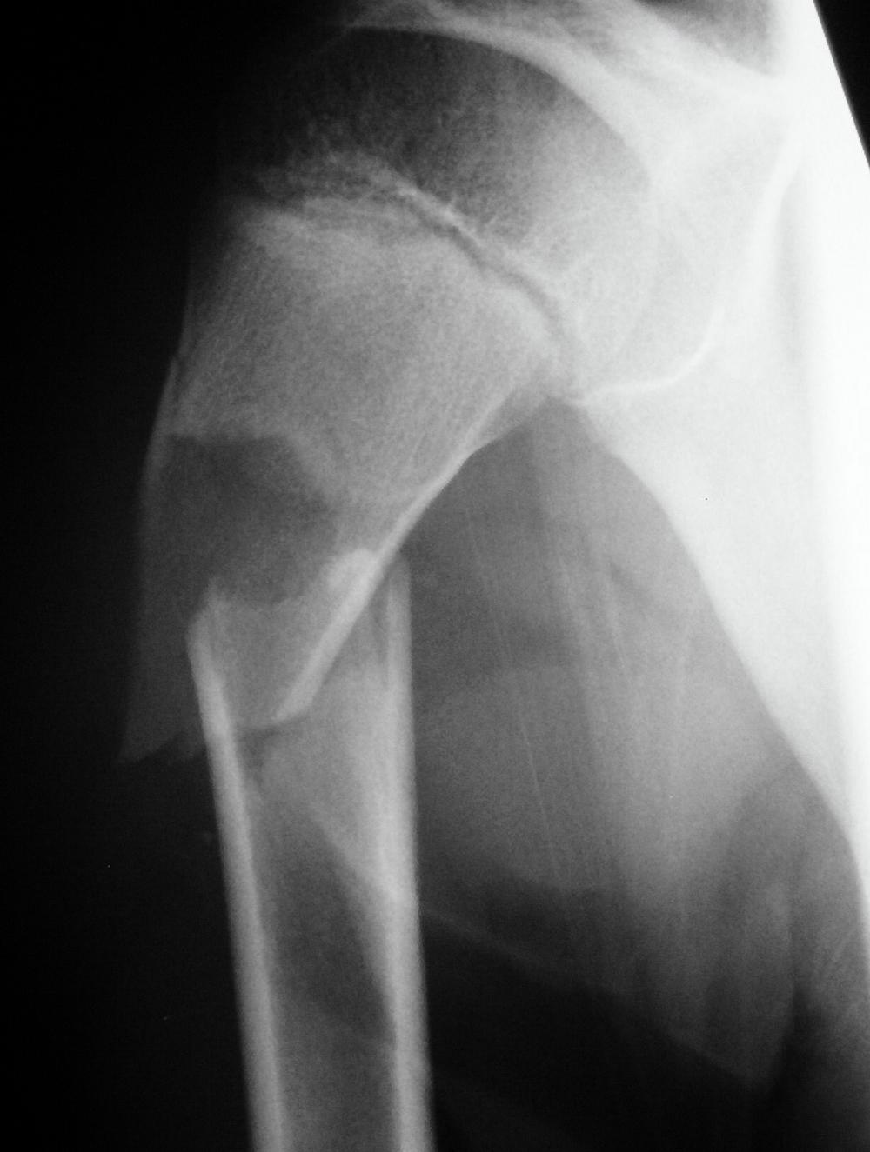
Pathological fractures
Fractures caused by trivial force on abnormally weak bone. Seen in:
Local bone disease
  Osteomyelitis
  Benign tumors and Bone cysts
  Malignant tumors and matastasis
Generalized disease
  Metabolic: osteoporosis, rikets
  Congenital: osteogenesis imperfecta
  Others: Paget’s disease

Slide 24
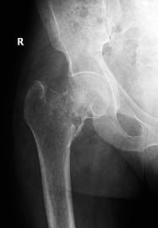
Pathological fractures
Fractures caused by trivial force on abnormally weak bone. Seen in:
Local bone disease
  Osteomyelitis
  Benign tumors and Bone cysts
  Malignant tumors and matastasis
Generalized disease
  Metabolic: osteoporosis, rickets
  Congenital: osteogenesis imperfecta
  Others: Paget’s disease

Slide 25
Force & Fractures
Normal bone:
  Strong force: ordinary fracture
  Repetitive stress: Stress (fatigue) fracture
Weak bone (Pathological fracture)
  Weak (trivial) force: pathological fracture
  Normal daily activity: Insufficiency fracture
Quality of Bone | Type of Force | Type of Fracture
Normal | Strong | Normal
Normal | Repetitive loading | Stress - fatigue
Abnormal - weak | Normal daily activities | Stress - insufficiency
Abnormal - weak | Trivial injury | Pathological

Slide 26
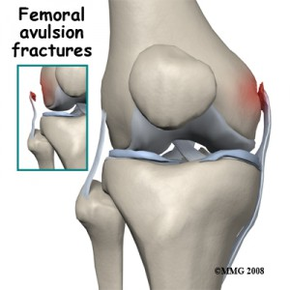
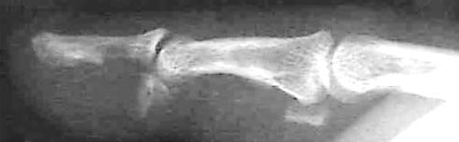
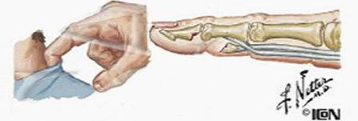
Avulsion fractures
Part of bone separated by forceful sudden resisted muscle action
  Caused by ligament or tendon pull on bone
  Part of bone avulsed – bone weaker than tendon/ligament

Slide 27
Type of injury
Direct
  Mild force: transverse / Severe force: comminution
  Soft tissue more injured
Indirect
  Pattern of fracture depends on force direction
  Less soft tissue injury
Penetrating
  Missiles
    Low velocity < 300 m/s - damage along the tract
      Comminution
    High velocity: >300m/s - sever comminution
      Comminution with wide soft tissue damage
https://www.researchgate.net/publication/236633377_

Slide 28
Force & fracture pattern
Fracture pattern suggests mechanism of force
  Spiral: (twisting)
  Short oblique: (compression)
  Wedge: (compression + bending)
  Transverse: (angulation) (avulsion)

Slide 29
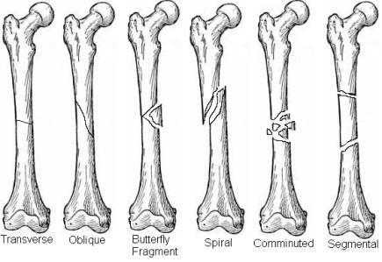
Force & fracture pattern

Slide 30
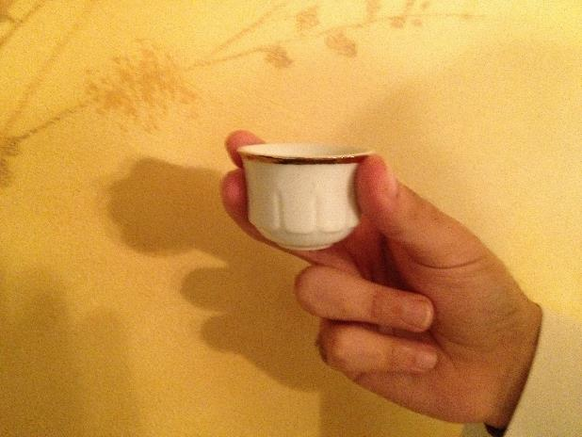
Coffee Break

Slide 31
Displacement
Described as: Position of distal in relation to proximal
  Un-displaced
  Displaced

Slide 32
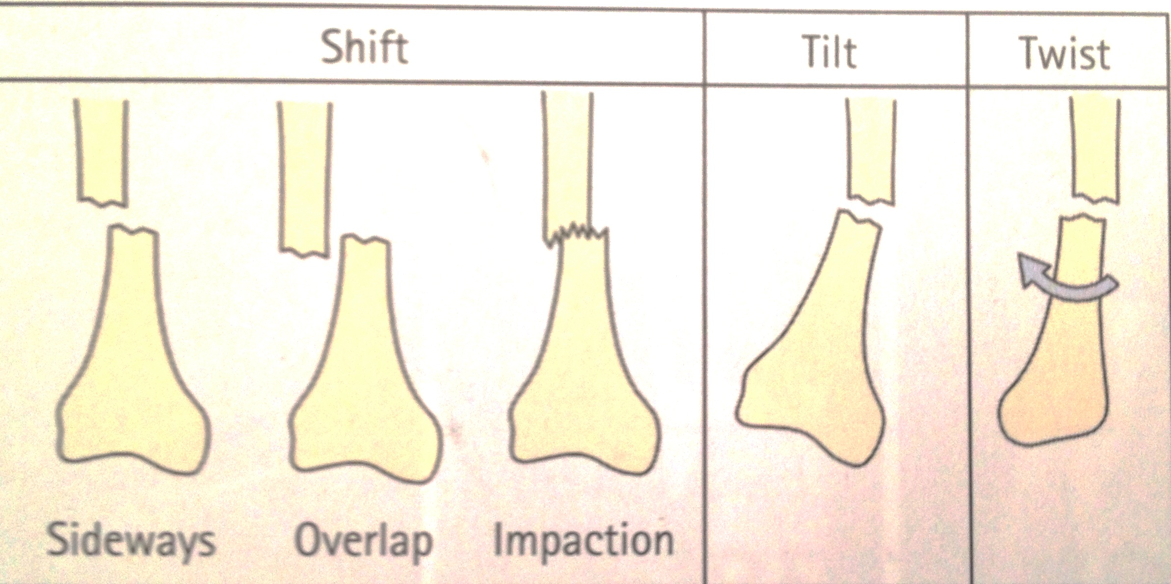
Displacement
Described as: Position of distal in relation to proximal
Un-displaced
Shift
  Sideways
  Shortening
  Distraction
Angulation
  In all planes
Rotation
SHIFT | ANGULATION /TILT | TWIST/ ROTATION
Sideways Overlap Impaction

Slide 33
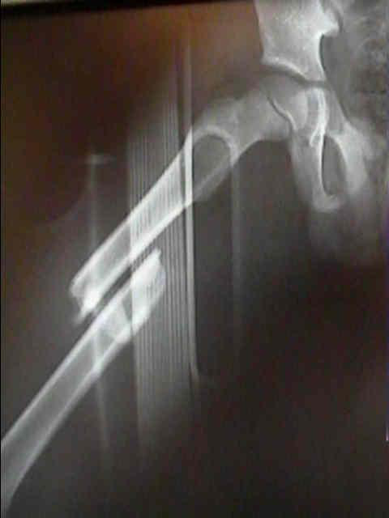
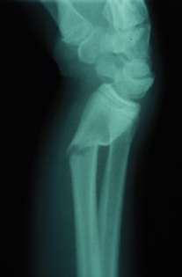
Displacement
Described as: Position of distal in relation to proximal
Un-displaced
Shift
  Medial / Lateral
  Anterior / Posterior
  Shortening (overlap)
  Distraction
Angulation
  In all planes
Rotation
volar
dorsal
Medial shift + overlap
No tilt because long axes are parallel
Dorsal tilting

Slide 34
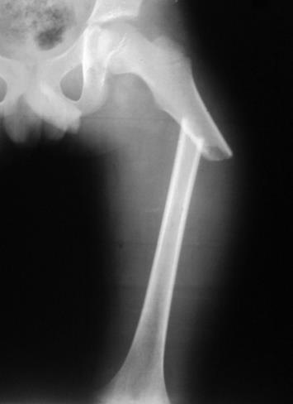
Displacement
Described as: Position of distal in relation to proximal
Un-displaced
Shift
  Medial / Lateral
  Anterior / Posterior
  Shortening (overlap)
  Distraction
Angulation
  In all planes
Rotation
Medial shift + medial tilt + overlap
http://medpic.org

Slide 35
Fracture Diagnosis
History
Clinical features
Imaging: Radiology (x-Ray)

Slide 36
Trauma History
Mechanism of injury
  Date, time, type, method of impact, …
Consciousness
Function of injured part
Open wound / bleeding
Other injuries
Anti-Tetanus status (if skin breached)

Slide 37
Approach - history
Details of injury
  Mechanism, force, bleeding, consciousness, …
Details of facture
  Deformity, pain, loss of function, ..
Other medical problems
Anti-tetanus status if open injuries
Careful:
  Fractures are not always at the site of impact
  Some fractures do not need severe force
Shall be discussed separately

Slide 38

Clinical Features
History of Trauma
Symptoms and signs:
  Pain
  Swelling
  Deformity
  Loss of function
  Localised bony tenderness
  Loss of motion
  Abnormal movement
  Crepitus

Slide 39
Approach – clinical exam
General medical condition
  Should be evaluated to exclude
    Shock
    Brain injury
    Other problems
Vital signs
  Should be observed and followed up

Slide 40
Approach – clinical exam
Look:
  Adequate exposure
  General on patient
  Local:
    Swelling, deformity, bruises, color, …
    Special attention is to be paid to wounds

Slide 41
Approach – clinical exam
Feel:
  Localized bone Tenderness
  Pulse distal to injury – capillary refill
  Sensory and motor deficits
  Compartment syndrome
  Temperature and crepitus on movement
Move:
  With care
    make sure not to cause more pain or injury
  Crepitus & abnormal movement indicates a fracture
  Joints distal to the affected area

Slide 42
Approach – clinical exam
Examination of the viscera
  Liver and spleen in rib fractures
  Urinary bladder and urethra in pelvic fractures
  Neurological examination in head and spinal injury

Slide 43
Investigations - Imaging
X-rays:
  Low of 2s
    Two views: AP and Lateral – special views
    Two joints: Above and Below
    Two sides: Right and Left
    Two occasions
    Two injuries
    Two Doctors !
  Special views:
    Obliques, Tunnel view, skyline, stress views,
    functional flexion/extension, traction films
    Arthrography:
      Shows intra-articular structures
    Functional in hip

Slide 44


Imaging
Plain x-ray: (law of twos)
  Two views: AP and Lateral
AP
Lat
AP
Lat
Apley’s System of Orthopedics & Fractures

Slide 45
Imaging
Plain x-ray: (law of twos)
  Two views: AP and Lateral
AP
Lat

Slide 46

Imaging
Plain x-ray: (law of twos)
  Two views: AP and Lateral
  Two joints: joint above and joint below
    To show other injuries
Apley’s System of Orthopedics & Fractures

Slide 47

Imaging
Plain x-ray: (law of twos)
  Two views: AP and Lateral
  Two joints: joint above and joint below
    To show other injuries
    To assess rotation
Hip AP view
(in the same x-ray)
Knee lateral view
http://medpic.org

Slide 48

Imaging
Plain x-ray: (law of twos)
  Two views: AP and Lateral
  Two joints: joint above and joint below
  Two limbs: for comparison
    more in children to
    compare epiphysis
Apley’s System of Orthopedics & Fractures

Slide 49

Imaging
Plain x-ray: (law of twos)
  Two views: AP and Lateral
  Two joints: joint above and joint below
  Two limbs: for comparison
  Two occasions
    e.g. stress fractures
    e.g. scaphoid fracture
Apley’s System of Orthopedics & Fractures

Slide 50


Imaging
Plain x-ray: (law of twos)
  Two views: AP and Lateral
  Two joints: joint above and joint below
  Two limbs: for comparison
  Two occasions
  Two injuries
    e.g. patellar fracture and hip injury
    e.g. calcaneal fractures & spine injuries
www.jumpintheair.com

Slide 51

Imaging
Plain x-ray: (law of twos)
  Two views: AP and Lateral
  Two joints: joint above and joint below
  Two limbs: for comparison
  Two occasions
  Two injuries
  .....and two Doctors!!
www.123rf.com/

Slide 52


Imaging
Plain x-ray: (law of twos)
Special views:
  Ankle mortis
  Calcaneal view
  Scaphoid views
  Shoulder dislocation: axial view
  Acetabular fractures: 45º tilt views
  Stress views
  Traction views
  Functional flexion/extension (spine)
http://osuemed.wordpress.com/
https://radiopaedia.org

Slide 53




Imaging
CT Scan:
  In complex and ntra-articular fractures
  In spine
  In pelvic and acetabular fractures
  In calcaneal fractures
www.learningradiology.com

Slide 54
Summary
What is a Fracture – the soft tissue part
Fracture types - classification
Relation between fracture and force
Principles of imaging – Law of “Two”s

