Slide 1
Spinal Disorders
Dr. Mustafa Elsingergy Consultant orthopedic surgeon Dallah Hospital

Slide 2
Objectives
To know the common spinal disorders
How to clinically diagnose spinal disorders cases ?
What is natural history of each case ?
What is suitable investigation ,and its limits ?
Treament of the common disorders

Slide 3
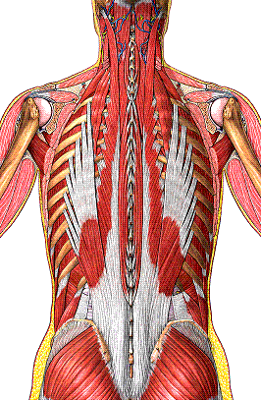
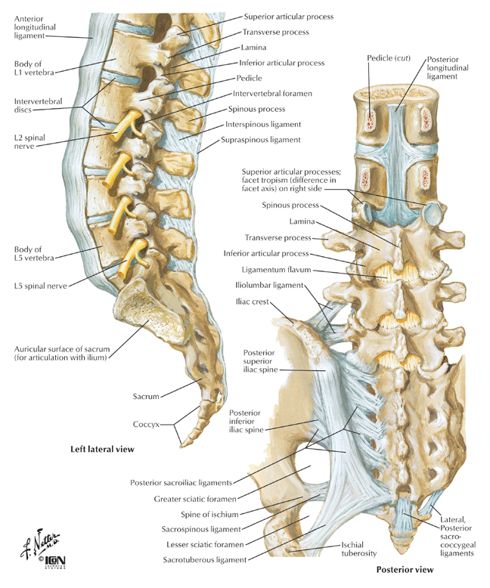
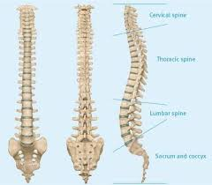
Spinal Disorders Normal Anatomy
Normally vertebral column is formed of 7 cervical,
12 THORACIC , 5 LUMBER VERTBRAE ,and SACRUM
Spine region has 3 major componants:
Spinal column (bone&disc)
neural elements (spinal cord & nerve roots)
Supporting structures (muscles & ligaments)

Slide 4
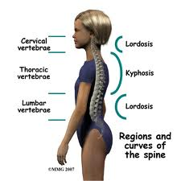
SPINAL DISORDERS NORMAL ANATOMY
Normally the spine has 4 natural curves that help to destribute mechanical stress as the body moves:
Cervical & lumber ( lordotic)
Thoracic & sacral (kyphotic)

Slide 5
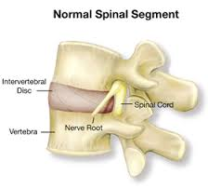
SPINAL DISORDERS
Structural unit of the spine
A number of disorders can change the structural relationship of the spine,damage the vertebrae as well as the surrounding tissues.

Slide 6
SPINAL DISORDERS
The common disorders are:
Deformity:
Scoliosis
Kyphosis
Infection:
Tb
Pyogenic
Intervertebral disc lesion
SPONDYLOLYSIS and SPONDYLOLISTHESIS
SPINE DEGENERATION and SPINAL CANAL STENOSIS

Slide 7
SPINAL DISORDERS
The common disorders are:
Intervertebral disc lesion
SPONDYLOLYSIS and SPONDYLOLISTHESIS
Deformity:
Scoliosis
Kyphosis
Infection:
Tb
Pyogenic
SPINE DEGENERATION and SPINAL CANAL STENOSIS

Slide 8
CLINICAL ASSESSMENT
Symptoms:
Pain
Stiffness
Deformity
Neurological symptoms (numbness , parasthesia & muscle weakness)
Other symptoms (urethral discharge , sore eye , diarrhea)

Slide 9
CLINICAL ASSESSMENT
Examination:
Look
Feel
Move
Special test
Full neurological ex

Slide 10
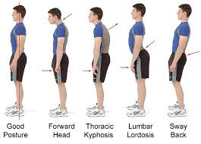
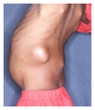
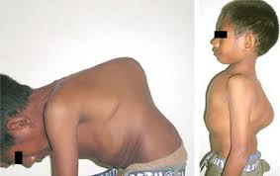
CLINICAL ASSESSMENT
Examination
Look
Posture
Deformity :
scoliosis
Kyphosis
Skin changes :
scar , sinus , redness
Swelling :
abscess

Slide 11
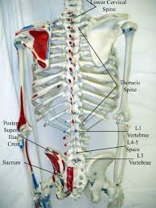
CLINICAL ASSESSMENT
EXAMINATION
FEEL
Tenderness
Temperature
Bony prominences
Step sign

Slide 12
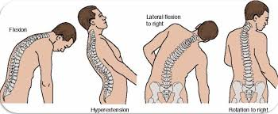
CLINICAL ASSESSMENT
EXAMINATION
MOVE :
Flexion
Extension
Lateral flexion
Rotation
Chest expansion
Muscle power of :
Planter flexor (tip toes walking)
Dorsflexor (heel walking)

Slide 13
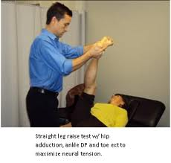
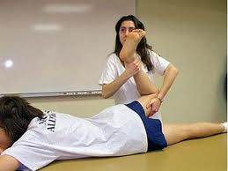
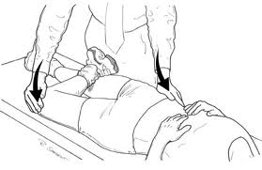
CLINICAL ASSESSMENT
EXAMINATION
SPECIAL TESTS:
Sciatic nerve stretch , straight leg raising (SLR) ,
Femoral nerve stretch tests
Sacroiliac stress test
Full neurological ex of lower limbs

Slide 14
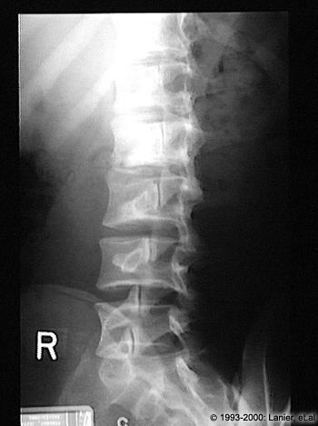
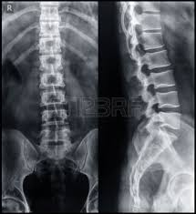
IMAGING FOR SPINAL DISORDERS
X ray:
Ap , lat ,oblique
Flexion-extension LAT
Deformity series eg scoliosis series
CT
Mri
N.B. Other invetigations are requested accordingly

Slide 15
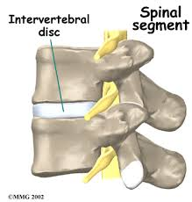
INTERVERTEBRAL DISC LESION
Structural unit of vertebral column

Slide 16
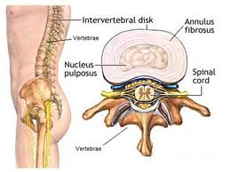
INTERVERTEBRAL DISC LESION
Anatomy
Disc is formed of :
nucleus pulposus ,
annulus fibrosus

Slide 17
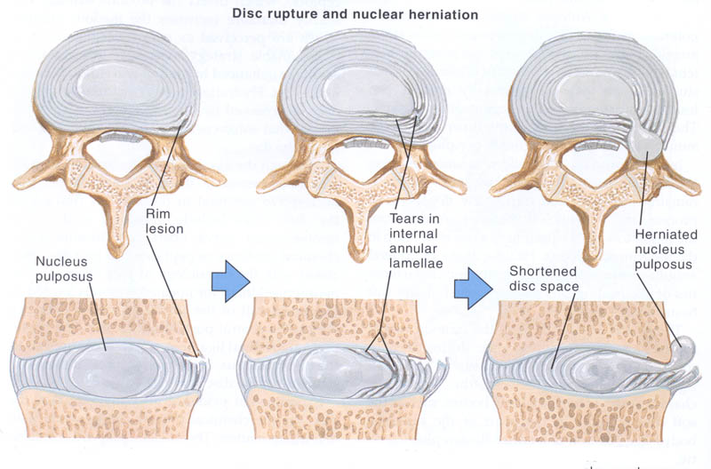
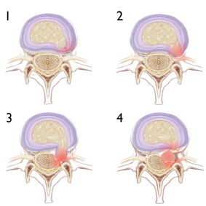
INTERVERTEBRAL DISC LESION
PATHOLOGY
Bulge → back pain
Protrusion → sciatica
Prolapse & sequestration → numbness , paresthesia , weakness

Slide 18
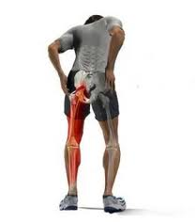
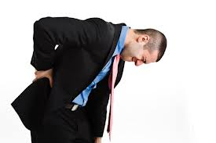
INTERVERTEBRAL DISC LESION
CLINICAL PICTURE :
Young adults are commonly affected but children and old age are not immune
HISTORY AND SYMPTOMS
Back pain and sciatica which increase with straining and coughing
Numbness and paresthesia
Motor weakness

Slide 19
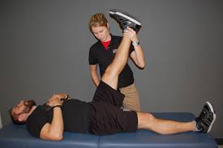
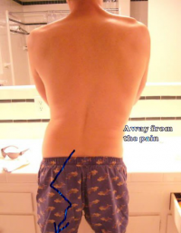
INTERVERTEBRAL DISC LESION
EXAMINATION AND SIGNS
Spinal list
Tenderness over the midline and paravertebral muscles
Straight leg raising test
Cross straight leg raising
Femoral stretch
Full neurological assessment
cauda equina lesion : sphincteric problem , and loss of sensation in the saddle area

Slide 20
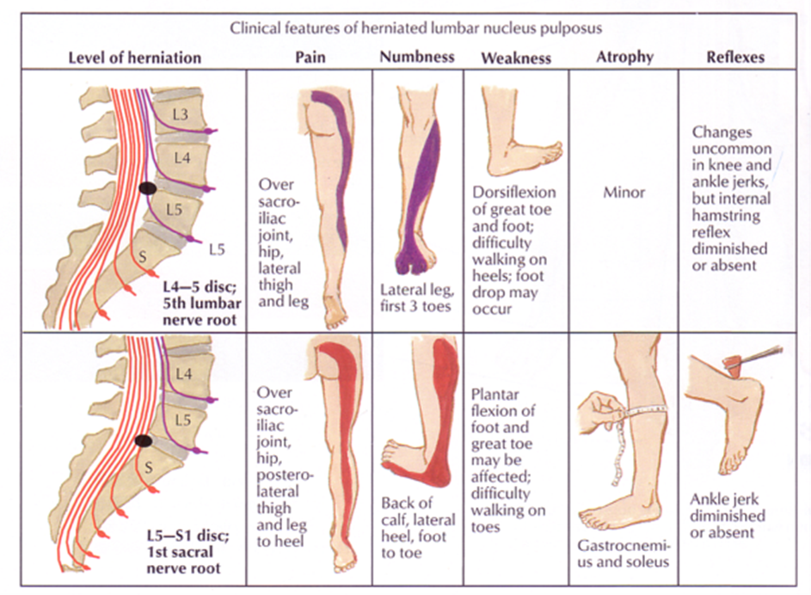
INTERVERTEBRAL DISC LESION

Slide 21
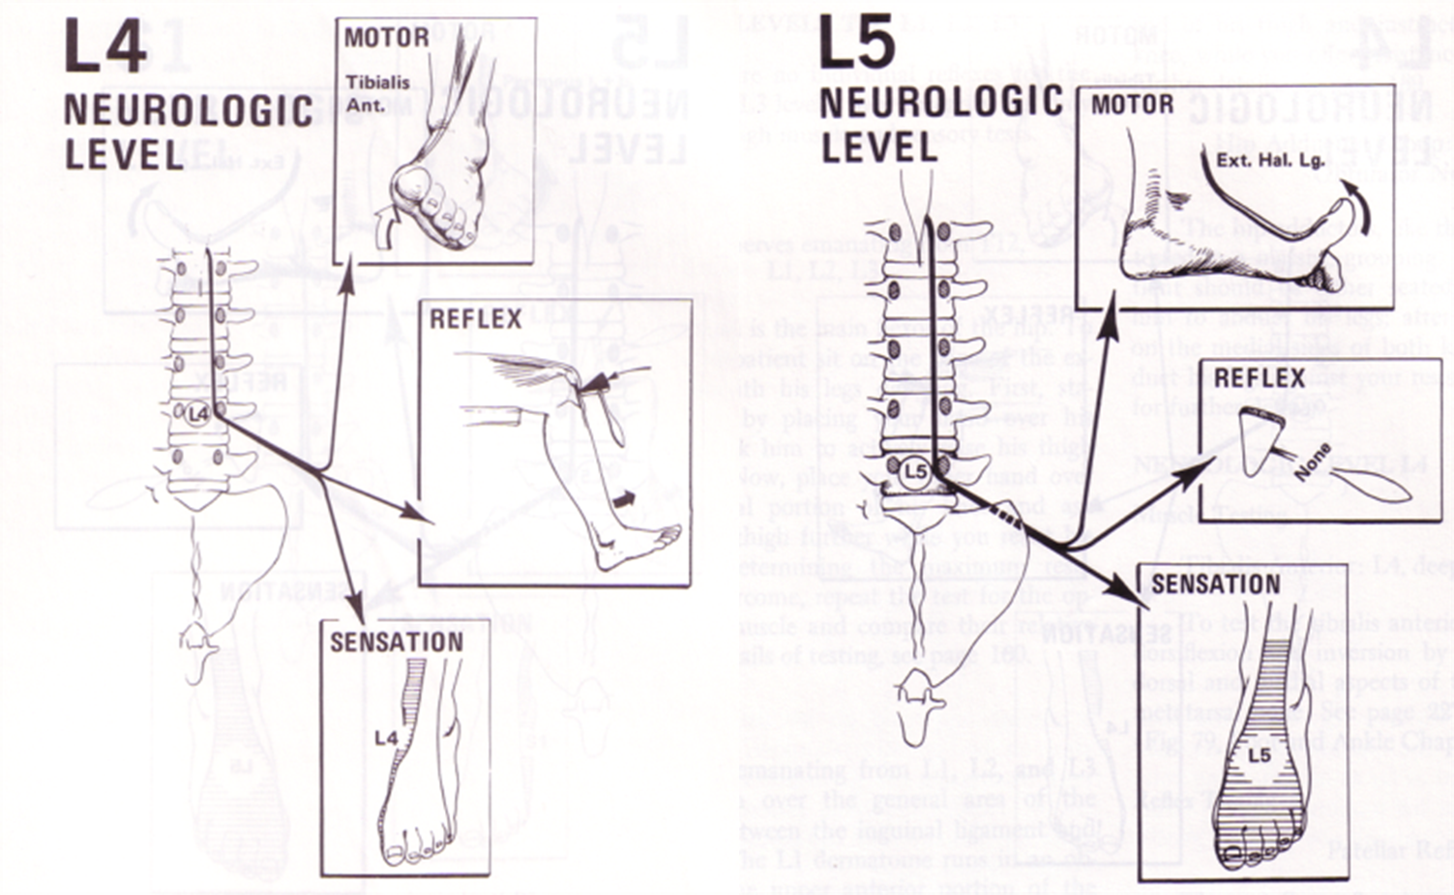
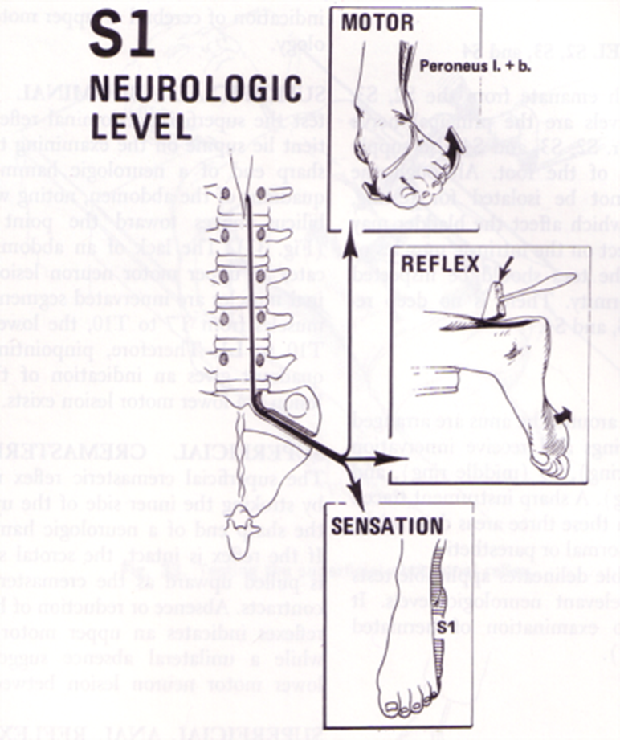
INTERVERTEBRAL DISC LESION

Slide 22
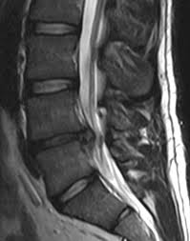
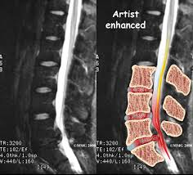
INTERVERTEBRAL DISC LESION
IMAGING
X ray
to roll out other bony pathology
Narrowing of the disc space
MRI
Is the gold standard to identify the disc and localize the lesion

Slide 23
INTERVERTEBRAL DISC LESION
TREATMENT
CONSERVATIVE
Rest
NSAID
Muscle relaxant
Physiotherapy
SURGICAL
Absolute indication
Cauda equina lesion
Relative indication
Persistent pain
Progressive neurological manifestations
Frequent attacks

Slide 24
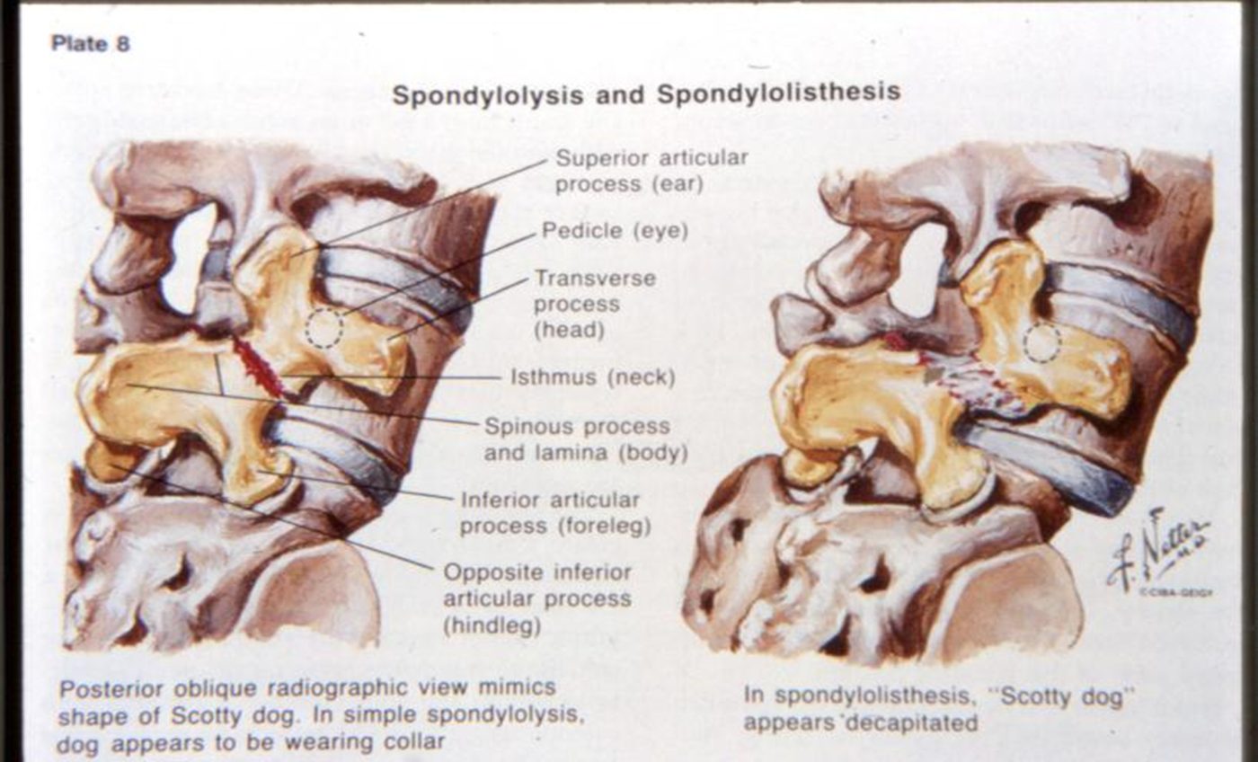
SPONDYLOLISTHIASIS
SPONDYLOLISTHIASIS
Anterior vertebral displacement
SPONDYLOLISIS
Defect in the paras interarticularis
Normal anatomy preventing anterior displacement ; lamina and facets

Slide 25
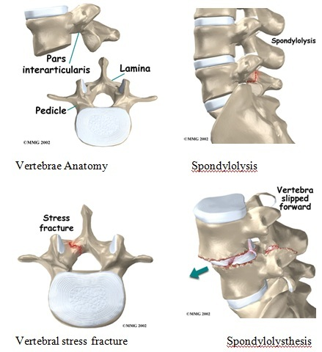
SPONDYLOLISTHIASIS
SPONDYLOLISTHIASIS
Anterior vertebral displacement
SPONDYLOLISIS
Defect in the paras interarticularis
Normal anatomy preventing anterior displacement ; lamina and facets

Slide 26
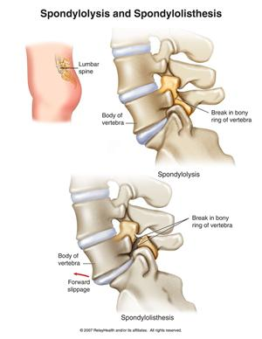
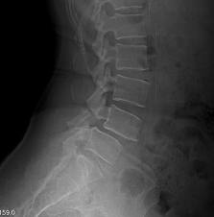
SPONDYLOLISTHIASIS
SPONDYLOLISTHIASIS
Anterior vertebral displacement
SPONDYLOLISIS
Defect in the paras interarticularis
Normal anatomy preventing anterior displacement ; lamina and facets

Slide 27
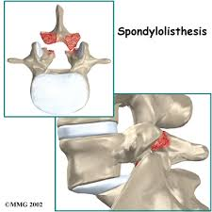
SPONDYLOLISTHIASIS
CAUSES OF SPONDYLOLISTHIASIS :
Dysplasia
Spondylolysis
Degenerative
Destruction by trauma , TB ,tumor

Slide 28
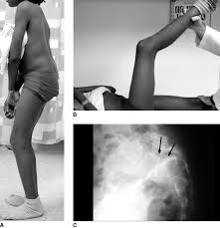
SPONDYLOLISTHESIS
CLINICAL FEATURES
DYSPLASTIC TYPE :
Children , painless
POSTURAL PROBLEM :
Protruding lower abdomen ,
tip toe walking with flexed knees

Slide 29
SPONDYLOLISTHESIS
CLINICAL FEATURES
SPONDYLOLYTIC TYPE :
Adult ,most common type
Backache after exercises
Flat buttock
Step sign
DEGENARATIVE TYPE :
Female > male ,
40 years
Ch back pain
Spinal stenosis symptoms

Slide 30
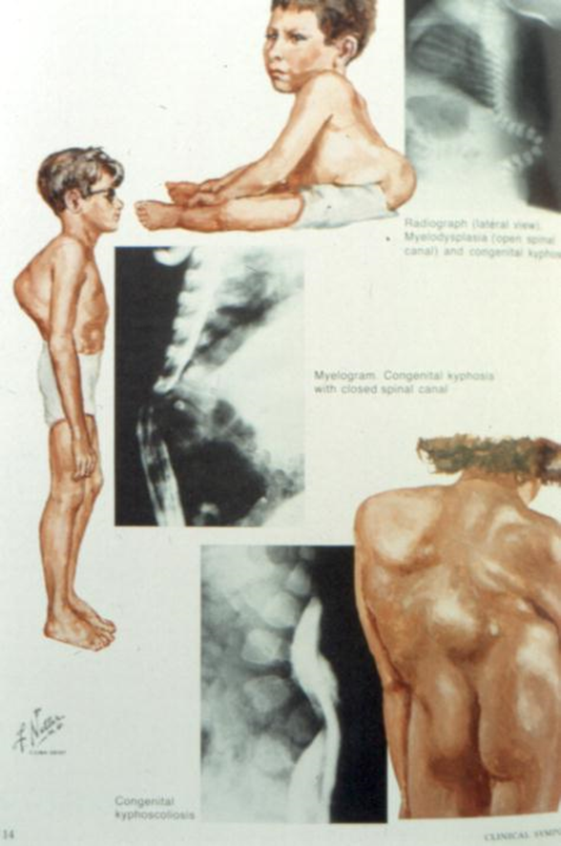
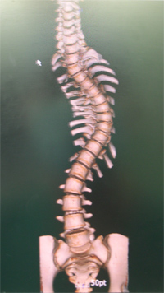
SPINAL DEFORMITY
SCOLIOSIS : Lateral curvature of the spine >10º accompanied by vertebral rotation
KYPHOSIS : Dorsal curvature of the spine >40º

Slide 31
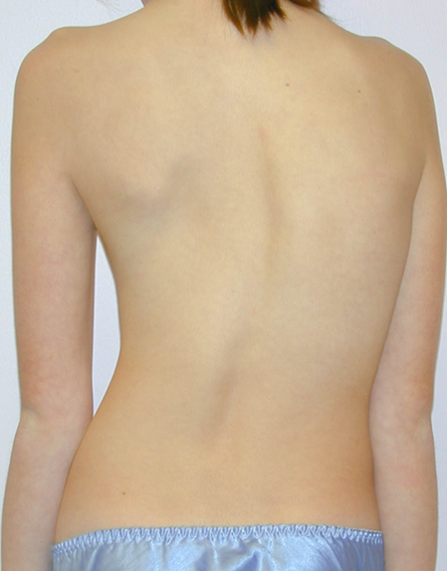
SCOLIOSIS
TYPES:
COMPANSATORY:
Deformity is secondary to pathology outside the spine
eg . Limb length discrepancy , pelvic tilt. disappear with sitting
STRUCTURAL:
Fixed not disappear by sitting . Usually associated with
bony abnormality.

Slide 32
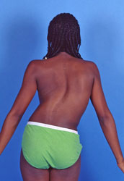
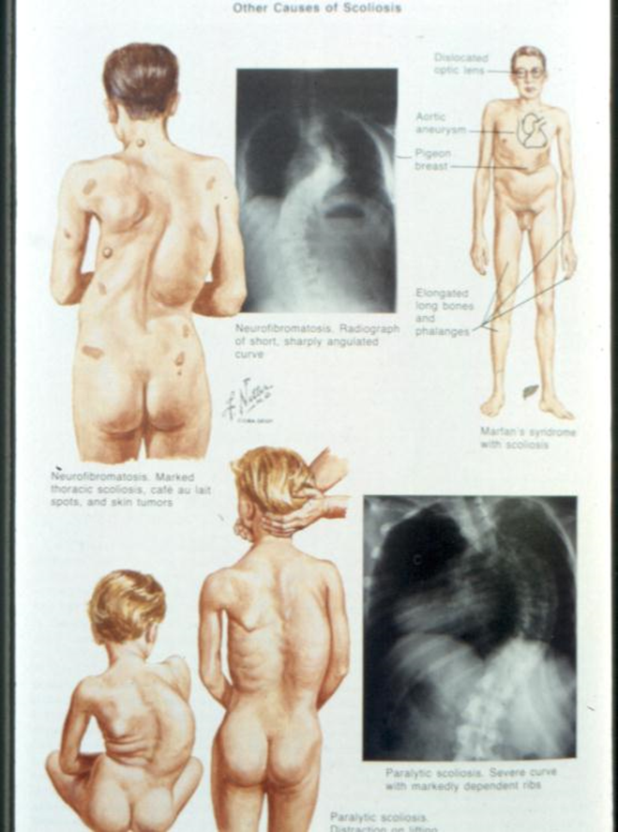
STRUCTURAL SCOLIOSIS
Idiopathic:
Infantile
adolescent
Neuropathic( paralytic )
Myopathy
neurofibromatosis

Slide 33
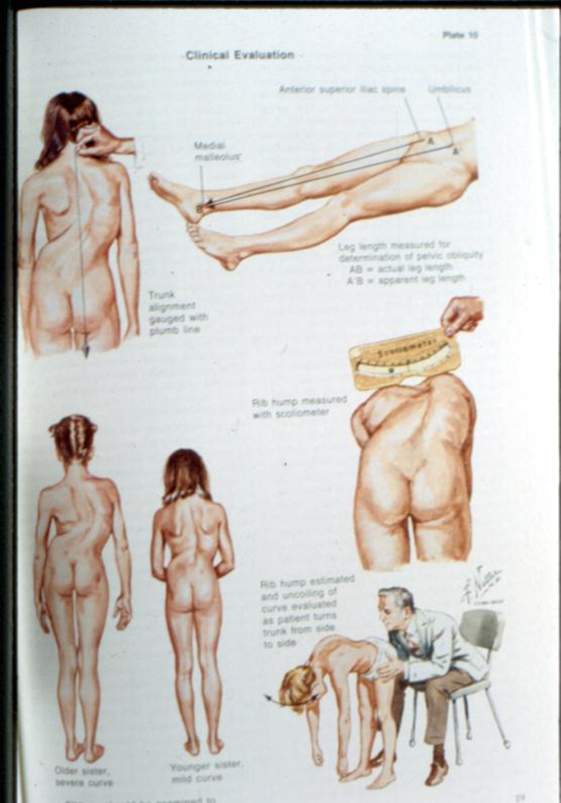
ADOLLESCENT IDIOPATHIC SCOLIOSOS CLINICAL FEATURES
Shoulders are different heights – one shoulder blade is more prominent than the other
Head is not centered directly above the pelvis
Appearance of a raised, prominent hip
Rib cages are at different heights
Uneven waist
Changes in look or texture of skin overlying the spine
Leaning of entire body to one side

Slide 34
ADOLLESCENT IDIOPATHIC SCOLIOSOS Natural history
Back pain not significantly higher in pts with scoliosis
Curves in untreated adolescents with curves < 30 º at time of bony maturity are unlikely to progress
Curves >50 º at maturity progress 1º per year
Life-threatening effects on pulmonary function do not occur until curve is >100 º (ie: Cor pulmonale)

Slide 35
ADOLLESCENT IDIOPATHIC SCOLIOSOS Natural history
Three main determinants of curve progression are:
(1) Patient gender
(2) Future growth potential
(3) Curve magnitude at time of diagnosis

Slide 36
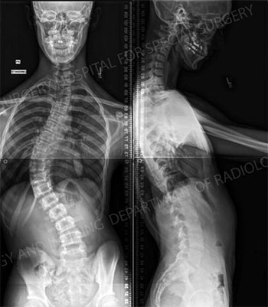
ADOLLESCENT IDIOPATHIC SCOLIOSOS IMAGING
X RAY:
AP and LAT of all spine ( COBB ANGLE )
AP pelvis ( RISSER GRADE )

Slide 37
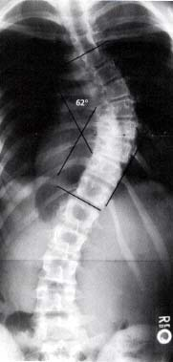
ADOLLESCENT IDIOPATHIC SCOLIOSOS COBB ANGLE
Choose the most tilted vertebrae above & below apex of the curve.
- Angle b/t intersecting lines drawn perpendicular to the top of the
superior vertebrae and bottom of the inferior vertebrae is the Cobb angle

Slide 38
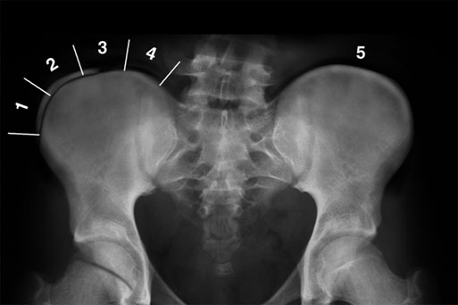
ADOLLESCENT IDIOPATHIC SCOLIOSOS Risser Grading
Assessing growth potential :
- Measures progress of bony fusion of iliac
apophysis
- Ranges from zero (no ossification) to 5 (complete
bony fusion of the apophysis)
- The lower the grade, the higher the potential for
progression

Slide 39
ADOLLESCENT IDIOPATHIC SCOLIOSOS TREATMENT
TREATMENT GUIDE LINES:
Aim of treatment is to prevent curve progression
Period of preliminary evaluation by photography , clinical evaluation , and radiological measuring the curve before decide to conservative or surgical treatment
No treatment for curves < 10
Treatment is initiated if :
skeletal immature curves < 19 progress 1o degrees /year
20 < curves < 29 progress 5 degrees /year

Slide 40
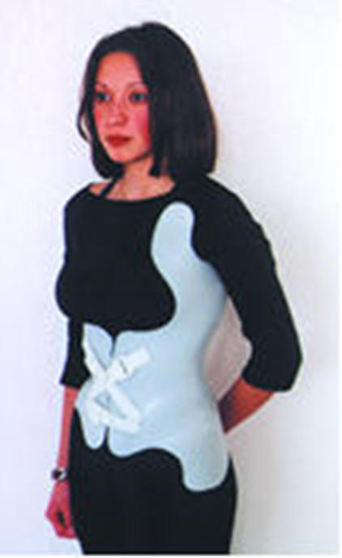
ADOLLESCENT IDIOPATHIC SCOLIOSOS TRATMENT
BRACING
Indications:
40 >curves > 20
Well balanced double curves
Young children who need surgery to hold curve stationary
To prevent recurrence

Slide 41
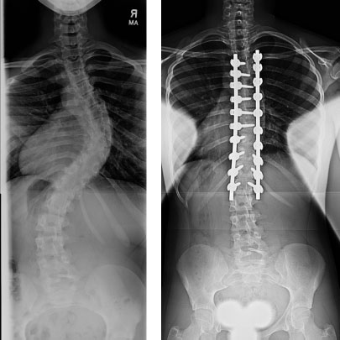
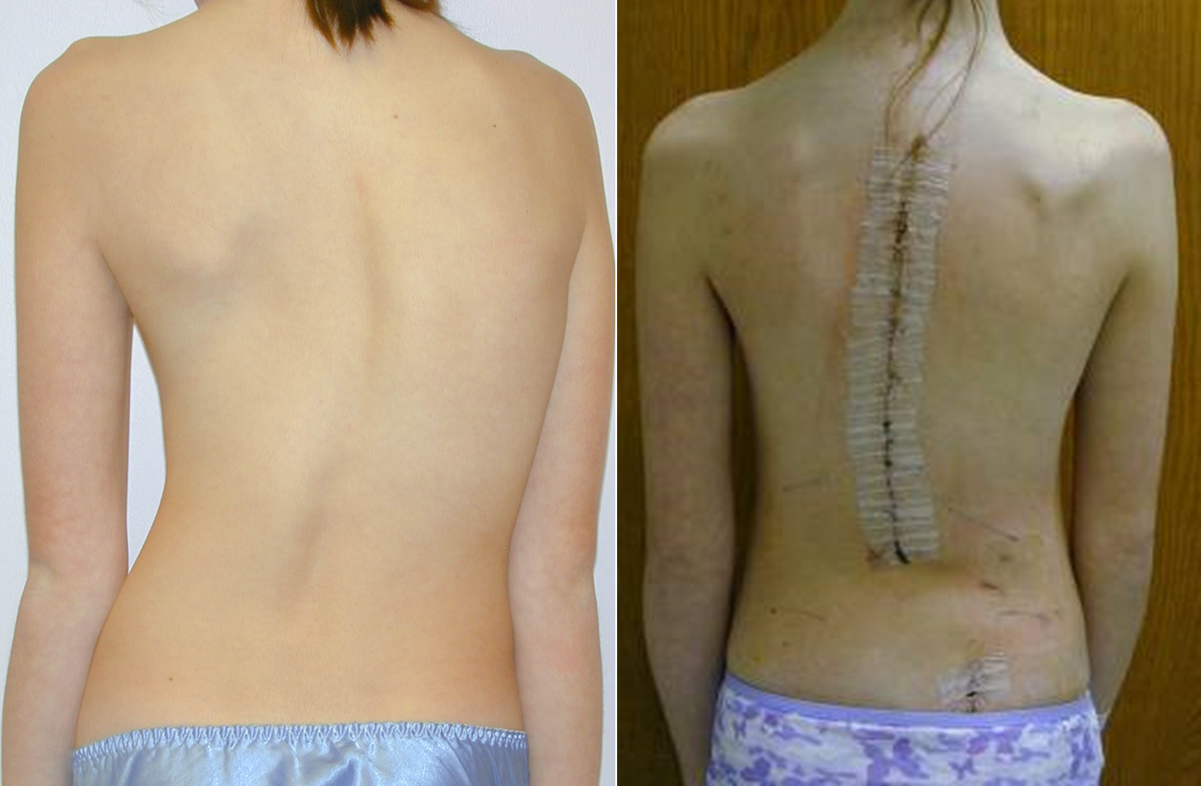
ADOLLESCENT IDIOPATHIC SCOLIOSOS TRATMENT
SURGERY
Indications:
Curves > 40 in skeletally immature
Adult documented progressive curves
PROCEDURE:
Correction
Instrumentation
Fusion

Slide 42
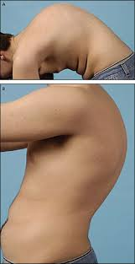
KYPHOSIS
DEFINATION : BACKWARD ANGULATION ABOVE 40 DEGREES
TYPES :
MOBILE :
Compensatory
Postural
STRUCTURAL :
Angular eg cong
TB
Rounded eg Scheurmann
Senile osteoporosis
Ankyloses spondylitis

Slide 43
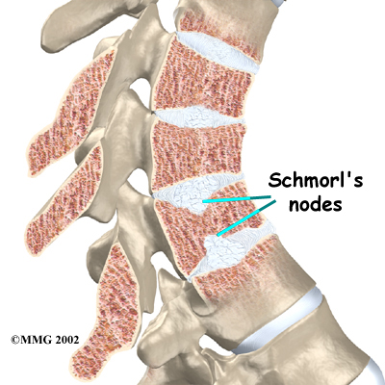
SCHEURMAN DISEASE
PATHOLOGY :
Irregular ossification of vertebral body epiphysis
Central herniation of disc material into the body(Schmoral Node)
Wedging of vertebrae
T YPES :
Thoracic
Thoracolumbar

Slide 44

SCHEURMAN DISEASE
CLINCAL FEATURES :
Shortly after puberty i.e teen agers
Boys > girls
Mid thoracic
Rounded shoulders
Rounded fixed kyphosis

Slide 45
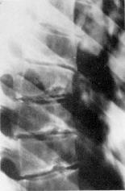
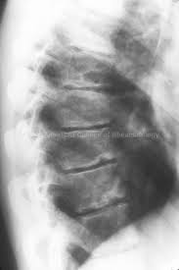
SCHEURMAN DISEASE
X RAY :
Irregular ossification of vertebral body epiphysis
Central herniation of disc material into the body(Schmoral Node)
Wedging of vertebrae

Slide 46
SCHEURMAN DISEASE
TREATMENT :
Mild unnoticed
Mild early brace
Severe surgery

Slide 47
T.B. SPINE( POTTS DISEASE)
PATHOLOGY :
Most common skeletal T.B
Blood born infection
Start bony adjacent to disc lead to caseation and destruction then spread to adjacent disc and vertebra these will lead claps and ANGULAR DEFORMITY
Collection of caseos mater to form Cold Abscess
Paraplegia

Slide 48

T.B. SPINE( POTTS DISEASE)
CLINICAL FEATURES
TB toxemia
Severe back pain
Fixed angular kyphosis
Cold abscess : paravertebral , ilio-psoas , gluteal
Movement : limitation of spinal movement
Paraparesis / paraplegia

Slide 49

T.B. SPINE( POTTS DISEASE)
INVESTIGATION
High ESR
CBC : leucopenia , lymphocytosis
Mantoux test : is a good –ve test
IMAGING : narrow disc space ,
soft tissue abscess ,
angular kyphosis ,
destruction of 2 adjacent vertebrae with disc space in between
MRI : is useful to asses spinal cord condition

Slide 50
T.B. SPINE( POTTS DISEASE)
TREATMENT
Early i.e. no destruction ,no abscess : anti-TB chemotherapy
Surgery is indicated in :
Abscess
Progressive deformity
Neurological deterioration

Slide 51
DEGENERATIVE SPINE DISORDER
CAUSES :
Recurrent attacks of disc prolapse
Aging leads to loss of hydration of the disk
Spinal instability

Slide 52

DEGENERATIVE SPINE DISORDER
PATHOLOGY :
Decrease in the disc height
Osteophytes of the vertebral margins
Degenerative changes of the facet joint

Slide 53

DEGENERATIVE SPINE DISORDER
CLINICAL FEATURES
Recurrent attacks of back pain
Catching sign (locking)
X-RAY
Narrowing of the disc space
Osteophytes
Osteoarthritic changes in facet joint
TREATMENT
Conservative measures

Slide 54
SPINAL CANAL STENOSIS
DEFINITION :
Narrowing of the spinal canal
Causes :
Degenerative changes of the bone and soft tissue of the spine
CLINICAL FEATURES :
Neurogenic claudication after standing or walking for a long time
Relieved by sitting or squatting (i.e flexing the spine)

Slide 55
SPINAL CANAL STENOSIS
IMAGING
X-ray: Lateral view may show degenerative spondylolisthesis or degenerative changes of the spine
MRI
Essential to show the extent of the stenosis
Treatment
Mild Conservative
Severe Surgical

Slide 56
Thank You

