Slide 1

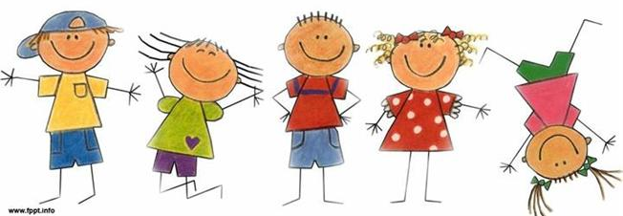
The Limping Child
Prof. Mamoun Kremli
Dr. Tarif Alakhras

Slide 2
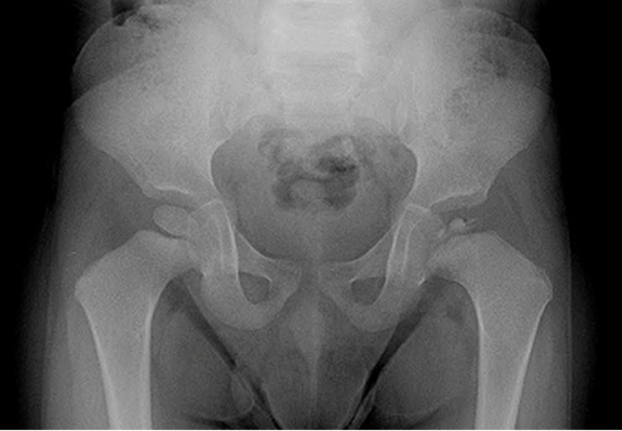
6-year-old, limping on L
http://www.choa.org/Childrens-Hospital-Services

Slide 3
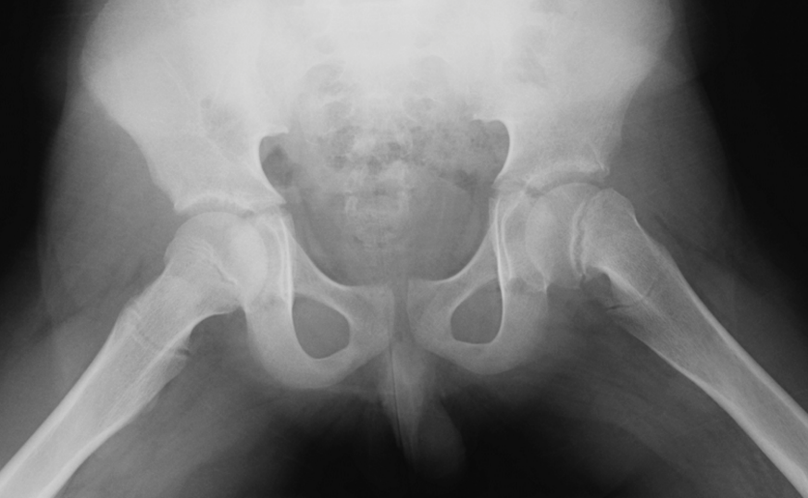
14-year-old boy, limping on L
http://www.choa.org/Childrens-Hospital-Services

Slide 4
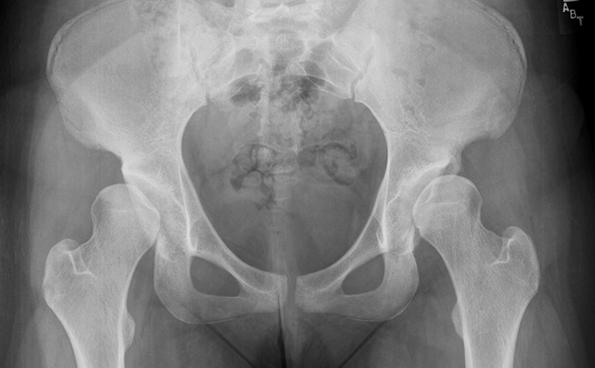
16-year-old, bilateral limping
http://www.choa.org/Childrens-Hospital-Services

Slide 5
Introduction
Limping is a common presentation in children
Seen by orthopedic surgeons, pediatricians, primary care physicians
Need to take a proper
History
Physical examination
Investigations
Some diseases related to specific age groups

Slide 6
History
Duration, when first noticed
Pain
History of trauma
Associated systemic symptoms
Fever, night sweating, anorexia, weight loss

Slide 7
Pitfalls
Misled by parents’ history
History of trauma
Noticing leg length inequality
Misled by patients’ complaint
Hip problems may present with knee pain
Children below 5 years may not complain of pain!

Slide 8
Many causes
Different diseases occur more commonly at specific age groups

Slide 9
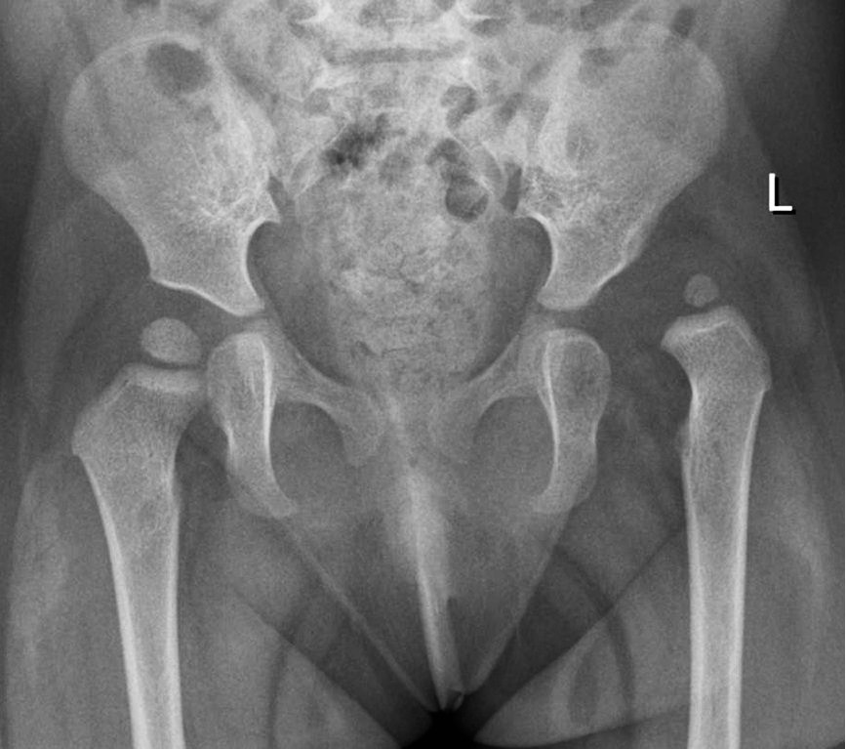
Age 1-4 years
CDH – DDH
History: at risk groups
e.g. F, breach, F.H, mihad (swaddle)
Torticollis, MT adductus, calc. valgus
Physical findings:
Asymmetrical folds
Limited abduction
Shortening
Positive Trendelenburgh sign

Slide 10
Age 3–6 years
Transient synovitis
Limping, painful to move, ?WBC, ? Fever, ? ESR
Resolves in days
Disappears without treatment
Septic arthritis
Limping-refuses to walk
Fever >38.5ºC
WBC >12,000
ESR >40 mm/h
If in doubt: Aspiration

Slide 11
Legg-Calve-Perthe's
Idiopathic avascular necrosis of femoral head
Age usually: 4-8 years, Boys: 4X girls
Blood supply of femoral head:
Peculiar blood supply dependent on lateral epiphyseal vessels which may be occluded easily

Slide 12
Legg-Calve-Perthe's
Idiopathic avascular necrosis of femoral head
Age usually: 4-8 years, Boys: 4X girls
Blood supply of femoral head:
Neonates: metaphyseal, lateral epiphyseal, and scanty ligamentum teres vessels
4 years: no epiphyseal vessels
7 years: ligamentum teres vessels developed well
4–7 years: dependent on lateral epiphyseal vessels
If trauma or synovitis, pressure occludes blood supply

Slide 13
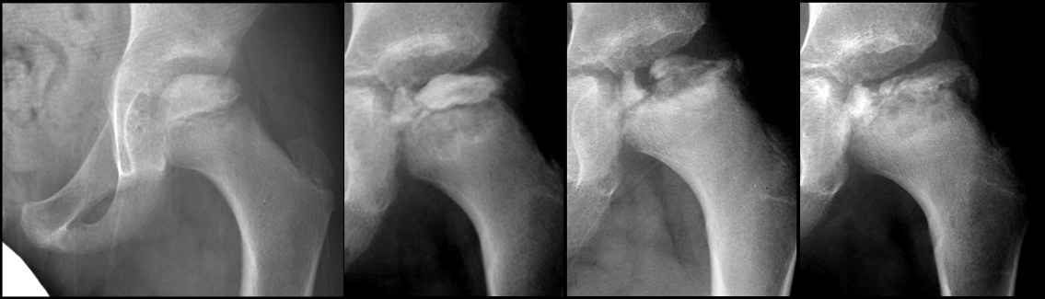
Legg-Calve-Perthe's
Stages:
Bone death:
May initially look normal on x-ray
Increased density, then collapse
Revascularization and Repair:
Reduced density and fragmentation on x-ray
Distortion and Remodeling
Distortion, flattening (coxa plana), and enlargement (coxa magna), with partial uncoverage

Slide 14
Legg-Calve-Perthe's
Clinical picture:
Boys X4 girls
Limping (painful / painless)
May present with knee/thigh pain
Early: limitation of all movements
Pain and muscle spasm with passive motion
Later: limitation of abduction and internal rotation
Positive Trendelenburgh

Slide 15
Legg-Calve-Perthe's
Different stages of Perthe's in a patient
Sclerosis Collapse Fragmentation Remodeling
http://community.tsrhc.org/Perthes-disease-about-perthes-disease

Slide 16
Legg-Calve-Perthe's
Apley’s System of Orthopedics and Fractures

Slide 17
Legg-Calve-Perthe's
Apley’s System of Orthopedics and Fractures

Slide 18
Legg-Calve-Perthe's
Treatment:
Rest
Physiotherapy: abduction / rotation
Containment by abduction splint
Surgery:
Containment: to improve cover
Acetabuloplasty / femoral varus osteotomy
Later: for residual deformity/problem

Slide 19
Legg-Calve-Perthe's
Prognosis:
Depends on
Age at onset: the earlier, the better
Extent of head involvement
all head involved: worse prognosis
Complication
Stiffness, related to deformed head
Secondary OA

Slide 20
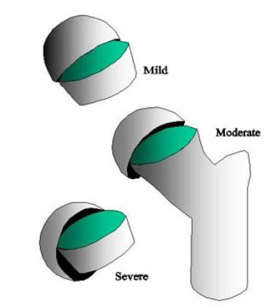
Age 10–15 years
Slipped Capital Femoral Epiphysis (SCFE)
Acute Vs. chronic
Boys, overweight, ?hypogonadism
Signs:
Limited internal rotation
Hip externally rotates when flexed
X-ray: AP and Frog lateral
Really is an antero-lateral slippage of the metaphysis
www2.massgeneral.org/ortho/SCFE.htm

Slide 21
SCFE
Around puberty
? Hormonal imbalance between gonadal and growth hormones
Tall, or obese, gonads underdevelopment
Presents with limping
May present with thigh/knee pain
Acute slip vs. chronic slip
Apley’s System of Orthopedics and Fractures

Slide 22
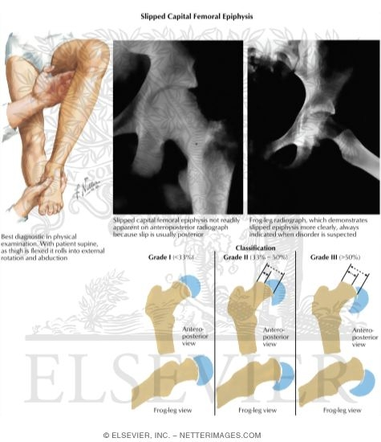
SCFE
Externally rotated hip
Loss of internal rotation
Obligatory external rotation on flexion
Slippage of other hip
In 1/3 of patients
Apley’s System of Orthopedics and Fractures
www.aafp.org/afp/2017/0615/p779.html

Slide 23
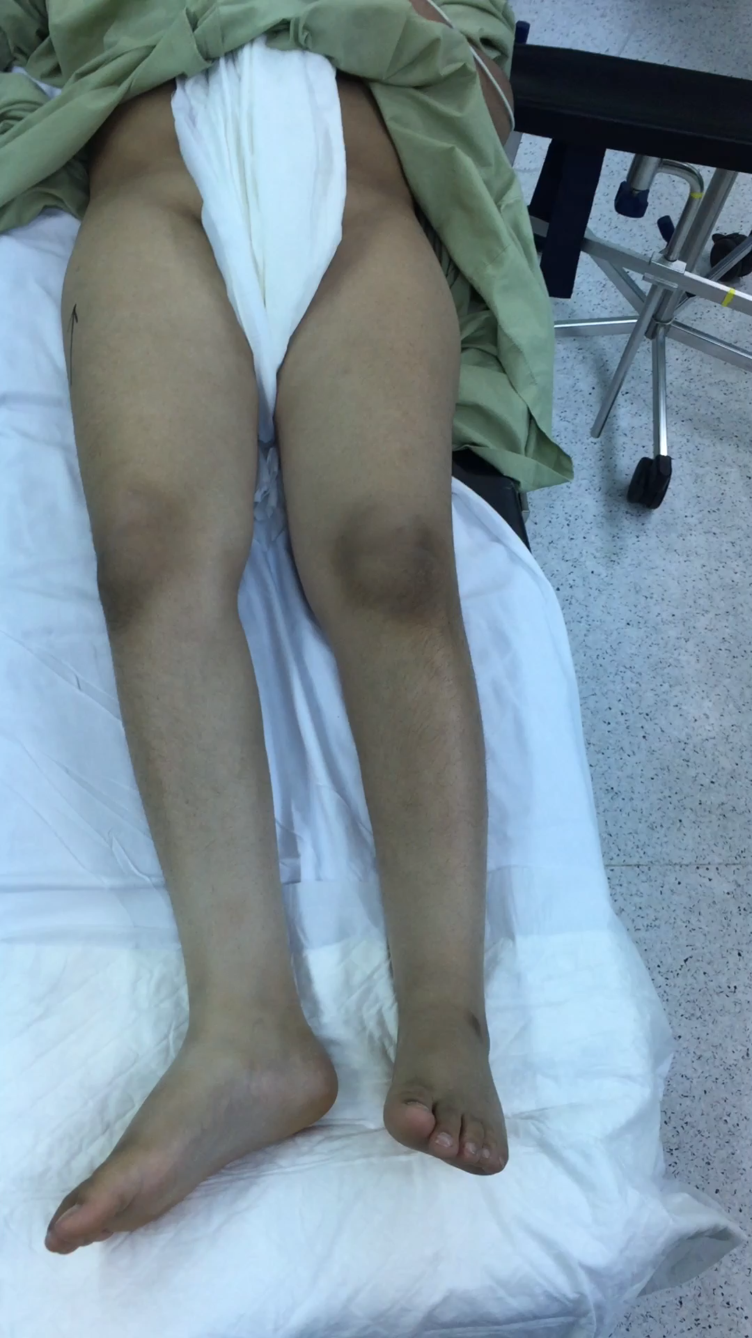
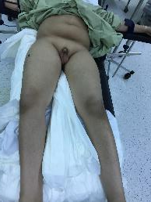
SCFE - Signs
Overweight
Hypogonadism
Externally rotated hip
Loss of internal rotation
External rotation on flexion

Slide 24
SCFE - Xray
Slipped Normal
AP
Frog lat
Apley’s System of Orthopedics and Fractures

Slide 25
SCFE – X-ray
Recent slip
Chronic slip
Hump
http://dontforgetthebubbles.com/

Slide 26
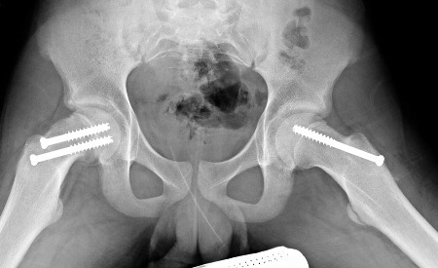
SCFE
Treatment
Manipulation to try to reduce the slip may cause AVN
Fixation in situ
? Fix the other hip
1/3rd affects other side
Complications:
Avascular Necrosis
Coxa Vara
Slippage of opposite hip
Secondary osteoarthritis
http://bestpractice.bmj.com/

Slide 27
3–12 years
Acute osteomyelitis:
Constitutional symptoms
WBC, CRP, ESR
X-ray may initially be normal
MRI

Slide 28
5–18 years
Trauma – site related to age
Household - early
Playground - childhood
School and Sports - older child - teenager
RTA – teenager
A prick or a splinter in sole of foot

Slide 29
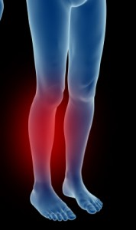
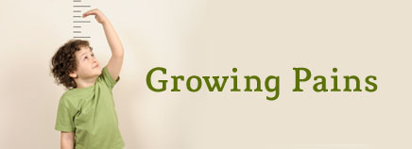
Growing pains
Diagnosis by exclusion of all other diseases
Pain in legs, not at joints
Age: (3-5 yrs.) – (8-12 yrs.)
http://kidshealth.org/
www.footphysics.co.uk

Slide 30
Growing pains
Diagnosis by exclusion of all other diseases
Pain in legs, not at joints
Age: (3-5 yrs.) – (8-12 yrs.)
Growing Pains” MUST Meet 3 Criteria
Leg pain is bilateral
Pain occurs only at night
No limping nor pain symptoms during the day

Slide 31
Growing pains
Inaccurately diagnosing a limping child with “growing pains” risks missing significant disease

Slide 32
6-year-old, limping on L
http://www.choa.org/Childrens-Hospital-Services

Slide 33
14-year-old boy, limping on L
http://www.choa.org/Childrens-Hospital-Services

Slide 34
Time algorithm
Trauma
Infection
Growing pain
Growing pain
SCFE
Perthe's
DDH
1
2
3
4
5
6
7
8
9
10
11
12
13
14
15
years

Slide 35
Time algorithm
Trauma
Septic arthritis
Osteomyelitis
Growing pain
Growing pain
SCFE
Perthe's
DDH
1
2
3
4
5
6
7
8
9
10
11
12
13
14
15
years

