Slide 1
X RAY READING
Dr. Majed Alasbali

Slide 2
Reading an x ray of fractured bone
Prerequisites: Use the following:
At least 2 views (True AP and lateral views) for trauma >> OLD ACID
entire bone length included for tumor >> 7Q
Appropriate joint views for osteoarthritis >> 5 things
Joint above and joint below for trauma cases
Comment on:
Adequacy of the views
Bone , joints and soft tissue
Need for previous x rays

Slide 3
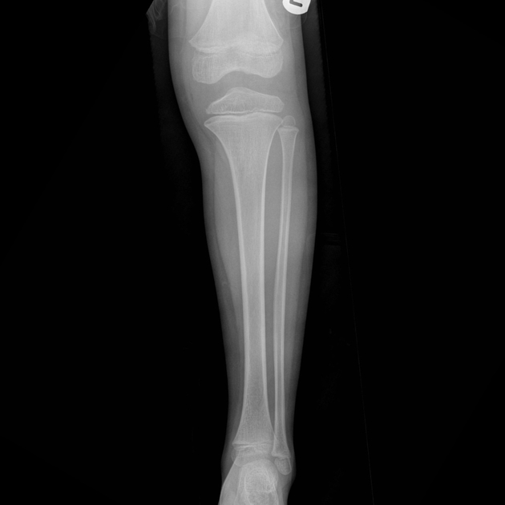

Slide 4
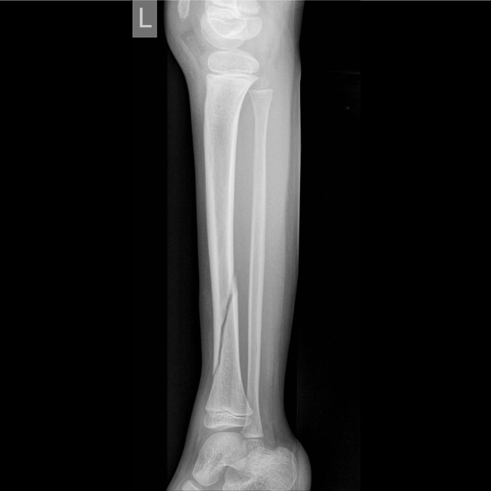

Slide 5
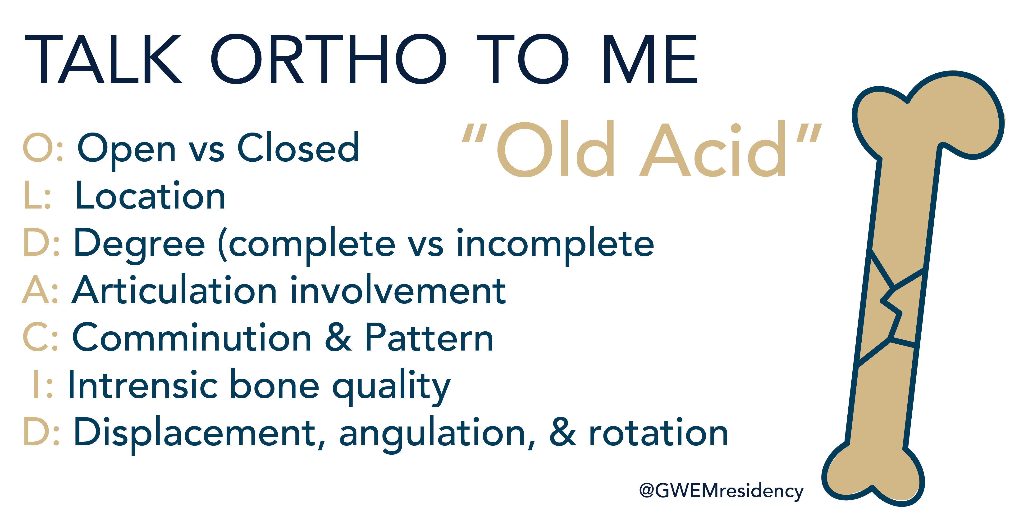

Slide 6
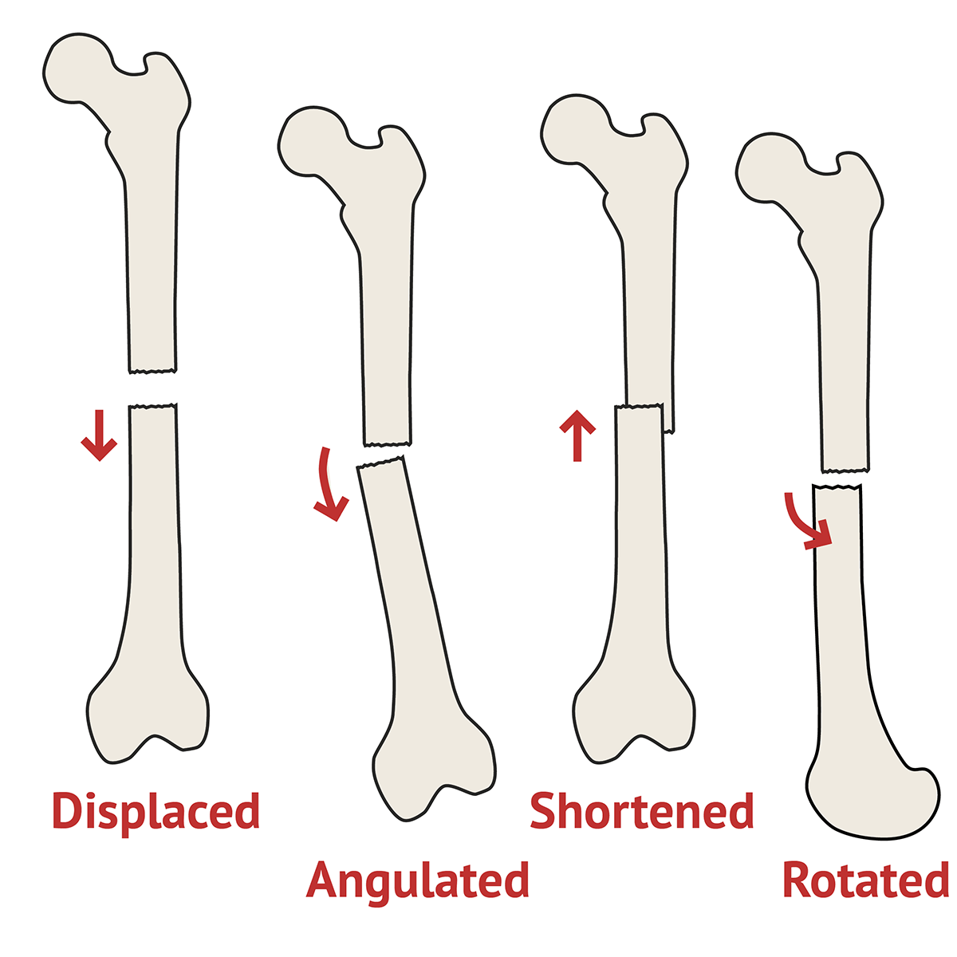
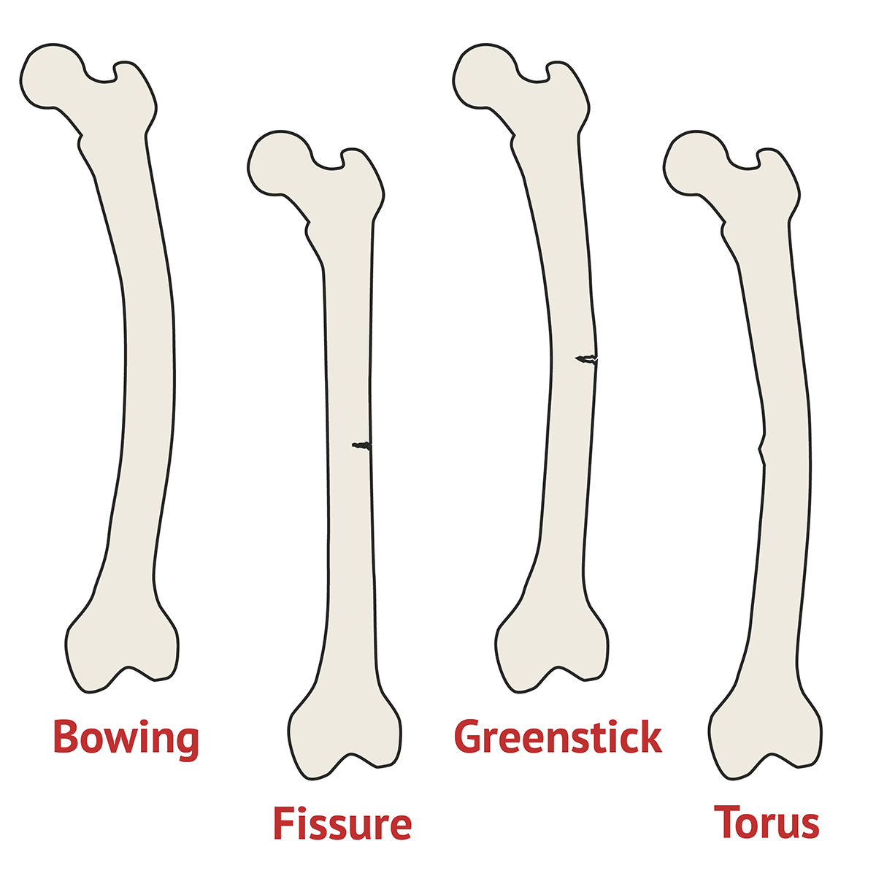
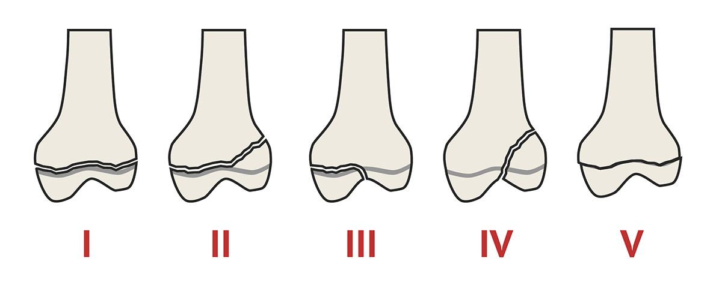

Slide 7
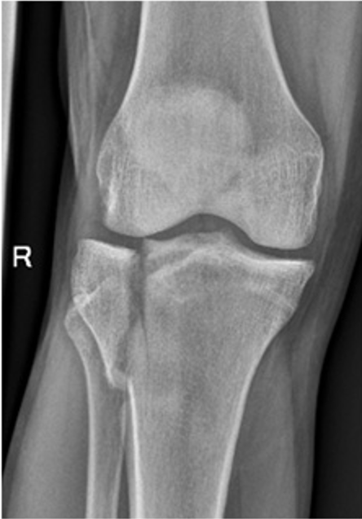

Slide 8
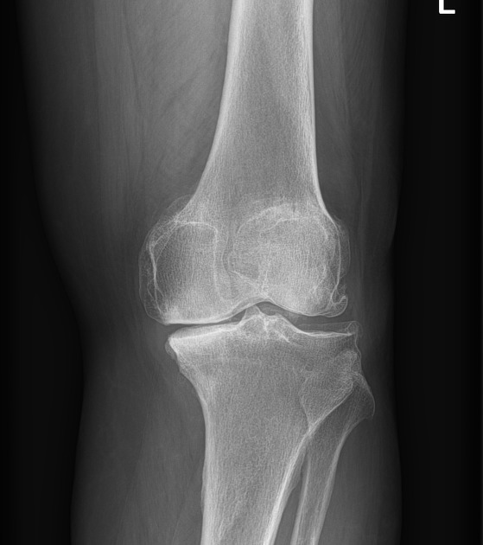
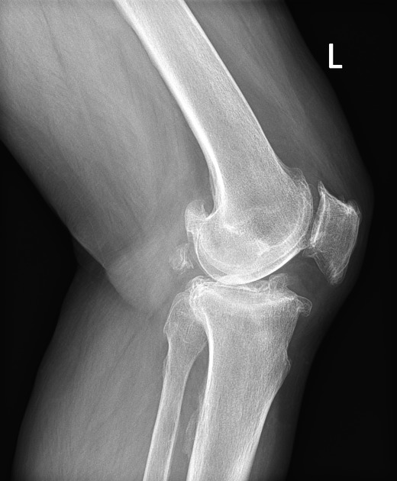
Reading an x ray of osteoarthritic knee joint

Slide 9
1- narrowing of the joint line
2-Formation of osteophyte
3- subchondral sclerosis
4- subchondral cyst
5-Joint deformity

Slide 10
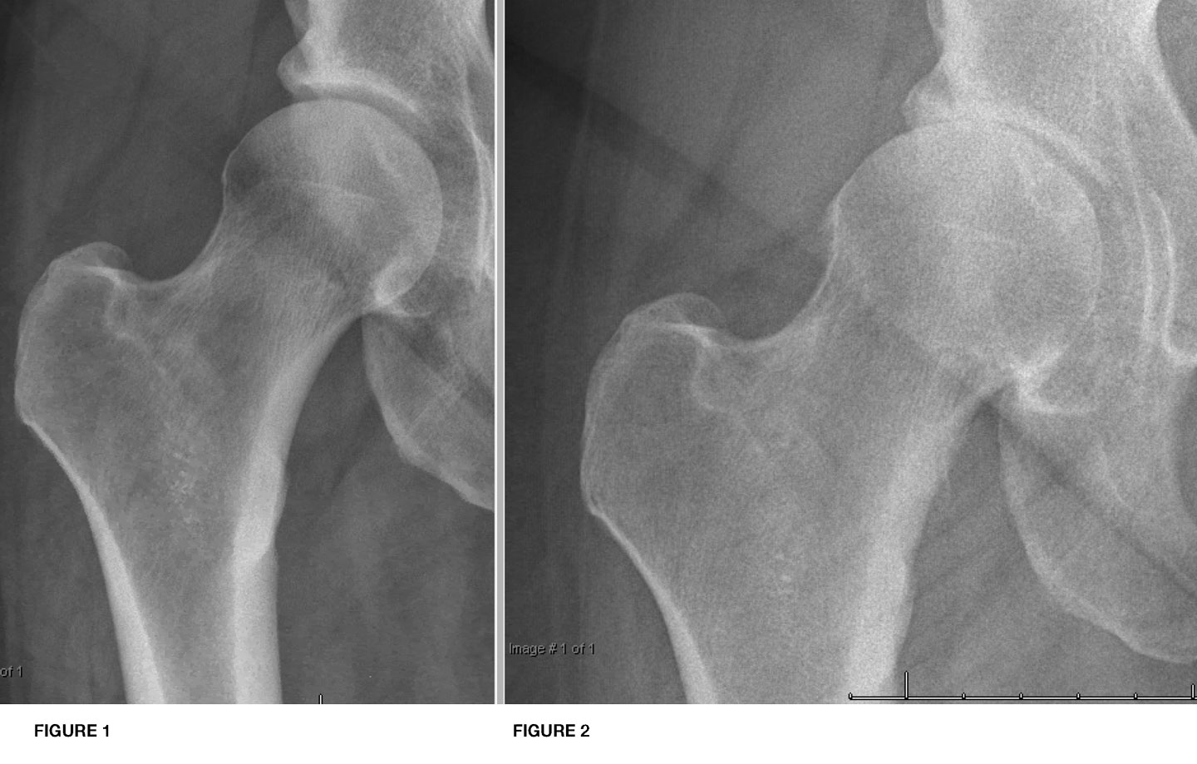

Slide 11
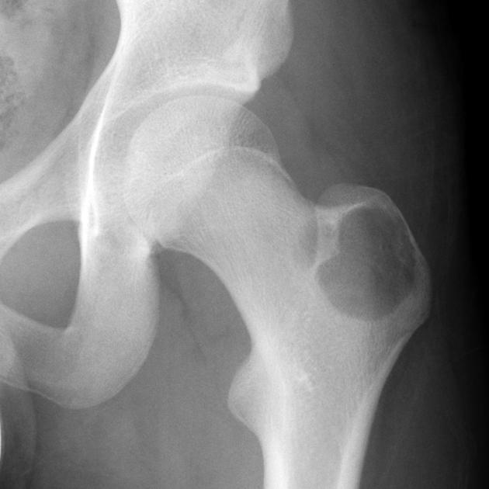
Reading an x ray of bone lesion

Slide 12
Site
Size
Matrix
Zone of transition
Lesion effect
Bone effect
Soft tissue

Slide 13
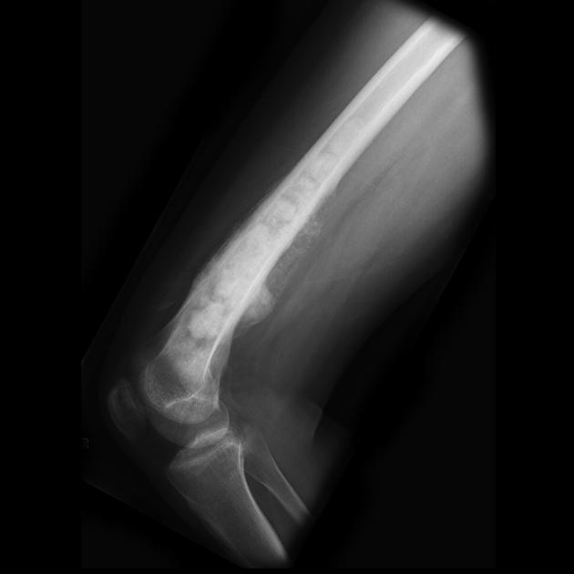
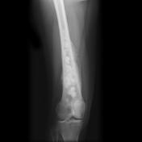
Reading an x ray of bone lesion

Slide 14
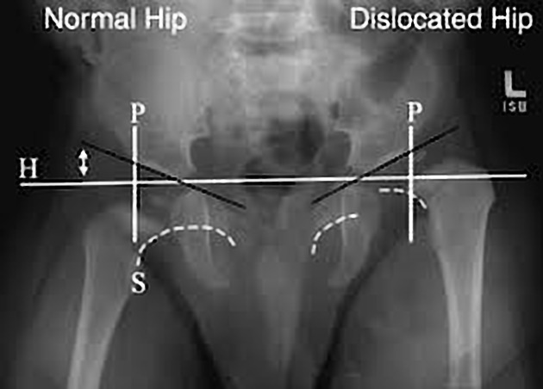
How to read an x ray of pediatric hip

Slide 15
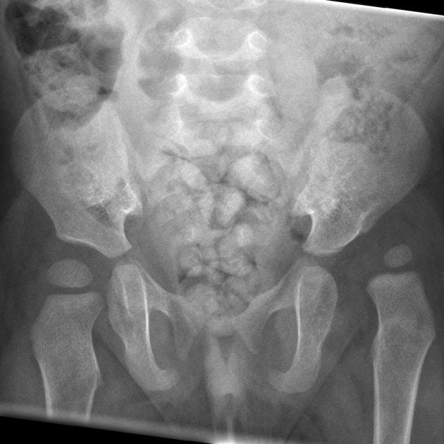

Slide 16
Reading an x ray of ankle joint injury
tibiofibular clear space
>5.3 mm (AP view)
tibiofibular overlap
<6 mm (AP view)
<2.8 mm (mortise view)
medial clear space
>4-5 mm (mortise view)

Slide 17
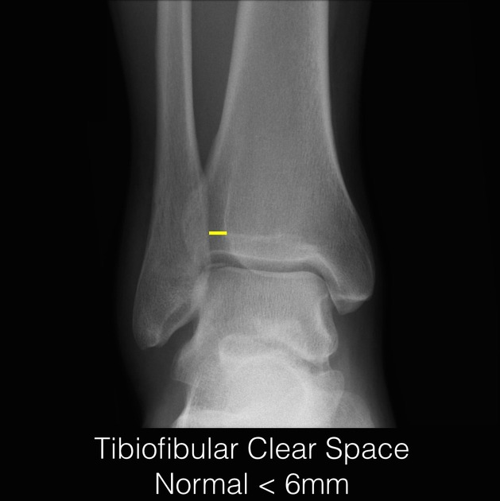
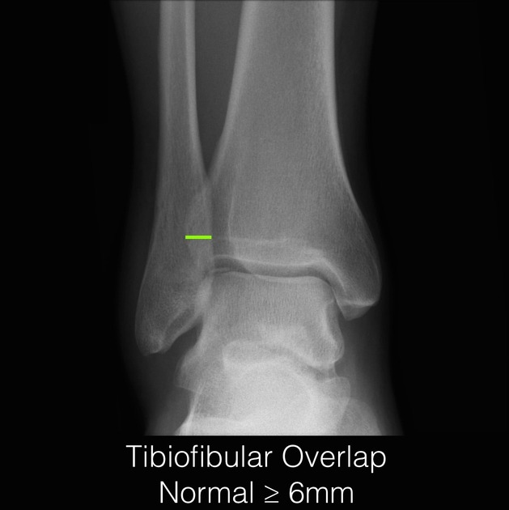
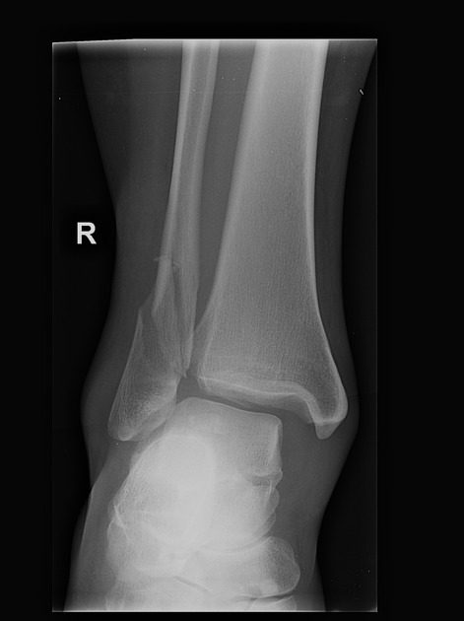

Slide 18
