Slide 1

Clinical Case Scenarios
Knee pain
Dr. Tarif Alakhras

Slide 2
Lady with Knee pain
54 year old lady, presented to the clinic with pain in both knees for 3 years.
No clear history of trauma

Slide 3
History:
Pain:
Site, onset,, character, radiation, associated, time course, exacerbating / relieving factors, severity…
Activity and pain
Sleep and pain
Working? Job? Activity?
Medications
Other diseases, previous surgery
Menopause
Diet

Slide 4
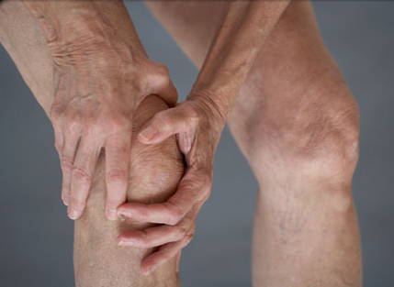
Clinical Examination:
General
In pain? , comfortable, overweight?, ill looking?, anemic, …
Local – general
Position, attitude, extra
Look, Feel, Move

Slide 5
Lady with Knee pain
Investigations:
General
Specific
Radiology
Both knees AP standing, and lateral
Skyline view?

Slide 6
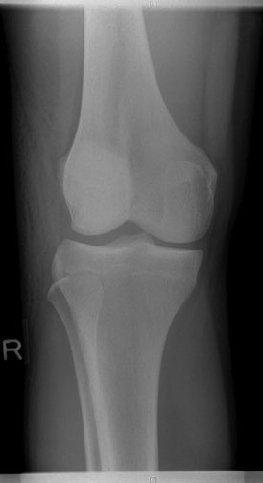
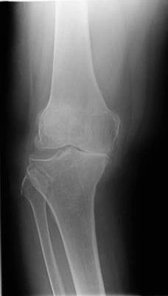
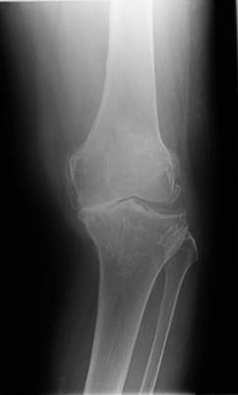
Normal

Slide 7
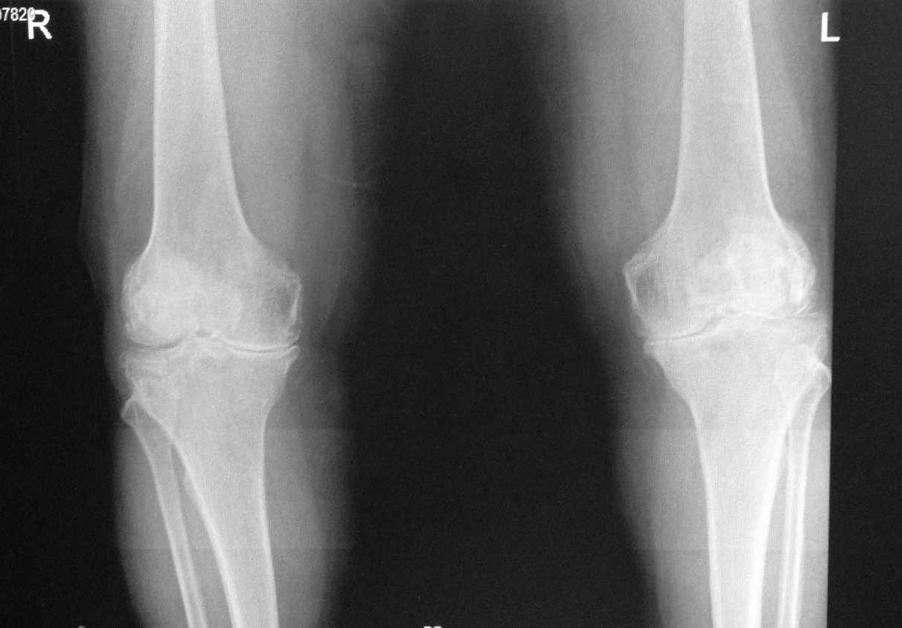
Lady with Knee pain

Slide 8
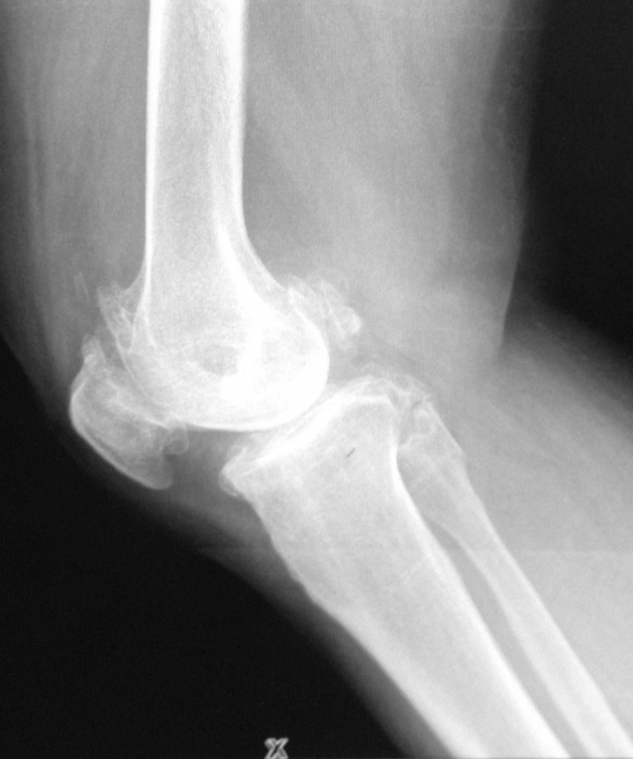
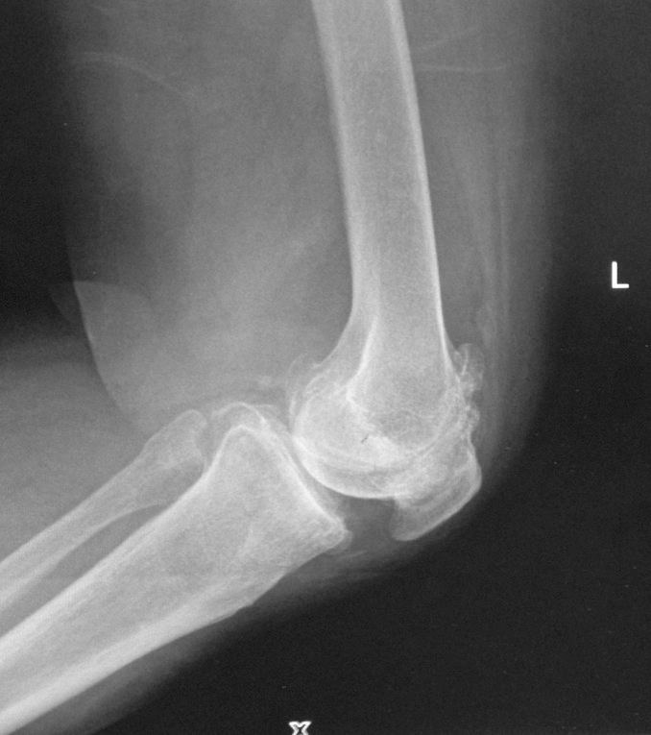
Lady with Knee pain

Slide 9
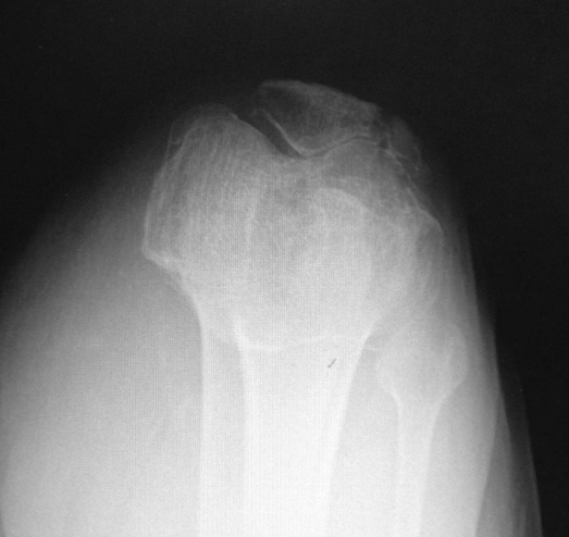
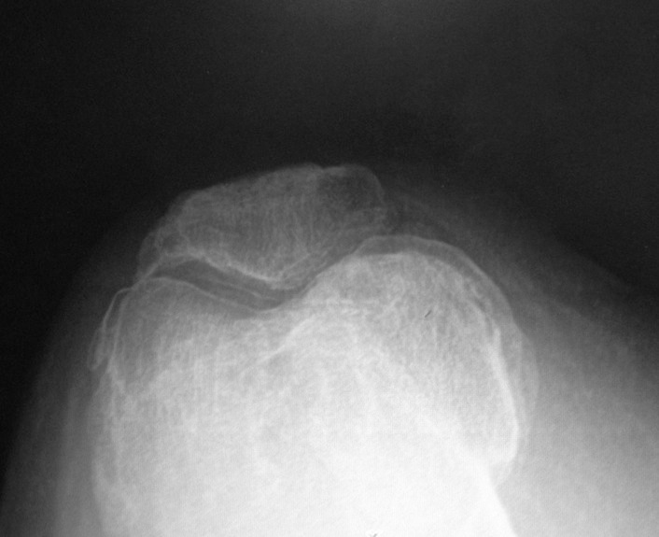
Lady with Knee pain

Slide 10
Lady with Knee pain
Management:
General:
Weight reduction
Walking aid
Physiotherapy
Specific:
Pain management
Surgery: when and how?

Slide 11
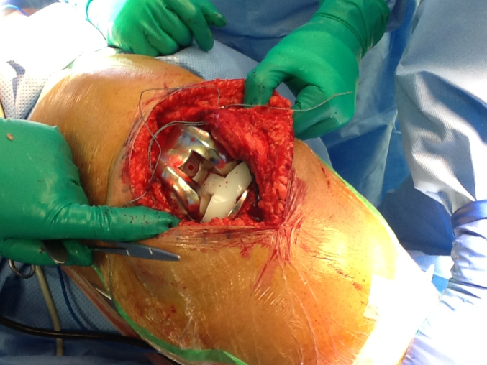
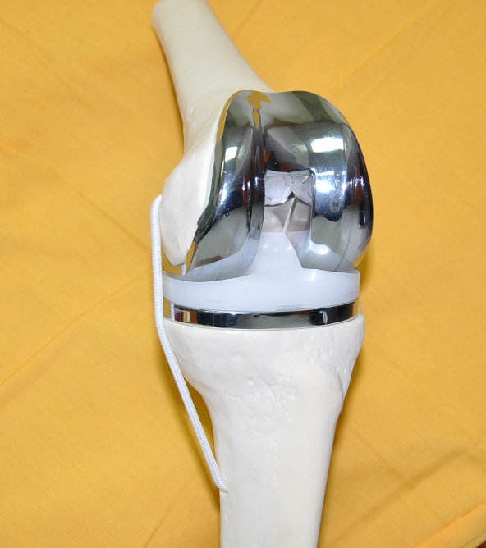

Slide 12
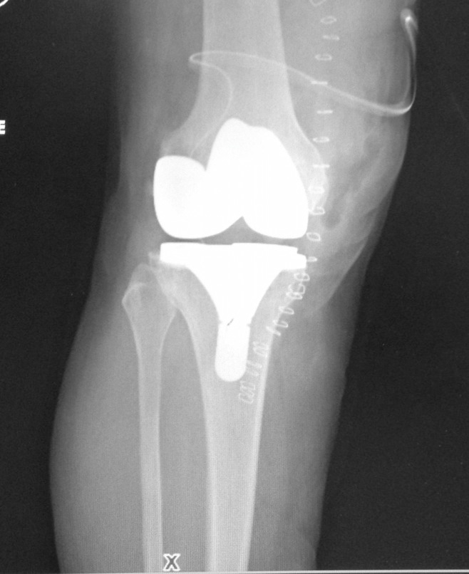
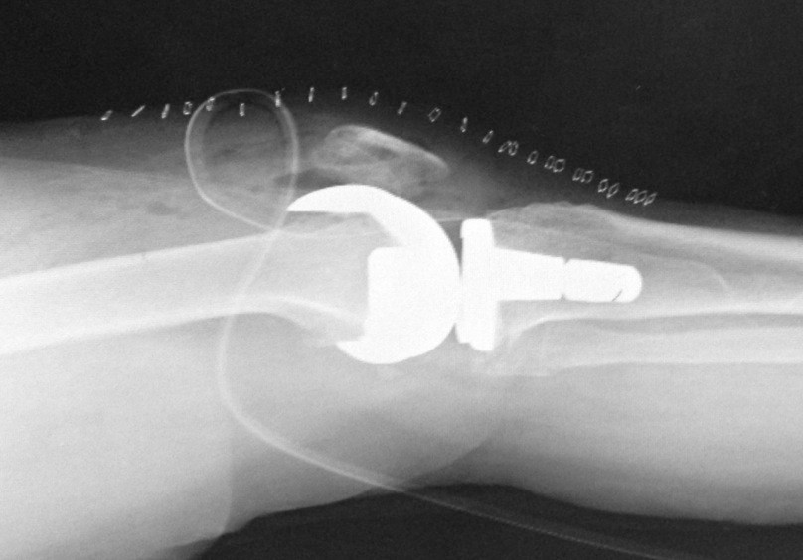
Lady with Knee pain

Slide 13
25 years old patient came to the clinic complaining of R knee pain.
History of acute injury(sport):
Acute pain
Mechanism of injury:
Violent rotation with flexion
Swelling – when immediate (why?)or later
haemarthrosis
Later-on:
History of giving way (sudden instability of knee)
Repeated attacks of swelling and pain

Slide 14
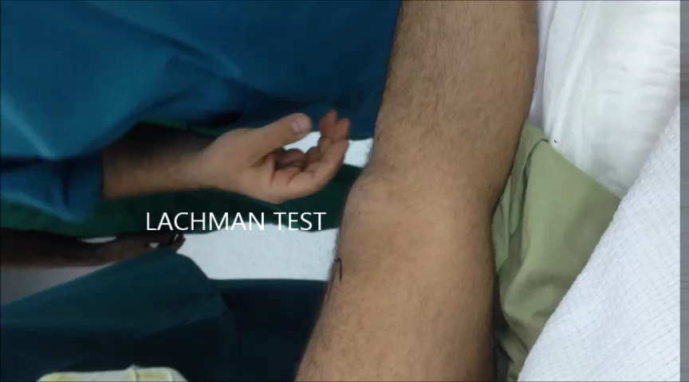
Signs:
Swelling:
(initially haemarthrosis, later effusion)
Wasting of quadriceps muscle
Special tests:
Anterior drawer
Lachemann's
Pivot shift
Managements
pT
surgery

Slide 15
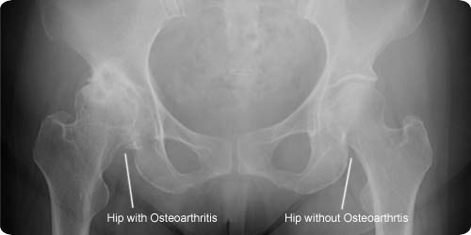

Slide 16
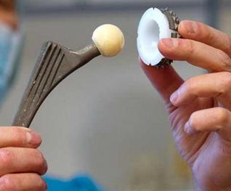
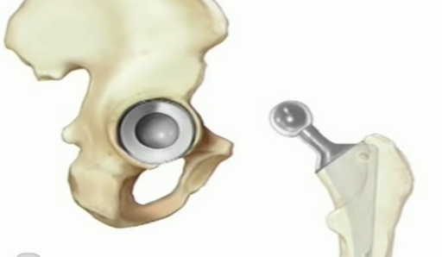

Management:

Slide 17
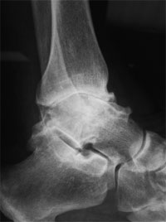
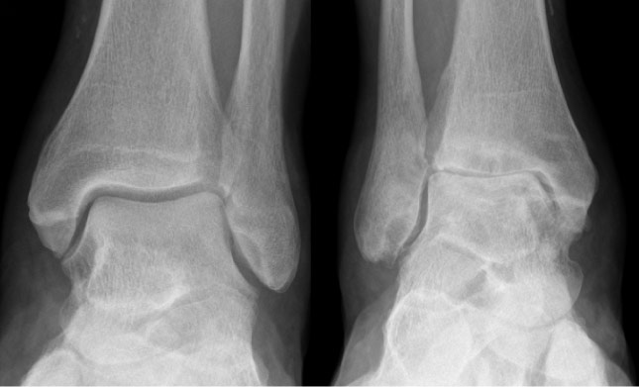

Slide 18
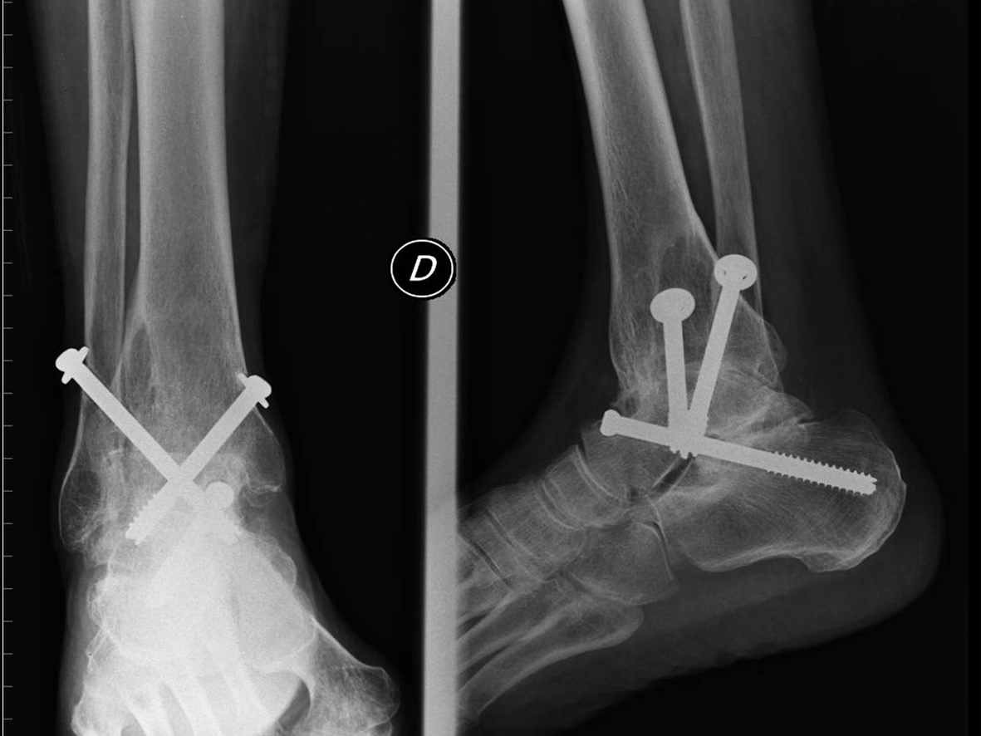
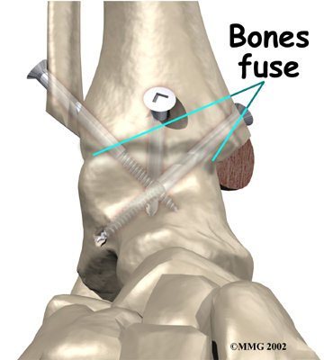
Management:

