Slide 1

Orthopedics Case Scenarios emergency case Dr. Tarif Al-Akhras

Slide 2
A 30 year old man was involved in a car accident, and brought to the emergency room unconscious with a large wound at the anterior aspect of left leg with severe deformity and bone exposed
Describe actions that you will take in the emergency management of this case

Slide 3
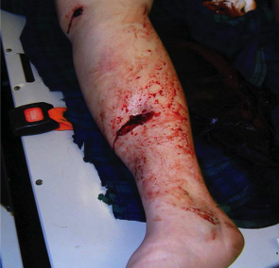
http://ospsj.tistory.com/8
http://orthopedics24x7.com/

Slide 4
Immediate actions in ER:
ABCDE: save life, save limb, save function
Cervical collar?
Cover wound with sterile dressing, Splint leg
Take picture of wound before dressing
Secondary survey
Check distal pulses
If no pulse, ? Correct major deformity by traction
IV Fluids: what? – request blood?
Anti Tetanus
Antibiotics –what?
Wound:
Clean major contamination, take picture, sterile dressing

Slide 5
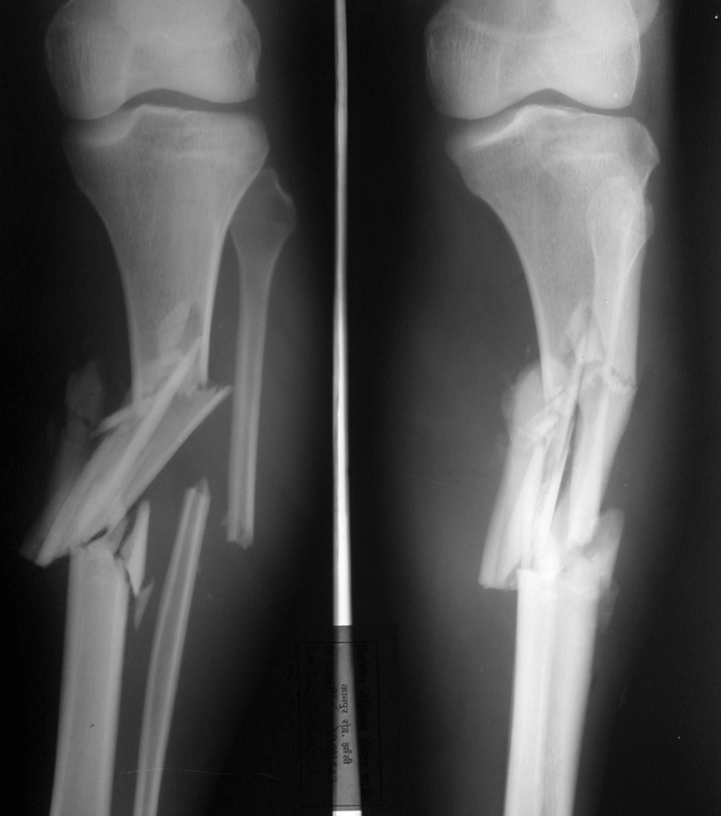
Open Fracture
http://www.ilizarov.org/casemore.asp?id=220

Slide 6
Further History: if possible
Accident:
Type of accident, Mechanism of injury, Place of injury, time since injury
Pre-hospital management
Patient:
Age, other diseases, medications
Consciousness if lost, when?
Anti-Tetanus vaccination?

Slide 7
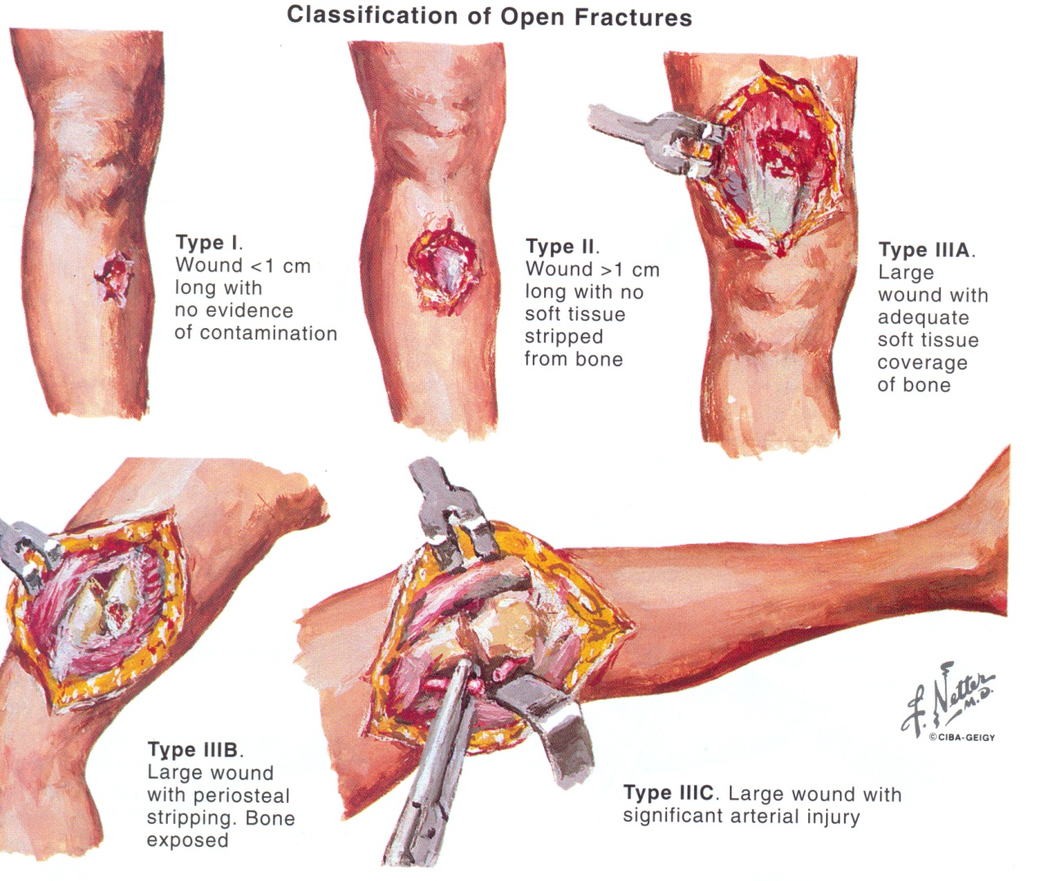
Admit to OR
Gustilo Classification
Debridement
Principles of debridement

Slide 8
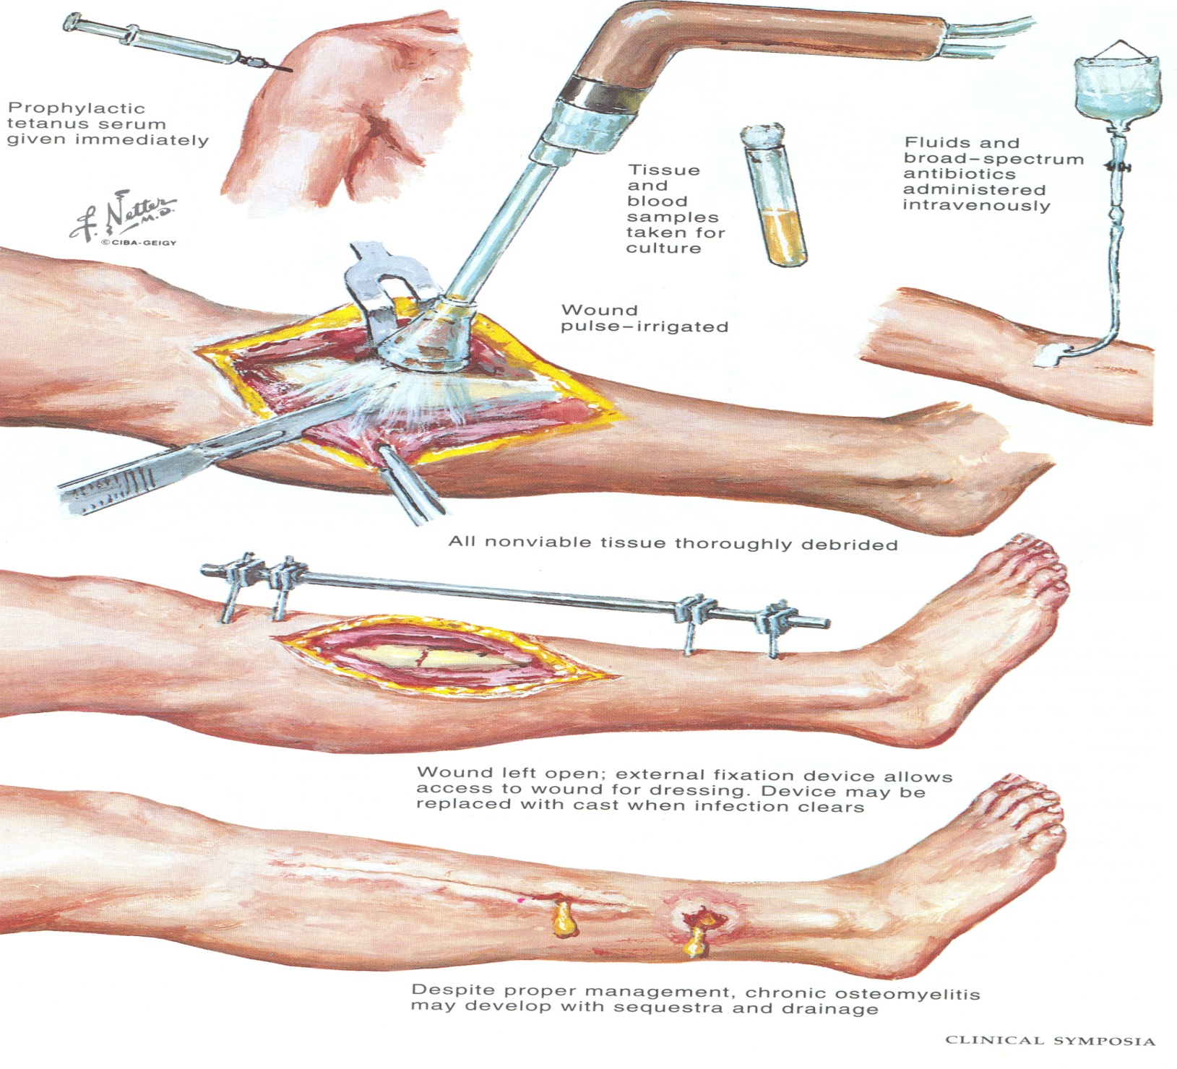
Dilution is the solution to pollution

Slide 9
Principles of fixation
Internal fixation???
External fixator

Slide 10
emergency case scenario-
25 years old man fell down on his R ankle.
What the urgent management you should give to him after ABC protocol was cleared

Slide 11
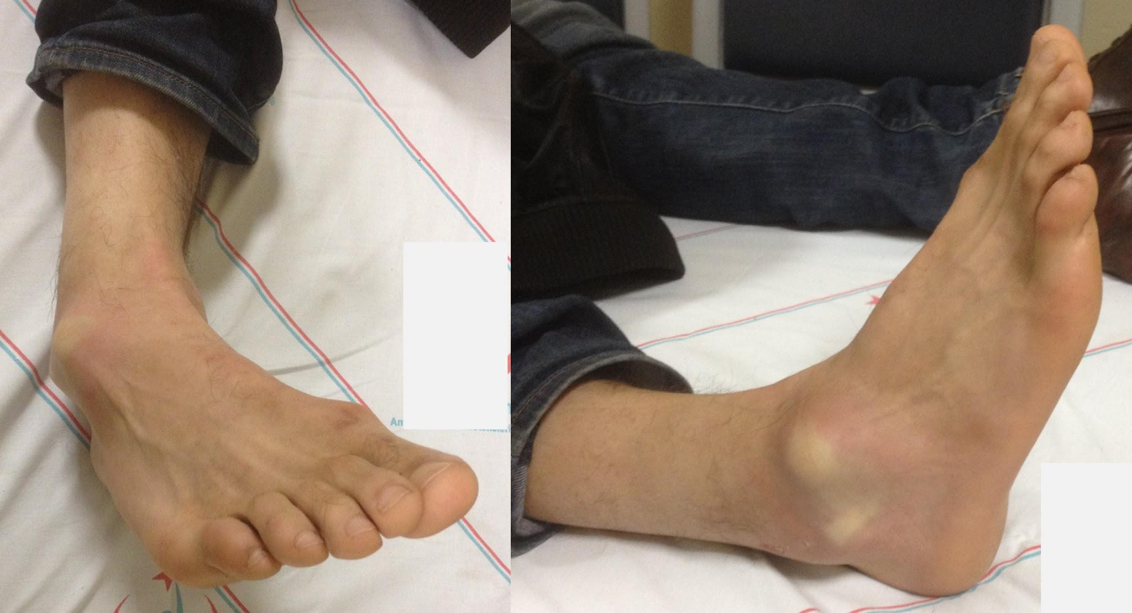
emergency case scenario

Slide 12
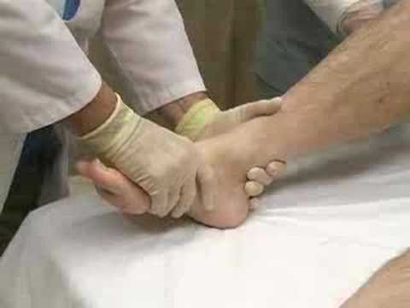
emergency case scenario

