Slide 1

Thyroid and parathyroid Imaging

Slide 2
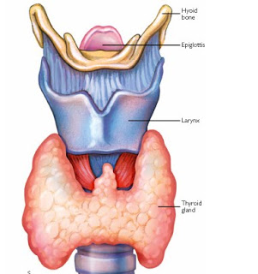
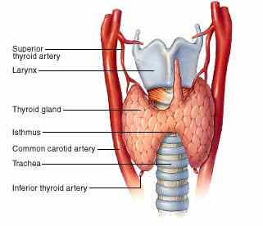
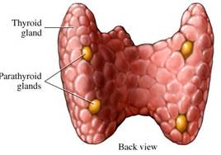

Slide 3
Imaging modalities used for evaluation of thyroid and parathyroid:
Ultrasound
Radionuclide studies
CT scan
Biopsy (US/CT guided)

Slide 4
Thyroid imaging
The thyroid is normally imaged by ultrasound.
The use of FNA with cytological examination of the aspirate has become the mainstay of diagnosis of thyroid cancer.(US guided).
Scintigraphy: Reserved for the investigation of abnormal thyroid function and in patients with known thyroid carcinoma.
Computed tomography is not often used to examine the thyroid except to demonstrate the extent of a retrosternal goitre and for the assessment of any local mass effect, such as tracheal compression

Slide 5
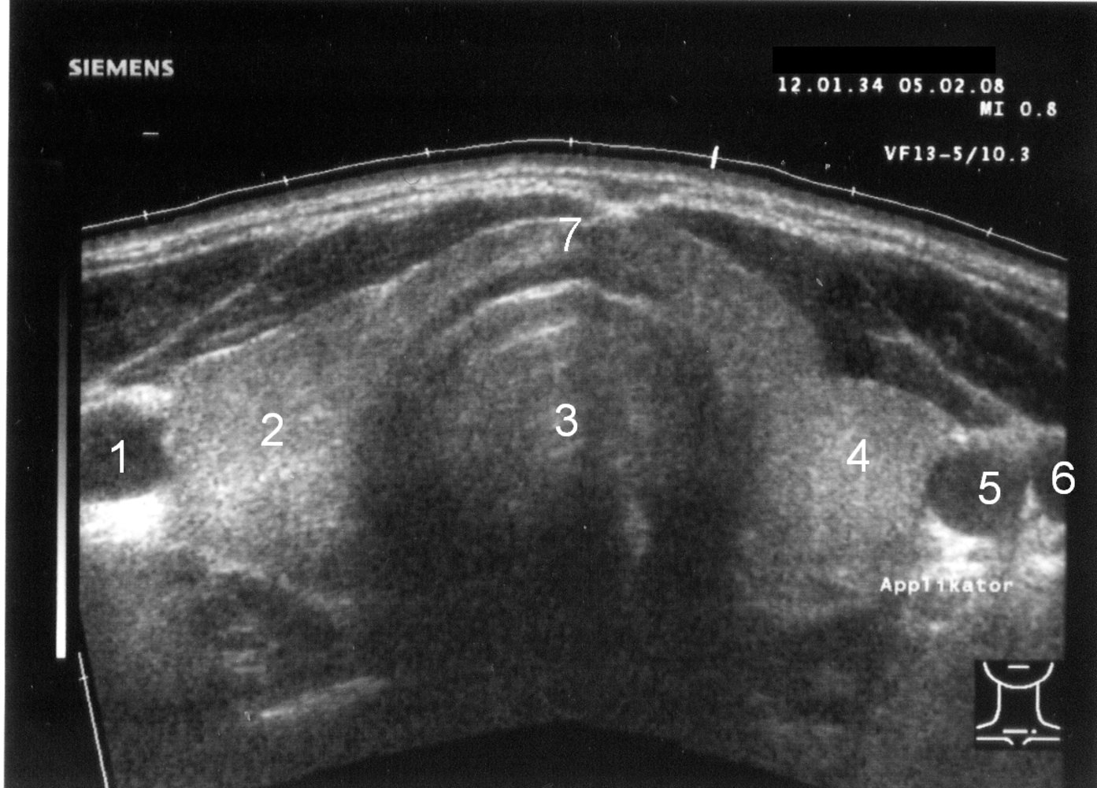
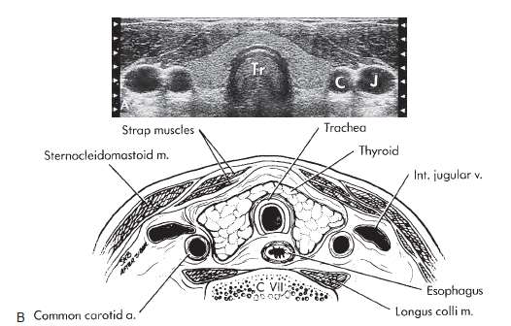
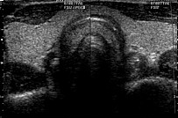
Normal thyroid
Ultrasound thyroid (transverse plane)
Normal image of the thyroid gland at the level of the isthmus.
1: right common carotid artery
2: right lobe
3: trachea
4: left lobe
5: left common carotid artery
6: left jugular vein
7: isthmus
ISTHMUS

Slide 6
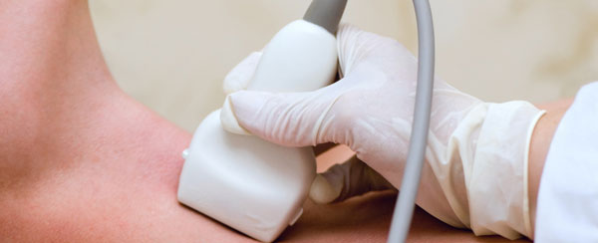
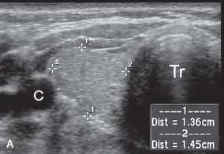
Ultrasound
Investigation of choice
Both right ,left lobes and isthmus are examined .Color Doppler is used to see vascularity. Ultrasound shows anatomical detail of thyroid and adjacent blood vessels and structures.
Normal parenchyma : homogeneous medium to high level echoes compared to adjacent neck muscles.
Ultrasound determines whether a nodule is cystic or solid or a mixture of both.
Simple cysts are invariably benign. Complex solid/ cystic lesions are usually benign. A solid mass could be a carcinoma or an adenoma.

Slide 7
Radioisotopes study
A radionuclide is injected or given orally.
Radioisotope taken up by thyroid/parathyroid
Radiotracer : - Oral: e.g: I-123, I-131
- I.V : e.g:Tc-99m pertechnetate
Normal thyroid tissue on nuclear medicine thyroid scan :
Normal-sized gland with evenly distributed activity

Slide 8
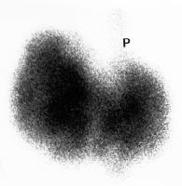
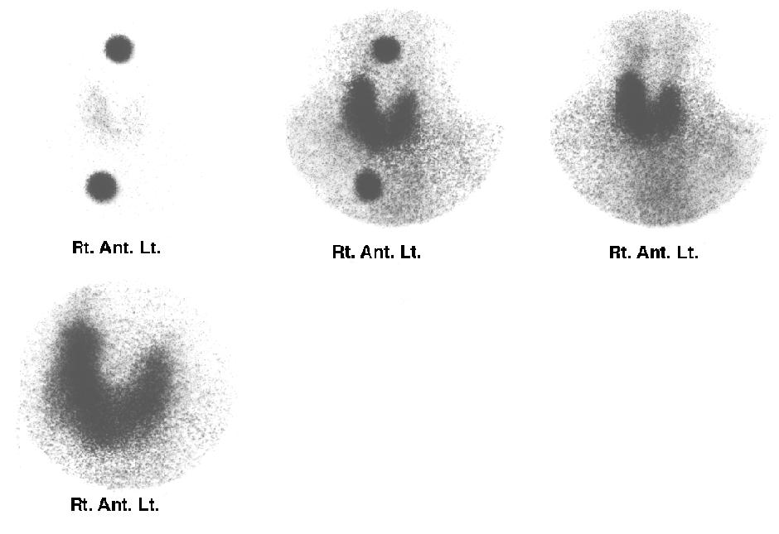
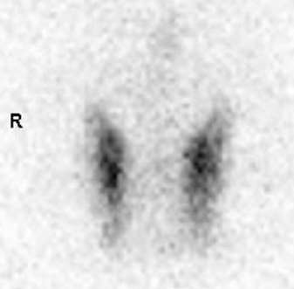

Radioisotopes study
Normal
Normal

Slide 9
Thyroid scan is usually indicated to
see the function.
Indications are :
Thyrotoxicosis
Graves' disease
Hyperplasia
Functioning nodule
Thyroid cancer?
Functioning thyroid or thyroid nodule will show high uptake
A nodule with high uptake is called hot nodule
A non functioning thyroid gland or nodule will show low or no uptake
A nodules with low uptake is called cold nodule
A hot nodule is usually benign
A cold nodule could be malignant

Slide 10
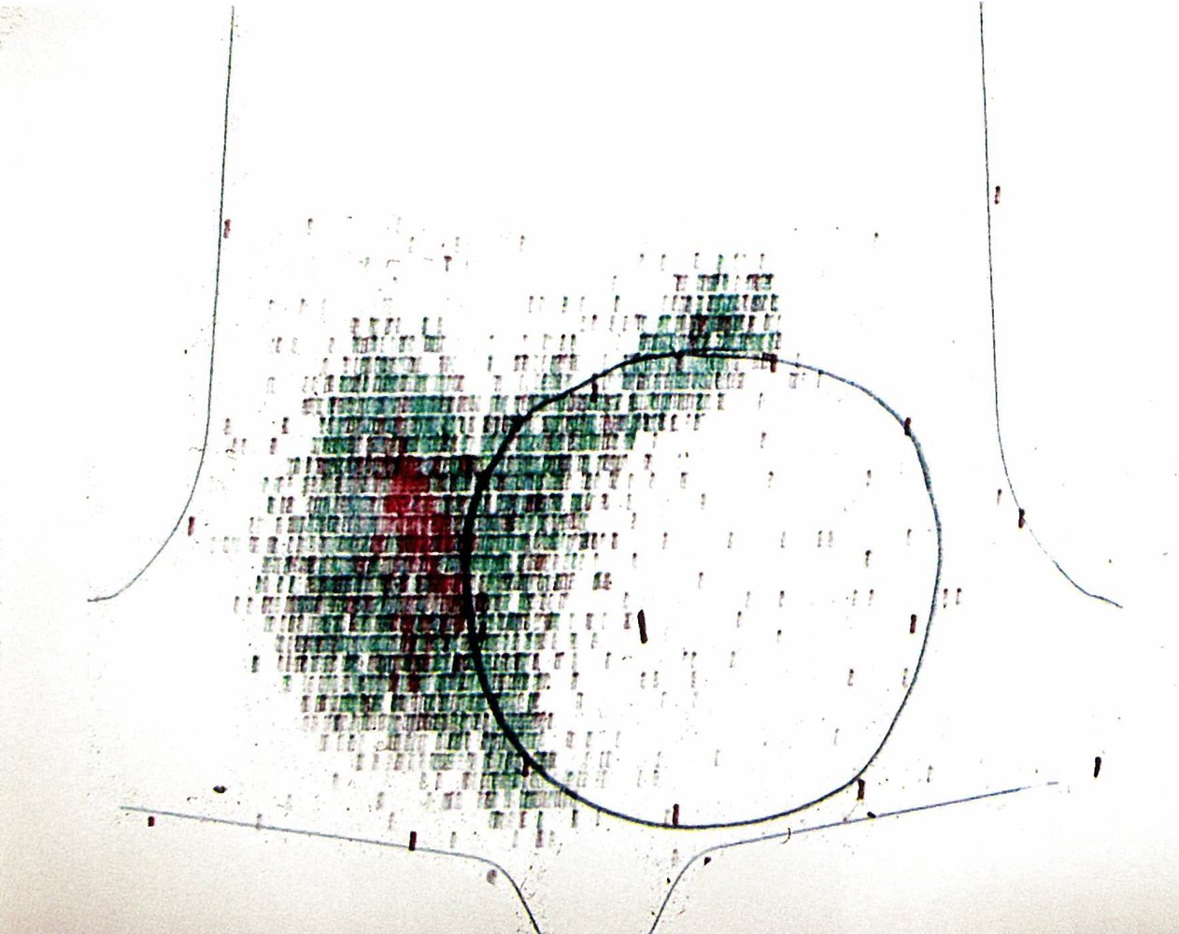
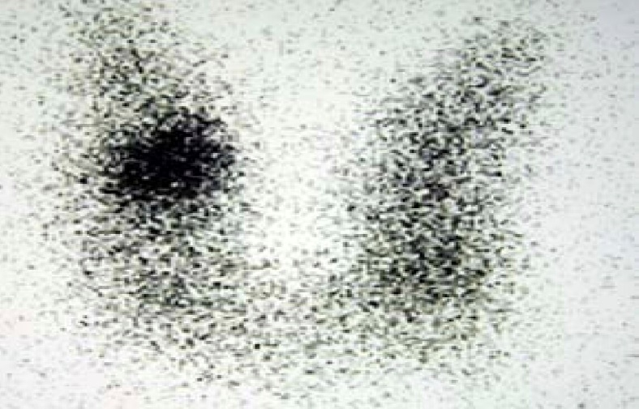
Cold nodule on thyroid scintigraphy
A large cold nodule (black circle) is visible within the left thyroid lobe as an area of decreased radiotracer uptake. Radiotracer uptake by the rest of the thyroid gland appears normal.
A cold nodule is associated with a higher risk of malignancy and warrants further workup (e.g., FNA if there are additional sonographic signs of malignancy on thyroid ultrasound).
Thyroid scan hot nodule
Nuclear medicine thyroid scintigraphy (Tc-99m pertechnetate)
The rounded area in the right thyroid lobe represents a so-called hot thyroid nodule, which shows increased radioisotope uptake compared to the rest of the thyroid gland.

Slide 11
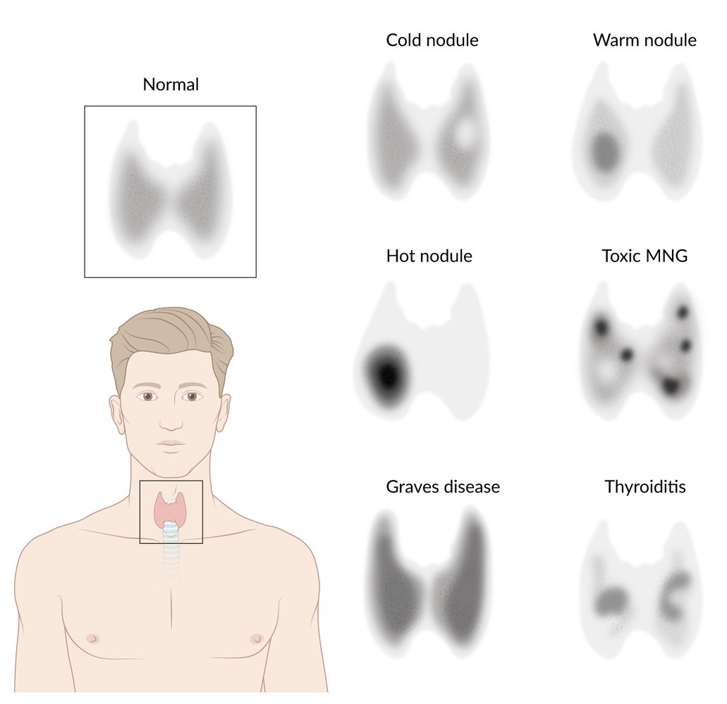
Thyroid scintigraphy
Overview of radioactive iodine uptake patterns in hyperthyroidism

Slide 12
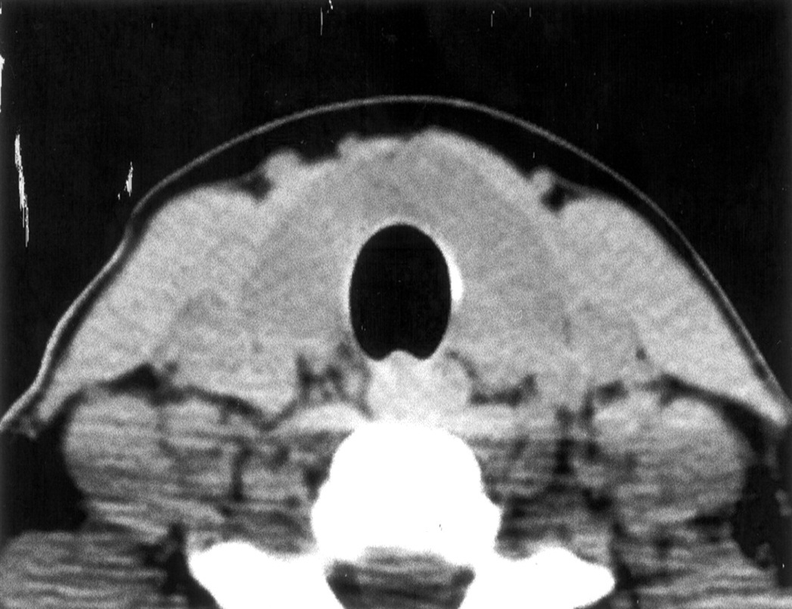
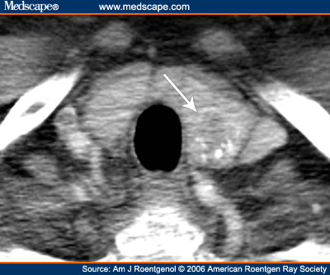
CT images of thyroid
CT shows clear anatomy of thyroid gland

Slide 13
Diseases of thyroid
Functional disorders: 1. Hyperthyroidism
2. Hypothyroidism
Inflammations: 1.Hashimoto
Nodular disorders: 1. Simple goiter
2. Multinodular goiter
Tumors: 1. Adenoma
2. Carcinoma

Slide 14
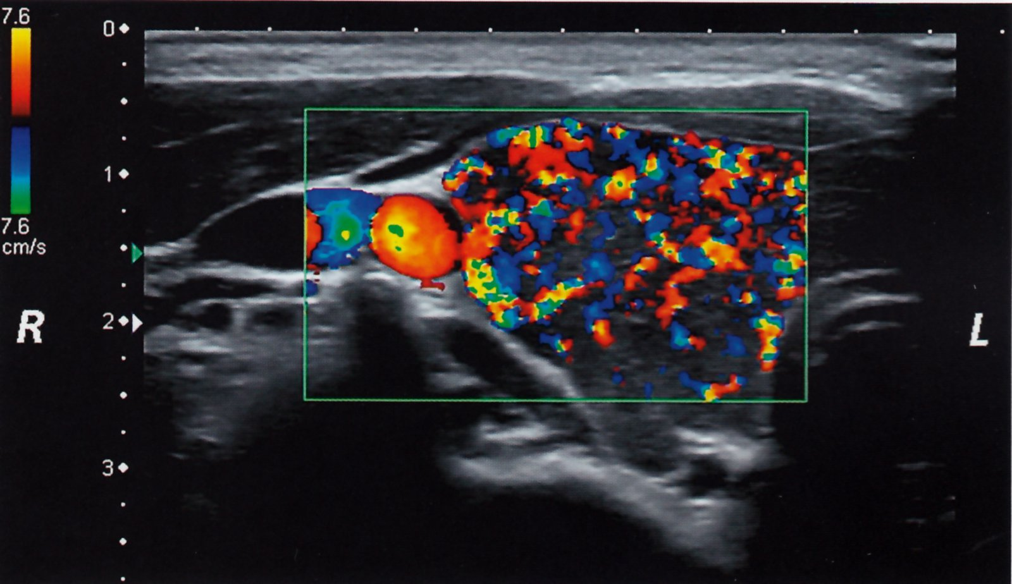
Graves disease
Thyroid scintigraphy
Shows a diffuse uptake of radioactive iodine
Thyroid ultrasound (with color Doppler)
Shows an enlarged, hypervascular thyroid
Thyroid ultrasound of the right thyroid lobe (color Doppler)
Numerous red and blue areas consistent with increased vascularization are visible within the color Doppler image window (green rectangle).
This finding is typical in Graves disease.

Slide 15
Thyroid tumors
Sonographic signs of benign thyroid nodules : (Adenoma)
Low risk :
- Isoechoic or hyperechoic solid nodule
- Cystic nodule with eccentric solid component
Partially cystic nodule.
Benign : Cystic nodules (anechoic) without solid component

Slide 16
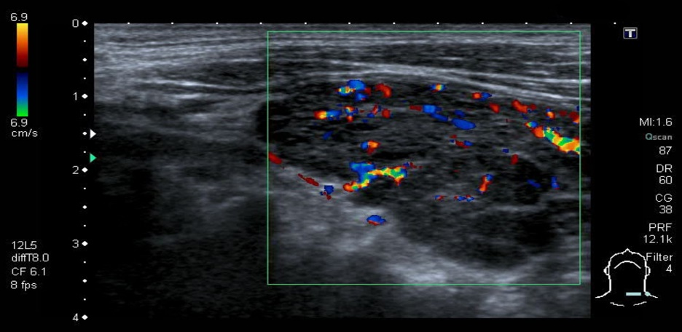
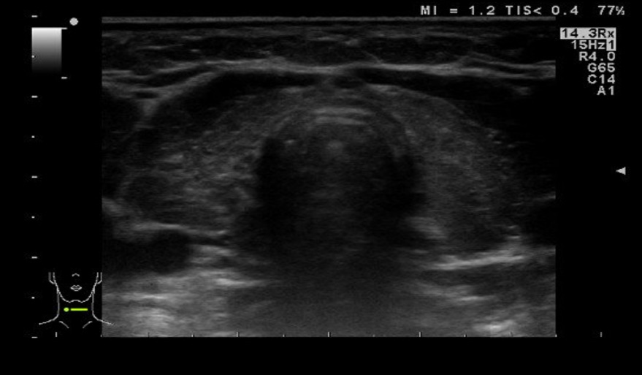
Hashimoto disease
is a common form of autoimmune thyroiditis and the leading cause of hypothyroidism.
Ultrasound: to assess thyroid size, echotexture, and to exclude thyroid nodules
Results depend on the form of Hashimoto thyroiditis.
Atrophic phenotype: Reduction in thyroid size.
Goitrous phenotype: Heterogeneous enlargement
Color-coded duplex sonography of the thyroid
There are hypoechoic and heterogeneous thyroid parenchyma and an enlarged thyroid. There is no increased vascularization or perfusion in the color-coded duplex ultrasound.
These findings are consistent with the acute stage of Hashimoto thyroiditis.
Hashimoto thyroiditis
Thyroid ultrasound (transverse view): marked reduction in size and a heterogenous, flaky echoic structure suggesting inflammatory infiltration. The thyroid is significantly hypoechoic and its appears lumpy compared to the surrounding muscles

Slide 17
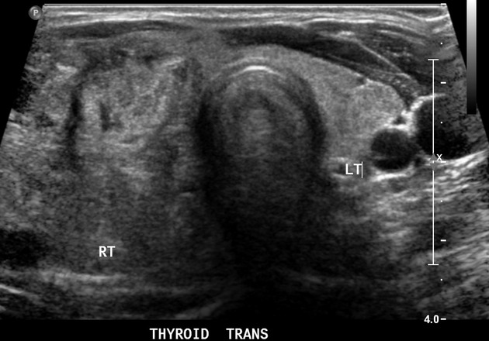
Multinodular goiter
Thyroid ultrasound:
Multiple nodules within the thyroid parenchyma.
Thyroid scintigraphy
Increased radioiodine uptake by multiple hyperfunctioning (hot) nodules.
FNAC:
Not routinely required

Slide 18
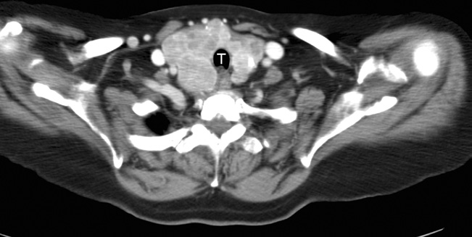
Multinodular goitre. The enlarged thyroid almost surrounds the trachea (T) and enhances avidly after intravenous contrast showing many nodules of varying size.

Slide 19
Thyroid cancer (Thyroid carcinoma)
Thyroid ultrasound: to assess for sonographic signs of thyroid malignancy
Irregular margins
Taller-than-wide shape
Microcalcifications within nodules
Extrathyroidal growth
Thyroid scintigraphy
Indications
Thyroid nodule(s) with ↓ TSH levels
Multinodular thyroids (to identify nodules that require FNAC)
Supportive findings: decreased or no radiotracer uptake (i.e., hypofunctioning or nonfunctioning nodules, referred to as cold nodules)
Solid, hypoechoic nodules with irregular margins, microcalcifications, taller-than-wide shape, extrathyroidal growth, and/or cervical lymphadenopathy should raise suspicion for malignancy and require further evaluation with FNAC.

Slide 20
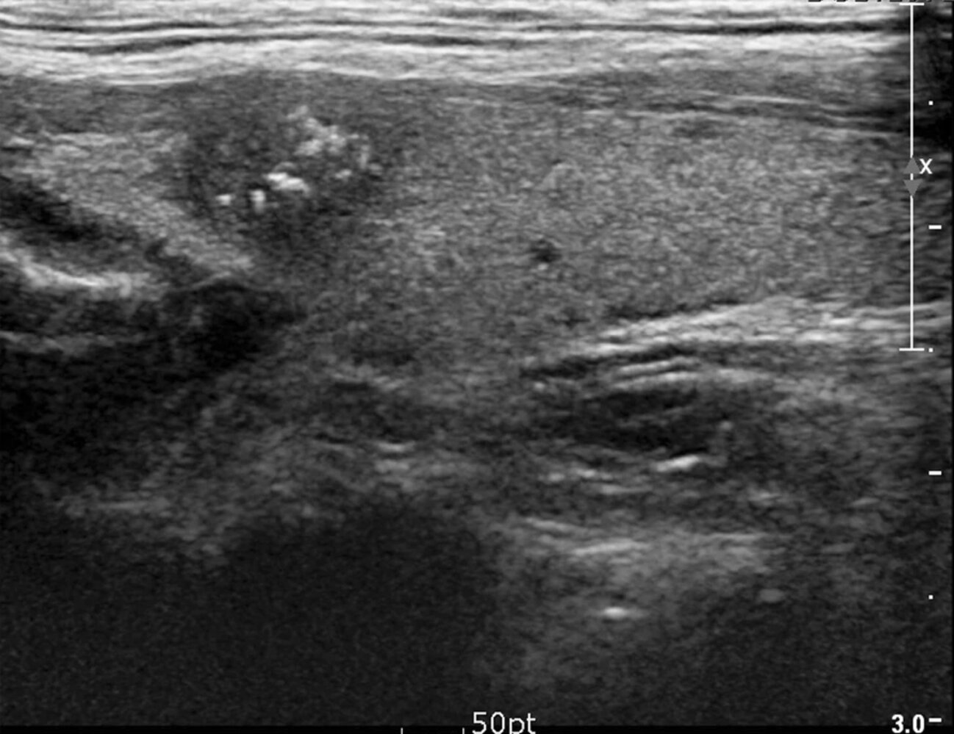
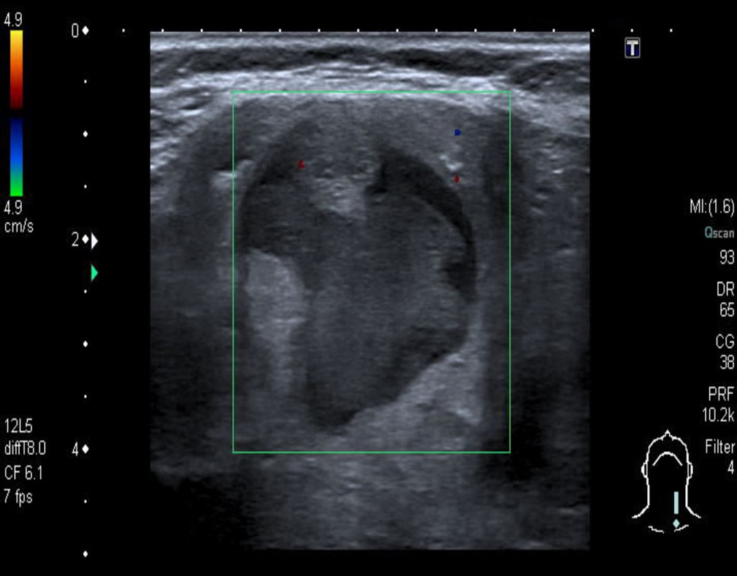
Solid thyroid nodule with microcalcifications
Ultrasound thyroid (longitudinal plane)
A solid nodule in the upper pole has ill-defined margins and contains multiple microcalcifications.
The presence of microcalcifications increases suspicion for malignancy
Mixed echogenicity thyroid nodule
Ultrasound thyroid (left lobe; longitudinal plane)
A rounded mixed-echogenicity nodule with irregular (lobulated) margins contains hypoechoic and hyperechoic components.

Slide 21
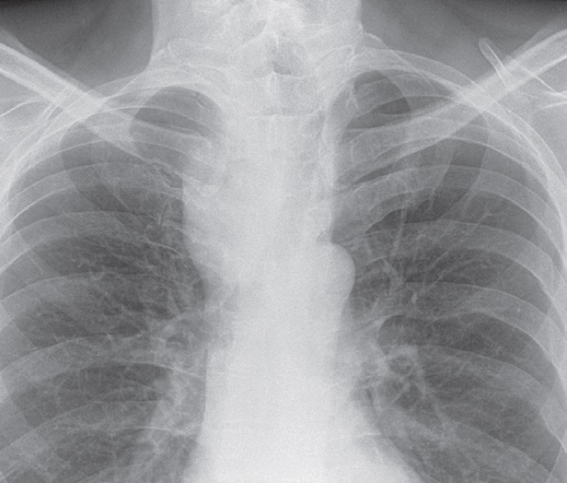
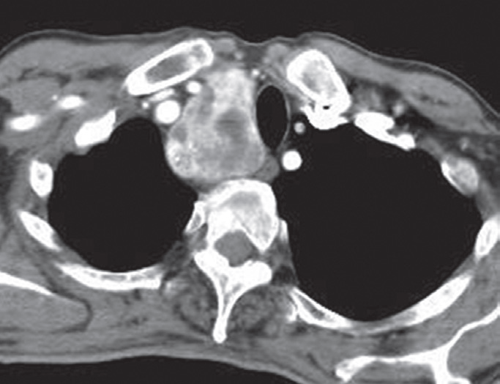
Intrathoracic thyroid masses (goitres):
are the most frequent cause of a superior mediastinal mass.
The characteristic feature is that the mass extends from the superior mediastinum into the neck and almost invariably compresses or displaces the trachea.
(a)
Retrosternal goitre.
X-Ray showing a large, right-sided, superior mediastinal mass displacing the trachea.
(b) CT in the same patient showing the heterogeneously enhancing mass to the right of the trachea
(b)

Slide 22
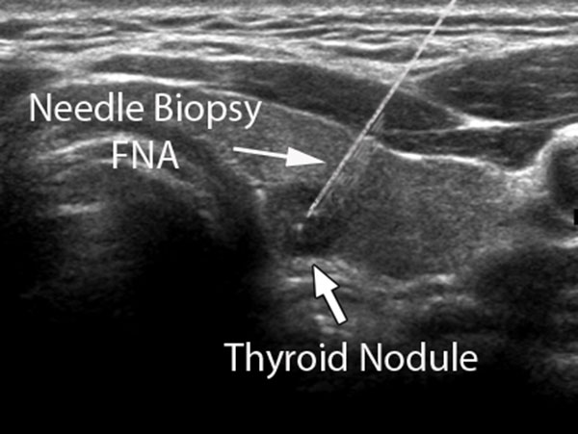
Ultrasound guided biopsy

Slide 23
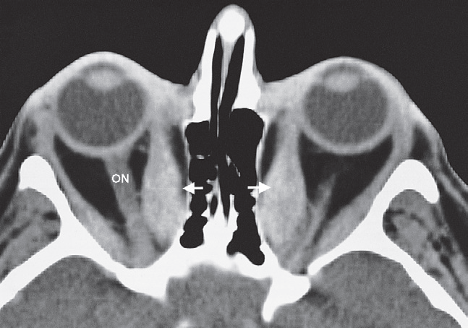
In thyroid eye disease, there is enlargement of the extraocular muscles which is frequently bilateral and may affect one, several or all the eye muscles.
There is also hypertrophy and oedema of the fat behind the eye which adds to the exophthalmos.
When severe, these changes can lead to compression of the optic nerve.
Thyroid eye disease. CT scan through the orbits showing enlargement of the extraocular muscles, particularly the medial rectus (arrows). ON; optic nerve.

Slide 24
Hyperparathyroidism
Primary hyperparathyroidism
Routine imaging studies
Obtain in ALL patients with confirmed pHPT to evaluate for renal and skeletal manifestations.
Skeletal evaluation
Assess for osteoporosis
Preferred modality: Dual-energy x-ray absorptiometry (DXA)
Alternative: Vertebral x-ray
Renal imaging
Assess for nephrolithiasis and/or nephrocalcinosis.
Options include abdominal CT without contrast, renal ultrasound, and abdominal x-ray.
Additional imaging studies
Neck imaging
For surgical planning to determine the location of the abnormal glands
Options include ultrasound neck and nuclear imaging

Slide 25
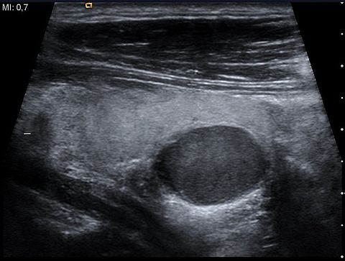
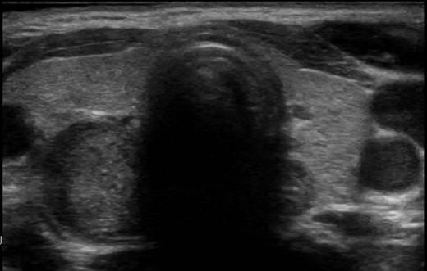
Parathyroid
Normal parathyroid can not be seen with U/S, however parathyroid adenoma can be sampled
Adenoma: is a benign lesion . It is well defined and hypo echoic.
Parathyroid carcinoma: Aggressive lesion irregular hypo echoic. Diagnosis is confirm by biopsy

Slide 26
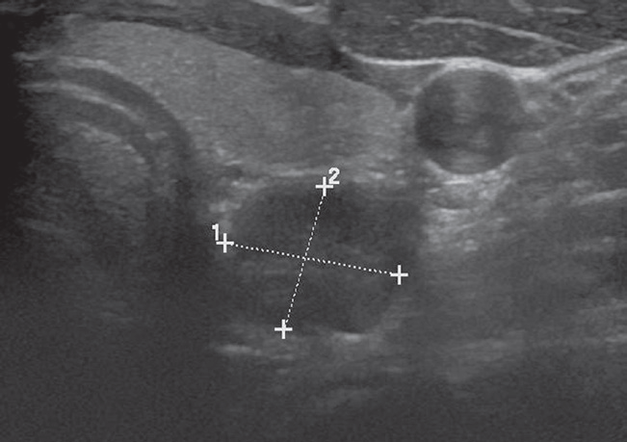
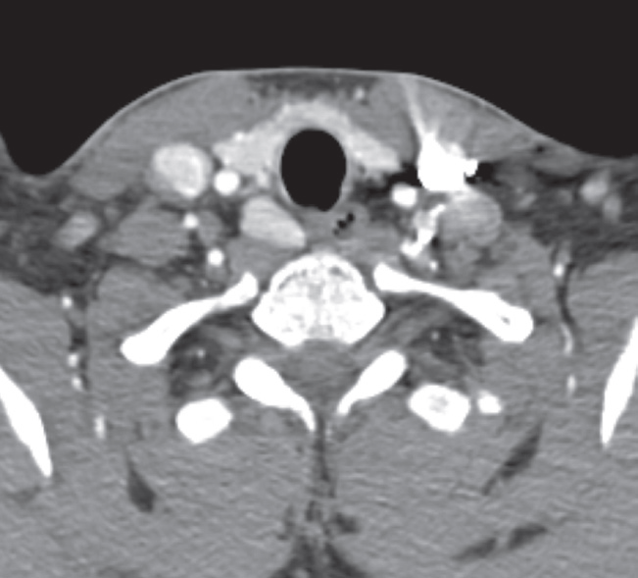
(b)
(a)
Parathyroid adenoma. (a) Transverse ultrasound of a parathyroid adenoma (calipers) seen behind the left lobe of the thyroid gland . The common carotid artery is also demonstrated. (b) CT of another patient showing an avidly enhancing right parathyroid adenoma.

Slide 27


References
Diagnostic Imaging by Andrea G. Rockall, 7th edition

Slide 28
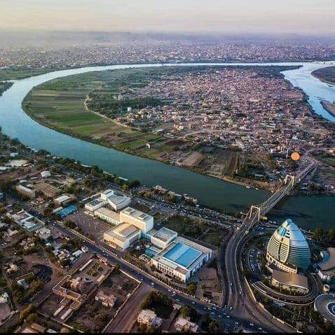
Thank you

