Slide 1


Slide 2


Slide 3

WELCOME TO MED 631

Slide 4

ARE YOU READY FOR THE MARATHON?

Slide 5
ANTI-PHOSPHOLIPID ANTIBODY SYNDROME
DR WAQAR
MBBS, MRCP, Int. Medicine( London)
MRCP, Endocrinology & DM(London)
ASST. PROFESSOR

Slide 6
Definition of autoimmune disease
Autoimmune diseases are conditions in which antibodies are formed against the person’s own body tissues
In some diseases, ab. are formed against one organ only ( DM type1, Grave’s disease) while in others, ab. are formed against many tissues

Slide 7
ANTI PHOSPHOLIPID SYNDROME
Definition of APA syndrome:
It is an autoimmune condition where there are some abnormal antibodies in the blood, which cause thrombosis in blood vessels.
Thrombosis can occur anywhere in the body (arteries or veins)

Slide 8
TYPES OF APA SYNDROME
1) Primary: no known cause
2) Secondary APA: Secondary to some other
disease eg SLE

Slide 9
Signs & symptoms:
a) Venous thrombosis (eg DVT in the legs)
b) Arterial thrombosis eg stroke, MI
c) Pregnancy complications: recurrent miscarriage, still birth, intrauterine fetal death
( females with recurrent abortions should always be screened for APA)
d) Skin discoloration called “livedo reticularis”: this is a “net like” appearance of the skin

Slide 10
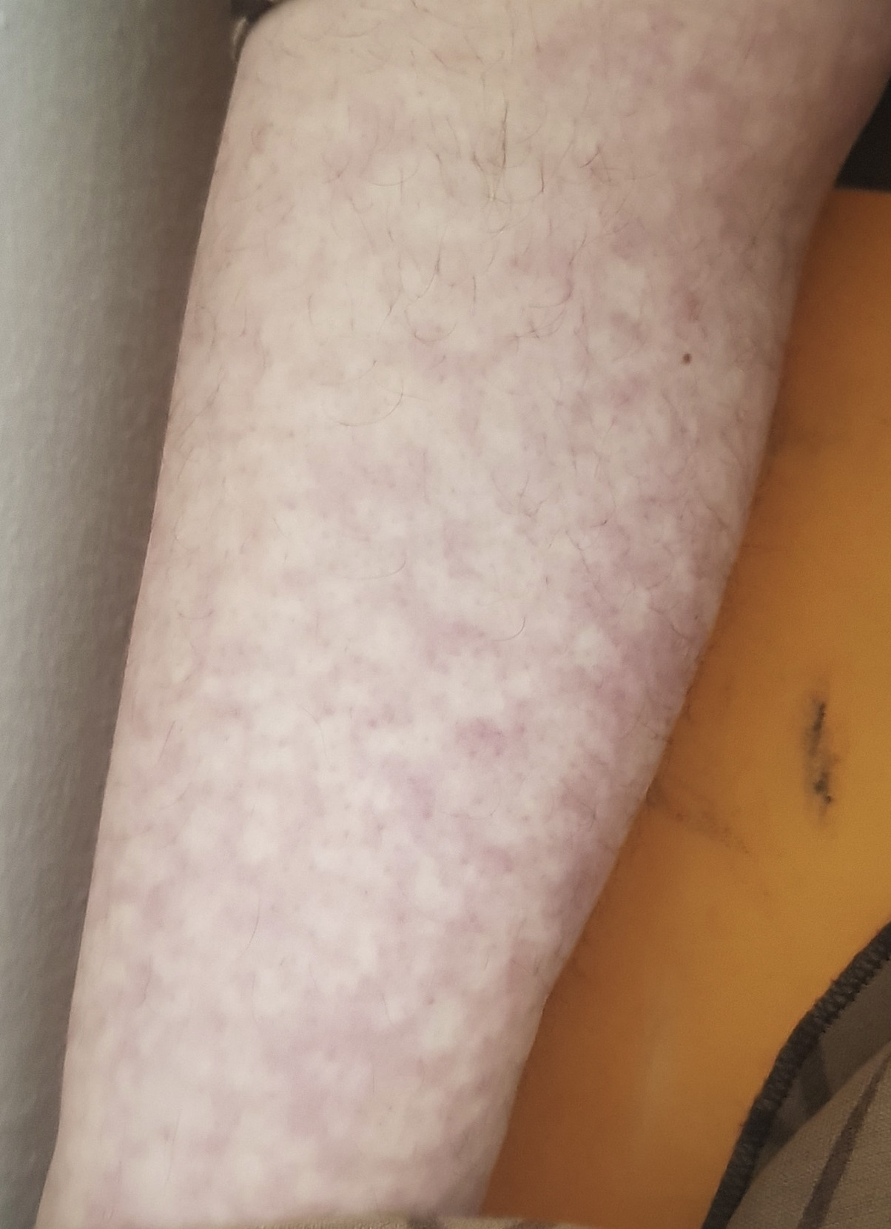
Livedo reticulitis

Slide 11
WHEN TO SUSPECT APA syndrome
“Unprovoked” DVT
Arterial thrombosis
Recurrent thrombosis
Thrombosis in unusual sites eg. : portal vein, hepatic veins, intracranial veins
Female with recurrent abortions, intrauterine fetal death

Slide 12
DIAGNOSIS
Blood tests:
Antiphopspholipid antibodies (3 types)
lupus anti- anticardio- antibody to
coagulant -lipin antibody β2 glycoprotein
2) Thrombocytopenia
3) High PTT ( ? Very strange, right?)
( PTT is high in bleeding disorders, not hypercoagulation disorders)

Slide 13
HOW TO DIAGNOSE
One or more episodes of thrombosis or pregnancy related complication( abortion etc)
PLUS
2) Positive antibodies ( do twice, 12 weeks
apart)
Diagnosis requires both 1 & 2
Either all 3 or just one or two antibodies may be present

Slide 14
If antibodies are present but no history of thrombosis, it is not APA syndrome

Slide 15
TREATMENT
For acute episode of thrombosis: i.v.Heparin or LMWH
For long term secondary prophylaxis:
Oral anticoagulants Injections
(warfarin is the best) ( LMWH)
Second choice

Slide 16
There is a new group of anticoagulant drugs called Direct acting Oral Anticoagulants (DOA). E.g. : rivaroxaban, apixaban
They are not the first choice in APA treatment
Benefits of DOAs:
a) Less chances of bleeding than warfarin
b) Less interaction with food & drugs
c) No routine monitoring needed with blood tests

Slide 17
VERY IMPORTANT
Female with known APA syndrome
On long term warfarin
Now becomes pregnant. What to do?
Stop warfarin and give LMWH during pregnancy
Warfarin is contraindicated in pregnancy
Apixaban etc are category C drugs ( possible teratogenic but may be used if strongly needed)

Slide 18
APA syndrome is a hypercoagulation disorder.
Following are some other hypercoagulation disorders:
Protein C deficiency
Protein S def.
Antithrombin 3 def

Slide 19
CASE 1
A 35 year old lady presents with pain and swelling in the right lower leg since 2 days.
Past history of recurrent abortions
Had a stroke 2 years ago
Also had popliteal artery thrombosis few years ago

Slide 20
What is your differential diagnosis?
Keeping in view the overall scenario, what is the most likely diagnosis?
What test will you do to confirm your diagnosis?
What treatment will you give to her now?
What treatment will you give long term?

Slide 21
LAST SLIDE IS VERY IMPORTANT

Slide 22
ALLAH HAS MADE SALAA ( prayers) LAAZIM, 5 TIMES A DAY
BUT
HE HAS MADE GOOD “AKHLAQ” LAAZIM 24 HRS
A DAY !

Slide 23


