Slide 1
ASCITES
DR WAQAR
MBBS, MRCP, Int. Medicine( London)
Specialist cert. exam, Endocrinology & DM(London)
ASST. PROFESSOR

Slide 2
DEFINITION
Accumulation of more than 25 cc of fluid in the peritoneal cavity is called ascites.
( normally, only about 25 cc fluid in the cavity)

Slide 3
GRADES OF ASCITES
1) Grade 1 : Mild ascites, only detected by
ultrasound. Physical exam normal.
2) Grade 2: Moderate ascites, causing moderate
abdominal & flank distension
3) Grade 3: Large ascites, causing huge abdominal
distension
( Grade 2 & 3 can be detected by physical exam)
At least 1.5 L fluid should be present in the abdomen so as to be detected by examination

Slide 4
S/S
Patient’s complaints:
* No complaints ( if very little fluid)
* Abdominal distension
* Respiratory distress
2) On Examination :
* Normal ( if very little fluid)
* Abdominal distension if significant fluid
* Shifting dullness is present
* Fluid thrill
* Umbilicus may be bulging

Slide 5
CLASSIFICATION
Ascites can be divided into 2 main types according to the protein concentration of the fluid
TRANSUDATE: Protein less than 30g/L in the ascitic fluid.
EXUDATE: Protein more than 30 g/L
A better way of classification is the SAAG ratio ( Serum to Ascites Albumin Gradient)

Slide 6
WHAT IS SAAG?
Serum albumin minus ascitic fluid albumin
( albumin difference)
* This difference can be more than 1.1g/100cc or less than 1.1g/100cc
So, ASCITES WITH
SAAG > 1.1 SAAG < 1.1

Slide 7
CAUSES OF ASCITES
SAAG > 1.1
SAAG < 1.1
Cirrhosis wth/portal HTN
Portal HTN due to any other cause
Heart failure
Budd-Chiari syndrome (hepatic vein obstruction)
d) Spontaneous bacterial
peritonitis
Bacterial & fungal peritonitis
b) Tuberculous peritonitis
d) Nephrotic syndrome
e) Pancreatitis
f) Low serum albumin

Slide 8
Some other types of Ascites
Hemorrhagic ascites: due to malignancy
Chylous ascites:
* Collection of white “milky” fluid
* Rich in fats/Triglycerides
* Occurs in lymphomas, TB peritonitis

Slide 9
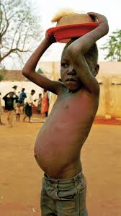
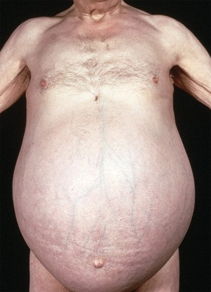
ASCITES
ASCITES DUE TO KWASHIORKOR

Slide 10
COMMONEST CAUSE OF ASCITES IS
CIRRHOSIS WITH PORTAL HTN
Why ascites occurs in cirrhosis
* Low serum albumin low oncotic pressure
ascites
* Backpressure in portal vein fluid comes
out

Slide 11
INVESTIGATIONS IN ASCITES
1) CBC, electrolytes, serum albumin
2) LFTs
3) Hepatitis serology
4) Abd. ultrasound

Slide 12
INVESTIGATIONS IN ASCITES
5) Paracentesis(ascitic tap): Every new patient
with ascites should get a “diagnostic” tap:
* Take out 10-20 cc fluid
* Check albumin( to calculate SAAG), neutrophils (to see infection), RBC, Gram stain & culture, cytology(malignant cells), amylase levels (in suspected pancreatic ascites)

Slide 13
Complications of paracentesis:
* Infection * Intestinal perforation
Relative contraindications:
* Pregnancy
* Bleeding disorders

Slide 14
MANAGEMENT OF ASCITES
Low salt & Diuretics Paracentesis
water intake
In very resistant ascites, a procedure called
TIPS is sometimes used. (transjugular intrahepatic porto-systemic shunt).

Slide 15
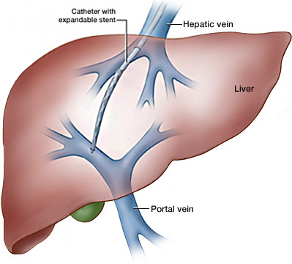
TIPS

Slide 16
MANAGEMENT OF ASCITES
Low salt & water: < 2 g/d of salt ( less than ½ tea spoon)
Diuretics:
* Spironolactone( aldactone): 1st choice.
side effects : gynecomastia, hyperkalemia
* Can add lasix (furosemide) if needed
* Reduce ascites gradually (0.5 to 1 kg wt. loss
daily). Too much wt. loss “suddenly” is not good!
In 95% of cases, ascites can be controlled by 1) & 2)

Slide 17
Management contd.
3) “Therapeutic Paracentesis”
* It is done if medicines don’t help (resistant ascites) or very big ascites causing respiratory difficulty.
* Upto 7 L can be removed at one time.
* Removal of more than 7L can cause
problems like hypotension, renal failure,
encephalopathy
* i.v. albumin given at the time of paracentesis
can prevent these complications

Slide 18
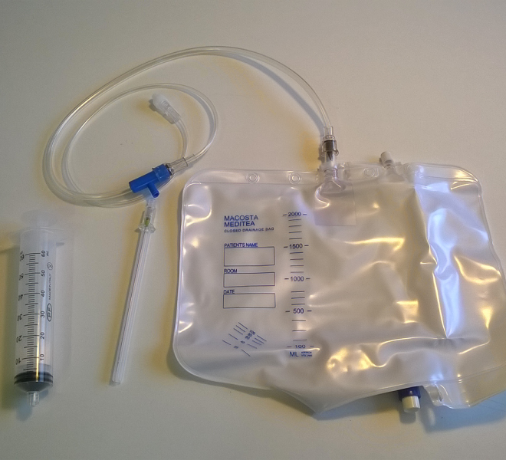
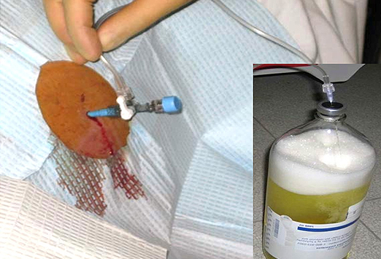
Therapeutic Paracentesis

Slide 19
Complications of Ascites
SBP Resp. distress
( sponta-
-neous bact.
peritonitis)

Slide 20
COMPLICATIONS OF ASCITES
SPONTANEOUS BACTERIAL PERITONITIS
(S.B.P.)
It is infection of the peritoneum & ascitic fluid, which occurs in the absence of any intra- abdominal source of infection. It usually occurs in people who have cirrhosis & portal HTN
RISK FACTORS:
* Previous episode of SBP
* Very low proteins in the ascitic fluid

Slide 21
SBP contd.
Which Bacteria? : * E.Coli *Klebsiella
* Pneumococci
How ir presents?
Mild abdominal pain & tenderness
2) Worsening of ascites
3) Mild fever
4) Encephalopathy
Any cirrhosis patient who gets worsening of his
ascites or develops encephalopathy rule out SBP by paracentesis

Slide 22
SBP contd.
DIAGNOSIS: Do paracentesis
* Neutrophil count in ascitic fluid: more than
250cells/uL
* Send fluid for Gram stain & culture: But Gram
stain can be negative, so don’t depend on it.
Please remember the neutrophil count ! It is
diagnostic even if Gram stain is negative. If the
neutrophils are less than 250/uL, it is not called
S.B.P. even if bacteria are present in Gram Stain.

Slide 23
SBP contd.
Treatment: i.v. antibiotics (3rd generation cepha-
-losporins like ceftazidime, cefotaxime.
Alternatives are i.v ciprofloxacin, norfloxacin.
After the first episode of SBP, patients should take lifelong antibiotic, either Ciprofloxacin or norfloxacin, for secondary prophylaxis.

Slide 24
Complications of Ascites (contd)
So , remember 2 complications of ascites:
* SBP
* Respiratory distress

Slide 25
BUDD-CHIARI SYNDROME
BUDD-CHIARI SYNDROME
It is hepatic vein thrombosis, leading to back-
pressure, liver congestion, portal HTN & ascites.
Etiology:
* Hypercoagulation disorders ( Protein C def., Protein S def., antithrombin 3 def., antiphospholipid antibody syndrome)
* Pregnancy, estrogen contraceptives
b) S/S : * Painful hepatomegaly * Portal HTN
* Ascites * Jaundice

Slide 26
Treatment of Budd Chiari
Anticoagulation with heparin, followed by warfarin
Angioplasty
Stent
Symptomatic treatment for ascites
TIPS ( sometimes)
If the risk of thrombosis is going to continue, anticoagulation is given for ever

Slide 27
How to Approach the patient
Take a detailed history keeping in view the causes of ascites
Do appropriate examination
Order investigations
Give treatment to remove the ascitic fluid
Treat the cause

Slide 28
RAPID FIRE QUES
More than how much fluid is detectable by examination?
How to detect ascites by physical exam?
How do you classify ascites based on albumin content? Which ratio?
What is the commonest cause of ascites?
Name some causes of ascites with SAAG more than 1.1?
Name some causes with ratio less than 1.1?
Hemorrhagic ascites means?

Slide 29
8) What is chylous ascites?
9) What color is chylous ascites?
10) Which disease causes chylous ascites?
11) What investigations to do in ascites patient?
12) After paracentesis, what things to check in the fluid?
13) Complications of paracentesis?
14) When not to do paracentesis?

Slide 30
15) Name 3 basic ways to treat ascites?
16) Which procedure to do in resistant ascites?
17) Which diuretic is the best?
18) Name 2 side effects of this diuretic?
19) Patient with ascites. Weight is 80kg. Diuretic started. Weight next day was 75kg. Good or bad?
During large volume paracentesis, what complications can happen?
What to give to prevent them?

Slide 31
22) Name 2 complications of ascites?
23) What is SBP?
24) Diagnostic test for SBP?
25) How does it present?
26) 2 risk factors for SBP?
27) Ascitic fluid shows bacteria, neutro. Count 100 cells. Is this SBP?
28) Ascitic fluid shows no bacteria, neutro count is 300. Is this SBP?

Slide 32
29) What to give for secondary prophylaxis of SBP?
30) What is Budd Chiari syndrome?
31) S/S?
32) Risk factoirs for BUDD CHIARI?
33) Treatment of Budd Chiari?

Slide 33
LAST SLIDE IS VERY IMPORTANT

Slide 34


