Slide 1
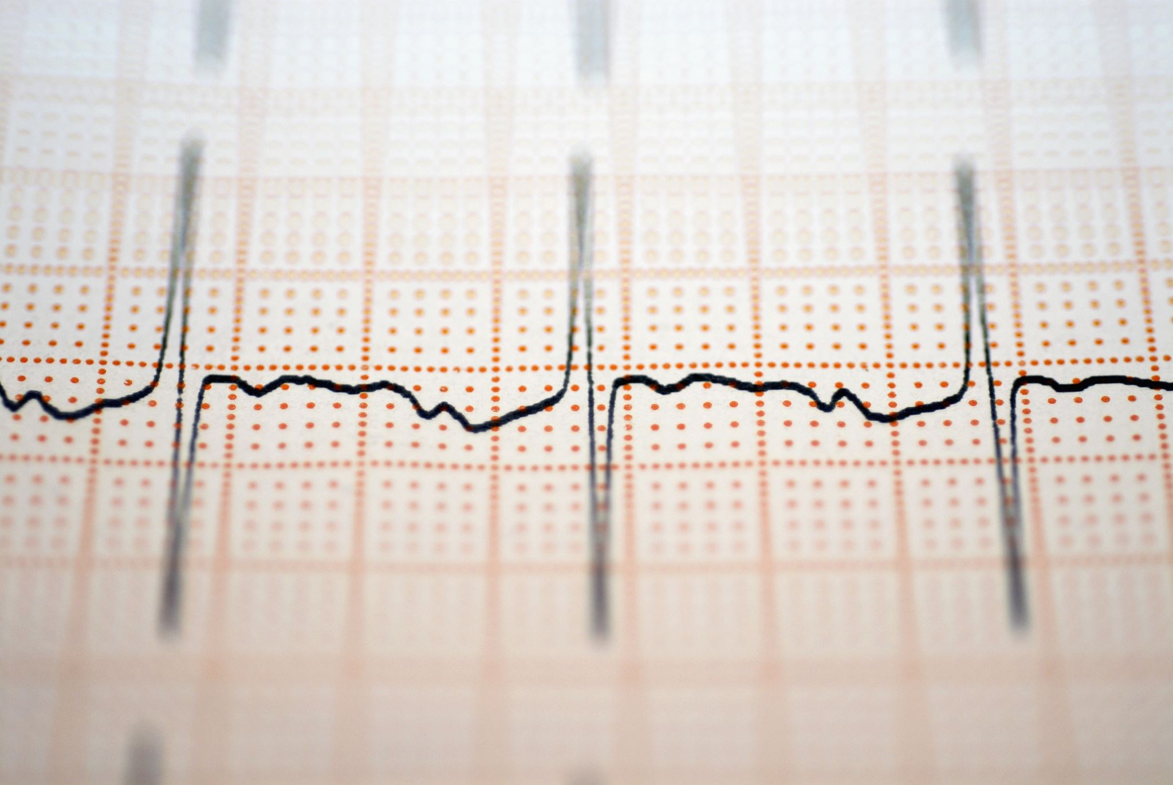
Acute Coronary Syndrome
Dr Nada Abdelrahman

Slide 2
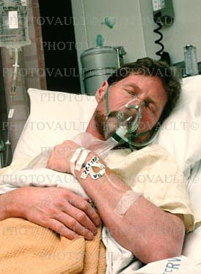
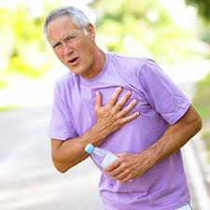
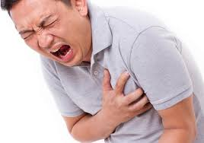



I walk into the ED and what do I see?
vs.

Slide 3



Acute Management
simultaneously
Efficient & direct history
Initiate stabilization interventions
Plan for further cardiac care

Slide 4
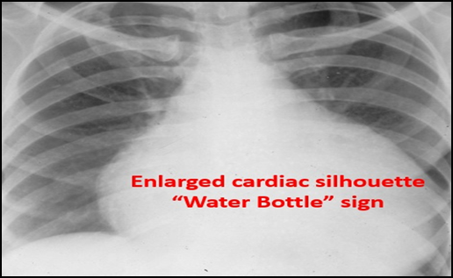
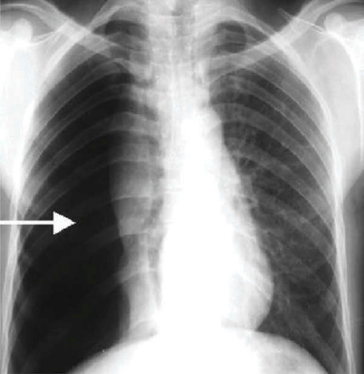
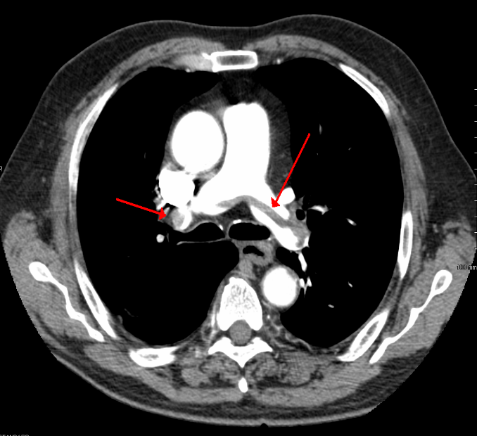
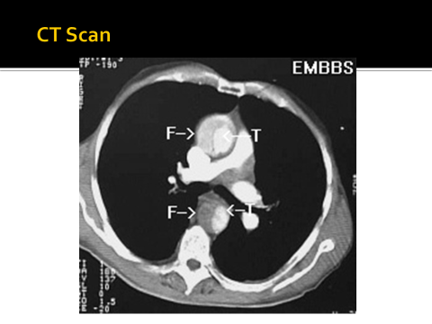
Remember important Life threating conditions causing chest pain
They
Can’t
Misses

Slide 5
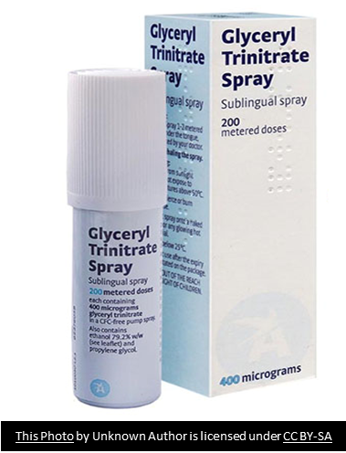

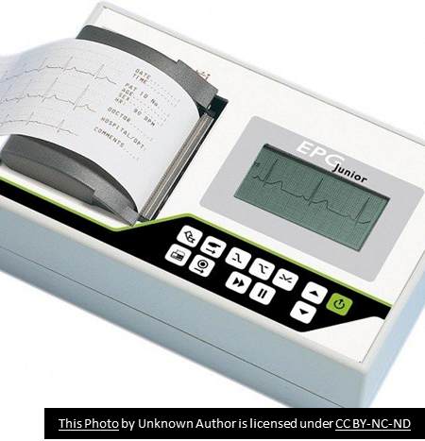
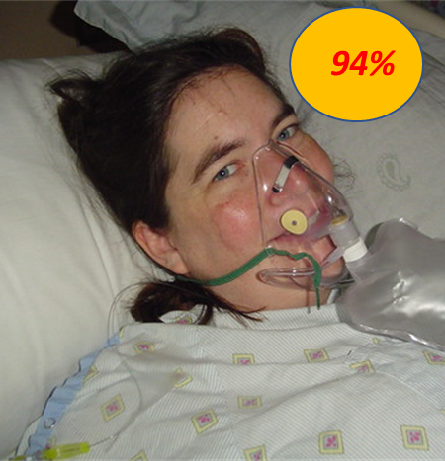
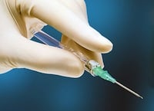
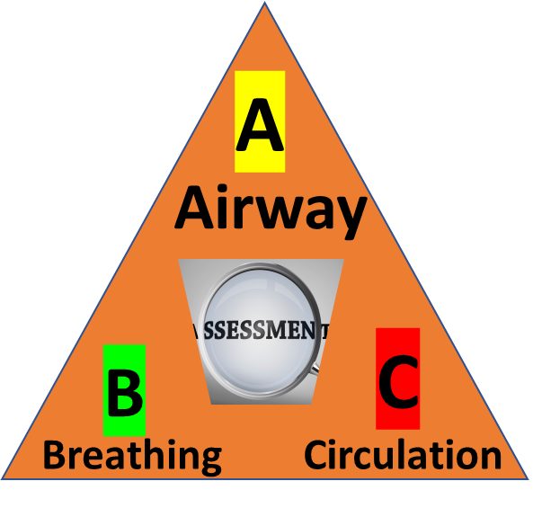
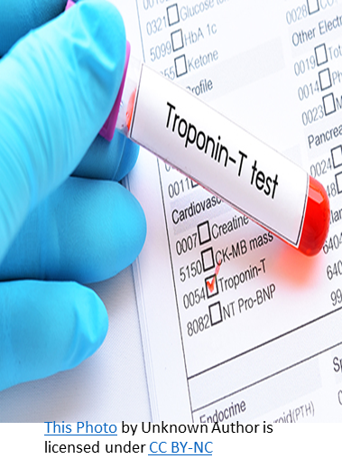
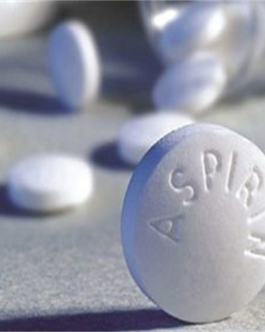
Initial Approach
This Photo by Unknown Author is licensed under CC BY-NC-ND
300mg

Slide 6
Chest pain suggestive of ischemia
Immediate assessment within 10 Minutes
Initial labs
and tests
Emergent care
History & Physical
  12 lead ECG
  Obtain initial cardiac enzymes
  electrolytes, cbc lipids, bun/cr, glucose, coags
  CXR
  IV access
  Cardiac monitoring
  Oxygen
  Aspirin
  Nitrates
  Establish diagnosis
  Read ECG
  Identify complications
  Assess for reperfusion

Slide 7
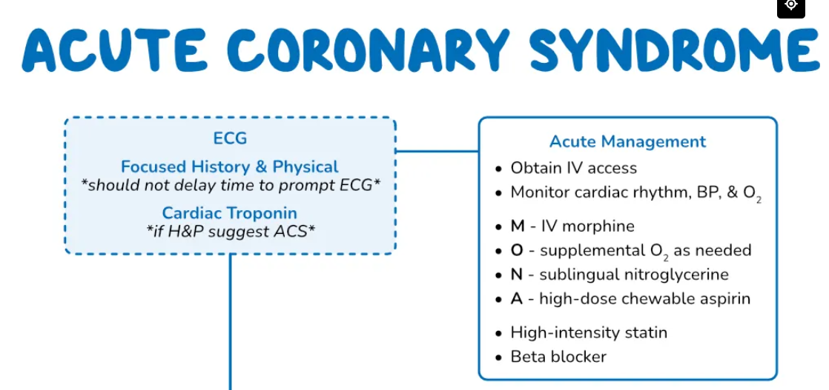
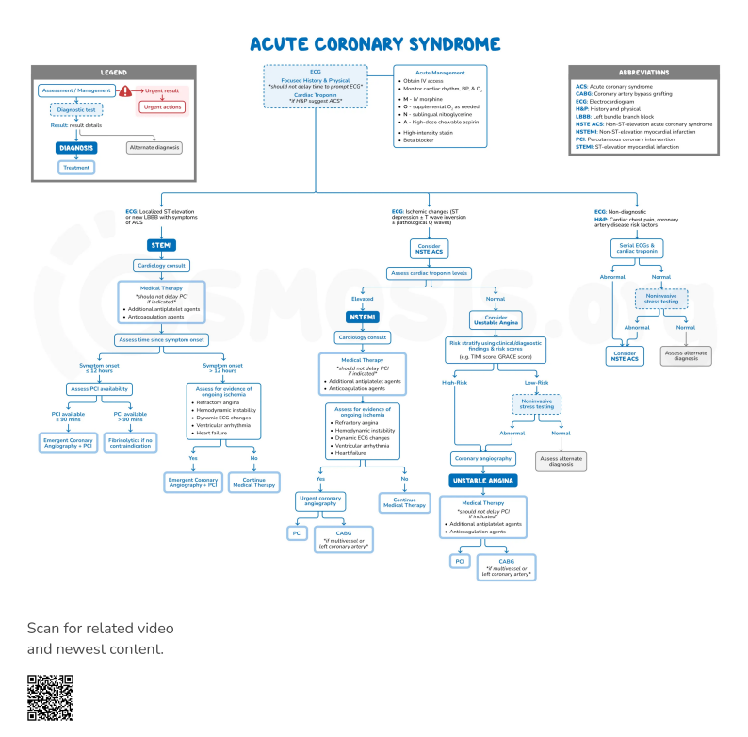

Slide 8
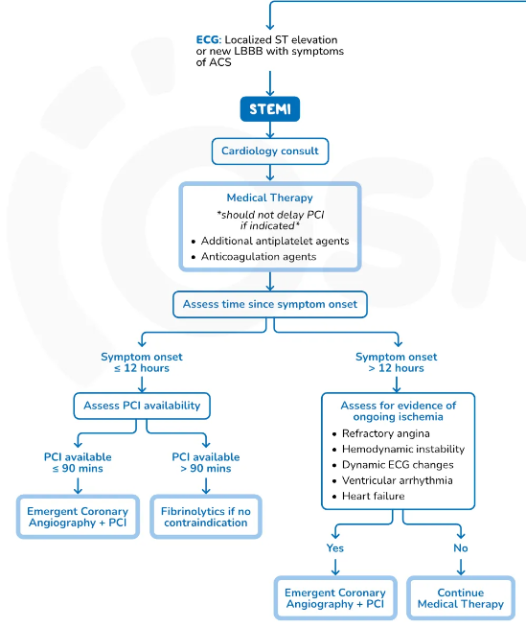
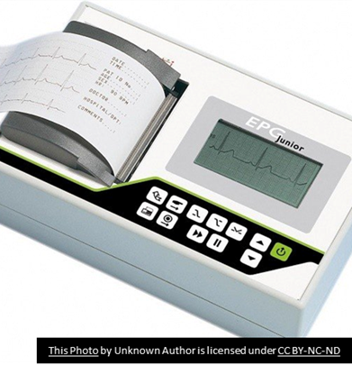


120 mins

Slide 9
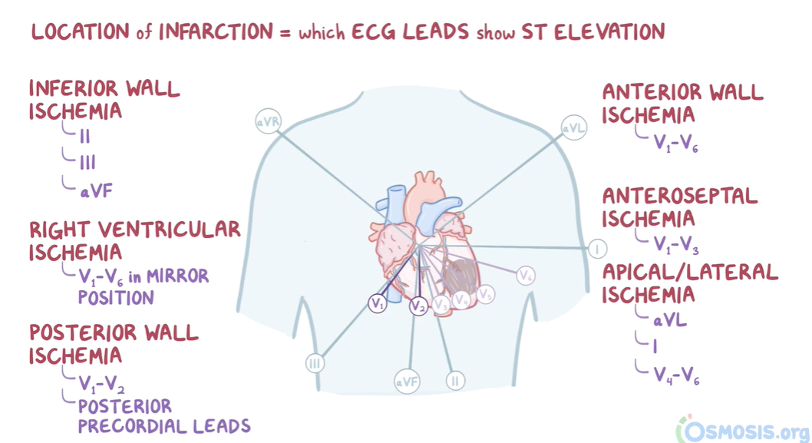
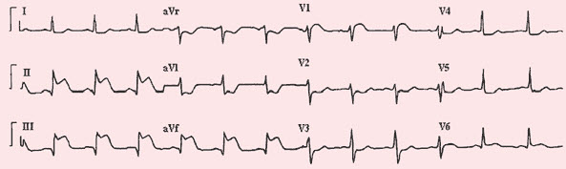
ST ELEVATION MI
ST ELEVATION IN LEAD II , III, aVF
INFERIOR MI
COMMENT ON ECG

Slide 10
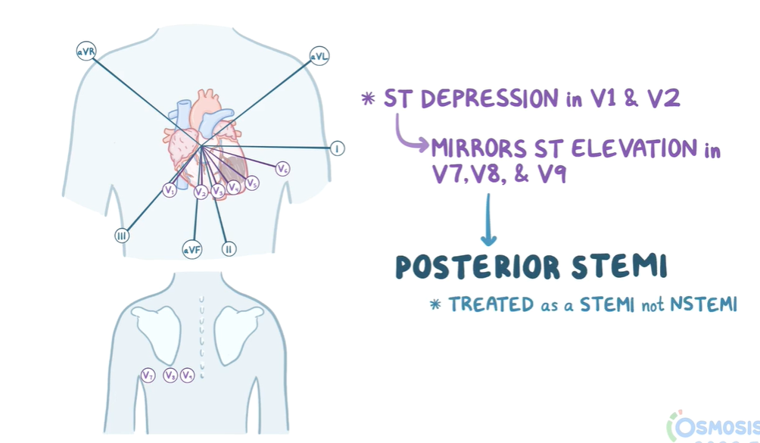
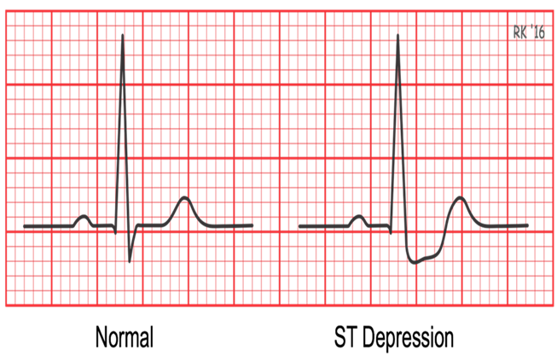
Posterior MI

Slide 11
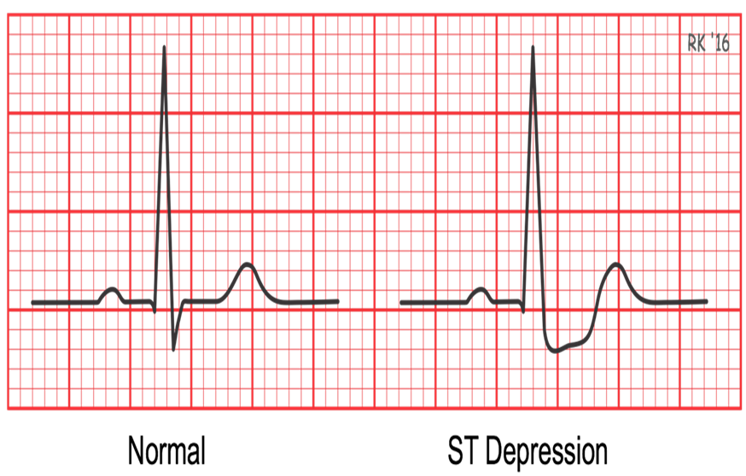

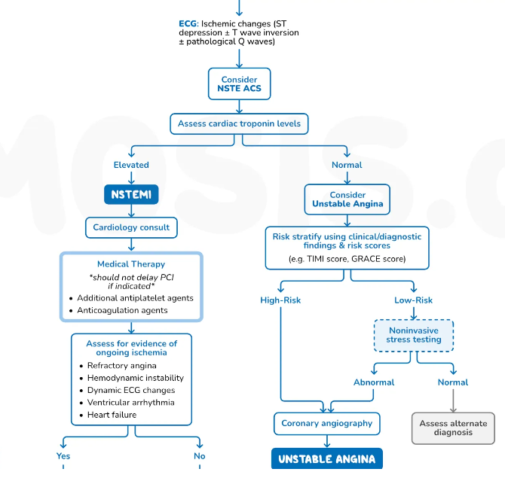

0.5 mm or 0.05 mV

Slide 12
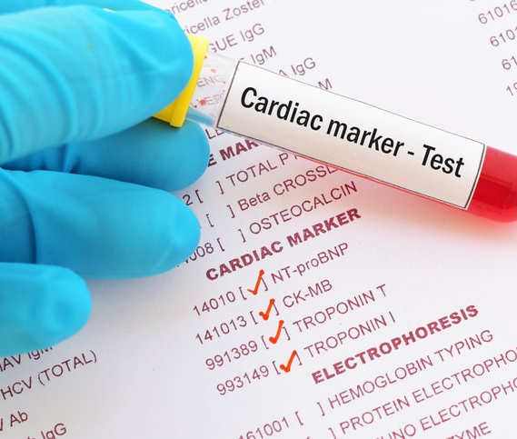
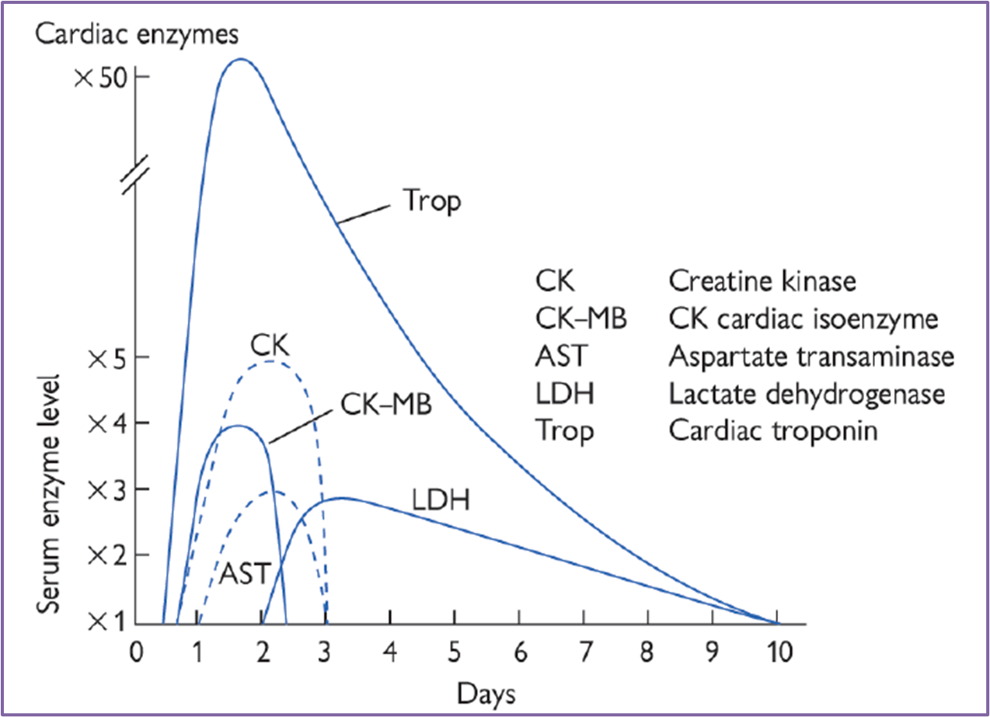
Troponin T and I: highest sensitivity and specificity for detecting MI; appear within 4 hours; peak at 24 to 48 hours and decline slowly; remain 7 to 10 days
Creatine phosphokinase myocardial band (CPK-MB): first measurable at 6 to 10 hours; peaks at 24 hours; baseline by 48 to 72 hours

Slide 13
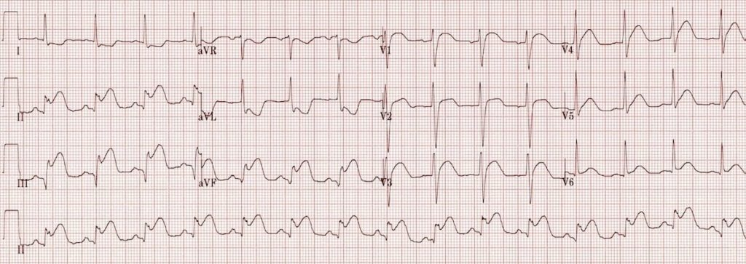

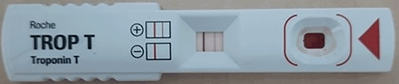
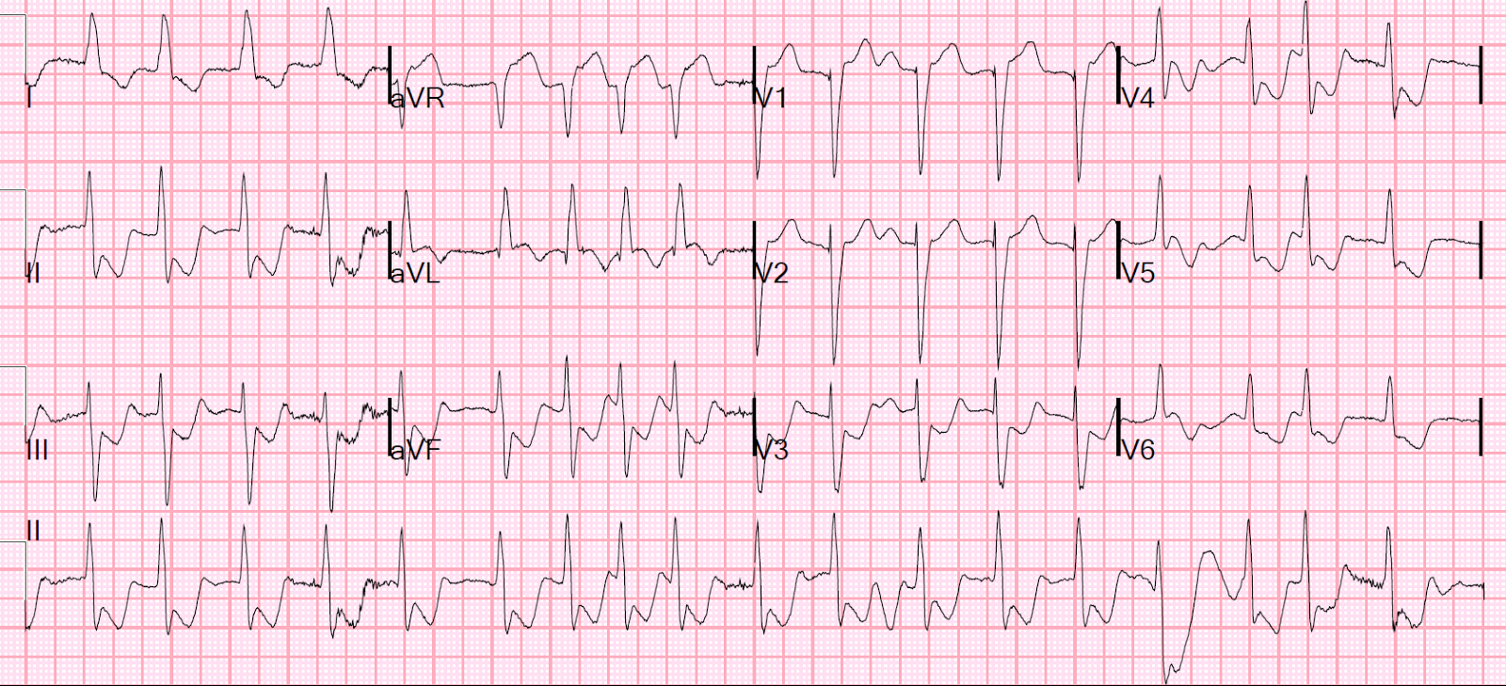
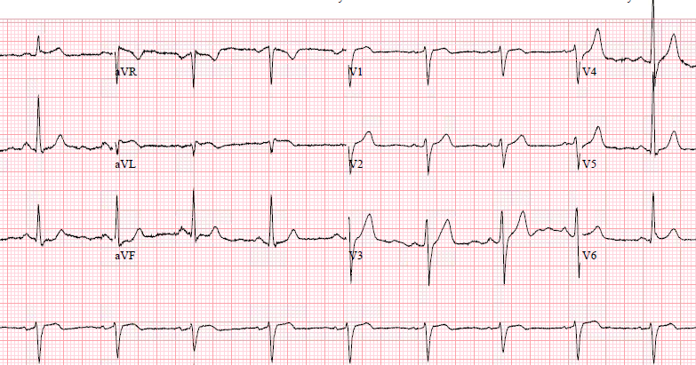
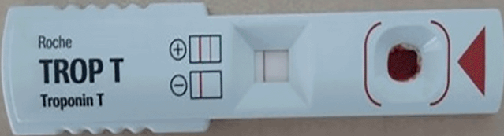
Acute coronary syndrome classification
STEMI
This Photo by Unknown Author is licensed under CC BY-SA-NC
NSTEMI
This Photo by Unknown Author is licensed under CC BY-NC
Unstable Angina
This Photo by Unknown Author is licensed under CC BY-NC

Slide 14
Acute coronary syndrome Managment
STEMI
This Photo by Unknown Author is licensed under CC BY-SA-NC
NSTEMI
This Photo by Unknown Author is licensed under CC BY-NC
Unstable Angina
This Photo by Unknown Author is licensed under CC BY-NC

Slide 15

STEMI (cont)
Thrombolytic therapy is given in STEMI
Thrombolytic therapy is NOT GIVEN IN UNSTABLE ANGINA AND NSTEMI
Notes:
THROMBOLYTIC GIVE IN PERIPHERY HOSPITAL WHEN PCI NOT AVAILABLE!!!!!!!!!!!!!!!!!!!!!!!!!!

Slide 16

STEMI confirmed what is the next step !!!

Slide 17
Immediately assess eligibility for coronary reperfusion therapy

Slide 18
Coronary Reperfusion therapy
Fibrinolysis
Percutaneous coronary intervention
Gold-standard treatment
Notes:
Primary percutaneous coronary intervention (PCI) has emerged as the gold-standard treatment for STEMI but is not available in all centres. Thrombolysis should be performed in patients without access to primary PCI

Slide 19


When time is muscle
Few minutes can save a life

Slide 20
Management options for STEMI
Diagnosis of STEMI should not be excluded based on a single ECG.
Treatment of choice
Percutaneous coronary intervention (PCI)
90 minutes from
(FMC)
If more than 120 minutes
Intravenous fibrinolytics
(30 minutes)
No contraindications
<12 hours
Immediate revascularization.
Notes:
ECG findings can change over time and with fluctuations in symptoms. FMC: First medical contact.

Slide 21
STEMI
PCI
PCI is advised within 90 min, where facilities are available when patient presented to hospital in 6 hours(up to 12 hours) of pain.
THROMBOLYSIS
If PCI not available ( small hospital ) Fibrinolysis (Thrombolysis) is done within 6 hours
( Up to 12 hrs )of STEMI
Drugs used for Thrombolysis are
Alteplase (human tissue plasminogen activator or tPA)
Streptokinase

Slide 22
Contraindications for fibrinolysis
SDL
Notes:
Severe hypertension unresponsive to emergency therapy Presence of intracranial conditions that increase the risk of bleeding (e.g. arteriovenous malformation) Intracranial malignancy Additionally for streptokinase: previous exposure within 6 months (highly antigenic)

Slide 23
Medical Treatment ACS
O2
Morphine and anti emetic (IV morphine: ! vomit)
Aspirin
Anti platelet agent: Clopidrogrel / prasugrel/ ticagrelor
Antithrombin drugs: Enoxaprin- low molecular heparin/Bivalirudin / Fondaparinux / Rivaroxaban
Beta blocker
ACE-Inhibitors
Nitrates
Statins eg lipitor
Glycoprotein IIB/IIIA inhibitors: Abciximab

Slide 24
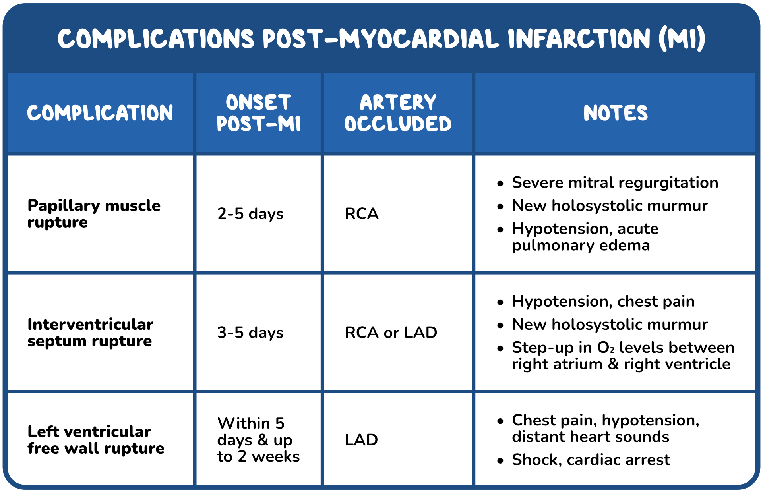
STEMI -COMPLICATIONS
Heart failure: Killip
Pericarditis
Notes:
Killip I – no crackles and no third heart sound
• Killip II – crackles in <50% of the lung fields or a third heart sound
• Killip III – crackles in >50% of the lung fields
• Killip IV – cardiogenic shock.

Slide 25
STEMI – CARDIAC ARRHYTHMIAS
Ventricular tachycardia
Ventricular fibrillation
( C death )
Cardiac arrest
Atrial fibrillation
Conduction defect - common with INFERIOR MI as Rt CA supplies SA & AV nodes
Notes:
V fib is more dangerous than v tach

Slide 26
Post ACS Life-style modification
Diet- Omega- 3 fatty acid from fish
Daily walk 20- 30 min daily
Stop smoking
Maintain alcohol consumption in safe limits 21 units/ week
If over-weight – reduce weight
Control Hypertension less than 140/90 mmHg , DM: 130/ 90 mmHg
Maintain Hb A1c less than 7% in Diabetic patient

Slide 27
NSTEMI & UNSTABLE ANGINA
Investigations and Treatment
High risk patient who are likely to progress to MI require urgent coronary angiography in less than 72 Hours
Who are high risk patient ?

Slide 28

NSTEMI & UNSTABLE ANGINA (Cont)
Patient having high risk score , these are those patient having
Increased Troponin
Dynamic ST or T wave changes
Previous MI
PCI within last 6 months
Previous CABG

Slide 29
Medical Treatment Unstable Angina &NSTEMI
O2
Morphine and anti emetic
Aspirin
Clopidrogrel (Plavix )- anti platelet agent OR : Dual AP therapy with Aspirin & Prasugrel or ticagrelor
Enoxaprin- low molecular heparin
Beta blocker
(Bisoprolol)
ACE-Inhibitors
Nitrates
Statins

Slide 30
Case Scenario
A 55-year-old man presented with severe, substernal chest pain. The pain started 3 hours ago with the sensation of pressure in his chest, and it has been increasing in severity.
He had a few similar episodes in the past couple of days, but the pain resolved on its own. The patient’s temperature is 37.0°C , blood pressure is 80/40 mmHg, pulse is 60/minute, and respirations are 25/minute.
The patient appears in distress and diaphoretic. Physical examination is otherwise unremarkable. An intravenous line is obtained, and normal saline is administered. Which of the following is the most appropriate next step in the management of this patient?
Obtain an echocardiogram
Obtain an emergent chest x-ray
Obtain a 12-lead ECG
Immediate admission of the patient for catheterization
Immediate administration of fibrinolytic agent

Slide 31
ST Elevation MI ( STEMI )
Leads Showing ST Elevation | Infarct Site
V2 – V5 | Anterior
V1 – V3 | Anteroseptal
V4 – V6, I, aVL | Anterolateral
I, aVL | Lateral
II, III, aVF | Inferior
V1, V2(Reciprocal) | Posterior
ECG changes in myocardial infarction (STEMI)

Slide 32
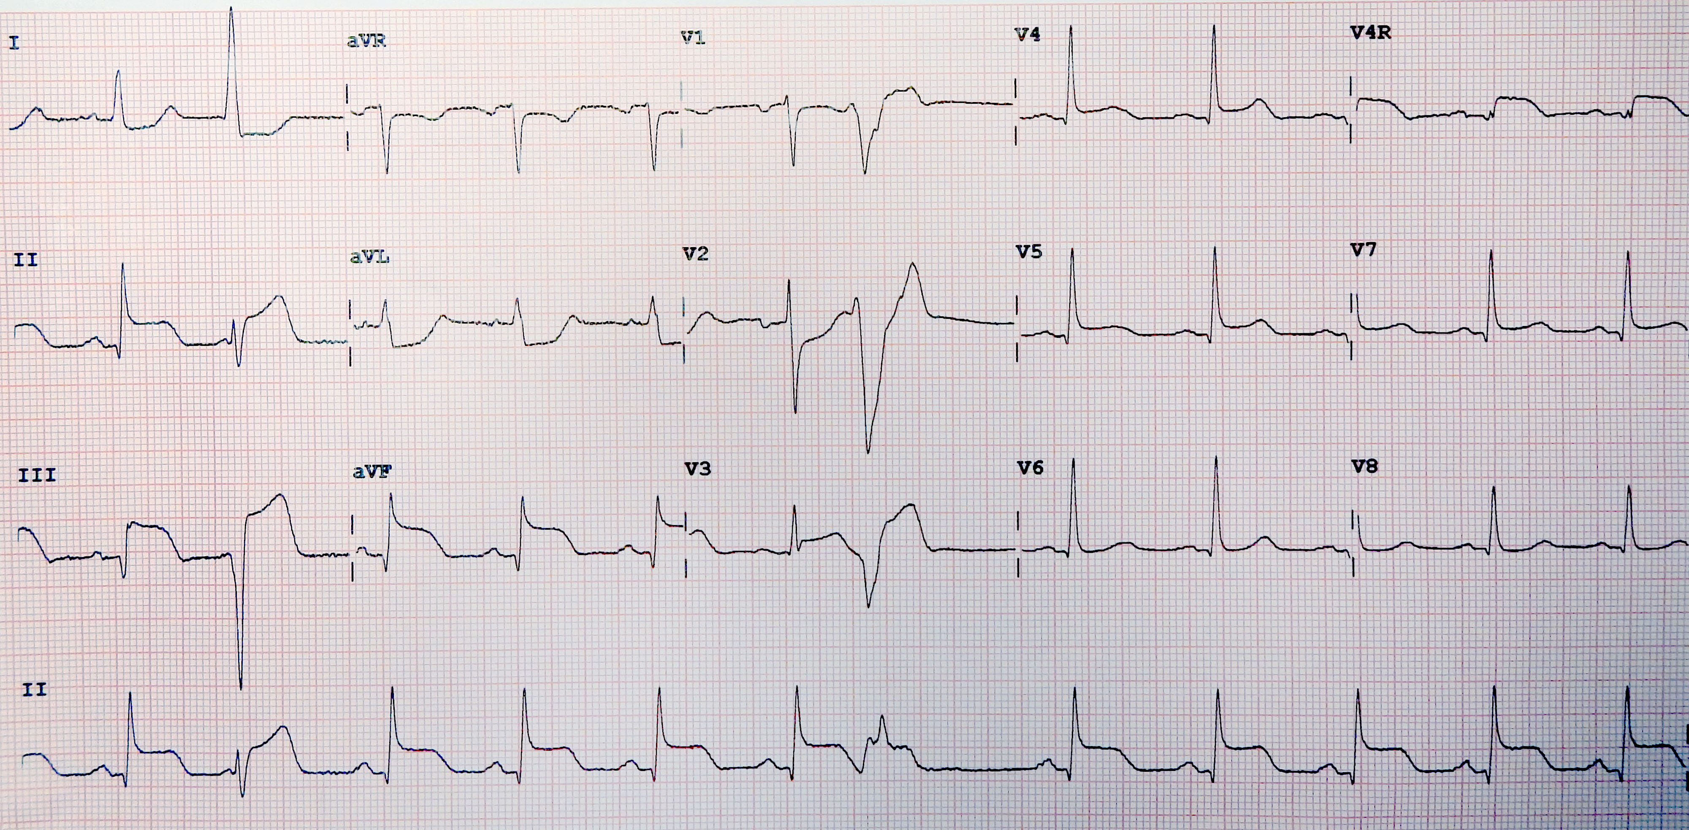
Case scenario
A 71-year-old diabetic woman presented with severe central chest pain for 30 minutes this morning. She says the pain was cramping in nature and radiated down her left arm.
Her temperature is 36.8°C (98°F), pulse is 97/min, respirations are 18/min, and blood pressure is 163/91 mm Hg. Cardiovascular examination shows no abnormalities. ECG is obtained and is shown below.
Which of the following biochemical measures would most likely be elevated and remain elevated for a week after this acute event?
Creatinine kinase-MB
Alanine aminotransferase
Lactate dehydrogenase (LDH)
Aspartate transaminase
Troponin I

Slide 33
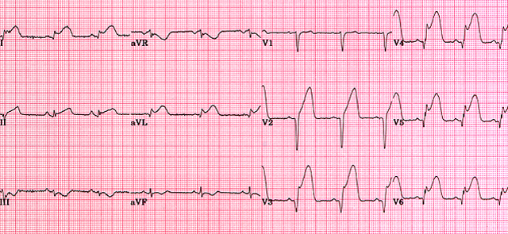
ST ELEVATION MI
COMMENT ON ECG
ST elevation in
lead 1 ,aVL, V2, V3 , v4,v5, v6
ANTERO-LATERAL MI
LAD

Slide 34
CASE HISTORY – A patient with hypertension and chest pain
A 50 year old smoker with hypertension develops central crushing chest pain radiating to his jaw. He has vomited and now feels short of breath. ECG was done which is shown.

Slide 35
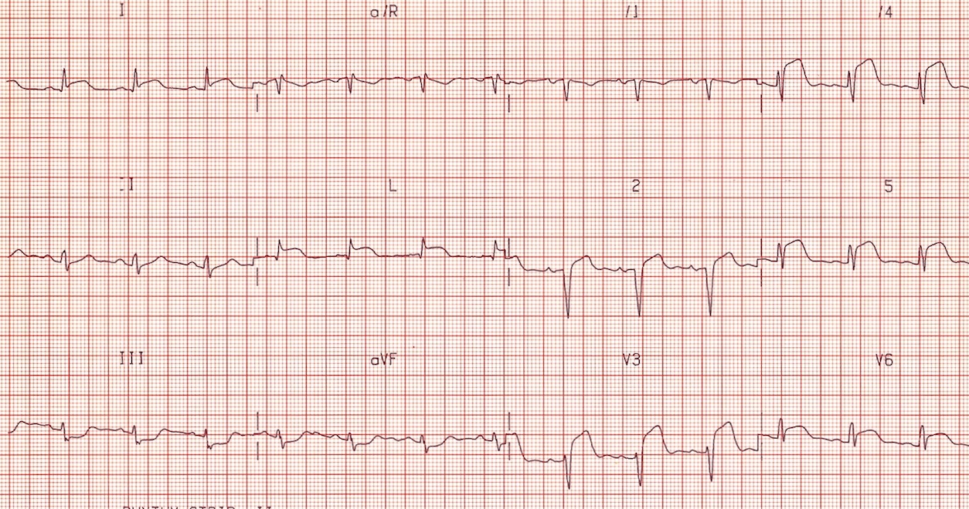

Slide 36
Questions:
What is the diagnosis?
a. Posterior MI
b. Inferior MI
c. Antrolateral MI
d. Pericarditis
Patient is given Morphine, anti-emetic and aspirin. He is taken immediately to the cardiac cath lab, where he undergoes coronary angiography and stenting to one of the vessels. Which coronary artery is stented?
a. Right
b. Circumflex
c. Diagonal
d. Left anterior descending (LAD)

Slide 37

Clinical scenario 3
A 75-year-old man presented with a 2hour history of crushing central chest pain. He is known to be an ex-smoker, hypertensive and diabetic on medications. Physical examination was unremarkable. His ECG is shown
Acute inferior STEMI
What is his most- likely diagnosis?
What are his management options?

Slide 38

This Photo by Unknown Author is licensed under CC BY-SA
For all patients with STEMI
Adjunctive medical therapy
Continuous telemetry, serial ECG
Serum troponins every 4–6 hours
ICU level of care

Slide 39
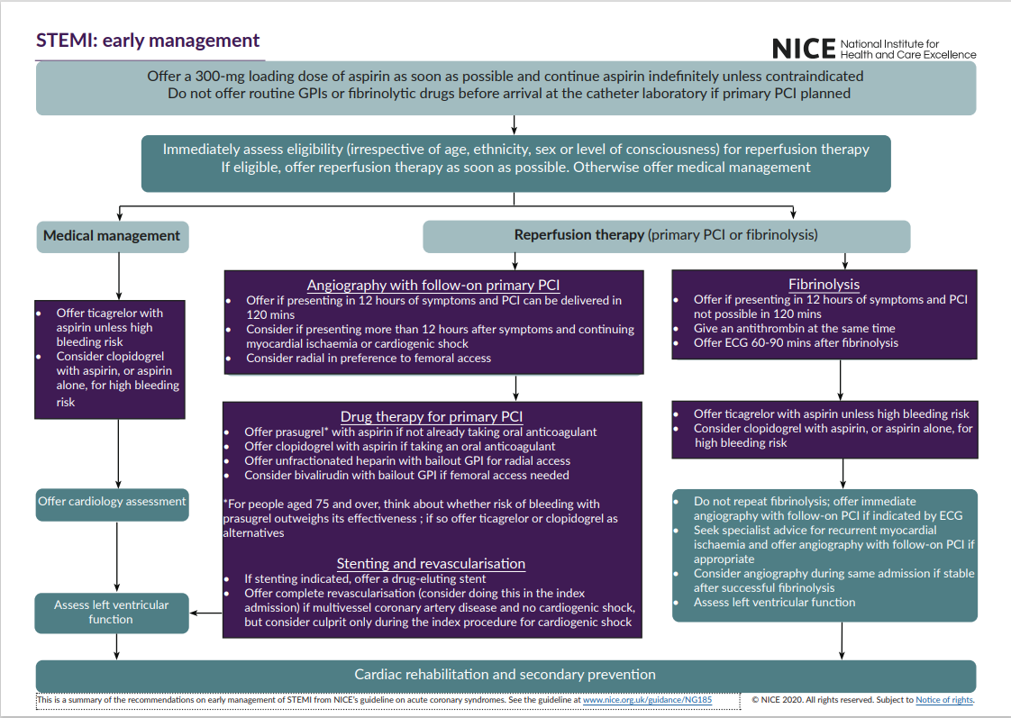
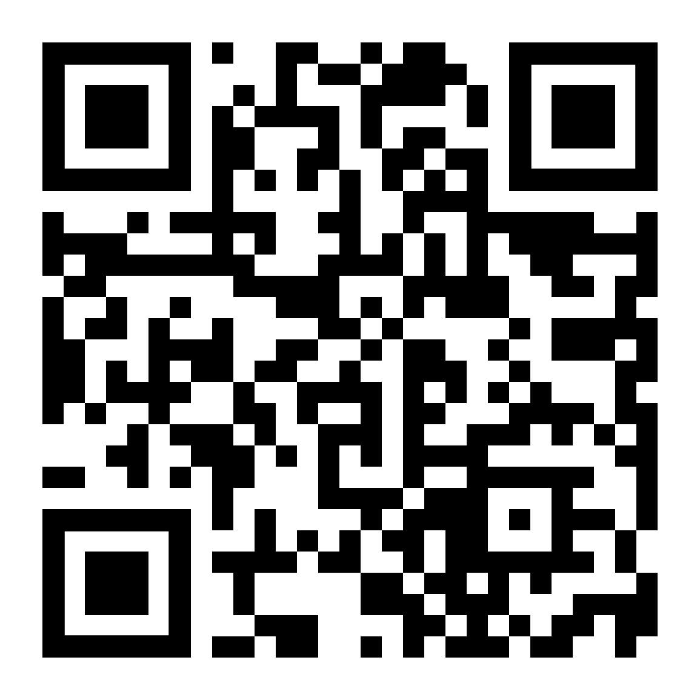

Slide 40

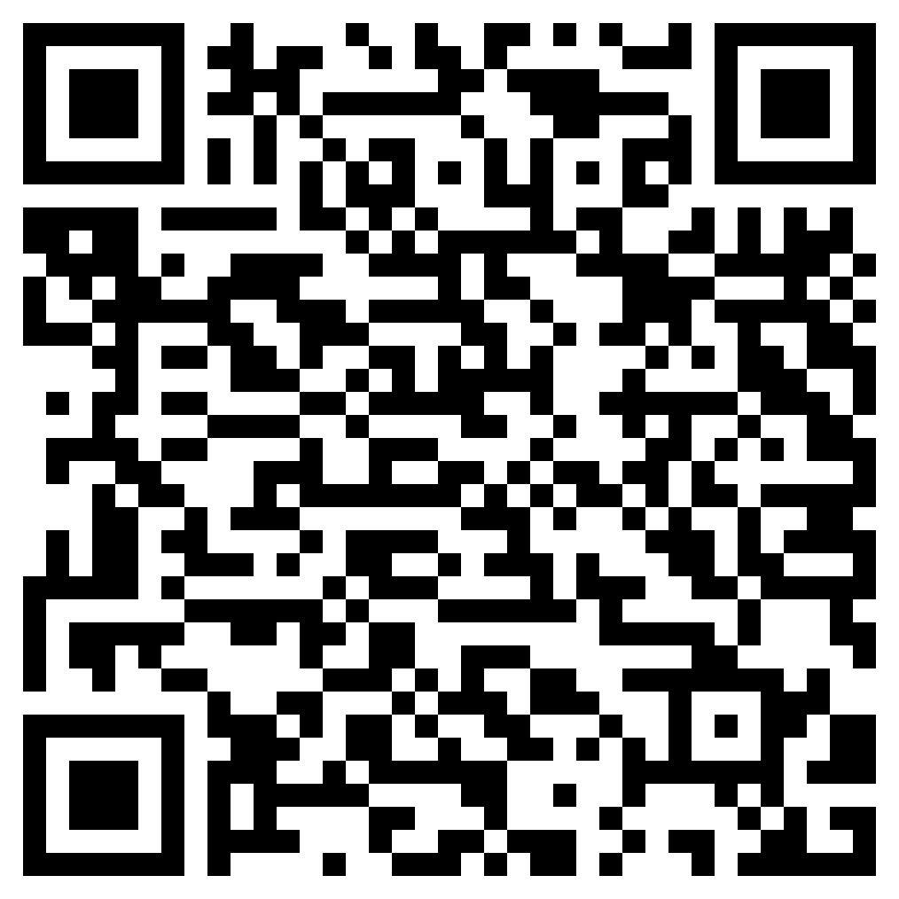
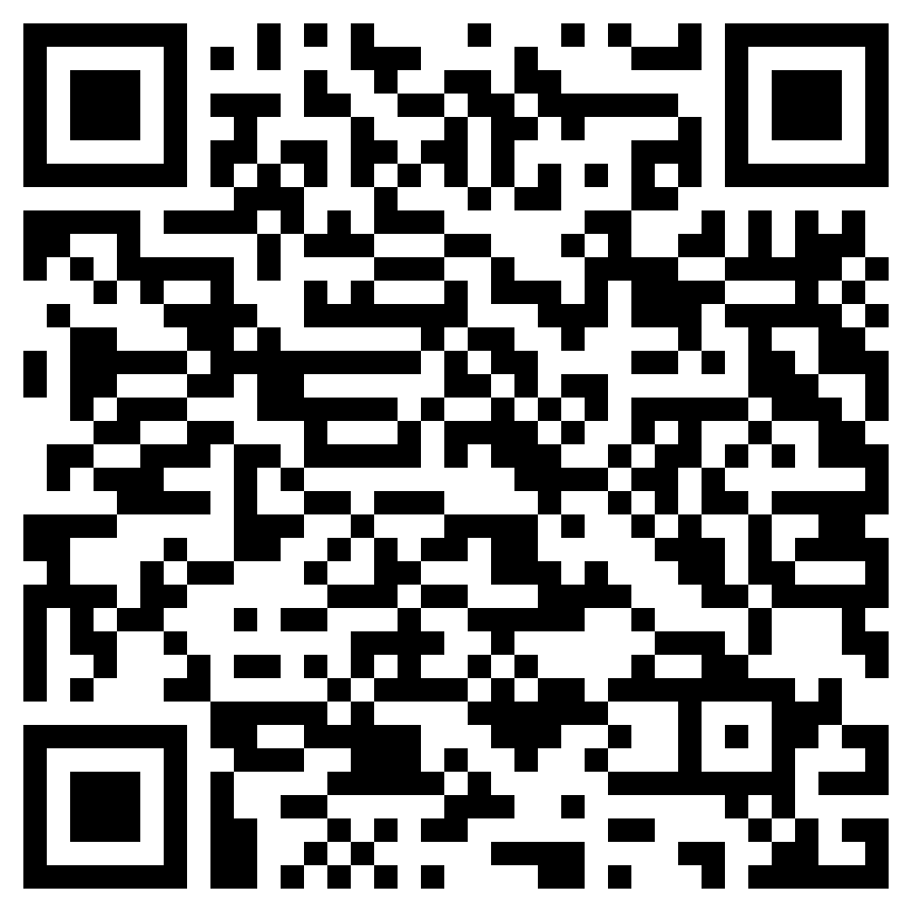

Thank you
References
Kumar & Clark P: 1079-1091

