Slide 1
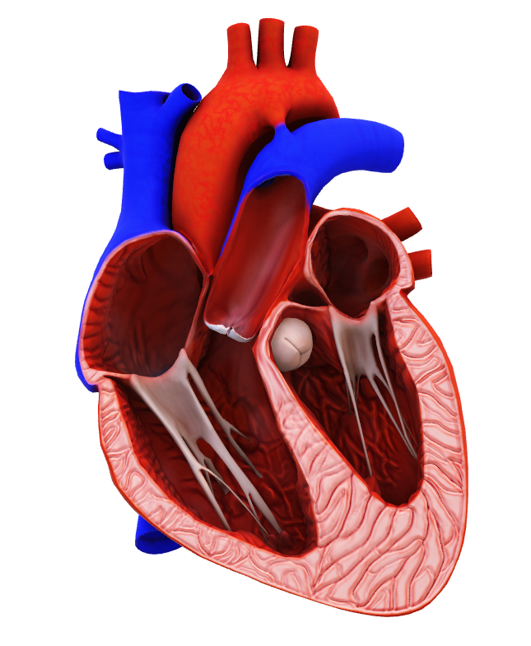
Valvular heart disease
Dr Nada Abdelrahman Associate professor of internal medicine

Slide 2
Learning outcomes
By the end of this session the student should be able to
Recognize the common etiologies of valvular stenosis and regurgitation.
Recognize the signs and symptoms of severe valvular stenosis and regurgitation.
Outline the management of different valvular lesions

Slide 3
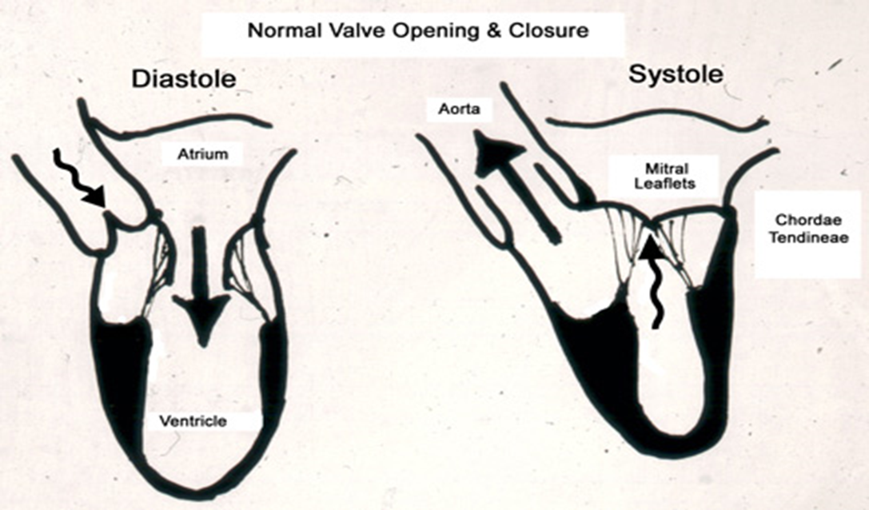
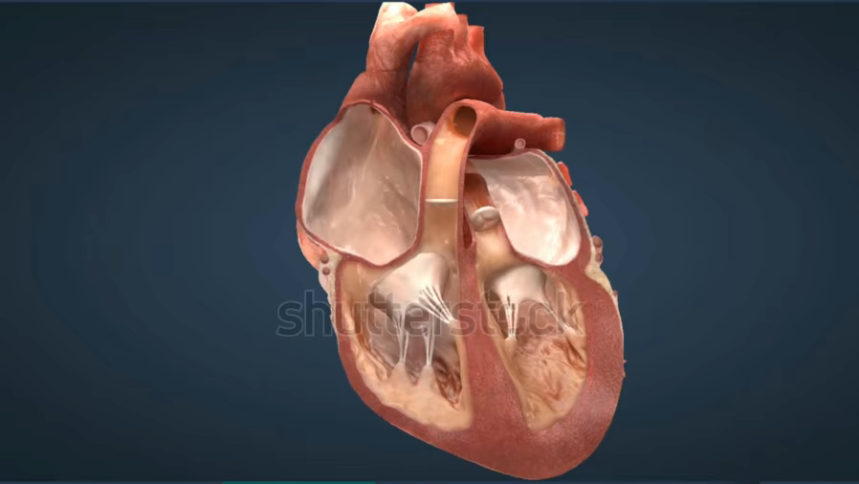
Basic concept
Systole AV/PV – opens
S1 MV/TV – closes
Diastole AV/PV – closes
S2 MV/TV – opens

Slide 4
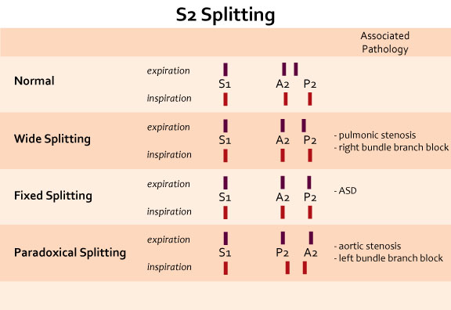
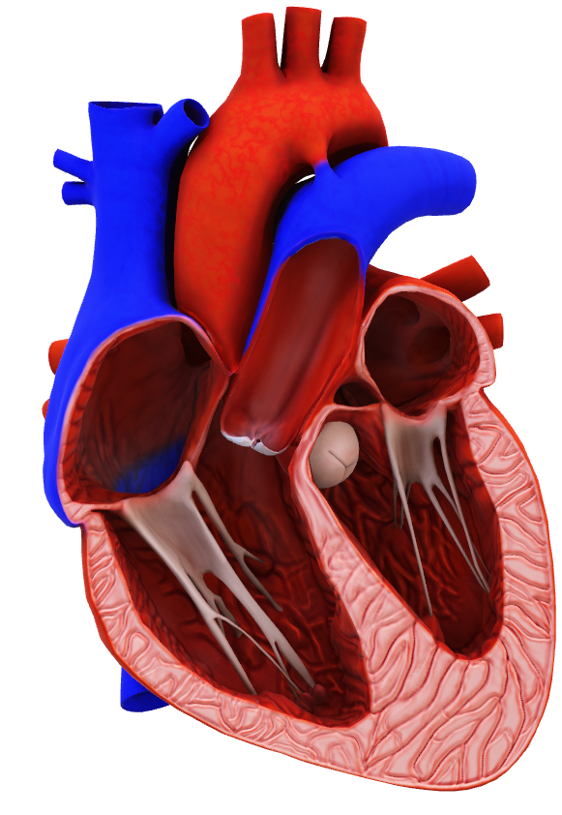
Normal heart sounds & S2 splitting
Basic concept

Slide 5
Basic concept
Regurg/ Insuff – leaking (backflow) of blood across a closed valve
Stenosis – Obstruction of (forward) flow across an opened valve
Systole AV/PV – opens-------Aortic Stenosis
S1-S2 MV/TV – closes------Mitral Regurg
Diastole AV/PV – closes------Aortic Regurg
S2-S1 MV/TV – opens-------Mitral Stenosis
These concepts are set in stone, it can’t occur any other way,
It would be anatomically impossible

Slide 6
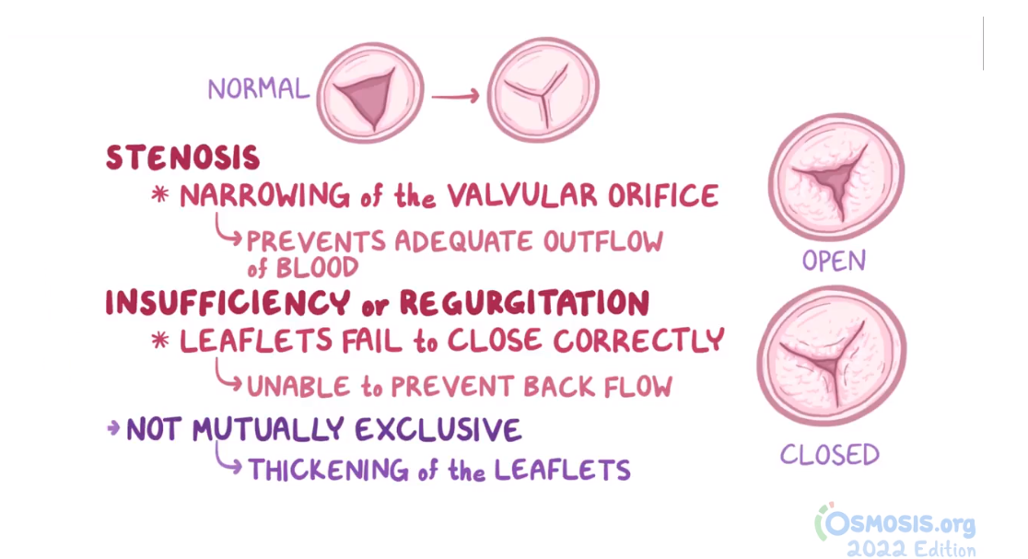
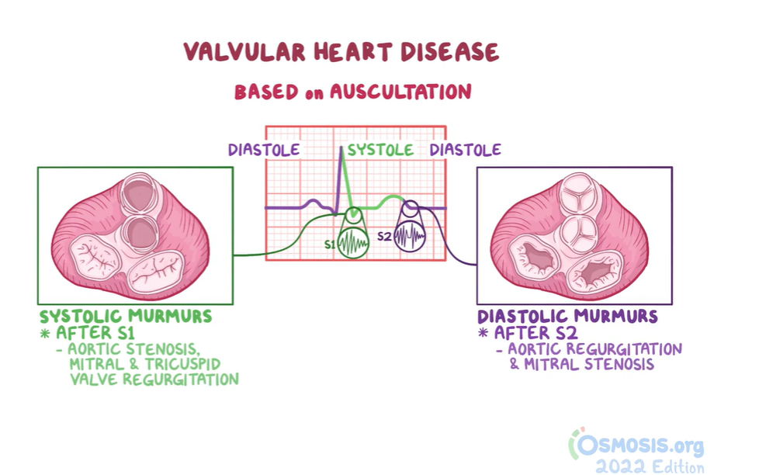
Basic concept

Slide 7
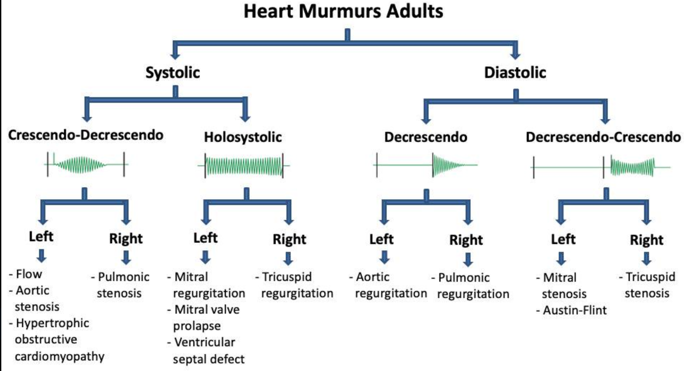



Slide 8
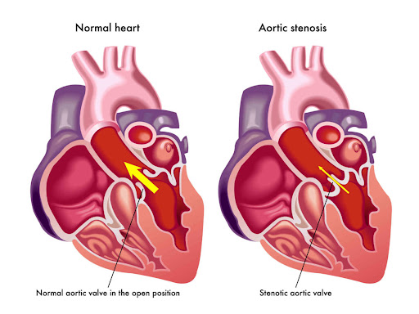
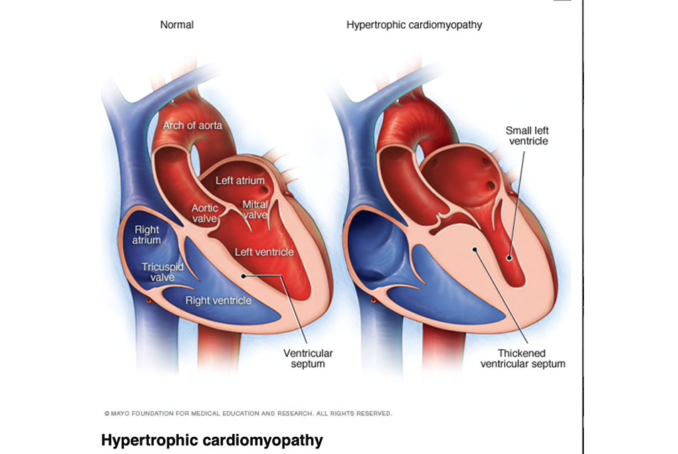
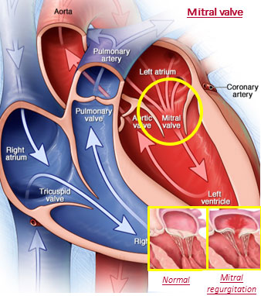
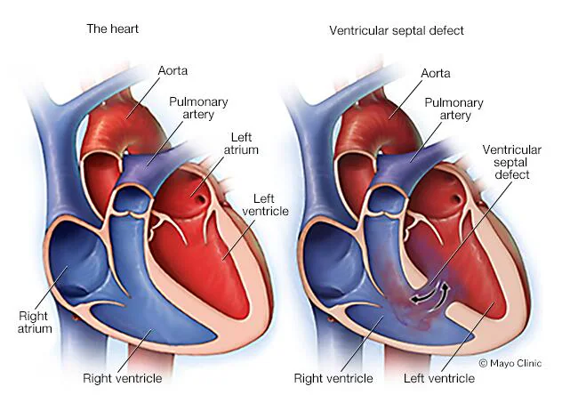

Slide 9
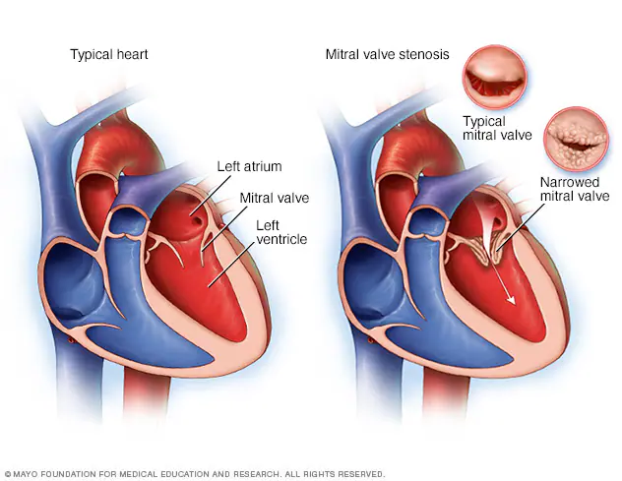
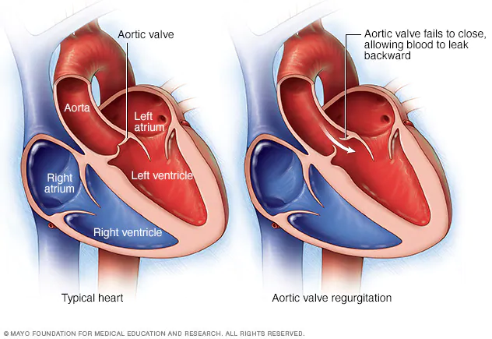

Slide 10
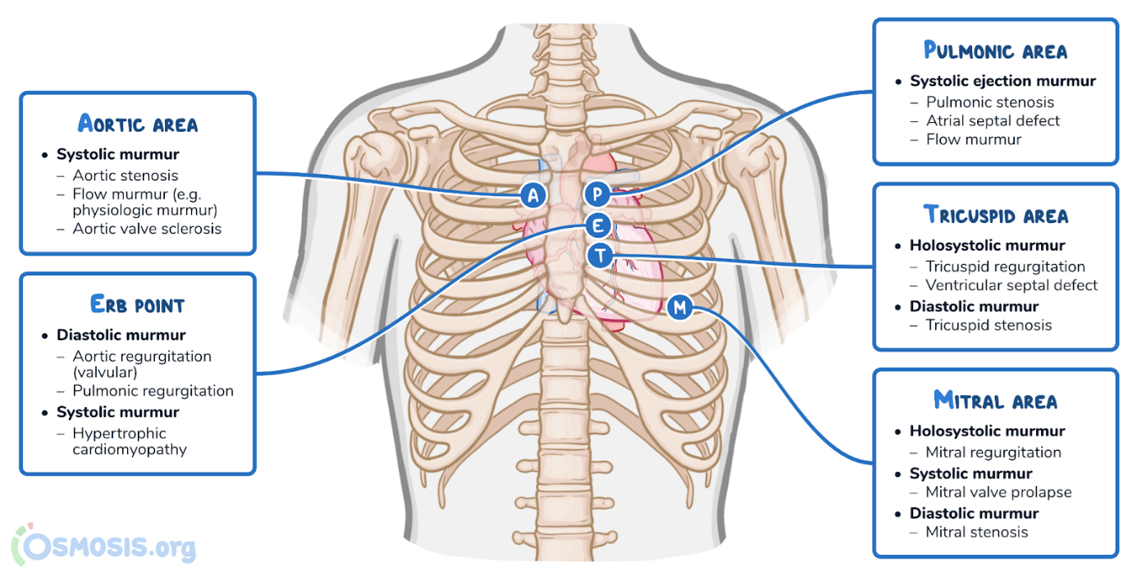

Slide 11
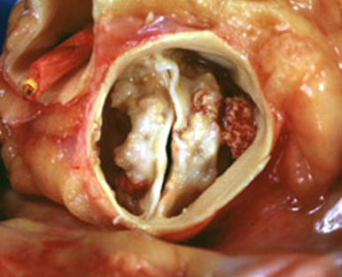
Aortic Stenosis

Slide 12
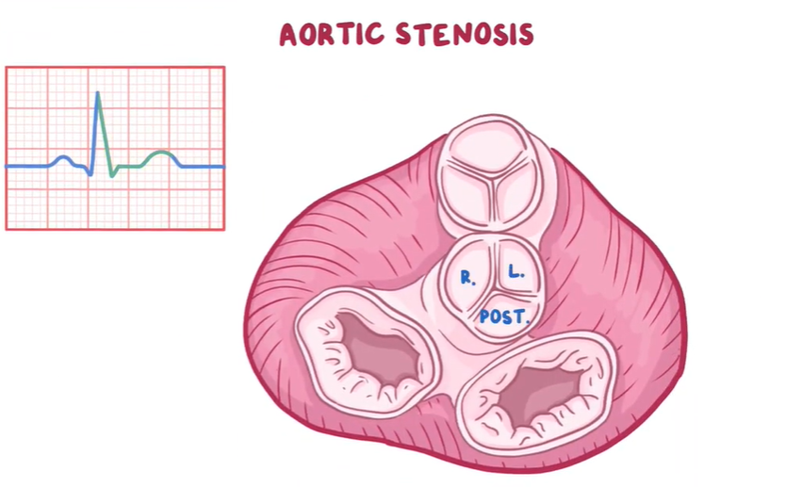
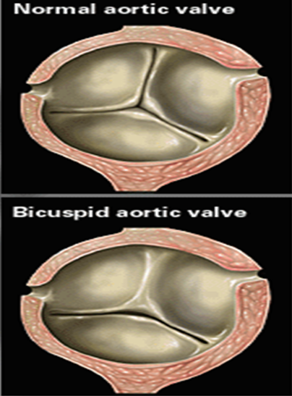

Normal Aortic valve
Three cusps, crescent-shaped
3 commissures
3 sinuses
supported by fibrous annulus
3.0 to 4.0 cm²
Symptoms: valve area: 1/4th of normal
Types:
Supravalvular: Williams Syndrome AD
Subvalvular
Valvular

Slide 13
Epidemiology
Most common VHD in industrialized countries
Frequently associated with AR
Prevalence: ↑ with age
Prognosis
Asymptomatic with normal LVEF: progression to symptoms or LV dysfunction at a rate of < 6% /yr
Asymptomatic pts with ↓ EF: progression to symptoms at a rate of > 25% per year
Unttt: die 2-3 years if no surgical intervention.

Slide 14

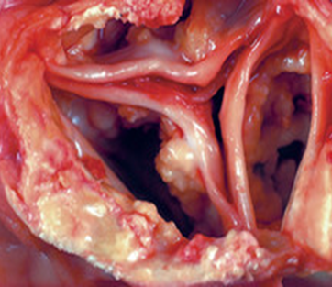
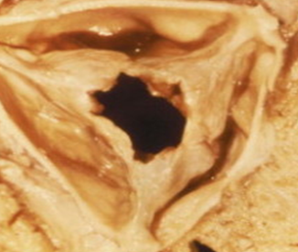
Aetiology
Aortic valve sclerosis: C st. Normal tips. ↑ with age ~ atherosclerosis
Bicuspid aortic valve (BAV): fusion leaflets in utero. C : males (3:1)
Dystrophic calcification and degeneration. Ass A coarctation, root dilation & A dissection.
Symptoms of AS: earlier than in regular aortic valve calcification.
Rheumatic fever
C in lower-income countries
Stenosis is caused by commissural fusion. 2nd turbulent flow, calcification of tips.

Slide 15
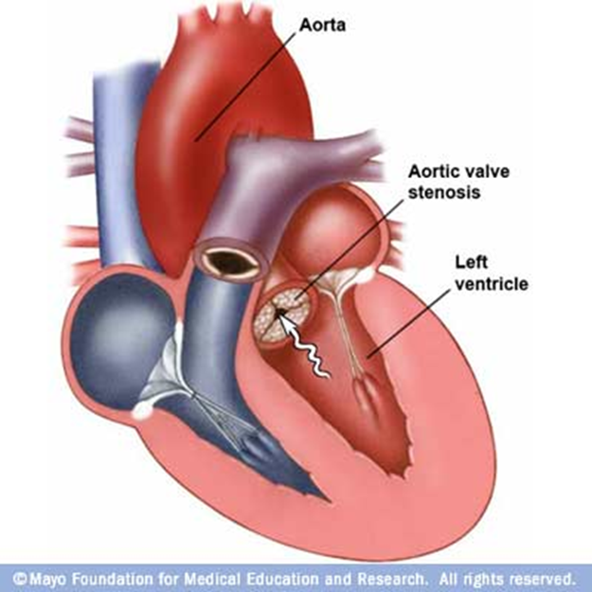

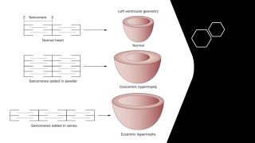
Pathophysiology
Progressive narrowing: ↓ flow across the valve. ↑ LV pressure LV hypertrophy (Stroke volume) and ↑ end-diastolic pressures and non-compliant LV.
Symptoms
Syncope: ↓ cerebral perfusion; triggered by cardiac arrhythmias or complete heart block.
Angina: high end-diastolic pressures reduce coronary artery perfusion
Dyspnoea: on exertion due to heart failure (systolic and diastolic)
This Photo by Unknown Author is licensed under CC BY-NC-ND
Notes:
Narrowed opening area of the aortic valve during systole → obstruction of blood flow from left ventricle (LV) → increased LV pressure → left ventricular concentric hypertrophy, which leads to: Increased LV oxygen demand
Impaired ventricular filling during diastole → left heart failure. Reduced coronary flow reserve Initially, cardiac output (CO) can be maintained , Later, the decreased distensibility of the left ventricle reduces cardiac output and may then cause backflow into the pulmonary veins and capillaries → higher afterload (pulmonic pressure) on the right heart → right heart failure

Slide 16
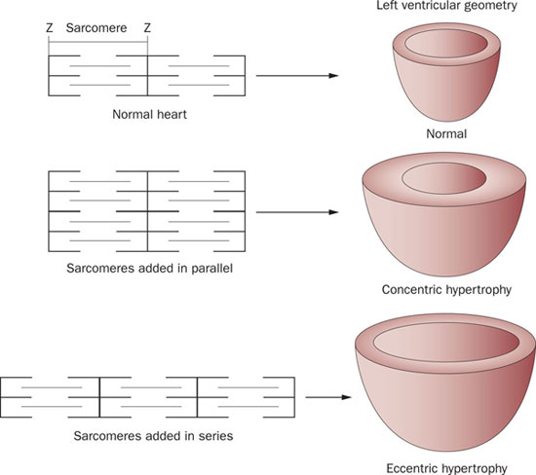

Slide 17
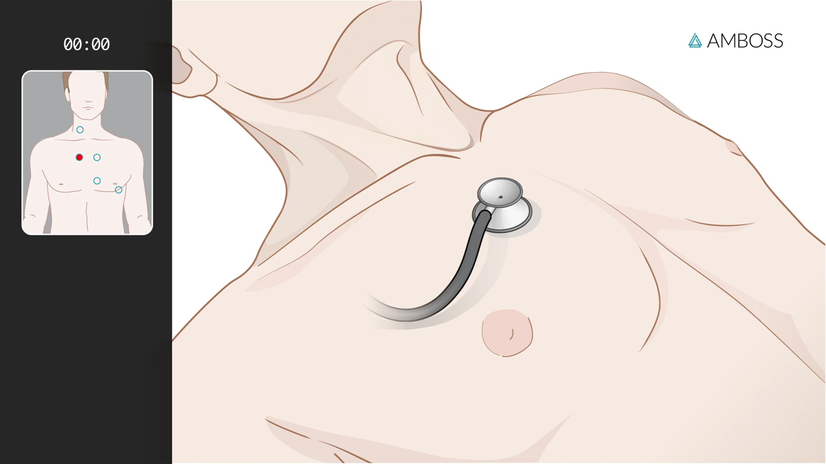

Clinical features
Examination findings
Weak & delayed distal pulse & decreased pulse amplitude
Narrow pulse pressure
Systolic thrill over the Aortic A
Apex: heaving
On auscultation:
S2: soft and reversed-split.
S4 gallop due to atrial contraction.
Crescendo–decrescendo ejection systolic murmur radiating to both carotids (best heard over the aortic area).
Triad of ‘SAD’ symptoms on exertion: Syncope, Angina, Dyspnoea
Sudden death
Loudness is not related to the severity

Slide 18
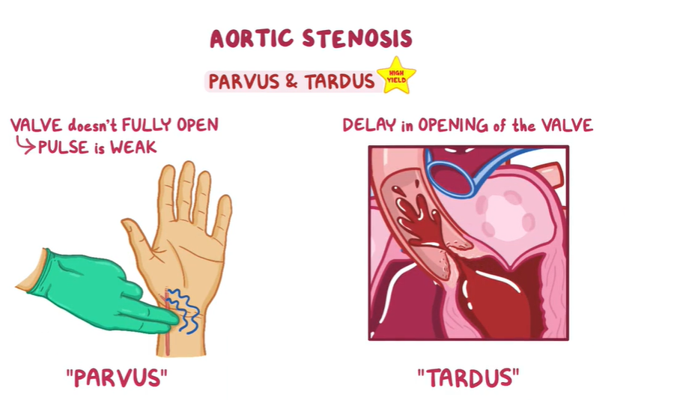

Slide 19

Investigations
First-line: non-invasive gold standard
Echocardiography and Doppler: a narrow AV is diagnostic; mean pressure gradient and jet velocity across the valve
ECG: left ventricular hypertrophy with strain pattern, left axis deviation.
CXR: Cardiomegaly, calcified aorta and aortic valve, and post—stenotic aortic dilatation
Calcification and narrowing of the AV
Increased mean aortic pressure gradient and transvalvular velocity
Signs of cardiac remodeling, e.g., concentric hypertrophy
Second-line
• Cardiac MRI: assess thoracic aorta: aneurysm, dissection or coarctation
• Cardiac catheterization:accurate , before surgery
Mild disease is a gradient < 30 mm Hg.
Moderate disease ;30–70 mm Hg,
severe disease > 70 mm Hg.

Slide 20
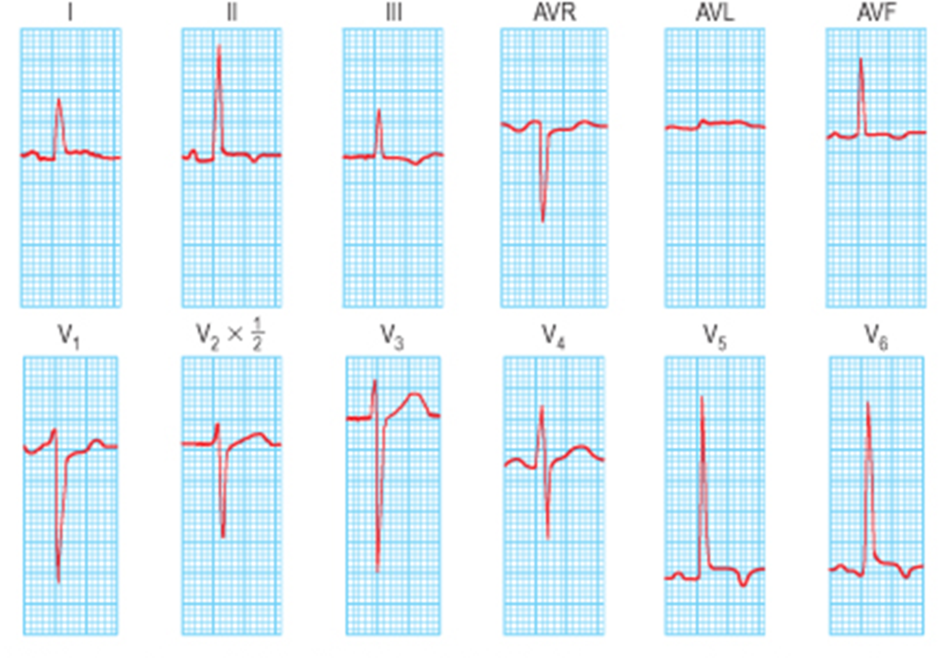

Slide 21
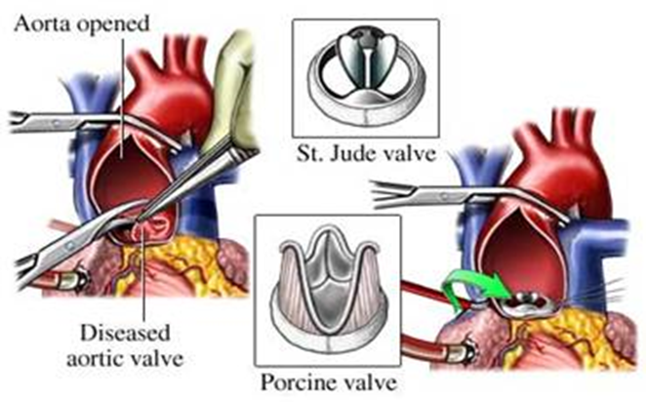
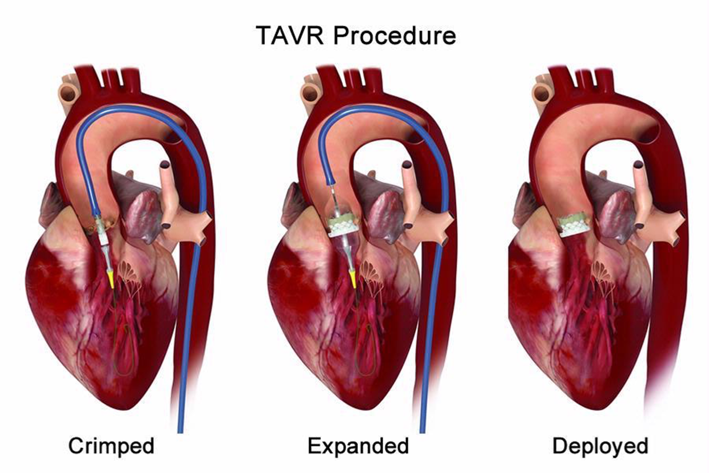

Slide 22
Symptoms are a good index of severity
Symptomatic
Asymptomatic
Surgical therapy
Aortic valve replacement (AVR): effective either with Bioprosthetic or Mechanical AVR
Two approaches:
Surgical AVR: low surgical risk.
Transcatheter AVR: high surgical risk or contraindication
Medical therapy (Treat symptoms)
Anticoagulants: AF or mechanical prosthesis
Vasodilators are relatively contraindicated in severe AS
Regular assessment
symptoms and echocardiography every 6–12 months to monitor
Surgical intervention :
Severe AS symptoms with LVEF of <50%.
undergoing cardiac surgery
Balloon valvuloplasty: children with no aortic valve calcification
Notes:
Aortic valve stenosis is a progressive condition and definitive management requires valve replacement.
Urgency of valve repair/replacement depends on staging.
Symptomatic and/or severe AS: aortic valve replacement usually indicated
Afterload reduction (e.g., with vasodilators or diuretics) in severe AS in severe AS may reduce cardiac output enough to compromise systemic and myocardial perfusion. Careful titration is recommended with specialist guidance
– peak velocity through the aortic valve >5.5 m/s
– Systolic pulmonary artery pressure >60 mmHg
– Rapid increase in velocity through the valve at >0.3 m/s/year
Hypertension: Follow standard hypertension guidelines; medication should be carefully titrated to avoid hypotension.
ACE-inhibitors may be beneficial in the prevention of cardiac remodeling.

Slide 23
A 75-year-old hypertensive man presented 20 minutes after he suddenly lost consciousness. He has had episodes of mild chest pain and abdominal discomfort for the past 2 months. Vitals signs: pulse 89/min BP110/88 mm Hg. Examination shows a grade 3/6 late systolic murmur at the right sternal border that radiates to the carotids. There is no swelling or erythema of the lower extremities. Neurologic examination shows no focal findings. Which of the following is the most likely cause of this patient's symptoms?
Rupture of the chordae tendineae
Fibrosis of the sinus node
Asymmetric septal hypertrophy
Calcification of the aortic valve
Embolus in the pulmonary artery

Slide 24
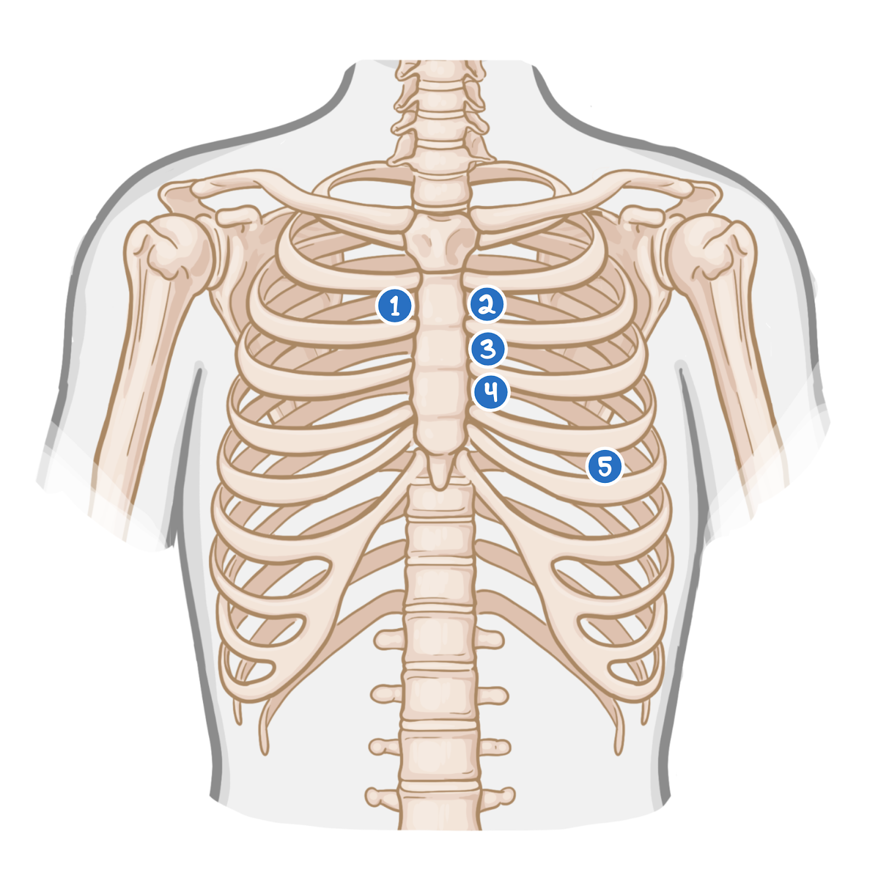
A 75-year-old man presented with an episode of syncope two days ago. The patient was working in his garden when he suddenly felt light-headed and lost consciousness for one minute. The patient endorses worsening shortness of breath and occasional chest pain during his usual morning walk for the past month. His temperature is 36.0°C (96.8°F), pulse is 75/min, and blood pressure is 138/87 mmHg. On physical examination, the lungs are clear to auscultation. Neurologic examination is normal. ECG; LVH. Cardiac auscultation will most likely reveal a murmur in which of the areas marked on the diagram below?
Area 1: Crescendo-decrescendo systolic murmur .
Area 4: Holosystolic murmur
Area 3: Systolic ejection murmur
Area 5: Opening snap followed by diastolic murmur
Area 2: Ejection murmur accompanied by a fixed split-second heart sound (S2)

Slide 25
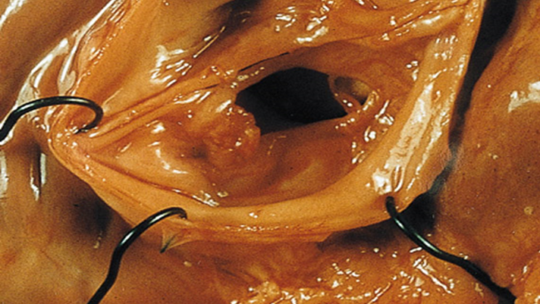
Aortic Regurgitation
Notes:
Aortic regurgitation results from an incompetent aortic valve causing a
regurgitant flow of blood in diastole.
• Usually presents 4th-6th decades of life.
• Affects males 3 times more commonly than women.
• Severe disease is seen in < 1% of the population.
• The most common causes are degenerative disease & congenital bicuspid valve.

Slide 26
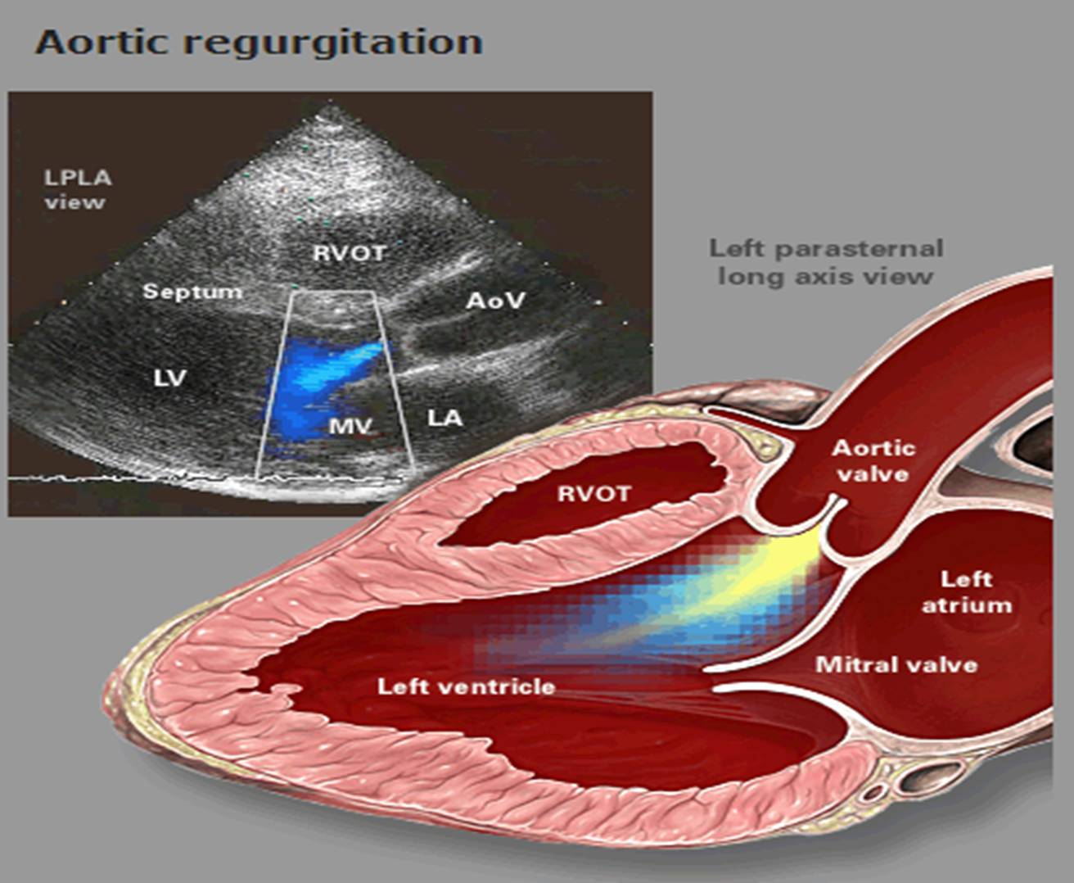
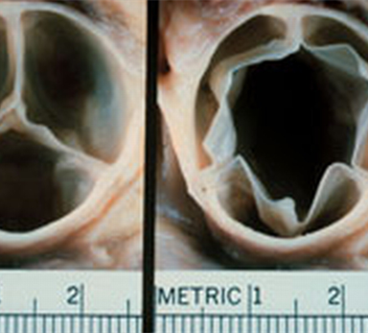
Aetiology of AR
Acute
Infective endocarditis
Acute rheumatic fever
Ascending aortic dissection
Failure of prosthetic valve
Chronic
Rheumatic Heart disease.
Bicuspid valve disease: commonest cause: young
Aortic dilatation
Connective tissue disease (Marfan’s syndrome, Ehlers–Danlos syndrome)
Vasculitis
Rheumatoid arthritis; Ankylosing spondylitis
SLE; Reactive arthritis
Late-stage syphilis (very rare)
Thoracic aortic aneurysm
Notes:
Aortic regurgitation results from an incompetent aortic valve causing a
regurgitant flow of blood in diastole.
• Usually presents 4th-6th decades of life.
• Affects males 3 times more commonly than women.
• Severe disease is seen in < 1% of the population.
• The most common causes are degenerative disease & congenital bicuspid
valve.–
–
Chronic aortic regurgitation [1][3]
Primary valvular defect
Calcific aortic valve disease: most common cause of AR in older patients in high-income countries
Aortic dilatation
Connective tissue disorders (e.g., Marfan syndrome, Ehlers-Danlos syndrome)
Chronic hypertension
Aortitis of any etiology (e.g., tertiary syphilis)
Thoracic aortic aneurysm

Slide 27
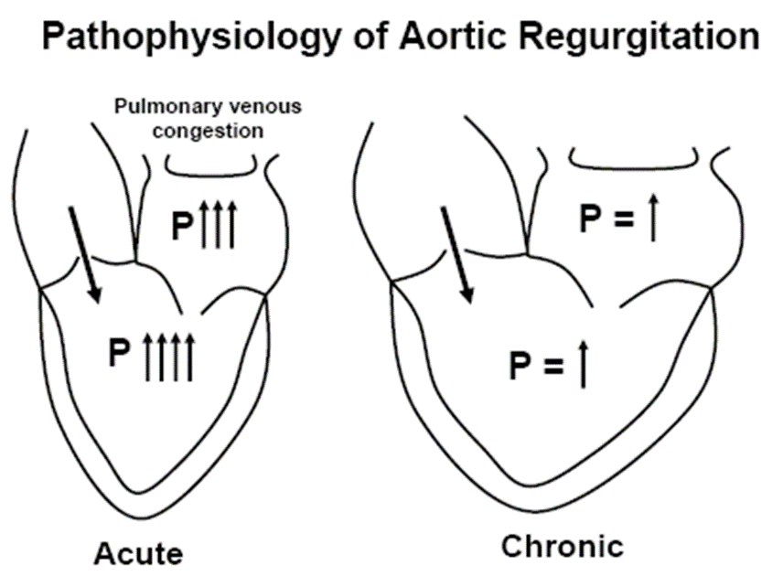
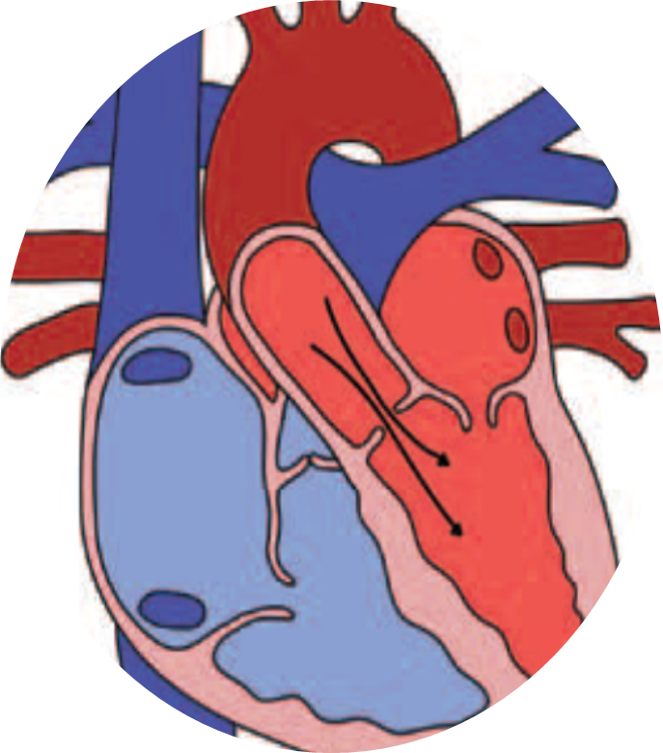

Pathophysiology
General
Regurgitation of blood from the aorta into the left ventricle (LV) leads to:
Water hammer pulse: Widened pulse pressure → ↑ systolic BP and ↓Diastolic BP (collapsing pulse) Seen in
hyperdynamic circulation
○ Stroke volume increased → (high Systolic BP)
○ Regurgitant volume increased → (Low Diastolic BP)
◆ Acute AR
LV end-diastolic pressure ↑ rapidly → pressure transmits backwards into pulmonary circulation → pulmonary oedema and dyspnea
↓ CO if severe → cardiogenic shock and myocardial ischemia
Chronic AR
Compensatory ↑ SV & adequate CO despite regurgitation (compensated HF)
↑LVED volume → LV enlargement and eccentric hypertrophy → left ventricular systolic dysfunction → decompensated heart failure
Notes:
Blood flows back into the left ventricle from the aorta, meaning that the left ventricle has to overcome the increased volume in its subsequent contraction.
A sharp increase in end diastolic volume with a relatively non-compliant left ventricle causes an increase in heart rate and contractility to counteract the increasing preload.
In acute aortic regurgitation, the left ventricle is of normal size and unable to compensate, leading to shortness of breath and pulmonary oedema due to backward transmission of pressure through the pulmonary system.
In chronic aortic regurgitation, there is compensation and ventricular remodelling which leads to improved compliance.
This eventually fails to provide adequate cardiac output, and heart failure symptoms ensue.

Slide 28
Clinical features
Acute aortic regurgitation
Signs and symptoms
Sudden, severe SOB
Rapid cardiac decompensation 2nd to LVF,
Symptoms underlying disease (fever, chest pain))
Auscultation
Soft and short early diastolic murmur
Collapsing (water hammer) pulse
Wide pulse pressure: most accurate
Diastolic murmur
Florid pulmonary edema

Slide 29




Slide 30


Slide 31

Physical Findings:
Auscultation
S3
High-pitched, blowing, decrescendo early diastolic murmur; best left 3-4 ICS At the border (Erb point)
AR (aortic root disease): best along RT sternal border
Worsens with squatting and handgrip SDL
Austin Flint murmur
Rumbling, low-pitched, mid-diastolic at the apex: premature closure of the mitral leaflets
In more severe stages: harsh, crescendo-decrescendo mid-systolic murmur that resembles the ejection murmur heard.
Chronic aortic regurgitation
Signs and symptoms
Asymptomatic with progressive LV dilation
Palpitations
Symptoms of LVF
Eponymous signs are associated with AR (these relate to high stroke volume associated with this condition):
Water hammer pulse: rapid upstroke and downstroke
• Corrigan’s sign: carotid pulsation
• de Musset’s: head nodding with each heartbeat
• Quincke’s: capillary pulsation in nail beds
• Duroziez’s: diastolic femoral murmur
• Traube’s: ‘pistol shot’ sound auscultated over femoral Art
Müller’s - systolic pulsation of uvula
Notes:
due to regurgitant blood striking the anterior leaflet of the mitral valve, which leads to

Slide 32
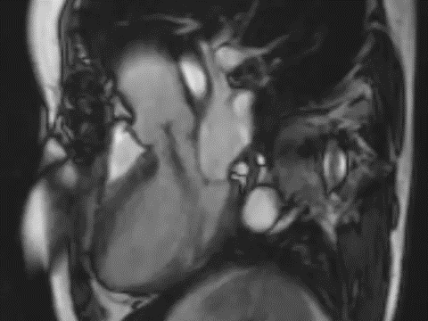

Slide 33
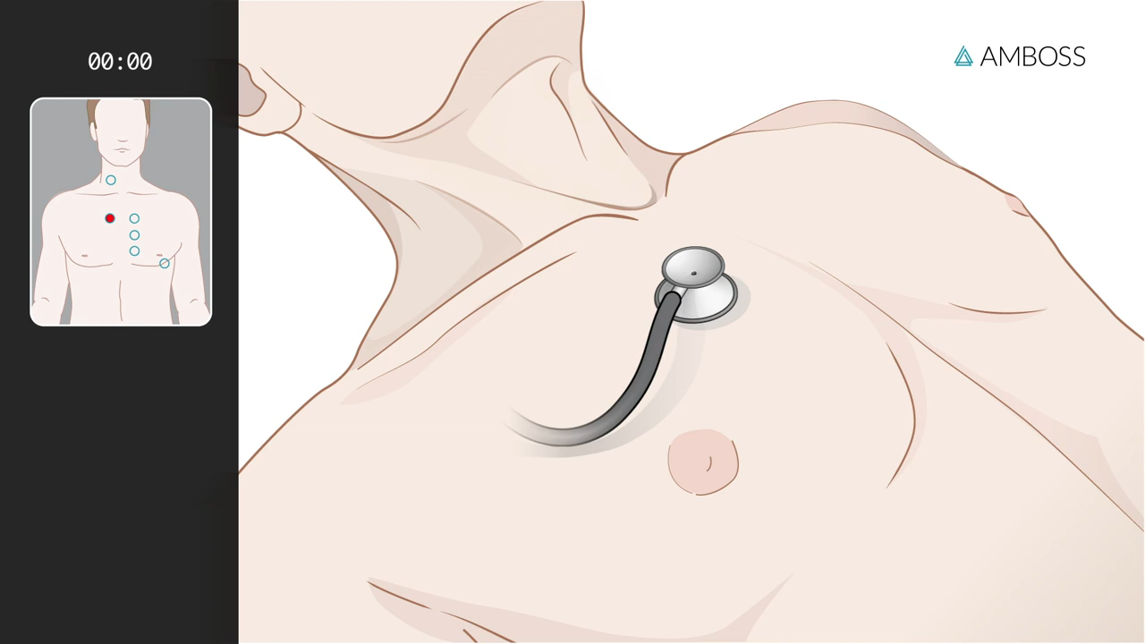
Physical Exam findings of AR
Wide pulse pressure
Hyperdynamic and displaced apical impulse
Auscultation-
Diastolic blowing murmur at the left sternal border
Austin flint murmur (apex)
Systolic ejection murmur: due to increased flow across the aortic valve

Slide 34


Slide 35
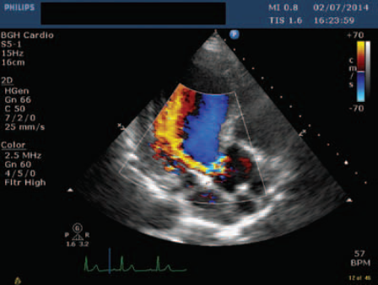
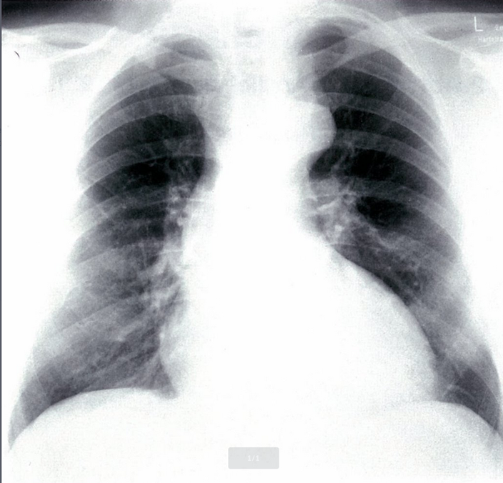
Investigations
(Regurgitant jet is diagnostic)
Echocardiography and Doppler (TTE): First-line diagnostic tool : assess the severity: LV dilatation.
CXR
Cardiomegaly: Dilating ascending aorta
Pulmonary oedema ( Acute AR) with normal cardiac size
ECG: LV hypertrophy
CTA Chest (or TEE): best diagnostic tool if aortic dissection
Cardiac MRI: Inadequate Echo (Evaluate Anatomy)
Cardiac catheterisation: Inadequate Echo (Evaluate hemodynamic)
Exercise stress testing: assess fitness
Other investigation: blood culture, BNP
Findings specific to acute AR
Reduced cardiac output
Elevated end-diastolic left ventricular pressure
Early mitral valve closing
Notes:
Imaging
A. Echocardiogram
• Allows visualisation of the origin of regurgitant jet and its width, detection of aortic valve
pathology and ventricular hypertrophy.
B. CXR
• May demonstrate cardiomegaly.
• Dilated ascending aorta.
• Calcification may be seen.
• Special
ü Cardiac MRI
ü Cardiac catheterisation
ü ECG exercise stress testing
Advanced imaging
Cardiac MRI [2][8]
Indication: moderate to severe AR (AR stage B–AR stage D) with inadequate echocardiographic imaging or a discrepancy between clinical presentation and echocardiographic findings
Objective: precise evaluation of anatomy and hemodynamics
CTA chest
Acute AR: indicated especially if aortic dissection is suspected
Chronic AR: not routinely recommended
Cardiac catheterization
Diagnostic hemodynamic cardiac catheterization with aortography
Indication: moderate to severe AR (AR stage B–AR stage D) with inadequate echocardiographic imaging or a discrepancy between clinical presentation and echocardiographic findings
Objective: hemodynamic evaluation (e.g., severity of regurgitation, intracardiac pressures, cardiac function)
Coronary angiography
Indications: preoperative cardiac risk stratification in patients with angina, reduced LVEF, signs of ischemia, or coronary risk factors
Findings: signs of CAD (e.g., coronary stenosis)
Exercise stress testing
Indication: may be used to provoke possible exertional symptoms or assess fitness in patients with severe AR
Findings: symptoms of aortic regurgitation (e.g., dyspnea, angina)

Slide 36
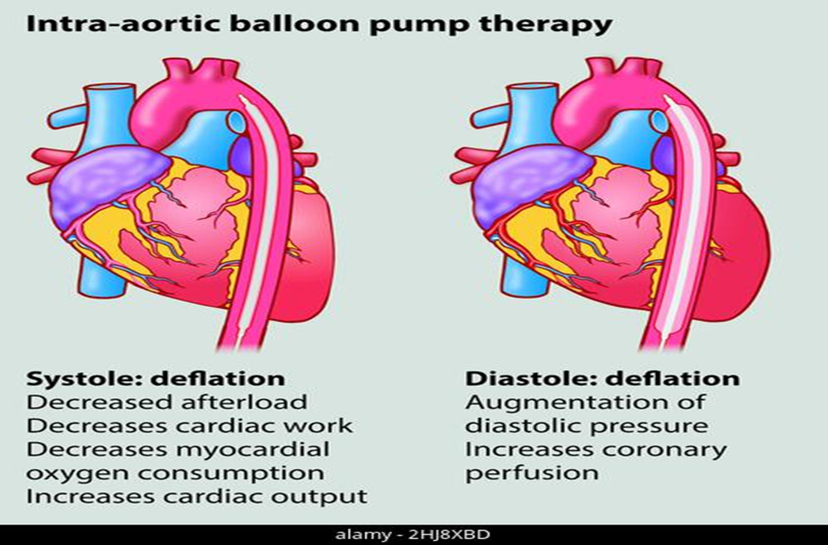
Management of AR
Chronic AR: (Usually asymptomatic)
Surgical therapy: Aortic valve replacement (AVR)
Symptomatic chronic severe AR
In asymptomatic with LVEF ≤ 50% (Serial Echo)
Advanced left ventricular dilatation
Severe AR undergoing cardiac surgery for other indications
Medical therapy:
● Treat HTN: Vasodilators ( ACE-I).
● ACE inhibitors/ARBs: severe symptomatic AR and/or LV dysfunction when surgery is C/I
● SBE (Subacute bacterial endocarditis) Prophylaxis
Acute AR : (Usually symptomatic)
Surgical therapy: immediate (AVR) is indicated
Medical therapy: Vasodilators and inotropes
Notes:
Predictors of prognosis include left ventricular size, systolic function and ejection fraction.
○ ○ Asymptomatic with LVEF >50% with a dilated LV (end-diastolic dimension >70mm or systolic dimension >50mm)
Symptomatic patients: mortality rate is > 10% per year.
Monitoring [5]
Serial echocardiography: Regular follow-up imaging is indicated for asymptomatic patients to identify possible progression and indications for intervention.
Mild regurgitation (AR stage B): every 3–5 years
Moderate regurgitation (AR stage B): every 1–2 years
AR stage C1 regurgitation: every 6–12 months
On-demand imaging is indicated for patients with any change in signs or symptoms.
Medical management [5]
Acute aortic regurgitation [3][15]
Medical management is focused on stabilizing hemodynamics prior to surgery, e.g., via:
Management of cardiogenic shock with inoconstrictors or inodilators (e.g., dobutamine or dopamine)
Afterload reduction with vasodilators for acute heart failure (e.g., nitroprusside)
Beta blockers may be indicated in aortic dissection; avoid in other causes of acute AR.
[5]
Avoid beta blockers in acute AR, unless due to aortic dissection. [5]
Chronic aortic regurgitation
All patients should be screened and treated for other cardiac risk factors. No medical treatments are known to influence the progression of the disease. [17]
Hypertension
Initiate treatment if systolic blood pressure is > 140 mm Hg and follow standard hypertension guidelines.
Vasodilators (e.g., ACE inhibitors, ARBs) may be preferable to beta blockers.
[17]
Heart failure: Manage according to guideline recommendations (see “Treatment of heart failure”).
Prophylactic antibiotics
At-risk patients, e.g., with prosthetic valves or a history of infective endocarditis: Consider antibiotic prophylaxis prior to certain dental procedures (see “Prophylaxis for endocarditis”). [6]
Rheumatic heart disease: long-term secondary prophylaxis (see “Prevention” in “Rheumatic fever” for details)
[18]
Surgical management ^{[5]}
The choice of procedure depends on the cause of the valve defect and comorbidities. All patients with severe aortic regurgitation being considered for intervention should be evaluated by members of a heart valve team if feasible.
Indications ^{[5][16]} Acute severe AR
Symptomatic chronic severe AR (AR stage D)
Asymptomatic chronic severe AR (AR stage C) with one of the following: Reduced LVEF ≤ 55% Consider if LVESD > 50 mm Cardiac surgery for other indications Surgical aortic valve replacement: Standard procedure for acute and chronic AR (see “Prosthetic heart valve” for details) ^{[3]} Alternative procedures ^{[2]} Valve-sparing repair of aortic sinuses and ascending aorta
: may be considered if AR is caused by aortic dilatation and the valve itself is unimpaired Primary valve repair: not routinely performed, but may be considered in isolated minor leaflet damage ^{[2]}
Transcatheter aortic valve replacement: not recommended for treatment of isolated AR
Follow-up Complications of aortic valve replacement include arrhythmias, endocarditis, and thromboembolism
Antithrombotic therapy for patients with prosthetic aortic valves depends on the choice of valve replacement (mechanical or bioprosthetic) and risk factors.
[5

Slide 37
A 62-year-old man presented with decreased exercise tolerance and progressive SOB. His pulse is 82/min, and BP: 155/53 mm Hg. Cardiac examination shows a high-pitched, decrescendo murmur immediately after S2 and is heard best along the left sternal border. There is an S3 gallop. Carotid pulses are strong. Which of the following is the most likely diagnosis?
Mitral valve stenosis
Mitral valve regurgitation
Aortic valve regurgitation
Aortic valve stenosis

Slide 38
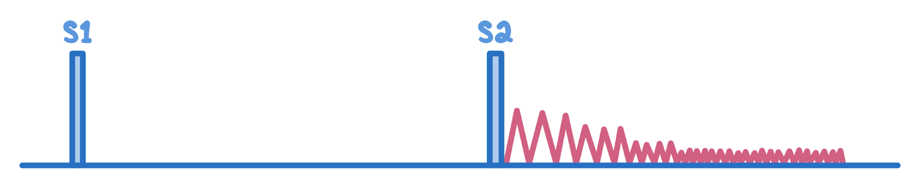
A 35-year-old man with Marfan syndrome presents with exertional dyspnea and pounding headaches for several months. His temperature is 37.0°C , pulse is 90/min, and blood pressure is 135/85 mmHg. On physical examination, the lungs are clear to auscultation. Cardiac auscultation reveals the murmur demonstrated below over the right sternal border. Palpation of the radial arteries shows a rapidly rising and falling arterial pulse. Which of the following is the most likely diagnosis?
Patent ductus arteriosus
Aortic regurgitation
Aortic stenosis
Coarctation of the aorta
Mitral stenosis

Slide 39
A 30-year-old woman presented with shortness of breath on exertion and occasional chest pain. does not use tobacco, alcohol, or illicit drugs. She immigrated from Peru two years ago with her family. Her temperature is 36.4°C ; pulse is 115/min, respirations are 24/min, and blood pressure is 130/60 mm Hg. Physical examination shows pulsations of the nail bed. Cardiac examination shows an abnormal heart sound over the left sternal border on auscultation (see image below). Which of the following maneuvers will likely decrease the intensity of this heart sound?
Sustained hand grip
Rapid squatting
Passive leg raising
Abrupt standing

Slide 40
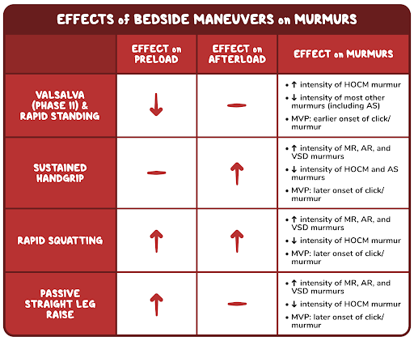
SDL

Slide 41
