Slide 1
DIALYSIS
BY
DR WAQAR
MBBS , MRCP
ASSISTANT PROFESSOR

Slide 2
NORMAL FUNCTIONS OF THE KIDNEY
To excrete toxic metabolites ( urea, creatinine, acids produced in the body)
To maintain serum electrolytes ( Na, K, Phosphorus, Cl, Mg. etc)
To maintain fluid balance
To regulate RBC synthesis ( erythropoeitin
production)
To make Vit D ( so, renal disease affects bone metabolism)

Slide 3
WHAT HAPPENS IN IN RENAL FAILURE?
Accumulation of urea, creatinine, K+, Mg, organic acids
Accumulation of fluid ( causes HTN and edema)
Impaired sysnthesis of RBC ( due to low erythropoeitin)
Bone disease ( non- activation of Vit.D)

Slide 4
First we try medical management for renal failure :
* Medicines ( eg for HTN, acidosis)
* Diet control ( eg low protein,low salt,
low K etc)
* Fluid control ( water intake)

Slide 5
When conservative /medical management fails, we go for :
RENAL REPLACEMENT THERAPY
DIALYSIS TRANSPLANT
( can be for ARF or CRF)

Slide 6
REMEMBER !
EVERY ONE WITH RENAL FAILURE DOES NOT NEED DIALYSIS !

Slide 7
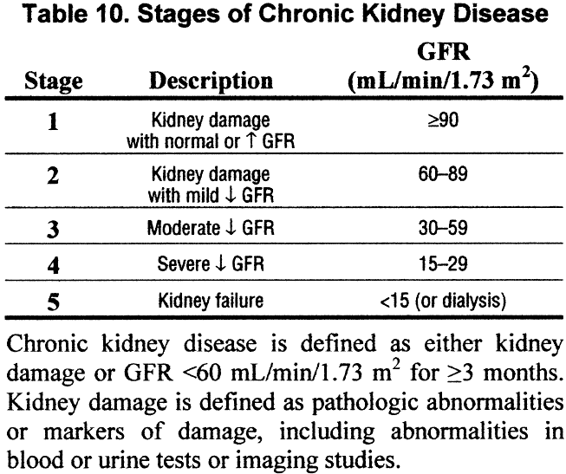
STAGES OF CRF

Slide 8
INDICATIONS FOR DIALYSIS
1) Pulmonary edema (not responding to diuretics)
2) Metabolic Acidosis( not controlled by HCO3 tab. )
3) Uremic encephalopathy ( siezures etc)
4) Neuropathy ( foot drop, wrist drop)
5) Very low GFR
* less than 10 ml/min
* in DM, less than 15 ml/min
6) Hyperkalemia ( more than 7 meq). ( do you remember other treatments of hyperkalemia? )

Slide 9
Indications contd.
7) Uremic pericarditis
8) Anemia refractory to erythropoeitin & Fe Rx
Some of the above may need urgent dialysis

Slide 10
Dialysis can be needed in , both, acute renal failure or chronic renal failure.
Dialysis is also done in many cases of drug overdose and poisonings ( to remove the drug) eg aspirin, methanol

Slide 11
TYPES OF DIALYSIS
HEMODIALYSIS
PERITONEAL DIALYSIS

Slide 12
HEMODIALYSIS
Most commonly used type of dialysis
Blood from the patient goes into the machine
“ dirty things” removed clean blood
returns to the body
The dialysis solution in the machine is called “dialysate”

Slide 13
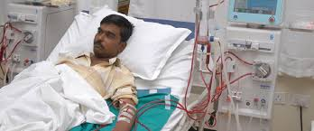

Slide 14
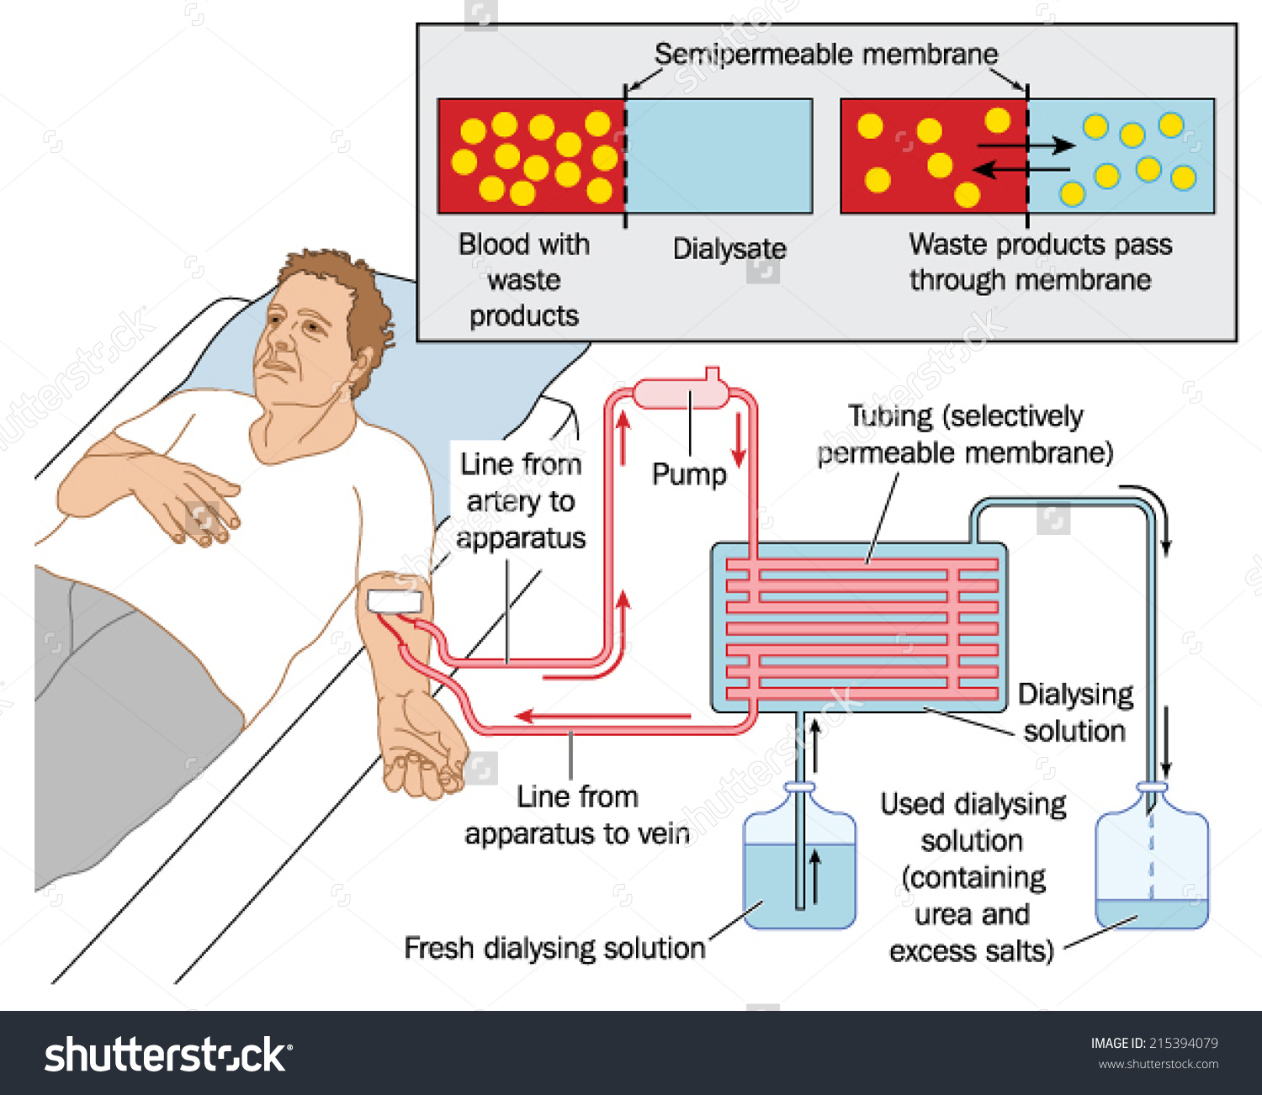
Hemodialysis:

Slide 15
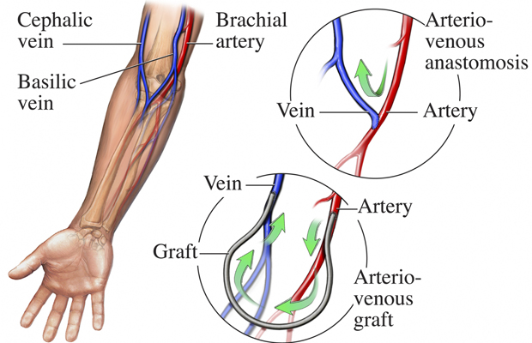
VASCULAR ACCESS FOR
HEMODIALYSIS

Slide 16
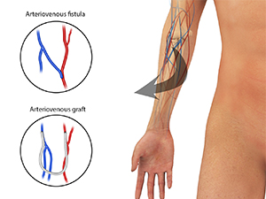

Slide 17
VASCULAR ACCESS FOR HEMODIALYSIS
FISTULA OR GRAFT
FISTULA IS PREFERRED( less chances of
infection & also longer lasting).
( remember : F F Fistula First) !
Fistula/Graft is always placed in the non-dominant arm.

Slide 18
Fistula or graft need some time to “mature” and so cannot be used immediately ( Fistula takes few months & graft takes few wks)
For immediate use central line
* Internal Jugular vein
* Subclavian vein
* Femoral vein

Slide 19
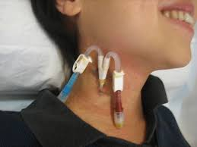

Slide 20
Hemodialysis is done in hosp. / dialysis centers
Usually done 3 times / wk
Each session is about 3-4 hrs.
Heparin is used as anticoagulant.

Slide 21
H.D.
ADVANTAGES
DISADVANTAGES
Efficient removal of waste
Needs special team and equipment
Needs heparinization
Can not be done if BP is low
Not possible in people with
poor veins

Slide 22
COMPLICATIONS of H.D.
1) Hypotension (during dialysis)
* due to too much fluid removal
* Rx : Give iv fluids, decrease the rate of
dialysis
2) Blockage of the fistula/graft ( thrombosis or
stenosis)
3) Infection of the graft, fistula or central line

Slide 23
COMPLICATIONS (contd)
4) Dialysis Disequilibrium syndrome
Occurs in the first few treatments when dialysis is started for the first time
Rapid removal of toxins and water causes osmolar shifts in the blood cerebral edema N/V, headache, siezures
So, in the beginning, start H.D. with shorter time duration ( may be 1-2 hrs each session).

Slide 24
COMPLICATIONS OF H.D.
5) Dialysis steal syndrome : Decreased blood flow to the palm & fingers, causing pain, pallor and may be necrosis of hand muscles

Slide 25
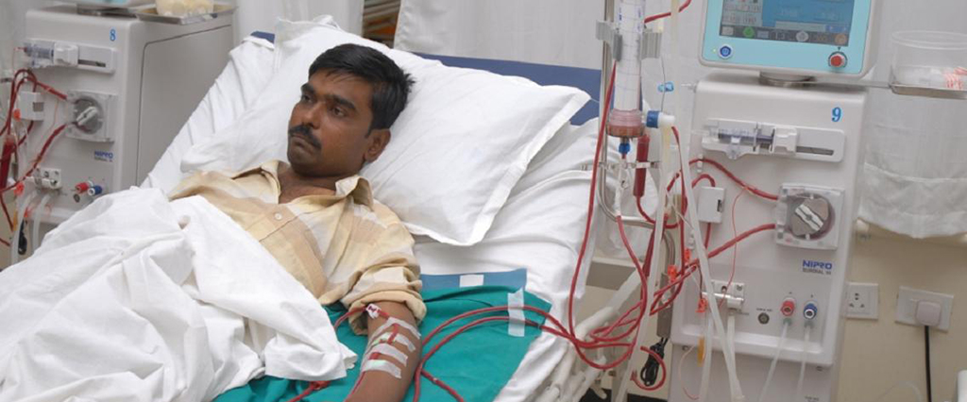

Slide 26
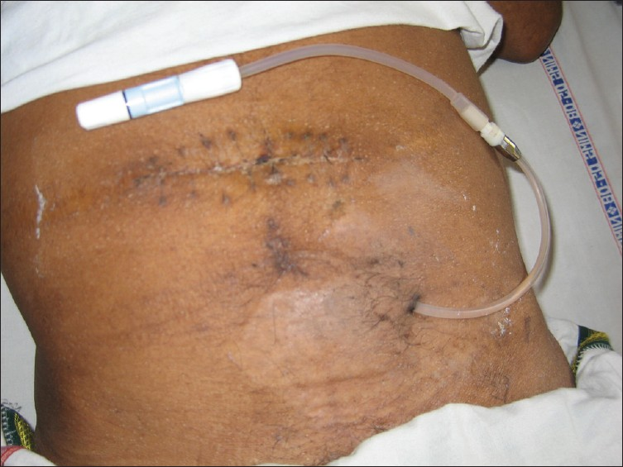
PERITONEAL DIALYSIS CATHETER

Slide 27
PERITONEAL DIALYSIS
In P.D., dialysate is put into the peritoneal cavity and left for few hrs.
Peritoneum acts like a semipermeable membrane.
Toxic wastes and water diffuse from the blood vessels of the peritoneum into the cavity.
The “dirty” dialysis fluid is then removed and new fluid is put. This is done 4-5 times daily ( by the patient at home)

Slide 28
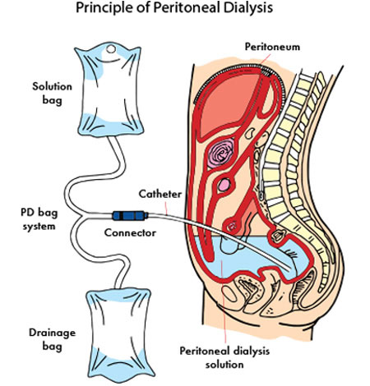

Slide 29
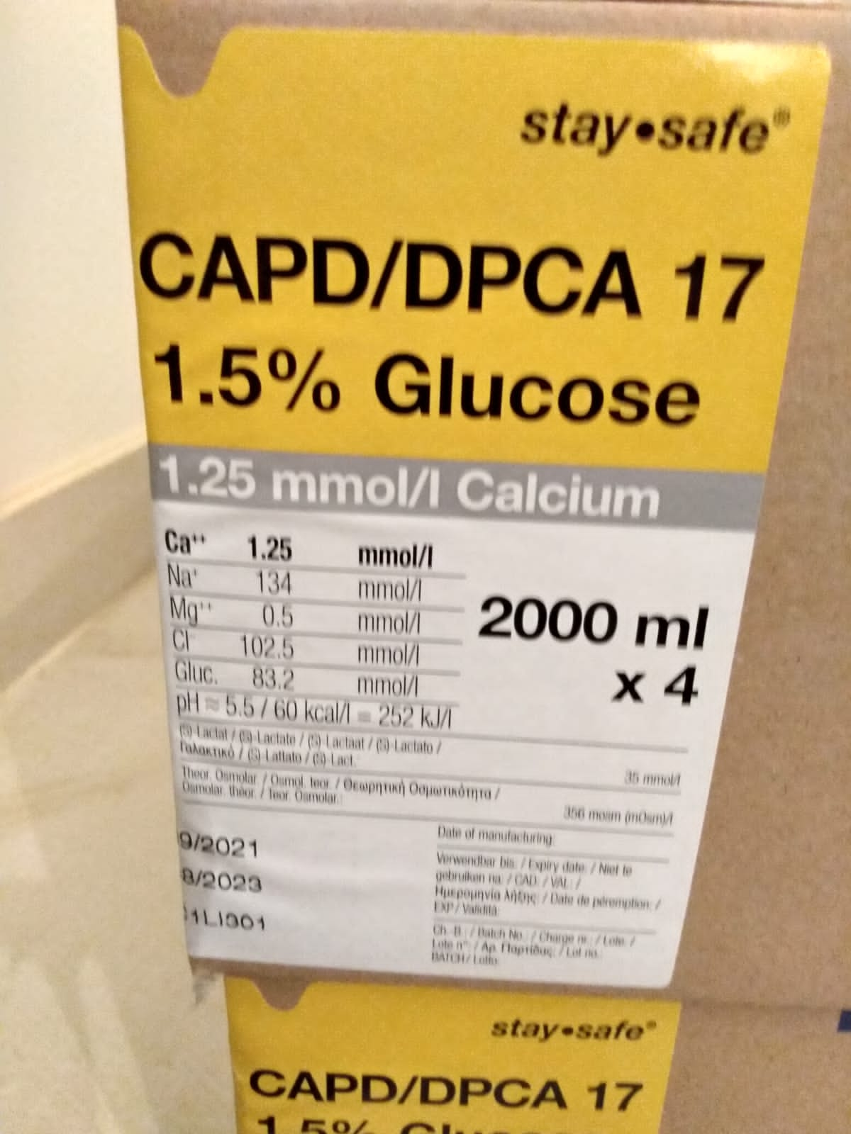
P.D. FLUID (dialysate)

Slide 30
IN PERITONEAL DIALYSIS, GLUCOSE IN THE DIALYSIS FLUID PULLS THE WATER OUT FROM THE BLOOD VESSELS BY OSMOSIS.

Slide 31
WHEN TO USE P.D. ?
Rarely used now.
Used in the following situations :
* In infants & very young children
* Poor blood vessels ( can’t make a fistula)
* Patient wants freedom

Slide 32
CONTRAINDICATION FOR
PERITONEAL DIALYSIS
1) Adhesions and fibrosis in the peritoneal cavity
( due to past surgeries)
2) Recent abdominal surgery

Slide 33
COMPLICATIONS OF
PERITONEAL DIALYSIS
Catheter site infection
Tube blocked / twisted
Peritonitis:
* Abdominal pain, tenderness, fever
* Give antibiotics

Slide 34
COMPLICATIONS contd.
4) Hyperglycemia : Dialysis fluid contains too
much glucose which is absorbed in the blood.
The hyperglycemia may need insulin.
5) Excess protein loss from the peritoneum (increase the protein intake to 1.2 g/kg/d in these patients)

Slide 35
P.D.
ADVANTAGES
DISADVANTAGES
SIMPLE
NO HEPARIN
Patient freedom
RISK OF PERITONITIS
EXPOSURE TO HIGH GLUCOSE ( SOMETIMES REQUIRING INSULIN)
Not very efficient

Slide 36
LONG TERM COMPLICATIONS
OF BOTH TYPES OF DIALYSIS
1) Cardiovascular disease ( due to accelarated atherosclerosis in coronaries).
It is the leading cause of death in these
patients
2) Amyloidosis ( Deposition of amyloid in various tissues).
3) Sepsis

Slide 37
RAPID FIRE QUES
Name some indications of dialysis?
At what GFR level you do dialysis?
Which dialysis is better and why?
Name the 2 types of vascular access for H.D.?
Which is better and why?
How to do dialysis urgently if no vascular access?
2 disadvantages of H.D.?

Slide 38
8) Name 5 complications of HD?
9) In the initial days of HD, which complication can occur?
10) How to avoid it?
11) Name 3 indications of peritoneal dialysis?
12) 4 complications of PD?
13) When is PD contraindicated?
14) PD is contraindicated in DM patients, right or wrong?

Slide 39
15) Long term complications of both types of dialysis?

Slide 40
LAST SLIDE IS VERY IMPORTANT

Slide 41


