Slide 1

HEADACHES
DR WAQAR
MBBS, MRCP, Internal Med. (London)
MRCP, Endo.& Diabetes( London)
ASST. PROFESSOR

Slide 2
GENERAL POINTS
One of the most common medical issues
Multiple etiologies, some very serious and some not. So, diagnosis can be challenging
Most cases of chronic headache do not have a serious etiology.
Headaches can be due to many systemic diseases, not just problems in the headache

Slide 3
BASIC CLASSIFICATION
Primary headaches Secondary headaches
Primary headaches: Not secondary to another disease
Sec. Headaches: secondary to some underlying disease, either intra cranial or extra cranial

Slide 4
SECONDARY HEADACHES
Intracranial disease ( meningitis, brain hemorrhage,brain tumor)
Eye diseases( vision problems are the commonest)
Sinusitis
Temporal arteritis ( inflammation of the temporal artery)
Head trauma
Systemic diseases )HTN)

Slide 5
PRIMARY HEADACHES
Some important ones are:
Migraine (& its variants)
Cluster Headache
Tension Headache (most common type)

Slide 6
MIGRAINE
Usually starts in adolescence or early adult life
Family history often positive
More common in females
CHARACTERISTICS:
Usually unilateral (may be generalized also)
Throbbing (may be continuous dull ache also)
Each episode lasts for 4-72 hours
Pain aggravated with physical activity

Slide 7
5) Often accompanied with nausea, vomiting, photophobia(?),
phonophobia (?), visual blurring
6) In some patients, “AURA” may occur just before the headache
AURA: Clinical features which occur 30 to 60 min. before the headache,
warning the person that the headache is coming
* Visual features like visual field defects (scotomas), flickering
lights, zig zag lines, colored spots before the eyes etc.
* Neurological features like Numbness, paresthesias, aphasia,
weakness, dysarthria

Slide 8
Some points about Aura
Occurs only in about 30% of the migraine patients
Some people get Aura but no headache ( aura without headache). Can be confused with stroke/TIA
Aura is not dangerous by itself

Slide 9
Pathogenesis of Migraine
Dysfunction of the neurons in the brain leads to release of chemicals (neuropeptides) act on the intra cranial blood vessels vasoconstriction produces headache
Remember 1 important neuropeptide : Calcitonin Gene- Related Peptide ( a peptide which is related to the calcitonin gene) CGRP

Slide 10
Things which can trigger a migraine attack
Sleep disturbances (less sleep, disturbed sleep pattern)
Emotional & excess physical stress
Menstruation
Dehydration
Excess exposure to TV / computer screens ( so, no PS4 )
Foods (Chocolate, Cheese, Coffee, alcohol, MSG found in Chinese foods)
Bright & flickering lights
Strong smells ( perfumes, benzene, chemicals, food smells)
Oral contraceptives

Slide 11
Work up in a Migraine patient
Migraine is a clinical diagnosis, based on the history
There is no blood test or imaging to “diagnose”
Imaging like CT or MRI brain is done to rule out other intracranial pathology

Slide 12
Management of Migraine
Avoid the triggering factors
Healthy lifestyle (good sleep, no alcohol, exercise, no stress, avoid TV or mobile phone screens for long periods)
Medicines to treat the acute attack
Maintenance treatment ( ALAATOOL) in some patients

Slide 13
Management of acute attack
Lie down in a dark quiet room
Avoid light and loud sounds
Medicines ( any of the following). Take at the start of the aura or headache.
A) Simple analgesics (Panadol with caffeine Panadol extra,
NSAIDs). Don’t overuse ( can lead to “medication overuse
headache”)

Slide 14
Management of acute attack (contd.)
B) Ergotamine containing meds.: e.g. Cafergot ( ergotamine +
caffeine). Avoid in pregnancy, CAD, HTN.
C) Triptans : eg sumatriptan, zolmitriptan etc.
* oral tabs, nasal sprays, subcutaneous injections
* Quick relief
* They are “serotonin receptor agonists”, & prevent the release of
“migraine causing neuropeptides”
* Contraindicated in pregnancy, uncontrolled HTN, CAD, history
of stroke

Slide 15
D) Blockers of “ calcitonin gene related peptides”(CGRP inhibitors)
E) Antiemetics:
* Metoclopramide, chlorpromazine, prochlorperazine
* Used along with analgesics to help the nausea/vomiting
Narcotic analgesics are not used (why? )

Slide 16
Chronic management of Migraine
Long term treatment given to people who have very frequent acute attacks (more than 3 times a month)
1)Some antihypertension meds like propranolol, verapamil,
& candesartan.
2) Anti epileptic meds like Topiramate, valproic acid
3) Antidepressants like Amitryptyline
4) Some monoclonal antibodies (injections)
5) Acupuncture

Slide 17
RAPID FIRE QUESTIONS OF MIGRAINE
Is it a primary or sec headache?
Name some secondary headache syndromes?
Name 3 primary headaches?
Usual location of migraine?
Nature of migraine pain, throbbing or continuous?
Other symptoms associated with the attack?
What is an aura?
Name some visual features of an aura?
Name some neurological features of an aura?

Slide 18
10) Is aura LAAZIM in all migraine patients?
11) Aura is dangerous, right or wrong?
12) Aura can occur without any headache, right or wrong?
Aura can be confused with what?
Which chemicals are released in the brain to cause migraine? Name any 1?
Which foods can trigger an attack?
Name some more triggering factors?

Slide 19
17) Diagnosis of migraine is based on what, CT or MRI?
During acute attack, what should the patient do, besides taking meds?
Name the 3 commonly used meds to treat an acute attack?
Why not to use pain killers for a long time?
Name any triptan?
Mode of action of triptans?
Name 3 contraindications to use triptans and ergotamine?

Slide 20
24) Name a newer drug to treat the acute attack?
25) What other symptomatic treatment alongwith analgesics?
26) When to give chronic treatment?
27) Name 3 meds used as chronic management?

Slide 21
Tension Headache
Most common type of headache
It is due to head and neck muscles becoming tense and tight
Clinical features:
a. Usually bilateral, in the forehead, neck or generalized
b. Like a tight band around the head (not throbbing)
c. No nausea/vomiting
d. Scalp & forehead tenderness usually MOJOOD
e. Patient may have sensitivity to light & sounds ( like migraine)
f. No neuro features or aura

Slide 22
Triggering factors are mostly same as migraine ( lack of sleep, dehydration, loud noise, glaring lights, stress etc)
ACUTE TREATMENT:
a. Take a nap
b. Eat something/ take fluids
c. Simple analgesics like Panadol, NSAIDs. Muscle relaxants may
be added (Relaxon tabs)
d. No triptans or other migraine specific drugs
e. Apply cold or hot packs to the head

Slide 23
CHRONIC TREATMENT: Given if very frequent headaches.
Antidepressants (amitriptyline)
Relaxation techniques

Slide 24
Migraine vs. Tension H.A. (comparison)
Migraine
Tension H.A.
Usually unilateral
Due to vasoconstriction
Nausea/Vomiting
Neurological features may be present
Triggering factors
Often have aura
Usually throbbing
Mostly bilateral/generalized
Due to tense muscles
No nausea/ vomiting
No neurological features
Trig. Factors often same
No aura
Tight band like

Slide 25
Migraine
Tension H.A.
8) Sensitivity to light & sounds
9) Treatment: simple analgesics, ergotamine, triptans etc.
8) Yes
9) Only simple analgesics. No ergot or triptans

Slide 26
RAPID FIRE QUES OF TENSION H.A.
What is the cause of tension headache?
What are the triggering factors?
What is the treatment?
Triptans and ergotamine are very good for this, right or wrong?
What is the nature of the headache?
Any aura or neuro features?
Any associated nausea /vomiting?

Slide 27
CLUSTER HEADACHE
CLINICAL FEATURES:
Recurrent episodes of severe unilateral headache, around the
eye & temples ( trigeminal distribution)
2) Sudden onset, very very severe headache
Accompanied by same side lacrimation, eye redness & swelling,
nasal congestion, runny nose & Horner’s syndrome (ptosis +
meiosis + anhidrosis)

Slide 28
4) Each episode lasts for few minutes to hours
5) Attacks occur daily for few weeks, then stop, then recur after a
variable period (clusters)
6) No aura 7) Occur at the same time each year (eg spring,
winter)

Slide 29
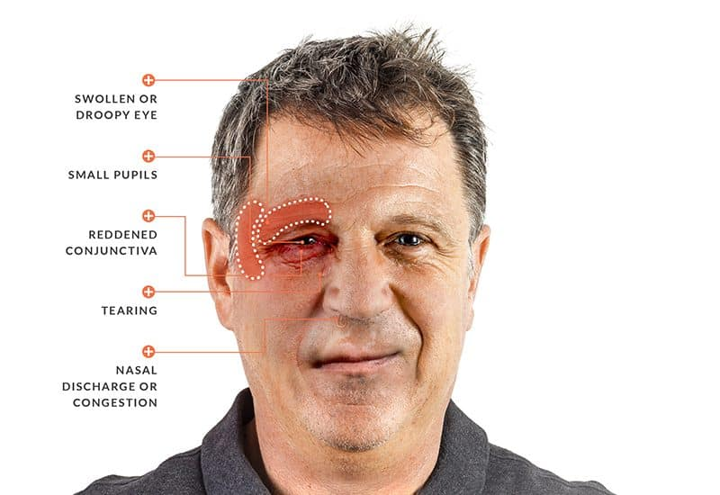

Slide 30
TRIGGERING FACTORS: Many of them same as migraine
Etiology: Unknown
Where is the problem? : Hypothalamus, which somehow affects
the trigeminal nerve
Diagnosis: Based on symptoms
Diff. Diagnosis: Migraine, Trigeminal neuralgia, Temporal arteritis

Slide 31
TREATMENT
Acute attack:
* 100% O2 at high flow rate(15L/min) for about 20 min
* Triptans ( intranasal or subcutaneous sumatriptan). Oral tabs
not very effective)
B) Maintenance prophylactic treatment (if attacks are frequent)
* Verapamil (first choice)
* Lithium tablets

Slide 32
RAPID FIRE QUES OF CLUSTER
Location of cluster H.A?
Where is the pathology?
Clinical features?
What is Horner’s syndrome?
Any triggers?
Acute treatment?
Chronic treatment?
Differential diagnosis?
Anu aura?

Slide 33
LAST SLIDE IS VERY IMPORTANT

Slide 34


