Slide 1

HEPATITIS
DR WAQAR
MBBS, MRCP, Int. Medicine( London)
MRCP, Endocrinology & Diabetes Mellitus
(London)
ASST. PROFESSOR

Slide 2
HEPATITIS
It means inflammation of the hepatocytes.
There are many etiologies of hepatitis :
Viruses: Most common cause
Drugs ( panadol, INH)
Ischemia of liver( ischemic hepatitis)
Autoimmune 5) Alcohol
Treatment is steroids

Slide 3
VIRAL HEPATITIS
Common Uncommon
A, B, C, D, E * Epstein Barr virus(EBV)
( more common) * Cytomegalovirus(CMV)
* Other rare viruses
( less common)

Slide 4
Hepatitis can be acute or chronic.
Acute: Duration of the disease is less than 6
months.
2) Chronic: Duration is more than 6 months
(clinical S/S or abnormal blood tests)
*Hep A causes only acute hepatitis
*Hep B,C,D &E can cause both, acute & chronic.
Chronic hepatitis B & C is the main cause of chronic liver disease, cirrhosis & hepatic cancer

Slide 5
HEPATITIS A
1) Most common cause of acute viral hepatitis.
2) Causes only acute hepatitis. No carrier state or chronic hepatitis. Usually, does not happen twice.
Mode of transmission:
Fecal-oral route( contamination of food & water due to poor hygiene by food handlers)
Saliva of the infected person also contains the virus but very little amount

Slide 6
Hep A contd.
Clinical Features:
Prodromal Phase ( initial 1 -2 wks)
* Anorexia,nausea, malaise, bad taste, fever
*Jaundice is absent initially
Icteric Phase (next 3-6 wks)
* Jaundice, pain in right upper quandrant, dark
urine, pale stools, tender hepatomegaly

Slide 7

SEVERITY OF HEP A
Asymptomatic Usually mild to Fulminant
moderate S/S hepatic
failure
usually in
children most cases

Slide 8
Hep A contd.
INVESTIGATIONS
L.F.T.s: * High bilirubin ( mainly direct)
* AST & ALT are very high
* Alk. Phosphatase slightly high
2) Urine : Contains bilirubin ( which type? )
3) Diagnostic test:
*Hepatitis A antibody (anti HAV)

Slide 9
TREATMENT
There is no special drug treatment. Disease is self limited and usually there is complete recovery within 3 months.
STRICT ISOLATION OF THE PATIENT IS NOT ADVISED BUT THEY SHOULD WASH THEIR HANDS AFTER DEFECATION
Good nutrition( whatever can be tolerated)
Vitamin supplements
Avoid alcohol & hepatotoxic drugs
Symptomatic treatment

Slide 10
PREVENTION
General Measures Immunization
* Good hygiene * Hep.A vaccine
* Drink bottled water
in high risk areas
* Avoid risky foods
Vaccine: Hep A vaccine is given to the following people:
* Patients with other chronic liver disease
* Patients going to a high risk area for a long
time

Slide 11
RAPID FIRE QUESTIONS
Mode of transmission of hep A?
Which test is diagnostic?
In hepatitis, which type of bilirubin is elevated predominantly?
Which specific drug for hep A treatment?
Who shud get hep A vaccine?
How to avoid getting infected?
A man tells you that he had hep A 2 years ago. Now he is jaundiced. The doctor tells him that he has hep A re- infection. Is the doctor right?

Slide 12
HEPATITIS B
Epidemiology:
* World wide problem( specially Africa, Mid-
East, S.America)
* 1/3rd of the world population has serological
evidence of past or present infection.
* About 1 million deaths occur per year due to
Hep B related liver disease & carcinoma

Slide 13
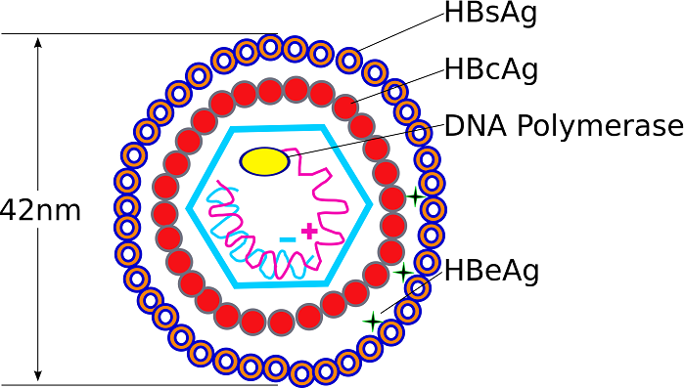
Structure of Hep B virus
1) Outer covering has
surface antigen( s ag.)
2) Inner center has:
* “e” ag.(envelop
antigen)
* “c”ag.
* DNA
(so, 3 ag. plus DNA)
It is a DNA virus ( hep A & hep C are RNA viruses)

Slide 14
SEROLOGIC MARKERS
1) After infection wth Hep B, “s” antigen, “e” ag.
& HepB DNA are detectable in the blood.
2) “c” antigen is not detectable in the blood.
Antibodies which appear in the blood (& clear the infection)
* Anti HB “s” ( against “s” ag.)
* Anti HB“e”( against“e” ag.)
* AntiHB “c” ( against “c” ag.)
Note that “c” antigen is not detectable in blood
but c antibody can be detected

Slide 15
* APPEARANCE OF ANTI HBs & ANTI HBe
MEANS INFECTION IS RESOLVED
* ANTI “c” does not kill the virus

Slide 16
Routes of Transmission
1) VERTICAL 2) PARENTERAL
(mother to fetus)
* Most common route
worldwide.
Modes of parenteral transfer
1) Needle sharing (i.v. drugs, tattooing)
2) Transfusion of infected blood & blood
products: V. rare in developed countries coz of
blood screening.
4) Needle stick injuries ( doctors &nurses at high risk)
5) Sexual transmission 6) Direct contact with blood of
HepB patient ( even small skin breaks are risky)

Slide 17
Saliva, sweat and tears also contain the virus but they are not considered as very significant modes (may spread)

Slide 18
SPECTRUM OF HEP.B INFECTION
Hep. B can cause any of the following:
Acute hepatitis : Duration less than 6 months
Chronic hepatitis: Duration more than 6 months
Chronic hep B is of further 2 types :
a) Chr. Active hepatitis
b) Chr. Carrier state
( details in later slides)

Slide 19
ACUTE HEP. B
Incubation Period: Very variable. Avg. 6 wks
S/S : * Jaundice + all others like Hep A
* May be asymptomatic
A) Blood Tests:
a) LFTs: bili., AST & ALT (same like hepA)
b) Hep B serology ( antigens & antibodies)
SEE NEXT FEW SLIDES

Slide 20
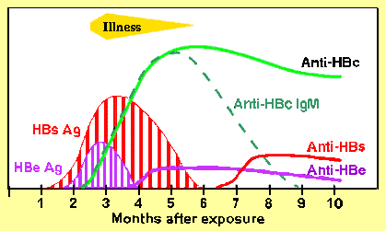
SEROLOGY IN ACUTE HEP B
Antigens which appear
* “s”ag. * “e”ag.
* HepB DNA levels
2) Antibodies which
appear:
AntiHBs means
* Anti Hbe recovery
AntiHBc
Once antibodies appear, antigens disappear & infection is resolved.
( Disappearance of antigens & appearance of antibodies is called SEROCONVERSION)

Slide 21
ANTI “c” ANTIBODY:
* does not kill the virus
* appears early in infection & persists for ever
* Initially, it is of IgM type, then changes to
IgG type.

Slide 22
SOME POINTS
“s” antigen is the first to appear in blood
“e” antigen is highly infectious
WINDOW PERIOD:
It is the time period in acute hepatitis B when the infection has just resolved. “s” ag. has disappeared but antiHBs antibody is till umeasurable. The only thing positive during this period is anti HBc, Ig M type (antibody to the “c” antigen)

Slide 23
WINDOW PERIOD

Slide 24
Treatment of Acute Hep B
Symptomatic
Usually, no specific treatment in acute cases

Slide 25
CHRONIC Hep B
Chronic active Carrier state
Hepatitis
( Infection present for more than ? )

Slide 26
Chronic “Active” Hep B
* Infection present for more than 6 months
* Patient may or may not have symptoms
* LFTs raised & liver biopsy abnormal
* “s” antigen, “e” antigen , hep B DNA
present in blood
* patient highly infectious ( because “e” ag.
is present)
* More chances of chronic infection in children & people with poor immunity( DM, long term steroid use, HIV etc)

Slide 27
Chronic “Carrier” State
* Infection present for more than 6 months.
* Patient asymptomatic
* LFTs & biopsy are normal
* “s” antigen present in the blood
* No “e” antigen in the blood (so patient is
much less infectious)
* DNA levels may be low or absent in the blood
So : s antigen yes, e antigen no, Hep B DNA low or absent in the blood

Slide 28
COMPARISON
Chronic active hep B
Chronic carrier state
Patient usually symptomatic
LFTs & liver biopsy abnormal
“e” ag. usually present
Hep B DNA levels high in the blood
Treatment is given
Patient usually asymptomatic
LFTs & biopsy norm.
“e” ag absent
Hep B dna levels low or absent
Treatment not given

Slide 29
SEROLOGIES IN DIFFERENT PHASES
Acute hep B :
a) s ag. Positive
b) e ag. Positive
c) Anti c positive (IgM type)
d) Anti s neg. & anti “e” neg
2) Resolved infection:
a) s ag. Neg.
b) e ag. Neg.
c) Anti c pos.( Ig G type)
d) Anti s pos. e) Anti e positive

Slide 30
3) Window period:
a) s ag. Neg
b) e ag neg.
c) Anti c positive (IgM type)
d) Anti s neg.
4) Chronic hepatitis (active & carrier)
a) s ag. Positive
b) e ag. Positive
c) Anti c pos. (IgG type)
d) Anti s neg.
e) Anti e negative

Slide 31
SO
Look for “s” antigen first
Positive Negative
Infec. “MOJOOD” No infection
Acute infec a. never infected
Chr active b. resolved infec
Chr carrier c. window period
d. Vaccinated

Slide 32
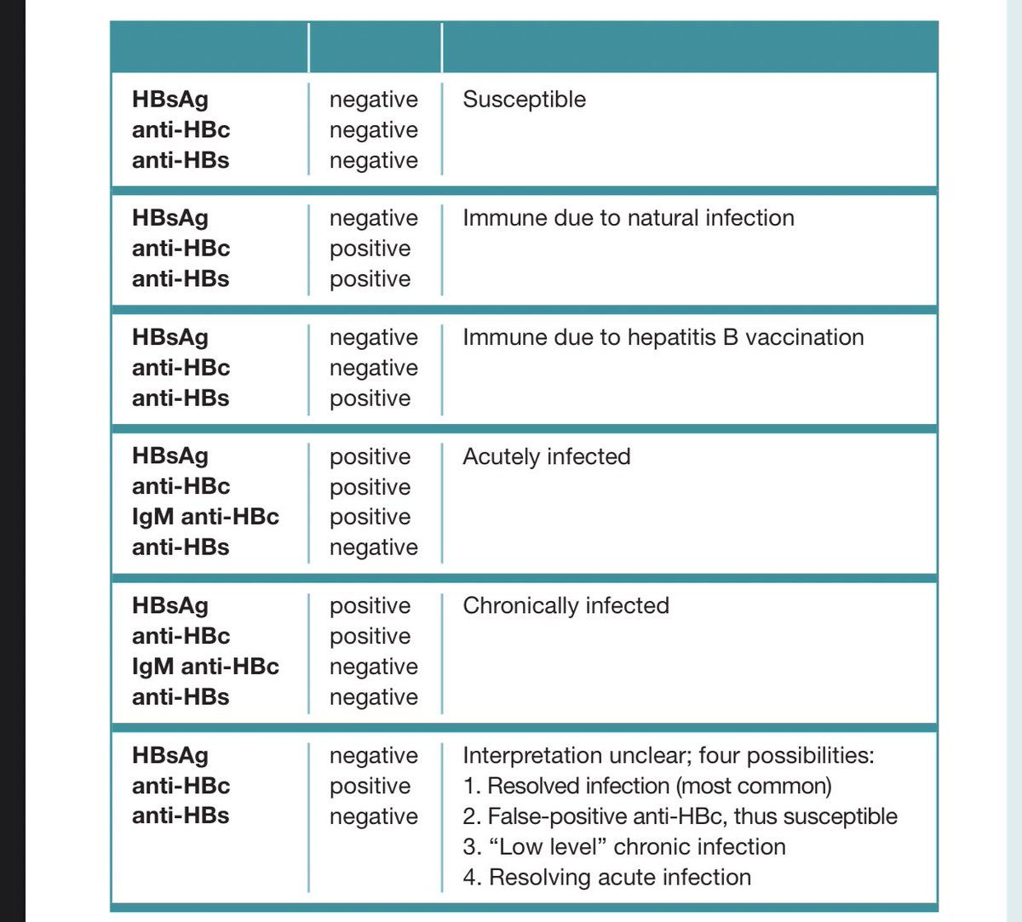
SUMMARY OF SEROLOGIES

Slide 33
TREATMENT OF CHR. HEP B
Drugs Liver transplant

Slide 34
TREATMENT OF CHR.HEP B
Drugs used:
* Nucleoside analogues: eg Entecavir oral
* Nucleotide analogues: eg. Tenofovir drugs
* Interferon ( Injections)
2) Treatment is 6 months to 1 yr.
3) Treatment is not given to chronic carriers
( patients who have only “s” antigen positive with normal LFTs & normal liver biopsy)

Slide 35
Liver transplant is done in end stage liver disease or fulminant hepatic failure
So:
* Acute hep B: no antiviral meds
* Chr. Active hep B: antiviral meds yes
* Chr carrier : no meds

Slide 36
PREVENTION OF HEP B.
Avoid risk factors ( iv drugs, needle sharing,
sexual contact wth. unknown or HepB positive
person, avoid direct contact wth blood, no
sharing of razors etc.
2) Vaccine: Given routinely to everyone.
* 3 doses: 0, I month,6 mnth (from the 1st dose)
3) Immune globulins: Given for immediate protection, if :
* Needle stick injury from a hep. B patient
* Sexual exposure to hep B patient
* Newborn baby ( if mother is hep B positive)

Slide 37
Immunoglobulins are JAAHIZ antibodies against the virus, available in ampoules. They provide quick but short term immunity.
Vaccines take time to be effective but provide long term immunity

Slide 38
COMPLICATION OF CHR.HEP B
a) Cirrhosis b) Hepatic carcinoma
REMEMBER
* Vaccine produces protective antibody after
some time (wks to months) but lasts long.
* Immunoglobulins provide immediate
protection that lasts for a short time.

Slide 39
Hep B & pregnancy
High chances of vertical transmission, so Hep B positive mother should be treated
Tenofovir is safe to give during pregnancy
Breast milk does not transmit the infection to the baby
What to do to the baby who is born to a hep B
positive mother? LISTEN TO ME !

Slide 40
RAPID FIRE QUES FOR HEP B
What are the modes of transmission?
Name the 3 antigens of hep B?
Which antibody is not detectable in the serum?
Which antibody is not protective ( does not kill the virus?
Of all the antigens, which is the most important to check to see infection?
Appearance of which antibodies means infection is resolved?

Slide 41
7) Saliva, sweat and tears of hep B patient are
highly infectious, right or wrong?
8) Duration of acute hep B?
9) Duration of chronic hep B?
10) Name the 2 types of chronic hep B?
11) Name 2 differences between the 2?
12) What will LFTs show in acute hep B?
13) What do you mean by “seroconversion” ?

Slide 42
14) In the window period, what is detectable in
the blood?
Which antiviral drug to treat acute hep B?
In acute hep B, what is detectable in the blood?
Which drug to use for chr carrier state/
Name the drugs used for hep B Rx?
Whats the vaccination schedule for hep B?

Slide 43
20) Who should get vaccination?
21) What to give immediately after exposure?
22) Vaccines provide quick immunity, right or
wrong?
23) Complications of chronic hep B?
24) Hep B is a contraindication to for pregnancy,
right or wrong?
25) What to give to the pregnant lady who has chr.
hep B?

Slide 44
26) During pregnancy, hep B virus goes to the
baby during which trimester?
27) Baby born to a hep B mother. How to deal
with?

Slide 45

HEP C
Epidemiology: Occurs worldwide but very common in Africa & Egypt.
Prevalence in KSA : 1%
2) Mode of Spread: (Parenteral)
* i.v. drug use ( West) * Blood transfusion (developing countries) * Contaminated needles
& instruments (surg., dental) * Sexual transmission is very less(<1%) *Perinatal : <1%
* Contact with infected blood( razors, cuts)
3) There are 7 subtypes of HepC ( 1 to 7)

Slide 46
WHAT HAPPENS AFTER INFECTION
Few patients (10-20%) get mild acute hepatitis which resolves and the infection gets cleared.
Most patients develop chronic hepatitis
CHRONIC HEP C
Usually asymptomatic & detected by chance on routine blood tests(slightly high AST & ALT). LFTS often fluctuate.
Often presents as cirrhosis after many years
Mild jaundice, fatigue may occur

Slide 47
DIAGNOSIS (HEP C)
Hep C antibody ( Anti HCV ab.)
* It is the initial test done
* Can be detected in the blood about 2 months
after infection
* This antibody is not protective(opposite of Hep B)
2) HepC RNA levels (by PCR):
* This is actual virus level in the blood
* Can be detected in blood after 1-2 wks of infec. ( earlier than antibody)
3) Liver Biopsy: Not done routinely for diagnosis, but only done before treatment to see disease severity

Slide 48
TREATMENT
1) Offered to most patients
2) Response to treatment depends on genotype
( 1 to 7) & some other factors (type 2 & type
3 Hep C have very good response to
treatment)
3) Latest treatments are mainly oral drugs. Sometimes, interferon can be added.

Slide 49
Drugs Used In Hep C
RIBAVIRIN : Used in combination with other
drugs.
2) Direct acting antivirals( DAA):
* Ledi-pasvir, *Sime-previr
* Sofos-buvir
3) Interferon : Sometimes added to the above.
Generally speaking, treatment is for 3 months.

Slide 50
OTHER THINGS IN MANAGEMENT
1) Patient counselling:
* Don’t donate blood or tissue
* No iv drugs, no needle/razor sharing
* Explain that there is a small risk of sexual
transmission
* Avoid alcohol ( can worsen the disease)
2) Check for Hep B & Hep A and vaccinate if negative for these
3) Check for HIV

Slide 51
VACCINE
No vaccine or immunoglobulins are available as yet.
OUTCOME
Without treatment, Hep C can lead to cirrhosis and hepatocellular carcinoma ( liver cancer).

Slide 52
Pregnancy & breast feeding in Hep C
Hep C in the female does not have any bad effect on pregnancy
1-2% chance of perinatal transmission
Breast feeding is safe, but if the nipples are cracked or bleeding, don’t breast feed

Slide 53
HEP D
Hep D virus is unable to cause infection on its own.It requires the presence of HepB virus to replicate.
Infection can occur together with Hep B ( co-infection) or occurs in a person who already has Hep B
Risk factors, mode of spread & S/S are like Hep B.

Slide 54
HEP E
Mode of transmission is like Hep A (contaminated food & water)
It mostly causes acute hepatitis but “may” cause chronic hepatitis also(in people who are on immuno-suppresive meds)
Infection is self limited ( no need of medicines)
Can be very severe if occurs in a pregnant lady (maternal mortality 20%)
Maternal and fetal complications can occur (fetal death, preterm delivery)

Slide 55
HOW TO REMEMBER
Hep B treatment Hep C treatment
Interferon a) Ribavirin
Entecavir b) Sofosbuvir/Simepra-
-vir
c) Tenofovir c) Ledipasvir
RaSuL ( + IFN)
( I Eat Tamar )

Slide 56
1) A combination of drugs is given
2) Aim is : to get the patient free of Hep C for ever, or for a long time. ( called sustained viral response)
NEVER GIVE A SINGLE DRUG ALONE

Slide 57
Rapid fire ques for HepC & E
Mode of transmission of hep C
Is sexual & perinatal transmission very common like hep B?
After Hep C infection, most patients develop acute or chronic?
Which 2 diagnostic tests for hep C?
Which one will you do first as a screening test?
Are the LFTs always very high?

Slide 58
7) A person gets infected with hep C today.
Which test will be positive first?
8) Anti C antibody can kill the virus, true or
false?
9) Name some drugs for hep C treatment?
10) In a patient with chr. Hep C, which 2 vaccines should you give?
11) If a patient gets infected with hep C today, you
can give immunoglobulins for treatment, true
or false?

Slide 59
12) What is the effect of hep C on pregnancy?
13) How to counsel a hep C lady about breast
feeding?
14) Hep E is more common in pregnant ladies,
true or false?
15) Mode of transmission of hep E?
16) Effects of hep C on pregnancy?

Slide 60
LAST SLIDE IS VERY IMPORTANT

Slide 61


