Slide 1
Von Willebrand's Disease

Slide 2
Von Willebrand's Disease
This is the most common hereditary coagulopathy.
Prevalence 1-2% in the general population
It can be congenital or acquired.
Pathophysiology
vWF is a multimeric glycoprotein encoded for by gene map locus 12 p13, chromosome 12.
Von Willebrand's disease (vWD) due
deficiency of (vWF).
Abnormal function of von Willebrand factor
Notes:
•
Von Willebrand's disease is the most common inherited bleeding disorder. The majority of cases are inherited in an autosomal dominant fashion* and characteristically behaves like a platelet disorder i.e. epistaxis and menorrhagia are common whilst haemoarthroses and muscle haematomas are rare Role of von Willebrand factor large glycoprotein which forms massive multimers up to 1,000,000 Da in size
promotes platelet adhesion to damaged endothelium
carrier molecule for factor VIII
Types type 1: partial reduction in vWF (80% of patients)
type 2*: abnormal form of vWF
type 3**: total lack of vWF (autosomal recessive)
Investigation prolonged bleeding time
APTT may be prolonged
factor VIII levels may be moderately reduced
defective platelet aggregation with ristocetin
Management tranexamic acid for mild bleeding
desmopressin (DDAVP): raises levels of vWF by inducing release of vWF from Weibel-Palade bodies in endothelial cells
factor VIII concentrate
*type 2A VWD is caused by defective platelet adhesion due to decreased high molecular weight VWF multimers (i.e. the VWF protein is too small). Type 2B is characterised by a pathological increase of VWF-platelet interaction. Type 2M is caused by a decrease in VWF-platelet interaction (not related to loss of high molecular weight multimers). Type 2N is caused by abnormal binding of the VWF to Factor VIII. There is no clear correlation between symptomatic presentation and type of VWD however common themes amongst patients include excessive mucocutaneous bleeding, bruising in the absence of trauma and menorrhagia in females. **type 3 von Willebrand's disease (most severe form) is inherited as an autosomal recessive trait. Around 80% of patients have type 1 disease

Slide 3
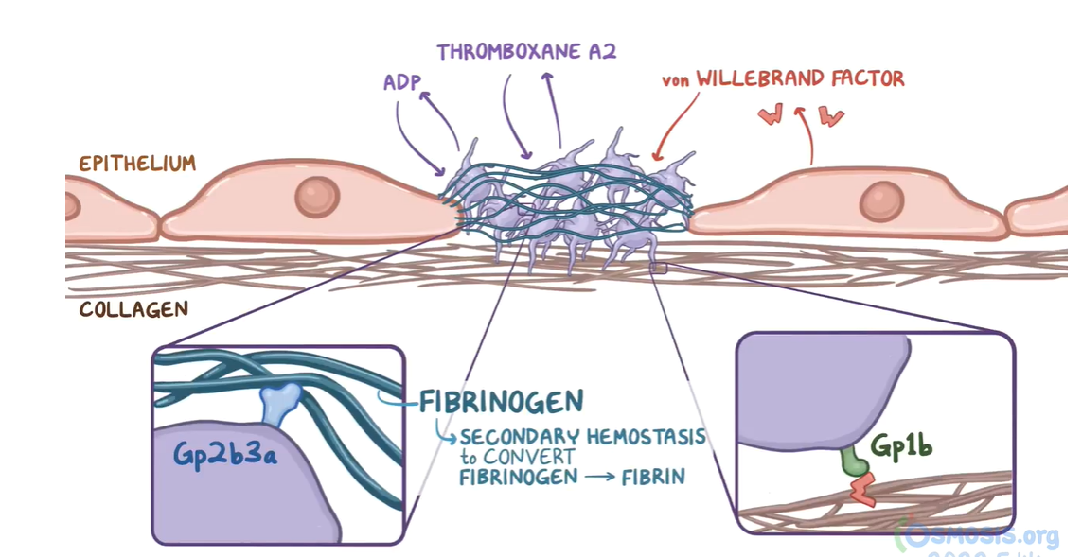

Slide 4
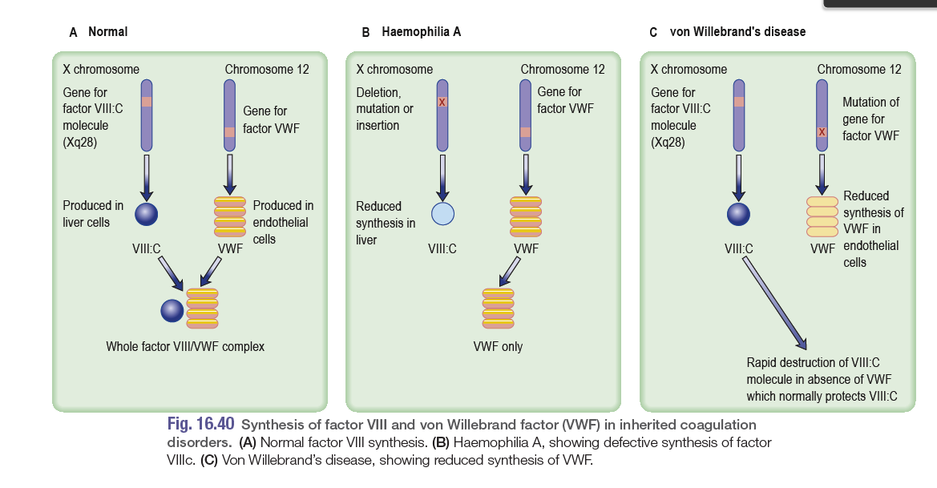
VWF : two main functions:
Assists in platelet plug formation by attracting circulating platelets to the site of damage.
Binds to coagulation factor VIII preventing its clearance from the plasma.

Slide 5
AEtiology
Hereditary – VWD caused by mutations in the vWF gene
Von Willebrand's Disease
Three types
vWD Type I, vWD Type II, and vWD Type III
Within the three inherited types of vWD there are various subtypes.
Acquired – (pseudo-VWD); found in:
Lymphoproliferative disorders
Myeloproliferative disorders
Solid tumors
Immunological disorders
Cardiovascular disorders : aortic stenosis, VSD
Wilms 'tumor
Hypothyroidism.
Type 1: partial reduction in vWF (80%): AD
Type 2*: abnormal form of vWF
Type 3**: total lack of vWF: AR
Notes:
Type 1 is partial quantitative deficiency of VWF; significant type
1 VWD is usually inherited as an autosomal dominant.
• Type 2 is due to a qualitative abnormality of VWF; it too is usually
inherited as an autosomal dominant.
• Type 3 is recessively inherited and patients have virtually complete
deficiency of VWF. Their parents are often phenotypically normal.
Many subtypes of VWD are described, particularly type 2 variants,
which reflect the specific qualitative changes in the VWF protein.
Deficiency or dysfunction of vWF leads to:
Dysfunctional platelet adhesion → impaired primary hemostasis
Reduced binding of factor VIII → increased degradation → ↓ factor VIII activity → impaired intrinsic pathway of secondary hemostasis

Slide 6
Von Willebrand's Disease
Asymptomatic
Symptomatic
Mucocutaneous bleeding
Ecchymoses, easy bruising
Epistaxis
Bleeding of gingiva and gums
Petechiae
Prolonged bleeding from minor injuries
Diagnostic Considerations
Bleeding after surgical procedures or tooth extraction
GI bleeding
Menorrhagia (affects up to 92% of women with vWD)
Severe cases: large hematomas, hemarthrosis, life-threatening bleeding (e.g., during childbirth)
Notes:
Clinical features: Clinical features - mucocutaneous bleeding
These are very variable. Type 1 and type 2 patients usually have
relatively mild clinical features. Bleeding follows minor trauma or
surgery, and epistaxis and menorrhagia often occur. Haemarthroses
are rare. Type 3 patients have more severe bleeding but rarely
experience the joint and muscle bleeds seen in haemophilia A.
Characteristic laboratory findings are shown in Box 16.30. Classically
VWF activity is measured as its platelet dependent function
in the presence of ristocetin.

Slide 7


Von Willebrand's Disease
Screening tests include:
CBC: Anaemia, Normal Platelet count
Prothrombin time (PT): Normal
Activated partial thromboplastin time (aPTT): Normal or Prolonged
↓ Factor VIII
↓ vWF antigen levels (type 1) normal (type 2)
Ristocetin cofactor assay: failure of platelet aggregation
Bleeding time: Prolonged
Historically, diagnostic test
Lab tests
aPTT is mildly prolonged 50% vWD, secondary to low levels of FVIII because one of the normal functions of vWF is to protect FVIII from degradation.
Notes:
History
Recurrent episodes of bleeding since childhood
Often positive family history
↓ vWF antigen levels Ristocetin cofactor assay: failure of platelet aggregation or a ristocetin cofactor level < 30 IU/dL
Further qualitative assessment by collagen binding assay
defective platelet aggregation with ristocetin

Slide 8
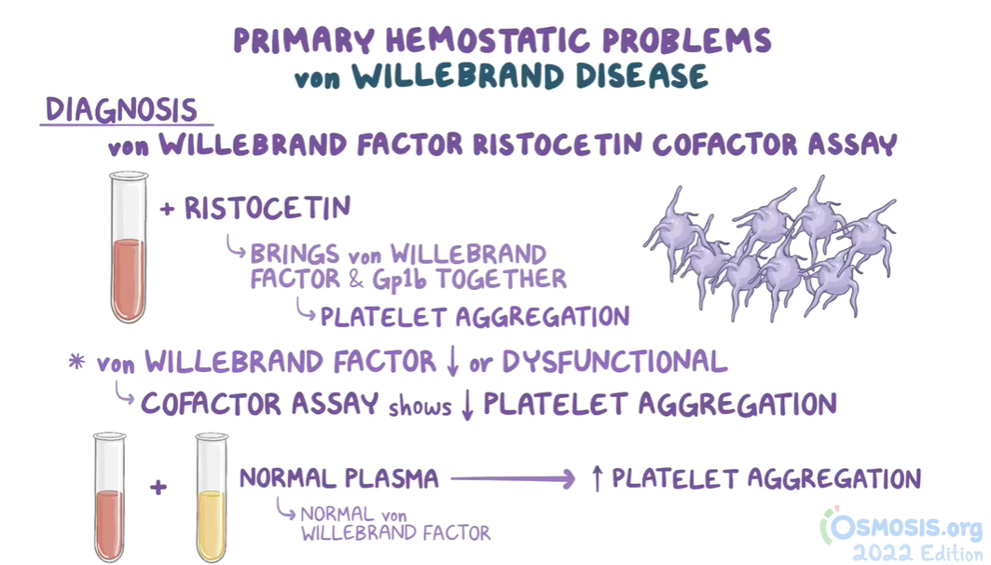

Slide 9
Von Willebrand's Disease
Diagnostic Considerations
Conditions to consider in the differential diagnosis of von Willebrand's disease include the following:
Hemophilia A, B, C
Platelet function defects
Antiplatelet drug ingestion
Fibrinolytic defects
Pseudo vWD

Slide 10
Treatment of
Von Willebrand's Disease
DDAVP (deamino-8-arginine vasopressin)
stimulates vWF release from endothelial cells and ↑ plasma VWF levels
for mild or moderate symptoms (typically type 1 ), not in type 2 disease
Not effective for type 3
Recombinant VWF
Plasma-derived factor VIII concentrates: contain intact VWF are the mainstay of replacement therapy.
Cryoprecipitate
Source of fibrinogen, factor VIII and VWF
Only plasma fraction contains VWF multimers consistently
indicated for severe bleeding, as prophylaxis for surgical procedures and if DDAVP treatment is ineffective
not virus-inactivated.
Notes:
Management
Management depends on the severity of the condition and may
be similar to that of mild haemophilia, including the use of desmopressin
where possible. Although recombinant VWF is becoming
available, plasma-derived
factor VIII concentrates that contain
intact VWF are the mainstay of replacement therapy. These specific
products are used to treat bleeding or to cover surgery in patients
who require replacement therapy, such as those with type 3 (severe)
VWD and those who do not respond adequately to desmopressin.
Cryoprecipitate could be used as a source of VWF but is avoided if
possible, since it is
Inherited von Willebrand disease
Desmopressin (DDAVP): stimulates vWF release from endothelial cells
Best initial treatment for mild or moderate symptoms (typically type 1 and, sometimes, type 2)
Not effective for type 3
Concentrates containing vWF and factor VIII: indicated for severe bleeding, as prophylaxis for surgical procedures and if DDAVP treatment is ineffective Other treatment options: antifibrinolytic drugs (i.e., aminocaproic acid, tranexamic acid), oral contraceptives for menorrhagia

Slide 11
Treatment of
Von Willebrand's Disease
Platelet aggregation inhibitors (e.g., aspirin, NSAIDs, clopidogrel) and intramuscular injections are contraindicated in VWD because they further increase the risk of bleeding!
ANTIFIBRINOLYTICS: Aminocaproic acid and tranexamic acid Indication: prior to dental procedure, nose and mouth bleeds, and for menorrhagia.
Oral contraceptives for menorrhagia

Slide 12
Medications & bleeding
Unfractionated heparin : antidote protamine sulfate
Low-molecular W heparin: protamine sulfate works incompletely.
Warfarin: ↑ PT, inhibits liver enzyme vitamin K epoxide reductase, (1972) + protein C and S.
Treatment of warfarin-related bleeding depends on the acuity of the bleed.
Slowly growing thigh hematoma: vitamin K and fresh frozen plasma – (higher volume and infused slowly )- taking effect over a couple of hours.
life-threatening intracerebral bleed, (low-volume prothrombin complex concentrates, contain (1972); rapidly and begins working within 15 minutes.
Xa inhibitors and direct thrombin inhibitors: prothrombin complex concentrates.

Slide 13
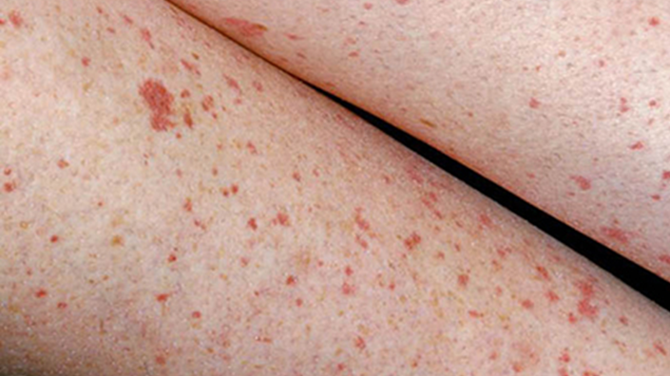
Autoimmune Thrombocytopenia

Slide 14
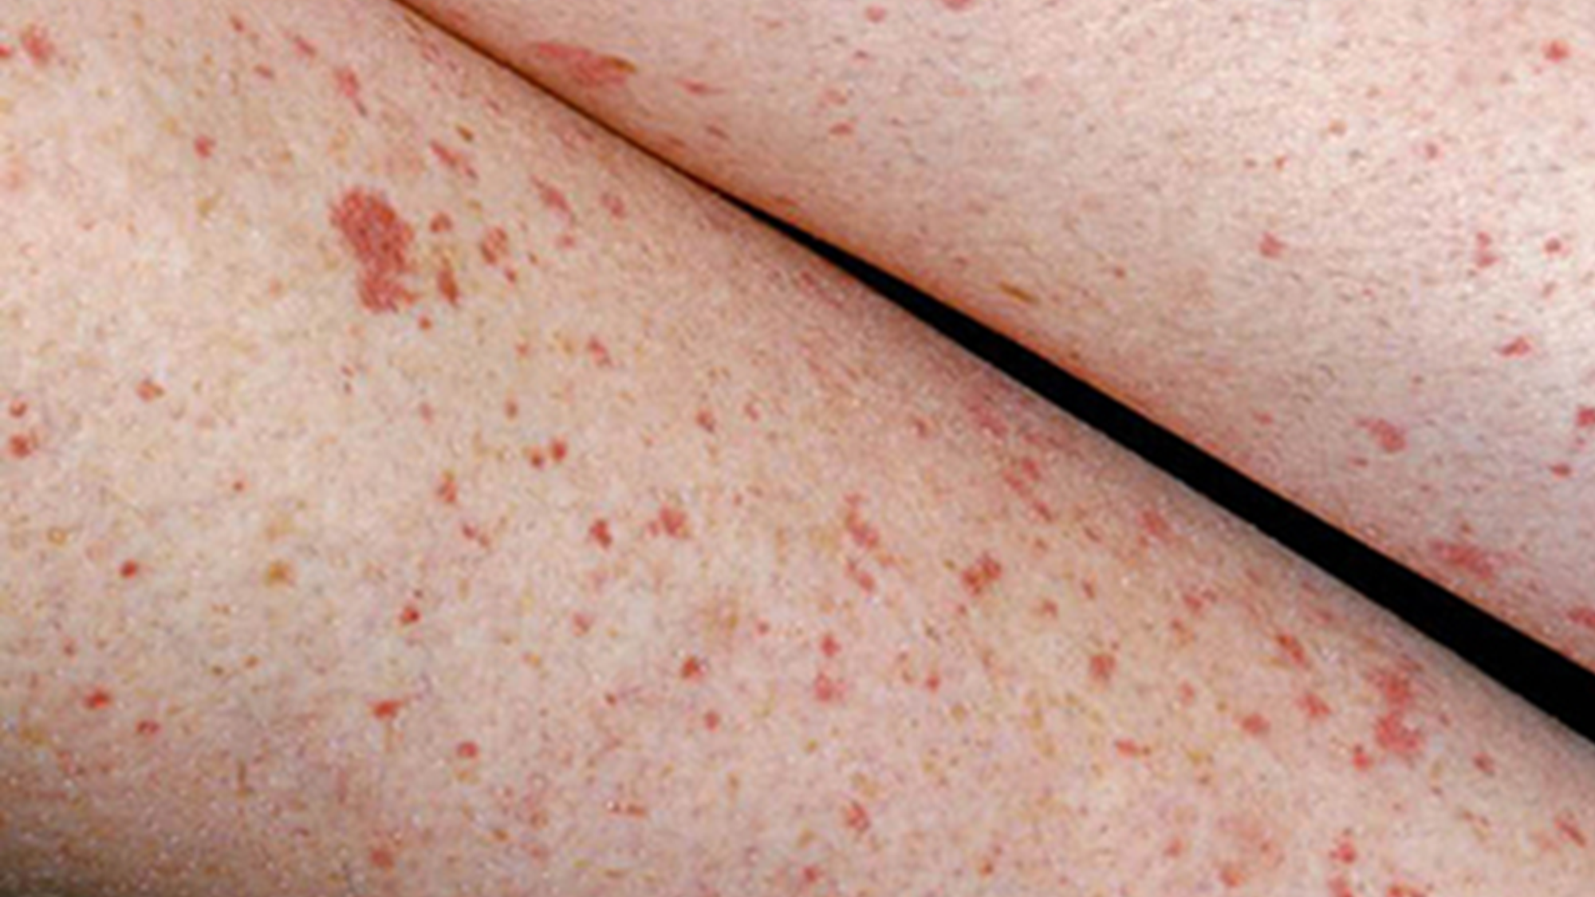
Definition
caused by
Antiplatelet antibodies (mostly IgG directed against, e.g., GpIIb/IIIa, GpIb/IX)
Immune thrombocytopenia: idiopathic thrombocytop
enic purpura (outdated): autoimmune disorder
Primary ITP: isolated thrombocytopenia (< 100,000/mm3)
with no known precipitating
Secondary ITP: isolated thrombocytopenia secondary to an identifiable trigger such as SLE, APS, HCV, HIV.
Malignancy: lymphoma, leukemia (CLL)
Drugs: quinine, carbamazepine, heparin, vaccines, linezolid, sulfonamides, vancomycin.
Newly diagnosed ITP: first 3 months
Persistent ITP: ITP lasting 3–12 months
Chronic ITP: ITP lasting > 12 months
Low platelet An incidental finding on a routine CBC in 25% of cases
Notes:
ITP is one of the most common autoimmune disorders. Platelets with antibodies on their surface are trapped in the spleen, where they are efficiently removed by splenic macrophages
Pathophysiology
Antiplatelet antibodies (mostly IgG directed against, e.g., GpIIb/IIIa, GpIb/IX) bind to surface proteins on platelets → sequestration by spleen and liver → ↓ platelet count → bone marrow megakaryocytes and platelet production increase in response (in most cases)

Slide 15

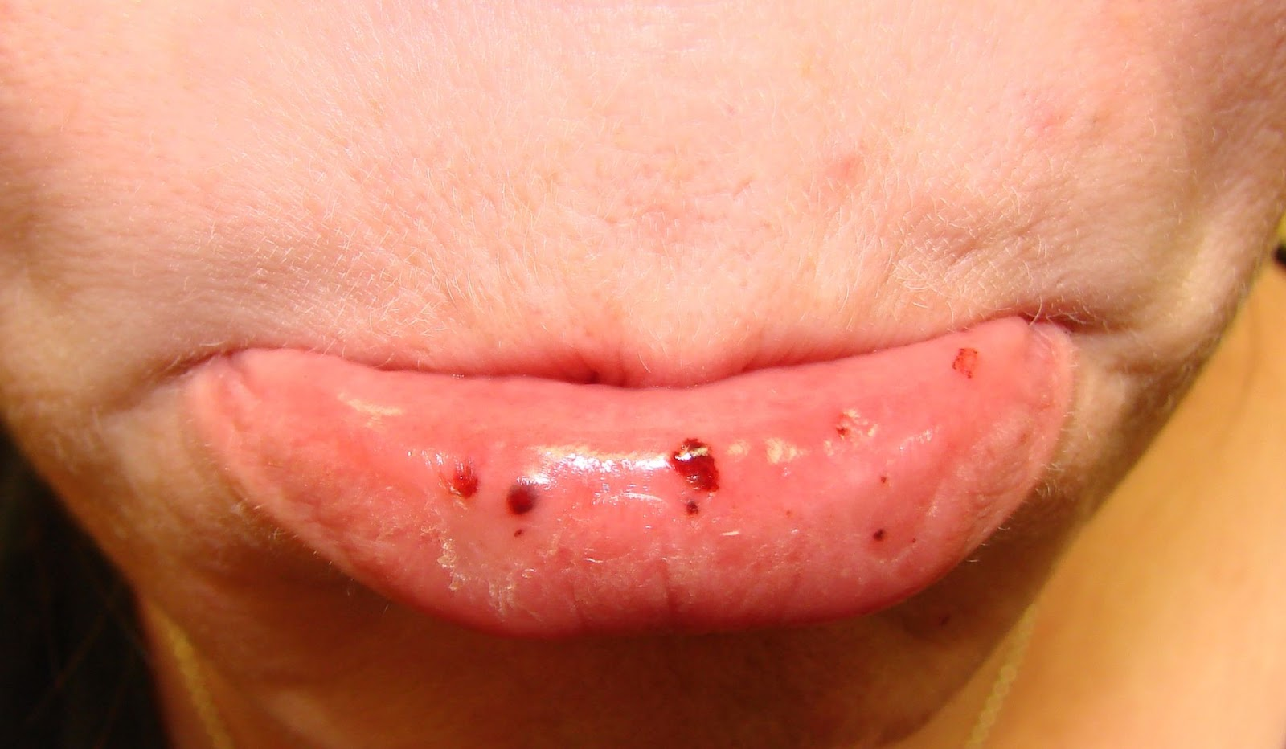

Presentation
Abrupt onset (childhood ITP)
Gradual onset (adult ITP) common
Asymptomatic: detected during routine tests.
Symptomatic:
Minor mucocut: Petechiae, purpura, Bruising tendency
Minor bleeding: Menorrhagia, epistaxis, gingival bleeding
Catastrophic bleeding (GIT, intracranial): uncommon.
Signs
Spontaneous bleeding: platelet count < 20,000/mm ³.
Retinal hemorrhages
Purpuric rash
Evidence of ICH, with neurologic symptoms
Prolonged or excessive traumatic or surgical bleeding
Splenomegaly is very unusual in ITP and makes other diagnoses more likely!
Notes:
Finally, most surgical procedures can be performed as long as the platelet count is above 50,000..
Platelets with antibodies on their surface are trapped in the spleen, where they are efficiently removed by splenic macrophages.

Slide 16

Diagnostic Considerations
ITP is a diagnosis of exclusion; patients typically have a low platelet count with no other abnormalities.
Routine
CBC: ↓ platelet count (< 100,000/mm3)
Coagulation panel: normal
Bleeding time: may be prolonged
Peripheral blood smear: N to large platelets
Bleeding time is rarely measured nowadays, replaced by another screening tool called platelet function analyzers.
All adults: HIV and HCV screening
Bone marrow biopsy: atypical cases
Findings: normal or ↑ megakaryocytes
Secondary ITP: antinuclear antibodies in SLE or H. pylori testing if the patient has GI symptoms or is from a high prevalence area

Slide 17
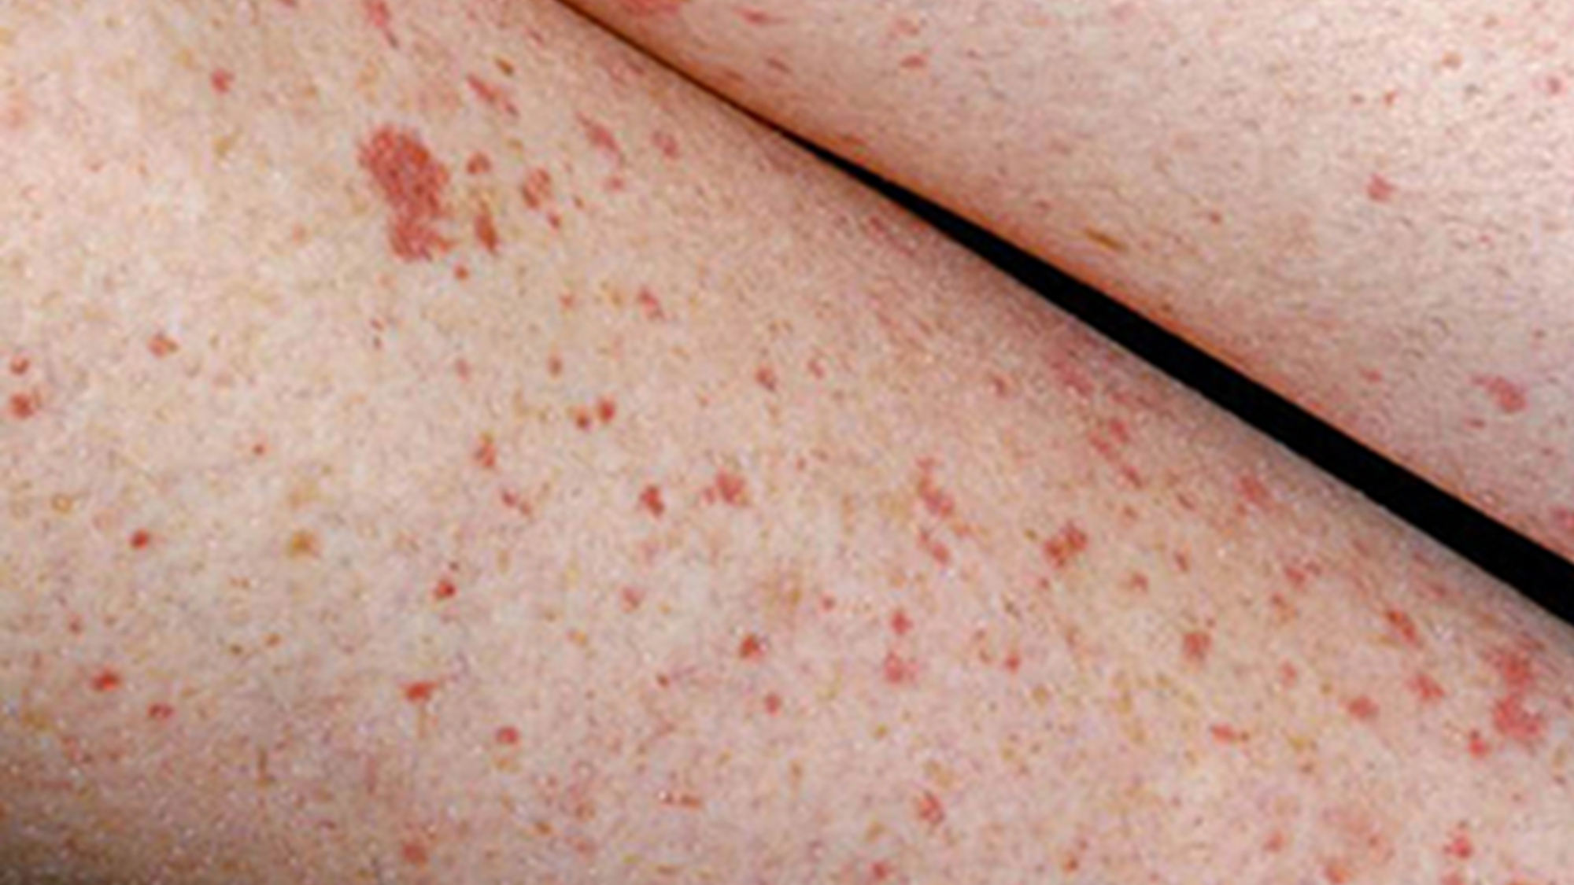
ITP: Diagnostic Considerations
Differential diagnosis
Liver disease
Lymphoproliferative
Pregnancy-associated thrombocytopenia
Infection/sepsis
Acute leukemia
Myelodysplastic syndrome
Malignancy
Megaloblastic anemia
Transfusion

Slide 18
ITP: Treatment & Management
All pt: Stop medications (NSAIDS), and ttt underline
Observation: only asymptomatic adults with a platelet count >=30 * 10⁹/L.
Minor symptoms : oral prednisolone as first choice.
Second choice (contraindication, non-response: IVIG or anti-Rho(D) immunoglobulin (risk of intravascular hemolysis)
Life-threatening bleeding: critical care.
Refractory cases: high-dose parenteral glucocorticoids and IV immunoglobulin (IVIg), with or without platelet transfusions.
IV immunoglobulins: increase platelet survival
Platelet transfusion is indicated for controlling severe hemorrhage prior to surgery.
Notes:
dentify and treat underlying causes. Consider stopping medications that impair platelet function, e.g., NSAIDs. ^{[15]}

Slide 19
ITP: Treatment & Management
Newly-diagnosed ITP refractory to first-line medical therapy, or persistent/chronic ITP.
Thrombopoietin receptor agonists (TPO-RAs): increase platelet production by stimulating megakaryocytes in the bone marrow : Romiplostim,
Rituximab
Splenectomy
Indications
Treatment-resistant thrombocytopenia lasting > 12 months
Emergency splenectomy: with life-threatening bleeding in whom medical therapy fails.
Notes:
dentify and treat underlying causes. Consider stopping medications that impair platelet function, e.g., NSAIDs. ^{[15]}

Slide 20
A 42-year-old female presented with gingival bleeding and dark purple spots on her legs. The patient first noticed the dark spots on her legs 2 months ago, but the gingival bleeding started 5 days ago. Past history is notable for intravenous drug use and hepatitis C infection. Normal vital signs. Examination of the patient’s oropharynx and gingiva reveals petechiae with pinpoint bleeding. Cardiac, pulmonary, and abdominal exams are noncontributory. Purpura are observed on the bilateral legs. Laboratory testing is obtained, and the results are shown below.
Platelet count 25,000/mm3
Hemoglobin (Hb) 13.5 g/dL
Leukocyte count 11,000/mm3
Which of the following serological findings would most likely be present in this patient?
Anti-Gp2b3a receptor antibodies
Anti-Ro antibodies
Antiphospholipid antibodies
Anti-ADAMTS13 antibodies
Lupus anticoagulant

Slide 21
An 18-year-old woman comes to her primary care provider because of menorrhagia over the last several years. She mentions that her menses "have always been heavy,", and that she has experienced easy bruising for as long as she can remember. Her father has never had bleeding problems, but her mother has had similar problems with bruising easily. Initial lab studies show the following, platelet count: 205,000/ml, PT: 12 seconds, and PTT: 44 seconds. Of the following, which is the most likely cause of her symptoms?
Von Willebrand's disease
Protein C deficiency
Hemophilia A
Factor V Leiden
Lupus anticoagulant

Slide 22
Reference : Kumar: 375- 378
THANK YOU

