Slide 1

LYMPHOMAS
Dr. WAQAR
MBBS, MRCP(Int.Med., London), MRCP(Endocrinology, London)
Asst Professor of Medicine

Slide 2
Lymphomas are malignancies arising in the lymphoid tissues, mainly the lymph nodes.
2 important ones are:
Hodgkin’s lymphoma Non Hodgkin’s

Slide 3
HODGKIN’S LYMPHOMA
It is a malignancy arising in the lymphoid tissues (mainly lymph nodes)
The cell of origin is the “B” lymphocyte
Etiology: Epstein-Barr virus is thought to play a
major role in most cases.

Slide 4
Epidemiology
1) Hodgkin’s lymphoma has a peak incidence in 2 age groups (bimodal) : young adulthood (in the 20s) & then above 50

Slide 5
SIGNS AND SYMPTOMS
Lymph node enlargement
a) Commonest feature
b) Most common is enlargement of axillary,
cervical,supraclavicular & inguinal nodes
c) Nodes are painless and rubbery
d) Nodes become acutely painful after alcohol
intake (2-3% patients)

Slide 6
2) Systemic features:
a) Low grade fever
b) Night sweats
c) Weight loss ( at least 10% of the body weight
in less than 6 months)
The above symptoms are called “B” symptoms and may/may not be present
d) Pruritus

Slide 7
PEL- EBSTEIN FEVER
* It is a cyclic pattern of fever, rarely seen in
Hodgkin’s patients
* Fever MOJOOD for few days, then afebrile for
few days (cycle continues)

Slide 8
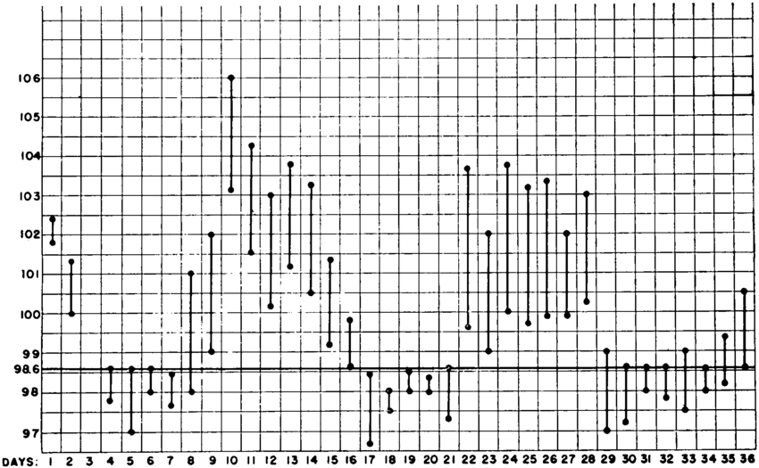
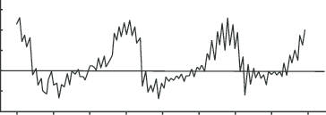
PEL-EBSTEIN FEVER PATTERN

Slide 9
S/S contd.
3) Splenomegaly : Often seen
4) Hepatomegaly: possible but not very common
5) Features of nephrotic syndrome (pathology in
glomerulus is minimal change disease)

Slide 10
DIAGNOSTIC FEATURE
The diagnostic feature are the malignant cells called Reed-Sternberg cells (R-S cells), seen on lymph node biopsy
Large cell with 2 nuclei, looking like BUMA eyes (owl eye appearance)
Biopsy shows R-S cells plus other reactive cells like lymphocytes, histiocytes and fibrosis

Slide 11
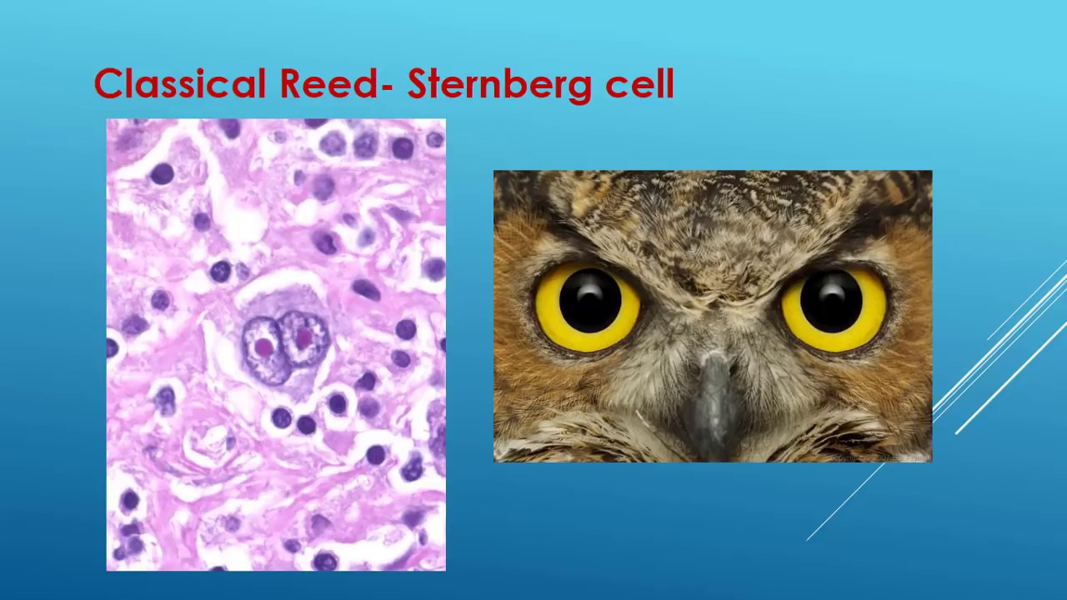
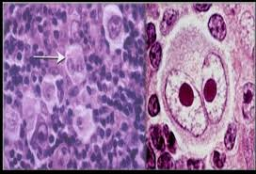
R-S CELL (owl eye appearance)

Slide 12
CLASSIFICATION OF H.D.
Classic Hodgkins Nodular lymphocyte
dominant type
most cases ( only 10% cases)

Slide 13
Classic H.D. is further divided into 4 types, based on the biopsy picture of the nodes:
Lymphocyte rich: RS cells + excess lymphos.
Lymphocyte depleted: RS cells plus very few
lymphos
3) Mixed cellularity type : Almost equal number
of RS cells and lymphos
4) Nodular sclerosis type: RS cells plus lymphos plus
fibrous tissue

Slide 14
DIAGNOSIS
Diagnosis is confirmed by lymph node biopsy, showing the classic R-S cells
After diagnosis, workup is done for staging the lymphoma, so that treatment options can be decided

Slide 15
WORK UP
Routine blood tests( CBC, electrolytes etc)
IMAGING
Whole body imaging is done to see which nodes are affected
CT usually
MRI one of
PET scan these

Slide 16
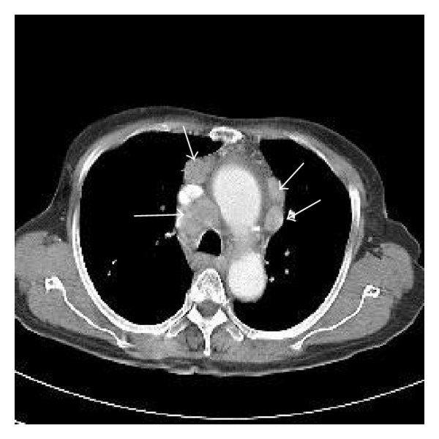
CT chest showing enlarged nodes

Slide 17
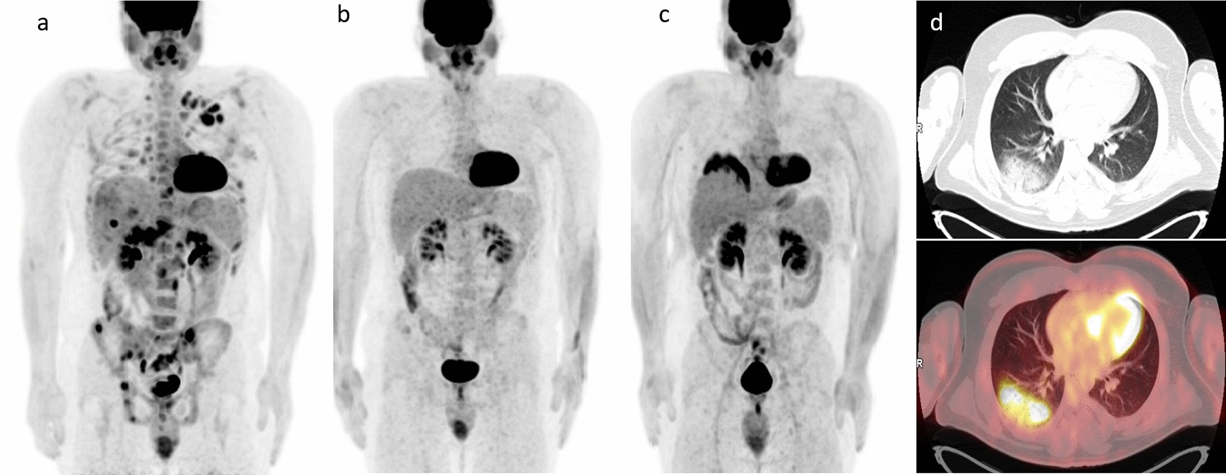
PET SCAN

Slide 18
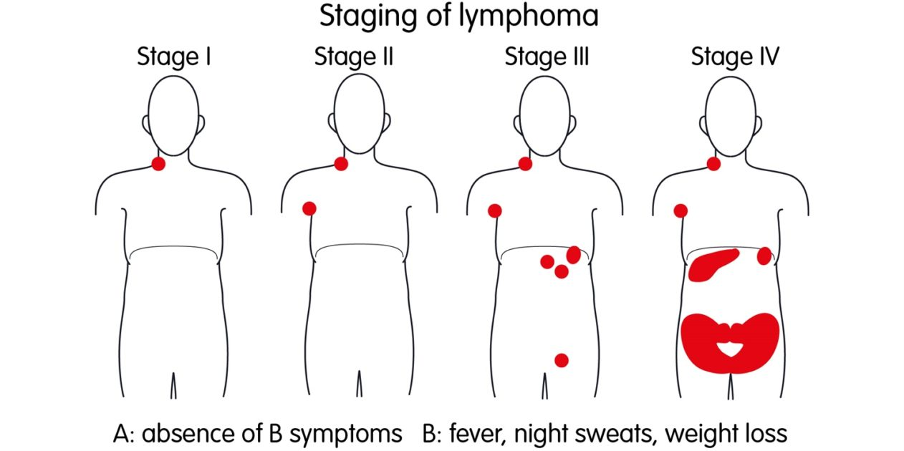
STAGES OF H.D.
Basically 4 stages, based on which lymph node
“regions” are affected
Stage 1: Involvement of only 1 lymph node
region (eg. only cervical, only axillary)

Slide 19
Stage 2: Involvement of 2 or more lymph node
regions on the same side of diaphragm
(eg. Cervical + axillary etc)

Slide 20
Stage 3: Involvement of 2 or more lymph node regions on both sides of the diaphragm

Slide 21
Stage 4: Disseminated disease (involvement of other organs (liver etc)

Slide 22
At any stage, if systemic symptoms (fever, weight loss, night sweats) are absent, we write “A” and if they are present, we write “B”. So
* Stage 1 A, or 1 B
* Stage 2 A, or 2 B
* Stage 3 A, or 3 B
* Stage 4 A or 4 B

Slide 23
QUESTION
Patient with HD with only cervical nodes affected. Also has fever, weight loss. What stage?
Patient with HD has cervical & axillary nodes affected. No systemic features. What stage?

Slide 24
Differential Diagnosis
Enlarged nodes could be due to:
Non Hodgkins lymphoma
Mets from other cancers
Infection in the nodes (primary or draining from other areas). Quite common. Also called lymphadenitis

Slide 25
Treatment of H.D.
Radiotherapy Chemotherapy
( above are given either alone or combined)
Selection of treatment depends on many factors: stage, patient’s age, type of HD etc.

Slide 26
CHEMO REGIMENS
Various combinations of chemo agents are available:
MOPP
ABVD
STANFORD V (5)
BEACOPP

Slide 27
MOPP :
Mustargen, Oncovin, Prednisone, Procarbaz-
-ine
b) Was used in the past. Rarely used now( only in
relapse)
2) ABVD:
Adriamycin, Bleomycin, Vinblastine, Dacarba-
-zine
b) Standard initial treatment in the U.S.

Slide 28
3) Stanford V:
Contains multiple drugs
Used in some countries
4) BEACOPP
Contains multiple drugs
Used mainly in Europe

Slide 29
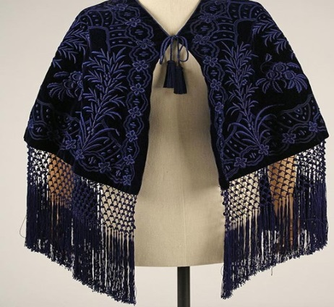
Radiotherapy
Used either alone or with chemo
Radiation to the neck, chest and axilla
mantle field
3) Radiation to the abdomen, spleen & pelvis
inverted Y field

Slide 30
PROGNOSIS
Prognosis of HD depends on many factors but overall, it’s a curable cancer in many patients
Overall 5 year survival rate is 85-90%
Poor prognostic factors are: old age, advanced disease (stage4), presence of B symptoms, large intra thoracic tumor mass

Slide 31
Non Hodgkin’s lymphoma
It also arises in the lymphoid tissues (mainly nodes
Symptoms are mostly the same like Hodgkin’s
No R-S cells
Often seen in HIV people
Treatment is chemo, radiotherapy or stem cell transplant

Slide 32
RAPID FIRE QUES
Which virus is thought to cause Hodgkin’s?
Which age group affected?
Commonest presentation?
Are the nodes painful?
What are the 3 B symptoms?
Does every patient have B symptoms?
What happens after alcohol intake?

Slide 33
8) Which fever pattern is sometimes seen?
9) What is the pattern of this fever?
10) What is the kidney pathology seen in
Hodgkin’s?
11) What is the confirmatory diagnostic test &
what does it show?
12) Name the 4 types of classic Hodgkin’s?
13) Which investigation is done for staging?

Slide 34
14) How many stages of Hodgkin’s?
15) What is stage 1, 2, 3, 4?
16) Patient has enlarged lymph nodes in the neck and axilla. Has also fever and weight loss. What stage?
17) Enlarged nodes in the axilla and the groin.
No fever or wt loss. What stage?
18) Differential diagnosis of enlarged nodes?

Slide 35
19) What are the 2 main Rx modalities?
20) Which chemo regimen is the most used?
21) Name some drugs of this regimen?
22) Name some other regimens?
23) What are the 2 patterns of radiotherapy?
24) Is it a curable cancer?
25) Name 3 poor prognostic factors?

Slide 36
LAST SLIDE IS VERY IMPORTANT

Slide 37


