Slide 1
Management of Diabetes Emergencies
DR H M ABDELRAHIM

Slide 2
Outline
Diabetic ketoacidosis (DKA)
Hyperosmolar hyperglycemic state (HHS)
Acute hyperglycemia
Acute hypoglycemia

Slide 3
Notes:
Because the evidence on which the guidelines are based is not very strong, you will find some differences in recommendations between the UK and the American guidelines
First there are small differences in the diagnostic criteria for DKA,
The threshold level of glucose required for diagnosis in the UK is 200 mg whereas it is 250 mg/dL or above in the American guideline

Slide 4
Notes:
The presence of ketones in serum or urine is required in both guidelines but a specific level is given in the UK guideline of 3 mmol/L or more if serum ketones are checked and two crosses or more if urine ketones are tested for by using urine ketone sticks

Slide 5
Notes:
Regarding the acidosis level required for diagnosis, both agree that a pH of less than 7.3 is needed to confirm acidosis
But for bicarbonate, a level of less than 15 mmol/l is chosen in the UK guideline but in the American guideline, they stated that a level of bicarbonate below 18 is enough to make a diagnosis of mild DKA

Slide 6
Notes:
And lastly, the American guideline talks about a high anion gap as needed for the diagnosis, but because in the UK checking chloride is not part of the routine biochemistry that is done, anion gap is not mentioned as a condition for making the diagnosis.
I will come back to talk in more detail about the anion gap and how to calculate it

Slide 7
Differences in DKA treatment recommendations between UK and ADA/uptodate guidelines
Recommendation | UK | ADA/Uptodate
IV fluids | 0.9% saline only | Consider 0.45% saline if sodium high
Change to dextrose | When glucose 250 mg/dl | When glucose 200 mg/dl
IV insulin bolus | No | Yes
Continue basal insulin analog | Yes | Not mentioned
SC insulin analog | No | Yes, for mild/moderate DKA
Bicarbonate | No | Consider when pH≤6.9
Notes:
There are also differences in management recommendations between the UK and the USA guidelines
First of all, the IV fluid recommended in the UK guidelines is 0.9% normal saline only
But the American guideline recommends considering half normal saline if the serum sodium is high

Slide 8
Differences in DKA treatment recommendations between UK and ADA/uptodate guidelines
Recommendation | UK | ADA/Uptodate
IV fluids | 0.9% saline only | Consider 0.45% saline if sodium high
Change to dextrose | When glucose 250 mg/dl | When glucose 200 mg/dl
IV insulin bolus | No | Yes
Continue basal insulin analog | Yes | Not mentioned
SC insulin analog | No | Yes, for mild/moderate DKA
Bicarbonate | No | Consider when pH≤6.9
Notes:
The UK guideline recommends changing the IV fluid to dextrose when the glucose level reaches 250 mg/dL whereas the cut-off level for change in the American guideline is 200 mg/dL

Slide 9
Differences in DKA treatment recommendations between UK and ADA/uptodate guidelines
Recommendation | UK | ADA/Uptodate
IV fluids | 0.9% saline only | Consider 0.45% saline if sodium high
Change to dextrose | When glucose 250 mg/dl | When glucose 200 mg/dl
IV insulin bolus | No | Yes
Continue basal insulin analog | Yes | Not mentioned
SC insulin analog | No | Yes, for mild/moderate DKA
Bicarbonate | No | Consider when pH≤6.9
Notes:
The UK guideline does not recommend an IV bolus of insulin before starting IV insulin infusion whereas this is recommended in the American guideline

Slide 10
Differences in DKA treatment recommendations between UK and ADA/uptodate guidelines
Recommendation | UK | ADA/Uptodate
IV fluids | 0.9% saline only | Consider 0.45% saline if sodium high
Change to dextrose | When glucose 250 mg/dl | When glucose 200 mg/dl
IV insulin bolus | No | Yes
Continue basal insulin analog | Yes | Not mentioned
SC insulin analog | No | Yes, for mild/moderate DKA
Bicarbonate | No | Consider when pH≤6.9
Notes:
The UK guideline recommends continuing the basal insulin analog but in the American guideline this is not mentioned

Slide 11
Differences in DKA treatment recommendations between UK and ADA/uptodate guidelines
Recommendation | UK | ADA/Uptodate
IV fluids | 0.9% saline only | Consider 0.45% saline if sodium high
Change to dextrose | When glucose 250 mg/dl | When glucose 200 mg/dl
IV insulin bolus | No | Yes
Continue basal insulin analog | Yes | Not mentioned
SC insulin analog | No | Yes, for mild/moderate DKA
Bicarbonate | No | Consider when pH≤6.9
Notes:
There is no mention in the UK guideline of using a subcutaneous insulin analog as a way of insulin administration whereas this is given as an option for treatment in the American guideline for mild or moderate DKA

Slide 12
Differences in DKA treatment recommendations between UK and ADA/uptodate guidelines
Recommendation | UK | ADA/Uptodate
IV fluids | 0.9% saline only | Consider 0.45% saline if sodium high
Change to dextrose | When glucose 250 mg/dl | When glucose 200 mg/dl
IV insulin bolus | No | Yes
Continue basal insulin analog | Yes | Not mentioned
SC insulin analog | No | Yes, for mild/moderate DKA
Bicarbonate | No | Consider when pH≤6.9
Notes:
And lastly the UK guideline does not recommend using IV bicarbonate to treat acidosis but the American guideline recommends considering giving bicarbonate if the pH is very low at less than 6.9

Slide 13
DKA/HHS/Hyperglycaemia
Spectrum of diabetic hyperglycemic emergencies
In any patient with severe hyerglycaemia, need to rule out DKA
DKA is the most important as relatively common and potentially fatal
HHS is more serious but rare
Notes:
The three conditions of DKA, HHS and just hyperglycemia should be considered as part of the spectrum of diabetic hyperglycemis emergencies
Whenever, any patient presents with severe hyperglycemia, the most important task is to rule out DKA because is the most common and can potentially be fatal
HHS is actually more serious and has a higher mortality but it is much less common

Slide 14
Epidemiology of DKA and HHS
In the USA:
Annual incidence: 5-8 per 1000 diabetic subjects
145,000 cases of DKA per year
2.8% of all diabetic admissions are due to DKA
HHS: <1% of all diabetes-related admissions
Notes:
How common are DKA and HHS?
Figures from the United States show that the annual incidence of this condition is between 5 to 8 per 1000 diabetic patients with 145,000 cases of DKA reported per year
and 2.8% of all diabetic admissions are due to DKA
Whereas HHS is a much less common condition, representing only less than 1% of all diabetes-related admissions

Slide 15
Mortality of DKA and HHS
DKA Mortality
Overall: <1%
Elderly + co-morbidities: >5%
Causes of death:
DKA
Underlying cause of DKA, e.g infection, MI
Complications of treatment e.g hypokalaemia, cerebral oedema
HHS mortality: 15%
Notes:
How about mortality from DKA and HHS?
Well, in DKA, the mortality is generally less than 1%
But the mortality can be as high as more than 5% in the elderly and in those with multiple co-morbidities
The causes of death in the DKA include the metabolic abnormalities of the DKA itself, but it could also be due to the underlying condition that caused the DKA such as infections or myocardial infarction
And death could also result from the complications of treatment such hypokalemia or cerebral oedema.
HHS is associated with a much higher mortality of up to 15%

Slide 16
Outline
Diabetic ketoacidosis (DKA)
Hyperosmolar hyperglycemic state (HHS)
Acute hyperglycemia
Acute hypoglycemia

Slide 17
Outline
Diabetic ketoacidosis (DKA)
Hyperosmolar hyperglycemic state (HHS)
Acute hyperglycemia
Acute hypoglycemia

Slide 18
Pathogenesis of DKA
A reduction in the net effective concentration of insulin
Elevation in counter-regulatory hormones
Glucagon
Cortisol
Growth hormone
Catecholamines
Notes:
The main factor in the pathogenesis of DKA is a reduction in the net effective concentration of insulin.
And there is usually an elevation in the levels of the counter-regulatory hormones to insulin which include glucagon, cortisol, growth hormone and the catecholamines.

Slide 19

Pathophysiology
Normal
Insulin
Counterregulatory hormones
Glucagon
Catecholamines
Cortisol
Growth hormone
Notes:
So in the normal situation, there is usually a balance between the activity of insulin and those of these counter-regulatory hormones

Slide 20

Pathophysiology
DKA
Insulin deficiency
Counterregulatory hormones
Glucagon
Catecholamines
Cortisol
Growth hormone
Notes:
And what happens in DKA is that there a disturbance of this balance by the absolute deficiency of insulin and the increase in concentration of these counter-regulatory hormones

Slide 21
Definitions
Gluconeogenesis: formation in liver of glucose from substrates such as amino acids (from protein breakdown) or glycerol (from fat breakdown)
Glycogenolysis: breakdown of glycogen in liver to form glucose
Ketogenesis: formation of ketone bodies in liver from fatty acids
Notes:
Before talking about the details of the pathogenesis of DKA, this is a quick reminder of the definition of some terms that are involved in this process
Gluconeogenesis is the formation in the liver of glucose which is made from substrates like amino acids that come from the breakdown of proteins and glycerol which comes from the breakdown of fat
Glyogenolysis is the term used for the breakdown of glycogen in the liver into glucose
And ketogenesis is another process that happens in the liver in which ketone bodies are made from fatty acids

Slide 22
Insulin Deficiency
Glucose uptake
Lipolysis
Proteolysis
Glycerol
Free Fatty Acids
Amino Acids
Hyperglycemia
Gluconeogenesis
Glycogenolysis
Ketogenesis
Osmotic diuresis
Acidosis
Dehydration
Excess counterregulatory hormones
Notes:
The centra mechanism in DKA is the absolute insulin deficiency which leads to reduced uptake of glucose, to increased breakdown of both proteins and fat
The reduced uptake of glucose into cells leads to excess glucose in blood which in turn leads to osmotic diuresis leading to dehydration.
The increased breakdown of protein in muscle provides amino acids which are substrates for gluconeogenesis exacerbating the hyperglycemia
Glycerol that comes from the breakdown of fats is also a substrate for increased gluconeogenesis
While the breakdown of fats also provides free fatty acids which lead to production of ketones causing the acidosis
And lastly the excess of the counter-regulatory hormones to insulin also contributes to gluconeogeneosis and also the breakdown of glycogen in the liver which again contributes to the hyperglycemia.

Slide 23
Precipitating causes of DKA
Cause | Percentage
Unknown ?poor compliance | 43%
Infections | 28%
Errors in management | 13%
New diagnosis of diabetes | 10%
Miscellaneous e.g MI | 6%
Notes:
So what are the actual precipitating causes of DKA?
These are results from a study done in Birmingham and most other studies showed more or less similar results.
In the large majority of cases (that is 43% in this study) there is no actual clear precipitating cause for DKA but there is always suspicion of poor compliance especially in younger patients who have difficulty coming to terms with their diabetes.
The commonest identifiable cause for DKA is infections and this is in about 28%.
Errors in management were identified in 13% of cases.
In 10% of cases, DKA was the first presentation of type 1 diabetes.
And there were micsellaneous causes in 6% of cases including conditions such as myocardial infarction.

Slide 24
DKA or HHS?
 | DKA | HHS
Age | Any | Older
Diabetes type | T1D (less common in T2D) | T2D
Period of development | Hours | Days
Glucose | ++ (usually 350-500 mg/dL) | ++++ (usually >800 mg/dL)
Notes:
So to compare the clinical DKA with those HHS
DKA usually affects younger patients but it can affect any age, whereas HHS usually affects the elderly
DKA usually occurs in patients with type 1 perhaps and much less commonly it can be seen in type 2 patients whereas HHS typically occurs in patients with type 2 diabetes.
DKA develops quickly over hours and usually within less than 24 hours but HHS develops over a much longer period of usually several days
The degree of hyperglycaemia is much more marked in HHS compared with DKA, with the typical glucose levels in the DKA between 350 and 500 mg/dl but in HHS it is usually more than 800 mg/dL.

Slide 25
DKA or HHS?
 | DKA | HHS
Hyperosmolality | + | ++++ >320 mOsmol/kg
Bicarbonate | <15 | ≥15
pH | <7.3 | ≥7.3
Urinary ketones | Moderate/large | Small/absent
Water deficit (L) | 4-10 | 8-15
Notes:
There is some hyperosmolality in patients with DKA from hyperglycemia but the typical feature of HHS is that the degree of hyperosmolality is much higher and usually more than 320 mOssmolper kilogram
The main dividing factor between the two conditions is the presence of acidosis in DKA its absence in HHS. So bicarbonate and pH will usually be low in DKA and normal in HHS.
Ketones when checked in urine are usually in moderate to large amounts in DKA but the presence of small amounts of ketones in the urine does not actually rule out HSS as these patients may have a small amount of ketones in urine due to starvation.
And lastly due to the degree of dehydration, there is usually a much larger water deficit in HHS than in DKA.

Slide 26
Typical deficits in DKA and HHS
Element | DKA | HHS
Water (ml/kg) | 100 | 100-200
Water (L) | 7 | 10
Sodium (mmol/kg) | 7-10 | 5-13
Chloride (mmol/kg) | 3-5 | 5-15
Potassium (mmol/kg) | 3-5 | 4-6
Notes:
In a patient with moderate DKA, these are the typical estimated deficits
There is dehydaration with a typical water deficit of 100 ml/kg which equates to about 7 litres in a 70 kg patient
With water there are also large deficit of sodium as well deficits in chloride and potassium

Slide 27
Diagnosis of DKA
All patients with T1D who present unwell, dehydrated or with osmotic symptoms should be investigated for DKA
If facilities limited, check plasma glucose and urine dipstick for ketones
If facilities allow, do venous blood gas for pH and bicarbonate
Arterial blood gas is only needed in critically ill patients (oxygen saturation <90%, hypotension or reduced level of consciousness)
Notes:
We should always have a low threshold for suspecting DKA in patients with type 1 diabetes, so if these patients present with being unwell, dehydrated or they have osmotic symptoms, they should be investigated to rule out DKA
The investigations of course will depend on what facilities are available, but the priority is to do plasma glucose and to do a urine dipstick to look for ketones
If facilities can allow, then doing a venous blood gas to check pH and venous bicarbonate can exclude or confirm acidosis
In most patients, an arterial blood has will not be needed, this is only needed in patients who are critically ill such as those with hypoxia with oxygen saturation of less than 90%, those with hypotension or with reduced level of consciousness

Slide 28
Diagnosis of DKA
Criteria | Level for DKA diagnosis
Hyperglycemia D | Plasma glucose ≥200 mg/dl Or Known diabetes
Ketonuria K | ≥2 + on urine dipstick
Acidosis A | Bicarbonate <15 mmol/L And/Or Venous/arterial pH <7.3
Notes:
For the diagnosis of DKA to be made, 3 criteria must be fulfilled: all three will need to be present, so you need the D (for diabetic) or the hyperglycemia, you need the K (for ketones in urine) and you need the A (for the acidosis)

Slide 29
Diagnosis of DKA
Criteria | Level for DKA diagnosis
Hyperglycemia D | Plasma glucose ≥200 mg/dl Or Known diabetes
Ketonuria K | ≥2 + on urine dipstick
Acidosis A | Bicarbonate <15 mmol/L And/Or Venous/arterial pH <7.3
Notes:
So for the D or hyperglycemia, this is defined as a plasma glucose of usually more than 200 mg/dl, however, in any patient who is known to have diabetes, if other features are present, even glucose levels lower than this may be associated with the so-called euglycemic diabetic ketoacidosis.

Slide 30
Diagnosis of DKA
Criteria | Level for DKA diagnosis
Hyperglycemia D | Plasma glucose ≥200 mg/dl Or Known diabetes
Ketonuria K | ≥2 + on urine dipstick
Acidosis A | Bicarbonate <15 mmol/L And/Or Venous/arterial pH <7.3
Notes:
The other criterion is the presence of ketones in urine, which is identified by the presence of 2 crosses or more of ketones on urine dipstick testing.

Slide 31
Diagnosis of DKA
Criteria | Level for DKA diagnosis
Hyperglycemia D | Plasma glucose ≥200 mg/dl Or Known diabetes
Ketonuria K | ≥2 + on urine dipstick
Acidosis A | Bicarbonate <15 mmol/L And/Or Venous/arterial pH <7.3
Notes:
And the third criterion is to demonstrate the presence of acidosis by showing either a plasma bicarbonate level of less than 15 mmol/l or venous or arterial pH of less than 7.3

Slide 32
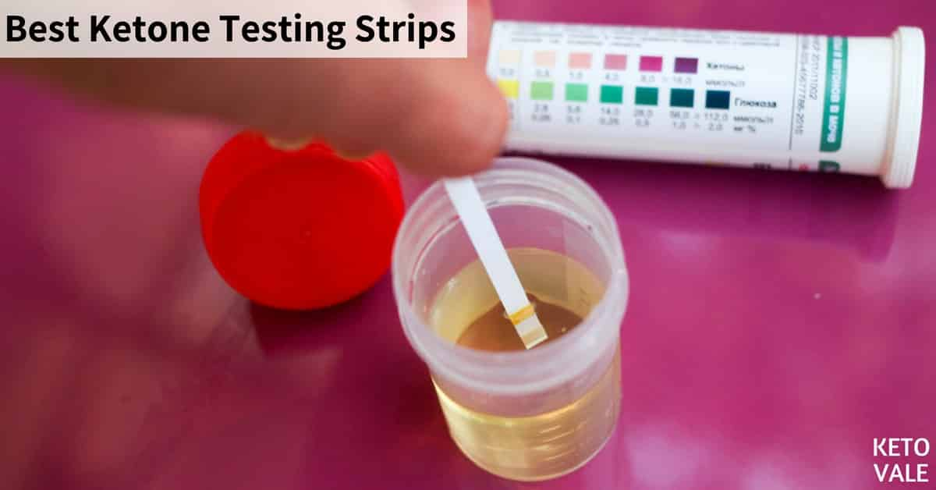
Ketones
Beta-hydroxybutyrate,
Acetoacetate
Acetone
The nitroprusside test used in urine test strips detects actoacetate and acetone but not beta-hydroxybutyrate
Beta-hydroxybutyrate is the predominant ketone in DKA
Ketoacidosis may be present without detectable urinary ketones
Notes:
A few words about ketones
There are three ketone bodies, beta-hydroxybutyrate, acetoacetate and acetone
The most commonly used test for ketones in urine is the nitroprusside test which which is used in the urine test strips, this test detects two ketone bodies in urine, acetoacetate and acetone but it does not detect the third ketone body which is beta-hydroxybutyrate
This is an important limitation of the nitroprusside test because beta-hydroxybutyrate is the predominant ketone in cases of DKA
And for this reason, it is possible to have DKA with negative ketones in urine

Slide 33
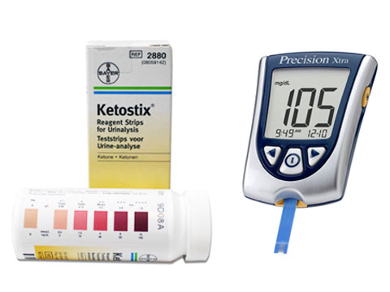
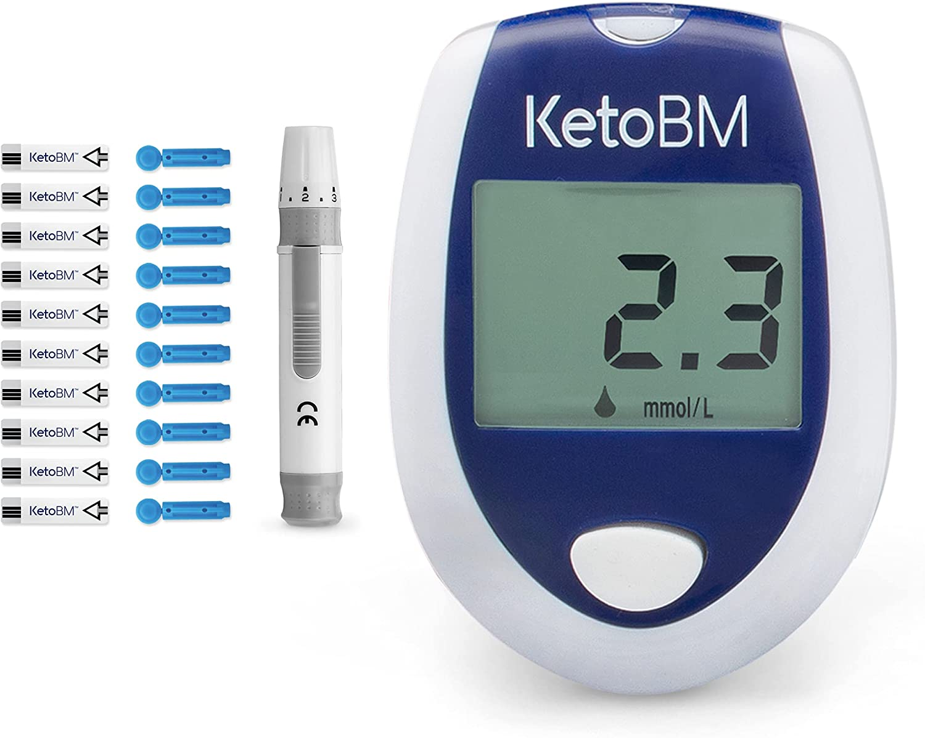
Ketones
Blood ketone testing detects beta-hydroxybutyrate
Blood ketone testing (if available) may enable early identification of DKA
Notes:
And because of this limitation of the nitroprusside test, a blood test that can detect beta-hydroxybutyrate in blood has been developed, unfortunately this test is more expensive and is not widely available, but if it can be done, it can be very helpful because it makes it possible to identify DKA early as well as follow patients during treatment with serial testing for plasma beta-hydroxybutyrate

Slide 34
The anion gap
Sodium – (Chloride + Bicarbonate)
Normal range: 7-10 mmol/L
High anion gap metabolic acidosis: >10
Differential diagnosis:
DKA
Lactic acidosis
Salicylate poisoning
Ethylene glycol ingestion
Alcoholic ketoacidosis

Slide 35
Beware of Euglycemic DKA
Plasma glucose <250 mg/dL
10% of cases of DKA
More in pregnancy
Poor oral intake
Partial treatment with insulin
Use of SGLT2i
Notes:
It is important to be alert to this condition called Euglycemic DKA
It is defined as DKA with the plasma glucose less than 250 mg per dL
This can be the situation in 10% of cases of DKA
It occurs more in pregnancy
And also when there is poor oral intake
In those who have received partial treatment with insulin
And it has been associated with use of the SGLT2 inhibitors

Slide 36
History
Thirst and polyuria
Nausea / vomiting
Abdominal pain
Notes:
Typically in DKA, there is a history of the osmotic symptoms of thirst and polyuria
Nausea and vomiting are common and some patients have abdominal pain

Slide 37
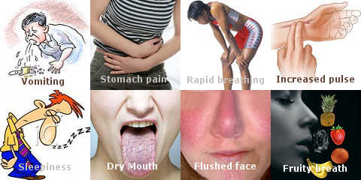
History
Thirst and polyuria
Nausea / vomiting
Abdominal pain
Physical examination
Tachycardia/ hypotension
Tachypnoea
Kussmaul’s respiration (air hunger)
Dehydration
Ketotic breath
Confusion / coma
Notes:
On examination of these patients, there is usually tachycardia and some patients may have hypotension
There is usually a rapid respiratory rate and some patients may have what is called Kussmalul’s respiration or air hunger
There will be signs of dehydration,
Some patients may have the smell of ketotic breath
And there may be impairment of consciousness with confusion and some patients may present in a coma

Slide 38
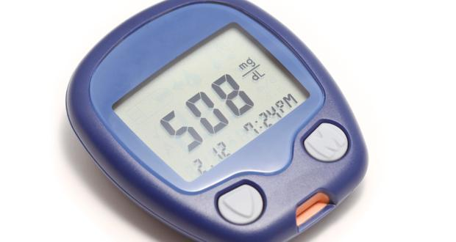
Investigations
Immediate for diagnosis:
Capillary blood glucose
Venous pH/ bicarbonate
Urine ketones
Notes:
The investigations that are needed immediately to make the diagnosis include a capillary blood glucose using a glucometer
Venous blood for pH or venous bicarbonate to confirm the acidosis
And testing the urine with dipstick to check for ketones

Slide 39
Investigations
Urgent for assessment and treatment:
Plasma glucose
Creatinine, urea, sodium and potassium
Complete blood count
Midsteram urine
Notes:
Other investigations that are also important urgently include
a laboratory plasma glucose done to confirm hyperglycemia
Plasma creatinine, urea, sodium and potassium
A complete blood count, mainly to look at the white blood cell count
A midstream urine sample to check for infection
And doing HbA1c will also be helpful as it gives an idea about diabetes control before the acute episode

Slide 40
Investigations
Other tests to be considered (if indicated):
Blood film for malaria
Urine culture
Blood culture
HbA1c
ECG
Chest-X-ray
Notes:
Other tests that may be needed in some cases, depending on the circumstances are:
A blood film for malaria
Culture of urine and blood to look for infection
An ECG and some patients may need chest-X-ray to look for evidence of chest infection

Slide 41
Management of DKA
IV fluids
IV (or SC) insulin
Potassium replacement
Treatment of precipitating cause
Transition to subcutaneous insulin
Notes:
These are the elements of management of DKA:
And I will look at each of them individually
They include: first resuscitation with intravenous fluids
Ideally insulin should be given by intravenous infusion, but if facilities are not available, it can be given subcutaneously
Replacing potassium
The underlying cause for DKA should be identified and treated
Regular fetal assessment should be performed
And when the DKA has resolved, there should be transition to subcutaneous insulin

Slide 42
Monitoring
Hourly:
Pulse
BP
RR
Fluid input/output
Capillary glucose
Four Hourly:
Potassium
Bicarbonate
Urine dipstick for ketones
Notes:
Regular monitoring of the patient includes checking hourly the pulse rate, blood pressure, respiratory rate, fluid input and output and capillary glucose
While potassium, venous bicarbonate l and urine dipstick for ketones should be checked at least every 4 hours

Slide 43
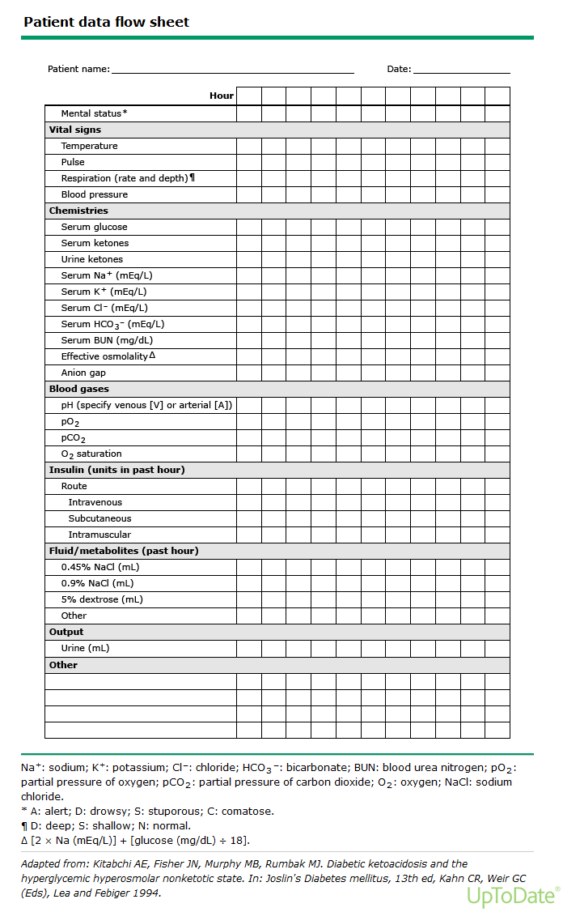

Slide 44
Indications for admission to ICU
(dependent on available facilities)
Bicarbonate <5 mmol/L
pH (venous or arterial) <7.0
Glasgow coma scale <10
Systolic BP<90 mmHg
Notes:
The criteria for admission to ICU are of course subjective and will always depend on what facilities are available
So generally speaking, patients who have severe DKA and may be considered for ICU treatment include:
Those who have a very low bicarbonate of less than 5 mmol/L
Those who have a very low pH at less than 7
If the Glasgow coma scale is low at less than 10
And if systolic blood pressure is less than 90 mmHg

Slide 45
IV fluids
Aims:
Correct hypotension by restoring circulatory volume
Clearance of ketone
Correct electrolyte imbalance
Notes:
The most important therapeutic measure in treatment of DKA is IV fluid replacement
And the aims of this include:
First to correct the hypotension by restoring the circulatory volume
To clear the ketones
And to correct the electrolyte imbalance

Slide 46
IV fluids
0.9% normal saline is the fluid of choice
If normal saline is not available, Ringer’s lactate is an acceptable alternative
When glucose reaches 250 mg/dL, change to 10% dextrose
For euglycemic DKA: replacement fluid should be dextrose 10%
Notes:
The fluid of choice for IV fluid replacement is normal saline
If, for any reason, normal saline is not available, then Ringer’s lactate is an acceptable alternative, one litre of this solution contains 131 mmol of sodium, 111 mmol of chloride and 5 mmol of potassium, which means it is close to the composition of normal saline
When glucose goes down to 250 mg/dL, the fluid should be changed to 10% dextrose, this can be in addition to continuing saline if it is felt that more IV fluids are needed.
For patients who present with euglycemic ketoacidosis, where the presenting sodium is not high, the fluid given should be dextrose 10% to allow giving insulin and avoid hypoglycemia.

Slide 47
Element | 0.9% sodium chloride (Normal saline) | Ringer lactate (Hartmann’s solution)
Sodium | 150 | 131
Chloride | 150 | 111
Potassium | 0 | 5
Lactate | 0 | 29
Calcium | 0 | 2
Source: BNF

Slide 48
IV fluids
Suggested guide for rate of IV saline infusion for most patients with DKA
Element | Rate ml/hour
1st litre over 1 hour | 1000
2nd litre over 2 hours | 500
3rd litre over 2 hours | 500
4th litre over 4 hours | 250
5th litre over 4 hours | 250
Notes:
This is a suggested guide for the rate of IV fluid replacement which may be suitable for most adult patients with DKA
One litre should be given over one hour
Then 2 litres to be given over 2 hours each
And then 2 litres to be given over 4 hours each

Slide 49
IV fluids
Suggested guide for rate of IV saline infusion for most patients with DKA
Element | Rate ml/hour
1st litre over 1 hour | 1000
2nd litre over 2 hours | 500
3rd litre over 2 hours | 500
4th litre over 4 hours | 250
5th litre over 4 hours | 250
5 litres over first 13 hours
Notes:
On average, 5 litres will be given over the first 12 to 13 hours

Slide 50
IV fluids
If systolic BP <90 mmHg, give 500 ml saline over 10-15 minutes
Repeat if systolic BP still <90 mmHg
Notes:
These are just a general guide for the average patient
But judgement and clinical assessment should be used to decide on the rate of fluid to be given, so some patients may need more quick and aggressive fluid replacement

Slide 51
IV fluids
If systolic BP <90 mmHg, give 500 ml saline over 10-15 minutes
Repeat if systolic BP still <90 mmHg
Slower rates of infusion in:
18-25 years
>70 years
Pregnant ladies
Cardiac or renal failure
Notes:
While others may need more gentle and slow fluid replacement

Slide 52
Potassium replacement
Hypokalemia may cause cardiac arrhythmias
In spite of potassium deficit, serum potassium on admission is usually normal
Aim to maintain potassium 4-5 mmol/L
Notes:
Replacing the potassium deficit is a crucial part of management because hypokaelmia may cause cardiac arrhythmias which sometimes can be life-threatening
It is important to remember that in spite of the overall potassium deficit, when we measure serum potassium on admission it may be normal
The aim of potassium replacement is to maintain the serum potassium at a level of between 4 and 5 mmol/l

Slide 53
Potassium replacement
If plasma potassium result available quickly on admission, follow table below:
Serum potassium | Potassium chloride/litre fluid
> 5.5 mmol/L | Give saline with no added KCl
3.3 - 5.5 mmol/L | Add KCl 20 mmol to each 500 ml bag of saline
<3.3 mmol/L | Add KCl 20 mmol to each 500 ml bag of saline and: consider increasing rate of infusion if fluid balance allows withhold insulin until potassium ≥3.3
Notes:
If we are able to get a plasma potassium done and the result available quickly, we should follow these recommendations from the joint British societies guideline for the management of DKA
If the potassium level on admission is more than 5.5 mmol/l, no potassium is added to the saline fluid
If the level is between 3.3 and 5.5 mmol/l, 20 mmol of potassium chloride should be added to each 500 ml bag of normal saline
And if potassium is very low at less than 3.3 mmol/l, two measures should be taken, first, we should consider increasing the rate of the infusion of the fluid containing potassium
And in this situation also insulin should be withheld until the potassium has risen to above 3.3 mmol/L as giving insulin will cause further lowering of potassium which can cause life-threateneing arrhythmias.

Slide 54
Potassium replacement
If plasma potassium result not available on admission:
The first 2 bags of 500 ml saline should be without added potassium
When potassium result known, follow previous table
Notes:
In case the plasma potassium result is not available on admission, the safe course of action is to give the first two bags without added potassium
And once the result of potassium is known, then one can follow the recommendations in the table I just showed

Slide 55
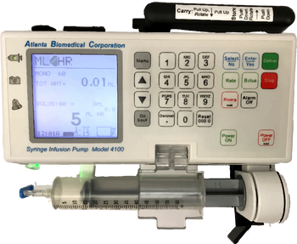
Insulin therapy
If syringe infusion pump available:
Add 50 units of soluble human insulin (e.g actrapid) to 50 ml normal saline, this gives a concentration of 1 unit/ml
This should be infused into a separate IV line and the solution should be changed every 6 hours
Infuse at a fixed rate of 0.1 unit/kg/hour, based on estimating patient’s weight (e.g 8 units/hour in an 80 kg person)
Notes:
Now coming to insulin therapy for DKA
And here again, the recommendation to follow will depend on whether a syringe infusion pump is available which is the ideal situation or whether it is not available
If a syringe infusion pump is available, then insulin should be given by IV infusion
The insulin used for IV infusion is usually soluble insulin and this is prepared by adding 50 units to 50 ml of normal saline, which gives a concentration of 1 unit per ml.
This should be given through a separate IV line to that used for the IV fluid replacement and the solution should be changes at leas6 every 6 hours
The infusion should be at a fixed rate of 0.1 unit per kilogram per hour which can be based on estimating the patient’s weight, so for example an 80 kg person can have the insulin infusion at a rate of 8 units per hour

Slide 56
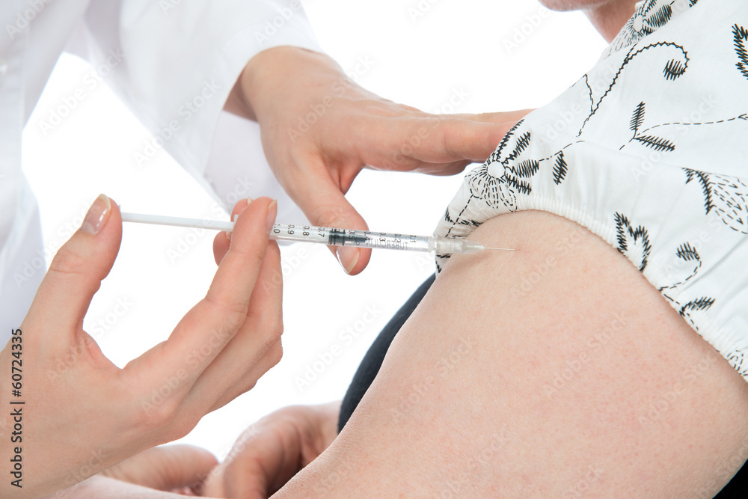
Insulin therapy
If syringe infusion pump is not available:
Give a subcutaneous injection of soluble human insulin (e.g actrapid) at a dose of 0.1 unit/kg every hour (or 0.2 units/kg every 2 hours)
With both IV or SC regimes:
Long-acting basal insulin analogs (glargine or detemir) should be continued
Notes:
If a syringe infusion pump is not available, the alternative method is to give insulin through the subcutaneous route
And here the soluble human insulin should be given at a dose of 0.1 unit per kilogram every hour, or alternatively it can be given every 2 hours at a dose of 0.2 units per kg every 2 hours
And with both the IV and the SC regimes, it is now recommended that patients who are on long-acting basal insulin analogs, should continue to have these insulins as they provide a background insulin supply that will be helpful after recovery from the DKA.

Slide 57
Insulin therapy
Aim to reduce plasma glucose gradually by 55-90 mg/dL/hour
If the drop of plasma glucose is less than 55 mg/dL/hour: increase insulin (IV or SC) dose by 1 unit/hour every hour until target achieved
If K<3.3, withhold insulin until K≥3.3
Notes:
A reasonable drop in plasma glucose to aim for is a reduction by 55 to 90 mg per dL every hour
And if the drop is less than 55 mg per dL per hour, then the rate of insulin given either IV or subcutaneously should be increased by 1 unit per hour every hour until the target is achieved
And again a reminder about this important point, which is that if the potassium level on admission is very low at less than 3.3 mmol/l, insulin infusion may actually worsen the hypokalemia leading to arrhythmias and therefore insulin infusion in these cases should be withheld until potassium has risen to above 3.3 mmol/l
The insulin used for IV infusion is usually soluble insulin and this is prepared by adding 50 units to 50 ml of normal ssline, which gives a concentration of 1 unit per ml.
This should be infused at a fixed rate of 0.1 unit per kilogram per hour
If targets are not achieved, the rate of insulin infusion should be increased by 1 unit per hour
It is important to point that if the potassium level on admission is very low at less than 3.3 mmol/l, insulin infusion may actually worsen the hypokalemia leading to arrhythmias and therefore insulin infusion in these cases should be withheld until potassium has risen to above 3.3 mmol/l
It is also recommended that patients who are on long-acting basal insulin analogs, these should be continued as they provide a background insulin supply that will be helpful after recovery from the DKA.

Slide 58
Signs of satisfactory progress
Venous bicarbonate should rise by 3 mmol/L/hour
Capillary glucose should fall by 55 mg/dL/hour
Target plasma glucose: 110-250 mg/dL
Notes:
The targets to be achieved during treatment of DKA are first:
Venous bicarbonate should rise by 3 mmol per litre per gour
And capillary glucose should fall by 55 mg per decilitre per hour
And capillary glucose should fall by 55 mg per decilitre per hour
The target plasma glucose to aim for in DKA is a level of between 110 and up to 250 mg per dL.

Slide 59
Bicarbonate
Rarely necessary and usually if pH <6.9
Should be given very cautiously, only in ICU
Notes:
All guidelines agree that bicarbonate is rarely necessary as the acidosis can be corrected by IV fluids and by insulin
The American guideline advises at least considering giving bicarbonate when the pH is very low at less than 6.9
If it is given, this should be done very cautiously and this should usually be in an intensive care unit setting

Slide 60
Treatment of precipitating cause
Detailed history and examination to direct investigations for cause
Omission of insulin is a common cause (history)
Investigate as appropriate for infection, fever is not necessarily present
Raised WBC up to 15,000 is common with DKA without infection
Notes:
It is also important to address the underlying cause for the DKA
And here it is important to take a detailed history and perform examination so that investigations can be directed appropriately
We should also remember that one of the commonest caused for DKA is omission of insulin and here the education of the patient is very important to avoid this happening again
When we are thinking about infection, we should remember that fever is not necessarily present in these cases
And it is also important to remember that a raised white cell count does not necessarily represent infection as it may be caused by excess cortisol and catecholamines

Slide 61
Resolution of DKA
Defined as:
pH >7.3 and/or bicarbonate >18 mmol/L
The patient is eating and drinking
Notes:
When DKA has resolved, the patient should be converted to subcutaneous insulin and the resolution is defined when these criteria are satisfied:
The pH rises to above 7.3 or the bicarbonate has risen to above 15 mmol per litre
And the patient should be able to eat and drink

Slide 62
Resolution of DKA
Disappearance of ketonuria is not a condition for resolution of DKA:
Acetone may remain positive in urine up to 36 hours after resolution of DKA and clearance of the main ketones, beta-hydroxybutyrate and acetoacetate
Notes:
Here it is also important to point out that we do not put clearance of ketones from urine as a condition for resolution of the DKA
And this is because acetoacetate is usually converted to acetone which is cleared slowly in urine and for this reason, acetone may remain positive in urine for up to 36 hours after the clearance of the other main ketones, acetoacetate and beta-hydroxybutyrate

Slide 63
Management of the recovery period from DKA
Restart usual insulin regime
For newly diagnosed diabetes, start basal bolus insulin at a total dose of 0.5-0.7 units/kg/day
Give first SC rapid-acting insulin before next meal and discontinue IV insulin one hour later
Notes:
When the DKA has resolved, the patient’s usual insulin regime should be restarted
For those who are newly diagnosed with diabetes, they should be started on a basal bolus insulin regime, a usual starting dose is 0.5 to 0.7 units per kilogram per day.
And because the half-life of the soluble insulin given intravenously is very short, the first subcutaneous dose of soluble insulin should be given before the next meal and the IV insulin should be continued for at least an hour before it is stopped.

Slide 64
Complications of DKA
Hypokalemia and hyperkalemia
Can be life-threatening,
Avoid by regular monitoring and careful potassium replacement
Hypoglycemia
Avoid by giving dextrose 10% when glucose reaches 250 mg/dL
Cerebral odema
Usually in children and adolescents
Avoid by cautious fluid replacement in young patients
Notes:
Complications that can occur during treatment of the DKA include
First potassium abnormalities hypokalemia and hyperkalemia
And these can be quite serious and life-threatening
But they can be avoided by monitoring potassium regularly and replacing it carefully
Hypoglycemia can be avoided by giving dextrose 10% when the glucose levels start to drop and reach a level of 250 mg/dL
And lastly cerebral oedema which usually occurs in children or adolescents and is thought to occur when fluid is given too aggressively can be avoided by giving replacement fluids gently and carefully in the younger patients

Slide 65
Complications of DKA
Hypokalemia and hyperkalemia
Can be life-threatening,
Avoid by regular monitoring and careful potassium replacement
Hypoglycemia
Avoid by giving dextrose 10% when glucose reaches 250 mg/dL
Cerebral odema
Usually in children and adolescents
Avoid by cautious fluid replacement in young patients
Notes:
Complications that can occur during treatment of the DKA include
First potassium abnormalities hypokalemia and hyperkalemia
And these can be quite serious and life-threatening
But they can be avoided by monitoring potassium regularly and replacing it carefully
Hypoglycemia can be avoided by giving dextrose 10% when the glucose levels start to drop and reach a level of 250 mg/dL
And lastly cerebral oedema which usually occurs in children or adolescents and is thought to occur when fluid is given too aggressively can be avoided by giving replacement fluids gently and carefully in the younger patients

Slide 66
Complications of DKA
Hypokalemia and hyperkalemia
Can be life-threatening,
Avoid by regular monitoring and careful potassium replacement
Hypoglycemia
Avoid by giving dextrose 10% when glucose reaches 250 mg/dL
Cerebral odema
Usually in children and adolescents
Avoid by cautious fluid replacement in young patients
Notes:
Complications that can occur during treatment of the DKA include
First potassium abnormalities hypokalemia and hyperkalemia
And these can be quite serious and life-threatening
But they can be avoided by monitoring potassium regularly and replacing it carefully
Hypoglycemia can be avoided by giving dextrose 10% when the glucose levels start to drop and reach a level of 250 mg/dL
And lastly cerebral oedema which usually occurs in children or adolescents and is thought to occur when fluid is given too aggressively can be avoided by giving replacement fluids gently and carefully in the younger patients

Slide 67
Complications of DKA
Hypokalemia and hyperkalemia
Can be life-threatening,
Avoid by regular monitoring and careful potassium replacement
Hypoglycemia
Avoid by giving dextrose 10% when glucose reaches 250 mg/dL
Cerebral odema
Usually in children and adolescents
Avoid by cautious fluid replacement in young patients
Notes:
Complications that can occur during treatment of the DKA include
First potassium abnormalities hypokalemia and hyperkalemia
And these can be quite serious and life-threatening
But they can be avoided by monitoring potassium regularly and replacing it carefully
Hypoglycemia can be avoided by giving dextrose 10% when the glucose levels start to drop and reach a level of 250 mg/dL
And lastly cerebral oedema which usually occurs in children or adolescents and is thought to occur when fluid is given too aggressively can be avoided by giving replacement fluids gently and carefully in the younger patients

Slide 68
Prevention of DKA
Educate patients and provide written sick day rules
Provide sticks for urine ketone testing and educate on management of ketonuria
Warn about potential insulin ineffectiveness e.g from expired insulin
Notes:
After treatment of the acute episode, one should consider prevention of further episodes of DKA
Any gaps in patient’s education should be identified and they should be re-educated, especially about the sick day rules which I will come to in the next slide
If possible, patients should be provided with sticks for urine ketone testing and they should be educated on what to do if urine ketones are positive
They should also be alerted to check for effectiveness of their insulin for example by checking the expiry date to make sure it is not expired

Slide 69
Prevention of DKA
Sick day rules:
Continue your insulin when you are not feeling well
If vomiting check glucose levels more frequently
Take small amounts of carbohydrates in liquid form with short-acting insulin
Seek help early if you continue to feel unwell
Notes:
Patients with type 1 diabetes, in particular should be reminded about the sick day rules
A very common mistake that patients with type 1 diabetes make is that they stop taking their insulin when they are unwell and not eating for fear of hypoglycemia
It should be stressed to them that they should not stop their insulin when they are not feeling well
If they are vomiting, they need to do more frequent glucose monitoring
It can be helpful for them to take carbohydarets in a liquid form and in small amounts and more often
But if they continue to feel unwell, they should delay seeking help.

Slide 70
Outline
Diabetic ketoacidosis (DKA)
Hyperosmolar hyperglycemic state (HHS)
Acute hyperglycemia
Acute hypoglycemia
Notes:
So that is all about DKA

Slide 71
Outline
Diabetic ketoacidosis (DKA)
Hyperosmolar hyperglycemic state (HHS)
Acute hyperglycemia
Acute hypoglycemia

Slide 72
Terminology
Hyperosmolar Non-ketotic Coma (HONKC)
Hyperosmolar Non-ketotic Hyperglycaemia (HNKH)
Hyperosmotic Hyperglycaemic Non-ketotic State (HHNKS)
New term:
Hyperosmolar Hyperglycaemic State (HHS)
Notes:
And I would like first to start by clearing some confusion about the terminology of this condition
Which in the past has been given several names including the hyperosmolar non-ketotic coma or HONK
The hyperosmolar non-ketotic hyperglycemia
And the hyperosmotic hyperglycemic non-ketotic state
All these terms should no longer be used, and the term used now is:
The hyperosmolar hyperglycemis state or HHS

Slide 73
Precipitating factors of HHS
Infection - most common
Discontinuation of/inadequate insulin
Myocardial infarction, stroke
Medications e.g corticosteroids, thiazides and sympathomimetic agents
Notes:
The commonest precipitating factors for HHS include
First infections, which are the most common cause
Discontinuation of insulin or inadequate intake of insulin can also be a factor
Sometimes the cause is another serious medical event such as myocardial infarction or a stroke
And in some patients, medications that cause hyperglycemia can be the reason such as giving steroids, thiazides or sympathomimetic agents

Slide 74
Pathogenesis of HHS
Less understood than that of DKA
Insulin enough to suppress ketogenesis but not to prevent hyperglycemia
20% of cases of HHS occur in those not previously known diabetic
Delayed recognition of hyperglycemic symptoms + restricted water intake in elderly leads to severe dehydration
Notes:
The pathogenesis of HHS is not s well understood as that of DKA b
These patients are also relatively insulin-deficient, but it is thought that they have insulin which is just enough to suppress ketogenesis but not enough to prevent the hyperglycemia
20% of cases of HHS occur in people who are not previously known to have diabetes
For those who do not know they have diabetes, they may not recognize the symptoms of hyperglycemia, and as HHS usually occurs in elderly patients who have a reduced thirst mechanism and therefore have a restricted water intake, all these factors increase the severity of the dehydration which is usually much more than that seen in DKA

Slide 75
Pathogenesis of HHS
Severe hyperglycemia
Osmotic diuresis
Renal loss of water in excess of sodium
Hypernatremia
Increased osmolality
Notes:
So in HHS, there is usually a severe degree of hyperglycemia,
This usually leads to increased osmotic diuresis
Which leads to renal loss of water in excess of sodium
leading to hypernatremia
And an increase in plasma osmolality

Slide 76
Diagnosis of HHS
Criteria | Level for HHS diagnosis
Plasma osmolality (Osmolality = 2Na + glucose in mmol/L) | ≥320 mOsmol/kg
Hyperglycemia | Plasma glucose ≥550 mg/dl
Clinical criteria | Severe dehydration and feeling unwell
Notes:
So the criteria for the diagnosis of HHS are:
First, a high plasma osmolality of more than 320 mosol per kilogram
The plasma osmolality is calculated by adding 2 times the plasma sodium + the glucose level in mmol per litre.
As I mentioned, the degree of hyperglycemia in HHS is much higher than that in DKA, and the cut-off level for the diagnosis of HHS is a plasma glucose of at least 550 mg per dL.
These are the laboratory criteria, but the diagnosis of HHS requires a clinical criteria of a severely dehydrated patient who is generally unwell

Slide 77
Diagnosis of HHS
Criteria | Level for HHS diagnosis
Absence of acidosis | pH >7.3 And/Or bicarbonate >15 mmol/lre
Absence of ketosis | Urinary ketones ≤ one cross
Occasional patients may have mixed HHS and DKA
Notes:
The diagnosis of HHS also requires ruling out DKA,
And this is by showing that there is no acidosis, confirmed by having a pH level of more than 7.3 or a bicarbonate level of more than 15 mmol/l
And there is usually absence of ketones in urine, so the urinary ketones should be negative or maximally one cross positive
However, it is also important to remember that it is occasionally possible to have a mixed picture of HHS and DKA

Slide 78
Investigations
Immediate for diagnosis:
Plasma glucose
Sodium with calculation of plasma osmolality (2Na + glucose in mmol/l)
Potassium and urea
Venous pH/ bicarbonate (or arterial blood gas if indicated)
Urine ketones
Notes:
In terns of investigations for a patient suspected of having HHS,
The immediate investigations that are needed to confirm the diagnosis are the plasma glucose
We should check sodium to calculate the plasma osmolality using this formula
We should also check potassium to guide potassium replacement
And urea to assess the degree of dehydration
Doing venous pH or venous bicarbonate will be important to rule out acidosis
Arterial blood gases are only indicated in critically ill patients
And checking urine for ketones is also needed to rule out DKA

Slide 79
Investigations
Immediate for diagnosis:
Plasma glucose
Sodium with calculation of plasma osmolality (2Na + glucose in mmol/l)
Potassium and urea
Venous pH/ bicarbonate (or arterial blood gas if indicated)
Urine ketones
Urgent for assessment and treatment:
Complete blood count
Creatinine
Midsteram urine
HbA1c
Blood film for malaria (if indicated)
Notes:
Other investigations that will also be needed include
A complete blood count to look at the white cell count
Creatinine to assess renal function
Doing a midstream urine to rule out UTU
HbA1c will also be helpful to assess whether the hyperglycemia is a truly acute episode or whether it has been longstading
And a blood film for malaria may be indicated in some patients

Slide 80
Indications for admission to ICU
Osmolality >350 mOsmol/kg
Sodium >160 mmol/L
Glasgow coma scale <10
Systolic BP<90 mmHg
Notes:
The indications for admission to ICU include
If the osmolality is very high at above 350 mosol per kg
If the sodium is very high at more than 160 mmol/l
If there is reduced level of consciousness with a Glasgow coma scale of less than 10
And if there is hypotension with a systolic blood pressure of less than 90 mmHg

Slide 81
Aims of treatment in HHS
Replace fluid and electrolyte losses
Gradually normalize plasma osmolality
Gradually normalize plasma glucose
Treat the underlying cause
Notes:
The aims of treatment in HHS include
First replacing the fluid and electrolyte losses
Plasma osmolality should be normalized but very gradually
We should also aim to gradually normalize the plasma glucose
And the underling cause for the HHS should be identified and treated

Slide 82
Aims of treatment in HHS
Reduce plasma osmolality by 3-8 mOsmol/kg/hour
Reduce plasma glucose by 55-90 mg/dL/hour
Target plasma osmolality: <315 mOsmol/kg
Target plasma glucose: 180-250 mg/dL
Notes:
So looking at these targets of treatment more specifically
The plasma osmolality should be reduced by between 3 and 8 mosmol per kg every hour
The target for plasma osmolality to be aimed for is less than 315 mosmol per kg
We should aim to reduce the plasma glucose by between 55 and 90 mg per dL
With a target plasma glucose of between 180 and 250 mg per dL

Slide 83
Other goals of treatment in HHS
Prevention of:
Arterial and venous thrombosis
Neurological complications e.g cerebral oedema/central pontine myelinolysis
Foot ulceration
Notes:
There are other goals while we are treating patients with HHS:
These patients are at high risk from arterial and venous thrombosis, so they should be treated by a prophylactic dose of low molecular weight heparin
They are also at risk from neurological complicatiions like cerebral oedema and central pontine myelinolysis and these should be prevented by careful fluid replacement
And lastly there is a risk of foot ulceration especially in patients who are unconscious and have neuropathy, so foot care is important in these patients

Slide 84
Monitoring
Hourly:
Pulse
BP
RR
Fluid input/output
Capillary glucose
Four Hourly:
Plasma glucose and sodium (with calculation of plasma osmolality)
Potassium
Notes:
Regular monitoring of the patient includes checking hourly the pulse rate, blood pressure, respiratory rate, fluid input and output and capillary glucose
While checking plasma glucose and sodium to calculate plasma osmolality should be done if possible every 4 hours or as close as possible to that
Potassium should also be checked if possible every 4 hours

Slide 85
IV fluids
An adult weighing 70 kg may be up to 10 litres in fluid deficit
0.9% normal saline is the fluid of choice
When glucose reaches 250 mg/dL, change to 10% dextrose at a rate of 125 ml/hour
The rate of fall of plasma sodium should not exceed 10 mmol/L in 24 hours
Notes:
Rehydration with IV fluids is the most important element in management of patients with HHS
These patients are usually much more dehydrated than those with DKA, with an adult patient who weighs 70 kg usually needing 10 litres of fluid
Similar to DKA, the fluid of choice is also normal saline
And when the plasma glucose level reaches 250 mg per dL, the fluid should be changes to 10% dextrose and this can be given at a rate of 125 ml per hour
It is important to make sure that the fall in sodium is gradual and should not be more than 10 mmol per in per 24 hours

Slide 86
IV fluids
Suggested guide for rate of IV saline infusion for most patients with HHS
Element | Rate ml/hour
1st litre over 1 hour | 1000
2nd litre over 2 hours | 500
3rd litre over 2 hours | 500
4th litre over 4 hours | 250
5th litre over 4 hours | 250
Notes:
Again this is a suggested guide for the rate of IV fluid replacement which may be suitable for most adult patients with HHS
One litre should be given over one hour
Then 2 litres to be given over 2 hours each
Ane then 2 litres to be given over 4 hours each

Slide 87
IV fluids
If systolic BP <90 mmHg, give 500 ml saline over 15 minutes
Repeat if SBP still <90 mmHg
In patients with cardiac or renal impairment, adjust rate accordingly
A urinary catheter may be needed to monitor urine output
Notes:
And again of course these rates are a general guide, and the rate should be adjusted according to clinical assessment of the severity of fluid deficit
So for patients who have a systolic BP<90 mmHg at presentation, 500 ml saline should be given over 10-15 minutes and should be repeated if systolic BP is still below 90 mmHg
Caution should be exercised in those who have cardiac or renal impairment
And in these cases, a urinary catheter may be needed so as to monitor the urine output

Slide 88
Potassium replacement
If plasma potassium result available quickly on admission, follow table below:
Serum potassium | Potassium chloride/litre fluid
> 5.5 mmol/L | Give saline with no added KCl
3.3 - 5.5 mmol/L | Add KCl 20 mmol to each 500 ml bag of saline
<3.3 mmol/L | Add KCl 20 mmol to each 500 ml bag of saline and: consider increasing rate of infusion if fluid balance allows withhold insulin until potassium ≥3.3
Notes:
And similar to the DKA guidelines, the recommendation for potassium replacement will depend on whether the result of plasma potassium is immediately available or not:
If we are able to get a plasma potassium done and the result available quickly, we should follow these recommendations from the joint British societies guideline
If the potassium level on admission is more than 5.5 mmol/l, no potassium is added to the saline fluid
If the level is between 3.3 and 5.5 mmol/l, 20 mmol of potassium chloride should be added to each 500 ml bag of normal saline
And if potassium is very low at less than 3.3 mmol/l, two measures should be taken, first, we should consider increasing the rate of the infusion of the fluid containing potassium
And in this situation also insulin should be withheld until the potassium has risen to above 3.3 mmol/L as giving insulin will cause further lowering of potassium which can cause life-threateneing arrhythmias.

Slide 89
Potassium replacement
If plasma potassium result not available on admission:
The first 2 bags of 500 ml saline should be without added potassium
When potassium result known, follow previous table
Notes:
And in case the plasma potassium result is not available on admission, the safe course of action is to give the first two bags without added potassium
And once the result of potassium is known, then one can follow the recommendations in the table I just showed

Slide 90
Insulin therapy
Fluid replacement alone (without insulin) will lower plasma glucose
Start insulin only if:
Rate of fall plasma glucose is less than 55 mg/dL/hour
Urinary ketones ≥++ (i.e mixed DKA and HHS)
Aim for reduction in plasma glucose of 55-90 mg/dL/hour
Target plasma glucose is 180-250 mg/dL
Notes:
The situation regarding insulin therapy in HHS is a little different from DKA
Here, it is expected that IV fluid replacement alone without insulin will result in lowering of glucose levels
And in HHS, it is recommended that insulin therapy should only be started in these situations:
First, if the rate of plasma glucose fall is less than the expected rate of 55 mg per dL per hour
Or if there are urinary ketones more than 2 crosses, which means the patient has a mixed picture of ketoacidosis and HHS
When insulin is given, the aim is to reduce plasma plasma glucose by between 55 and 90 mg per dL
And the target is to maintain plasma glucose between 180 and 250 mg per dL

Slide 91
Insulin therapy
If syringe infusion pump available:
Add 50 units of soluble human insulin (e.g actrapid) to 50 ml normal saline, this gives a concentration of 1 unit/ml
This should be infused into a separate IV line and the solution should be changed every 6 hours
Infuse at a fixed rate of 0.05 unit/kg/hour, based on estimating patient’s weight (e.g 4 units/hour in an 80 kg person)
Notes:
And similar to DKA, the recommendation to follow will depend on whether a syringe infusion pump is available which is the ideal situation or whether it is not available
If a syringe infusion pump is available, then insulin should be given by IV infusion
The insulin used for IV infusion is usually soluble insulin and this is prepared by adding 50 units to 50 ml of normal saline, which gives a concentration of 1 unit per ml.
This should be given through a separate IV line to that used for the IV fluid replacement and the solution should be changes at leas6 every 6 hours
The infusion should be at a fixed rate of 0.05 unit per kilogram per hour which can be based on estimating the patient’s weight, so for example an 80 kg person can have the insulin infusion at a rate of 8 units per hour, which is a lower rate than that used in patients with DKA because patients with HHS usually need less insulin than those with DKA.

Slide 92
Insulin therapy
If syringe infusion pump is not available:
Give a subcutaneous injection of soluble human insulin (e.g actrapid) at a dose of 0.05 unit/kg every hour (or 0.1 unit/kg every 2 hours)
Reduce dose to 0.025 unit/kg/hour SC when glucose is <250 mg/dL
Notes:
If a syringe infusion pump is not available, the alternative method is to give insulin through the subcutaneous route
And here the soluble human insulin should be given at a dose of 0.05 unit per kilogram every hour, or alternatively it can be given every 2 hours at a dose of 0.1 units per kg every 2 hours
And when the glucose level reaches 250 mg per dL, the dose of subcutaneous insulin should be reduced to 0.025 unit per kg per hour

Slide 93
HHS- Other management issues
Seek an infective source based on history/examination + relevant investigations (urine culture, blood film for malaria, etc)
Give prophylactic dose of low molecular weight heparin
Take measures to avoid pressure on feet, especially in patients with neuropathy or PVD
Notes:
It is also important to identify and treat the underlying cause of HHS, infection is a common cause, so a source of infection should be looked for carefully by first taking a good history and performing examination and then direct investigations accordingly such as doing urine culture or a blood film for malaria
To prevent thrombosis, a prophylactic dose of low molecular weight heparin should be given
And one should also take measures to avoid pressure on feet, this is especially important in those who already have neuropathy or peripheral vascular disease

Slide 94
Resolution of HHS
Stop insulin (IV or SC) when:
The patient is fully conscious
Well-hydrated
Eating and drinking
Plasma osmolality <315 mOsmol/kg
Notes:
Resolution from HHS is defined when these criteria are satisfied:
And the patient should be fully conscious
Should be well-hydrated
Should be able to eat and drink
And the plasma osmolality should be less than 315 mosmol per kg

Slide 95
Management of the recovery period from HHS
If previously on insulin: restart usual insulin regime
If previously on diet/oral hypoglycemic drugs: restart if clinically well and stable
If newly diagnosed diabetes: decide on appropriate treatment (diet, OHAs or insulin) depending on clinical condition and HbA1c
Educate patient to reduce risk of recurrence of HHS
Notes:
After recovery from HHS, a decision should be made about the treatment for diabetes
So for those who are already on insulin, they should be restarted on their usual insulin regime
For those who were previously on diet or oral hypoglycemic drugs, if they return to their baseline situation and if their previous diabetes control was satisfactory, they can actually go back to their usual treatment
For those who are newly diagnosed with diabetes, a decision should be made on the appropriate treatment, depending on their overall clinical condition and the HbA1c level
Patients who have been admitted with HHS should also receive education to reduce the risk of it happening again

Slide 96
Outline
Diabetic ketoacidosis (DKA)
Hyperosmolar hyperglycemic state (HHS)
Acute hyperglycemia
Acute hypoglycemia

Slide 97
Outline
Diabetic ketoacidosis (DKA)
Hyperosmolar hyperglycemic state (HHS)
Acute hyperglycemia
Acute hypoglycemia

Slide 98
Acute hyperglycemia without DKA
Priority is to rule out DKA, especially in patients with type 1 diabetes
If DKA confirmed, follow DKA protocol
Notes:
And here the first priority, especially in women with type 1 diabetes, is to rule out DKA
And if DKA is confirmed, they should be managed along the lines of the DKA protocol I mentioned before

Slide 99
Acute hyperglycemia without DKA
Once DKA ruled out, the next priority is to decide on need for hospital admission
If clinically unwell, vomiting or unable to take orally, stabilization in hospital is preferred
Notes:
Once DKA has been ruled out, the next priority after this is to make a decision on whether the patient can be treated as out-patient or will need to be admitted to hospital
If the patient is clinically unwell, vomiting and unable to take orally, they need to be admitted to be stabilized in hospital

Slide 100
In-hospital treatment of acute hyperglycemia
Clinical assessment to identify and treat reason for hyperglycemia e.g UTI, chest infection, etc.
If dehydrated, treat with IV saline
If on insulin: review insulin regime and step up insulin doses aiming for normoglycemia
Continue basal insulin, adjust short-acting insulin according to monitored glucose levels
Notes:
When admitted, a clinical assessment should be performed to look for and treat any reasons for the hyperglycemia such as a urinary tract infection or chest infection
If they are dehydrated and not able to take oral fluids, IV saline should be started
And as for the specific treatment for the hyperglcyemia, if they are on insulin, their insulin regime should be reviewed and insulin doses should be stepped up to achieve normoglycemic targets.
Usually, the basal insulin would be continued and adjustment should be made to the dose of the short-acting insulin based on their monitored glucose levels.

Slide 101
In-hospital treatment of acute hyperglycemia
Avoid using insulin sliding scales as it results in fluctuating levels
Identify gaps in patient education and arrange for education by educator/dietician
Notes:
We should avoid giving insulin via what is called the sliding scale, because it was shown to lead to large fluctuations in glucose levels
And when these patients are admitted, the opportunity should be taken to identify any gaps in their education and address it accordingly, making use of members of the diabetes team such as the diabetes educator or dietician

Slide 102
Out-patient management of acute hyperglycemia
Suitable if patient is clinically well, eating and drinking normally
Seek help from diabetes educator
Give glycemic targets and step up insulin doses
If on orals, consider transfer to insulin
Advise to avoid dehydration
Notes:
Some patients who present with acute hyperglyemia are well enough to be treated as out-patient, this is usually the case if they are able to eat and drink normally
Again here one can make use of the diabetes educator
They should be given glycemic targets to aim for and should be advised on stepping up insulin doses
If they are on oral treatment, one can consider changing them to insulin
And they should be specifically advised to avoid dehydration by drinking plenty of non-sugary fluids

Slide 103
Out-patient management of acute hyperglycemia
Advise frequent glucose monitoring
Advise checking for urinary ketones
Re-educate on sick day rules
Arrange follow up
Notes:
Those who are treated as out-patient should be advised to do more frequent glucose monitoring
Patients with type 1 diabetes, in particular, should also be advised to check for urinary ketones
They should be re-educated and remined about the sick day rules
And further follow up should be arranged

Slide 104
Outline
Diabetic ketoacidosis (DKA)
Hyperosmolar hyperglycemic state (HHS)
Acute hyperglycemia
Acute hypoglycemia

Slide 105
Outline
Diabetic ketoacidosis (DKA)
Hyperosmolar hyperglycemic state (HHS)
Acute hyperglycemia
Acute hypoglycemia

Slide 106
Definition of hypoglycemia
Development of autonomic or neuroglycopenic symptoms
Plasma glucose <70 mg/dL
Response to carbohydrate load
Notes:
So hypoglycemia is defined by this triad
First, the patients develop what is called the autonomic or neuroglycopenic symptoms
Second, the plasma glucose should be less than 70 mg per decilitre
And third, the symptoms should respond to treatment with a carbohydrate load

Slide 107
Symptoms of hypoglycemia
Neurogenic | Neuroglycopenic
Trembling | Dizziness
Palpitations | Weakness
Sweating | Difficulty concentrating
Anxiety | Visual change
Hunger | Difficulty speaking
Nausea | Confusion
 | Drowsiness
Notes:
These are the symptoms of hypoglycemia
And they are divided into first the neurogenic symptoms, caused by the excess catecholamines including trembling, palpitations, sweating, anxiety, hunger and nausea
And then we have what is called the neuroglycopenic symptoms which are caused by reduced glucose supply to the brain and these include
Feeling dizzy,
Feeling weak
Having difficulty concentrating
Visual blurring
Difficulty with speech
Then confusion
Followed by drowsiness

Slide 108
Classification of hypoglycemia
Notes:
The ADA standards and other guidelines now agree on a unified classification for hypoglycemia
So level 1 hypoglycemia is defined as a glucose level that is less than 70 mg/dl but is more than 54 mg/dl

Slide 109
Classification of hypoglycemia
Notes:
Level 2 is a level that is below 54 mg/dl

Slide 110
Classification of hypoglycemia
Notes:
While level 3 hypoglycemia does not depend on a measured glucose level but is a severe event which is characterized by alteration in the mental and or the physical status which requires help or assistance from someone else to treat the hypoglycemia.

Slide 111
Factors that increase the risk of hypoglycemia
Use of insulin or insulin secretagogues e.g SUs
Impaired renal or hepatic function
Long duration of diabetes
Frailty and old age
Cognitive impairment
Impaired counter-regulatory response e.g hypoglycemia unawareness
Polypharmacy
Notes:
There are certain factors that make patients more prone to developing hypoglycemia
Of course the use of insulin or insulin-secretogogues such as sulphonylureas increase the risk
Patients with impaired renal function or hepatic function are more at risk
Those who have had diabetes for many years
Older and frail patients
Those with cognitive impairment
And those who have impaired counter-regulatory response i.e they have hypoglycemia unawareness are more at risk
And lastly those who take many drugs or what we call polypharmacy because of the interactions between drugs

Slide 112




Treatment of hypoglycemia
Notes:
The ADA advises treating hypoglycemia with approximately 15 to 20 grams of glucose if the patient is conscious and their glucose level is below 70 mg /dl and here any form of carbohydrate that contains glucose of 15 to 20 grams can be used

Slide 113
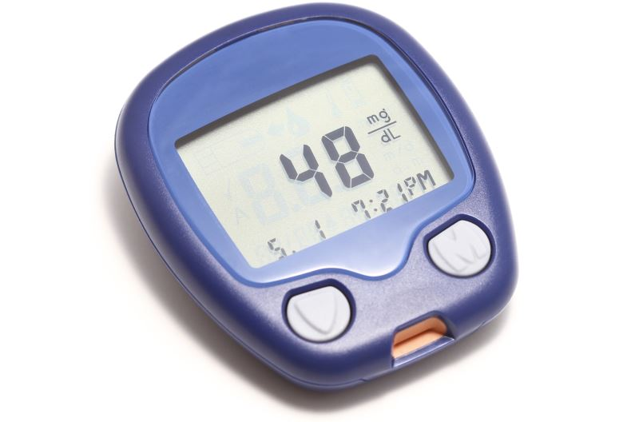
Treatment of hypoglycemia
Notes:
It recommends that 15 minutes after this, if the blood glucose monitoring shows the patient still has hypoglycemia, the treatment should be repeated

Slide 114



Treatment of hypoglycemia
Notes:
Once the blood glucose monitoring shows the levels going up, the patient should be made to consume a meal or snack to prevent recurrence of the hypoglyemia

Slide 115
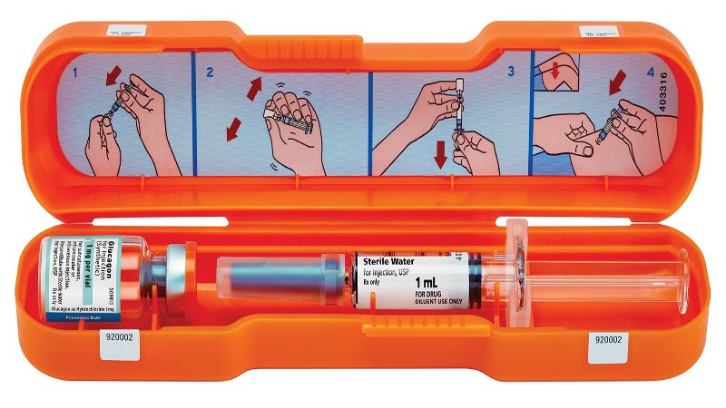
Treatment of severe hypoglycemia in an unconscious patient
Give glucagon (SC or IM)
Notes:
For those who are unconscious, the treatment of choice is glucagon should be used which can be given subcutaneously, intramuscularly and recently an intranasal preparation has been made available.

Slide 116
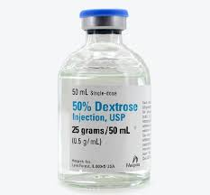
Treatment of severe hypoglycemia in an unconscious patient
Treat with 10-25 g of glucose (20-50 mL of Dextrose 50%) intravenously over 1-3 minutes
Re-test in 15 minutes to ensure the gluocse >70 mg/dL and re-treat with a further dose of dextrose 50%
Once conscious, eat meal or a snack
Notes:
The other alternative for treating severe hypoglycemia is to give intravenous glucose in the form of dextrose 50% over one to three minutes
Glucose level should be re-tested in 15 minutes to ensure it has gone above 70 mg/dl and if not, another dose of dextrose 50% should be given
Once the patient is conscious, they should be made to eat a meal or a snack

Slide 117
Prevention of hypoglycemia
Notes:
And again here, education is key to prevention of hypoglycemia
So here, education not only for the patient but also for family members on prevention, recognition and treatment if hypoglycemia

Slide 118
Summary
Have a low index of suspicion for DKA in any unwell patient with hyperglcemia
HHS is less common than DKA but is associated with a higher mortality
The cornerstones of management of DKA and HHS include: IV fluids, IV insulin and potassium replacement
Hypoglycemia should be treated with any rapid-acting glucose
Education is key to prevention of DKA, HHS and hypoglycemia
Notes:
So in summary,
We should have a low index of suspicion for DKA in any unwell patient with hyperglycemia, especially in type 1 diabetes
HHS is much less common than DKA but it is much more serious and is associated with a higher mortality
The cornerstones for management of both DKA and HHS are intravenous fluids, IV insulin and replacement of potassium
Hypoglycemia is another important emergency and should be treated by any rapid-acting glucose available
And the most important message is that education is the most important measure to prevent DKA, HHS and also hypoglycemia

