Slide 1
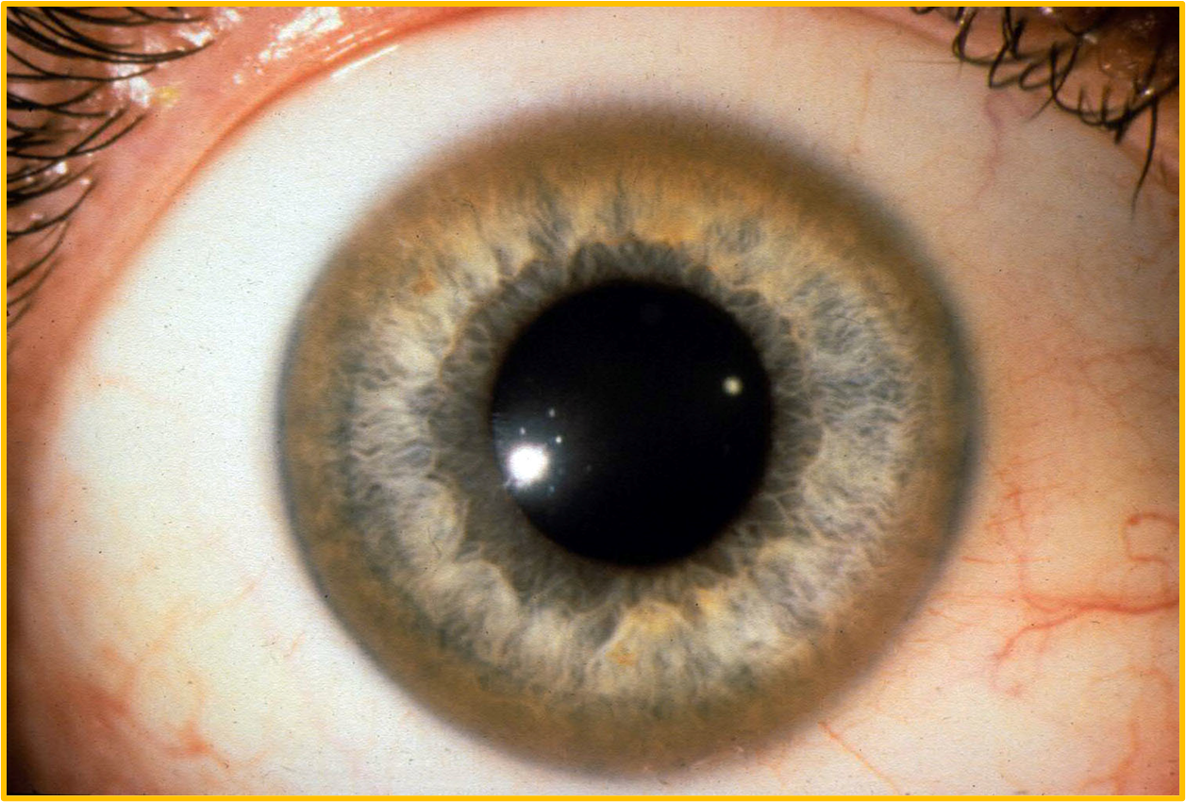
Wilson`s Disease

Slide 2

Learning Outcomes
By the end of this lecture the students should be to
1
Define Wilson`s disease, its aetiology & pathophysiology based on copper metabolism
2
Recognize and interpret symptoms & signs of Wilson`s disease
3
Enumerate, and analyze the appropriate investigations for the work up of Wilson`s disease
4
Outline the management of Wilson`s disease

Slide 3
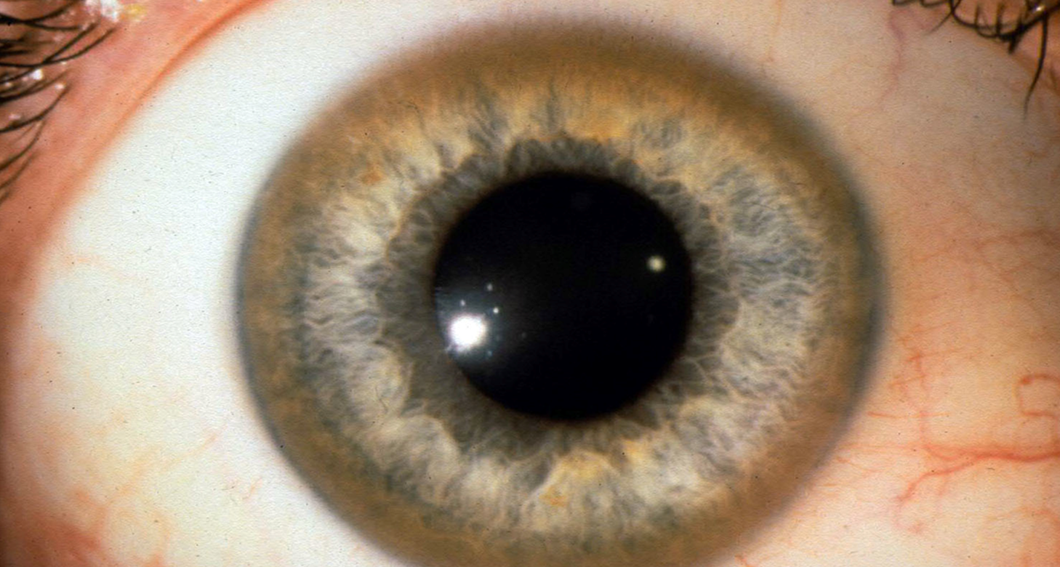
Definition
Wilson disease (WD) or (hepatolenticular degeneration) is an autosomal recessive disorder of impaired formation of ceruloplasmin, leading to copper accumulation in the liver, brain, kidney, and cornea
Rare: approximately 15– 30/ 100 000 per year

Slide 4
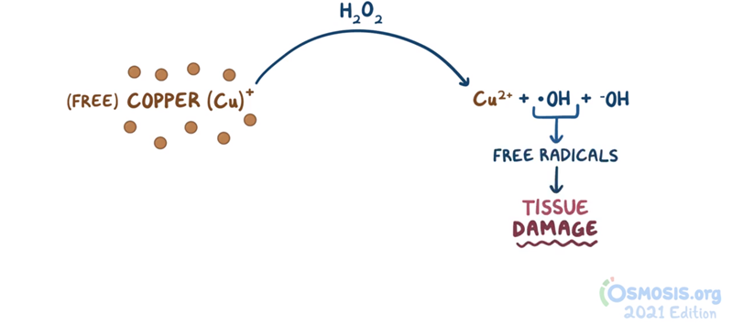
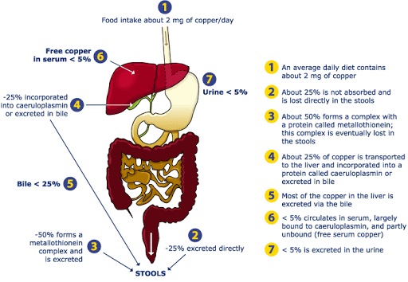
Copper Metabolism
Functions of copper
cofactor for many proteins and copper- containing enzymes involved in
cellular respiration,
antioxidant defence,
pigment production
Neurotransmitter Formation
connective tissue synthesis,
iron homeostasis.
90%
Notes:
Metallothionein is a transport protein that facilitates copper absorption. Copper
Copper is used for pipes and roofing materials, in alloys and as a pigment.
It is a component of several endogenous enzymes, including
tyrosinase and cytochrome oxidase, and is essential for the utilization
of iron. Copper sulphate is used as a fungicide, an algicide, and
in some fertilizers.
Following ingestion, copper transport across the intestinal mucosa
is facilitated by cytosolic metallothionein. In blood, copper is initially
albumin- bound and transported via the hepatic portal circulation
to the liver where it is incorporated into caeruloplasmin. Ninetyeight
(98%) per cent of copper in the systemic circulation is bound
to caeruloplasmin and free copper is excreted via a lysosome- to- bile
pathway. This process is essential to normal copper homeostasis
and provides a protective mechanism in acute copper poisoning.
An impaired or overloaded biliary copper excretion system results
in hepatic copper accumulation, as occurs in Wilson’s disease (see
Chapter 12.7.2) and copper poisoning.
Free reduced Cu(I) can bind to sulfhydryl groups and inactivates
enzymes such as glucose- 6- phosphate dehydrogenase and glutathione
reductase. In addition, copper may interact with oxygen species
(e.g. superoxide anions and hydrogen peroxide) and catalyse the
production of reactive toxic hydroxyl radicals. Copper(II) ions can
oxidize haem iron to form methaemoglobin.

Slide 5
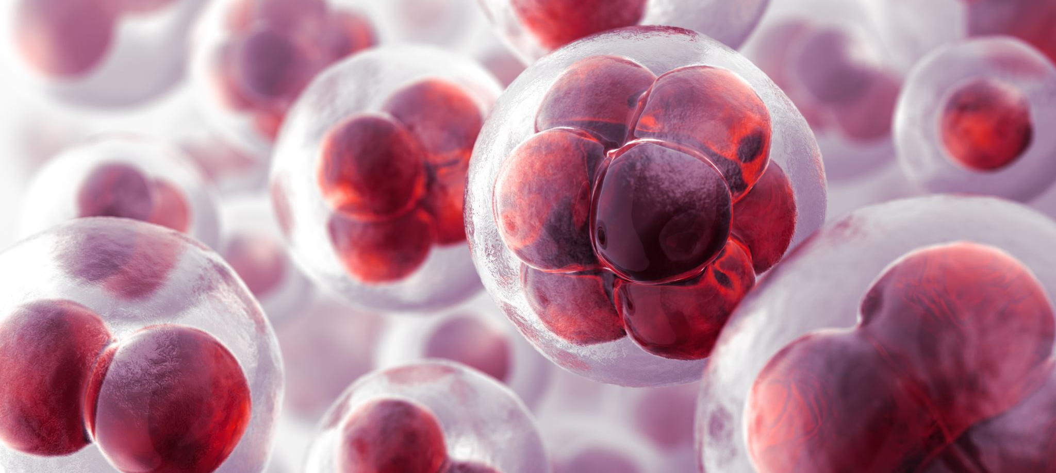
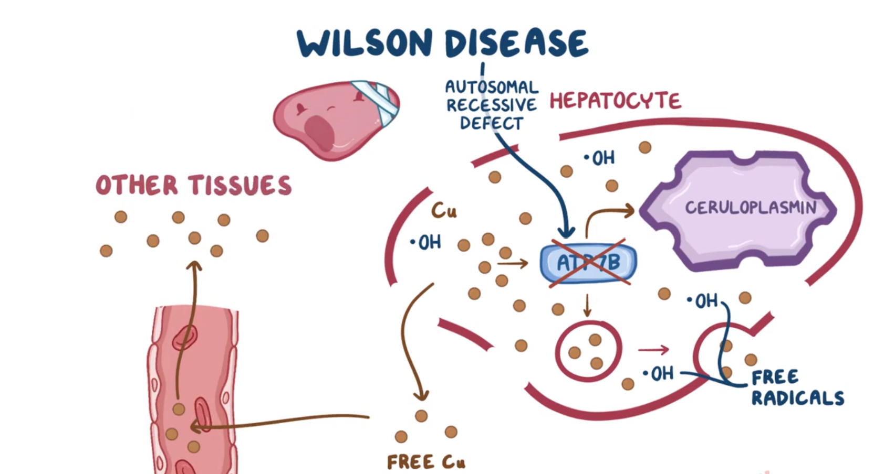
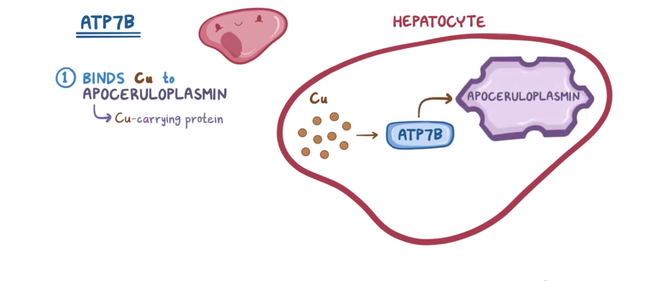
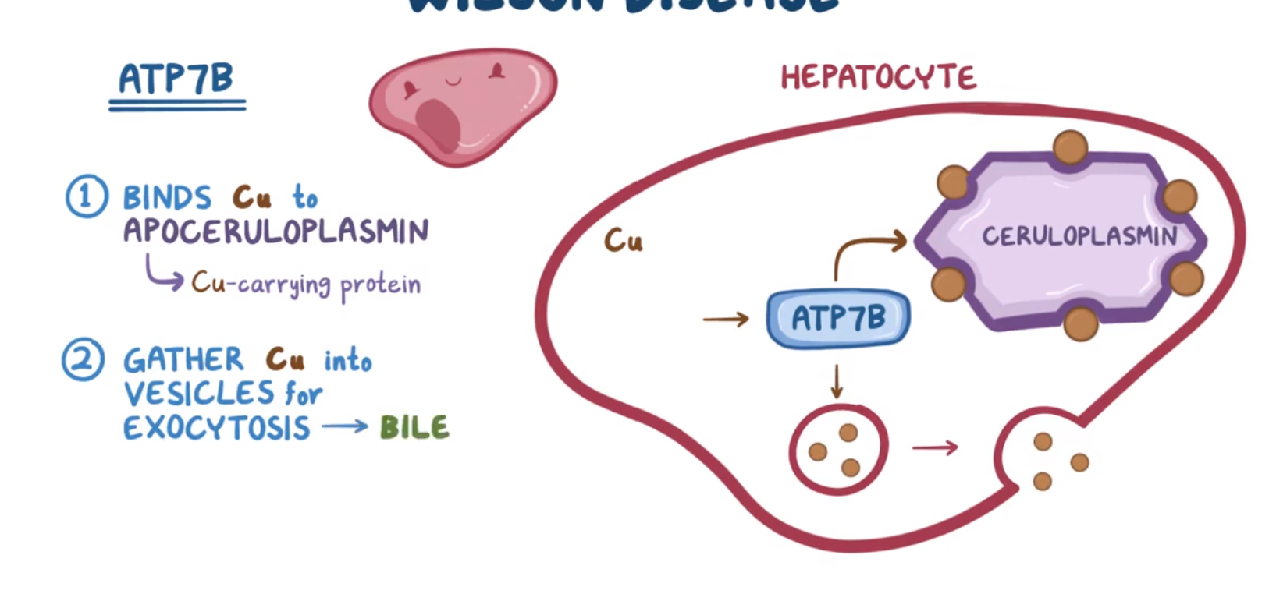
Aetiology
It is caused by mutations in the ATP7B gene on chromosome 13q14.3, which encodes a copper- transporting ATPase.

Slide 6
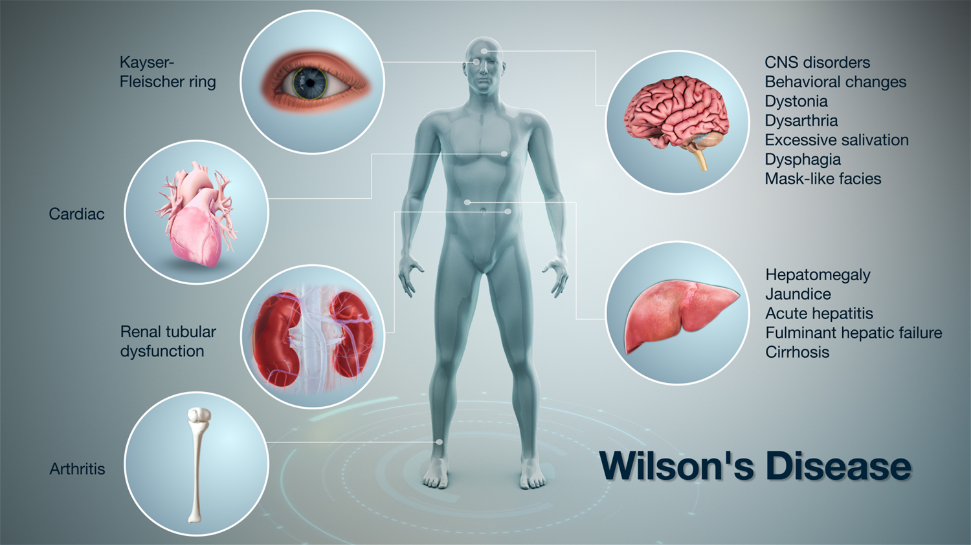
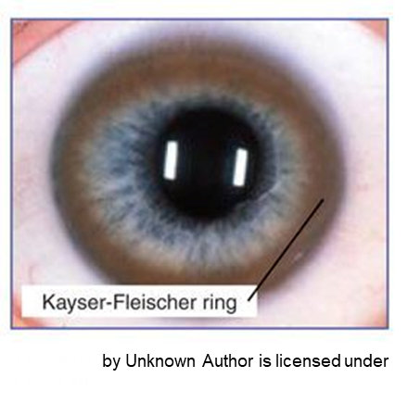
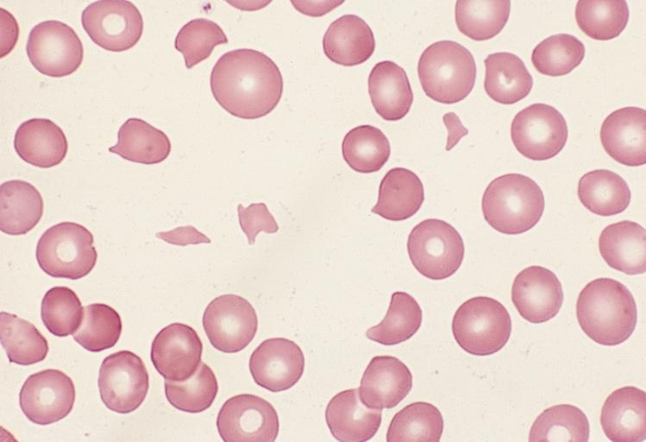
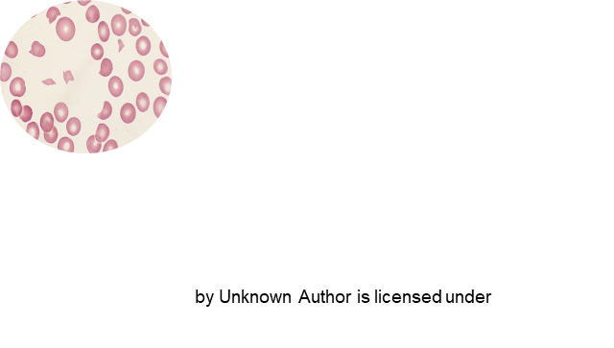
Depression
Neurotic behaviours
Personality changes
Psychosis
Cardiomyopathy
dysrhythmias
Isolated splenomegaly
Aminoaciduria
Nephrolithiasis
Children: 10-13 years
Osteoporosis
Blue nails
Coombs’- negative haemolytic anaemia
Notes:
Movement disorders (tremor, involuntary movements)
Pseudobulbar palsy
Dysautonomia
Migraine headaches
Insomnia
Seizures
Kayser– Fleischer rings are present in approximately 95% of patients with a neurological presentation but in only approximately 40 to 50% of patients with predominant.
hepatic disease at the time of diagnosis.

Slide 7
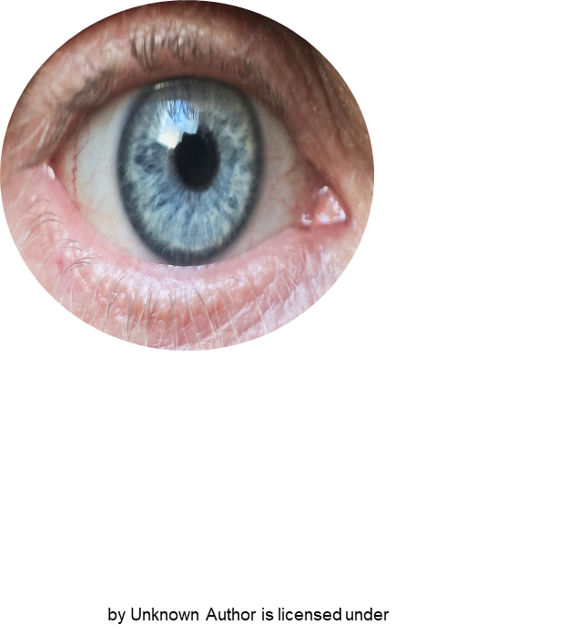
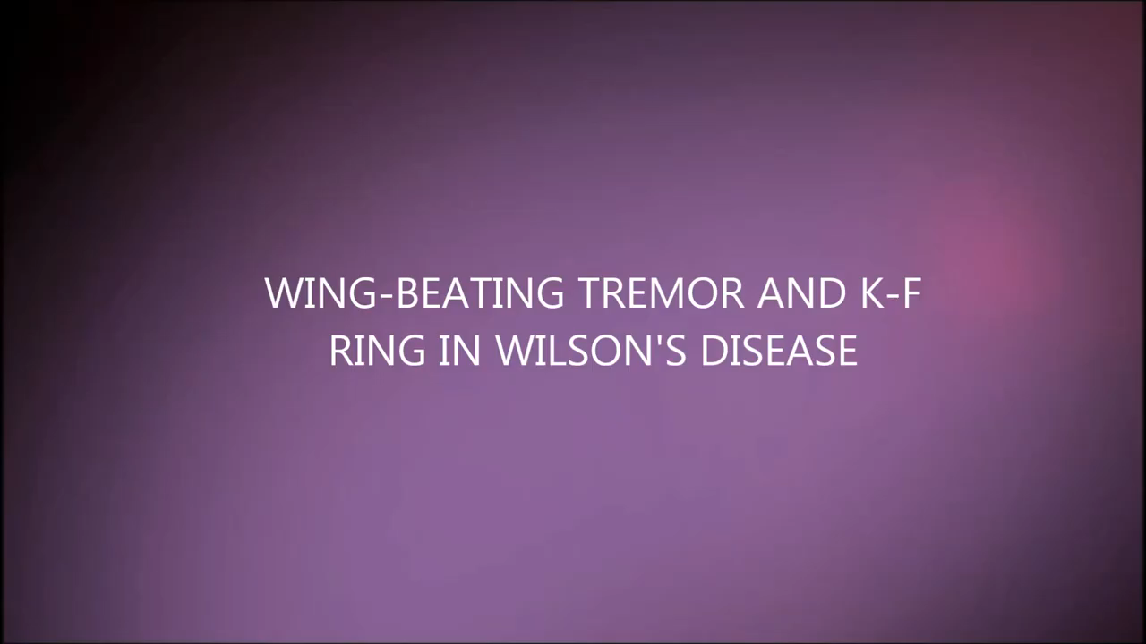

Slide 8


Slide 9
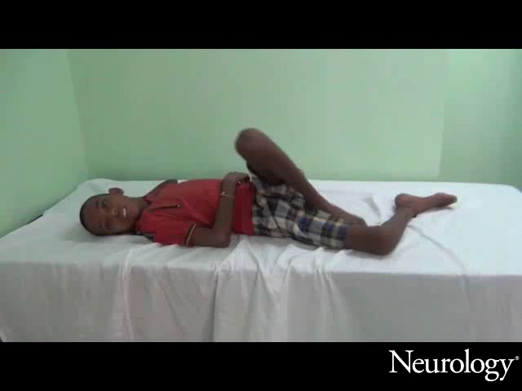

Slide 10
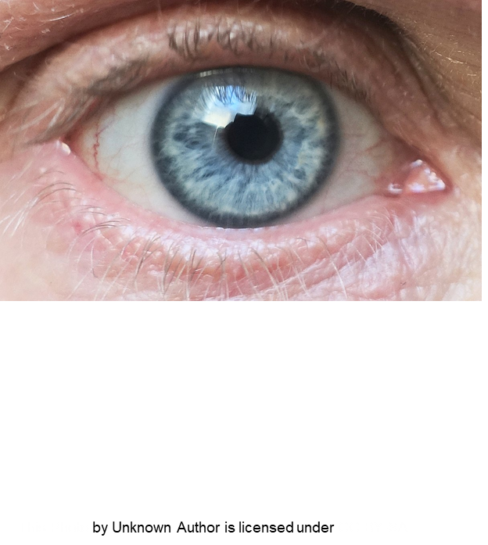
Liver disease
Occur : 10 and 13 years
Asymptomatic hepatomegaly
Isolated splenomegaly
Persistently elevated liver enzymes
Fatty liver
Acute hepatitis - autoimmune hepatitis
Cirrhosis— compensated or decompensated
Fulminant hepatic failure
Movement disorders (tremor, involuntary movements)
Drooling, dysarthria
Rigid dystonia
Pseudobulbar palsy
Dysautonomia
Migraine headaches
Insomnia
Seizures

Slide 11
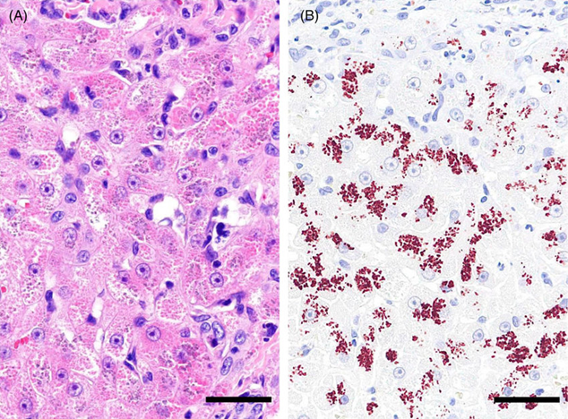
Investigations
Rhodanine staining
Haemolysis and anaemia
Liver biopsy
Liver copper concentration : measurement of the amount of copper in the liver (>250 μg/g dry weight.
Genetic analysis
Brain MRI
Rhodanine staining of the cytoplasmic granules of the liver. A, The hepatocytes were swollen, and a number of eosinophilic cytoplasmic granules were observed B, The granules were stained red to brown on rhodanine staining .

Slide 12
Bilateral abnormal signal in the striatum and thalamus in Wilson’s disease (left) and ‘face of the giant panda’ (right) on T2 weighted MRI sequences in Wilson’s disease.

Slide 13
Diagnostic Investigations
↑↑ Urinary copper
(100–1000 μg/day) normal < 40
Caeruloplasmin levels
Liver function test
↑↑ Serum aminotransferase
Wilson disease
↓↓ caeruloplasmin level
Serum Copper
↓↓ Serum Copper
Urinary copper

Slide 14
Management & Prognosis
Life long treating with copper chelating Agent
Penicillamine
Dose: 1–1.5 g daily
Monitor: Urinary copper levels
Side/effects
Proteniuria
skin rashes,
Leucopenia,
Myasthenia Gravis
Other drugs
Trientine hydrochloride:
zinc acetate (Children)
↓ Dietary copper : chocolate & peanuts
Good prognosis : Early diagnosis and effective treatment.
Neurological : permanent . Liver cirrhosis/ acute failure: Liver transplant

Slide 15






Case scenario
A 30-year-old man admitted for the evaluation of personality changes. At work, he has recently gotten into several heated arguments with colleagues and has missed several deadlines." He does not consume alcohol, tobacco, or illicit substances. Family history is notable for “liver disease” in his maternal uncle and grandfather, but he is unaware of additional details. Physical examination reveals greenish-brown rings around the iris. The liver is palpated 4 cm below the right costal margin. Resting tremors are present in the bilateral hands. Which of the following sets of laboratory values would most likely be seen in this patient?

Slide 16
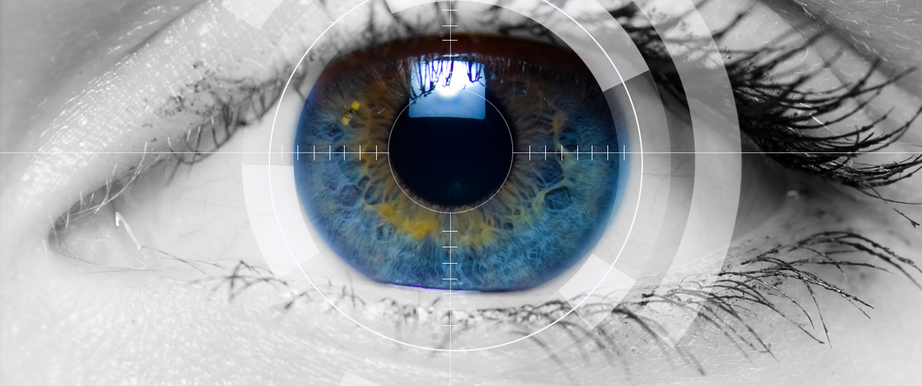
Thank you
Insert the title of your subtitle Here

