Slide 1
Nephritic syndrome
BY ISRA

Slide 2
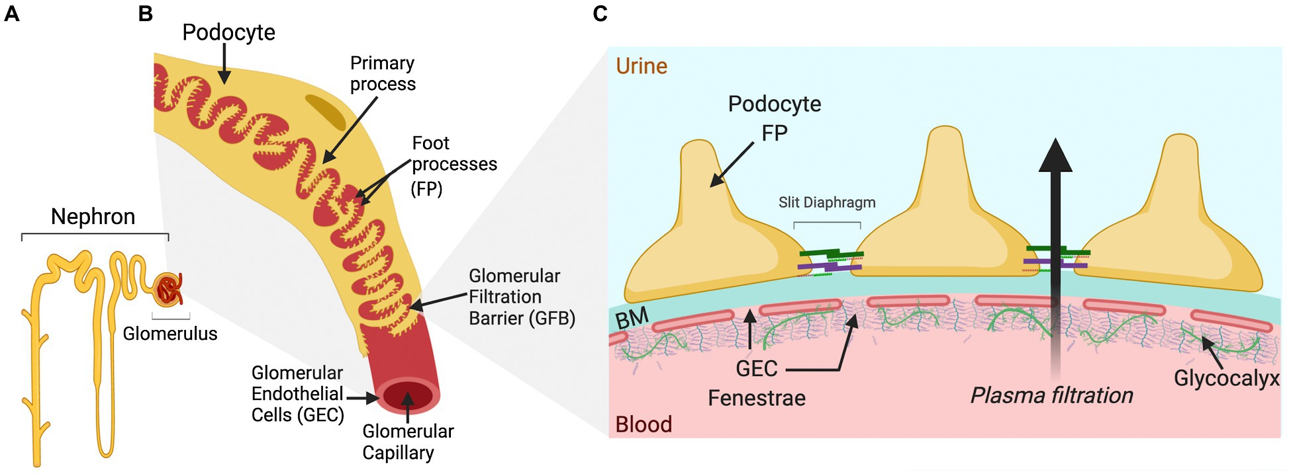
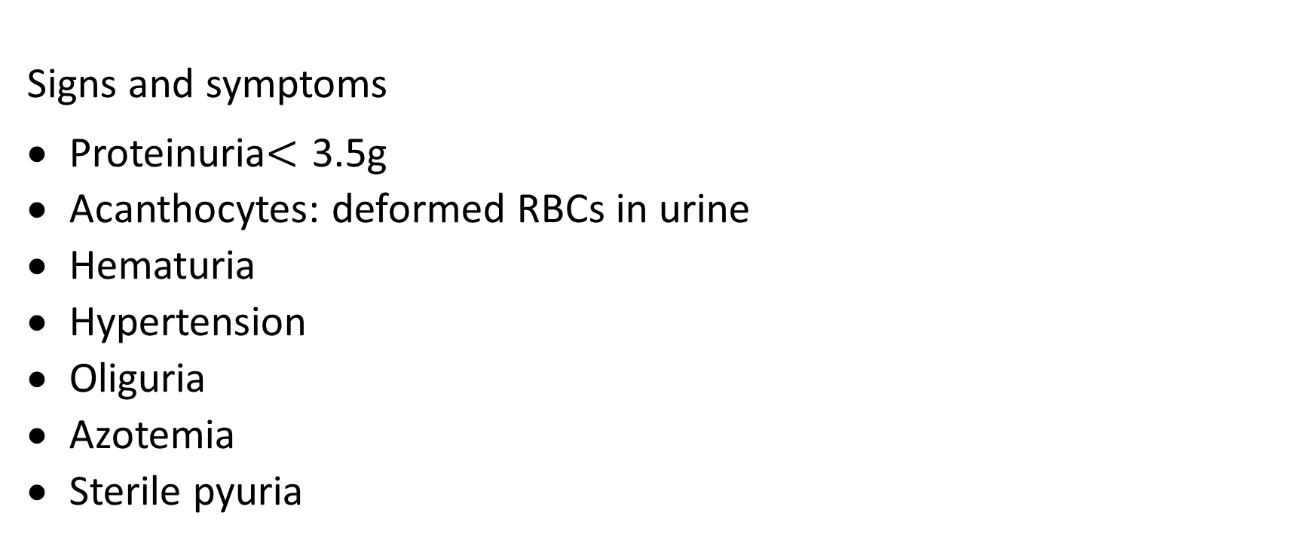
Nephritic syndrome
Signs and symptoms
Proteinuria$<$ 3.5g
Acanthocytes: deformed RBCs in urine
Hematuria
Hypertension
Oliguria
Azotemia
Sterile pyuria

Slide 3
A.Rapid progressive GN (Crescentic GN)
Rapid decline in renal function
Causes
Anti GBM disease (Good pasture syndrome): antibodies against type 4 collagen which is present in the basement membrane of the kidney and alveoli. Patient will present with GN and hemoptysis. Diagnosis is by renal biopsy (linear deposits). Treatment is by immunosuppressants and plasmapheresis (be careful before deciding on renal transplantation on these patients???

Slide 4
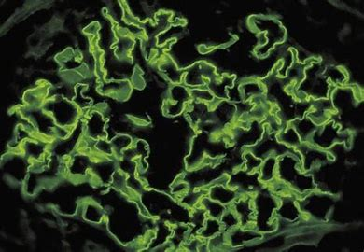
LINEAR DEPOSITS OF GPS

Slide 5
A.Rapid progressive GN (Crescentic GN)
2. Immune complex diseases
IgA nephropathy it can be either isolated GN or part of systemic illness i.e., Henoch Schonlein purpura. The problem in this disease is that there is delayed clearance of abnormal IgA antibodies. IgA will be attacked by IgA and the Ab/Ab complex will deposit in the mesangial cell. This will cause damage of the kidney. It is important to note that C3 level will be normal. Hx will include URTI or GI infection one to three days before onset of GN or systemic illness. Renal biopsy will show mesangial deposits. Treatment is by immunosuppressant and plasmapheresis in severe cases

Slide 6
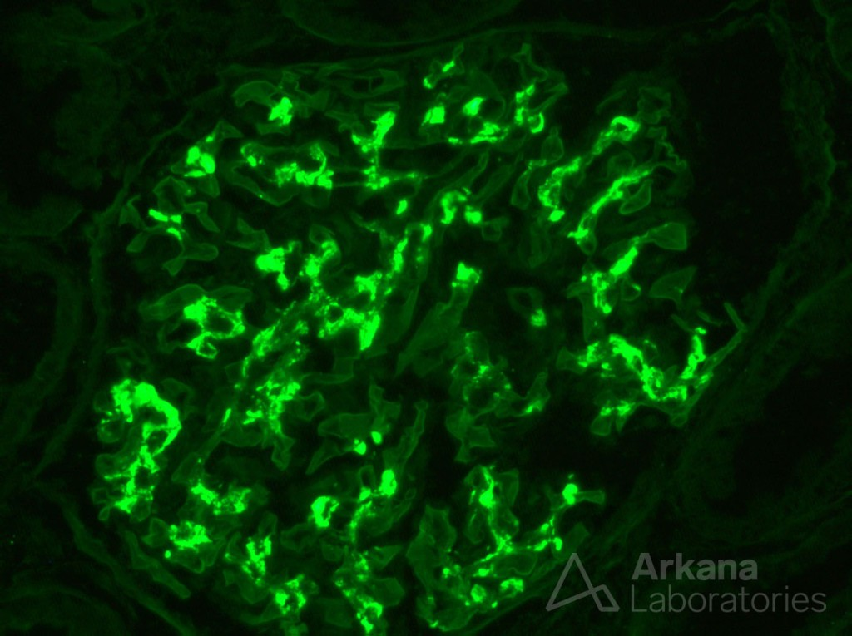
MESINGAL DEPOSITS IgA

Slide 7
A.Rapid progressive GN (Crescentic GN)
B. Post streptococcal GN: Occur after infection by streptococcus pyogenes either throat or skin infection, the symptoms will occur 2-3 weeks after initial infection. Antigen and antibodies (IgG) complex will deposit in the subepithelial space. Complement system will be activated which will consume C3 and lower its level. Diagnosis is by typical Hx, blood test will show high ASO titer. Renal biopsy will show lumpy-bumpy subepithelial deposits. Treatment by antibiotics.

Slide 8
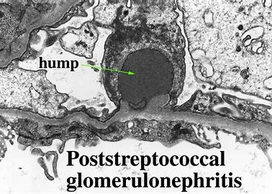
SUBEPITHELIAL DEPOSITS (EM)

Slide 9
A.Rapid progressive GN (Crescentic GN)
C. diffuse proliferative GN (Lupus nephritis):50% of the glomeruli will be affected(diffuse). Antigen/antibodies complex will deposit in the blood vessels(subendothelial), blood vessels will become thickened showing wire loop appearance in renal biopsy. Treatment is immunosuppressant e.g., IL2 inhibitors

Slide 10
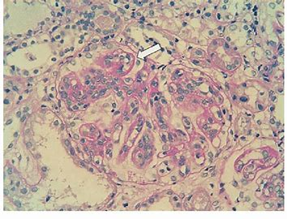
WIRE LOOPING(LM WITH STAIN)

Slide 11
A.Rapid progressive GN (Crescentic GN)
3. Pauci-immune disease: mainly caused by vasculitis
_ Granulomatosis with polyangiitis (Wegener granulomatosis) c. ANCA +
_ Eosinophilic granulomatosis with polyangiitis (Churg-Struss syndrome) p-ANCA+
Renal biopsy will show no immunocomplex deposition

Slide 12
B. Alport syndrome
X-linked disease, it occurs due to mutation in type 4 collagen which will lead to abnormal basement membrane of the kidney + sensorineural hearing loss+ lens abnormality (lenticonus, corneal dystrophy and macular thinning). Diagnosis is by family history, genetic testing, kidney biopsy will show lamellation of the basement membrane. Management is only supportive. Avoid renal transplantation????

Slide 13
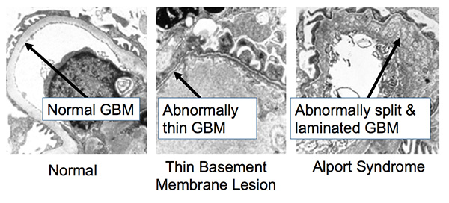

Slide 14
C. Membranoproliferative GN
Mainly it causes nephrotic syndrome (sometimes nephritic)
Type 1: caused by Hepatitis C&B, Cryoglobulinemia and infective endocarditis. Antigen/antibody complex deposition in the basement membrane &sub-endothelium. Mesangial cells will cause splitting of the membrane giving the characteristic tram-track appearance in renal biopsy
Type 2: AKA dense deposit disease. In this disease there is antibodies that stabilize C3 convertase which will lead to activation of complement pathways and C3 consumption. These antibodies are known as nephritic factor. Complements will deposit in the basement membrane. Renal biopsy will show tram-track appearance.

Slide 15
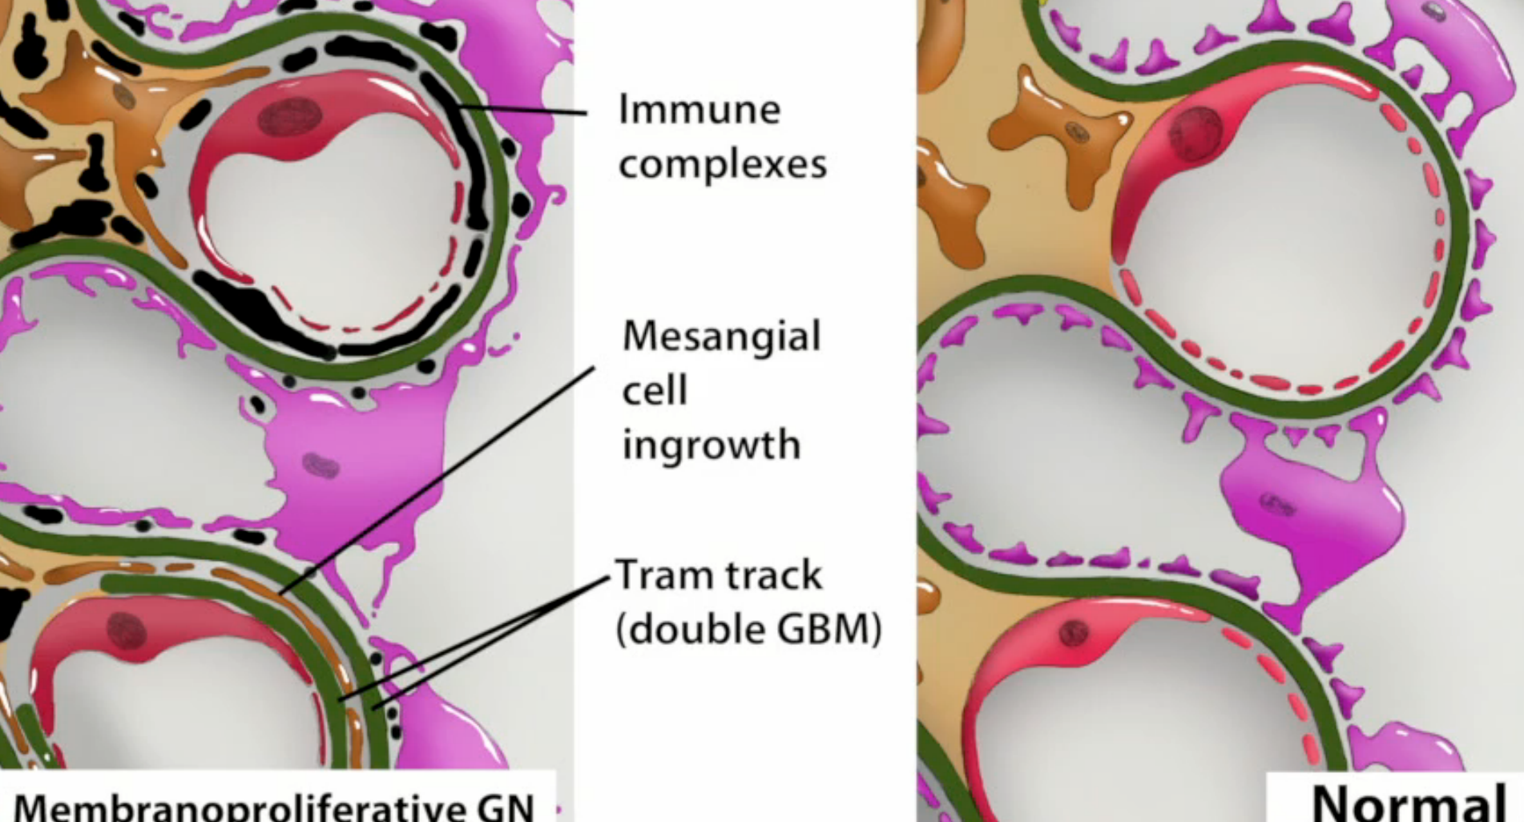
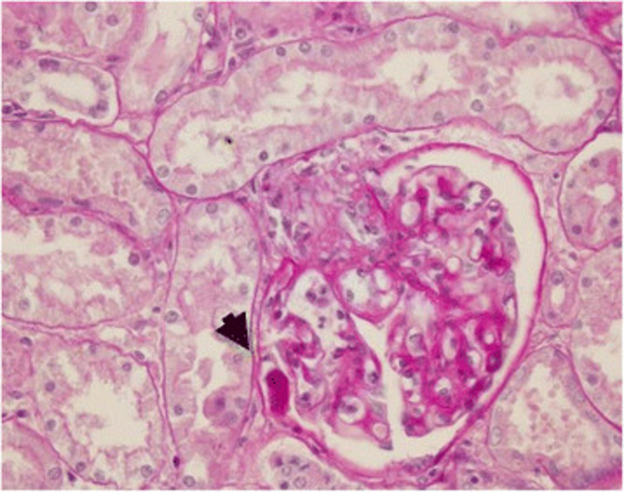

Slide 16
Management of symptoms of GN:
Proteinuria: ACEIs
Acanthocytes/ RBCs cast/ hematuria: corticosteroids& immunosuppressants
Volume overload: frusemide
HTN: ACEIs
Oliguria: diuretics / dialysis
Azotemia: if uremia
Sterile pyuria: decrease with decrease inflammation

Slide 17
GOOD LUCK

