Slide 1


Slide 2


Slide 3
Dyspepsia & Peptic Ulcer Disease
DR WAQAR
MBBS, MRCP, Int. Medicine( London)
MRCP Endo. & Diabetes
Royal College of Physicians, London
ASST. PROFESSOR

Slide 4
OBJECTIVES
By the end of this lecture, student should know:
* Difference b/w PUD & dyspepsia
Etiologies
Signs and Symptoms
Investigation for H. Pylori and peptic ulcer
Treatment of Peptic ulcer
Know which tests to do after treatment
What is Zollinger Ellison Syndrome

Slide 5
CASE 1
25 year old male
Pain in epigastric area, off and on since 2 months. Relieved with food
Smoker, on NSAIDS since long time
Very stressful job
Physical examination normal
Name some differentials

Slide 6
Case 2
50 year old female
Epigastric pain since 3 months off and on. More after eating
Pale stools which are difficult to flush
Weight loss of 10 kg in 3 months
Chronic alcoholic. Serum triglycerides very high
Jaundice present
What is your differential?

Slide 7
Dyspepsia
What is Dyspepsia ?
The term “ dyspepsia” is a broad term and includes any of the following:
- Heart burn
- Food related discomfort in the upper abdomen
- Nausea, gas etc
- Feeling of fullness after eating a little

Slide 8
Every dyspepsia patient does not need urgent & detailed investigations. However, presence of any of the following warrants urgent workup (alarm symptoms)
Dysphagia
Weight loss
Severe Vomiting
Severe anorexia
Hematemesis
Melena
( WHY? )

Slide 9
PEPTIC ULCER
Definition:
It is a break in the gastric /duodenal mucosa, extending down to the muscularis layer.
EROSIONS: Superficial breaks in the mucosa alone, not extending deep.

Slide 10
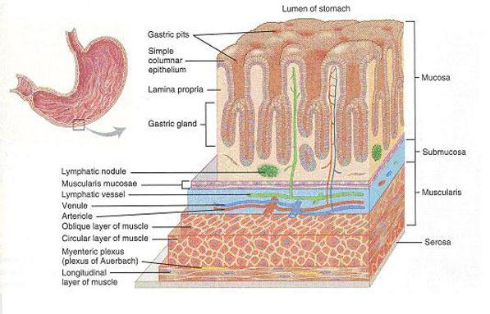
Layers of Stomach

Slide 11
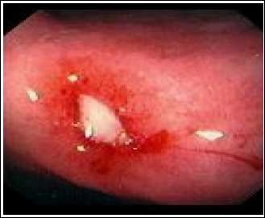
Bleeding gastric ulcer

Slide 12
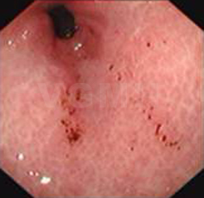
Erosions

Slide 13
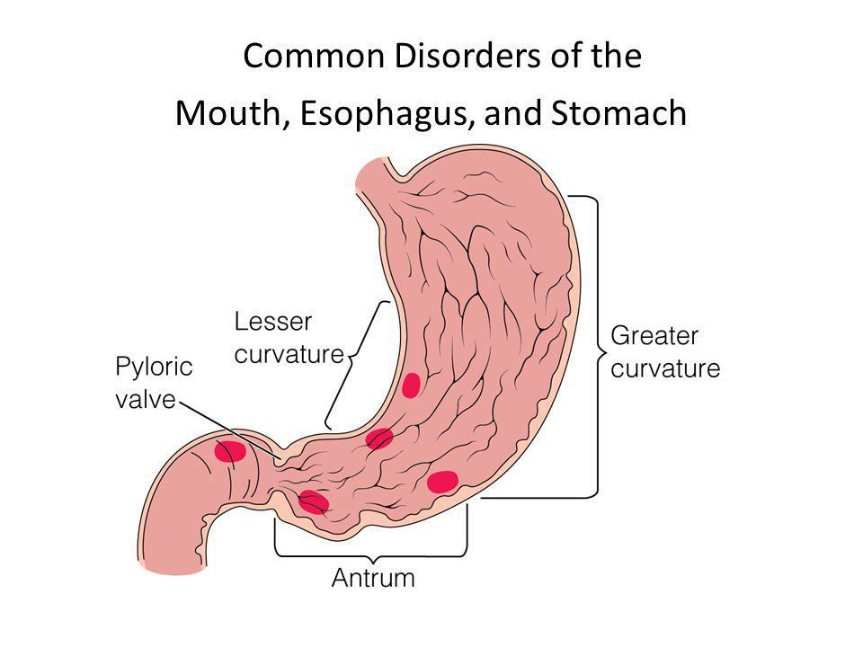
Most common sites of peptic ulcers:
Duodenal bulb (most
common)
* Lesser curvature
* Antrum of the stomach

Slide 14
SOME GENERAL POINTS
Duod. Ulcers Gastric ulcers
Much more common * More likely to be
than gastric ulcers malignant
Usually in the duod. * Eating worsens
bulb(1st part) the pain
Almost never malignant * Usually above age 50
* May be malignant
Eating relieves pain

Slide 15
ETIOLOGY OF ULCERS
1) Helicobacter Pylori infection most
2) NSAID/ Aspirin use common
3) Hyperacidity states (eg Zollinger Ellison syndrome
4) Biphosphonates ( medicines used in osteo-
porosis)
Stress
Alcohol, dietary factors & smoking may aggravate the symptoms.

Slide 16
SO: In patients with peptic ulcers, the first 2 things to rule out are:
1) H. Pylori infection (by tests)
2) NSAID use (by history)

Slide 17
Some points about H. Pylori
It is a bacterium infecting the gastric & duodenal mucosa
2/3rd of the world population is infected
Poor hygienic conditions more chances of infection
Can cause “no” symptoms OR erosions, gastritis, ulcers

Slide 18
Points about ulcer producing drugs
1) Long term use of aspirin & ‘traditional’ NSAIDs (diclofenac, ibuprofen etc), increases the risk of peptic ulcers. ( gastric more than duodenal)
2) Use of these meds in ulcer patients high
risk of complications
3) COX 2 inhibitors(which are also NSAIDs) have much less risk of peptic ulcer disease ( eg celecoxib). They may be called “gastro-protective” )
4) Long term steroid use increases ulcer risk

Slide 19
So, ulcer producing drugs are:
* NSAIDs
* Aspirin
* Steroids

Slide 20
SIGNS & SYMPTOMS of ULCERS
1) Asymptomatic: 70% of patients can be totally
asymptomatic, specially those on NSAIDs.
2) Epigastric pain:
* Classic symptom
* Usually a dull ache
* Relieved by antacids
* Food relieves pain in DU

Slide 21
S/S contd
2) Nausea, belching, heartburn, bloating etc.
( dyspeptic symps).
3) Physical exam is usually normal ( may be mild
epig. tenderness)
Clinical S/S can not distinguish between DU & gastric ulcer

Slide 22
INVESTIGATIONS
In uncomplicated ulcers, basic investigations like CBC and chemistry are usually normal ( Hb may be low in bleeding ulcers)
The 2 “specific” investigations in peptic ulcer patients are:
Endoscopy (confirms ulcer)
H. Pylori testing
( Barium studies are no longer done)

Slide 23
ENDOSCOPY
It is the best investigation to diagnose ulcers
During endoscopy, biopsy of the ulcer is always taken and sent for H. Pylori testing(CLO TEST)
In case of gastric ulcer, biopsy is also sent to rule out carcinoma( some gastric ulcers can be malignant)
DU are never malignant.

Slide 24
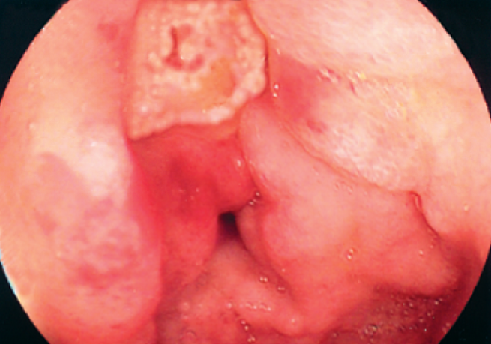
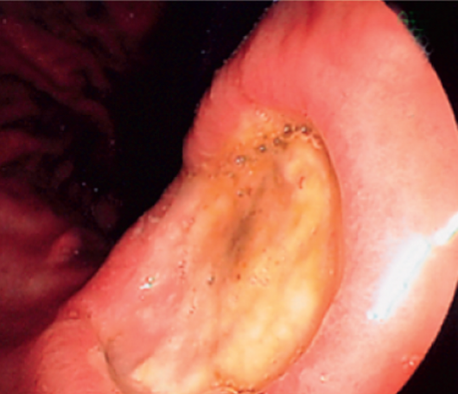
Endoscopic views
DUODENAL ULCER
GASTRIC ULCER

Slide 25
H. Pylori testing
4 commonly used methods of detecting H. Pylori:
Urea breath test most frequently used
Stool antigen test with 95% sensitivity
CLO test (after biopsy)
Serum antibody titers very frequently
used but low specificity. Can be done if 1,2 & 3
are not available

Slide 26
Before understanding the urea breath test and CLO test , remember the following:
H. Pylori produces the enzyme “ urease” which can split urea into NH3( ammonia ) and CO2
urease
UREA NH3 + CO2

Slide 27
Urea breath test:
* Pt. ingests urea tablets which contain C₁₄
* H. Pylori urease splits urea into NH3 & CO2
* CO2 (which contains C14) is exhaled through
the lungs and collected in a bag
* Results are very quick ( 15 min)

Slide 28
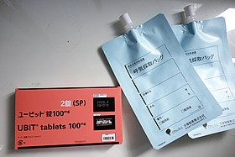
Tablets & bag ( full kit)

Slide 29
2) Stool Antigen test: H. Pylori antigens are checked in the stool.
3) CLO test ( rapid urease test):
* Biopsy of the ulcer taken during endoscopy
* Sample is placed in a solution which
contains urea
* Urease of H. Pylori splits urea & releases NH3
color of the solution changes
Before doing 1, 2 and 3, stop PPIs for 14 days

Slide 30
STEPWISE MANAGEMENT
S/S SUGGESTING PEPTIC ULCER DISEASE
Patient less than 60 yrs. & no alarm symptoms( wt loss, dysphagia, hematemesis, melena) Endosc. not LAAZIM. Check for H. pylori & treat. If neg., give PPIs for 1 month
If age more than 60 OR alarm symps. MOJOOD endoscopy & H. pylori testing. Then treat accordingly

Slide 31
MANAGEMENT OF PUD
Avoid smoking
Avoid aspirin, NSAIDs and steroids
No specific dietary restrictions but avoid things which cause hyperacidity (spices,caffiene)

Slide 32
MEDICAL TREATMENT
SYMPTOMATIC H. Pylori treat.
1) Antacids (PPIs etc)
2) Mucosal protective
agents

Slide 33
MEDICINES For PUD
PPIs ( eg. omeprazole)
H2 antagonists ( Zantac)
Antacids
Aluminium OH/Mg OH( tabs, liq)
( GAVISCON)
2) Mucosal protective agents ( Bismuth)
3) H. Pylori eradication meds.

Slide 34
MANAGEMENT
a) PPIs are the most effective & safest
*Omeprazole, es-omeprazole, pantoprazole
* Once daily before breakfast
* Usually given for 1 month to heal the
ulcer, then stopped
* Long term use only in some patients
b) H2 receptor antagonists:
* Ranitidine( zantac), Nizatidine, famotidine
* Zantac has been withdrawn in the U.S.

Slide 35
c) Aluminium/Mg hydroxide: provides acute symptomatic relief of ulcer pain. ( Gaviscon tabs / syrup)
2) Mucosal protective agents (Bismuth) : They “coat” the ulcer

Slide 36
Treatment of H. Pylori
Till recently, the following was the most common regimen used but now it is not the first line therapy:
Amoxicillin + Clarithromycin + PPI (all for 10 to 14 days)

Slide 37
FIRST LINE REGIMENS
(American coll. of Gastroentero.)
QUADRUPLE THERAPIES
1) * PPI bid
* Bismuth tablets (4 times daily) 14
* Tetracycline tabs( 4 times daily) days
* Metronidazole (Flagyl) tid
(2 antacids + 2 antibiotics)
OR
* PPI (bid) 14
* Amoxicillin(bid) days
* Flagyl
* Clarithromycin
(1 antacid + 3 antibiotics)

Slide 38
HOW TO REMEMBER?
Patchi Chocolate For Ahmed
P: PPI
C: Clarithromycin
F: Flagyl
A: Amoxicillin

Slide 39
These regimens have a high eradication rate and low recurrence of symptoms
After this treatment, continuous PPI treatment is not needed in most cases( some may need)
To confirm eradication, do one of these:
a) Urea breath test after 1 month
b) H. Pylori stool antigen test

Slide 40
Failure to eradicate with these regimens or recurrence of symptoms may need other regimens or surgery
Never use the same regimen twice

Slide 41
Ulcer prevention in special situations
Patients on long term NSAIDs, aspirin or corticosteroids high risk of PUD so, give prophylactic PPI & use gastroprotective NSAIDs( eg celecoxib)
Hospitalised patients more chances of stress ulcers so PPI routinely given

Slide 42
Complications of PUD
Bleeding (most common complication)
Perforation (can lead to ? )
Ulcer in the pylorus can become fibrosed/scarred gastric outlet obstruction persistent vomiting

Slide 43
ZOLLINGER ELLISON SYNDROME
It is a syndrome due to a gastrin secreting tumor (usually in the pancreas or duodenum).
Excess gastrin hyperacidity duodenal ulcers & diarrhea
When to suspect:
* Ulcers not responding to usual treatment
* Large ulcer * Multiple ulcers

Slide 44
DIAGNOSIS:
Fasting serum gastrin levels : High
Serum gastrin levels after giving i.v. “secretin” ( secretin stimulation test). In gastrinoma, further rise in serum gastrin levels
Rx: Surgical removal of the tumour

Slide 45
RAPID FIRE QUESTIONS
Difference between ulcer & erosion?
Name 2 most common causes of peptic ulcer?
Which medicines can cause ulcer?
Name 4 alarm symptoms in dyspepsia patient, where endoscopy is LAAZIM?
Name 3 most common areas where ulcers occur?
Food worsens the pain in which ulcer?

Slide 46
7) Which ulcers can be malignant, duod or gastric?
8) Symptoms suggesting ulcer disease. What are the next 2 steps to do?
9) H. Pylori can cause what?
10) Which NSAIDs are gastro-protective?
11) Can ulcer patients be asymptomatic?
12) Name the 4 tests for H. Pylori? Which is NOT the best?

Slide 47
13) Which enzyme is produced by H. Pylori?
14) Patient is taking PPI form before. You want to do H.Pylori test. Whats the first step to do?
15) What are the “symptomatic” treatments for peptic ulcer disease?
16) Which drug was withdrawn in the U.S?
17) Treatment of H. Pylori is “3 drugs for 10 days”, right or wrong?

Slide 48
18) Treatment of H. Pylori? Name any 1 regimen?
19) After treatment, which test to do to confirm eradication? When to do?
20) When to give prophylactic PPIs? Name any 2 situations?
21) 3 complications of ulcer disease?
22) What is high in Zollinger Ellison syndrome?
23) When to suspect this syndrome?
24) Rx of Zollinger?

Slide 49
LAST SLIDE IS VERY IMPORTANT

Slide 50


