Slide 1
PULMONARY FUNCTION TESTS (PFTs)
Prof. Salih Bin Salih
Professor, Department of Medicine
King Saud Bin Abdulaziz University for Health Sciences, Riyadh
MD; FRCP (Edin), ABIM; FACP

Slide 2
DEFINITION
These are some tests done to see the functioning of the lungs. They tell us about the amount of air moving in & out of the lungs, the amount of air inside the lungs & also the diffusion of air in the alveoli. They are very useful in the following situations:
To diagnose certain lung diseases
To monitor the response to treatment
They also tell us if the pathology is in small airways or large ones.

Slide 3
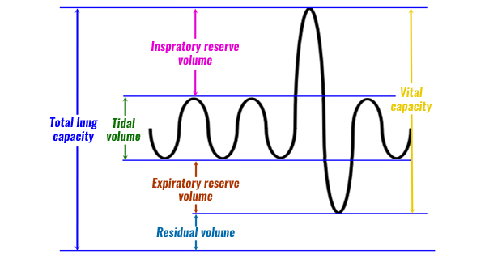
LUNG VOLUMES & CAPACITIES

Slide 4
Definitions of volumes & capacities
Tidal Volume (TV): amount of air moving in & out of the lungs with each breath ( N: 500cc)
Inspiratory reserve vol.(IRV): Extra air which you can inhale with full force, after a normal inspiration ( after TV). (N is about 3000 cc)

Slide 5
3) Expiratory reserve vol.(ERV) : Extra air which can be blown out forcefully, at the end of normal expiration(after TV). (N is about 1000cc)
4) Residual volume(RV) : Even after full forceful blowing out, some air remains in the lungs, which is called RV.

Slide 6
CAPACITIES
2 or more volumes, added together, give a capacity. Remember two most important capacities:
Vital Capacity( V.C.) : Maximum forceful
inhaling + maximum forceful exhaling
( TV + IRV + ERV)

Slide 7
Capacities contd.
b) Total lung capacity(TLC): Maximum amount of air which the lungs can hold after a deep inspiration
( T.V. + IRV + ERV + RV)
or
( VC + RV)
When you take a deep breath in & then hold, this is the total capacity of your lungs.
(N: about 5700cc)

Slide 8
NAMES OF PULM. FUNC. TESTS
Spirometry
Peak expiratory flow measurement
DLCO ( diffusing lung capacity of carbon monoxide). Here we check how good is the diffusion of gases in the alveoli)
ABGs
Pulse oximetry
In practice, PFT usually means spirometry

Slide 9
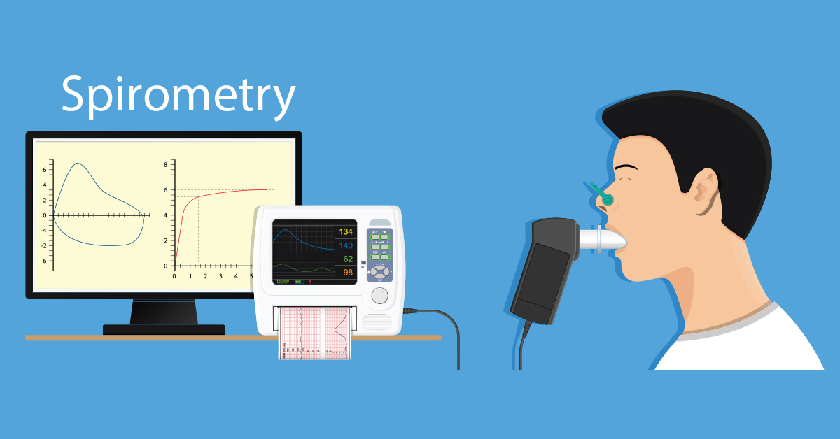
MOST IMPORTANT PFT

Slide 10
A spirometer is an apparatus used to measure the volume of air inhaled and exhaled by the lungs.
After attaching the mouth piece, patient inhales maximally then exhales forcefully. This is recorded by the machine.

Slide 11
Two very important measurements by the spirometer are:
1) FEV1: forced expiratory volume in 1 second.
This is the amount of air which comes out in
the 1st second of forced expiration.
2) Vital capacity( also called forced vital
capacity or FVC)
Remember: most of the air comes out in the 1st sec. of exhalation

Slide 12
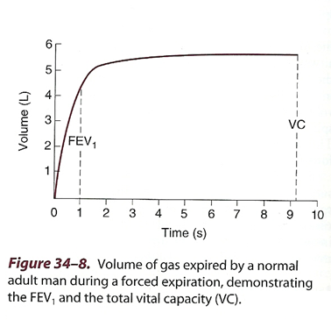
FEV1/ VC

Slide 13
The FEV1 is used to classify the severity of obstructive lung diseases traditionally based on 0% predicted values into five levels.
FEV1>70% of predicted is mild
FEV1 60-69% of predicted I is moderate
FEV1 50-59% of predicted is moderately severe
FEV1 35-49% of predicted is severe
FEV1 <35% of predicted is very severe

Slide 14
SOME NORMAL VAUES
TV: 500 cc
F.V.C. : 5 liters(5000cc)
FEV1 : 4 liters (4000cc)
TLC: 5.7 liters (5700cc)
FEV1/FVC ratio : 4/5 = 75% to 80%

Slide 15
USES OF SPIROMETRY
Diagnosis of certain lung diseases eg asthma, COPD, interstitial lung diseases (obstructive pattern vs. restrictive pattern)
To see the effect of medicines being given for those diseases
Pre-operatively, to assess lung function

Slide 16
Spirometry results in some lung diseases
Obstructive diseases (asthma, COPD)
a) FEV1 is too much reduced
b) FVC is slightly reduced, so
c) FEV1 /FVC ratio is
reduced.
d) TLC is increased
( air trapped inside)
eg FEV1= 1.3L, FVC = 3.2L, ratio
will be (1.3/3.2) x 100: 41%

Slide 17
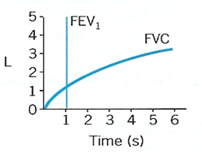
Normal
obstructive lung disease

Slide 18
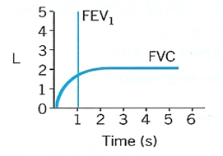
Spirometry results in some lung diseases
2) Restrictive diseases ( pulm. fibrosis, decreased chest movement)
a) FEV1 reduced
b) FVC equally reduced, so
c) FEV1/ FVC ratio is normal
d) TLC is decreased
Eg: FEV1 1.7L, FVC 2L, ratio
( 1.7/2) x100 : 85%

Slide 19
PEAK EXPIRATORY FLOW RATE (PEFR)
This is another type of PFT
Very simple and cheap, can be done at home
using a peak flow meter
It shows how quickly and forcefully you can
blow out air, after a deep inhalation

Slide 20
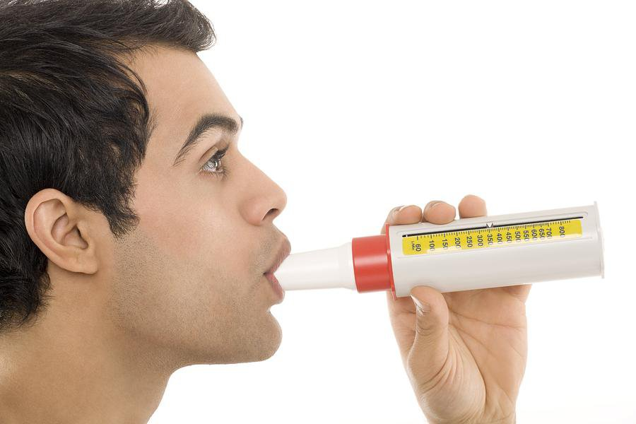
PEAK FLOW METER

Slide 21
PEFR
Very helpful in tracking the severity of asthma and response to treatment.
Should not be used to diagnose asthma
Technique:
* Breathe in as deep as you can.
* Then, blow forcefully into the mouthpiece
as hard & fast as you can

Slide 22
DLCO
DIFFUSION CAPACITY OF LUNGS FOR CARBON
MONOXIDE
It is a common PFT that measures how effective is gas diffusion in the alveoli.
Patient inhales small amounts of CO reaches the alveoli then diffuses across the alveolar wall into the pulmonary capillaries.
The speed with which CO diffuses, tells us how good is the gas exchange.

Slide 23
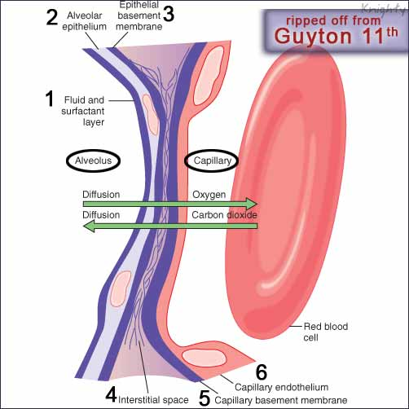
Alveolar-Capillary membrane

Slide 24
Gas transfer ( DLCO) is reduced in:
a) COPD ( surface area of exchange is reduced)
b) Fluid in alveoli ( not blood)
c) Pulmonary fibrosis & Interstitial lung disease
d) Anemia
Gas transfer is increased in :
a) Asthma ( may be normal)
b) Polycythemia
c) Pulmonary hemorrhage

Slide 25
ABG
1) Tells us about O2 and CO2 saturation in the
blood.
2) Very important during management of acute asthma,
acute COPD exacerbations and respiratory
failure. Repeated measurements may be
needed.
3) VBG( venous blood gas) is an acceptable
alternative but not so accurate as ABG.
4) Normal blood pO2 : 80-100mmHg
pCO2 : 35-45 mmHg

Slide 26
THANK
YOU

