Slide 1
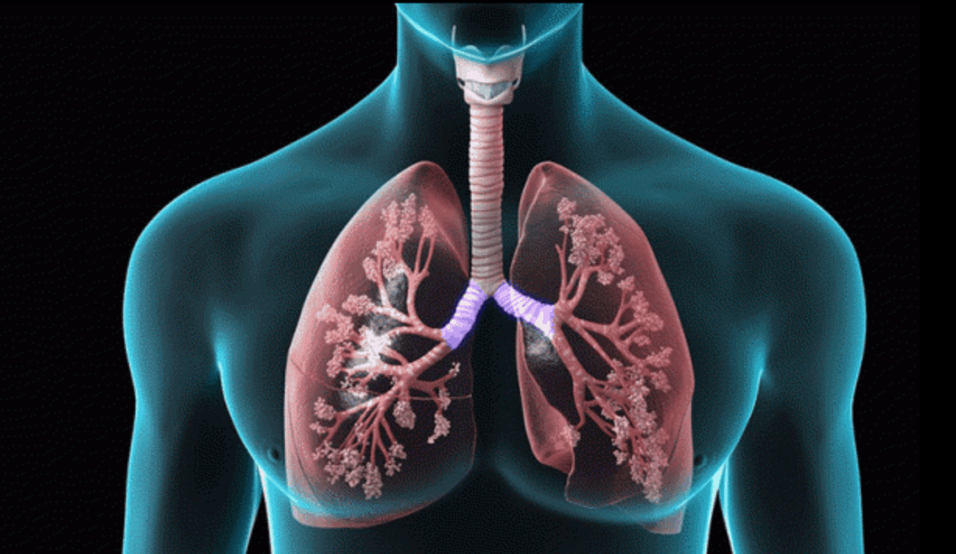
PLeural disorders
Dr Nada Abdelrahman
Associate Professor of internal medicine

Slide 2

Learning objectives
By the end of this session, the students should be able to
Describe the clinical features of major pleural disorders
Diagnose and manage major pleural disorders

Slide 3
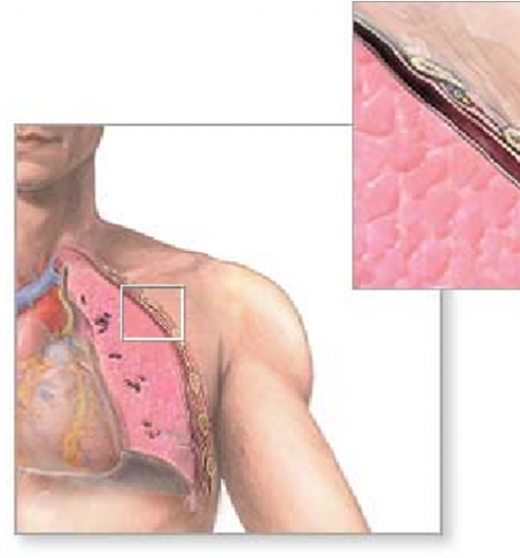
Introduction
Pleura : a layer of connective tissue covered by simple squamous epithelium.
Two layers: visceral (cover the lungs surface) and parietal pleura (lines thorax)..
Normal intrapleural pressure is negative.
Pleural fluid: small lubricating fluid (5-10 ml ) between the visceral and parietal pleura.
Pleurisy: a sharp localized pain worse on deep inspiration
Empyema: accumulation of pus
Haemothorax: accumulation of blood
Chylothorax: milky accumulation of lymph in the pleural space, leakage from the thoracic duct following trauma or carcinoma.
visceral
parietal
This Photo by Unknown Author is licensed under CC BY-SA-NC

Slide 4
Pleurisy: Aetiology
Bacterial infections
Inflammatory conditions
Systemic lupus erythematosus
Sjogren syndrome
Rheumatoid arthritis
Pulmonary conditions
Pneumothorax
Asbestosis
Malignancy e.g., mesothelioma
Pulmonary embolism
Viral infections: most common : coxsackieviruses,
Tuberculosis (TB pleuritis)
Pneumonia (parapneumonic pleuritis)
Cardiac conditions
Myocardial infarction
Aortic dissection
Cardiac surgery
Drugs
Amiodarone, bleomycin, methotrexate
Isoniazid, procainamide, hydralazine
Bornholm Disease: Epidemic myalgia
A self-limiting disorder characterised by upper RTI due to coxsackie B virus in young adults, followed by
Pleuritic chest pain, and upper abdominal pain with tender muscles.
§ X-ray chest is normal

Slide 5

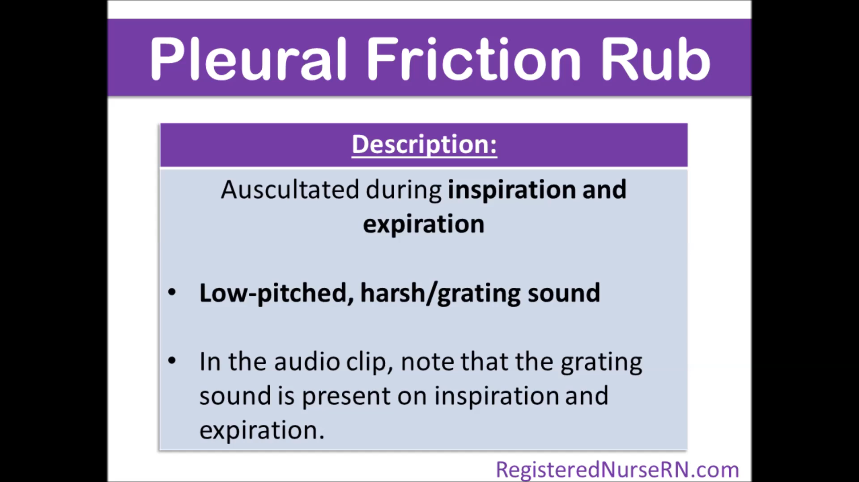
Pleurisy: Clinical feature
Other features include
Pleuritic chest pain
Further symptoms depend on the underlying disease, e.g.:
Constitutional symptoms
Dry cough
Dyspnea
Pleural rub: is heard on deep inspiration on auscultation.
sound of inflamed pleural layers rubbing together during inspiration and expiration)

Slide 6

Diagnosis
Treatment
Analgesia: NSAIDs (first line) : relief of symptoms
Treat underlying cause accordingly.
History and physical examination
CXR: signs of underlying pulmonary pathology e.g., pneumonia, pleural effusion
Rule out life-threatening causes of pleuritic chest pain: ECG (MI or pericarditis).
Differential diagnosis of pleuritic chest pain
Myocardial infarction
Pulmonary embolism
Pneumothorax
Pericarditis
Bornholm disease
This Photo by Unknown Author is licensed under CC BY-SA

Slide 7
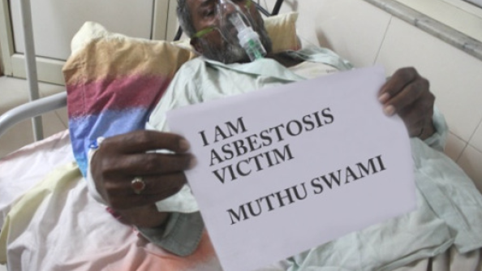
Asbestosis
This Photo by Unknown Author is licensed under CC BY-NC-ND

Slide 8
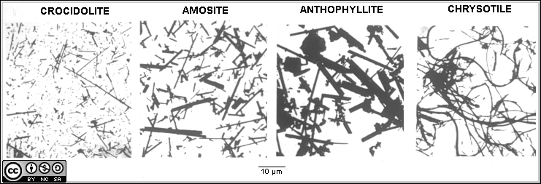

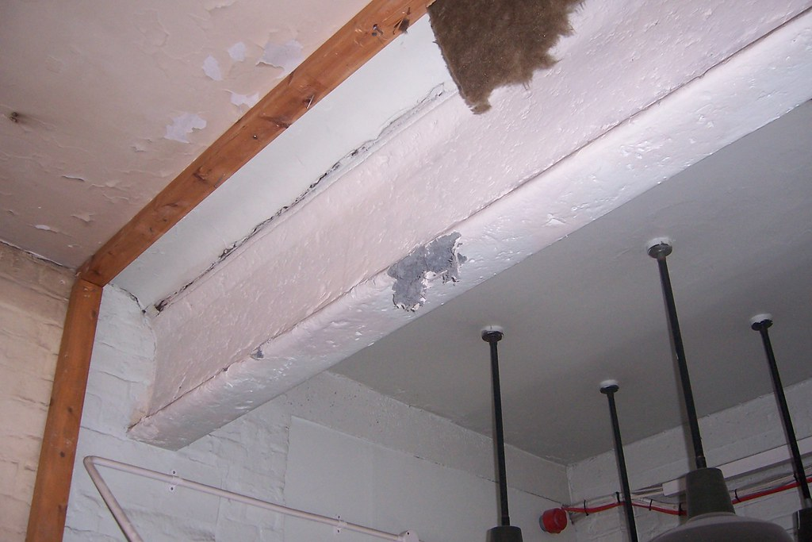
Asbestosis
It is mixture of silicate of iron, magnesium, nickel, cadmium, and aluminum
Fiber and is used for roofing, insulation, fire proofing .
Types of Asbestos
Chrysotile- white asbestos : 90% of worlds production .
Crocidolite- blue asbestos: is associated with asbestosis and mesothelioma.
Amosite – brown asbestos
This Photo by Unknown Author is licensed under CC BY-SA-NC
This Photo by Unknown Author is licensed under CC BY-SA
This Photo by Unknown Author is licensed under CC BY-NC-ND

Slide 9
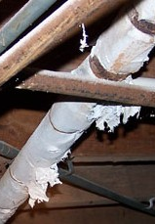
Asbestosis
Exposure to Asbestos : shipyards and construction, pipes (occupational)
After exposure to Asbestos – Mesothelioma : 20-40 years later
Asbestos dust causes pleural thickening, asbestosis, mesothelioma and Adenocarcinoma lung.

Slide 10
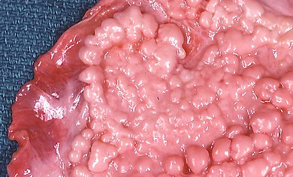
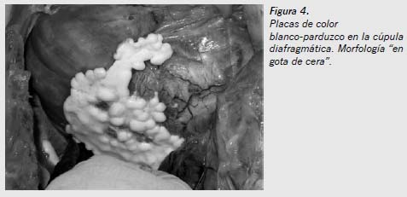
Asbestosis
Asbestosis is nodular interstitial fibrosis due to asbestos dust (silicate).
Crocidolite (blue asbestos)
Slowly progressive. Fibrosis of parietal & visceral
Symptoms
-Breathlessness
-Finger clubbing *
Bilateral basal end-inspiratory crackles
Complications: Respiratory failure, pulmonary hypertension and cor pulmonale
This Photo by Unknown Author is licensed under CC BY-SA
This Photo by Unknown Author is licensed under CC BY-NC
Notes:
Clubbing, however, has been shown to be a poor prognostic indicator as it has been associated with progression to mesothelioma.
Asbestosis is usually slowly progressive and has a better prognosis
than untreated IPF. In advanced cases respiratory failure, pulmonary
hypertension and cor pulmonale may still develop, and treatment is supportive.
Those with asbestosis have a 10-fold increased risk of developing
lung cancer, with rates even higher amongst those with additional
smoking history

Slide 11
Mesothelioma
This Photo by Unknown Author is licensed under CC BY-NC-ND

Slide 12
Pleural effusion

Slide 13
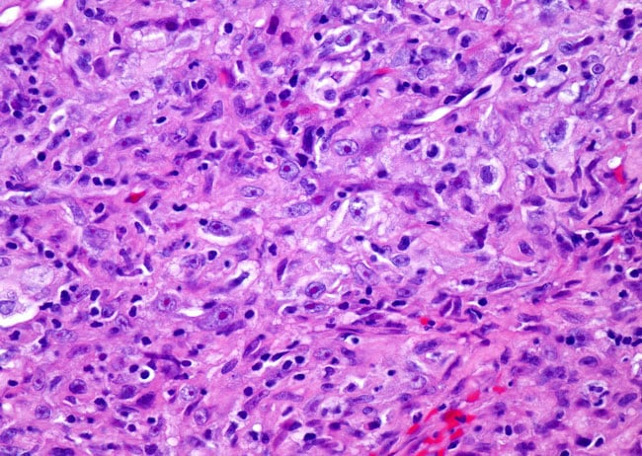
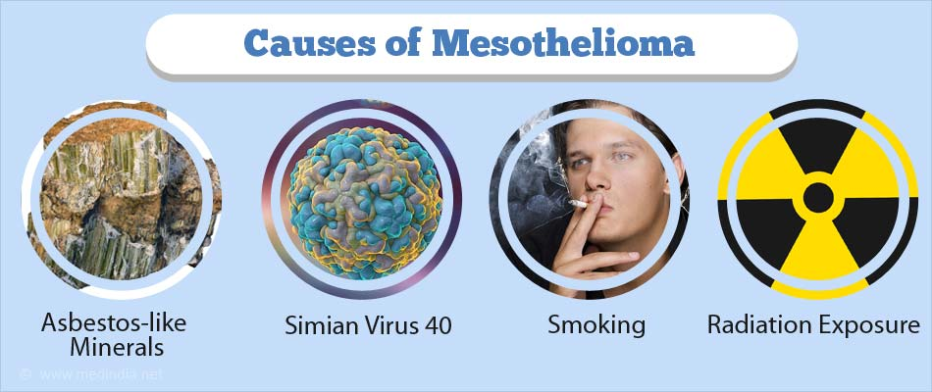
Mesothelioma
Mesothelioma is a malignant tumour of pleura or rarely peritoneum.
usually associated with Crocidolite blue asbestos
after 20 years of exposure
chest pain, unremitting: involvement of the chest wall
Increasing breathlessness:
Pleural effusion
Treatment
- Chemotherapy: 3 months
Prognosis: very poor.

Slide 14
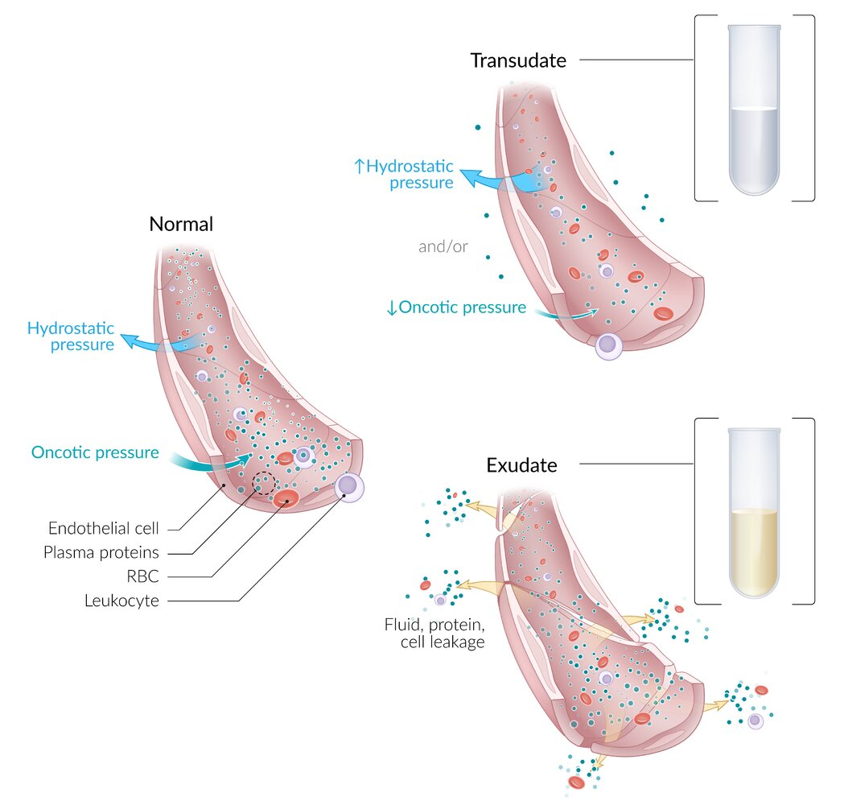
Pleural effusion
An imbalance between the oncotic and hydrostatic forces that govern pleural fluid formation and lymphatic drainage can result in excessive fluid accumulation.
Transudate: clear, extravascular fluid caused by increased capillary hydrostatic pressure (CHF) or decreased capillary oncotic pressure (hypoalbuminemia). Low in protein and cells
Exudate: yellow /cloudy extravascular fluid caused by increased capillary permeability (inflammation or malignancy). high in protein and cells
Notes:
It is detected on X-ray when 300ml of fluid is present.
§ Small pleural effusion can be identified by
ultrasound, CT.
§ Clinically it is detected when 500ml fluid or more is
present
15
Fluid permeates into the pleural cavity through intact pulmonary vessels, e.g., in congestive heart failure (CHF).
fluid escapes into the pleural cavity through lesions in blood and lymph vessels, e.g., due to inflammation or tumors.
Exudate Exudate is and therefore tends to be yellow or cloudy.

Slide 15
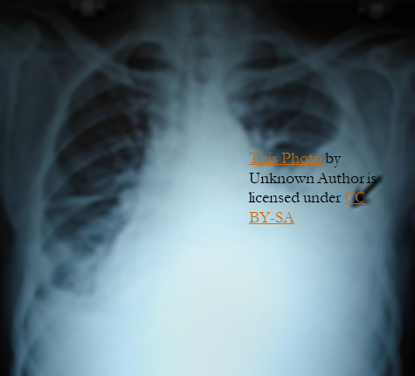
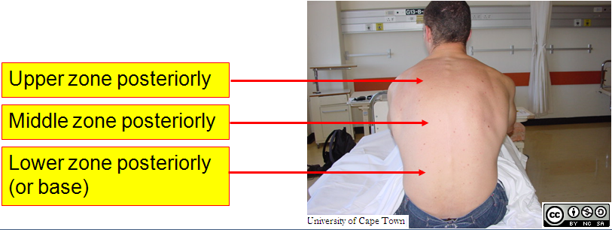
Clinical features
This Photo by Unknown Author is licensed under CC BY-SA-NC
Asymptomatic : small pleural effusion (< 300 mL)
Characteristic symptoms
Dyspnea
Pleuritic chest pain (sharp retrosternal pain)
Dry, nonproductive cough.
Symptoms of hypoxia
Symptoms of the underlying disease (fever in empyema, cachexia in cases of malignancy, symptoms of left-sided heart failure)
Physical exam findings: clinically detected if > 500 ml.
Inspection and palpation (affected side)
Asymmetric expansion (↓Chest movement)
Mediastinal displacement ( Trachea shifted )away from side of lesion in massive effusion.
Reduced Tactile fremitus
Percussion: stony dullness
Auscultation
Faint or absent breath sounds over the area of effusion
Vocal resonance – reduced or absent
Notes:
- Breath sound – reduced or absent
-
- Added sound – none

Slide 16
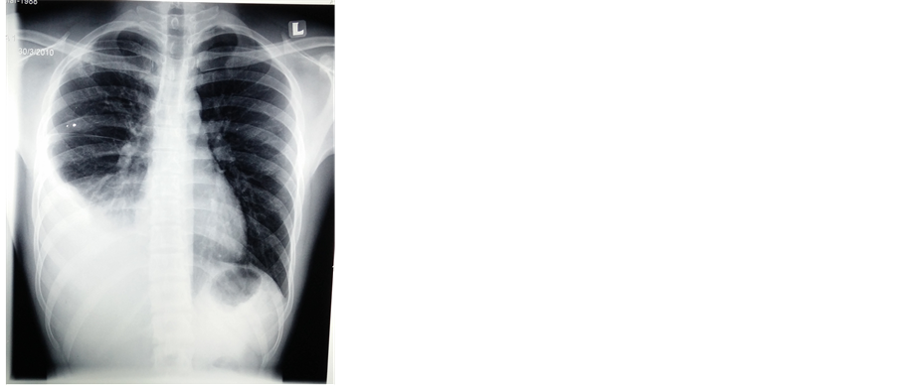
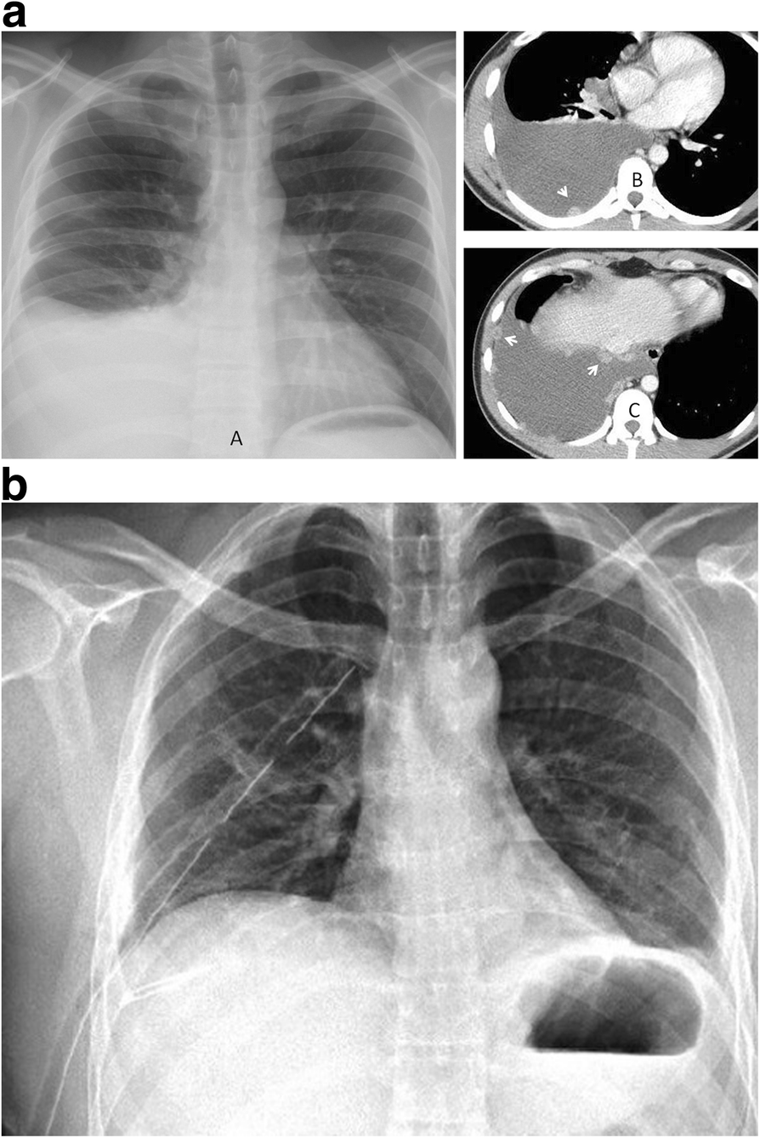
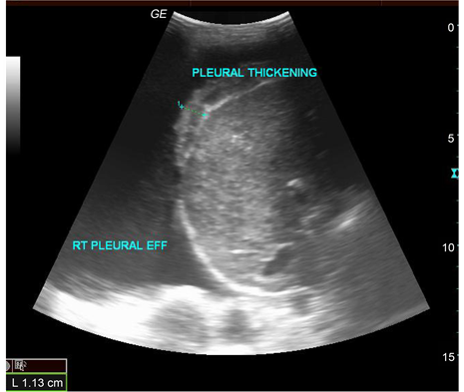
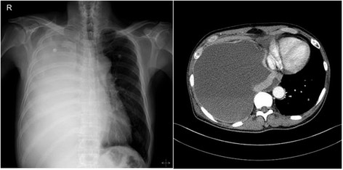
Diagnostics
Imaging to confirm the diagnosis
Chest Xray: Lateral decubitus view (most sensitive): > 200 ml
unilateral blunting of the costophrenic angle
Homogeneous density with a meniscus-shaped margin (meniscus sign)
Complete opacification of the lung (Large effusion) and Mediastinal shift and tracheal deviation.
Ultrasound: Quick, bedside assessment, if planning thoracentesis.
Very sensitive: 20 ml. hypoechoic collection.
detection of pleural thickening and pleural nodules
CT: Gold standard for small
Guiding placement of indwelling pleural catheters
Directed thoracentesis of a loculated effusion
Suspected parenchymal or pleural pathology
Thoracentesis: 21G needle 20 ml syringe under aseptic condition through intercostal space towards top area of dullness.
This Photo by Unknown Author is licensed under CC BY
This Photo by Unknown Author is licensed under CC BY
Notes:
contrast CT is now increasingly performed to investigate the underlying cause, particularly for exudative effusions

Slide 17
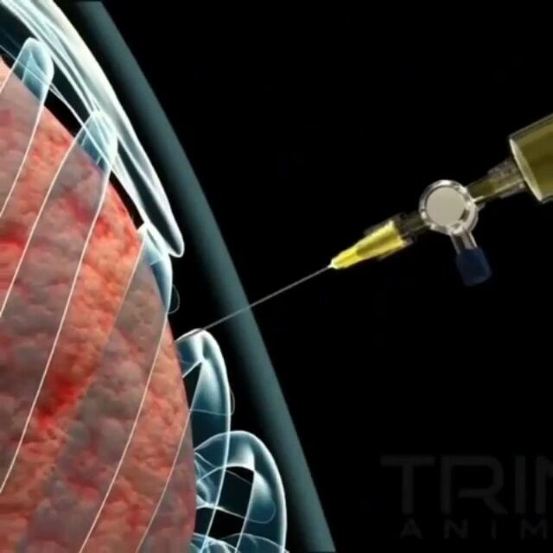
Diagnostic thoracentesis
For diagnostic and/or therapeutic purposes
Indications:
New unilateral effusion
Hx malignant tumor with effusion
Pneumonia with parapneumonic effusion
Heart failure with atypical findings (e.g., pleuritic chest pain, fever, unilateral effusion)
C/I: local infection, bleeding risk.
Studies (5 C)
Color Cytology Culture Cell count Chemistry
TB testing: adenosine deaminase, AFB smear microscopy

Slide 18
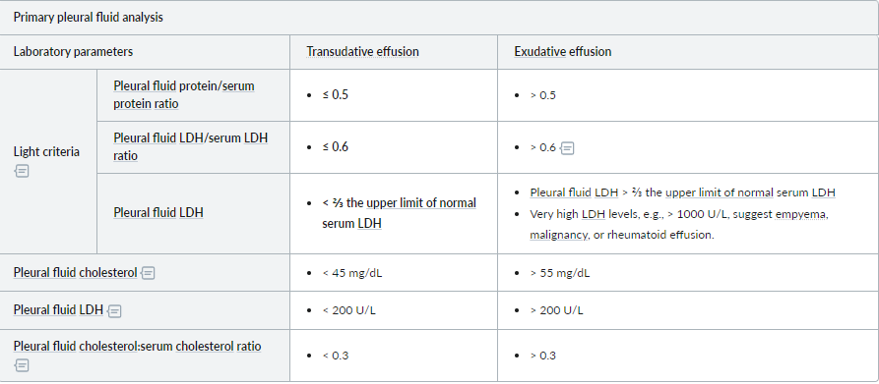
Pleural fluid analysis: Light criteria
Differentiating transudates (Bilateral) from exudates
criteria for borderline cases:
Exudates have a protein level of >30 g/L, transudates have a protein level of <30 g/L
If the protein level is between 25 and 35 g/L, Light's criteria should be applied.
MEAT has low glucose: Malignancy, Empyema, Arthritis (rheumatoid pleurisy), and Tuberculosis are causes of pulmonary effusion associated with low glucose levels.
Notes:
The BTS recommend using the criteria for borderline cases:
exudates have a protein level of >30 g/L, transudates have a protein level of <30 g/L
if the protein level is between 25-35 g/L, Light's criteria should be applied. An exudate is likely if at least one of the following criteria are met:

Slide 19
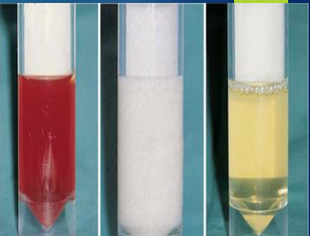
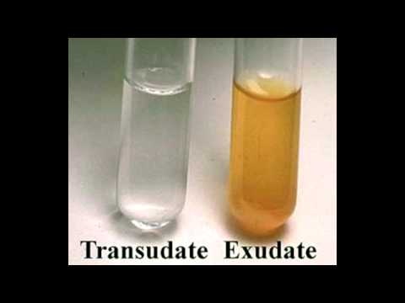
Common causes
Exudate
Trauma (high vascular permeability)
Rare
- Bacterial pneumonia(parapneumonic), empyema, T.B
- Carcinoma of bronchus, lymphoma
- Pulmonary Infarction
- Post-MI
- Acute pancreatitis – (↑amylase)
- SLE, Rheumatoid arthritis ( Connective tissue disorders)
- Mesothelioma ( Asbestosis )
Very rare causes
Sarcoidosis
Yellow nail syndrome (lymph oedema)
Familial Mediterranean fever
Parasitic illness (amebiasis, echinococcal disease)
Common
Transudate:30g of protein
Congestive heart failure
Hepatic cirrhosis
Nephrotic syndrome
Protein-losing enteropathy
Hypo-albuminaema

Slide 20
Differential diagnosis of exudative effusions
Pleural fluid parameter | Associated conditions
WBC count > 10,000 cells/mm³ | Parapneumonic effusion Pancreatitis Pulmonary embolism
Neutrophils > 50% of total leukocytes | Acute infection Pulmonary infarct
Lymphocytes > 50% of total leukocytes | Tuberculous infection Malignant effusion Chylothorax
RBC count > 5,000 cells/μL | Hemothorax Malignant effusion Pulmonary embolism/infarct
pH < 7.2 | Complicated parapneumonic effusion Empyema Malignant effusion Esophageal perforation
Positive Gram stain or culture | Parapneumonic effusion Empyema
Adenosine deaminase > 50 mcg/L Positive AFB smear microscopy | Tuberculous effusion
Abnormal cytology | Malignant effusion
Amylase > 200 mcg/dL | Pancreatitis Esophageal perforation Ruptured ectopic pregnancy
Notes:
Pleural infection
All patients with a pleural effusion in association with sepsis or a pneumonic illness require diagnostic pleural fluid sampling
if the fluid is purulent or turbid/cloudy a chest tube should be placed to allow drainage
if the fluid is clear but the pH is less than 7.2 in patients with suspected pleural infection a chest tube should be placed

Slide 21
Management
Treat the underlying condition
Large: drainage. Maximum aspiration of pleural fluid at one time is 1000ml
All patients with a pleural effusion in association with sepsis or a pneumonic illness require diagnostic pleural fluid sampling
if the fluid is purulent or turbid/cloudy a chest tube should be placed to allow drainage
if the fluid is clear but the pH is less than 7.2 in patients with suspected pleural infection a chest tube should be placed
Malignant pleural effusion
Symptomatic and reaccumulate: aspirated to dryness followed by PLEURODESIS.
Instillation of a sclerosing agent as tetracycline or talc ( Magnesium silicate).
https://youtu.be/gASiQ2I_4KY

Slide 22
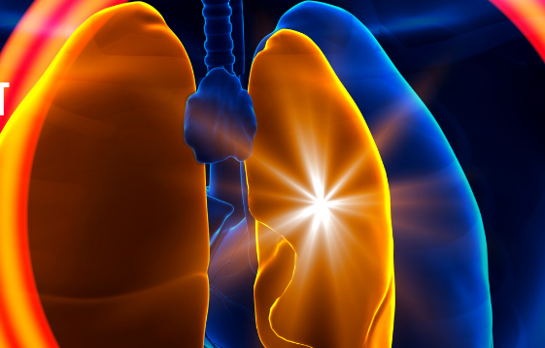
This Photo by Unknown Author is licensed under CC BY-NC-ND
Pneumothorax

Slide 23
Pneumothorax
Definition
Pneumothorax: a collection of air within the pleural cavity that can lead to partial or complete pulmonary collapse.
Classified as:
Spontaneous pneumothorax
Primary SP: without clinically apparent underlying lung disease
Secondary SP: a complication of underlying lung disease
Recurrent pneumothorax: a second episode of SP either ipsilateral or contralateral.
Traumatic pneumothorax: caused by trauma (e.g., penetrating injury, blunt, iatrogenic trauma: mechanical ventilation )
Iatrogenic pneumothorax: complication of medical procedures (thoracentesis, CV placement, ventilation, including non-invasive ventilation or lung biopsy.
Tension pneumothorax: a life-threatening characterized by progressively increasing pressure within the chest and cardiorespiratory compromise.
Notes:
evere respiratory distress and haemodynamic collapse..

Slide 24
Aetiology and epidemiology of pneumothorax
Primary pneumothorax:
It is caused by rupture of apical pleural bleb, due to a congenital defect in the connective tissue of alveolar wall.
Risk factors
Family history
Male sex M : F ratio 6:1
Young age
Asthenic body habitus (slim, tall stature)
Smoking (90% of cases): up to 20-fold
Homocystinuria
Marfan Syndrome
Secondarily pneumothorax:
Commonest Causes
COPD: rupture emphysema bullae
Bronchial asthma
Carcinoma
Lung abscess – bronchopleural fistula
Cystic fibrosis: severe pulmonary fibrosis with cyst formation
Infections: TB, Pneumocystis pneumonia
Catamenial pneumothorax : rare

Slide 25
Clinical features
Additional findings in tension pneumothorax
Valvular mechanism: when air is sucked into the pleural space during inspiration but not expelled during expiration ↑ pleural pressure lung collapse and mediastinum shift. This will ↓ venous return and ↑ respiratory difficulty.
Clinically:
Severe acute respiratory distress: cyanosis, restlessness, sweating
Distended neck veins
Hemodynamic instability (tachycardia, hypotension, pulsus paradoxus)
Secondary injuries (open or closed wounds).
Asymptomatic
Sudden, severe, and/or stabbing, ipsilateral pleuritic chest pain and dyspnea
Physical signs
Chest movement reduced on the affected side
Mediastinal shift: Trachea shifted to the opposite
Percussion note – hyper resonant
Breath sound – reduced or absent
Vocal resonance – reduced or absent
Added sound – none
Subcutaneous emphysema
P-THORAX: Pleuritic pain, Tracheal deviation, Hyperresonance, Onset sudden, Reduced breath sounds (and dyspnea), Absent fremitus, X-rays show collapse.
Notes:
Clinical features
Symptoms tend to come on suddenly:
dyspnoea
chest pain: often pleuritic
Signs
hyper-resonant lung percussion
reduced breath sounds
reduced lung expansion
tachypnoea
tachycardia
In tension pneumothorax:
respiratory distress
tracheal deviation away from the side of the pneumothorax
hypotension

Slide 26
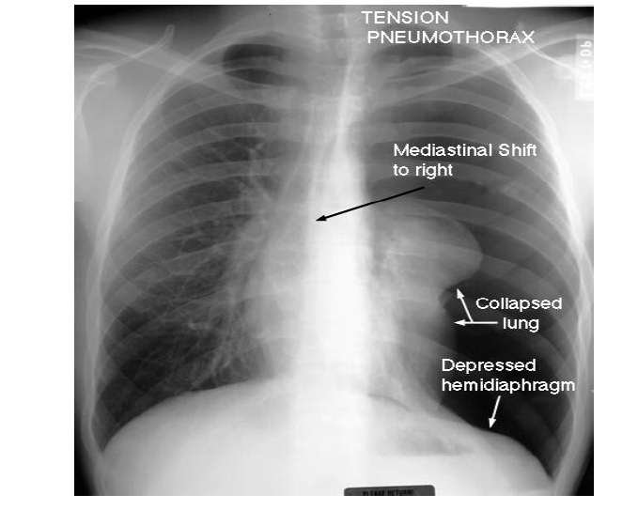
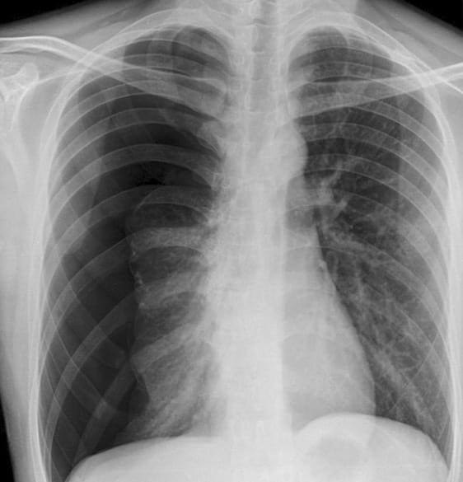
Tension pneumothorax
Normally intrapleural pressure is negative
In Pneumothorax, it becomes positive leading to collapse of lung
In cases of tension pneumothorax, immediate decompression is a priority and should not be delayed by imaging.
This Photo by Unknown Author is licensed under CC BY-SA-NC
Notes:
There are completely absent lung markings on the right, with the right lung collapsed and pushed across into the left hemithorax, along
with the mediastinal contents.

Slide 27
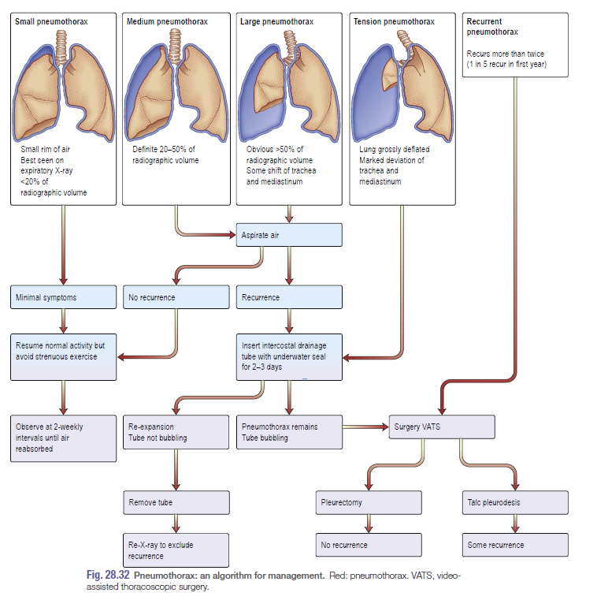
Management
Kumar : 974 Respiratory disease

Slide 28
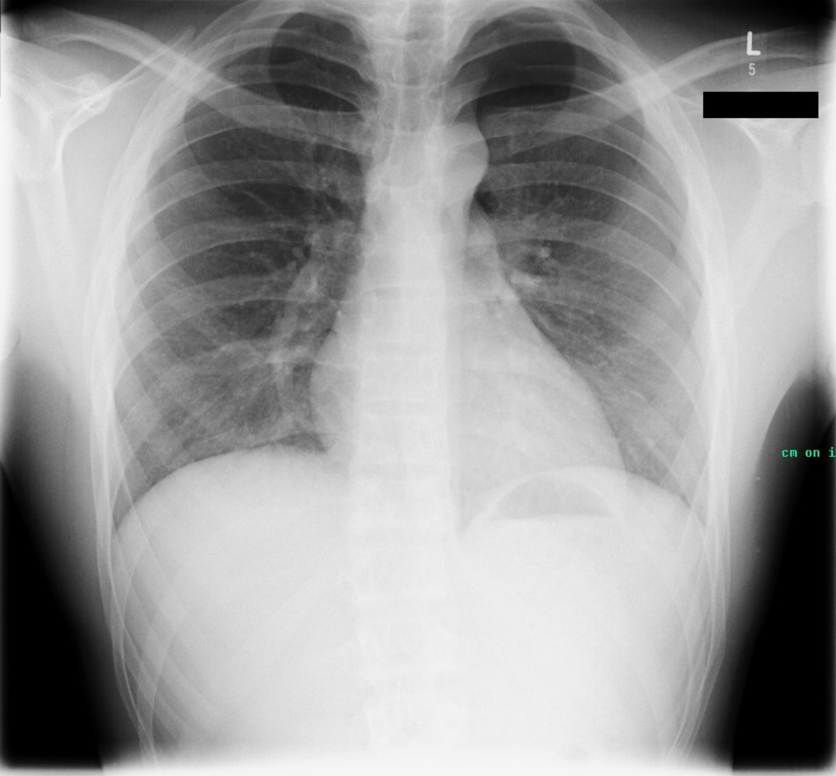
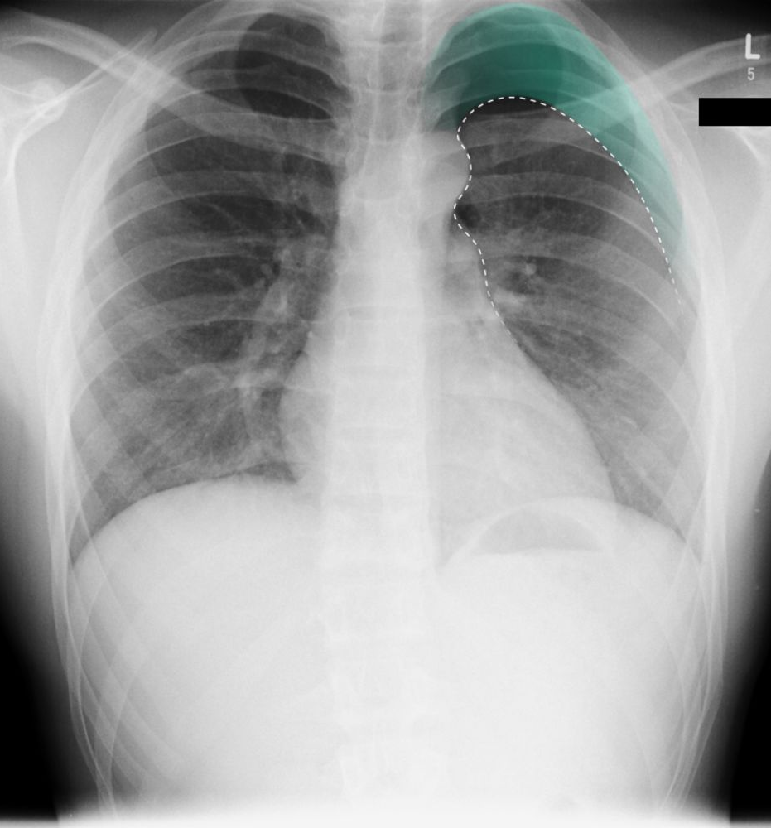
Management of Pneumothox
Small Pneumothorax: < 20% of radiographic volume ( Best seen in expiratory film)
minimal symptoms
Observe 2 weeks until air is reabsorbed
resume normal activity but avoid strenuous exercise

Slide 29
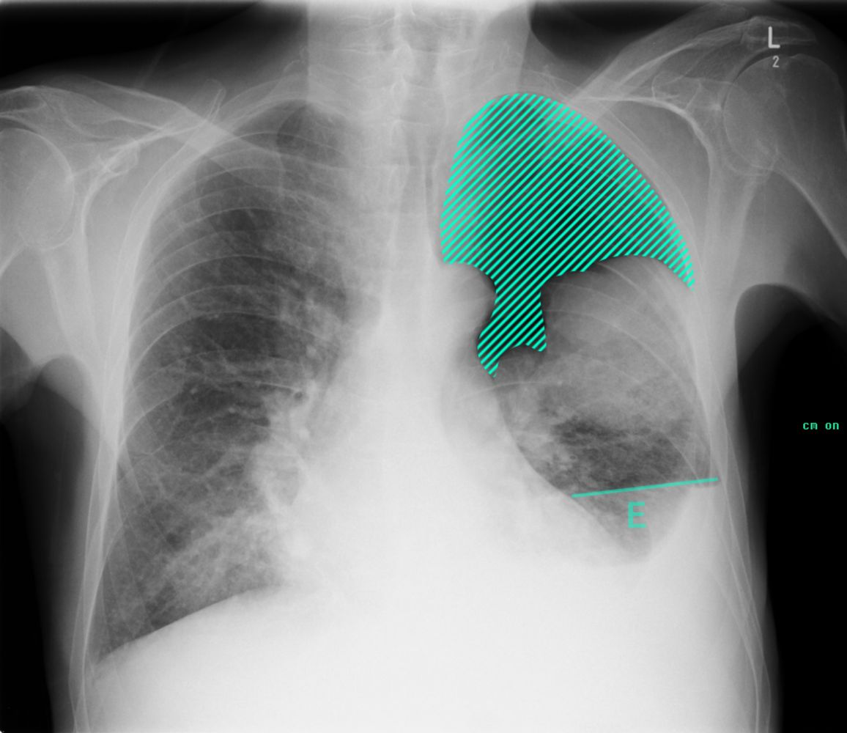
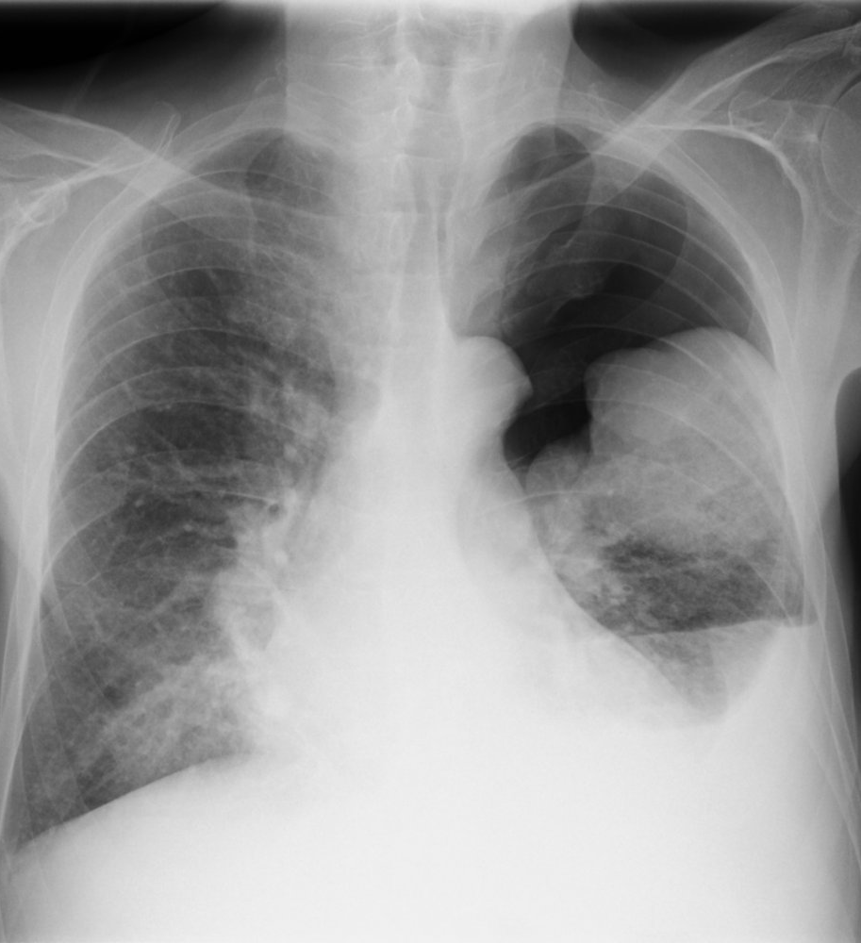
Moderate Pneumothorax
When there is 20-50% of radiographic volume
Aspirate air

Slide 30
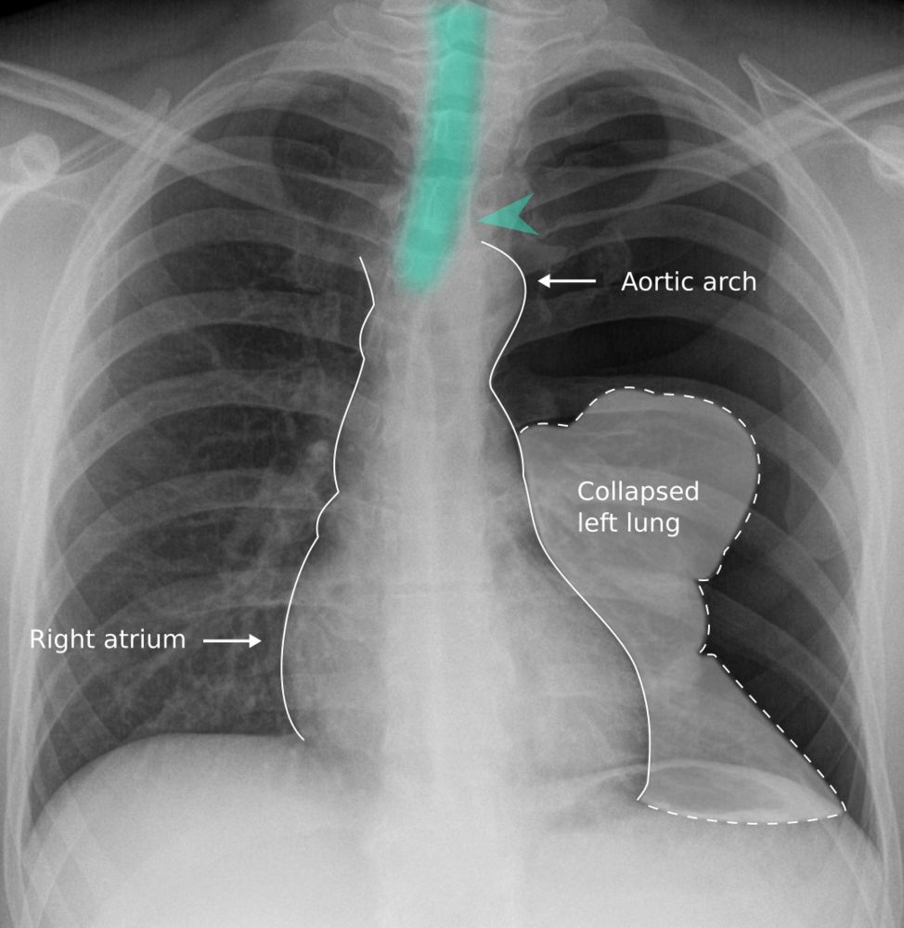
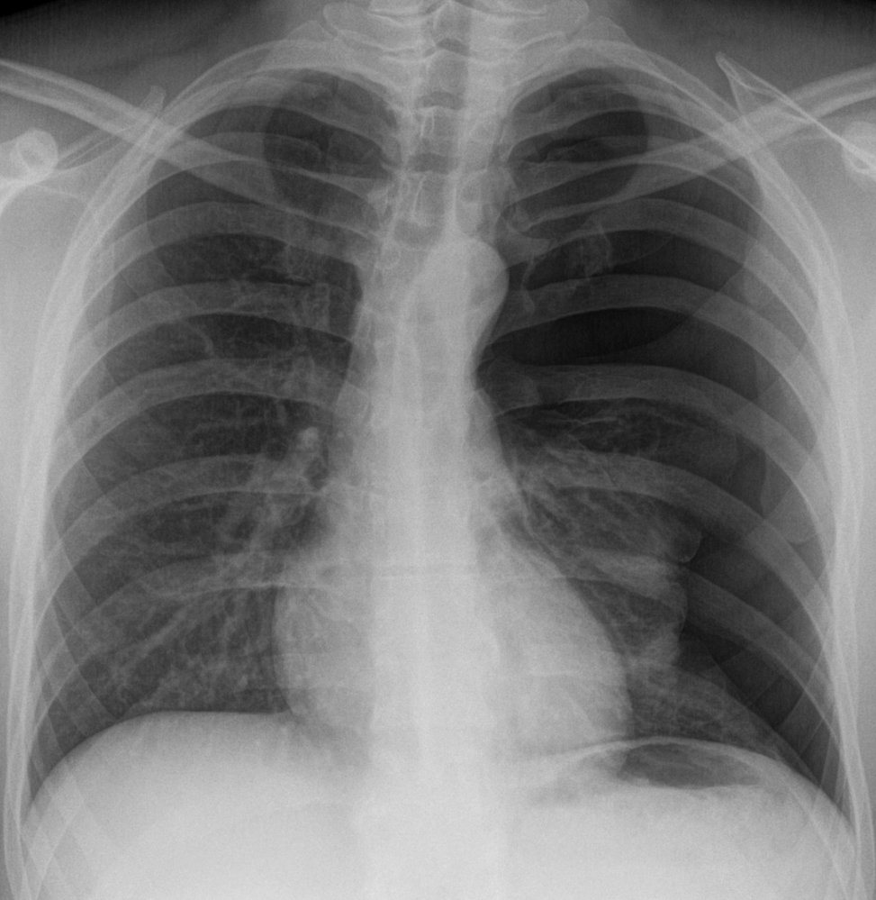
Management
Large Pneumothorax
§ When more than 50% of the radiographic volume and it
causes shift of trachea and mediastinum
§ Aspirate air
§ If reoccurrence, insert intercostal drainage tube with under water seal for 2-3 days
§ Look for reexpansion (tube not bubbling) and remove tube and do X-ray chest

Slide 31
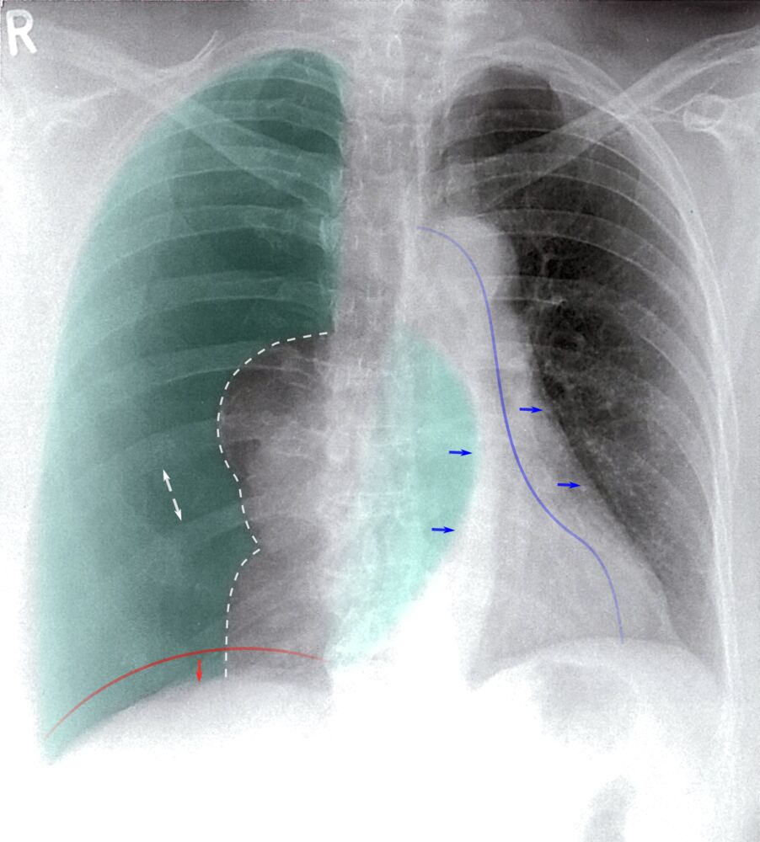
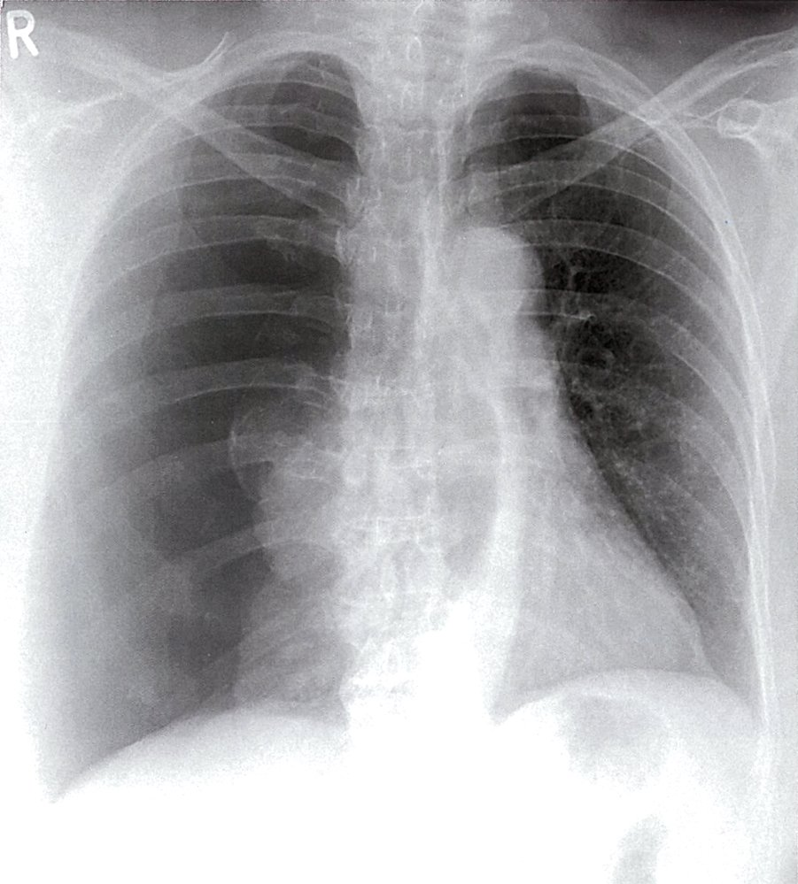
Management of Tension Pneumothorax
Causes collapse of lung and shifting of trachea and mediastinum to opposite side.
§ Aspirate air till preparing drain
§ insert intercostal drainage tube with under water seal for 2-3 days
§ Look for reexpansion (tube not bubbling) and remove tube and do X-ray chest

Slide 32
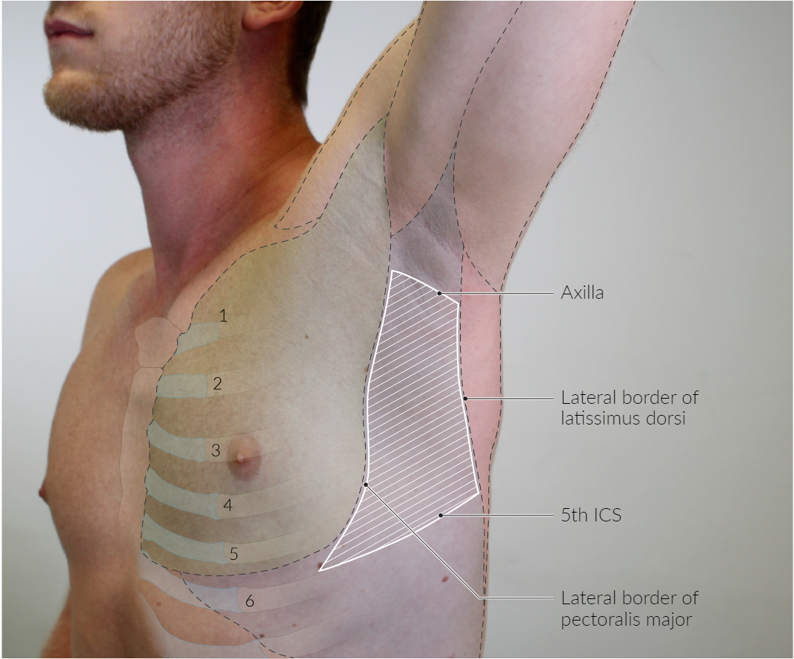
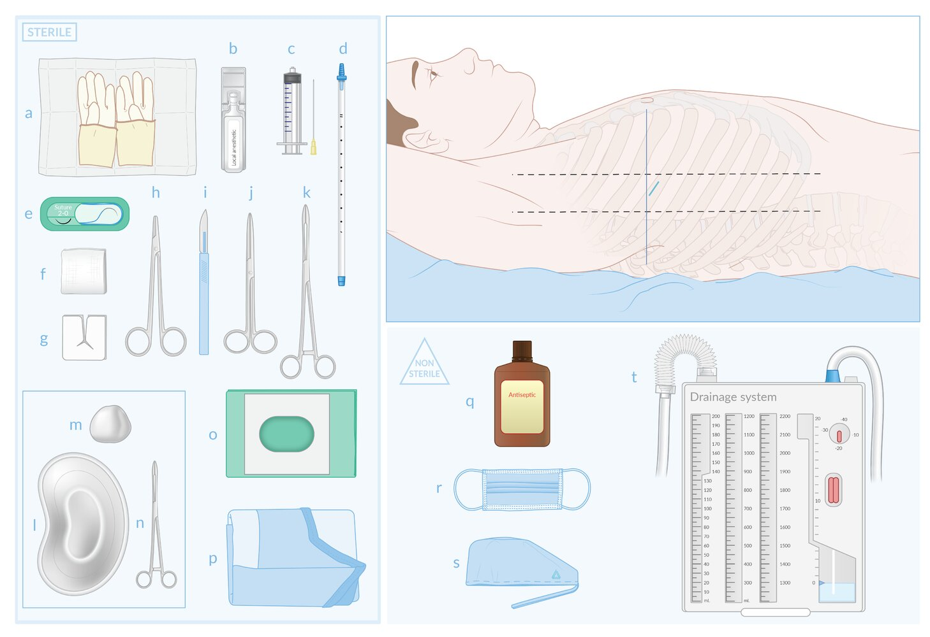
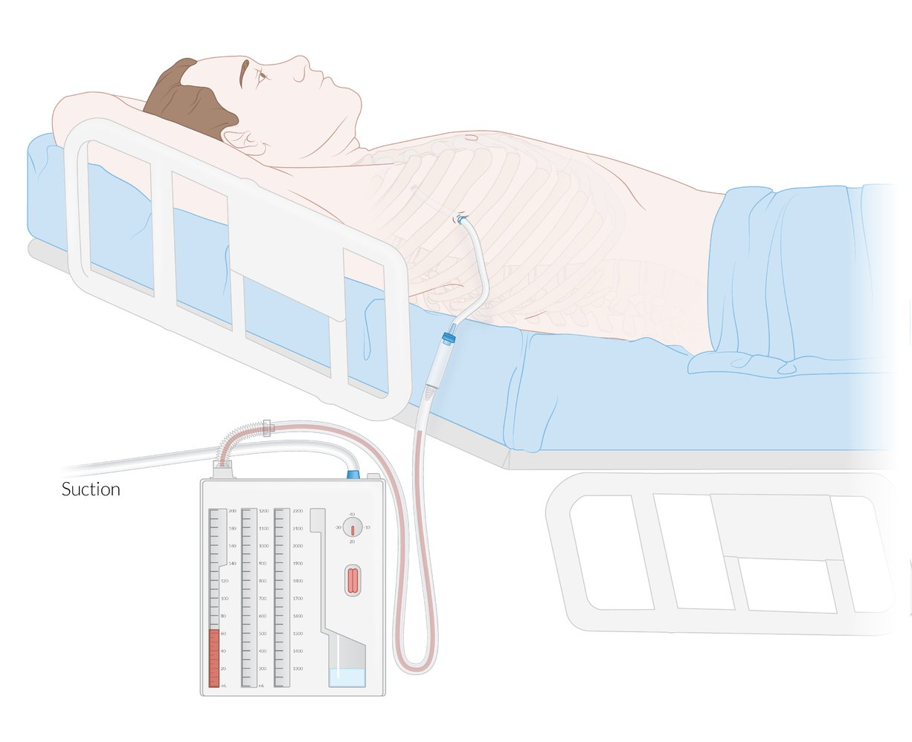
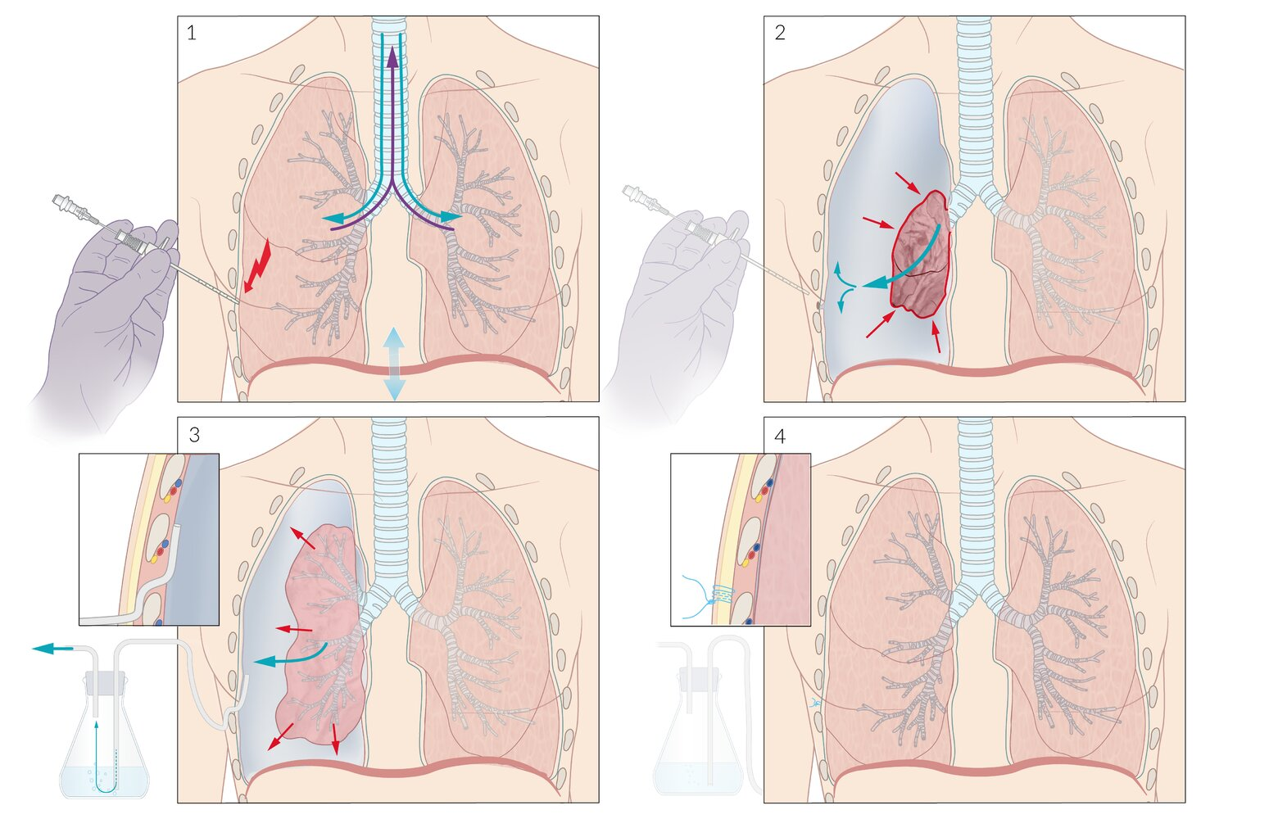
Safe Triangle

Slide 33
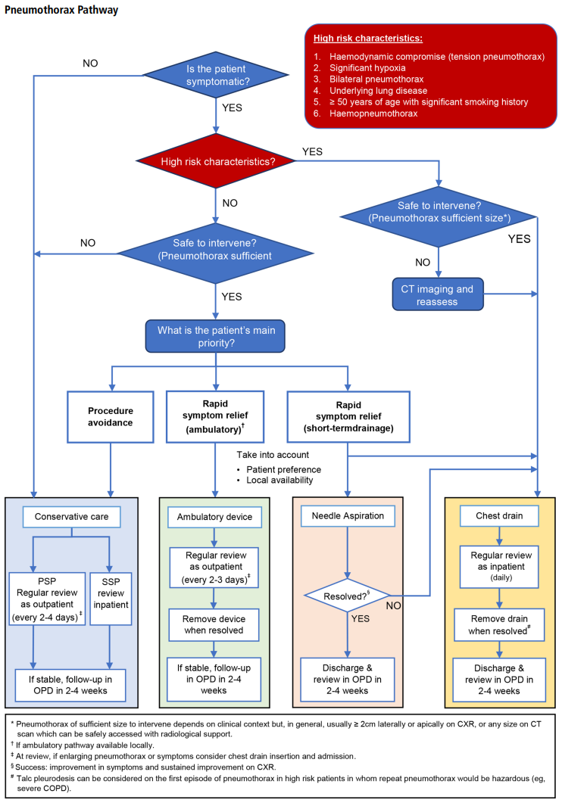
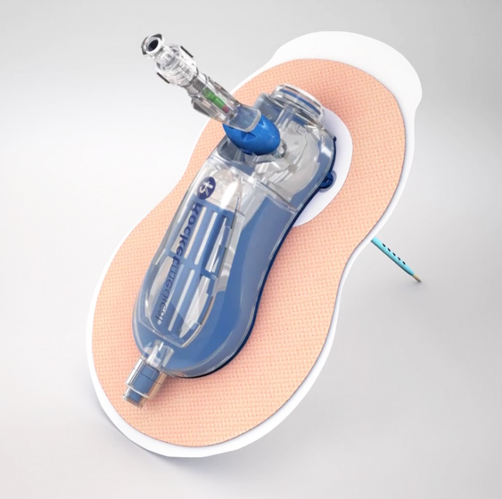
Rocket® Pleural Vent™
Notes:
it includes an 8FG catheter mounted on an 18G needle and a pigtail catheter to minimize the risk of occlusion
ambulatory devices typically have a one-way valve and vent to prevent air and fluid return to the pleural space while allowing for controlled escape of air and drainage of fluid
many devices also have an indication diaphragm that signals when the catheter tip enters the pleural space and continues to fluctuate with respiration, aiding in the assessment of pneumothorax resolution

Slide 34
Discharge advice
Smoking: avoid smoking to reduce the risk of further episodes - the lifetime risk smoking men is around 10% compared with around 0.1% in non-smoking men
Fitness to fly: 1 week post check x-ray
Scuba diving:
the BTS guidelines state: 'Diving should be permanently avoided unless the patient has undergone bilateral surgical pleurectomy and has normal lung function and chest CT scan postoperatively.'

Slide 35
References
https://youtu.be/J1n2mJ00xKs
https://youtu.be/M4D0I45_mQ0
https://youtu.be/Bt0axpDlTd8

