Slide 1
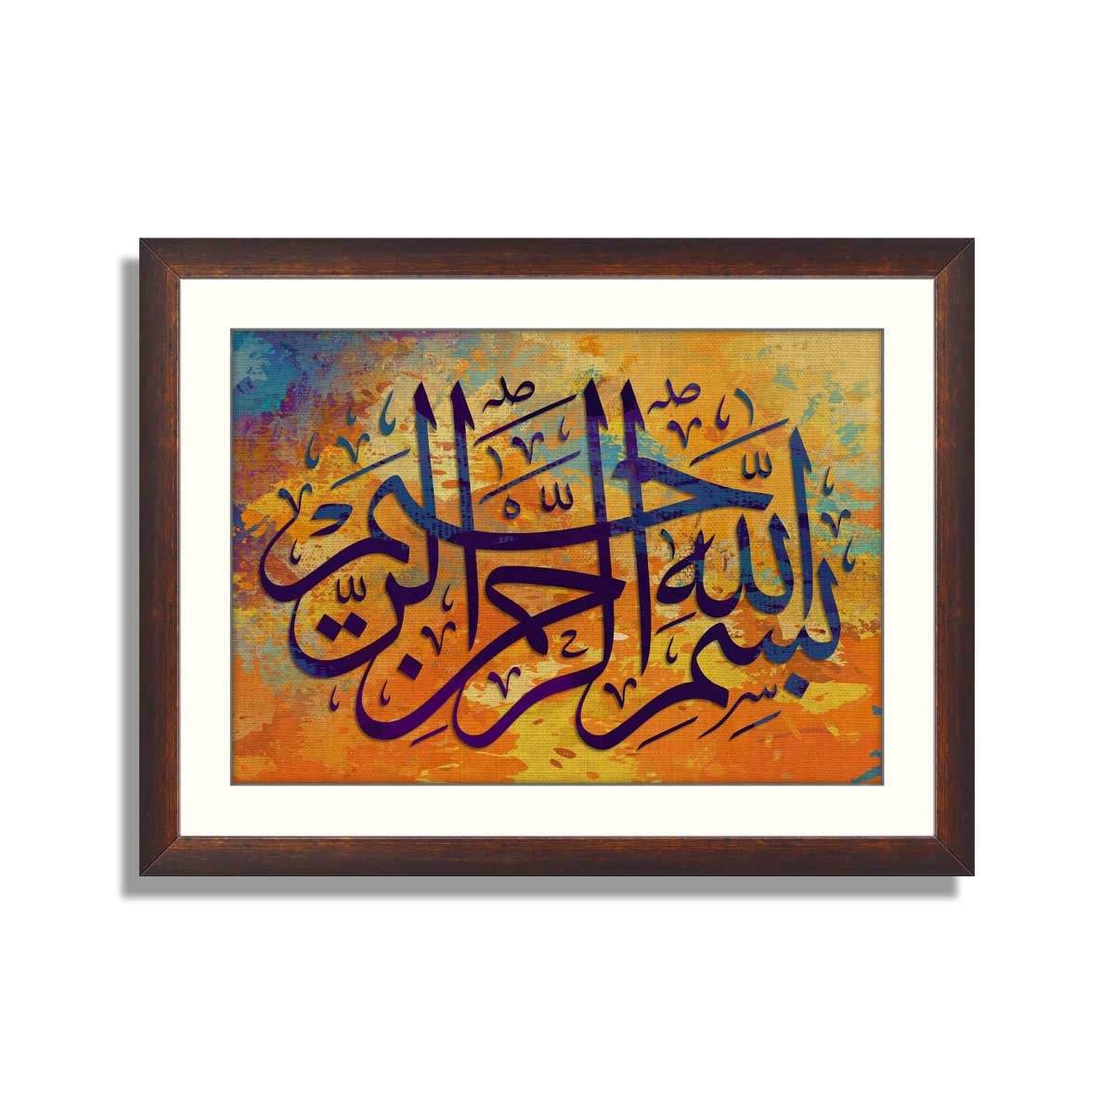

Slide 2


Slide 3
SICKLE CELL DISEASE
DR WAQAR
MBBS, MRCP, Int. Medicine( London)
MRCP, Endocrinology & DM(London)
ASST. PROFESSOR

Slide 4
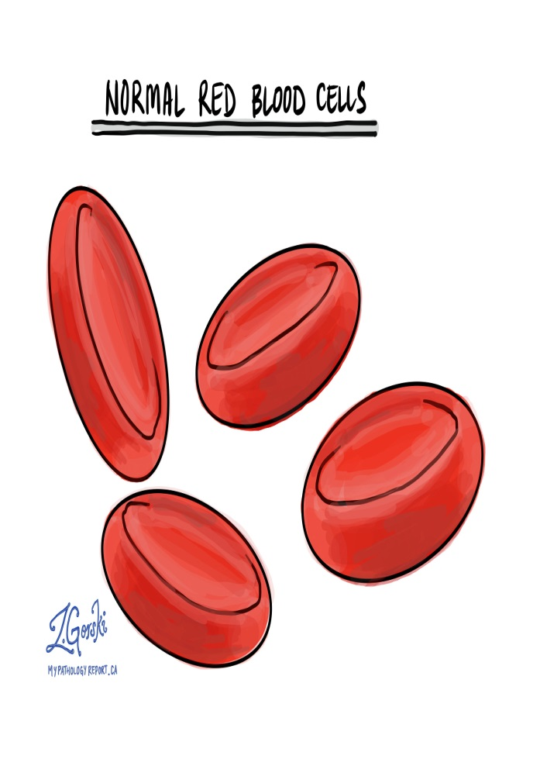
NORMAL
RBCs are round
Most of the hemo-
globin is Hb.A

Slide 5
WHAT IS SICKLE CELL DISEASE
It is a type of hemo-globino-pathy
It is a hereditary condition
An abnormal Hb. called Hb.S, replaces the normal Hb.A
Hb.S is produced when the amino acid “glutamic acid” (in the normal Hb.A) is replaced by another amino acid “valine”
The Hb.S causes the RBCs to become sickle shaped (MANJAL) which causes problems (blocking of blood vessels & hemolysis)

Slide 6

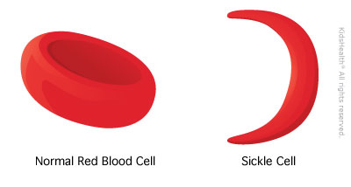
SICKLED CELLS

Slide 7
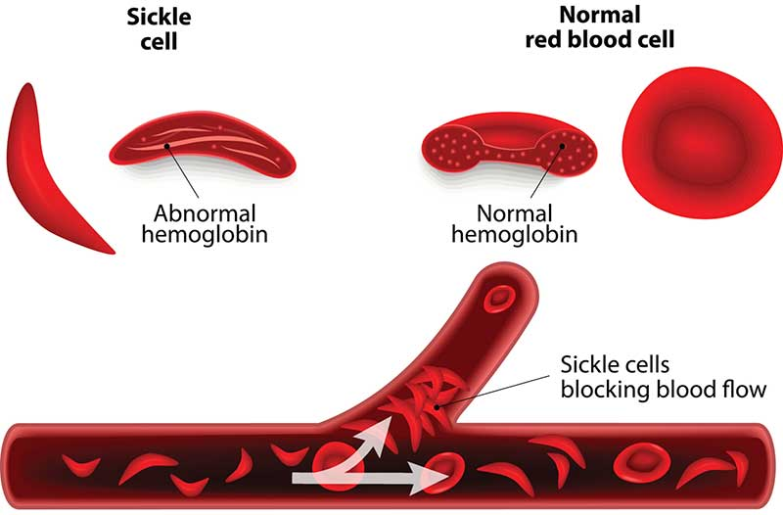
VASO-OCCLUSION BY SICKLED CELLS

Slide 8
GENETICS OF SCD
*Pattern of inheritance: Autosomal recessive
Normally, Hb. is produced by 2 genes
If both genes are abnormal sickle cell disease (no Hb. A)
If only one gene is abnormal, it is called sickle cell trait (carrier state ,Hb.AS) half of body’s Hb is HbS & half is Hb A. Not full blown disease

Slide 9
SO
1) Normal Genetics : AA
2) Sickle cell trait: AS
3) Sickle cell disease : SS

Slide 10
VARIANTS OF SCD
Hb.SC disease: Presence of Hb.S plus Hb.C.
( hemoglobin C is another type of abnormal
Hb.)
2) Hb.S/β : Sickle cell gene plus beta thallass.
gene

Slide 11
SO,
Sickle cell disease (Hb.SS) Symptomatic
Sickle cell trait (Hb.AS) usually asymptomatic but can cause sudden death if patients do vigorous exercise
Hb.S/β disease (sickle + thallassemia) symptomatic
Hb.SC disease: Symptomatic, but milder than SCD

Slide 12
EPIDEMIOLOGY
Very common worldwide
In the U.S., 1 in 625 births have SCD
More in African-Americans
Common in Mideast, Africa, Mediterranean areas (Greece, Turkey, Italy)
In KSA, high prevalence in Eastern region & southwestern areas (Jizan)

Slide 13
INVESTIGATIONS TO DO
CBC: * Anemia( Hb. usually around 8g)
* WBCs & platelets high (due to
hyperactive bone marrow)
* Reticulocytes are high
2) LFTs: high bilirubin( which type? )
3) Peripheral smear: shows sickled cells
4) Hb.Electrophoresis: This is confirmatory. It
shows: * 80-90% Hb.S * remaining is Hb.F
* No Hb.A (in pure Hb.SS)

Slide 14
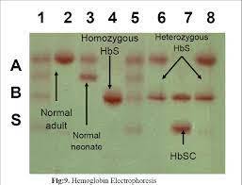
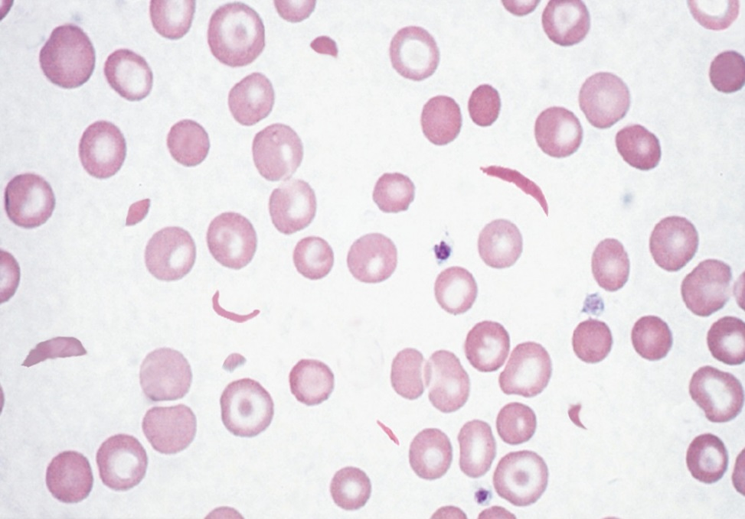
Electrophoresis
peripheral Smear

Slide 15
5) Solubility test: Patient’s blood mixed with sodium di-thio-nite solution solution turns turbid (due to sickling. See next slide)
6) Sickling test :Drop of blood on a slide add sodium meta-bi-sulphite causes excess sickling (seen under the microscope)
7) Genetic testing. Available but not done routinely for diagnosis.

Slide 16
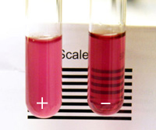
SOLUBILITY TEST
TURBID

Slide 17
SCREENING
Screening for SCD done on all new borns in the U.S. and most countries
Premarital screening done in K.S.A.
In utero screening of the fetus can be done
( sample of amniotic fluid or placenta
genetic analysis)

Slide 18
SIGNS & SYMPTOMS
A stable patient (no acute symptoms) will have :
Anemia (Hb. around 8)
May be jaundice (due to?)
Sometimes leg ulcers

Slide 19
Various Crises in SCD
Vaso-occlusive pain crisis
Acute chest syndrome
Aplastic crisis
Hemolytic crisis
Splenic sequestration

Slide 20
Pain Crisis
Most common crisis
Vaso-occlusion tissue ischemia pain
Pain is typically in the long bones, back, chest and abdomen
Precipitated by: hypoxia, infection, dehydration, weather changes, sometimes idiopathic

Slide 21
Treatment of pain crisis:
a) Analgesia, usually narcotics (morphine)
b) Good hydration
c) Check for any infection (eg UTI, chest infec. &
treat)
d) No transfusion
e) O2 (if hypoxic)

Slide 22
ACUTE CHEST SYNDROME
It is a life threatening crisis
Occlusion of the pulmonary blood vessels
Dyspnea/tachypnea, fever, infiltrates on X ray, hypoxia, high WBCs
Often difficult to distinguish from pneumonia
Treatment: a) Analgesia
b) O2
c) Transfusion
d) Antibiotics (empirically)

Slide 23
Aplastic Crisis
Sudden & transient decrease in marrow activity. Marrow stops forming RBCs
Mostly seen in children due to Parvo virus B19 infection
Sudden drop in Hb. & also retic.count
Treatment: a) Transfusion b) Folic acid

Slide 24
HEMOLYTIC CRISIS
Sudden excessive hemolysis
May need transfusion
SPLENIC SEQUESTRATION CRISIS:
* Acute sequestration of RBCs in the spleen
* Sudden drop in hemoglobin and acute painful
splenomegaly
* Treatment: Transfusion. Sometimes splenectomy

Slide 25
OTHER FEATURES OF SCD
Priapism: It is painful erection of male
genitalia. Repeated attacks may cause
impotence. Treatment: analgesia, transfusion
2) Stroke/ TIA : Due to blockage of cerebral
vessels.

Slide 26
Other Features(contd)
3) Asplenia (non functioning spleen)
* Repeated vaso-occlusion causes splenic
infarcts spleen shrinks & becomes
non-functional
* Most cases occur by age of 1 year
* Non functioning spleen risk of infections with
encapsulated bacteria (Pneumococci,
meningococci, H.Flu.)
* Howell-Jolly bodies seen on a peripheral smear
( remains of DNA in the RBCs)
(Howell Jolly bodies indicates asplenia)

Slide 27
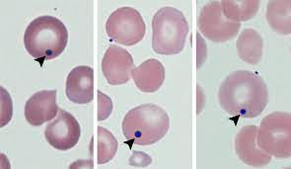
Howell-Jolly bodies
(seen if there is no spleen)

Slide 28
4) Renal problems:
* Renal medullary infarction causes
tubular damage impaired water absorption
fluid loss
5) Retinopathy : Due to retinal infarcts (vaso-
occlusion)
6) Cholelithiasis: Hemolysis increased biliru-
bin bili. stones in the gallbladder (look for a
surgical scar)

Slide 29
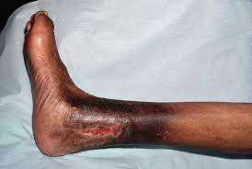
7)Leg ulcers:
* due to vaso-occlusion
* Usually on the ankles

Slide 30
8) Pulm. HTN: Increased risk of this in SCD
patients.
9) Bone problems:
* Increased fractures
* Osteomyelitis: Due to Staph Aureus &
Salmonella
* Avascular necrosis of femoral & humeral
head (due to vaso occlusion)

Slide 31
10) Dactylitis:
* Pain & swelling in the fingers & toes
* Often the presenting feature in children
* Due to ischemic damage to the bones
* Also called HAND-FOOT disease

Slide 32
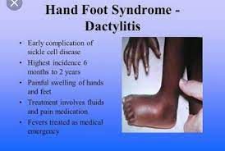

Slide 33
Long Term Treatments for SCD
Hydroxyurea:
* All patients should take it
* It increases the levels of Hb.F in the RBCs
which reduces sickling
2) Folic acid tablets: “LAAZIM” for all patients
(why?)
3) L-Glutamine (oral):
* Approved by U.S. FDA
* Reduces frequency of vaso occlusive crisis
ALL THE ABOVE TREATMENTS SHOULD BE TAKEN LONG
TERM

Slide 34
4) Stem cell transplant: Can “cure” the disease
BUT
* Very costly
* Limited donor availability * Toxicity issues
5) Gene therapy : Still awaiting approval by FDA
* The abnormal Hb. gene is replaced by a
normal gene. Can be a curative treatment

Slide 35
PREVENTIVE MEASURES TO BE DONE
Avoid dehydration, hypoxia
Folic acid, hydroxyurea, glutamine
Vaccinations for Pneumococci, meningococci, H. Flu (why?)
Annual eye exam, to check for retinal damage
Due to asplenia high risk of many infections so give antibiotic prophylaxis
Oral PCN till the age of 5 years.

Slide 36
TRANSFUSION
INDICATIONS FOR TRANSFUSION IN SCD
Hemolytic crisis
Aplastic crisis
Stroke
Chest syndrome
Splenic sequestration

Slide 37
TRANSFUSION
INDICATIONS FOR TRANSFUSION IN SCD
Hamoud And Saleh Cry Soon
H= hemolytic crisis
A = aplastic crisis
S = splenic sequestration crisis
C = chest syndrome
S = stroke

Slide 38
Rapid Fire Ques
What is the inheritance pattern of SCD?
What is the genotype of a normal person, SCD and trait?
Which amino acid is present in SCD?
Is sickle cell trait symptomatic?
CBC findings in SCD?
Why is retic count high?
Name some specific tests to diagnose SCD?

Slide 39
8) What is the cause of jaundice in SCD?
Name 5 acute crises in SCD?
Transfusion is the main treatment of pain crisis, right or wrong?
What is the cause of pain in acute pain crisis?
5 indications of transfusion in SCD?
What can precipitate a pain crisis?
Treatment of pain crisis?

Slide 40
15) What is the cause of aplastic crisis?
16) What will CBC show in aplastic crisis?
17) Treatment of acute chest syndrome?
18) Name 3 crises which can cause sudden Hb
drop?
19) What happens to the spleen in SCD
patients?
20) What happens to the eyes, male genitalia,
brain, kidneys, bones?

Slide 41
21)Patient with SCD has a surgical scar in the
right upper abdomen. Why?
22) What vaccines should be given to SCD patients?
22) In children with SCD, what can happen in the hands & the feet?
23) Name 3 medicines which are given long term?
24) What preventive measures should be taken in SCD patients?

Slide 42
25) In a patient with SCD, what will you see in a peripheral smear?
26) High chances of infection with which bacteria?
27) Name 2 advanced treatments for SCD?

Slide 43
LAST SLIDE IS VERY IMPORTANT

Slide 44


