Slide 1


Slide 2
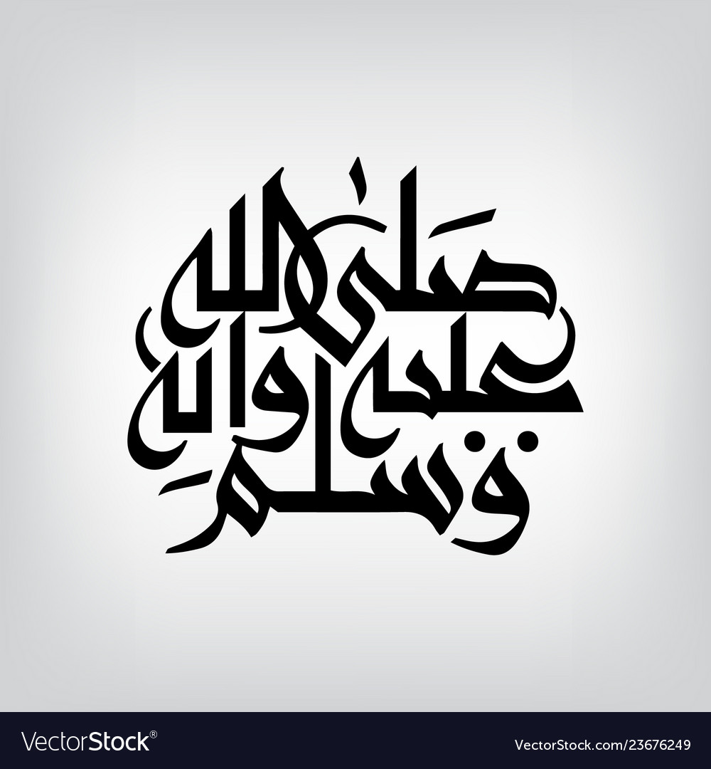

Slide 3

THYROID DISORDERS
Dr Waqar
MBBS, MRCP, Internal med(London)
MRCP, Endo & DM (London)

Slide 4
GENERAL POINTS ABOUT THYROID GLAND
Normal sized thyroid is usually not palpable
Moves up on swallowing

Slide 5
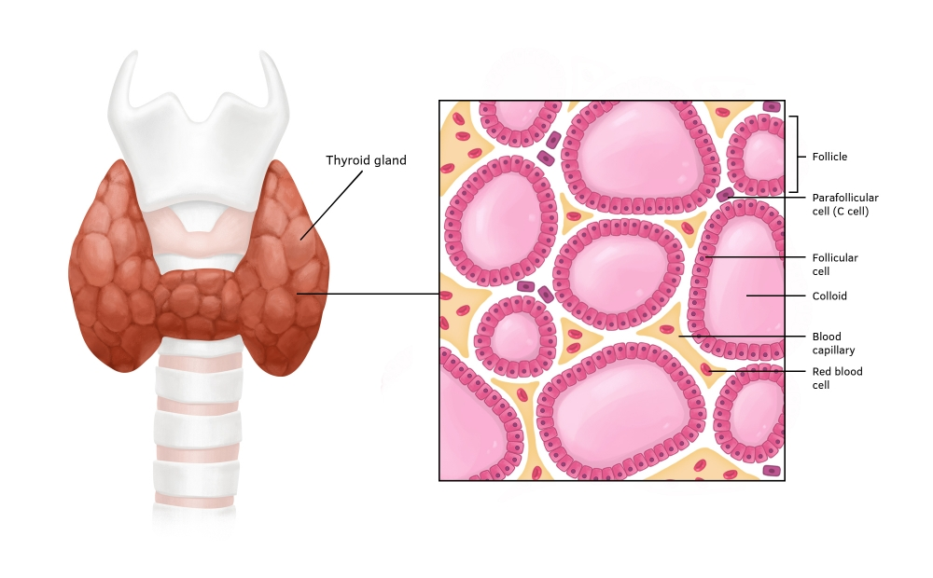
THINGS PRODUCED BY THYROID
Thyroxine (T4) hormones from
Tri-iodo-thyronine(T3) follicles
Calcitonin (produced by parafollicular cells)
Thyroid peroxidase(TPO): an enzyme required in hormone synthesis

Slide 6
GENERAL POINTS ABOUT HORMONES
“Balanced” amount of Iodine is needed for hormone synthesis ( so, its def. or even, excess can cause problems)
Most of the T4 &T3 is bound to plasma proteins in the blood:
a) Thyroxine binding globulin (TBG)
b) Thyroxine binding pre-albumin
c) Albumin

Slide 7
GENERAL POINTS (contd)
The remaining free hormones are physiologically active( fT4 & fT3)
Conditions which increase or decrease the plasma protein levels will affect the total hormone levels but free levels usually remain normal, so be careful while interpreting the results

Slide 8
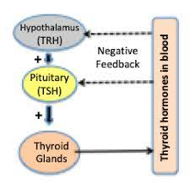
CONTROL OF SECRETION

Slide 9
Hypothalamus produces TRH (thyrotropin releasing hormone stimulates the ant. pituitary produces TSH (thyroid stimulating hormone) stimulates thyroid gland T4 & T3 produced

Slide 10
MAIN DISEASES OF THYROID
Hyperthyroidism (overactive gland)
Hypothyroidism (underactive gland)
Thyroid adenomas, cysts, carcinoma
GOITER
An enlarged thyroid gland is called goiter
Enlargement may be diffuse, partial, smooth, nodular
Can be associated with S/S of hyperthyroidism or hypothyroidism or even no symptoms (euthyroid state)

Slide 11
Investigations in Thyroid diseases
Thyroid func. Tests (TFTs)
* fT4 * fT3 * TSH
These tests can be abnormal even in some severe non-thyroid diseases, specially ICU patients but then, the patient is clinically euthyroid (sick euthyroid syndrome)
When ordering TFTs, always order free T3 & free T4, not total.

Slide 12
Investigations (contd)
2) Thyroid scan (imaging)
* With radioactive Iodine or technetium
* Radioactive substance is taken up by the gland &
pics are taken
* Used to see the “activity” of the gland
* Normal gland: normal uptake pattern
Hyperactive gland: Increased uptake
Hypoactive gland: Decreased uptake

Slide 13
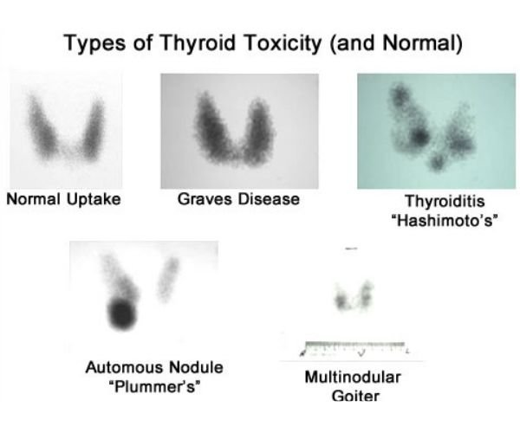
IMAGES OF SCANS

Slide 14
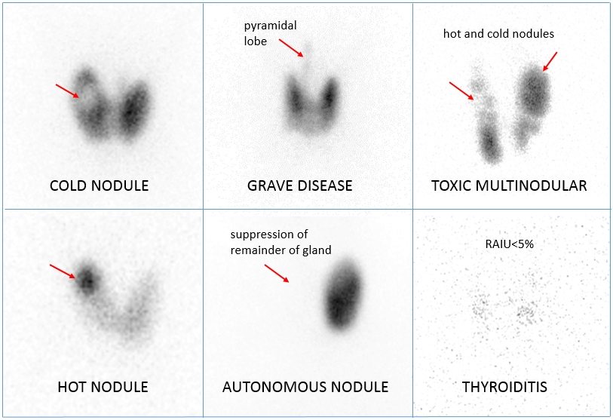

Slide 15
3) Ultrasound (imaging): May help to see nodules /cysts in the gland, but cannot differentiate benign from malignant.
4) Fine needle aspiration (needle biopsy)
* Also called FNA biopsy
* Done if there is a nodule (benign or malig)

Slide 16
HYPOTHYROIDISM
(underactive gland)
Primary Secondary
Main problem in Main problem in TSH
the thyroid. secretion from brain
( very very rare)
Low T3/T4 TSH low(main problem)
High TSH Low T3, T4

Slide 17
PRIM. HYPOTHYROIDISM
ETIOLOGIES
1) Hashimoto’s thyroiditis ( most common cause)
2) Iodine deficiency
3) Surgical gland removal
4) Radio-iodine therapy for hyperthyroidism (gland
destruction)
5) Radiotherapy to the neck region
6) Drugs (Interferon, amiodarone)

Slide 18
Hashimoto’s thyroiditis (chr. autoimmune thyroiditis)
a) Autoimmune disease
b) “Anti TPO antibodies” present
c) Most cases are females
d) Goiter present ( nodular)
e) Patient may have other autoimmune diseases
( vitiligo, DM, pernicious anemia, Addison’s)

Slide 19
Iodine def.
a) Common in many countries
b) Decreased iodine in the diet decreased
hormone synthesis
c) Goiter present
d) Use of “iodised salt”prevents this problem

Slide 20
Drugs:
a) Amiodarone, IFN
b) Check baseline TFTs & then regularly at least
every 6 months (if pt. taking these drugs)
c) Amiod. can cause either hypothy. or hyper-
- thy., or just abnormal TFTs without any
clinical features

Slide 21
S/S of hypothyroidism
Weight gain
Tiredness/ fatigue
Cold intolerance
Constipation
Dry skin, dry hair
Hair fall
Bradycardia
Hyporeflexia

Slide 22
9) Menstrual irregularities
10) Infertility
( rule out hypothy. in any female with 9 or 10)
11) Increased sleep
12) Slowed actions
13) Dementia, mental slowness, psychosis
14) Puffy eyes
15) Myalgias, arthralgias
16) Carpal tunnel syndrome

Slide 23
WHAT IS MYXEDEMA
Hypothyroidism plus generalised edema due to deposition of subcutaneous mucopolysaccharides. Leads to thickening of facial features & generalised edema
All hypothyroid patients do not have myxedema

Slide 24
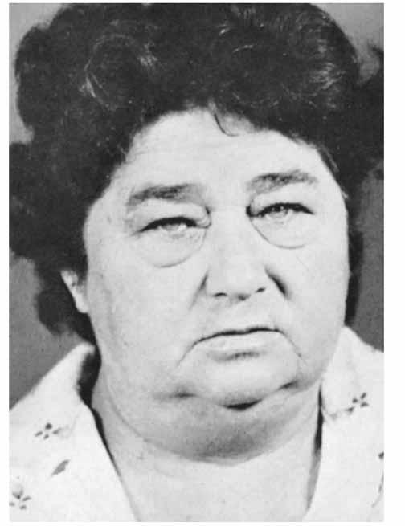
Myxedema

Slide 25
Investigations in hypothy.
TFTs: * Low fT4 & fT3
* High TSH ( low in sec. hypo)
2) In Hashimoto’s thyroiditis: Serum anti TPO ab.
very high
3) CBC: Usually macrocytic anemia, but may be
microcytic
4) Hyponatremia
5) High CPK
6) High cholesterol & triglycerides
7) Radio I scan shows decreased uptake( but not done as a
routine

Slide 26
TREATMENT of HYPOTHYR.
Levothyroxine tabs. (synthetic T4) is the main treatment
Taken for ever
Take in an empty stomach
Start with a medium dose about 50 micrograms/d in young & otherwise healthy people. Increase as needed
In elderly & in IHD, start 25 mcg( higher dose can cause arrhythmias)
Levothyroxine is safe in preg. & should be continued

Slide 27
TREATMENT( contd)
Check TFTs 6 weeks after starting or any dose change (TSH takes some to normalise)
Increase the dose gradually ( about 25mcg). Rapid hormone correction is dangerous
(arrhythmias)
Once TSH, T3 & T4 are normalised, maintain the dose. Later, routine TFTs once a year is enough
Do not suppress the TSH to below normal
Improvement of S/S takes a few months

Slide 28
MYXEDEMA COMA
Patients with myxedema may go into coma ( due to infection, surgery, non compliance)
Needs ICU
Altered mental status, hypothermia,hypotension, hypoventilation, hypoglycemia, cardiac failure,hyponatremia
In addition to TFTs, check cortisol levels also ( frequently low)

Slide 29
TREATMENT OF MYXED. COMA
i.v. thyroxine
i.v fluids (saline)
Gradual rewarming the body(warming blankets)
O2
i.v. steroids & glucose

Slide 30
RAPID FIRE QUESTIONS
Name the hormones tested in TFTs?
Which enzyme forms the thyroid hormones?
Whats the effect of iodine?
Name the thyroid binding proteins in the blood?
Can a person with goiter be without any thyroid symptoms?
fT4 low, fT3 low, TSH high. What is this?
fT4 low, fT3 low, TSH low. What is this?

Slide 31
8) What is sick euthyroid syndrome?
9) Name the 4 investigations for thyroid?
10) Name some causes of primary hypothyroidism?
11) Whats the commonest cause of hypothy?
12) Whats the effect of amiodarone on thyroid?
13) Name another drug which can cause hypo?
14) Which antidodies in Hashimoto’s thyroiditis?

Slide 32
15) Name some features of hypothy?
16) What is myxedema?
17) In a hypothyroid patient what do you see in CBC, electrolytes & lipid profile?
18) What does thyroid scan show in Hashimoto’s?
19) Can thyroxine tab. Be given during pregnancy?
20) After starting thyroxine, when should you recheck TFTs?
21) Treatment of myxedema coma?

Slide 33
HYPERTHYROIDISM
Less common than hypothy
99% cases are due to problem in the gland ( prim. hyperthyroidism).
* Pituitary causes, like TSH secreting adenoma
only 1% (sec. hyperthy)

Slide 34
ETIOLOGIES OF HYPERTHY.
Grave’s disease (most common cause)
Toxic multinodular goiter
Toxic solitary nodule
Drugs (amiodarone). Can cause hypo also
Sub acute thyroiditis (viral infection of the gland)
Overdose of thyroxine tabs.
Thyrotoxicosis factitia(use of thyroxine for non thyroidal illness -----------? )

Slide 35
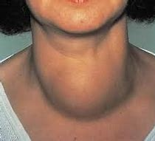
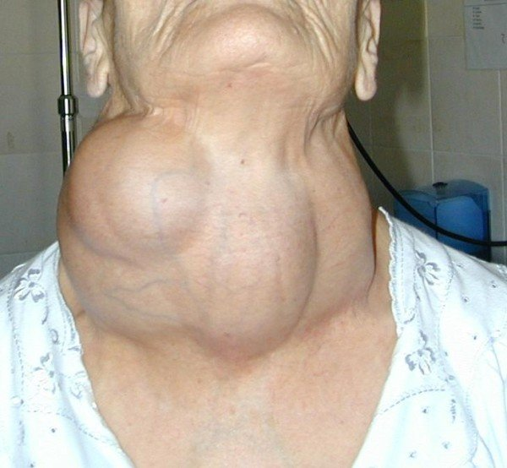
Diffuse goiter (Grave’s)
Multinodular goiter

Slide 36
Grave’s disease:
* Autoimmune disease
* Overactivity of the gland due to TSH Receptor
Stimulating antibodies or TRAB.( these anti-
-bodies are specific for Grave’s)
* On exam, gland is diffusely enlarged, bruit
present, non tender
* Other autoimmune diseases may also be present

Slide 37
2) Solitary Toxic nodule(adenoma)
* Single overactive nodule in the gland
3) Toxic multinodular goiter:
* Multiple overactive nodules
* Goiter present (multiple nodules palpable)
4) Sub acute thyroiditis(De Quervain’s thyroiditis)
* Viral infection of the gland (gland damage)
* Gland mildly enlarged & tender
* Often, recent history of a viral resp tract infection

Slide 38
5) Amiodarone induced:
* Due to its iodine content, amiod. affects the
thyroid
Hypo Hyper Euthyroid
* more * Abnormal TFTs
common than but patient
hyper clinically normal
( most cases)
( patients on amiod check TFTs every 6 months)

Slide 39
S/S of HYPERTHY
Weight loss (inspite of increased appetite)
Tachycardia or atrial fibrillation palpitations
Excess sweating, warm wet palms
Continuous low grade fever
Heat intolerance
Feeling warm even in cold weather
Diarrhea
Hand tremors
Polydipsia

Slide 40
S/S (contd)
10) Hyperactive & restless
11) Lack of sleep
12) Weakness, fatigue
13) Menstrual irregularities
Proximal myopathy
Systolic HTN
Goiter (often)
Hyper reflexia

Slide 41
3 Features seen in Grave’s dis. only
Exophthalmos (proptosis)
* Also called Grave’s ophthalmopathy
* Protruding eyes
* Lid retraction
* Lid lag
* Ophthalmoplegia (?)
* Leads to corneal drying

Slide 42
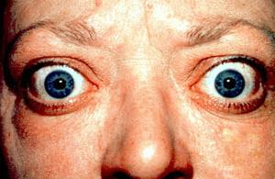
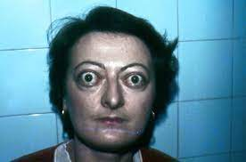
EXOPHTHALMOS

Slide 43
2) Pretibial myxedema
* Plaques of thick scaly skin in lower legs
* Topical steroids may help
3) Clubbing of fingers (thyroid acropachy)

Slide 44
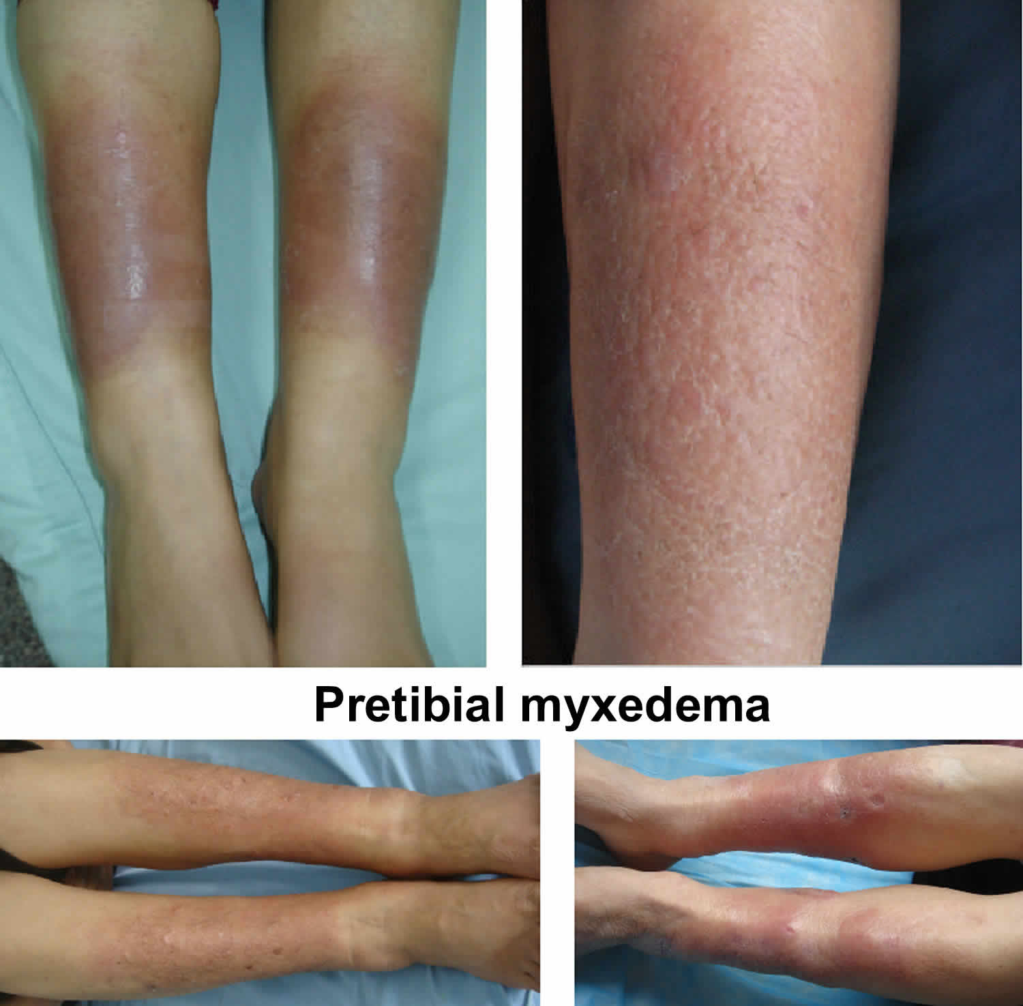
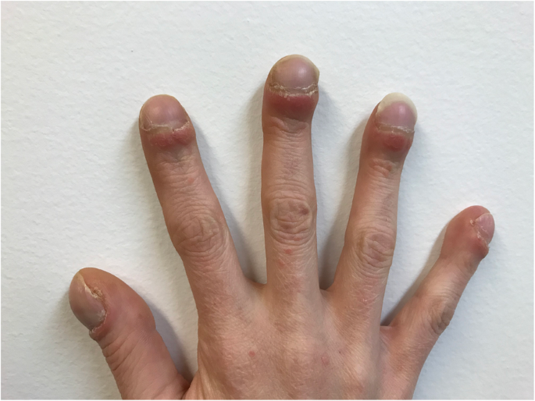
Pretibial myxedema
Clubbing

Slide 45
INVESTIGATIONS (in hyperthyr.)
TFTs RAIU scan Serum antibodies
not done in every case
TFTs:
* fT4 : high
* fT3 : High
* TSH: Low

Slide 46
2) Radioactive iodine uptake scan( RAIU scan)
* Radio iodine given orally or i.v.
* Taken up by the active areas of the gland
- Grave’s : Increased uptake diffusely
- Toxic multinodular goiter: Increased uptake
by the nodules
- Toxic adenoma : increased uptake by the
single nodule only
- De quervain’s & post partum thyroiditis: Low
uptake

Slide 47
3) Serum antibodies: Present in hyperthyroidism due to Grave’s disease
* TSH receptor stimulating ab.(specific)
(also called TRAB)
* Anti TPO antibodies (in some Grave’s
patients)
(anti TPO are present mainly in Hashimoto’s thyroiditis which causes hypothyroidism)

Slide 48
TREATMENT
( Grave’s, toxic multinodular, toxic adenoma)
Symptomatic Rx Definitive Rx
* Beta blockers * Antithyroid drugs
( control palpitations, * Radioiodine
sweating, restlessness) * Surgery
( definitive Rx does not have a quick effect)

Slide 49
Gen. points about antithyroid drugs
Carbimazole/methimazole, Propylthiouracil (PTU)
Not a permanent cure disease relapses in many cases after stopping, specially Grave’s
First choice drug is always Carbimazole (in preg., 1st choice is PTU)
After starting or changing the dose, check TFTs after at least 6 wks. ( hormones take some time to normalise)

Slide 50
Anti thyroid drugs
S/E:
Hepatitis: Report to the doctor if jaundice develops
Rash
Agranulocytosis (low neutros); may cause fever, sore throat. Report immediately to the doc.

Slide 51
Radio iodine Rx
First choice Rx in the U.S.
LAA in pregnancy( do preg. test before giving)
Radio active Iodine given orally suppresses thyroid hormone synthesis
A single dose permanently controls hyperthy. in 90% patients.
Normalisation of S/S & labs takes few months (so continue beta blockers till then)

Slide 52
Side effects of radio iodine Rx:
* Hypothyroidism very common
( have to start thyroxine then)
* No risk of malignancy
* No risk of congenital abnormalities in
babies born to mothers who got this Rx

Slide 53
SURGICAL TREATMENT
Subtotal thyroidectomy provides long term control of the disease
Done if drugs fail, or if patient refuses radio iodine

Slide 54
STEP WISE TREATMENT OF GRAVE’S
First, beta blockers (symptomatic control)
Carbimazole ( for about 2 months), to lower the hormone levels
Finally, once hormones normalise, Radio iodine treatment (in the U.S.)
If you give Iodine treatment without giving prior
carbimazole, it can be a problem

Slide 55
DeQuervain’s thyroiditis
Due to viral infection
Painful tender goiter, fever, malaise, S/S of hyperthyroidism
Often “after” a viral resp. tract infec.
Causes transient hyperthyroidism
May take few months to resolve
Rx: * Beta blockers (symptom control)
* NSAIDs (for inflammation)
* Prednisone (for inflammation)

Slide 56
What will the radio-iodine scan show in De Quervain’s thyroiditis?

Slide 57
Hyperthyroidism in a preg. lady
PTU in the first trimester, then switch to Carbimazole

Slide 58
THYROID STORM
A rare but life threatening exacerbation of thyrotoxicosis
Precipitated by any infection, surgery, thyroid surgery
Needs ICU admission
S/S: High fever, Altered mental status, Tachycardia/palpitations, Fluid loss

Slide 59
Treatment of storm
PTU
SSKI (saturated solution of potassium iodide)
Cooling blanket
i.v. fluids
Beta blockers
Prednisone

Slide 60
RAPID FIRE QUESTIONS
What is prim. Hyperthy?
What is sec. hyperthyroidism?
Name 4 causes of hyperthyroidism?
Whats the commonest cause?
What is De Quervain’s thyroiditis?
What is thyrotoxicosis factitial?
Which antibody is diagnostic for Grave’s?

Slide 61
8) What kind of myopathy do you see in hyperthy?
9) What are the scan findings in : Grave’s, Toxic multinodular goiter, De Quervain”s thyroiditis?
10) Name 3 features which are specific for Grave’s only?
11) TSH low, ft4 high, fT3 high. What is this?
12) TSH high, fT4 high, fT3 high. Whats this?
13) What is the symptomatic treatment for hyperthy?

Slide 62
14) Name 3 specific treatments for hyperthyroidism?
15) Which treatment is curative?
14) Name 2 antithyroid drugs?
15) Which drug is the drug of first choice?
16) Which drug is safe in pregnancy?
17) Can you radio iodine treatment in pregnancy?

Slide 63
18) Side effect of radio-iodine treatment?
19) What is the cause of De Quervain’s thyroiditis?
20) Which of these will you use for De Quervain’s, Carbimazole or radio iodine?
21) What is the treatment for De Quervain’s?
22) Whats the scan finding in De Quervain’s?
23) ARE YOU AN EXPERT ON THYROID DISORDERS NOW?

Slide 64


