Slide 1
Malaria
By Dr. Israa

Slide 2
Types:
P.Falciparum
P.vivax( affect younger RBCs)
P.ovale (affect old RBCs)
P.malariae
P.Knowlesi ( Simian malaria )

Slide 3
Life cycle:
There are two stages :
Sexual (anopheles mosquito)
Asexual phase

Slide 4
Pathophysiology of malaria:
1- anopheles’ mosquito ( carries the plasmodium in her salivary gland )
2- it’s bite then transmitted the plasmodium sporozoite(infective stage) into your blood and circulate for a 30 min then it will enter the liver
3- in the liver: the sporozoite enter the hepatocyte to multiply forming schizonts → schizonts multiply asexually forming merozoites
4- within 2 weeks thousands of merozoites will be formed and rupture the hepatocytes and released of merozoite into the blood
5- in the blood : merozoites enter erythrocytes → mature into trophozoites → schizonts multiply asexually forming thousand of merozoites in RBCs → rupture of RBCs ( the clinical feature start here )
6- released of merozoites into the blood and either :
Infect other RBCs
Stay in blood to become gametocytes
Fate of gametocytes: the anopheles' mosquito will suck your blood again and take the gametocytes into her intestine → multiply sexually forming sporozoite→ then it will infect you again by the sporozoite
Blood film is done to know which type of malaria and choose the proper treatment.

Slide 5
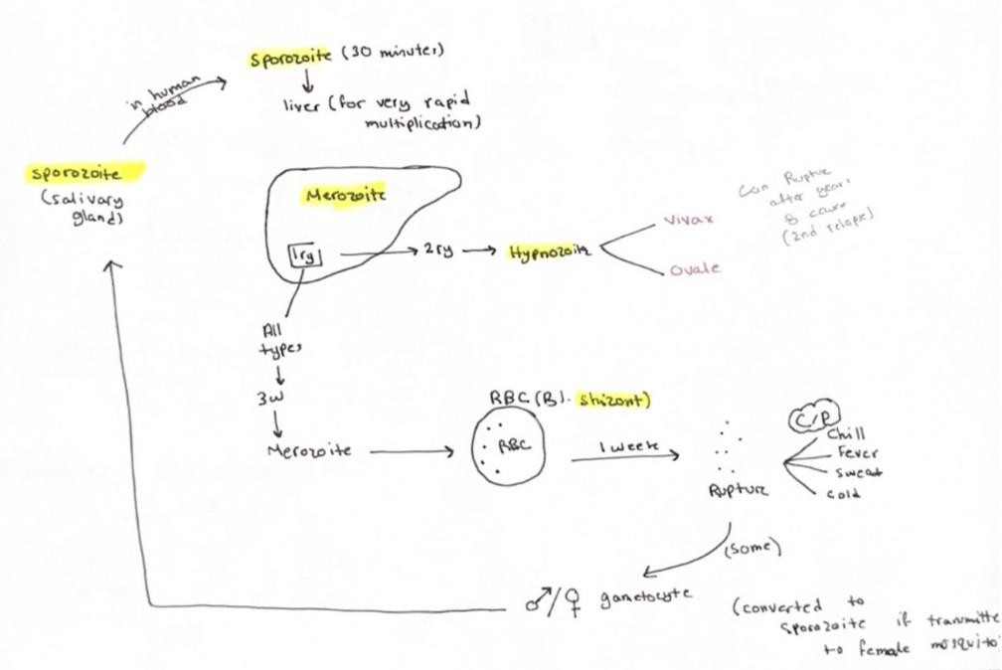

Slide 6
Early and late malaria trophozoite :
Tertian malaria: periodic fever and spikes every 48 hours (all except p.malaria)
Quartan malaria: periodic fever spikes every 72 hours ( p.malaria).
Malignant tertian malaria: (associated with falciparum malaria): irregular fever spikes without a noticeable rhythm.

Slide 7
Sever malaria :
Definition: potentially fatal manifestation or complications of malaria.
Most commonly a result of falciparum malaria (Higher at risk : pregnant and children).
Infected erythrocytes occlude capillaries——- sever organ dysfunction.

Slide 8

Criteria :
Criteria ? 1 Of the following in a patient with proven malaria .
CNS: cerebral malaria – cerebral edema – seizures- swollen brain –
- hallucinations- confusion – loss of consciousness.
CVS : HF
Pulmonary: Adult Respiratory distress syndrome.
Kidney: acute kidney injury — proteinuria and glomerulonephritis + black water fever ( hemoglobinuria )
GIT: jaundice – diarrhea- increase liver enzyme – hepatitis –
splenomegaly.
Others: sever anemia - acidosis - high fever.
- cerebral malaria caused either due to hypoglycemia or occlusion of arteries or capillaries as a result of sticky RBCS

Slide 9
Diagnosis:
Blood smear : it may be :
Thin : for the type of the parasites.
Thick : To see the parasites.
PCR

Slide 10
Important terms:
Relapse: (p.ovule and p.vivacious ) recurrence of disease after it has been apporentisc caused.
Reinfection: by different species.
Recrudescence : insufficient treatment by malarial treatment

Slide 11
Treatment:
Uncomplicated:
1. Chloroquine persistent
Artemether + lumefantrine
OR atovaquone + proguanil
OR Quinine + doxycycline
Vivax or ovale : give PART Rey : 1- primaquine Or 2- tafenoquine
2. Chloroquine sensitive : chloroquine ( retinal deposition)

Slide 12
Complicated:
1. IV Artesunate.
*** prophylaxis? Some medication but do not use same medication if infected . ( chloroquine and Mefloquine—— safer in pregnancy).
*** vaccine? Mosquerix.
*** prevention? Avoid exposure + mosquito control.

