Slide 1
MEGALOBLASTIC ANEMIA
BY
DR WAQAR
MBBS, MRCP( Int. Medicine)
MRCP( Endo. & Diabetes)
ASST. PROFESSOR of MEDICINE

Slide 2
ANEMIA
Normocytic Microcytic Macrocytic
(normal RBC ( small RBC ( big RBCs, so
size,so norm. MCV low) MCV high)
MCV)
Megaloblastic Non-
megaloblastic

Slide 3
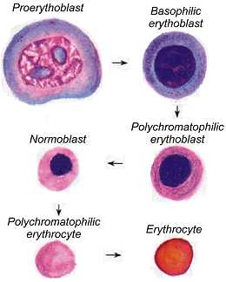
Normal RBC synthesis in bone marrow

Slide 4
Many substances are required for this normal
process of RBC synthesis.
2 things which are very important for RBC synthesis ( and also for synthesis of WBC & platelets) are :
a) Vitamin B12
b) Folic acid
These are required for normal maturation of cells

Slide 5
What happens in B12 or folic acid deficiency
Due to deficiency of B12 or folic acid, the cells in the marrow cannot develop normally.
This results in large abnormal cells with immature nucleus. These cells are called “megaloblasts”
Some RBC megaloblasts lose the nucleus and go in the blood as large “macrocytes.”

Slide 6
DEFINITION of Megaloblastic anemia
Megaloblastic anemia is a type of macrocytic anemia characterised by the presence of“megaloblasts” in the bone marrow, and is mostly due to Vit.B12 or Folic acid deficiency. The RBCs which enter the blood, are large (macrocytes)
“Megaloblasts” are large, abnormal cells with immature nucleus due to problem in cell maturation. WBCs & platelets are also affected.

Slide 7
CAUSES OF MEGALOBLASTIC ANEMIA
Vitamin B12 deficiency
commonest causes
Folic acid deficiency
Drugs

Slide 8
VITAMIN B12
(CYANOCOBALAMIN)
Water soluble vitamin
Found in meat, fish and animal products(milk, eggs )
Not found in vegetables.
Stored in the body mainly in the liver (2-3 mg)
which is enough for more than 2 yrs.

Slide 9
Absorption &
Transport of B12
1) B12 in the food comes in the stomach released from the food by gastric acid.
2) Free B12 binds with a substance called “intrinsic factor in the stomach ( which is secreted by parietal cells)
3) This intrinsic factor & B12 complex reaches the terminal ileum
4) B12 is then released from I.F. & absorbed in the terminal ileum carried to all the tissues
5) Some B12 is absorbed in the duodenum without intrinsic factor ( direct absorption)

Slide 10
IMPORTANT CAUSES OF B12
DEDFICIENCY
Decreased intake ( eg.in vegetarians)
2) Decreased gastric acid (PPIs, old age)
Gastrectomy
3) Loss of intrinsic factor
Pernicious anemia

Slide 11
5) Chronic pancreatitis
6) Terminal ileal disease( Crohn’s, surgery, celiac)
7) Metformin (decreases absorption)
8) Infection by Diphyllobothrium latum (fish
latum)

Slide 12
PERNICIOUS ANEMIA
It is an autoimmune disorder in which antibodies are formed against the parietal cells of the stomach & against intrinsic factor, resulting in loss of “intrinsic factor” production. This then causes Vit.B12 deficiency, which then produces a megaloblastic anemia.
OTHER CAUSES OF VIT.B12 DEFICIENCY ARE NOT CALLED PERNICIOUS ANEMIA. THEY ARE JUST CALLED MEGALOBLASTIC ANEMIA DUE TO VIT. B12 DEFICIENCY

Slide 13
LETS DISCUSS PERNICIOUS ANEMIA
* A common cause of B 12 deficiency in the West
More common in old people
Associated with other autoimmune diseases:
* Autoimmune thyroiditis * Vitiligo
* Addison’s disease * DM
Most patients have “parietal cell antibodies” & “intrinsic factor antibodies.”( more specific)

Slide 14
S/S of Vit B12 deficiency develop slowly over few yrs., because, as said before, liver has enough amounts of B12 which can last for
more than 2 yrs.

Slide 15
S/S OF PERNICIOUS ANEMIA
Features of anemia Features due to neuro-
- logical
involvement
Glossitis ( brain, spinal cord,
nerves)

Slide 16
Anemia S/S
All symptoms of anemia all
Pallor, tachycardia, systolic murmur anemias
weakness, fatigue cause this
Glossitis (tongue inflammation)

Slide 17
NEUROLOGICAL S/S OF
B12 DEFICIENCY
Peripheral Nerves
Spinal cord
Brain

Slide 18
Peripheral neuropathy:
* Tingling & numbness in the toes & fingers
( symmetrical)
2) Subacute combined degeneration of the cord
* There is damage to the posterior column & lateral white column of the spinal cord. This leads to:
a) Loss of position & vibration sense leads
b) Weakness to
c) Ataxia imbalance

Slide 19
Neuro S/S contd.
3) Brain : dementia, psychiatric problems
If neuro features are present for less than 6 months, they can be corrected
NOTE: Neuro features can occur even without
anemia & with a normal CBC

Slide 20
INVESTIGATIONS IN
PERNICIOUS ANEMIA
CBC * Low Hb
* MCV high ( due to macrocytes)
* May be low WBC & plts. ( late)
2) Peripheral Smear :
* Macrocytes
* Large abnormal neutrophils with
hypersegmented nucleus ( multilobed
nucleus)

Slide 21
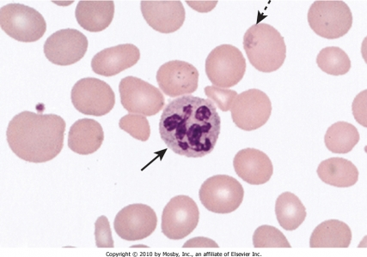
Peripheral Smear
Note the large
RBCs & the large
neutrophil with
multilobed
nucleus

Slide 22
Investig.(contd)
3) Low Vit.B12 levels in the blood
4) In some cases of borderline B12 levels, check MMA (methylmalonic acid). It is high
4) Serum autoantibodies:
* Intrinsic factor ab.
* Parietal cell ab.
( if B12 deficiency is due to other causes, these antibodies will not be present)

Slide 23
Investig. Contd.
5) Bone Marrow:
* Megaloblasts ( large cells with immature
nucleus)
* Frequently not done in a straightforward case
of macrocytic anemia with low B12 levels.
So, specific diagnostic tests for pernicious anemia are: a) Parietal cell antibodies
b) Intrinsic factor antibodies

Slide 24
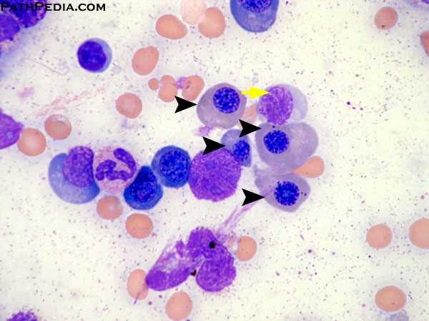
Bone marrow

Slide 25
D/D of Pernicious Anemia
Folic acid deficiency
Drug induced megaloblastic anemia

Slide 26
TREATMENT OF P.A.
i.m. injections of B12 : Different protocols are
used :
* 1mg i.m. daily for 1 wk
* Then, 1mg once a wk. for 1 month
* Then 1 mg once a month “forever”
JUST REMEMBER THAT TREATMENT IS BY I.M.
INJECTIONS & IT IS FOREVER
2) High doses of oral B12 can be used (absorption by alternate pathway, not requiring intrinsic factor). However, this is not preferable.

Slide 27
B12 deficiency causes folic acid def. also. So, for
a few months, give folic acid also alongwith
B12

Slide 28
Treatment contd.
Anemia is corrected in few weeks, but mild neuro S/S improve in 6-12 months
Full blown neuro features are irreversible
Stomach cancer risk
Patients with pernicious anemia have an increased risk of gastric carcinoma. So they should be regularly screened for this, by endoscopy or barium studies.

Slide 29
FOLIC ACID DEFICIENCY
This is another cause of Megaloblastic anemia
It causes anemia BUT NO NEURO S/S
Folic acid is found in fruits & green leafy
vegetables
CAUSES OF FOLIC ACID DEF.
Decreased intake (not eating KHUDRAA & FAWAAKA, alcoholics, poor diet)
2) Increased requirements:
a) Pregnancy, lactation
b) Dialysis patients (loss of folic acid)

Slide 30
Causes of def. contd
c) Hemolytic anemias ( loss of RBCs bone
marrow becomes overactive to compensate
needs more nutrients
d) B12 def. can cause folic acid def.

Slide 31
Causes of folate deficiency contd.
3) Drugs : Methotrexate, Phenytoin
4) Malabsorption : * Celiac disease
Body stores of folic acid are not too much, so
deficiency occurs quickly, in about 4 months

Slide 32
INVESTIGATIONS IN FOLIC ACID
DEFICIENCY
CBC , Peripheral smear & bone marrow findings are same as in B12 def.( low Hb. & macrocytes in the blood, megaloblasts in the marrow)
Serum folic acid levels are low
RBC folic acid low( more accurately indicates
body stores of folate),so it is test of choice

Slide 33
TREATMENT
Correct the cause
Folic acid tablets, 1 or 5 mg daily
Prophylactic folic acid is given in all hemolytic anemias , eg sickle cell disease, & also in pregnancy, lactation, dialysis patients
If it is due to B12 def. give that also

Slide 34
Review this slide again
ANEMIA
Normocytic Microcytic Macrocytic
(normal RBC ( small RBC ( big RBCs, so
size,so norm. MCV low) MCV high)
MCV)
Megaloblastic Non-
megaloblastic

Slide 35
OTHER CAUSES OF HIGH MCV
( but no megaloblasts)
Pregnancy
Hypothyroidism
Drugs (azathioprine)
Liver disease

Slide 36
APPROACH TO HIGH MCV
Rule out any drug induced cause, preg., hypothyroidism
Do peripheral smear
Check B12 plus folate levels
If both are low, give both
Never give folic acid alone if there is only B12 def. It will correct the anemia but neuro features will progress

Slide 37
RAPID FIRE QUESTIONS
Causes of microcytic anemia?
2 causes of megaloblastic anemia?
What 2 things are needed for B12 absorption?
Which foods contain B12?
Causes of B12 def?
Where is B12 absorbed?
No B12 is absorbed in the duodenum, true or false?

Slide 38
8) Besides anemia, what else can occur in B12
def?
9) Name 3 neuro problems?
10) What will you see on peripheral smear?
11) If B12 levels are borderline, what to check
next?
12) Bone marrow biopsy LAAZIM ?
13) What is pernicious anemia?
14) Name the antibodies of pernicious?

Slide 39
15) B12 def due to gastrectomy is called pernicious anemia, true or false?
16) Best treatment for pernicious, injections or oral?
17) Patient has B12 def. What 2 medicines to give?
18) In B12 def., are neuro features reversible?
19) Food sources of folic acid?

Slide 40
20) Causes of folate def?
21) Can B12 def cause folate def?
22) Best test to diagnose folate def?
23) Folate def causes neuro problems, true?
24) Causes of macrocytic anemia without megaloblasts?
25) Name 1 drug which causes macrocytic anemia?

Slide 41
26) 50 year old male. Vegetarian
TANMEEL in hands & feet since 1 month
No anemia on physical exam
CBC normal
What will you do next?

Slide 42
LAST SLIDE IS VERY IMPORTANT

